Slide 1
An ICU Library Supporting the Display of Complex Text
Eric Mader
ermader@us.ibm.com
Globalization Center of Competency, Cupertino, CA
Notes:
This presentation is about the ICU LayoutEngine; an ICU library which supports the display of complex text.
My name is Eric Mader and I work on complex text at the IBM Globalization Center of Competency, in Cupertino, CA.

Slide 2
Overview
What is complex text?
What is the ICU LayoutEngine?
How does it support the display of Indic, Arabic and Thai text?

Slide 3
What Is Complex Text?
Unicode: not just a bigger character set
  Bidirectionality: mixed directions on a line
  Shaping: character shapes depend on context
  Ligatures: mandatory special forms, and no Unicode equivalent
  Positioning: vertical and horizontal adjustments
  Reordering: character positions depend on context
  Split characters: some characters appear in more than one position
Notes:
Latin script, which is by far the most commonly-used script among software developers, is also the simplest script (especially as it is used to write English).
Other writing systems exhibit complications not found in Latin script. These characteristics are called ‘Complex Text.’ Arabic, Hebrew, Indic, and Thai all exhibit many of these features:
Bidirectional text runs both right to left and left to right (for numbers).
Letters can change shape depending on context.
Mandatory ligatures: A ligature is a combination of more than one character. Sometimes the original character shapes are not easily identifiable in the resulting ligature.
Vertical and horizontal adjustments (a form of kerning) are necessary to properly align characters.
Some characters can change position in the text based on context.
Some characters can appear in more than one visual position at the same time, occupying multiple character cells, or surrounding other characters.

Slide 4
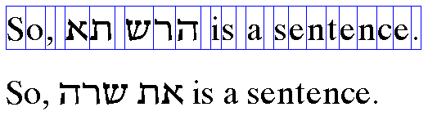
Bidirectional Text
Visual order differs from storage order
Arabic and Hebrew read right to left, but numbers still read left to right
memory
reading order
Notes:
Not all scripts are read from left to right; Arabic and Hebrew are read from right to left. Unicode text is stored in the order in which it is read - not the order in which it is displayed- so a conversion must be done before displaying the text. The Unicode bidi algorithm defines how this is to be done.
This example shows mixed English and Hebrew text. The text is stored in logical order, the order in which it is read. You can see that the Hebrew text is displayed from right to left, while the English reads left to right.
Mixed directions occur even when all the text is Hebrew or Arabic, since numbers in these languages still are written left to right. So this complication arises even when you don’t mix Hebrew or Arabic with other writing systems.
Since the Unicode bidi algorithm can require up to a paragraph of context, the minimal unit of analysis when laying out text is a paragraph.
In a paragraph, each line of text is logically contiguous. If we were to wrap this example text over two lines, the Hebrew text would never display such that it started on the second line and finished on the first. So the final positions of characters also depend on where the line breaks are chosen.

Slide 5

Character Shaping
Arabic character shapes change to connect adjacent characters
Notes:
In some scripts characters take on different shapes depending on the characters around them. For example, Arabic text is ‘cursive’ in that letters change shape to connect with the characters on either side. This cursive shaping is required whenever Arabic text is displayed - it is not just fancy typography.
This graphic shows text containing the Arabic letter ‘noon’ three times in succession. When displaying this sequence, three different shapes are used for the same letter: one that connects to the left, one that connects to both the left and the right, and one that connects to the right.
Contextual shaping means that characters cannot be measured or rendered in isolation. For example, you cannot cache a character’s ‘width’ since the width can vary depending on context.

Slide 6
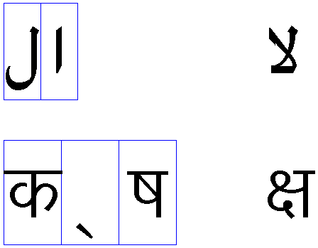
Ligatures
Arabic and Devanagari represent some character sequences with ligatures
Notes:
Other scripts display certain character sequences as a single shape, known as a ligature.
In the top example, on the left you see the Arabic characters lam and alef. When rendered, this lam-alef sequence is displayed using the ligature on the right.
In the bottom example, the three Devanagari characters on the left KA, VIRAMA, SSA are displayed using the single ligature on the right.
Many of these ligatures are required, not optional as they generally are in English. The ligatures used depend on the language, not just the script. For instance, Hindi and Sanskrit both are written in the Devanagari script, but use different ligatures.
Unlike the common typographic ligatures found in English, the resulting shape can be completely different from the original characters. Often there is no obvious place to put a caret. For example, if the text caret is between the KA and the VIRAMA in the second example.
Also notice that the lam-alef ligature has a Unicode code point (U+FEFB – an Arabic presentation form) but that the KA-SSA ligature does not.

Slide 7
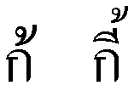
Character Positioning
Thai (and other scripts) require characters to reposition
Notes:
Thai can have multiple combining marks over a single base character. This requires repositioning some of the marks so they don't collide with other marks.
On the left is the Thai consonant KO KAI followed by the tone mark MAI THO. The tone mark positions directly above the consonant. On the right, the vowel mark SARA UEE has been added immediately after the consonant. It too positions above the consonant, and so the tone mark must be resized and moved up, so as not to collide with the vowel mark.
Hindi also positions characters, but positions horizontally so that the vowel marks lie over the vowel stem of the consonant or consonant cluster.
This technique is similar to kerning, which is used to control the amount of white space between characters. Here the consequences of not doing the adjustments are even more severe- characters collide or misalign.

Slide 8
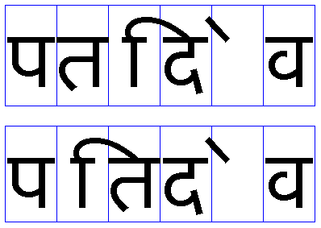
Reordering
Some Hindi characters reorder based on context
Logical Order
Visual Order
Notes:
In some writing systems, such as Indic, individual characters can reorder.
This example shows the logical and visual order of the characters in the Hindi word ‘patidev.’ Notice how the Devanagari vowel sign I reorders to the left of the consonant it follows. (For illustration, only the visual reordering is shown, positioning and other adjustments have not been applied.)
Also, the Devanagari letter sequence RA + VIRAMA can reorder to the right of a consonant cluster (not illustrated here).
This reordering is contextual and applies to individual characters, unlike, for example, the reordering that occurs in Arabic and Hebrew, which typically applies to a sequence. Since individual characters can move in opposite directions, Hindi text can sometimes get a bit ‘scrambled.’
Reordering differs from positioning in that it changes a character’s visual order- the character moves ‘before’ or ‘after’ neighboring characters.

Slide 9
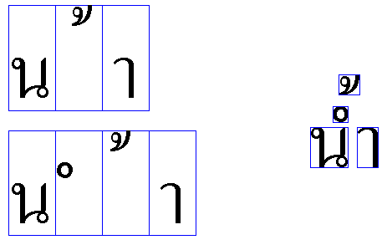

Split Characters
Thai and many Indic languages display a single character in multiple positions
Logical Characters
Visual Glyphs
Displayed Result
Notes:
In Thai, the character SARA AM has two components: a vowel and a diacritic. In some cases another character can be written between these two components, ‘splitting’ the SARA AM character.
This is illustrated in the example. The three original characters NO NU, MAI THO, SARA AM at the top left are converted to four glyphs, and reordered, as shown below left. After positioning, they display as shown on the right.
Many of the Indic scripts (although not Devanagari) have characters that display on both sides of a consonant cluster, such as the Tamil vowel sign OO.
Unicode provides different ways of encoding these situations. Conceptually this can be thought of as normalizing the Unicode text into additional characters, then contextually reordering them. It’s not a good idea to make the typist have to think too much about this!

Slide 10
What is the ICU LayoutEngine?
Open source w/ GPL compatible license
Written in portable subset of C++
Notes:
The ICU LayoutEngine is part of the ICU open source project, and is covered with the X open source license. This license is compatible with the GNU GPL, allowing the ICU LayoutEngine to be incorporated into a wide variety of software projects.
It is written in a portable subset of C++. It does not use templates, exceptions or operator overloading, making it easy to port to different platforms. It is used in JDK 1.4 and has been tested on the following ICU reference platforms:
Red Hat Linux 6.1
Solaris 2.6
HP/UX 11
AIX 4.2.1
Windows NT/2000
Note that testing has been done on both big- and little-endian platforms. This is important because OpenType and AAT font tables are stored in big-endian order and must be byte-swapped on little-endian platforms. Testing on both kinds of platforms insures that the byte-swapping logic is correct.

Slide 11
What is the ICU LayoutEngine?
Open source w/ GPL compatible license
Written in portable subset of C++
Portable, platform independent
Notes:
The ICU LayoutEngine is also platform independent. All access to fonts is through an abstract base class that models a TrueType font at a particular point size and device resolution:
A font is a collection of images, called glyphs. Each glyph in the font is referred to by a 16-bit glyph id.. (With the advent of Unicode 3.1 glyph id’s will probably change to 32-bits.)
There is a mapping from Unicode code points to glyph ids. There may be glyphs in the font for which there is no mapping.
The font contains data tables referred to by 4 byte tags. (e.g. ‘GSUB’, ‘cmap’). These tables can be read into memory for processing.
There is a method to get the scaled advance width of a glyph.
There is a method to get the scaled position of a control point from a glyph.
An instance of this class must be written for each target platform. I have written instances for Windows GDI and the JDK. I have also written a simple one that uses the Standard C Library to access TrueType fonts, though this one does not provide control point access.

Slide 12
What is the ICU LayoutEngine?
Open source w/ GPL compatible license
Written in portable subset of C++
Portable, platform independent
Simple, uniform interface
Notes:
The ICU LayoutEngine provides a simple, uniform interface for preparing complex text for display.
The caller must first resolve the text into runs of a single font, direction, script and language. ICU provides an implementation of the Unicode Bidi algorithm that can be used to identify directional runs. An interface to identify script runs according to Unicode TR#24 has been prototyped and will be added to ICU 2.0.
Once the font, script and language have been determined, these are passed to a factory method that returns an instance of the LayoutEngine class.
The LayoutEngine class has a method which takes an array of characters (in logical order), the run direction and a starting position, and computes an array of glyph ids in display order, an array of glyph positions, and a mapping from glyphs to the original characters.

Slide 13
Supporting Complex Text
Smart font technologies
  OpenType
    Uses ‘GDEF’ ‘GSUB’ ‘GPOS’ tables
    Processing is script, language specific
    “up-front” text processing
  AAT
    Uses ‘mort’ table
    Applies default features
    Only left to right text
    No positional processing
Notes:
The ICU LayoutEngine’s OpenType processing is a fairly complete implementation of the ‘GDEF’ ‘GSUB’ and ‘GPOS’ tables. (“extension substitution” and “cursive adjustment” are not yet implemented)
OpenType processing requires some script-specific character-level processing before the tables are applied. For Arabic text, the ICU LayoutEngine identifies characters which should be displayed using initial, medial or final forms and tags them with the appropriate OpenType feature tags. It also adds the ligature feature tag so that ligatures will be formed.
For Indic scripts, the text is broken into consonant + vowel “clusters.” Then each cluster is reordered and the appropriate OpenType feature tags are applied to any special combinations. An example of reordering for Hindi text would be moving the short I vowel to the front of the cluster. Special combinations are things like REPH (an initial RA + VIRAMA) and VATTU (a trailing RA + VIRAMA)
The AAT processing in the ICU LayoutEngine is not yet finished. At present it will only apply default features, will only process left to right text, and does not do positional processing. This code has been tested using an AAT Hindi font. Note that AAT processing is not explicitly script-specific, so other AAT fonts will probably work as well (though none have been tested).

Slide 14
Supporting Complex Text
Smart font technologies
Unicode presentation forms
  Used for Arabic and Hebrew
  Only if no OpenType, or AAT tables in font
  Uses “canned” OpenType tables
    Generated from Unicode Character Database file
    Uses code points rather than glyph ids
    Uses filter to skip missing forms, ligatures
Notes:
If the font does not contain an OpenType ‘GDEF’ table for the given script and language, and does not contain an AAT ‘mort’ table, and the text is Arabic or Hebrew, then the Unicode presentation forms will be used.
This is done using “canned” OpenType tables generated using the Unicode Character Database. These tables use Unicode code points rather than glyph ID’s. Of course, not every font will contain all of the presentation forms, so OpenType processing uses an optional filter that inhibits the generation of the presentation forms that aren’t contained in the font.
This is implemented as a subclass of the standard OpenType processing, so that the up-front character processing and table processing can be easily reused.

Slide 15
Supporting Complex Text
Smart font technologies
Unicode presentation forms
Special processing for Thai
  No OpenType specification for Thai
  State table based processing
  Uses Microsoft, Apple, IBM encodings
Notes:
There’s currently no specification for OpenType Thai processing, so the ICU LayoutEngine uses special Thai-specific processing. This processing is done using a state table to generate the contextual forms of the Thai vowel, tone and diacritic marks. The state table was built from a character pair table used to check the validity of Thai text.
The contextual forms have Unicode code points within the Private Use Area. There are three versions the LayoutEngine recognizes: Microsoft’s, Apple’s and IBM’s. The ICU LayoutEngine probes the font to determine which set of contextual forms are present, then uses that set.
(Note: the IBM forms are in the Thai code block *not* in the PUA.)

Slide 16
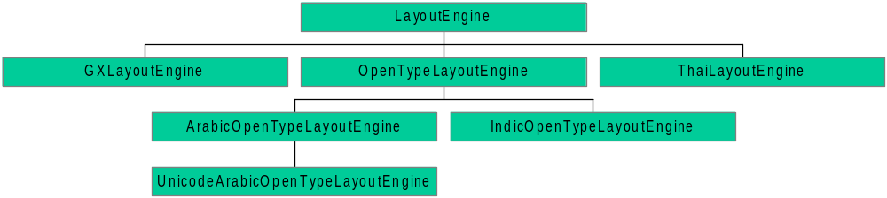
LayoutEngine Class Hierarchy
Notes:
Here is the class hierarchy of the ICU LayoutEngine.
LayoutEngine is the base class. It contains methods to map Unicode code points to glyph id, to position the glyphs, and to access the glyph id and position arrays. It also contains the factory method, called layoutEngineFactory.
GXLayoutEngine uses the AAT ‘mort’ table to process the text.
OpenTypeLayoutEngine uses the OpenType ‘GDEF’ ‘GSUB’ and ‘GPOS’ tables to process the text. It contains a method to apply the “up-front” processing needed by OpenType.
ArabicOpenTypeLayoutEngine and IndicOpenTypeLayoutEngine are subclasses of OpenTypeLayoutEngine. They contain methods to perform the “up-front” character processing for Arabic and Indic text, respectively.
UnicodeArabicOpenTypeLayoutEngine uses “canned” ‘GDEF’ and ‘GSUB’ tables to generate Unicode presentation form. Once this has been done, it maps these code points to glyph ids.
ThaiLayoutEngine does the special Thai-specific processing.

Slide 17
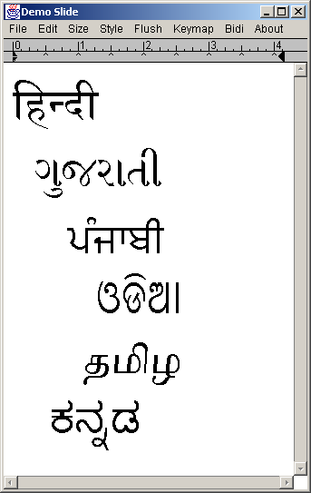
Demo

Slide 18
Resources
ICU:
  http://oss.software.ibm.com/icu
OpenType Specifications:
  http://www.microsoft.com//typography/tt/tt.htm
TrueType Font File Specification:
  http://fonts.apple.com/TTRefMan/RM06/Chap6.html
Notes:
Here are some URL’s you can use to get more information. The first one is the main web page for ICU. You can use this page to view the documentation, download the source, and report bugs.
The second URL points to a Microsoft web page with links to the current OpenType specification, the Indic OpenType specification and the Arabic OpenType specification.
The third URL points to Apple’s web page describing the format of the TrueType font tables.

Slide 19
