Slide 1
An Overview of ICU
Helena Shih Chapman
hchapman@us.ibm.com
Doug Felt
dougfelt@us.ibm.com
Globalization Center of Competency, Cupertino, CA
Notes:
Helena Shih Chapman is manager of the ICU (International Components for Unicode) team at IBM’s Globalization Center of Competency (GCoC) in Cupertino, California. She is also the chair of the project management committee of ICU and the leader of the Linux API development environment group of the Linux Internationalization Initiative standards group of the Free Standards Group.
Doug Felt is project lead for ICU4J, one of the ICU projects. He also works on support for complex text, such as Indic, Arabic and Hebrew. He has helped provide complex text support in both IBM and Sun JVMs.

Slide 2
Agenda
What is ICU?
Open Source
GPL-Compatible Licensing
Unicode Standard Conformance
Features
Performance
Architecture
Open Development Process
References

Slide 3
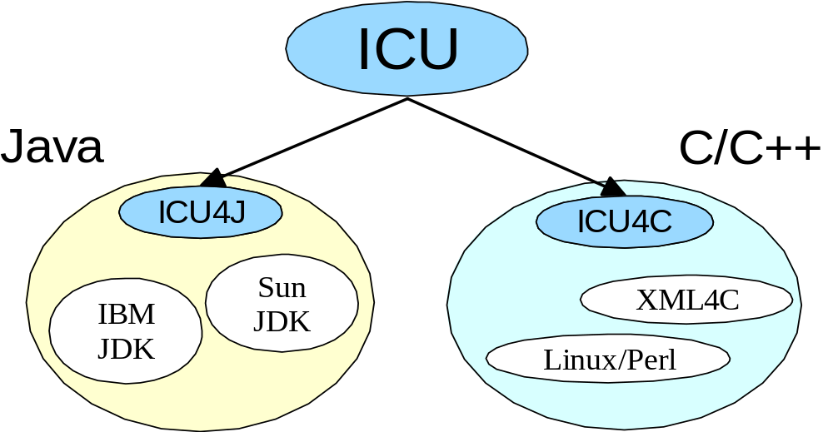
What is ICU?
International programming library
Any language – multiple languages at the same time
High performance features
Cross platform
Unicode standard compliant components
Code once, distribute anywhere
Comprehensive documentation
Notes:
ICU (International Components for Unicode) consists of two related projects, ICU4C and ICU4J. Several years ago, IBM’s ICU team in Cupertino designed and implemented a good portion of the internationalization capabilities in Sun’s JDK. We then ported these capabilities to C++, and made them available through the ICU4C project. Later on, we greatly improved them, and rewrote most of them in C to better meet the needs of our C clients. Meanwhile, other Java components we developed that haven’t made their way into the JDK are available through the ICU4J project. Code originating in the ICU project is used in both IBM and Sun versions of the JDK and in XML4C.
ICU is designed to help you build your application so that a single source, single binary version of your software can interact with users around the world according to the local conventions of their culture. As we all know, computer usage is rising most rapidly in non-English speaking countries. Therefore, it is becoming increasingly important for developers to satisfy their global customers in a flexible manner. We are seeing more requirements to support true multilingual applications. ICU lets you do this– and in fact, it supports multiple local conventions concurrently within the same application.
The biggest concern most users have regarding Unicode support is performance. ICU is comparable to competitive Unicode libraries such Windows, and often better.
As computing environments become more heterogeneous, software portability becomes more important. ICU lets your produce the same results across all the various platforms you support.
ICU is easy to learn and use. ICU contains extensive API reference documentation and a comprehensive user’s guide.

Slide 4
Open Source
Mature ICU more quickly
Encourage Unicode adoption
Promote use of IBM technologies
Support other open source projects
Notes:
One of the most-often-asked questions about ICU is “Since internationalization is so essential, why is IBM making this technology open-source?”
Making ICU open-source helps mature the technology faster, allowing the C/C++ and Java projects to benefit from collaborative effort, and increased feedback, on features and implementation. Moreover, even though the Unicode Standard has been around for quite a while, there’s no easily available single product that provides a standard implementation. By lowering the barrier, the ICU open-source initiative encourages more applications to adopt and fully support the Unicode Standard.
IBM is an active participant in the Linux development community, so making this technology available to provide a standardized solution across all IBM platforms is extremely important. This ensures that all IBM platforms, such as S/390, can interoperate with the Linux distributions consistently. That in turn makes ICU pervasive across various computing environments. Other IBM open-source technologies also rely heavily on ICU for Unicode support, for example, IBM’s XML parser in Apache.
In addition, ICU is also included as part of the Linux Internationalization Initiative standard group’s Li18nux2000 specification. These open-source projects require their components to be open source, and to come with compatible license agreements.

Slide 5
GPL-Compatible Licensing
ICU4C 1.8.1 and later: X license (GPL-Compatible)
  http://oss.software.ibm.com/developerworks/opensource/cvs/~checkout~/icu/license.html
ICU4J 1.3.1 and later: X license
  http://oss.software.ibm.com/developerworks/opensource/cvs/icu4j/~checkout~/icu4j/license.html
All prior ICU releases remain available under IPL (IBM Public License)
Notes:
Starting with the ICU4C 1.8.1 and ICU4J 1.3.1 release, we have changed the licensing terms to match those in the X license. We did this in order to make ICU available to our Linux customers who need multilingual support, such as Gnome, and who require GNU Public License (GPL) compatibility. Though the IBM Public License (IPL) is a well-regarded open source license, it is not considered GPL compatible. The X license is a non-viral and recommended free software license that is compatible with the GPL.
Users of ICU releases prior to 1.8.1 and 1.3.1 will continue to utilize the IPL. Starting with the ICU4C 1.8.1 and ICU4J 1.3.1 releases, users will need to accept the terms and conditions of the X license.
For more details on the X license, please see http://www.x.org/terms.htm. For information regarding GNU’s definition of “GPL compatible”, please see http://www.gnu.org/philosophy/license-list.html#GPLCompatibleLicenses.

Slide 6

Unicode Standard Conformance
Description | ICU4C | ICU4J | Sun JDK
Unicode 3.0 character properties
Normalization Process
Language-sensitive sorting (UCA)
Bidi algorithm
SCSU compression
Notes:
ICU intends to conform to the more up-to-date Unicode standard where applicable. For example, the ICU4C 1.8.1 release includes implementation of the approved technical reports and 3.0 database when the 3.0 database was the most recent Unicode standard database available during ICU4C 1.8.1 development cycle.
Since ICU is open source and closely tracks the Unicode Standard, ICU can support changes and additions to the Unicode Standard much more quickly than Java. Java support for Unicode is tied to major releases of the JDK, and can lag the Unicode Standard by a year or more.
The internal Bidi implementation in Sun’s current JDK was provided by the ICU team. It is scheduled to become public API in the next major release of the JDK. (The next release of the JDK, Java 1.4, also plans to support Unicode 3.0 character properties).

Slide 7
Common Features
Locale and resource management
Date/time support
Format and parse number, date/time and messages
Transliteration between various scripts
Notes:
In addition to basic Unicode 3.0 standard conformance, both ICU and Sun’s JDK also provide a number of very useful features:
ResourceBundle supports a hierarchical data lookup mechanism. It manages system locale data as well as user-specific data. Currently, over 145 locales are supported in ICU4C and the JDK. To request an international service, you specify a locale identifier. A Locale object is a light-weight identifier that you use to request locale-specific implementation of a particular service.
Calendar allows you to convert a Date instance to meaningful time fields such as year, month, day, hour, minute and second. A time zone represents an offset applied to Greenwich Mean Time (GMT) to obtain local time. The offset may vary throughout the year depending on if the daylight savings time (DST) is used or not.
Date and Number formatters allow you to translate between non-text data values and textual representations of those values. In addition, MessageFormat allows you to format multi-lingual messages through a unified interface.
Transliteration provides a way to convert characters from one script to another, such as from Greek to Latin. You can also specify custom rules to convert a range of characters to any other character-based representation you want. (Note: transliteration is NOT translation. It simply converts letters.)

Slide 8
Other ICU4C Features
Portable data interface
Unicode string manipulations
Character set conversion facilities
Integrated tools for data delivery
Complex text layout engine
Notes:
Other ICU4C features include:
Data loading is portable and flexible. All data can be loaded from either DLL or memory mappable files via the UData interface. This interface is written to be portable. For platforms of the same endianess, the same memory map data file can be used.
The UnicodeString class is reference-counted. It’s also designed to be light-weight so you can return it by value if necessary. It includes string manipulation functions such as ‘append’, ‘remove’, ‘extract’ and so on. Internally ICU uses arrays of Unichar (UTF-16 code points) for performance and to facilitate use by the ICU4C C APIs.
The codepage conversion interface is written natively in C. It’s designed to handle encoding conversion to/from Unicode efficiently. The information is data-driven so you can reconfigure the data package to add or remove support very easily. For more information regarding conversion facilities in ICU4C, please see the B-5 presentation by Markus Scherer, George Rhoten and Ram Viswanadha.
ICU provides a packaging tool that helps with the configuration of different settings. This package tool is invoked when building ICU4C source code, to configure the ICU4C system locale data files. It can also be used to configure and manage user data file distribution.
The layout engine supports rendering Hebrew, Arabic, Thai and several Indic scripts, using OpenType and other font technology. It is also integrated into IBM’s 1.3 JVM, and scheduled for SUN’s upcoming 1.4 JVM, though the full API is not public. For more details, please see Eric Mader’s presentation.

Slide 9
Other ICU4J Features
Complete RuleBasedBreakIterator support
Language-sensitive searching
International calendars, Hebrew/Islamic/Japanese/Buddhist/Chinese
Holiday framework
Styled text editing package
Notes:
Other ICU4J features include:
Enhanced break iterator support. ICU4J allows you to dynamically specify your own break rules, and also provides dictionary-based rule break support. These features are under consideration for porting to ICU4C.
A StringSearch class that provides language-sensitive searching using an instance of RuleBasedCollator (available as part of core Java).
Number spellout format . This allows you to represent numbers as strings (for example, “one thousand two hundred and twenty-five”) in a locale-sensitive way. Default rules for several locales are provided. These rules can be customized at runtime. This is being ported to ICU4C.
Additional calendar support beyond that in either the JDK or ICU4C. Hebrew, Islamic, Japanese, Buddhist, and Chinese calendars are supported.
A holiday framework that lets you find out holiday information for a given locale, and in particular, which dates a particular holiday falls on. Religious holidays are particularly sensitive to the year, for example. This framework is extensible.
A styled text editing package that supports bidirectional text, paragraph and character styles, and multiple undo. It is available with both Swing and AWT GUIs, or can be embedded with a custom GUI in your application.

Slide 10
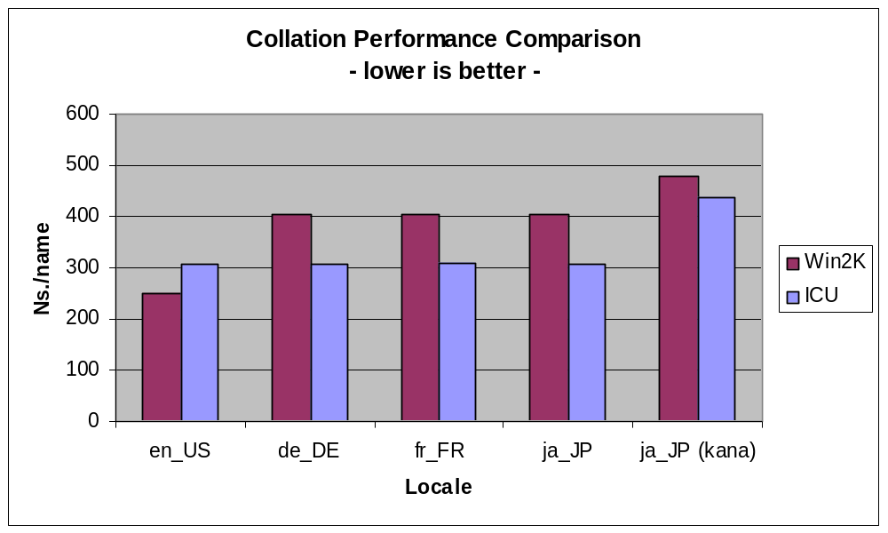
Collation Performance
Notes:
ICU collation performance is better than native in most cases.
This chart compares the performance of string collation in ICU4C and native Windows, using a few representative locales and data sets.
ICU is consistently faster by 10-25%, except for the en_US case, where it appears Windows has hand-tuned their collation implementation for this particular locale.
ICU collation is also substantially faster than Solaris and glibc (Linux, and other platforms using gcc) collation.
Tests were run under Windows 2000 on a 866 MHz Pentium III. Times are nanoseconds per name. The data file for the first four cases is a list of approximately 7600 English names using Latin-1 characters. The data file for the second ja_JP case is a list of approximately 22,700 Japanese names using hiragana characters. More detailed information will be available on our website.

Slide 11
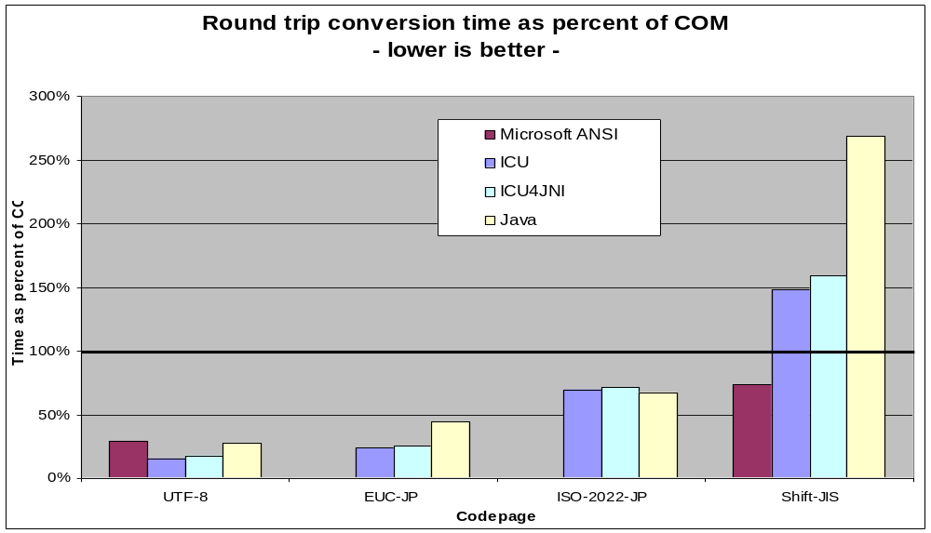
Charset Conversion Performance
Notes:
ICU character set conversion is comparable to native, and better in many cases.
This chart compares different conversion APIS for a few different character sets. APIs compared are Microsoft COM (the 100% line), Microsoft ANSI, ICU, ICU4JNI, and Java.
ICU4C is significantly faster than COM in many cases, and leads the pack for UTF-8. Windows ANSI is the leader for Shift-JIS, followed by COM.
ICU4JNI, which lets you call ICU libraries from Java code, provides an attractive alternative to pure Java for large conversions, as in these 1K tests. It provides native speeds, and access to the full suite of ICU character converters.
Tests were run under Windows 2000 on a 750 MHz Pentium III. Values are round-trip conversion time of a 1K buffer of data, expressed as a percentage of the COM time to perform the conversion. The UTF-8 text was composed of characters from various ranges of Unicode, chosen to exercise various aspects of UTF-8 conversion. The Japanese text was from a web page originally encoded in SJIS. Java figures are using JDK 1.3. More detailed information will be available on our website.

Slide 12
Common Architecture
Light-weight locale IDs
Code and data extensibility
  Data-driven services, ease of customization
  Shared constant data
Request and reuse model
  Can use multiple locales in a single thread
Notes:
ICU4C and ICU4J share common architectural features.
ICU identifies locale-specific resources using a Locale ID. This ID is just a name, not a data structure. It's composed of language, country and variant information, following the ISO-639 and ISO-3166 standards. For example, Italian, Italy, Euro is “it_IT_EURO.” Locale IDs are lightweight and easily shared.
Both code and data can be customized.
Services are designed with an abstract base class where it is possible to subclass and provide custom solutions.
Data-driven services are managed by ResourceBundle. It is designed not only to manage system information, but also application-specific or general services data. It maps a key to data. Currently, it supports string and integer data types, arrays, and binary object data types.
Services can be built at compile time or run time.
Services can be merged.
Services can be locale-dependent and locale-independent.
ICU interfaces employ a request and reuse model, which allows you to customize a service once, and then reuse this customized service as long as you need to. It also supports multiple locales, so you can use the same service customized for different locales at the same time, from within the same application and even the same thread. This provides more flexibility than the POSIX model.

Slide 13
ICU4C Architecture
Versioning management
Multi-thread support
Cross-platform portability
Preflighting and buffer overflow report
Notes:
ICU4C provides a versioning management interface, so users can easily provide compatibility support between releases.
ICU4C’s request and reuse model enables multiple thread support. Thread-specific data is kept in a small handle, while the bulk of the data, collation tables for example, is shared between threads. Different threads can perform collation for different locales, or differently customized collation for the same locale, at the same time.
ICU4C requires minimum compiler support so it can be easily ported to new platforms. For example, ICU
Returns error codes, instead throwing C++ exceptions.
Does not use templates, namespaces, or any newer C++ language features.
Does not use C strings to initialize data, and so avoids host encoding problems.
Machine-dependent information (such as library calls or sizes of integral types) is defined in a few machine-specific files to ease porting to new platforms.
The C APIs allow users to preflight calls in order to avoid out-of-memory errors. They also report on buffer overflow status. These features make it easier for C users to deal with memory management issues.

Slide 14
ICU4JNI
Access to ICU4C components from Java
  Full charset conversion support
  UCA compliant collation framework
Fast for bulk operations
Notes:
ICU4JNI provides access to certain ICU4C native libraries from Java, using the Java Native Interface. For each ICU4JNI release, the corresponding ICU4C snapshot is also required.
Currently ICU4JNI provides access to two components, converters and collation. Both of these provide substantial performance benefits compared to the standard Java classes. ICU4C also provides a wider range of converters than Java.
The converter API lets you access ICU4C converters through a custom interface. (In JDK 1.3, the converter interface is not public.) Instructions are provided for clients who have licensed the JVM from Sun and wish to try out the ICU converters. It is also possible to use the converters directly.
The collation API provides a conformant implementation of the Unicode Collation Algorithm for Unicode 3.0, which is not currently available in Java. Using ICU4JNI also offers performance benefits as compared to pure Java collation.
ICU4JNI is faster than pure Java when working with large quantities of data. There is a small fixed cost due to JNI overhead, but average per-character time is smaller, so the more data in a single JNI call, the greater the advantage. For character conversion we find ICU4JNI outperforms Java with buffers of 250 characters or more. Using the BufferedReader and BufferedWriter classes in Java provides adequate buffering.

Slide 15
ICU 2.0 Features
Unicode 3.1 character support
  All 3.1 normative properties
  Supplementary character support throughout
  Most support already in current releases
Extended transliteration
Common functionality in ICU4C and ICU4J
Notes:
In the fall of 2001, ICU4C and ICU4J will adopt a common release numbering scheme. This next reference release will be version 2.0 for both projects.
A primary goal for the 2.0 release is Unicode 3.1 character support. This will provide access to all the normative character properties in the Unicode 3.1 database, and some descriptive properties. Supplementary characters will be fully supported in the APIs and implementation. In the current release of ICU, most code already supports supplementary characters.
Release 2.0 will enhance transliteration support. Transliteration will handle denormalized text, by implicitly applying NFC as a first step. It will provide additional script rules. And it will provide more control in selecting the transliteration. For example, you will be able to select ‘Greek-Latin/Modern’ or ‘Greek-Latin/Classical’.
ICU4C and ICU4J have diverged somewhat in their feature sets. We intend to correct this, and with the 2.0 release most features in ICU will be fully supported by both projects. (Character conversion is supported by the Java runtime, and new API for this is forthcoming in JDK 1.4, so pure java character conversion will not be added to ICU4J.)

Slide 16
ICU Future Plans
Performance and robustness enhancement
Easy configurability
Future Unicode standard updates
New internationalization support

Slide 17
Development Process (1)
How to get ICU4C
  http://oss.software.ibm.com/icu/download
  Source only, requires ANSI C++ compiler
  Already ported to a wide variety of platforms
    Windows, AIX, Solaris, HP-UX, Linux, S/390
How to get ICU4J
  http://oss.software.ibm.com/icu4j/download
  Source, and class files available in jar
How to get ICU4JNI
  http://oss.software.ibm.com/icu4j/icu4jni/icu4jni.html
Notes:
Because of the language difference, ICU4C and ICU4J are packaged slightly differently. ICU4C (and ICU4JNI) must be built for your platform, while ICU4J’s class files are portable.
ICU4C releases are available at http://oss.software.ibm.com/icu/download. After downloading, you will need to build the libraries for your platform, since ICU4C does not release prebuilt libraries. Instructions for building the libraries are in the ReadMe document available in the download. Although we don’t provide prebuilt libraries, we build on a number of reference platforms internally, and other people have ported to still more platforms (16 at last count). So even if ICU hasn’t already been ported to your platform, chances are that you’ll find ICU a clean and straightforward port.
ICU4J releases are available at http://oss.software.ibm.com/icu4j/download. Each release snapshot contains the source files, jar file and documentation. You can pick the desired class files from the jar file directly and integrate them into their products, or ship the jar file. Building ICU4J requires JDK 1.2 or later. For more information, see the ReadMe included with the download.
ICU4JNI is distributed separately and requires a compatible release of ICU4C. You can get it at http://oss.software.ibm.com/icu4j/icu4jni/icu4jni.html.

Slide 18
Development Process (2)
ICU mailing lists
  http://oss.software.ibm.com/icu/archives
Proposal and patch submission
Conflict resolution by PMC (project management committee)
CVS for source control, jitterbug for bugs
  Will convert to use SourceForge in the future
Notes:
ICU maintains a number of mailing lists, to which you can subscribe by following links on the public web sites. See http://oss.software.ibm.com/icu/archives.
To submit a proposal or patch contribution to ICU, post it to icu@oss.software.ibm.com, and include:
A purpose statement, why ICU needs it, pros and cons.
The API and complete documentation on input/output parameters, side effects, return value and potential error conditions.
Sample code that uses the proposed API.
ICU is a true open-source project, it’s not controlled by just one company. The Project Management Committee (PMC) oversees the project. Its responsibilities are:
Oversee the strategic direction of the project, and ensure the project’s welfare.
Participate in overall development plans, help alleviate bottlenecks, resolve conflicts, and monitor the overall technical progress of the project.
The PMC as a group does not participate in the day-to-day coding, but members of the PMC can also contribute code. PMC is composed of representatives from several companies, such as Progress Software, RealNames, Lotus and IBM.
Currently, ICU uses CVS as its source code control system, and jitterbug as its bug reporting system. These are common applications for open-source projects. More information on CVS can be found on http://www.cvs.org. The details on Jitterbug can be found on http://samba.anu.edu.au/jitterbug/. In the future, the system will be updated to use SourceForge. However, the change is simply at the tools level, it does not affect the process.

Slide 19
References
IBM ICU OpenSource Web Site:
http://oss.software.ibm.com/icu
IBM ICU4J OpenSource Web Site:
http://oss.software.ibm.com/icu4j
IBM Unicode Web Site:
http://www.ibm.com/developer/unicode/
Unicode Standard Web Site:
http://www.unicode.org/
Notes:
To find out more about ICU4C, please visit the ICU4C open-source website at http://oss.software.ibm.com/icu. To find out how to use ICU4JNI to access ICU4C converters and collation from Java, follow the link on the ICU4C home page. To get a better feel for how to use ICU in your own applications, follow the link to the user’s guide.
To find out more about ICU4J, please visit the ICU4C open-source website at http://oss.software.ibm.com/icu4j.
IBM has a developer’s community website called “Unicode Zone”. This website contains a lot of articles about Unicode from industry experts. See http://www.ibm.com/developer/unicode.
And of course, for official information about Unicode, such as technical reports and data, please see the Unicode website at http://www.unicode.org.

