Slide 1
Transformation Support
Alan Liu
Globalization Center of Competency
IBM Emerging Technology Center

Slide 2
Transformation
Unicode-to-Unicode mappings
  Normalization
  Case Mapping
  Transliteration

Slide 3
Unicode Normalization
Normalization is described in UTR 15
Canonical composition / decomposition
Compatibility composition / decomposition
Locale independent

Slide 4
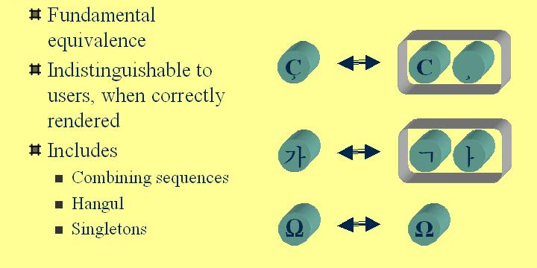
Canonical Equivalence
*This slide taken from UTR 15

Slide 5
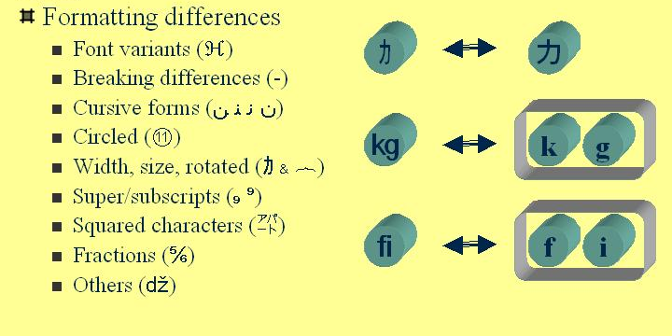
Compatibility Equivalence
*This slide taken from UTR 15

Slide 6
Case Mapping
Described in UTR 21
Based on Unicode 3.0 database and the SpecialCasings.txt file

Slide 7
Case Mapping
Lowercase, uppercase, and titlecase (for composite characters: ‘dz’, ‘DZ’, ‘Dz’)
May depend on context: ‘Σ’ capital sigma lowercases to ‘σ’ small sigma if it is followed by another letter, but ‘ς’ small final sigma if not
May depend on locale: ‘I’ capital letter i lowercases to ‘ı’ small dotless i in Turkish

Slide 8
Transliteration
Unicode-to-Unicode mapping
Typically for phonetic script conversion
Algorithmic or rule-based
Identified through programmatic IDs such as “Latin-Greek”
Notes:
Not translation

Slide 9
RuleBasedTransliterator
Regular expression derived syntax
Excerpt from lgreek.txt (Latin-Greek):
$alpha = \u03B1;
a <> $alpha;
''e <> [Ee]{$epsilon};

Slide 10
RuleBasedTransliterator
$alpha | Variable
\u03B1 \$ ‘$’ | Escapes
a > b | Forward rule
a < b | Reverse rule
a <> b | Bidirectional rule
L{a}R > b | Context
a > |b | Revisit

Slide 11
CompoundTransliterator
Composes two or more transliterators
Easy: Create via ID:
t = Transliterator::
createTransliterator(
“Greek-Latin;Latin-Arabic”);
Can also create programmatically

Slide 12
Creating a custom transliterator
Easy:
Write RuleBasedTransliterator rules
Hard:
Create a subclass of Transliterator

Slide 13
Transliteration Exercises
Exercise 1
  Create a Greek-Latin transliterator
  Use it to transliterate Greek text
Exercise 2
  Create a rule-based transliterator
  Combine it with the Greek-Latin transliterator in a compound transliterator

Slide 14
Normalization Exercises
Exercise 1
  Create a transliterator that uses a normalizer to remove combining characters

