Slide 1
Unicode from a distance…
Mark Davis
Chief Software Globalization Architect, IBM
President, Unicode Consortium

Slide 2
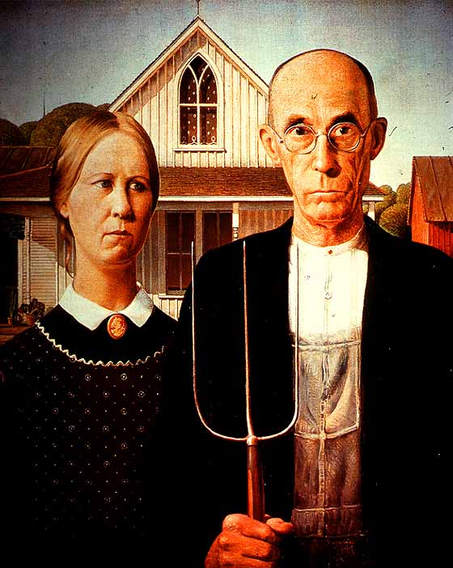
Starting back a bit before Unicode…

Slide 3
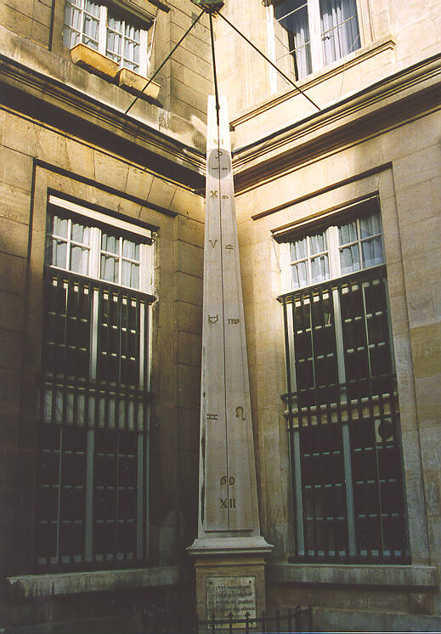
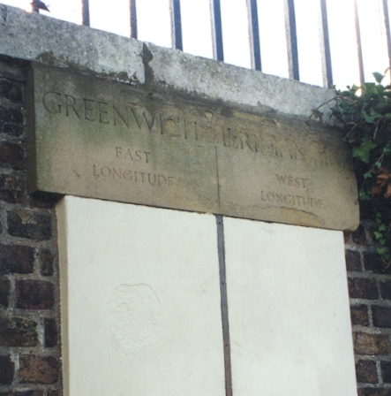
1850: Where? When?
Longitude non-standard
  Paris meridian
  Greenwich meridian
  Berlin meridian
Time non-standard
  7:16 Boston
  6:52 DC
  4:06 LA
  3:51 SF
That had to change…

Slide 4
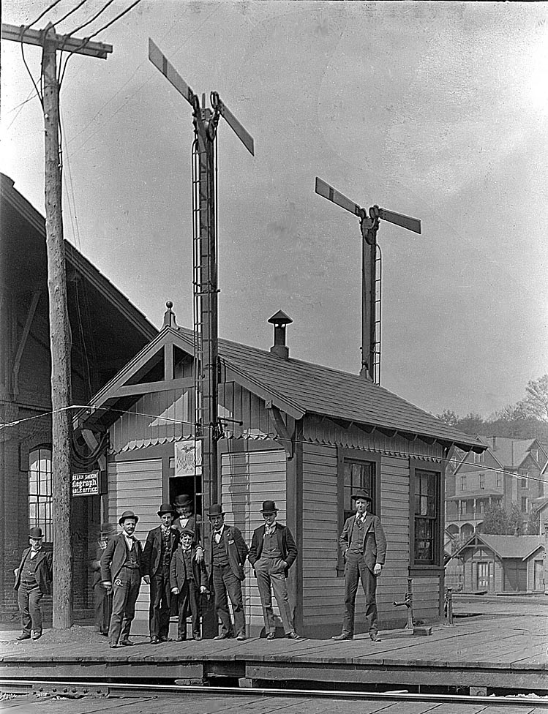
That had to change…
Telegraph →
exact longitudes
Railway →
timezones
Shipping →
Prime Meridian
  Washington, 1884
  France delays until 1914…

Slide 5
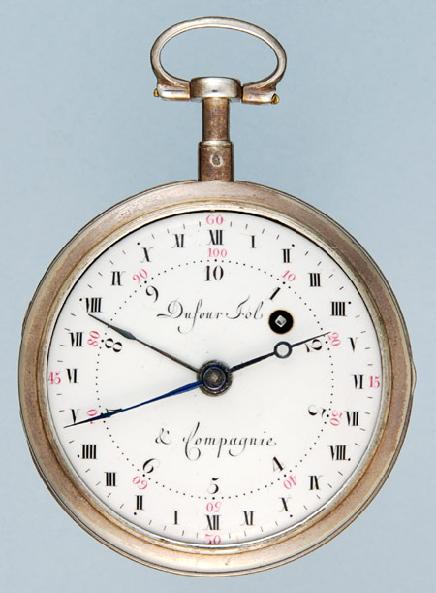
Uniformity Winning
Of course, the French gave us all the metric system
  Portuguese mile
  Roman mile
  Hamburg mile
  US mile
But we didn’t get metric time
  Still Babylonian…
Why one and not the other?

Slide 6
Fast forward a few years

Slide 7
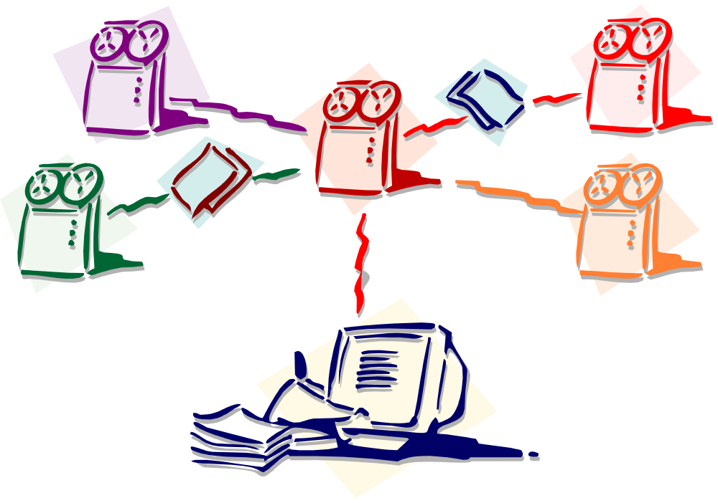
1985: Characters not Standardized – Data Exchange Limited
ก๊กเฮงแซ่แต้
徐順宏
✗
✗
✗
✗
✗
Игорь
Лукашев
Vladimir
Jelicačačić
Bjørn Vestergård

Slide 8
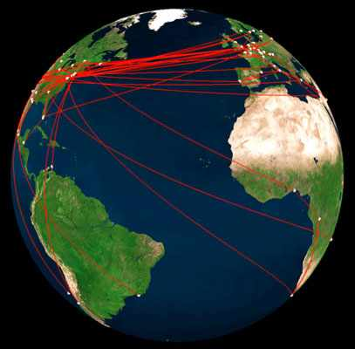
That had to change…

Slide 9
No longer data “islands”
Customers could be from any country
Companies have heterogeneous systems
People can’t tolerate it when text is lost or corrupted in transmission, or when lookups fail
English / European languages only part of the world market…

Slide 10
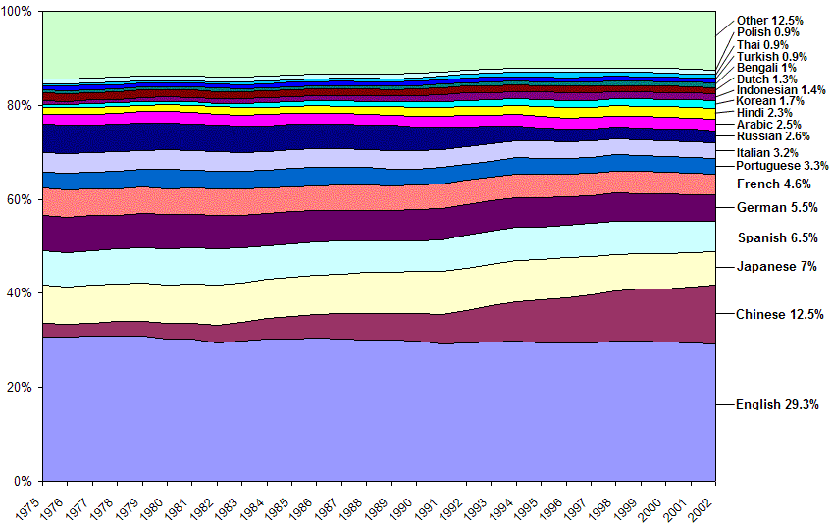
GDP-PPP – 1975..2002

Slide 11
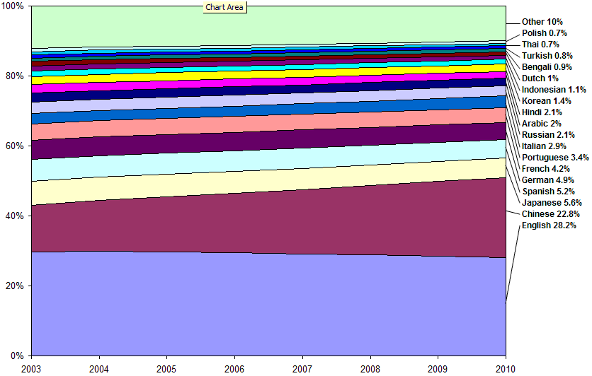
GDP-PPP– 2003..2010

Slide 12
Silicon Valley, 1991 - Unicode
ก๊กเฮงแซ่แต้
徐順宏
The Unicode Standard provides:
  a unique code for every character in the world
  a model and architecture for every script
  properties and behavior, isolating programmers from details.
Игорь
Лукашев
Vladimir
Jelicačačić
Bjørn Vestergård

Slide 13
2004 – Unicode, the “Prime Meridian” of computing
96,000+ Characters (V4.0)
Wide-ranging specifications for uniform cross-product behavior
Used
  in every major operating system
  in all major office software
  as the core definition of text in XML, HTML, …
  as the core of Java, C#, C (with ICU), …

Slide 14
Website Globalization
Websites present both static and composed data, the latter frequently backed by one or more databases
Unicode makes the entire architecture vastly simpler
  from back-end databases
  to pages served to client
People used to convert to legacy sets on output
  but less needed now, except special circumstances

Slide 15
Unicode Consortium
Development of Key SW Globalization Standards
  Unicode Standard
  Other Specs: Sorting, Int’l Regular Expressions, Matching (case-insensitive), Line-breaking, Identifiers,…
  New Projects: Common Locale Data Repository
    Uniform date/time/number formatting, sorting,… across programs/platforms
  Open to new Members:
    Corporate, Associate, Specialist
    http://www.unicode.org/consortium/why_join.html

Slide 16





References
ICU
Longitude
The Unicode Standard
UTN #13: GDP by Language
Einstein’s Clocks, Poincaré’s Maps
More about Unicode: March 31 - April 2!

