Slide 1
Unicode and WebSphere
Presenter : Andy Heninger
Authors: Kentaro Noji Debasish Banerjee
On the Development and Deployment of
Unicode Based Multilingual Web Applications
in IBM WebSphere Application Server

Slide 2
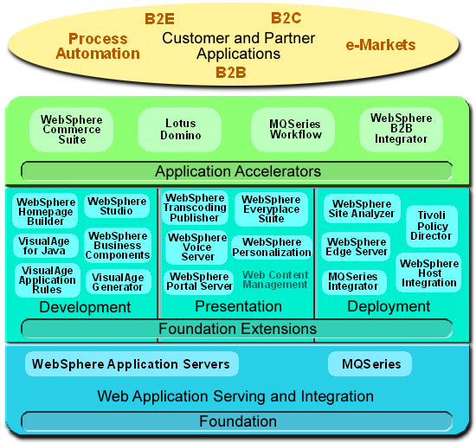
IBM WebSphere Platforms

Slide 3

WebSphere Application Server V4.0
Java 2 Enterprise Edition V1.2
  Servlet V2.2
  Java Server Pages V1.1
  Enterprise Java Beans V1.1
  JDBC V2.0
  …
Web Services
  SOAP, UDDI, WSDL
XML
  XML4J (Xerces V1.2)
Notes:
The latest version of IBM WebSphere Application Server is V4.0, and the key feature functions are J2EE and Webservices runtime environment. We provide Servlet V2.2 and JSP V1.1 runtime environment for dynamic web serving programming and runtime environment. WebSphere adds Web services runtime environment from V4.0.

Slide 4
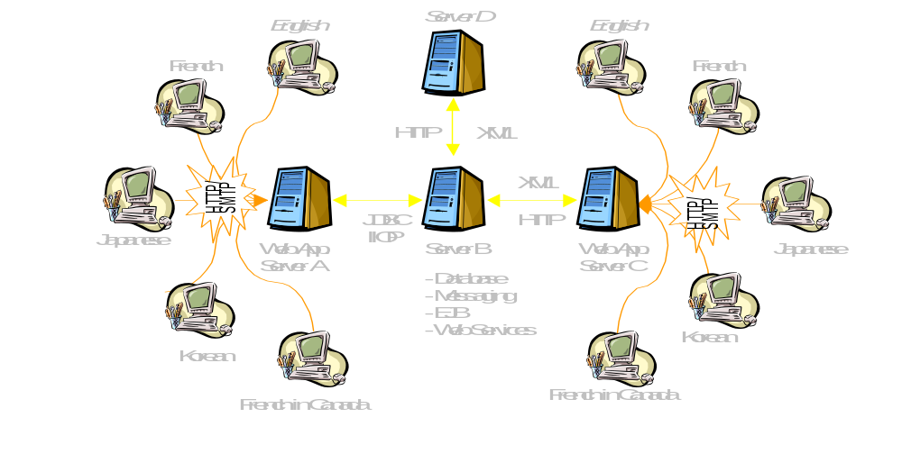
Model of Global WebSphere Applications

Slide 5


Considerations
Unicode will be the best solution.
However, customers still would like to use traditional code sets because not all web clients are ready for Unicode.
Especially for requests and responses composed of text/html data.
Also for handling data from data stores.

Slide 6
Goal
Easy deployable environment for Unicode-based J2EE Web application.
Multiple code set support for HTTP communication by single Web application server.
Notes:
I have two items for the Goal.
At first, WebSphere should be easy for deployment of Unicode based web applications.
The second, In addition to Unicode support, WebSphere should be easy for deployment environment for multiple coded character set support by single web application server.

Slide 7
HTTP response and request
MULTPLE CODE SETS
UNICODE
REQUEST
GET
REQUEST
RESPONSE
REQUEST
POST
Web Services
REQUEST
RESPONSE
Web Browsers
WebSphere

Slide 8
HTTP Request
FORM application is processed by the ServletRequest interface of Servlet.
ServletRequest.getParameter() family of methods return parameters’ data from FORM.

Slide 9
Problem
ServletRequest.getParameter() family of method must return string in Unicode after transcoding the parameter values from the code set of the FORM to Unicode.
There is no reliable way to decide the code set of the FORM…
However

Slide 10
Solution used WebSphere
WebSphere provides a flexible code set determination mechanism.
Two customizable properties
  encoding.properties file
  default.client.encoding system property
Notes:
WebSphere provides a flexible code set detection mechanism about FORM applicaions. This mechanism utilize the two kinds property that WebSphere originally provides.
Converter.properties contains the list for the pair of language and charset. The default.client.encoding is a WebSphere unique system property, and used to set the default code set for web client.

Slide 11
encoding.properties
#LOCALE=IANA_CHARSET
en=ISO-8859-1
…
th=windows-874
vi=windows-1258
ja=Shift_JIS
ko=EUC_KR
zh=GB2312
zh_TW=Big5
hy=UTF-8

Slide 12
Code Set Determination for the Request
Step 1
  If content-type of the FORM contains a charset value, use it and break.
Step 2
  If encoding.properties file contains a pair of language and charset, use the charset associated with accept-language and break.
Step 3
  If default.client.encoding contains a charset value, use it and break.
Step 4
  Use ISO-8859-1.

Slide 13
Step 1
Step 1 will usually fail because charset value is not usually added to content-type of the FORM.
  Charset supporting:
    Some WAP devices (because of WML specification)
  No charset support:
    Most Browsers for PCs.
Notes:
If Step 1 is really working on the real web programming, I think nobody complain. Normally appropriate charset value is not sent from the most of web browsers. Therefore. The step 1 will usually fail.

Slide 14
Step 2
Step 2 is used for accept-language based multi-language Web applications.
Administrator is allowed to customize the code set in the encoding.properties file.
Accept-charset cannot be used -- it is not intended to provide the request encoding.
Notes:
Step 2 is effective if browser’s language configuration is appropriate. Accept-language is configurable by Web browser, so user is able to set the appropriate language in the web browser’s property. As the converter.properties are customizable by web administrator, it is possible to change the default code set for the language.
Websphere does not utilize the accept-charset, because the accept-charset usually does not provide reliable code set information.

Slide 15
Step 3
When neither Step 1 nor Step 2 are effective, Step 3 is used.
Step 4
Step 4 defaults to ISO-8859-1.

Slide 16
HTTP Response
Content-type header allows adding charset attribute.
  e.g
  Content-type: text/html; charset=Shift_JIS
  Content-type: application/xml; charset=UTF-8
Notes:
HTTP response is normally used to send the html, xml data and so on. Content-type has charset attribute, so web application specifies the appropriate charset on the content-type.

Slide 17
Problems
If charset is not included, what is the appropriate charset?
Some Java code set values are not registered in the IANA charset database. Can’t I use the Java private code set?
Notes:
It looks there is no problem, but actually the problems exist.
At first, we should think about what is default code set in the absence of charset in the content-type. Is it US-ASCII? ISO-8859-1? UTF-8? What is correct and realistic?
The second problem is about Java unique encoding. The charset used in content-type must be registered in IANA, however there are some code set Java supports are not registered in IANA. Is there no way to use these java unique encoding?

Slide 18
Solution used WebSphere
WebSphere provides flexible methods for HTTP responses.
Two customizable properties files.
  encoding.properties
  converter.properties
Notes:
WebSphere provides two properties files to solve this problem. One is encoding.properties and the another is converter.properties. Both properties files are used for code set detection.

Slide 19
Code Set Determination for the Response
Step 1
  If a charset value is contained in content-type, use it. break.
Step 2
  If setLocale() method is invoked for the response, use a charset associated with the locale defined in “encoding.properties”. break.
Step 3
  Use ISO-8859-1.
Notes:
This is step to detect appropriate code set for http response.

Slide 20
IANA and Java Code Sets
WebSphere Application Server provides “converter.properties” file to map a Java code set to a IANA charset
  e.g
  Shift_JIS=Cp943C
  Big5=Cp950
  (iana_charset = java_code_set)
Notes:
WebSphere provides a solution to use Java private code set name for World Wide Web.
WebSphere has mapping property file between IANA and Java code set name, and all websphere applications are remapped based on this rule. For example, when a customer needs to use CP943C for Shift_JIS IANA code set name, Websphere maps Shift_JIS as Cp943C. Cp943C is one of Shift_JIS variant Java code set name.

Slide 21
converter.properties
#IANA_CHARSET=JAVA_CHARSET
Shift_JIS=Cp943C
EUC-JP=Cp33722C
EUC-KR=Cp970
EUC-TW=Cp964
Big5=Cp950
GB2312=Cp1386
ISO-2022-KR=ISO2022KR

Slide 22
Unicode Configuration
UTF-8 configuration
  default.client.encoding=UTF-8
  Mask encoding.properties
  Specify charset=UTF-8 for the content-type of the http response
Notes:
In order to use Unicode for http request and response, this is the configuration.

Slide 23
Conclusion (1)
Both Unicode and multiple traditional code sets are used easily by WebSphere Application Server.
WebSphere Application Server provides special code set detection mechanisms for HTTP requests and responses.

Slide 24
Conclusion (2)
WebSpere provides the following configuration files or value.
  encoding.properties
  converter.properties
  default.client.encoding

Slide 25
Conclusion (3)
The specifications of code set identification are vague for web programming.
Hopefully new specification such as XForms will fix the FORM internationalization problem.
Hopefully all Web clients will support UTF-8. This is the main reason why UTF-8 is not currently used in text/html.

Slide 26
WebSphere Plans
Add and refine the internationalization extensions for each of WebSphere components.

Slide 27
Notes
Other venders such as BEATM Weblogic Server, are also provide IANA to Java encoding mapping functions.
Several J2EE carriers provide their own proprietary code set determination logics for the ServletRequests.

Slide 28
Thank you
Acknowledgements
Rob High of IBM Austin, IBM WebSphere
Shannon Jacobs of IBM Japan, HRS
References
Banerjee, Debasish., et al. Internationalization Service
Fielding, R., et al. RFC 2068 HyperText Transfer Protocol V1.1
Hunter, Jason., Java Servlet Programming 2nd Ed., O’Reilly
Sun Microsystems, Java 2 Platform Enterprise Edition Specifications, V1.2 and V1.3

Slide 29
Backup

Slide 30
Hints and Tips for the FORM
There are some tricks to detect the encoding.
  Store the charset information of the FORM on the server side
    Needs a session mechanism.
  Utilize hidden charset parameter in the FORM
    Needs to embed charset for all form application, and add the logic to get the hidden charset
  Use the charset of content-type of the sent back FORM data.
    Needs to check whether the Web browsers send the charset in content-type.
  Use UTF-8
    Needs to check whether the Web browsers support UTF-8 or not.

Slide 31
Java Shift_JIS
Java supports 6 kinds of Shift JIS variant coded character set.
JIS family : SJIS, PCK
Close to JIS X0208:1997 standard
MS family : MS932, Shift_JIS, ms_kanji
Close to MS Windows Code Page 932 standard
IBM family : Cp942, Cp942C, Cp943, Cp943C
IBM standard
White : Master code set name
Gray : Alias name

