Slide 1
Sorting and Searching
Helena Shih
GCoC Manager
IBM

Slide 2
Agenda
What is language-sensitive collation?
An overview of the ICU collation components.
How to add customized collation rules?
What is the collation versioning mechanism?
How to do searching with ICU collation APIs?
What’s the difference between ICU, JDK and ICU4J?
Examples and exercises.

Slide 3
Introduction
How hard can this be? Isn’t Unicode just another character set?
Accented characters:
  minor variants: e vs. é vs. e´
  distinct letters: Å sorts after Z and Æ in Danish
  two letters: ä is ae in traditional German

Slide 4
Introduction
How hard can this be? Isn’t Unicode just another character set?
Accented characters
Expanding and contracting characters:
  German ß treated as ss
  Spanish ch treated as single letter after c

Slide 5
Introduction
How hard can this be? Isn’t Unicode just another character set?
Accented characters
Expanding and contracting characters
Ignorable characters:
  blackbird vs. black–bird
  The “–” is ignorable

Slide 6
Collation in ICU
Simple, data-driven, rule based collation
Rule support for more than 35 languages
Correct handling of the accents, expansion, contraction and so on
Easily customizable for your needs
Offering both incremental comparison for simple comparison and collation keys for batch processes

Slide 7
Examples
C++:
UErrorCode status = U_ZERO_ERROR;
Collator *myCollator = Collator::createInstance(Locale::US, status);
if (FAILURE(status))
{
cout << “Failed to create a US collator.\n”;
return;
}
delete myCollator;
C:
UErrorCode status = U_ZERO_ERROR;
Collator *myCollator = ucol_open(ULOC_US, &status);
if (FAILURE(status))
{
printf(“Failed to create a US collator.\n”);
return;
}
ucol_close(myCollator);

Slide 8
Extended Example
C++:
UErrorCode status = U_ZERO_ERROR;
Collator *myCollator = Collator::createInstance(Locale::US, status);
if (FAILURE(status))
{
cout << “Failed to create a US collator.\n”;
return;
}
myCollator->setStrength(Collator::PRIMARY); if (collator.compare("café", "cafe") == 0) {
cout << “Success!! Strings compare as equal.\n”;
}
delete myCollator;

Slide 9
Collation Options
Collation strength:
  PRIMARY: a letter difference, e.g. 'a' and 'b'.
  SECONDARY: an accent difference, e.g. 'ä' and 'å'.
  TERTIARY: a case difference, e.g. 'a' and 'A'.
  IDENTICAL: bitwise equality, e.g. 'a' and 'a'.
Normalization mode:
  NO_OP: no normalization
  COMPOSE: UTR 15 form C.
  COMPOSE_COMPAT: UTR 15 form KC.
  DECOMP: UTR 15 form D.
  DECOMP_COMPAT: UTR 15 form KD.

Slide 10
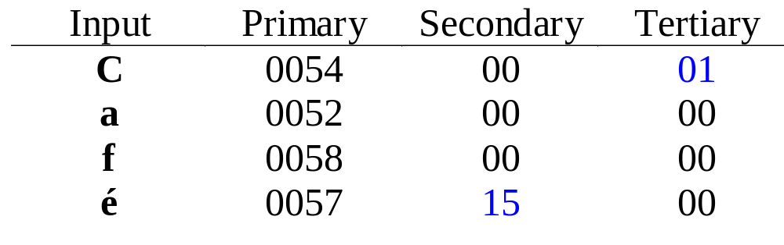
Secrets Behind the Scene
The string is converted to a list of “collation elements”.
Each element contains 3 components: primary, secondary and tertiary.
Example:

Slide 11
CollationElementIterator
Direct access to collation elements:
UErrorCode status = U_ZERO_ERROR;
RuleBasedCollator *myCollator = (RuleBasedCollator*)Collator::createInstance(Locale::US, status);
CollationElementIterator *iter =
myCollator->createCollationElementIterator("café");
int32_t elem;
while ((elem = iter.next(status)) != CollationElementIterator::NULLORDER) {
if (U_FAILURE(status))
return;
cout << “Element is:” << itoa(elem, 16) << ‘\n’;
cout << “ primary:” << itoa(CollationElementIterator::primaryOrder(elem), 16) << ‘\n’;
}
delete iter;
delete myCollator;

Slide 12
The rule symbols and their usage
'@': French secondary
'<' : Greater, as a primary difference
';' : Greater, as an secondary difference
',' : Greater, as a tertiary difference
'=' : Equal, no difference
'&‘ : Reset
All punctuation symbols in ASCII range are reserved

Slide 13
Examples
Rules | Comparison Examples
" a, A < b, B < c, C < ch, cH, Ch, CH < d, D < e, E" | "abc" <<< "ABC" "achb" < "adb"
" a, A < b, B < c, C < d, D < e, E & AE; ä " | "aeb" << "äb" "acb" < "äb"
".... q, Q & Question'-'mark = '?' ...." | "?" == "Question-mark"
".... & aa ; a- & ee ; e- & ii ; i- & oo ; o- & uu ; u- ...." | "baab" << "ba-b"
Note: ‘<<<‘ : tertiary difference
‘<<‘ : secondary difference
‘<‘ : primary difference
‘==‘ : no difference

Slide 14
Collation and ResourceBundle
Collation rules can be overwritten completely (or not).
Two sets of version information provided:
  Data: “CollationElement”:”Version” tag from ResourceBundle
  Code: Collator::getVersion() or ucol_getVersion().

Slide 15
ResourceBundle Example
{
CollationElements {
Version { "1.0" }
Override { "FALSE" }
Sequence { "& A < \u00E6\u0301 , \u00C6\u0301& Z < \u00E6 , \u00C6;"
" a\u0308 , A\u0308 < \u00F8 , \u00D8 ; o\u0308 , O\u0308 ; o\u030B, O\u030B< a\u030A"
" , A\u030A, aa , aA , Aa , AA & V, w, W & Y ; u\u0308 , U\u0308" }
}

Slide 16
Searching in ICU
Compare “collation elements” not characters
Brute-force search works

Slide 17
Comparing Collation Elements
UBool match(const CollationElementIterator* text,
const CollationElementIterator *pattern)
{
UErrorCode status = U_ZERO_ERROR;
while (TRUE) {
int32_t patElem = pattern->next(status);
int32_t textElem = text->next(status);
if (U_FAILURE(status)) return FALSE;
if (patElem == CollationElementIterator::NULLORDER) {
return TRUE; // End of the pattern
}
else if (patElem != textElem) {
return FALSE; // Mismatch
}
}
}

Slide 18
Simple Search Example
UnicodeString text("Now is the time for all good women“);
UnicodeString pattern("for“);
CollationElementIterator *patternIter =
myCollator::createCollationElementIterator(pattern);
CollationElementIterator *textIter = myCollator::createCollationElementIterator(text);
for (int32_t i = 0; i < text.length(); i++) {
textIter->setOffset(i, status);
patternIter.reset();
if (match(patternIter, textIter)) {
// Found a match at position i
}
}
delete patternIter;
delete textIter;

Slide 19
What’s Wrong?
match() treats any difference as significant
  Won't find résumé if searching for resume
  Won't find ß if searching for ss ….

Slide 20
What’s Wrong?
match() treats any difference as significant
Ignorable characters aren’t ignored
  Won’t find black–bird if searching for blackbird

Slide 21
Collation Element
An ICU collation element is a 32-bit integer
  16 high bits for the primary portion
  8 bits for secondary
  8 low bits for tertiary
Use bitmasks to implement weights:
int32_t getMask(Collator::ECollationStrength weight)
{
  switch (weight) {
  case Collator.PRIMARY: return 0xFFFF0000;
  case Collator.SECONDARY: return 0xFFFFFF00;
  default: return 0xFFFFFFFF;
  }
  }

Slide 22
Updated Match() I
UBool match(const CollationElementIterator* text,
const CollationElementIterator *pattern,
Collator::ECollationStrength weight)
{
UErrorCode status = U_ZERO_ERROR;
int32_t mask = getMask(weight);
while (TRUE) {
int32_t patElem = pattern->next(status);
int32_t textElem = text->next(status);
if (U_FAILURE(status)) return FALSE;
if (patElem == CollationElementIterator::NULLORDER) {
return TRUE; // End of the pattern
}
else if ((patElem & mask) != (textElem & mask)) {
return FALSE; // Mismatch
}
}
}

Slide 23
Ignorable Characters
Still don’t handle ignorable characters, e.g. the ‘–’ in “black–bird”
Accented letters can be represented in two different ways:
  Precomposed character: é (00E9)
  Combining sequence: e + ´ (0065 0301)

Slide 24
Ignorable the Element
Accents have collation elements too:
  e 00570000
  e ´ 00570000 00001500
For primary weight, mask with FFFF0000:
  e 00570000
  e ´ 00570000 00000000
Hyphen works the same way
  – 00007201
  00000000

Slide 25
Update match() to Ignore Elements
Pattern
b
l
a
c
k
b
i
r
d
Target
b
l
a
c
k
–
b
i
r
d
00530000
005e0000
00520000
00540000
005d0000
00007201
00530000
005b0000
00640000
00550000
00530000
00530000
005e0000
00520000
00540000
005d0000
00007201
00530000
00530000
005e0000
00520000
00540000
005d0000
00007201

Slide 26
Boyer-Moore searching
silly_spring_string
string
Start comparing at the end.
The space in the text doesn't match the "g"
There is no space anywhere in the pattern, so we can advance by six characters rather than just one.

Slide 27
Boyer-Moore searching
silly_spring_string
string
"p" and "t" do not match
There is no "p" in the pattern, so we can advance by two.

Slide 28
Boyer-Moore searching
silly_spring_string
string
"s" and "g" do not match
We know there is an "s" at the start of the pattern

Slide 29
Boyer-Moore searching
silly_spring_string
string
We found a match!
There were 13 comparisons, vs. 21 for the brute-force approach.
A less-contrived example would be even better: fewer spurious matches.

Slide 30
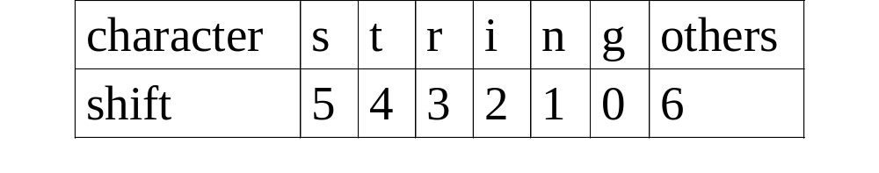
Shifting
How do you know how far to shift?
Precomputed shift tables:
Computing the tables:
  Value is how far from the end of the pattern a character occurs
  If it occurs twice, take the lower number

Slide 31
Shifting Issues
If you shift the pattern too far, you can miss a valid match in the text.
Shifting too little only hurts performance.
When in doubt, less is better
  If a character occurs twice in the pattern, use the lesser of the two shift distances.

Slide 32
Boyer-Moore and Unicode
Traditional Boyer-Moore shift table indices are 1-byte characters (256 entries).
Unicode is too big: table would have 65536 entries.
Collation elements have over 4 billion possible values.

Slide 33
Hashing
Large character sets can be collapsed to a manageable size with hashing.
Shift table indices are hash values, not characters.
Collision? Use the smaller shift distance!

Slide 34
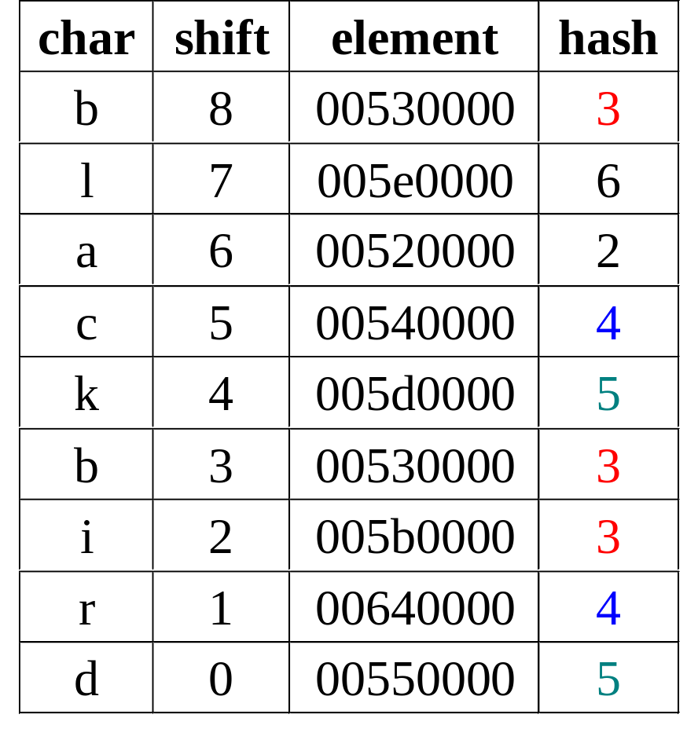
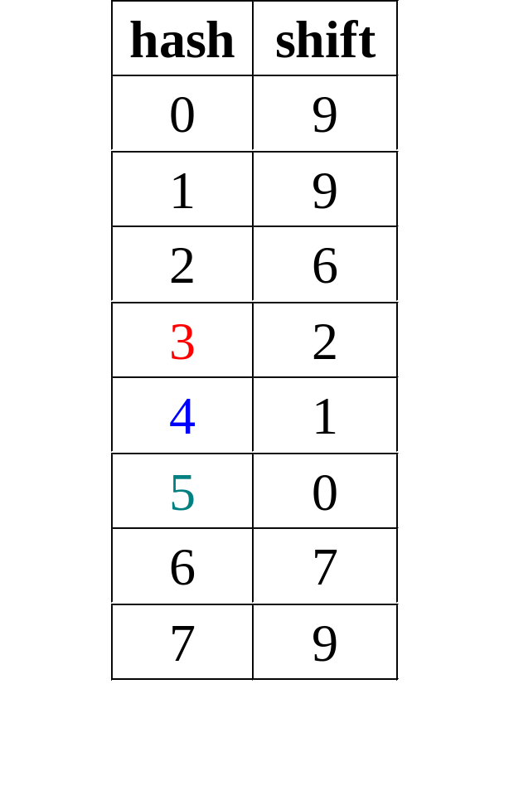
Example

Slide 35
Hash Functions
Simple hash functions are fine:
static int hash(int element)
{
return (element >>> 16) % 0x00FF;
}
Complicated ones may be slightly better:
static int hash(int element)
{
return ((element >>> 16) * 5821 + 1) % 251;
}

Slide 36
Searching Mechanism
Build
Shift
Table
textIndex =
patLength
textIndex
< length?
Pattern
Matches?
yes
patIndex =
patLength
yes
Found!
no
no
Not Found
textIndex
+= shift

Slide 37
ICU and Java
The collation service is built-in for Sun’s JDK.
Parallel design/architecture/resources of collation service for ICU and Java.
Additional enhancements may be in ICU4C and IBM’s JVM only.
The searching service is available via ICU4J.

Slide 38
Summary
Language-sensitive Unicode collation in ICU
Why is Unicode collation important
What are the collation options
Simple and extended example usage
Collation element iterator usage
Simple brute-force searching example
Efficient Boyer-Moore searching and Unicode
ICU and Java comparison

Slide 39
References
ICU4C website
http://oss.software.ibm.com/icu
ICU4J website
http://oss.software.ibm.com/icu4j
ICU Workshop Information
http://oss.software.ibm.com/icu/workshop

Slide 40
Future Directions
Further collation performance enhancements
Upgrade to full Unicode collation algorithm
Misc. collation features
Boyer-Moore searching APIs

Slide 41
Collation Exercises (C and C++)
Exercise 1:
  Opens a collator with a locale.
  Compares two strings with the collator.
  Sets the strength to tertiary and compare the strings again.
  Gets the keys for the strings and compare them.
Exercise 2:
  Open a Collator with customized rules and attributes.
  Compare two strings with the collator.
  Open a CollationElementIterator.
  Walk through the text with the element iterator.

