Slide 1
Automatic Character Set Recognition
Eric Mader, IBM
Andy Heninger, IBM

Slide 2
Overview
What is character set detection?
How is it used?
Character set detection libraries
How ICU’s library is implemented
Conclusion

Slide 3
What is Character Set Detection?
Tower of Babel
  Dozens of character encodings in common use
  Web pages, emails, plain text files
  Protocols specify character encoding
Encoding information may be missing or incorrect
  Encoding information may be missing
  Server may have incorrectly overridden
  Translator may have failed to update
Character set detection to the rescue!

Slide 4
How is Character Set Detection Used?
Web browsers, search engines, email
  Web pages, email have character encoding information
  This information may be missing or incorrect
File indexing
  Must handle plain text files
  Character encoding information may be incorrect

Slide 5
Character Set Detection Libraries
Mozilla
  C++ and Java versions
  Incremental operation
Windows API
  ImultiLanguage2::DetectInputCodepage
  ImultiLanguage2::DetectCodepageInIStream
ICU
  C and Java versions

Slide 6
ICU’s Character Set Detection Library
Detection function
  Returns character set, confidence
Conversion function
  Converts data to Unicode
Convenience functions to do both

Slide 7
Three Classes of Character Sets
Single Byte
  Each byte corresponds to one Unicode character
Multi-Byte
  Two or more bytes represent a single Unicode character
Algorithmic
  Encoding scheme produces distinctive byte patterns

Slide 8
Detecting Single Byte Character Sets
Can’t use byte patterns
  Any byte legal in any position
Use statistical method
  Have statistics for each language
  Match statistics of input to each language
  Assumes input is natural language plain text

Slide 9
Language Statistics
Trigrams
  Groups of three adjacent letters
  Treat runs of punctuation, spaces as single space
Data is list of most common trigrams
  Computed from large, varied sample of text
Compute trigrams for input, compare
  Confidence based on number of common trigrams

Slide 10
Single Byte Character Sets Detected By ICU
Name | Languages
ISO-8859-1 | Danish, Dutch, English, French, German, Italian, Norwegian, Portuguese, Spanish, Swedish
ISO-8859-2 | Czech, Hungarian, Polish, Romanian
ISO-8859-5 | Russian
ISO-8859-6 | Arabic
ISO-8859-7 | Greek
ISO-8859-8 | Hebrew
ISO-8859-9 | Turkish
Windows-1251 | Russian
Windows-1256 | Arabic
KOI8-R | Russian

Slide 11
Multi-Byte Character Set Detection
Used for Chinese, Japanese, Korean
Can use byte patterns
  Rules for which bytes can be in each position
  Can reject data that breaks the rules
Must use statistics
  List of most commonly used characters
  Confidence based on percentage of common characters

Slide 12
Chinese GB-2312, GBK, GB18030
GB-2312 (1980)
  6,763 Han characters
GBK (1995)
  Extends GB-2312
  Adds all Han characters from Unicode 2.0
GB18030 (2000)
  Extends GBK
  Adds all of Unicode
ICU Always matches GB18030
  Common characters are from GB-2312
  GB18030 to Unicode converter will handle all three

Slide 13
Multi-Byte Character Sets Detected By ICU
Name | Language
Shift-JIS | Japanese
EUC-JP | Japanese
EUC-KR | Korean
GB18030 | Chinese
Big5 | Chinese

Slide 14
Algorithmic Character Sets
Identified by distinctive byte sequences
  Don’t need language statistics
UTF-8, UTF-16, UTF-32
ISO-2022-CN, ISO-2022-JP, ISO-2022--KR

Slide 15
Algorithmic Character Sets: UTF-8
Unicode encoding
Represents characters as sequence of one to four bytes
Can start with Byte Order Mark (BOM):
  EF BB BF
Very distinctive byte pattern
# of Bytes | Allowable Values at Each Position
1 | [00-7F]
2 | [C0-DF] [80-BF]
3 | [E0-EF] [80-BF] [80-BF]
4 | [F0-F7] [80-BF] [80-BF] [80-BF]

Slide 16
Algorithmic Character Sets: UTF-16
Unicode encoding
Represents characters as sequence of 16-bit words
Starts with Byte Order Mark (BOM):
  FE FF (big-endian)
  FF FE (little-endian)
Confidence based on presence of BOM
  Could check for defined characters, script runs, etc.

Slide 17
Algorithmic Character Sets: UTF-32
Unicode encoding
Represents characters as 32-bit words
Can start with Byte Order Mark (BOM):
  00 00 FE FF (big-endian)
  FF FE 00 00 (little-endian)
Confidence based on presence of characters in Unicode range
Byte pattern is fairly distinctive
  Lots of zero bytes

Slide 18
Algorithmic Character Sets: ISO-2022
Used for Chinese, Japanese, Korean
  Widely used in email
Uses embedded escape sequences, shift codes
  e.g. 1B 24 29 43 is Korean escape sequence
Confidence based on escape sequences:
  Presence of known sequences, absence of unknown
  No overlap for Chinese, Japanese, Korean sequences

Slide 19
Character Set Detection and Markup
HTML documents contain headers, markup, JavaScript
Can interfere with language-based detection
  Not part of text content
  Uses Latin alphabet
ICU provides a basic markup filter
  Use if text known to contain markup
  Use for languages written in Latin alphabet

Slide 20
How Much Text is Required?
Good results with a few hundred bytes of plain text
Complex web sites can have kilobytes of markup
  Usually at the beginning
  Our experience: 6 kilobytes is enough
Trade-off between speed and accuracy
Test results:

Slide 21
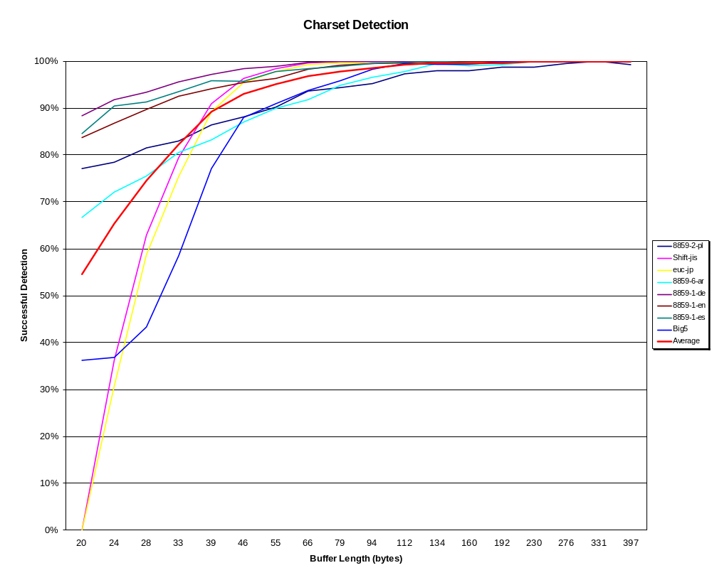

Slide 22
Language Detection
Language detected as side effect
No language for UTF encodings
  We could adapt single-byte data
Closely related languages my be confused
  e.g. French, Spanish, Portuguese
Use linguistic analysis libraries for more accuracy
Test results:

Slide 23
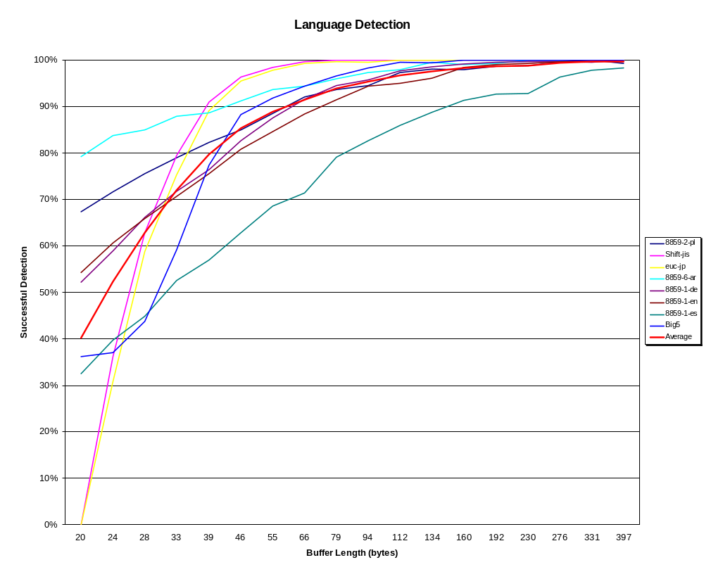

Slide 24
Cautions
Character set detection is not 100% reliable
  Based on statistics
  Assumes data is natural language text
  Doesn’t have data for all encodings
Designed to work on plain text
  Markup, etc. will confuse it
  Won’t work on binary formats, like word processing documents

Slide 25
Conclusions
Can read and understand text in unknown encoding
Any program that reads text from uncontrolled sources can benefit
Freely available implementations make character set detection easy to use

Slide 26

Questions and Answers

Slide 27
Character Sets Detected by ICU
Name | Type | Languages
ISO-8859-1 | Single Byte | English, German, French, Spanish, Danish
ISO-8859-2 | Single Byte | Czech, Hungarian, Polish
ISO-8859-5 | Single Byte | Russian
ISO-8859-6 | Single Byte | Arabic
ISO-8859-7 | Single Byte | Greek
ISO-8859-8 | Single Byte | Hebrew
ISO-8859-9 | Single Byte | Turkish
KOI8-R | Single Byte | Russian
Shift JIS | MultiByte | Japanese
EUC JP | MultiByte | Japanese
ISO 2022 JP | Algorithmic | Japanese
GB18030 | MultiByte | Chinese
ISO 2022 CN | Algorithmic | Chinese
Big5 | MultiByte | Chinese
EUC KR | MultiByte | Korean
ISO 2022 KR | Algorithmic | Korean
UTF 8/16/32 | Algorithmic | All (Unicode)

