Slide 1
Workforce
Stabilization
Efforts
by Martin Zanaj

Slide 2
Problem
Marion County Health & Human Services has selected Workforce Stabilization as a priority area for its current Strategic Plan; it deems critical to understand and address staff shortage issues.
Provide a summary along with key findings
Potential future areas of exploration

Slide 3
Data
The dataset represents current job positions within the Health and Human Services Department.
Observations (rows) | 557
Features (columns) | 20 Department, Position, Position #, Employee, Column 1, Employee #, Assigned FTE, Budgeted FTE, Asg Grade, Pos Grade, Unit, PF Flag, Org w/in Dept, Pos Start Date, Pos End Date, Bilingual, Bilingual Language, Cash Handler, Credit Card Handler, Job#

Slide 4
Data
Observation Example
Department | HHS
Position | Nutritionist
Position # | 1098
Employee | Vacant
Column 1
Employee # | n/a
Assigned FTE | n/a
Budgeted FTE | 1.00
Asg Grade | n/a
Pos Grade | 06.C53 A
PF Flag
Unit | 06
Org w/in Dept | Maternal Child HS
Pos Start Date | 08-Jan-2023
Pos End Date | 31-Dec-4712
Bilingual | N
Language | n/a
Cash Handler | Y
Credit Card | N
Job# | 582

Slide 5
Data
Occam’s Razor
In philosophy, Occam's razor is the problem-solving principle that recommends searching for explanations constructed with the smallest possible set of elements. It is also known as the principle of parsimony, which translates as "Entities must not be multiplied beyond necessity."
Among many possible theories/solutions,choose the simplest scientific explanation that fits the evidence

Slide 6
Data
Irrelevant Features
Department | HHS
Position | Nutritionist
Position # | 1098
Employee | Vacant
Column 1
Employee # | n/a
Assigned FTE | n/a
Budgeted FTE | 1.00
Asg Grade | n/a
Pos Grade | 06.C53 A
PF Flag
Unit | 06
Org w/in Dept | Maternal Child HS
Pos Start Date | 08-Jan-2023
Pos End Date | 31-Dec-4712
Bilingual | N
Language | n/a
Cash Handler | Y
Credit Card | N
Job# | 582

Slide 7
Data
Reduced Observation
Department | HHS
Position | Nutritionist
Employee | Vacant
Assigned FTE | n/a
Budgeted FTE | 1.00
Asg Grade | n/a
Pos Grade | 06.C53 A
Unit | 06
Org w/in Dept | Maternal Child HS
Pos Start Date | 08-Jan-2023
Bilingual | N
Language | n/a
Cash Handler | Y
Credit Card | N
Job# | 582

Slide 8
Data Exploration

Slide 9
General → Specific
Department
→ Organization within Department
→ Unit
→ Job#
→ Position

Slide 10
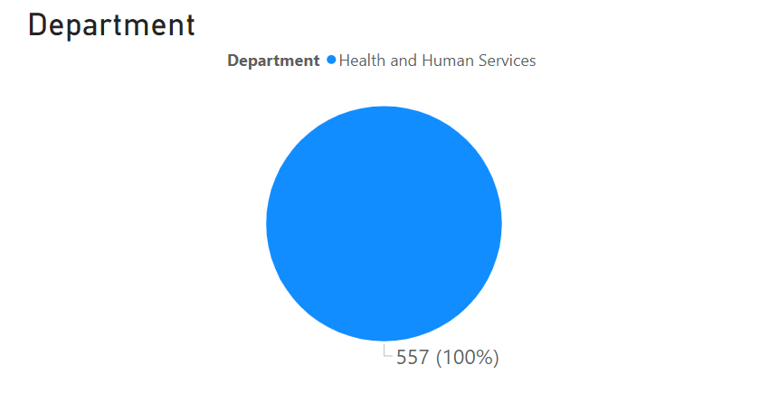

Slide 11
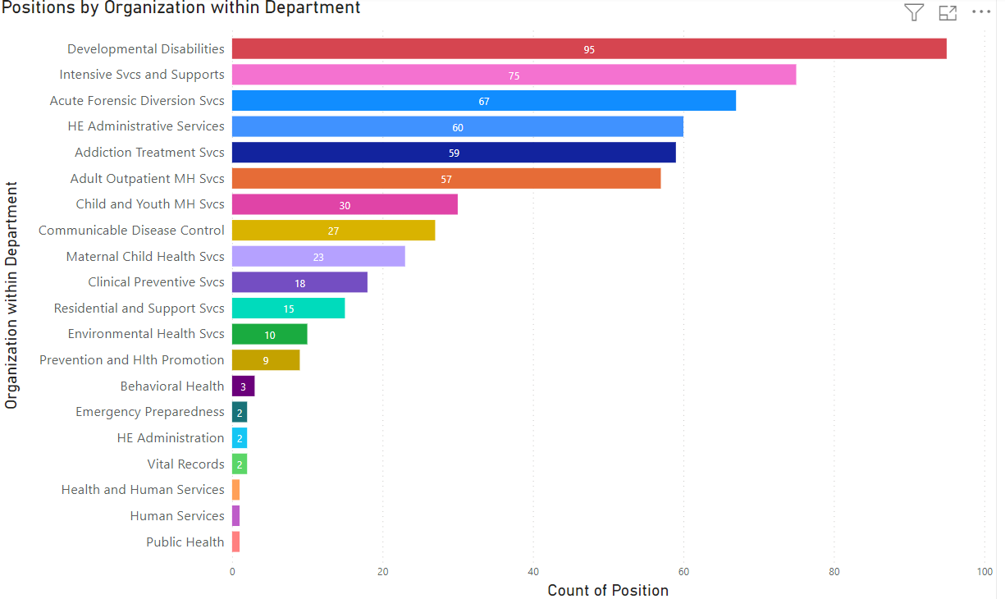

Slide 12
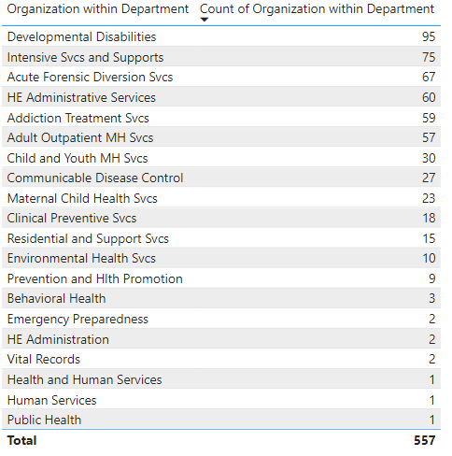

Slide 13
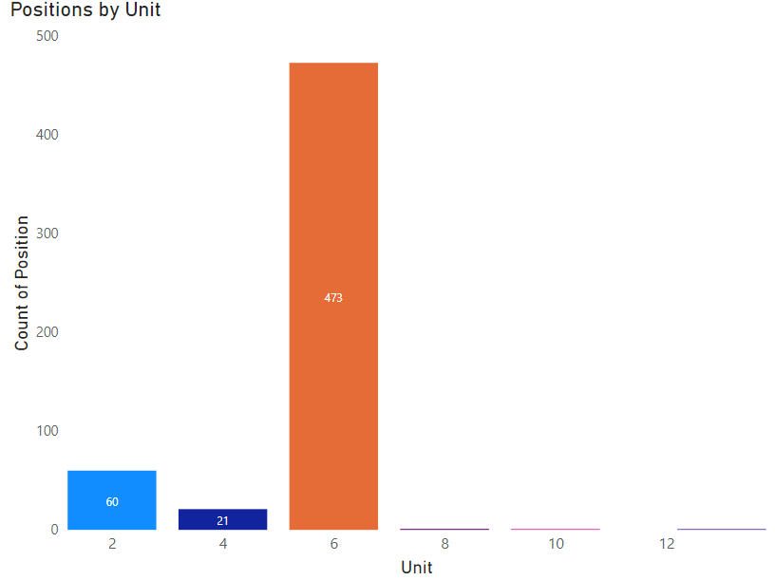

Slide 14
Unit
Unit # | Description
2 | Supervisory
4 | Oregon Nurses Association (ONA)
6 | Marion County Employees Assoc. (MCEA/SEIU) Non-Information Technology (employees not in nursing or law enforcement)
8 | Marion County Employees Assoc. (MCEA/SEIU) Information Technology
10 | Department Heads and Undersheriff
13 | Non-Supervisory

Slide 15
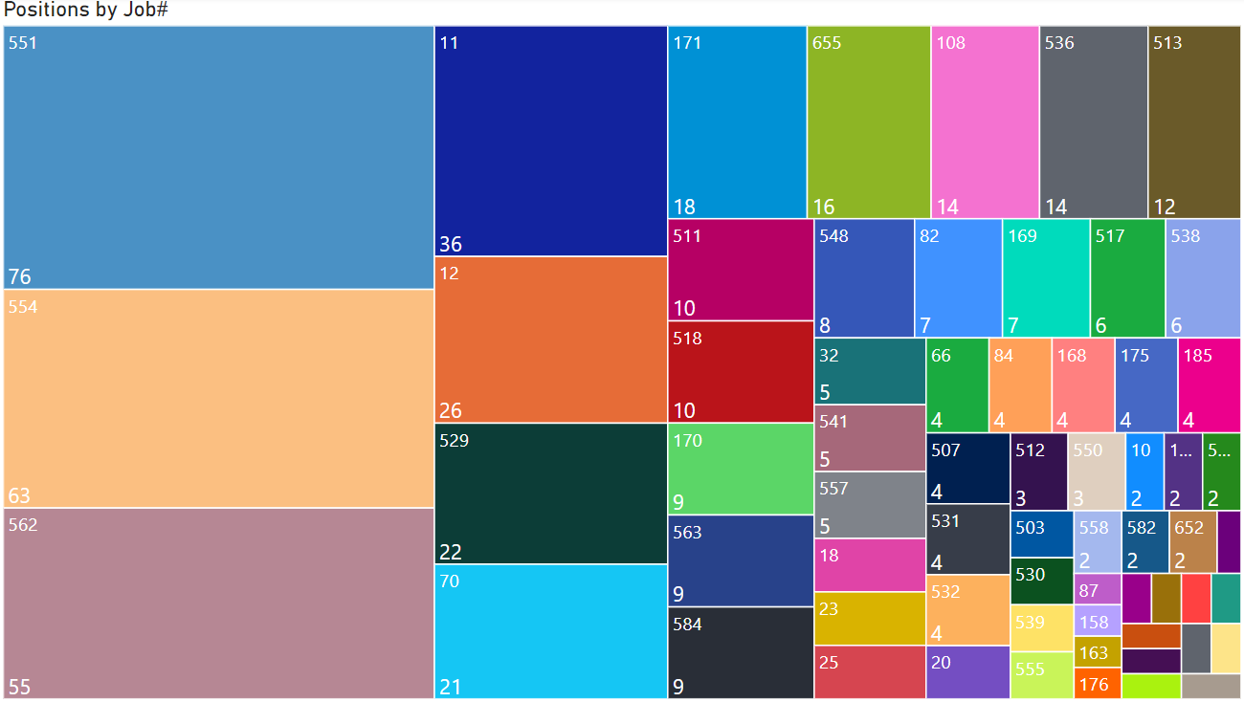

Slide 16
Clinical
Supervisor
2
Office Specialist 2
Mental Health Assoc
Office Specialist 3
Mental Health Spec
Addiction Treat Association
Development Disabilities Assoc
Peer Support
Specialist

Slide 17
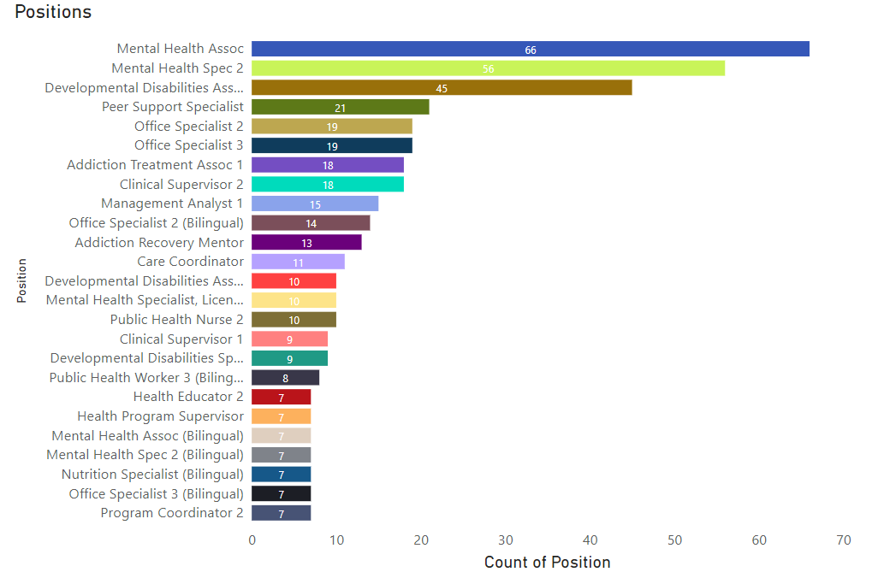

Slide 18
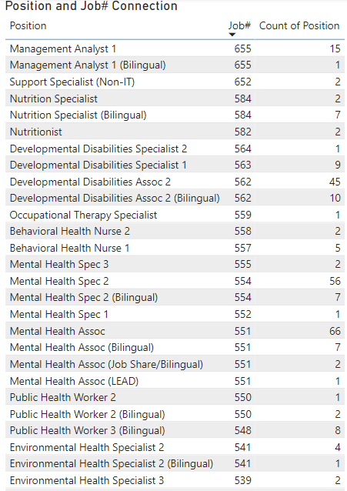
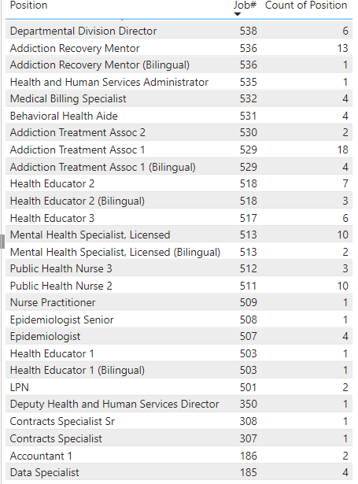

Slide 19
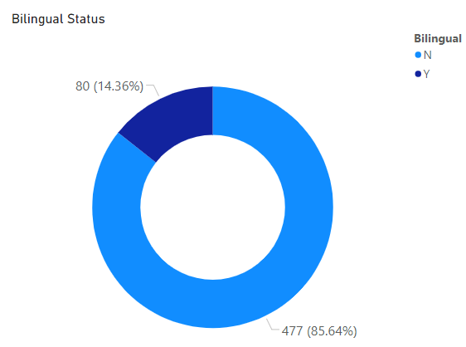
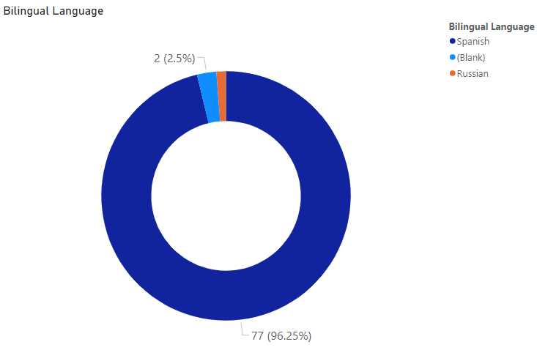

Slide 20
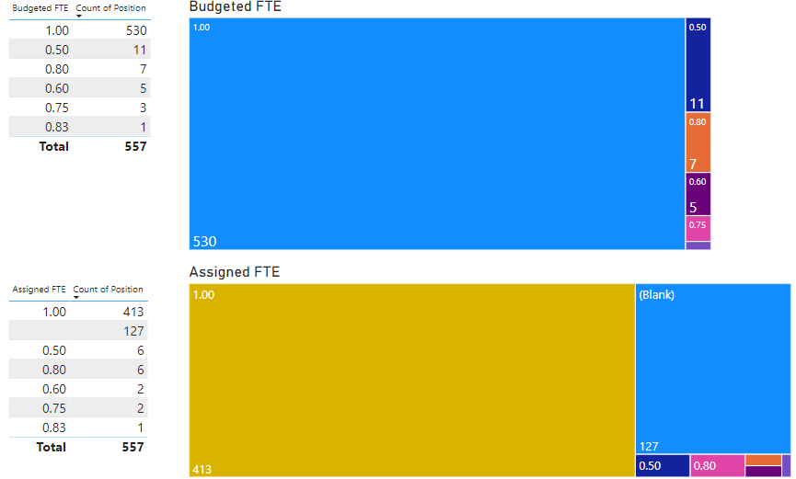

Slide 21
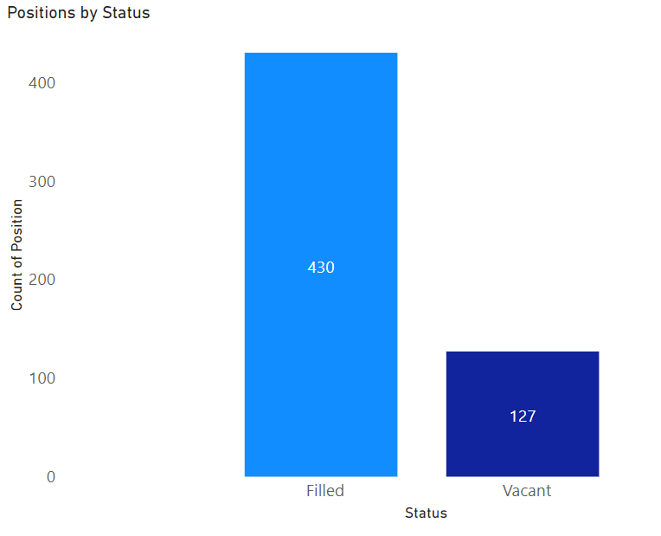

Slide 22
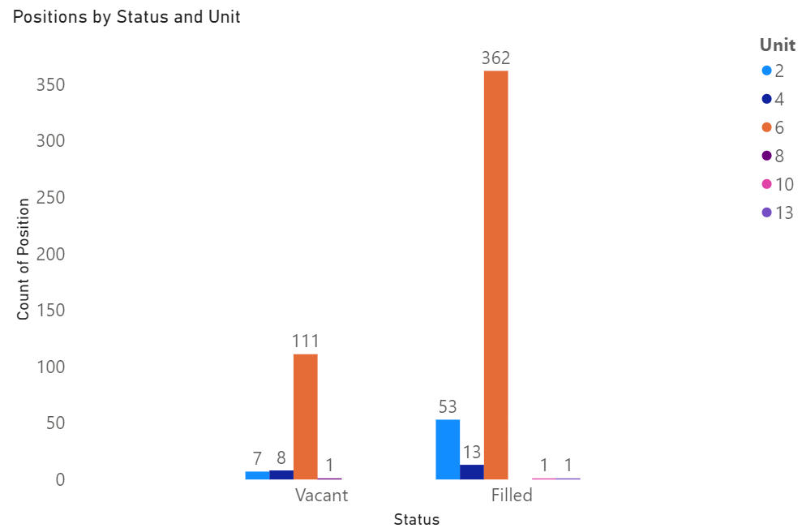

Slide 23
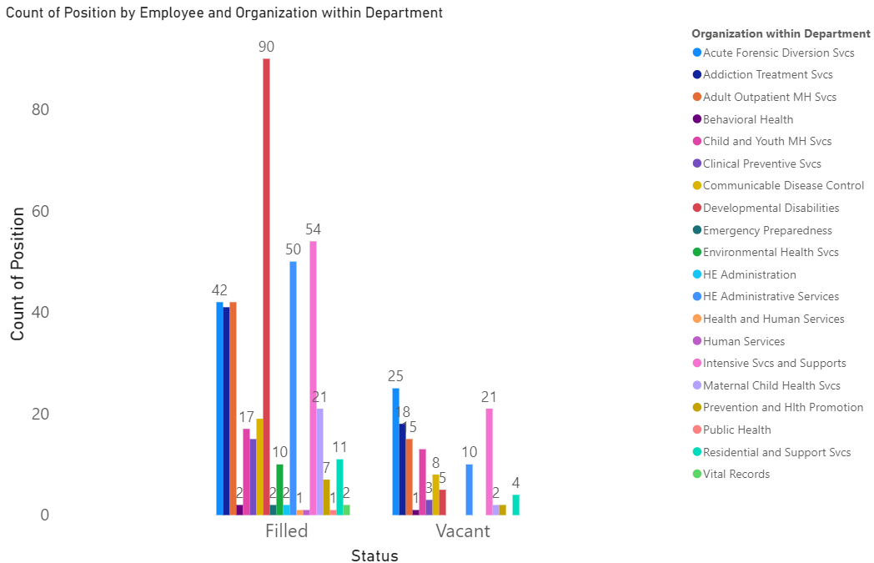

Slide 24
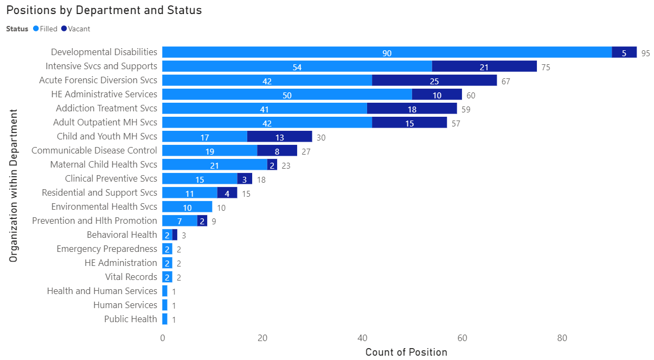

Slide 25
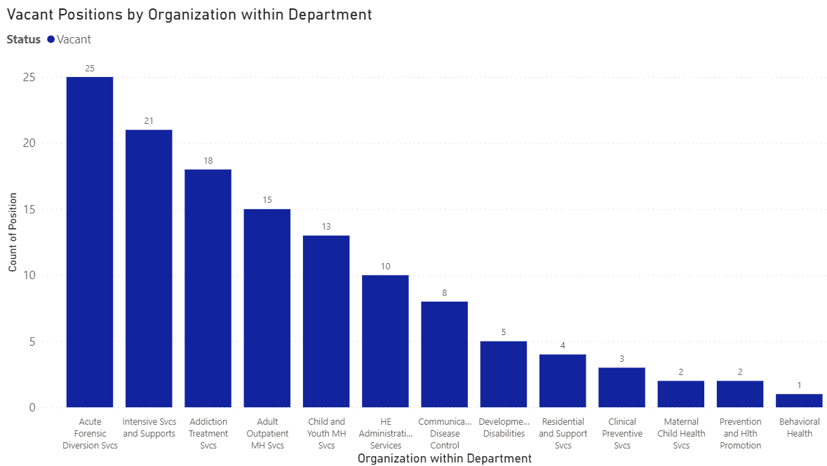

Slide 26
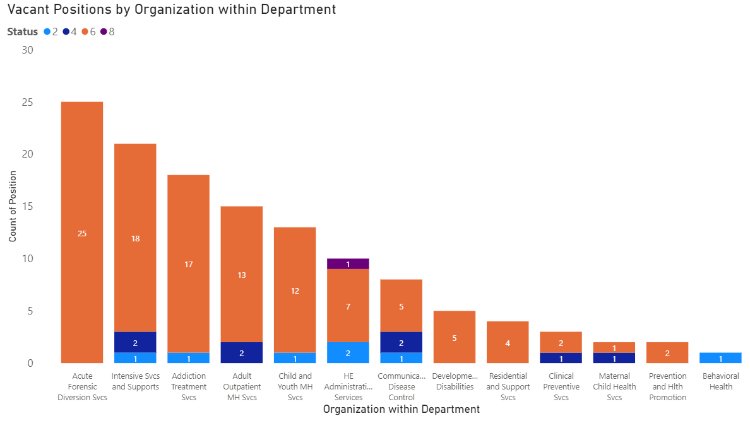

Slide 27
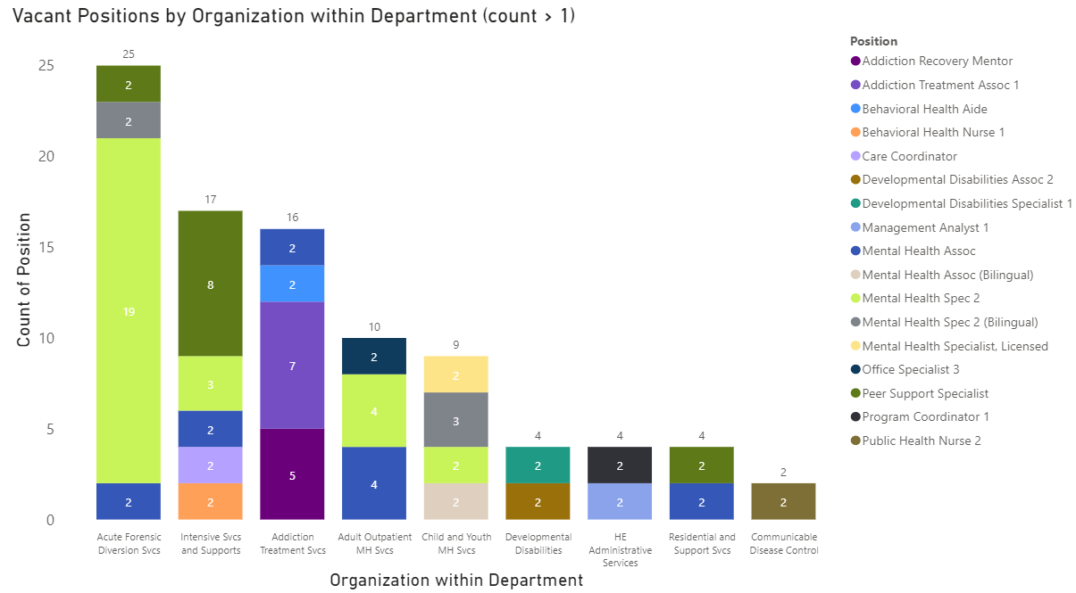

Slide 28
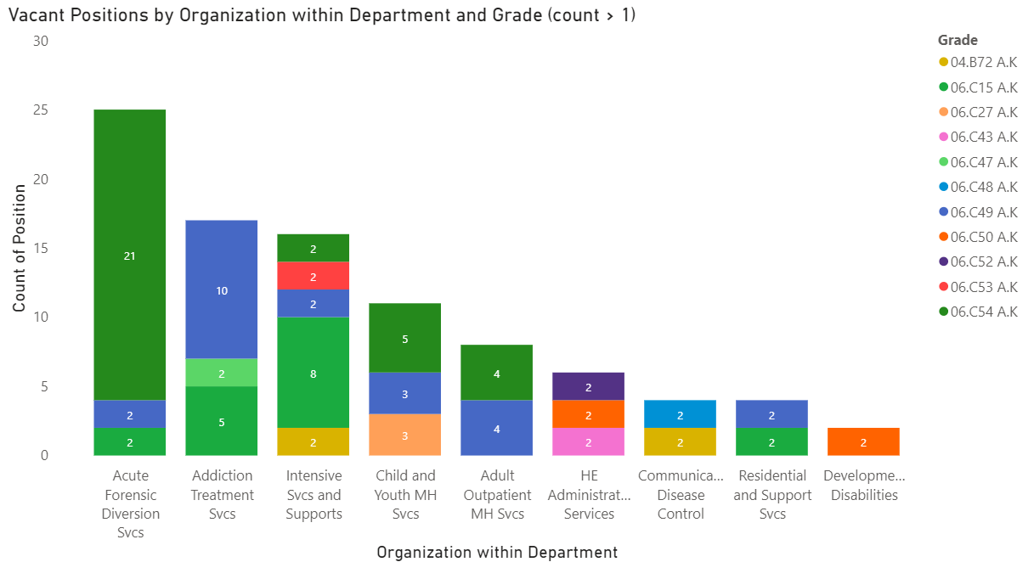

Slide 29
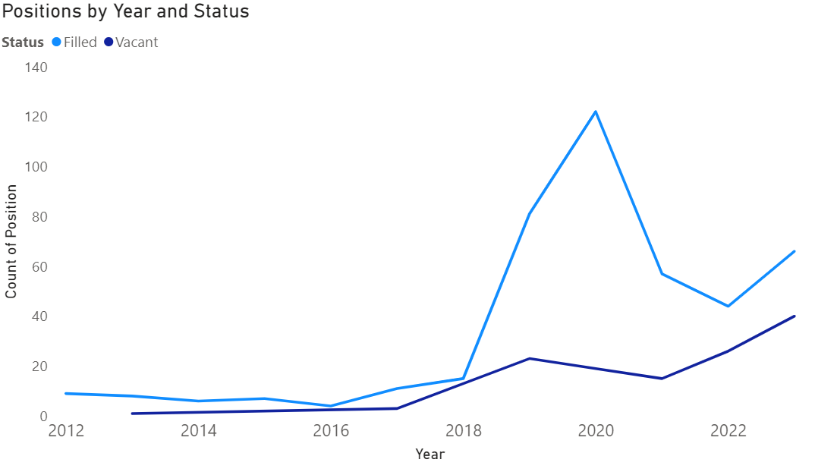

Slide 30
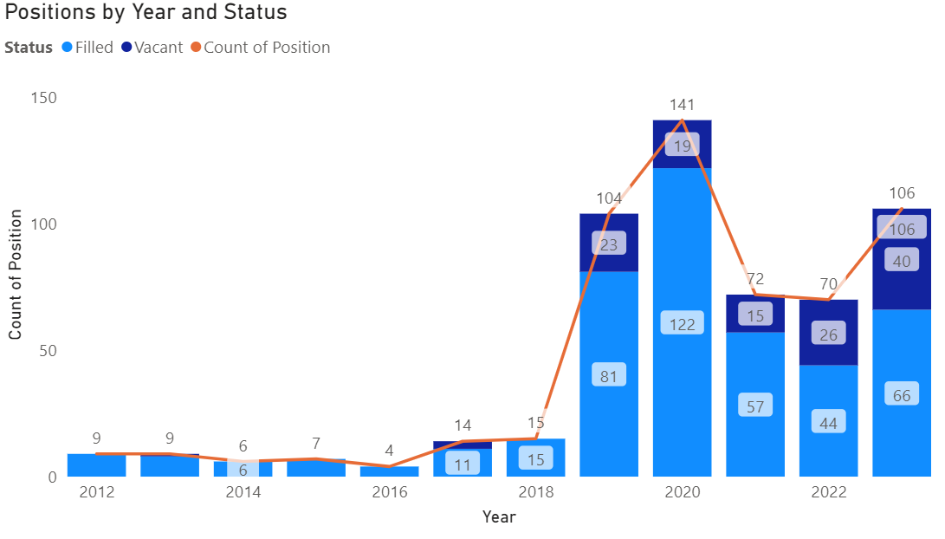

Slide 31
Key Findings
All postings are from Health & Human Services
There are positions 20 different department with HHS, with 7 departments accounting for 80% of the total postings (DD most common)
Unit 6 accounts for 84.92% of positions; vacant (111), filled (362)
Mental health comprises 25% of job# category postings
﻿﻿Count of positions was highest for Mental Health Assoc at 66, followed by Mental Health Spec 2 and Developmental Disabilities Assoc 2
Bilingual positions account for 15% of postings, with Spanish being the most common
Full-time positions are the most prominent type of employment (95%+)
﻿﻿Count of Position for Filled (430) was higher than Vacant (127)﻿﻿﻿﻿﻿﻿
Development Disabilities makes up the majority of filled positions with few vacancies
Acute Forensic Diversion Svcs has the most vacancies across different roles
06.C54 A.K. is the most common grade type for vacancies
2019,2020 unusual number of job posting (Covid-19?)

Slide 32
Next Steps
Why are people quitting (Workload, pay, management, job satisfaction, …)?
Employee Satisfaction/Engagement Surveys
Exit Interviews
Salary Analysis
Recruitment Strategies
Skillset Analysis
Job Sharing / Part-time Opportunities
Career progress
Staff training & Development
Work-life balance/ wellness programs
Diversity and inclusion initiatives

Slide 33
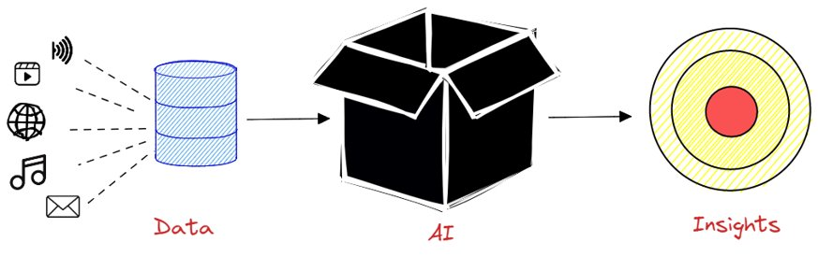
Next Steps
Artificial Intelligence (machine learning)
Build a classifier that is able to determine if a particular job posting is more likely to be filled or vacant.

Slide 34

Next Steps

Slide 35
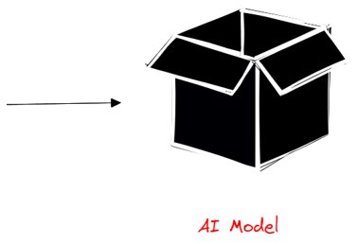
Next Steps

Slide 36
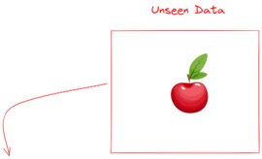
Next Steps

Slide 37
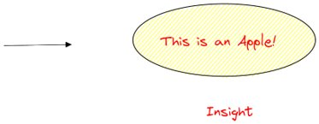
Next Steps

Slide 38
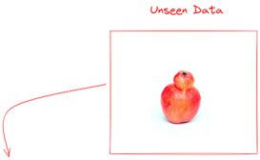
Next Steps

Slide 39
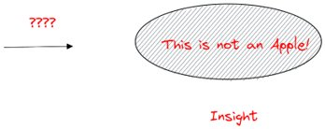
Next Steps

Slide 40
Disclaimer
Please note that these are preliminary observations and more detailed information would be required for an in-depth analysis. For example, it would be beneficial to know the total number of each position, the history of vacancies for each role, and other relevant details about working conditions or benefits.
When we look at the current dataset, all we have at disposition is job postings, some still open and some filled; we can look at trends for what it pertains the kind of jobs that are being advertised, what departments are involved, and different frequency metrics.

Slide 41

Thank you for your attention.
Any Questions?

