Slide 2
Raptor Clone Digital Twin Demo
SOW - The purpose of this effort - known as team Raptor clone - is to create a scalable digital thread and digital twin for a selected engine part. This thread/twin capability can be scaled to other components, and other programs. This is expected to drive value to the program in terms of execution, understanding, and support to the customer, and to the customer in terms of fleet understanding and autonomous decision-making as desired.
MBDT Specific SOW - Deliverable: Aug 31, 2025: Review target information format and create an ontology / knowledge graph (KG) for the individual part. Desire is for ontology to also scale across multiple parts or systems in the future. Provide a solution to the team that is capable of answering decision support questions once the Knowledge graph is populated.
Start Date: July 8, 2025
Current Date: Aug 29, 2025
Hrs spent so far: 90 (MBDT),

Slide 3
5-Phase Ontology Development Lifecycle
Iterative & Incremental Approach to Knowledge Engineering
DISCOVER
Understand domain & gather requirements
MODEL
Design concepts & validate with data
BUILD & TRANSFORM
Create formal ontology & semantic data pipeline
DEPLOY & INTEGRATE
Implement knowledge graph & operationalize
EVOLVE & GOVERN
Monitor, maintain & expand
Key Activities
Conduct stakeholder interviews
Define domain scope
Develop competency questions
Create initial domain lexicon
Identify and profile data sources
Deliverables
Domain Scope
Competency Questions
Domain Lexicon Data
Profiling Report
Key Activities
Build concept hierarchy
Align with upper ontologies
Map concepts to data sources
Define properties & constraints
Design semantic ETL pipelines
Deliverables
Conceptual Model
Taxonomy Data
Mappings
ETL Design Specs
Key Activities
Develop OWL/RDF ontology
Implement semantic ETL pipelines
Transform raw data to RDF
Entity resolution & reconciliation
Relationship inference
Create SHACL validation
Deliverables
Formal Ontology
ETL Pipeline Code
RDF Datasets
Data Quality Reports
Key Activities
Setup KG platform
Execute semantic ETL at scale
Implement DataOps CI/CD
Create query templates
Integrate with systems
Knowledge share
Deliverables
Knowledge Graph
Automated ETL Query
Library Training Docs
Key Activities
Monitor ETL performance
Process change requests
Version updates
Maintain data quality
Identify new data sources
Govern with DataOps
Deliverables
Governance Docs ETL
Dashboards Quality
Reports Roadmap
Success Factors
Iterative feedback loops, Automated validation, Strong governance, Clear documentation, Measurable criteria

Slide 4
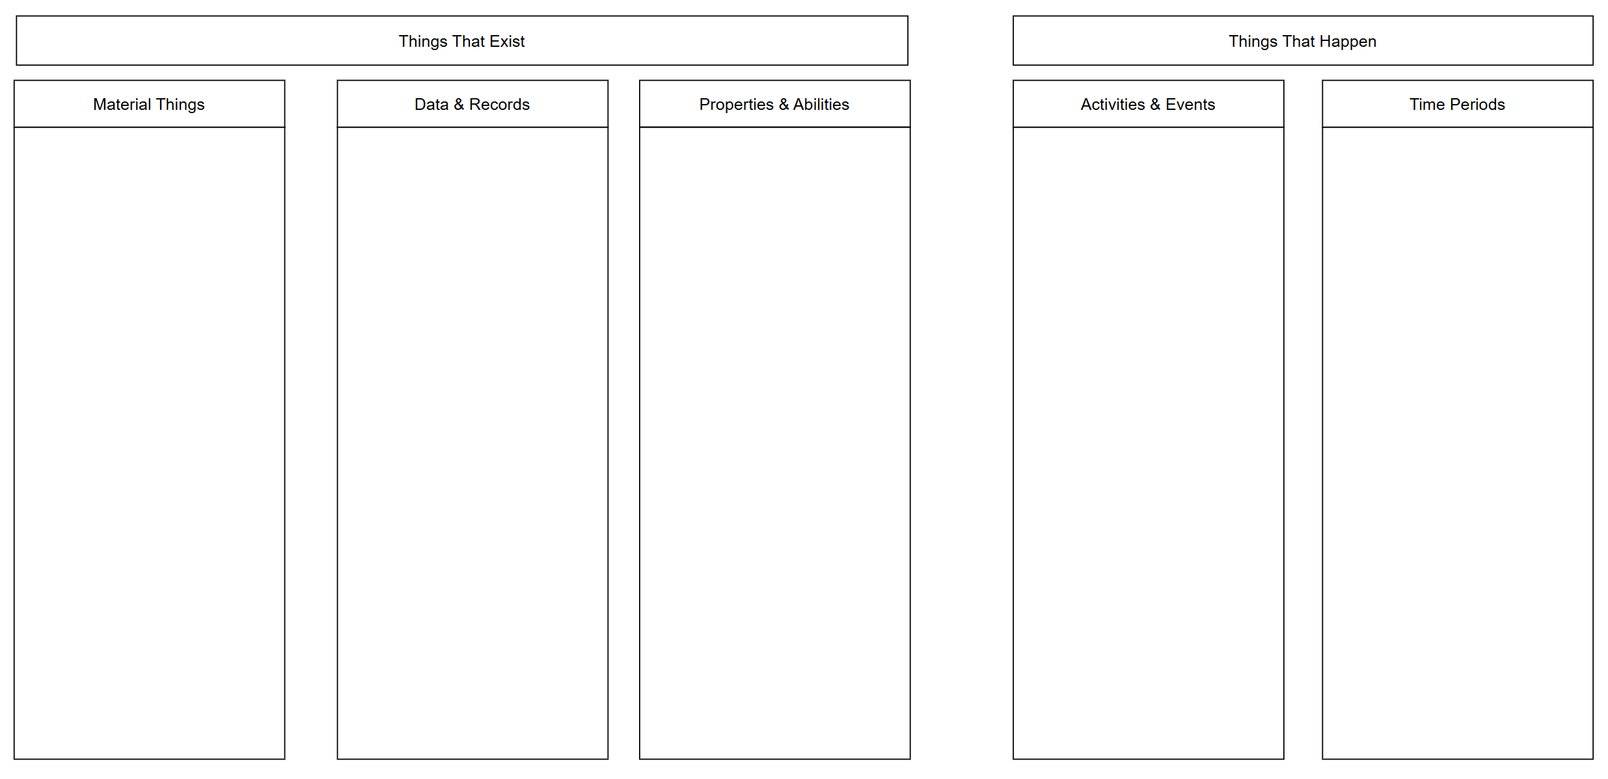
Ontology Class Canvas

Slide 5
Top-Down Approach

Slide 6
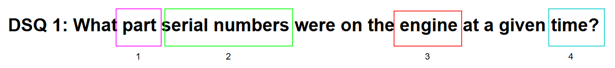
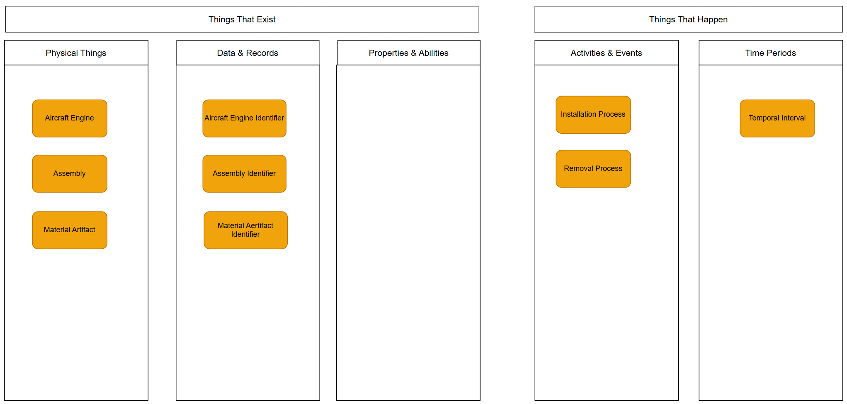
Top-Down Approach

Slide 7
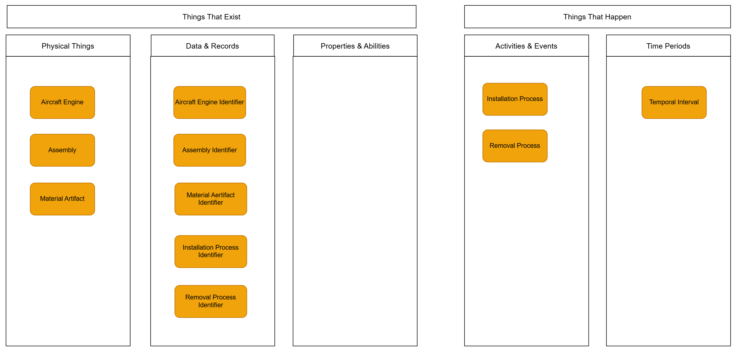
Bottom-Up Approach
HAMR.OFF_EQUIP_ENG_WRITEUP
JCN | WCE | WRITEUP_SN | WRITEUP_PN | LOT_NUMBER | UNIT_ID | PERFORMING_WCC | DISCREPANCY_SYMBOL | PRIORITY | WHEN_DISC_CODE | TYPE_MAINT_CODE | ACTION_TAKEN_CODE | HOW_MAL_CODE | MAINT_REQ_NARR | MAINT_ACTION_NARR | WRITEUP_STATUS | WRITEUP_STATUS_DTG | LCN
Job Control Number
Work Center Event

Slide 8
Bottom-up Approach (Structural Profiling)

Slide 9
Bottom-Up Approach
HAMR.OFF_EQUIP_ENG_WRITEUP
JCN | WCE | WRITEUP_SN | WRITEUP_PN | LOT_NUMBER | UNIT_ID | PERFORMING_WCC | DISCREPANCY_SYMBOL | PRIORITY | WHEN_DISC_CODE | TYPE_MAINT_CODE | ACTION_TAKEN_CODE | HOW_MAL_CODE | MAINT_REQ_NARR | MAINT_ACTION_NARR | WRITEUP_STATUS | WRITEUP_STATUS_DTG | LCN
ESAS_ECL_DEFECT
ENGINE_SN | DEFECT_DTG | HOSTNAME | JCN | WCE | PART_NO | POSITION_ID | SUBPOSITION_ID | LOCATION_X | LOCATION_Y | DEFECT_NO | AREA | DELETED | VERSION | BASE | DOWNLOAD_DATE | DELETED_DATE | CREATION_DTG | DELETION_DTG

Slide 10
Bottom-up Approach (Domain Laxicon)
RTX Sources of Definitions
Subject Matter Experts
Standard Documents
Literature Survey

Slide 11
Modeling Information Pattern

Slide 12
Modeling Assembly and Component Pattern

Slide 13
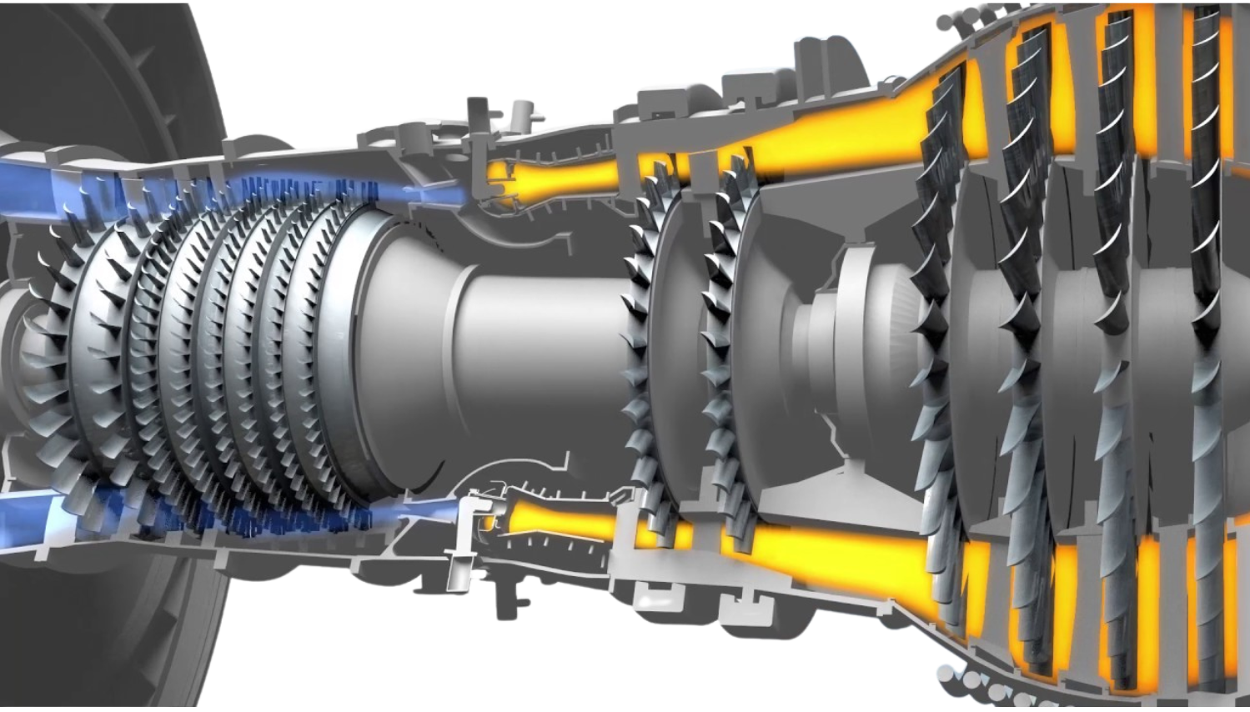
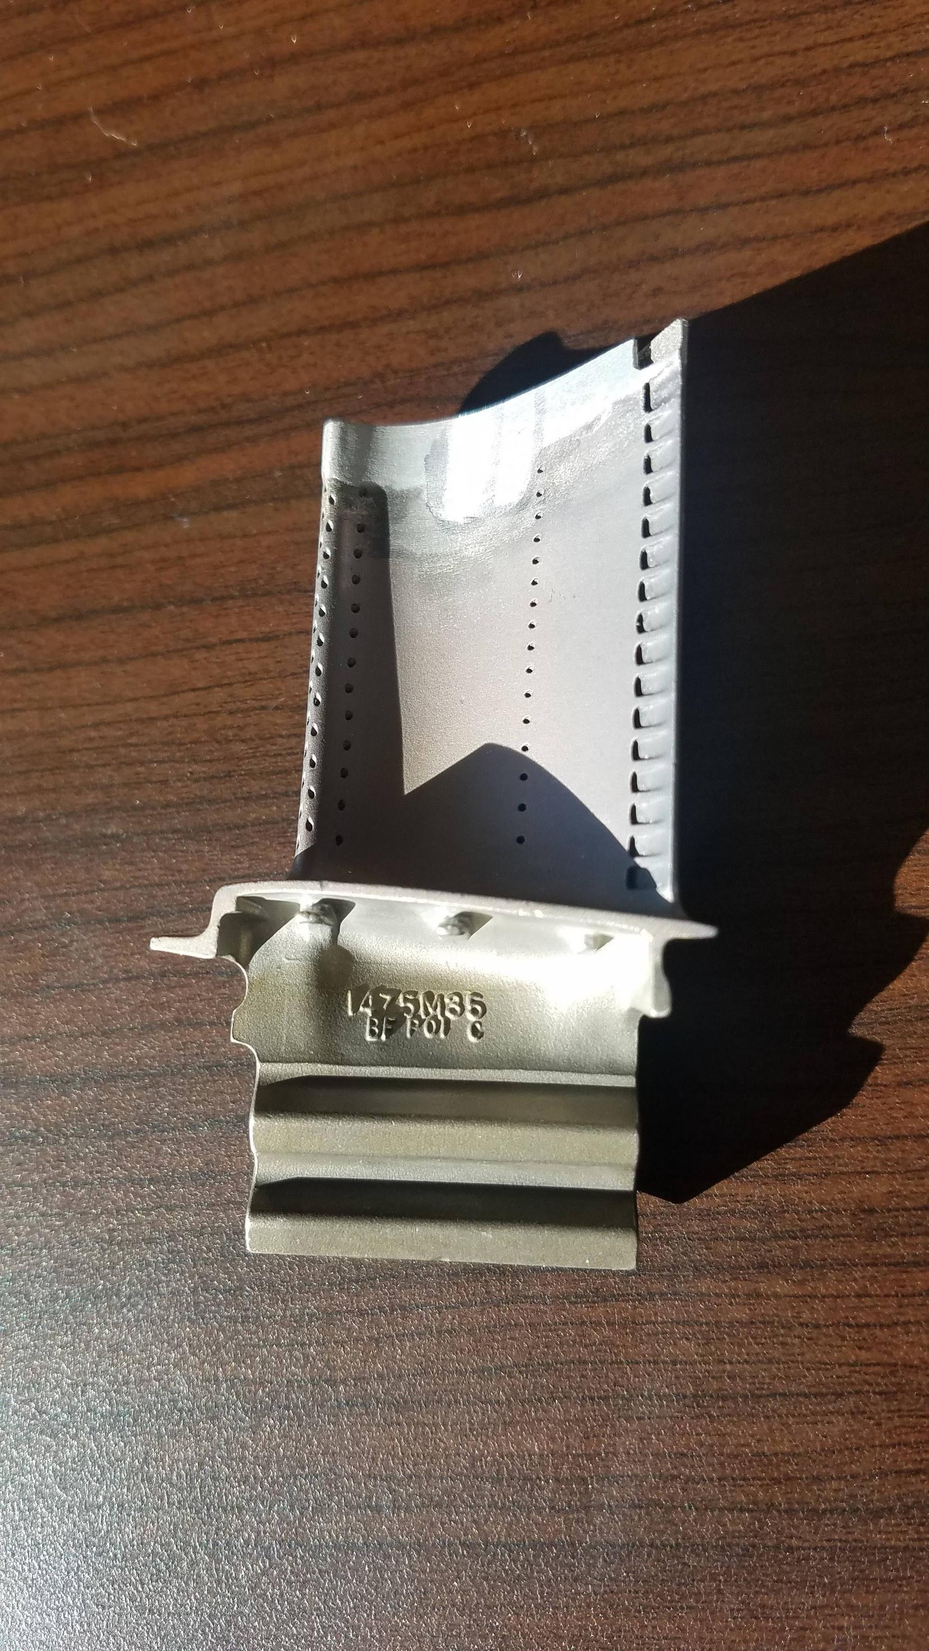


Turbine Blade Installed on Engine
Turbine Blade in Maintenance Facility
Engine Component
Engine Component
Material Artifact
Material Artifact

Slide 15
DSQs
Scope and Purpose

Slide 16
Physical Entities (what exists): - EngineModule (has SerialNo, PartNo) - EngineSubModule (has SerialNo, PartNo, NHA)
Functional Classifications (what role): - ConfigurationItem (ConfigItem field) - PartNumber (specific design)
Spatial Designations (where installed): - Position (installation slot/location)
Temporal Relationships (when): - Installation/Removal events - Configuration states over time

Slide 17
This separation is crucial because your decision support questions require tracking:
What was installed (SerialNo)
Where it was installed (Position)
When it was installed (Installation_Date)
What type it was (ConfigItem)

Slide 18
BOM natural graph

Slide 19
CAD – STEP , QIF, natural graph fit

Slide 20
XML, JSON – natural graph fit
Hierarchical files: JSON, XML.

Slide 21
x% data semi structured json, xml
Easy to have in graph
In tables need to flatten not optimal
Easy to search and connect to others in graph

Slide 22
The decision to convert semi-structured data like XML, JSON, and text files into a relational table or a semantic knowledge graph is not a one-size-fits-all solution. The optimal choice depends heavily on the nature of your data, your primary goals, and the applications you intend to build. Both approaches have distinct advantages and disadvantages.
### Converting to a Relational Table: The Structured Approach
Relational databases store data in tables with rows and columns, enforcing a predefined schema. This model is ideal for data that is consistent and can be neatly organized.
**When is it a good idea?**
* **Transactional Integrity:** If your application requires high levels of data consistency and integrity, such as in financial systems or inventory management, the ACID (Atomicity, Consistency, Isolation, Durability) properties of relational databases are crucial.
* **Structured, Predictable Data:** When your XML, JSON, or text files have a consistent and predictable structure that can be easily mapped to tables, a relational database is a natural fit.
* **Well-Defined Queries:** For applications with predefined, routine queries, such as generating standardized reports, SQL provides a powerful and efficient language for data retrieval.
* **Legacy System Integration:** If you need to integrate with existing applications that already rely on a relational database, converting your data to this format is often the most straightforward path.
**What are the drawbacks?**
* **Rigid Schema:** Relational databases have a rigid schema, meaning the data structure must be defined in advance. Adapting to changes in the source data, such as new fields in a JSON file, can be difficult and time-consuming.
* **Complex Hierarchies:** Forcing deeply nested or complex hierarchical data from XML or JSON into a flat, tabular structure can lead to a proliferation of tables and complex joins. This process, often called "shredding," can make the data difficult to understand and query.
* **Loss of Context:** The relationships and context inherent in a hierarchical or graph-like structure can be lost when the data is broken down into separate tables.
### Converting to a Semantic Knowledge Graph: The Connected Approach
A semantic knowledge graph represents data as a network of entities (nodes) and the relationships between them (edges). This model excels at capturing the rich context and complex interconnections within your data.
**When is it a good idea?**
* **Complex and Evolving Data:** Knowledge graphs are schema-free, making them highly flexible and adaptable to new or changing data without requiring a redesign of the entire model.
* **Discovering Relationships and Insights:** The primary strength of a knowledge graph is its ability to uncover hidden patterns and complex relationships that are difficult to identify with relational models. This is ideal for applications like recommendation engines, fraud detection, and advanced search.
* **Data Integration:** Knowledge graphs are excellent for integrating and harmonizing data from diverse and heterogeneous sources. They can create a unified view of structured, semi-structured, and even unstructured data.
* **AI and Machine Learning:** The structure of a knowledge graph is well-suited for artificial intelligence and machine learning applications, as it provides rich, contextualized data for analysis and reasoning.
**What are the drawbacks?**
* **Less Ideal for Transactional Systems:** While graph databases have improved, traditional relational databases are often still favored for high-volume, transactional operations.
* **Querying Can Be Different:** Querying a knowledge graph typically involves graph-specific languages like SPARQL or Cypher, which may have a steeper learning curve for teams accustomed to SQL.
* **Overkill for Simple Data:** For straightforward, tabular data with simple relationships, a knowledge graph might be an unnecessarily complex solution.
### The Verdict: Relational Table vs. Knowledge Graph
| **Consideration** | **Relational Table is Likely a Better Fit** | **Semantic Knowledge Graph is Likely a Better Fit** |
| :--- | :--- | :--- |
| **Data Structure** | Consistent, predictable, and relatively flat. | Complex, hierarchical, and likely to change over time. |
| **Primary Goal** | Storing and retrieving data with high integrity for operational systems. | Discovering insights, understanding complex relationships, and integrating diverse data. |
| **Query Types** | Predefined and structured queries (e.g., standard reports). | Exploratory and complex queries that traverse many relationships. |
| **Flexibility** | A rigid, predefined schema is acceptable. | The ability to easily add new types of data and relationships is critical. |
| **Use Cases** | Financial applications, inventory management, e-commerce order processing. | Recommendation engines, fraud detection, enterprise search, and AI applications. |
It's also important to note that this doesn't have to be an either/or decision. A hybrid approach is often the most effective solution. For example, an e-commerce platform could use a relational database for managing customer orders and inventory while leveraging a knowledge graph to power a sophisticated product recommendation engine based on customer behavior and product relationships.

Slide 23
Synthetic data in pipeline
https://pypi.org/project/ydata-sdk/
https://docs.sdk.ydata.ai/latest/
https://gretel.ai/
https://synthetics.docs.gretel.ai/en/stable/
https://fakerjs.dev/guide/

Slide 24
Semantic ETL
Schema

Slide 25
DSQ

Slide 26
DSQ 1: What part serial numbers were on the engine at a given time?
This question is about the configuration of a physical object at a specific point in time.
Key Concepts: Part, Serial Number, Engine, Time.
Classes & BFO/CCO/IOF Categorization:
Material Entities:
Engine: A subclass of cco:Object. It is the aggregate material entity.
Part: A subclass of cco:Object.
Processes / Activities / Events:
PartInstallation: A subclass of bfo:Process. This event represents the act of installing a part onto an engine.
PartRemoval: A subclass of bfo:Process. This event represents the act of removing a part.
Space and Time:
TemporalInterval: A subclass of bfo:TemporalRegion. This will be associated with the installation/removal events.
Information Things:
SerialNumber: A subclass of cco:Identifier, which is a subclass of bfo:InformationContentEntity. The serial number is the information, not the physical etching on the part.
Key Relationships (Object Properties):
Engine cco:has_part Part (This shows the current state, but the event-based model below is more robust for historical questions).
Part cco:has_identifier SerialNumber.
PartInstallation iof-core:has_participant Engine.
PartInstallation iof-core:has_participant Part.
PartInstallation cco:occurs_at TemporalInterval.
(Similarly for PartRemoval).
Modeling Pattern & Notes: Instead of just stating a part is part_of an engine, we model the events of installation and removal. To find the parts on an engine at time T, you query for all PartInstallation events that occurred before T for that engine, and subtract the parts whose PartRemoval events also occurred before T. This event-based history is crucial for configuration management.

Slide 27
DSQ 1: What part serial numbers were on the engine at a given time?
This question is about the configuration of a physical object at a specific point in time.
Key Concepts: Part, Serial Number, Engine, Time.
Classes & BFO/CCO/IOF Categorization:
Material Entities:
Engine: A subclass of cco:Object. It is the aggregate material entity.
Part: A subclass of cco:Object.
Processes / Activities / Events:
PartInstallation: A subclass of bfo:Process. This event represents the act of installing a part onto an engine.
PartRemoval: A subclass of bfo:Process. This event represents the act of removing a part.
Space and Time:
TemporalInterval: A subclass of bfo:TemporalRegion. This will be associated with the installation/removal events.
Information Things:
SerialNumber: A subclass of cco:Identifier, which is a subclass of bfo:InformationContentEntity. The serial number is the information, not the physical etching on the part.
Key Relationships (Object Properties):
Engine cco:has_part Part (This shows the current state, but the event-based model below is more robust for historical questions).
Part cco:has_identifier SerialNumber.
PartInstallation iof-core:has_participant Engine.
PartInstallation iof-core:has_participant Part.
PartInstallation cco:occurs_at TemporalInterval.
(Similarly for PartRemoval).

Slide 28
DSQ 1: What part serial numbers were on the engine at a given time?

Slide 29
DSQ1: What part serial numbers were on the engine at a given time?
The core insight here is that the relationship "part is on engine" is not static. It is the result of a process (an installation) and is terminated by another process (a removal). Modeling these processes is the key to answering the question for any point in time.
1. Class Definitions
Here are the necessary classes, categorized as you requested.
A. Material Entities / Object Aggregates
These are the physical things that exist in the world.
Engine
Parent: cco:ObjectAggregate
Description: A complex physical object composed of multiple parts. Examples: PW F135 Jet Engine.
Part
Parent: cco:Object
Description: A single, identifiable component of an engine. It is the bearer of a serial number. Examples: a specific turbine blade, a fuel pump.
B. Processes / Activities / Events
These are the occurrences that change the state of the material entities.
PartConfigurationProcess
Parent: bfo:Process
Description: An abstract parent class for any process that changes the composition of an object aggregate.
PartInstallation
Parent: PartConfigurationProcess
Description: The specific event of attaching a Part to an Engine. This process has the part and the engine as participants and occurs over a specific time interval.
PartRemoval
Parent: PartConfigurationProcess
Description: The specific event of detaching a Part from an Engine.
C. Space and Time
These entities contextualize the processes.
TemporalInterval
Parent: bfo:TemporalRegion
Description: The specific period of time during which a process occurs. CCO provides properties to define start and end times (cco:has_start_time, cco:has_end_time).
MaintenanceSite
Parent: bfo:Site
Description: The physical location where a configuration process (like an installation) takes place.
D. Information Things
These are informational artifacts that describe or identify material entities and processes.
SerialNumber
Parent: cco:Identifier (which is a subclass of bfo:InformationContentEntity)
Description: The unique string of characters that identifies a specific, individual Part. The serial number is information; the physical etching on the part is a quality of the part that denotes this information.
MaintenanceRecord
Parent: cco:InformationContentEntity
Description: A report or log entry that is the output of a PartConfigurationProcess. It documents the event, including what part was installed/removed, on which engine, when, and by whom.
2. Relationships (Object Properties)
These properties connect the classes to form a coherent model.
Connecting Participants to Processes:
PartInstallation iof-core:has_participant Engine
PartInstallation iof-core:has_participant Part
(The same properties would apply to PartRemoval).
Connecting Processes to Time and Space:
PartInstallation cco:occurs_at TemporalInterval
PartInstallation cco:occurs_at_site MaintenanceSite
Connecting Information to Reality:
Part cco:has_identifier SerialNumber (A Part is identified by a SerialNumber).
PartConfigurationProcess cco:has_output MaintenanceRecord (The process generates a record).
MaintenanceRecord cco:is_about PartConfigurationProcess (The record describes the event).
SerialNumber cco:denotes Part (The information denotes the physical thing).

Slide 30
DSQ 2: How many hours, cycles, etc., did a part get used?
This is about aggregating usage data that is generated by processes over time.
Key Concepts: Hours, Cycles, Part, Usage.
Classes & BFO/CCO/IOF Categorization:
Material Entities:
Part: A subclass of cco:Object.
Processes / Activities / Events:
Flight: A subclass of bfo:Process. Represents a single operational flight.
FlightCycle: A subclass of bfo:Process. Could be a sub-process of a Flight.
Space and Time:
TemporalInterval: To know the duration of each flight.
Information Things:
UsageMeasurement: A subclass of cco:MeasurementInformationContentEntity. This entity holds the value of hours or cycles for a single event.
UsageGuideline: A subclass of cco:Guideline, an bfo:InformationContentEntity. Represents "cycles since new" or "cycles since overhaul."
Key Relationships (Object Properties):
Flight iof-core:has_participant Part.
Flight cco:has_output UsageMeasurement.
UsageMeasurement cco:is_about Part.
UsageMeasurement cco:has_value xsd:decimal (a data property with the value, e.g., "1.5" hours).
UsageMeasurement cco:is_measured_in cco:UnitOfMeasure (e.g., an instance representing "hours").
Modeling Pattern & Notes: The ontology doesn't store the total hours. It stores each individual usage event (Flight, FlightCycle). The total usage is then calculated by a query (e.g., a SPARQL query) that finds all Flight processes a Part participated in and sums the UsageMeasurement values associated with them. This is more flexible, as you can query for usage within any arbitrary time frame.

Slide 31
DSQ 2: How many hours, cycles, etc., did a part get used?

Slide 32
DSQ 5 & 6: What base locations correlate with changes in coating loss?
This question links environmental/locational data with material degradation data.
Key Concepts: Base Location, Coating, Coating Loss, Change.
Classes & BFO/CCO/IOF Categorization:
Material Entities:
Coating: A subclass of cco:Object, which is part_of a Part.
Processes / Activities / Events:
CoatingInspection: A subclass of bfo:Process. The event where coating loss is measured.
EngineOperation: A subclass of bfo:Process. The period of time an engine is operating at a base.
Space and Time:
Site: A subclass of bfo:Site.
BaseLocation: A subclass of Site. Represents the physical air force base.
Information Things:
CoatingLossData: A subclass of cco:MeasurementInformationContentEntity. The output of the CoatingInspection.
Key Relationships (Object Properties):
EngineOperation cco:occurs_at BaseLocation.
EngineOperation iof-core:has_participant Engine.
CoatingInspection cco:has_input Coating (inspecting the physical coating).
CoatingInspection cco:has_output CoatingLossData.
CoatingInspection cco:occurs_at BaseLocation (or can be inferred from the engine's operational history).
Modeling Pattern & Notes: By linking EngineOperation events to a BaseLocation, and also linking CoatingInspection events (and their resulting CoatingLossData) to the engine's timeline, you create a dataset where you can correlate location with measurement data. A query can retrieve a time-series of coating loss measurements for an engine and align it with the sequence of bases where that engine operated.

Slide 33
DSQ 7 & 8: When is it acceptable to re-use a part? When is it acceptable to waive a requirement?
These are about compliance, rules, and dispositions—all purely in the information realm.
Key Concepts: Acceptance, Requirement, Waiver, Part, Re-use.
Classes & BFO/CCO/IOF Categorization:
Material Entities:
Part.
Processes / Activities / Events:
DispositioningProcess: A bfo:Process where a decision is made.
WaiverIssuance: A subclass of DispositioningProcess.
Space and Time:
(Not central, but the decision process occurs at a TemporalInterval).
Information Things:
Requirement: A subclass of cco:Requirement, which is a type of bfo:GenericallyDependentContinuant. Represents the rule.
AcceptanceCriteria: A subclass of cco:InformationContentEntity. Describes the conditions for acceptance.
Waiver: A subclass of cco:InformationContentEntity. This is the official document or record that waives a requirement. It is the output of the WaiverIssuance process.
PartInspectionData: The data used as input to the DispositioningProcess.
Key Relationships (Object Properties):
DispositioningProcess cco:has_input PartInspectionData.
DispositioningProcess cco:has_input Requirement.
WaiverIssuance cco:has_output Waiver.
Waiver cco:is_about Part.
Waiver cco:waives Requirement.
Modeling Pattern & Notes: This shows the power of the BFO/CCO distinction between physical things and information. The decision to "re-use a part" is a DispositioningProcess that consumes information (Requirement, InspectionData) and produces new information (Waiver, Authorization). The ontology can capture this entire decision-making paper trail.

Slide 34
Life Cyle Data
As-Designed
As-Manufactured
As-Installed
As-Used
As-Maintained

Slide 35
Architecture
ETL Tool

