Slide 2
The Problem: Two Separate Worlds of Knowledge
Graph 1: From DI-SESS-81000F (The "Engineering Blueprint")
Core Concept: A class called ProductEngineeringDesignData.
It Describes: Things like Item, EndProduct.
It Contains: Information like Requirement, Parameter.
Its Purpose: To support a MaintenanceProcess.
Graph 2: From DI-ADMN-81249B (The "Meeting Plan")
Core Concept: A class called ConferenceAgenda.
It Describes: A Conference.
It Contains: Information like Topic, Location, Schedule.
Its Purpose: To manage an AcquisitionProcess.
Notes:
On the surface, these two graphs have nothing in common. A simple search for "Conference" in Graph 1 would find nothing. A search for "Item" in Graph 2 would find nothing. They are two different information silos.

Slide 3
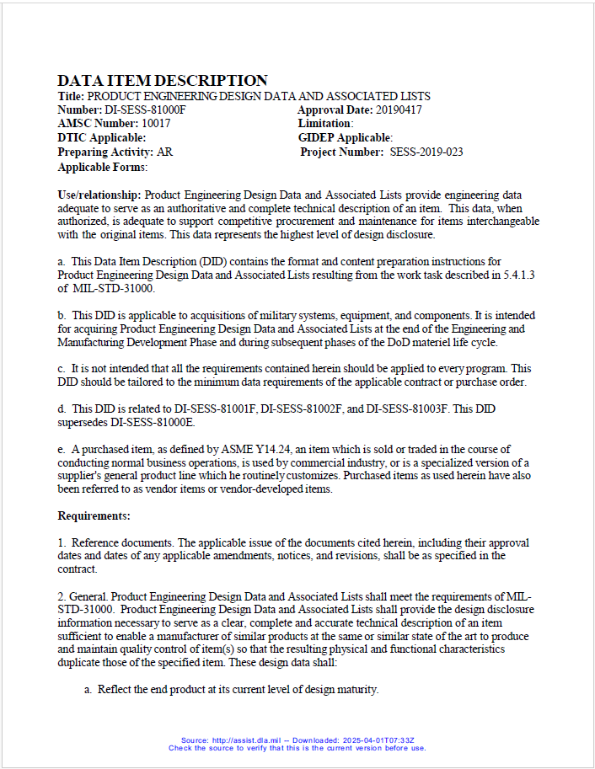
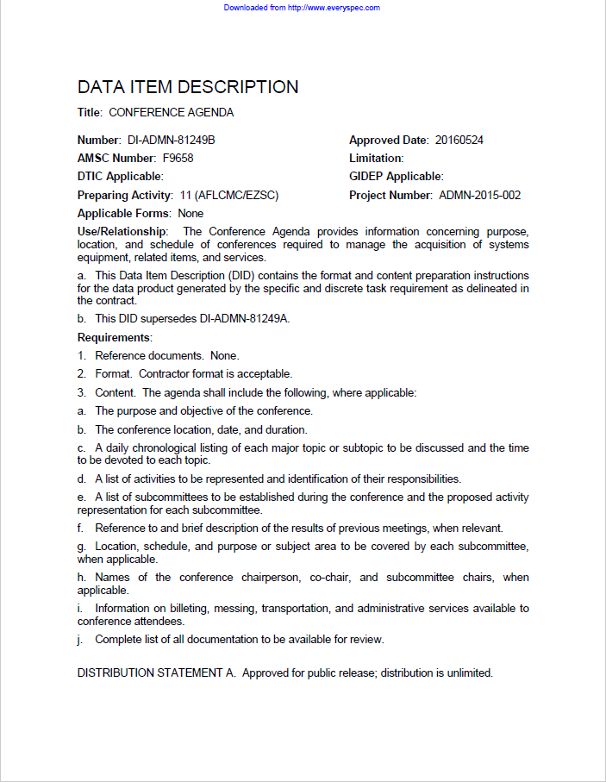
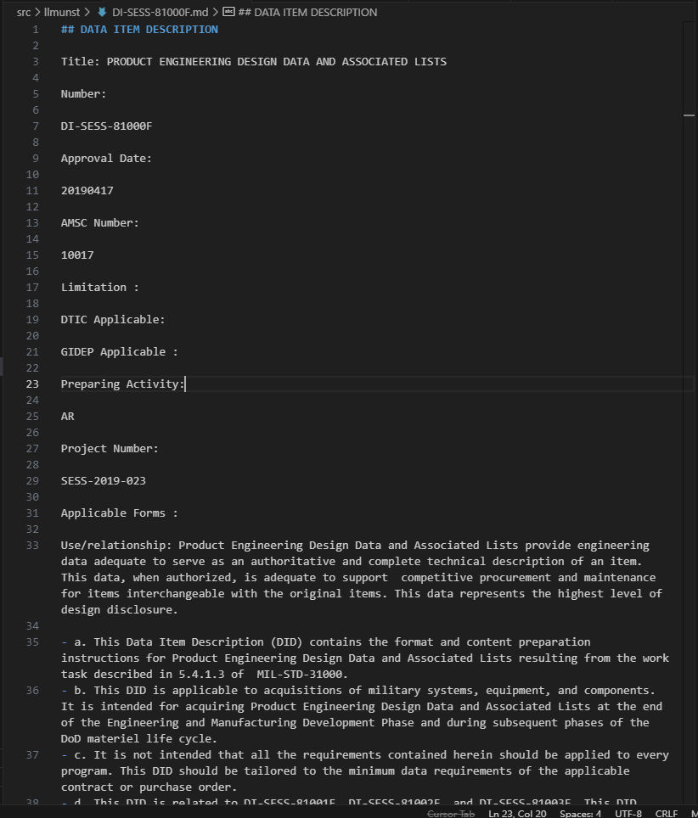
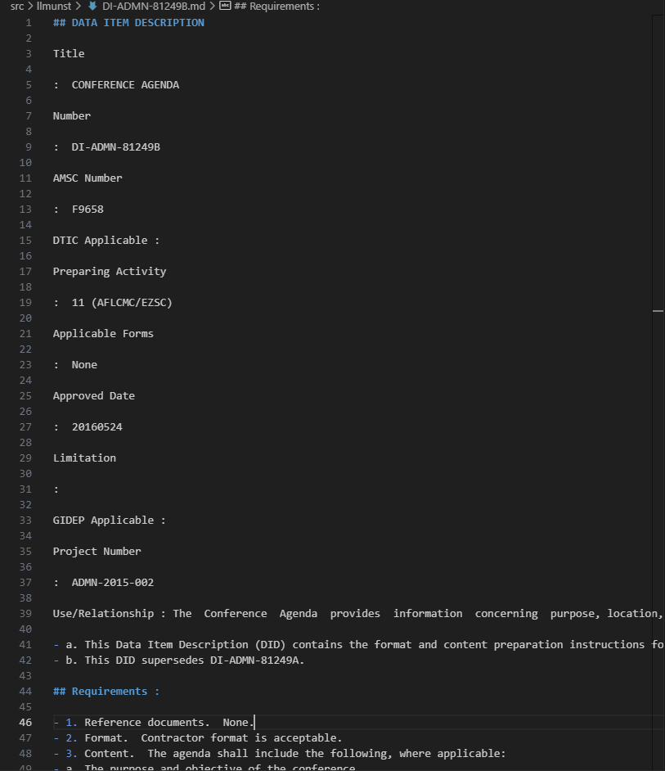
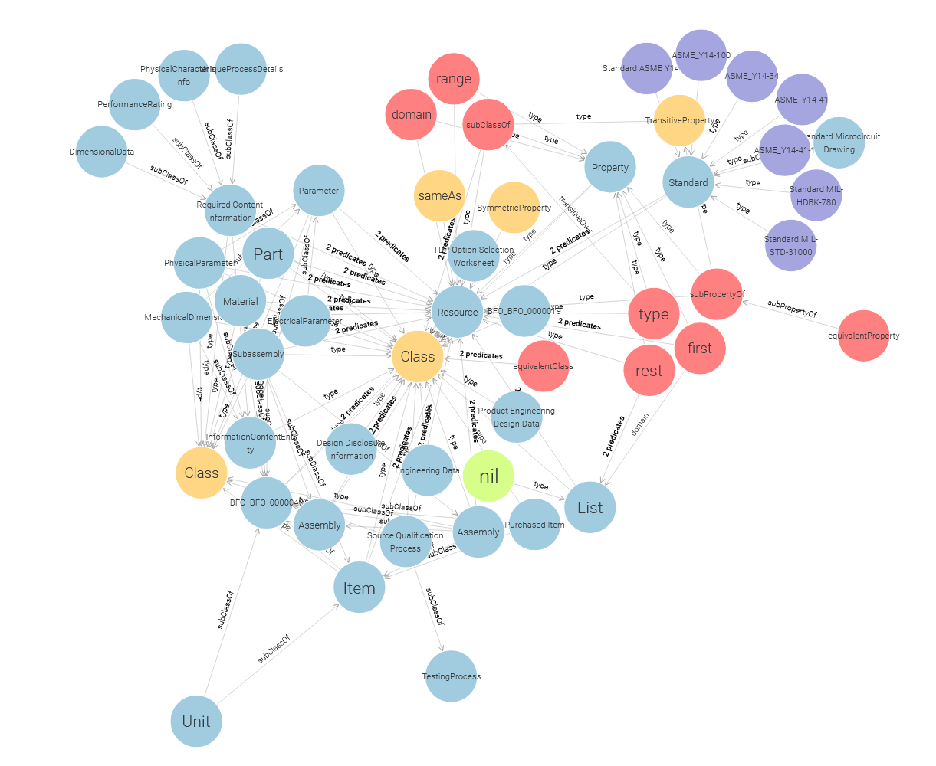
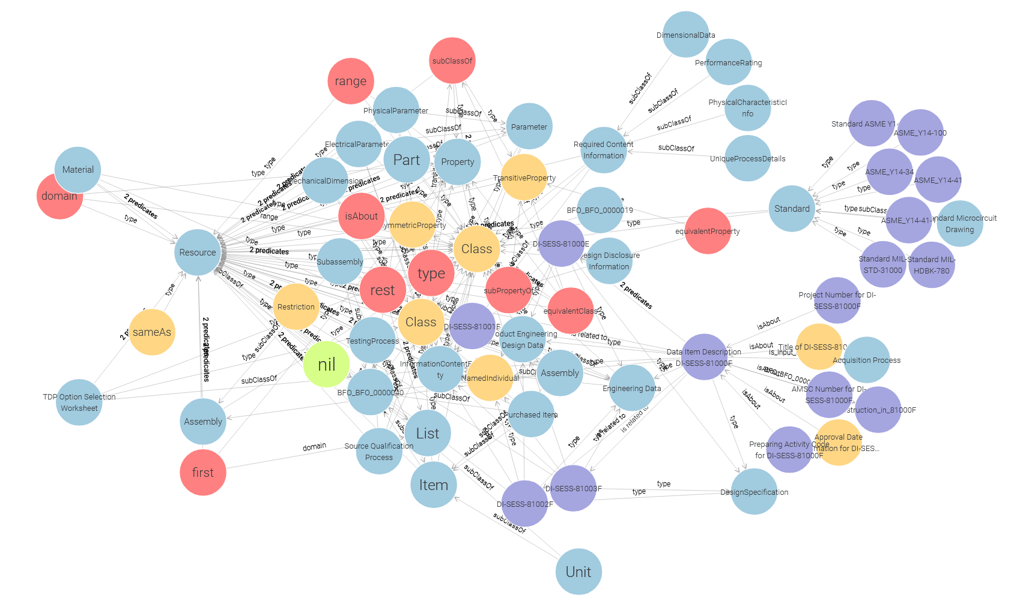
The Problem: Two Separate Worlds of Knowledge
Graph 1: From DI-SESS-81000F (The Engineering Blueprint)
Core Concept: A class called ProductEngineeringDesignData.
It Describes: Things like Item, EndProduct.
It Contains: Information like Requirement, Parameter.
Its Purpose: To support a MaintenanceProcess.
Graph 2: From DI-ADMN-81249B (The Meeting Plan)
Core Concept: A class called ConferenceAgenda.
It Describes: A Conference.
It Contains: Information like Topic, Location, Schedule.
Its Purpose: To manage an AcquisitionProcess.
Notes:
Imagine your automated system processes both DIDs. Without a foundational ontology, it would create two separate, isolated knowledge graphs:

Slide 4
Common BFO Classes:
bfo:Process (BFO_0000015): An occurrent that unfolds over time.
In the Engineering DID, the MaintenanceProcess and AcquisitionProcess are instances of bfo:Process.
In the Agenda DID, a Conference is a quintessential bfo:Process.
Both DIDs talk about things that happen. BFO gives us a single, universal class for all such happenings.
bfo:GenericallyDependentContinuant (BFO_0000031): An entity whose existence depends on being "instantiated" or "concretized" in some bearer. This is the BFO category for information, plans, and specifications.
In the Engineering DID, the ProductEngineeringDesignData itself, a Requirement, and a Parameter are all types of information, making them subclasses of bfo:GenericallyDependentContinuant.
In the Agenda DID, the ConferenceAgenda is a plan, and a Topic is a piece of information. Both are bfo:GenericallyDependentContinuant.
Both DIDs are fundamentally about creating and managing information artifacts. BFO provides the correct category for this.
bfo:MaterialEntity (BFO_0000040): A continuant that has some matter as a part.
In the Engineering DID, an Item, System, or EndProduct is a bfo:MaterialEntity. The people associated with these are material entities.
In the Agenda DID, while not central, the topics discussed could be about the Item, System, or EndProduct is a bfo:MaterialEntity. The Location of the conference might be a bfo:Site which is defined in relation to a bfo:MaterialEntity (the building). The people attending are also material entities.
Both domains ultimately relate to the physical world.

Slide 5
The Most Important Common BFO Relation:
BFO object properties are the key to connecting :
bfo:has_participant (BFO_0000057)
Definition: A relation between a bfo:Process (the domain) and a bfo:Continuant (the range) that participates in that process.
In Simple Terms: "A thing that takes part in a happening."
Why it's the bridge: A Conference (bfo:Process) has things that it is about—its topics for discussion. These topics are its participants. What can a topic be? A person, a problem, or, crucially, a document.
A document, like our ProductEngineeringDesignData, is an information artifact—a bfo:GenericallyDependentContinuant. Therefore, it can be a valid participant in a conference process. This relation is an example of how we connect the two graphs.

Slide 6
How the Connection Enables a Cross-Domain Query
Scenario: A System Design Review (SDR) is being held for the Avionics subsystem.
An agenda, Agenda-SDR-01, is created using the rules from DI-ADMN-81249B.
One of the "documents to be available for review" listed on this agenda is the engineering data package for the flight computer, PEDD-FC-007, which was created using the rules from DI-SESS-81000F.

Slide 7
The Connected Knowledge Graph Snippets:
From Graph 2 (Agenda):
Generated turtle
# The Conference is a process
:SDR_Conference_for_Avionics rdf:type bfo:BFO_0000015 .
# The Agenda is a plan (information) that is about the conference
:Agenda-SDR-01 rdf:type :ConferenceAgenda , bfo:BFO_0000031 ;
:describes_process :SDR_Conference_for_Avionics .
From Graph 1 (Engineering):
Generated turtle
# The engineering data is a specification (information)
:PEDD-FC-007 rdf:type :ProductEngineeringDesignData , bfo:BFO_0000031 .
The BFO Bridge Axiom (The connection your agent would create):
This is the new piece of knowledge that links the two. When the system sees that the agenda lists the PEDD as a topic, it asserts:
Generated turtle
# The conference process has the engineering document as a participant.
:SDR_Conference_for_Avionics bfo:BFO_0000057 :PEDD-FC-007 . # bfo:has_participant

Slide 8
The SPARQL Query That Crosses the Bridge
Now, a project manager can ask a question that is impossible to answer without this connection:
"Which engineering data packages (from DID-81000F) were on the agenda (from DID-81249B) for the Avionics SDR?"
The SPARQL query would look like this:
PREFIX : <http://www.yourdomain.com/ontology/dido#>
PREFIX bfo: <http://purl.obolibrary.org/obo/>
SELECT ?engineering_document
WHERE {
# Step 1: Start in the "Agenda" world. Find the specific conference process.
?conference rdf:type bfo:BFO_0000015 . # It's a process
# Let's say we identified it by its agenda
:Agenda-SDR-01 :describes_process ?conference .
# Step 2: Use the BFO bridge to cross into the "Engineering" world.
# Find all participants in that conference.
?conference bfo:BFO_0000057 ?participant . # bfo:has_participant
# Step 3: Filter the results to find only the participants that are
# the specific type of engineering data we care about.
?participant rdf:type :ProductEngineeringDesignData .
# Bind the final result to our variable
BIND(?participant AS ?engineering_document)
}

Slide 9
Result of the Query: The query would correctly return :PEDD-FC-007.
Summary of the Value
By grounding both DIDs in BFO's common, abstract classes (Process, GenericallyDependentContinuant) and using its universal relation (has_participant), we enabled a query that:
Started with a meeting plan.
Hopped to the meeting process itself.
Hopped again to the participants of that meeting.
Filtered those participants to find a specific type of engineering blueprint.
This demonstrates the true power of your project: creating a unified knowledge space where administrative, engineering, and logistical data can be seamlessly interconnected and queried, revealing insights that were previously locked away in separate documents.

