Slide 1
This DID is applicable to acquisitions of military systems, equipment, and components
The document DI-SESS-81000F is applicable to a process of acquisition of military systems.
The document DI-SESS-81000F is applicable to a process of acquisition of military equipment.
The document DI-SESS-81000F is applicable to a process of acquisition of military components.
Declaration(Class(:AcquisitionOfMilitarySystem))
SubClassOf(:AcquisitionOfMilitarySystem bfo:BFO_0000015) // A BFO Process
ObjectPropertyAssertion(iof:is_input_of :DI-SESS-81000F :AcquisitionOfMilitarySystem)
Declaration(Class(:AcquisitionOfMilitaryEquipment))
SubClassOf(:AcquisitionOfMilitaryEquipment bfo:BFO_0000015) // A BFO Process
ObjectPropertyAssertion(iof:is_input_of :DI-SESS-81000F :AcquisitionOfMilitaryEquipment)
Declaration(Class(:AcquisitionOfMilitaryComponent))
SubClassOf(:AcquisitionOfMilitaryComponent bfo:BFO_0000015) // A BFO Process
ObjectPropertyAssertion(iof:is_input_of :DI-SESS-81000F :AcquisitionOfMilitaryComponent)
Notes:
Declaration(Class(:AcquisitionOfMilitarySystem))
SubClassOf(:AcquisitionOfMilitarySystem bfo:BFO_0000015) // A BFO Process
ObjectPropertyAssertion(iof:is_input_of :DI-SESS-81000F :AcquisitionOfMilitarySystem)
Declaration(Class(:AcquisitionOfMilitaryEquipment))
SubClassOf(:AcquisitionOfMilitaryEquipment bfo:BFO_0000015) // A BFO Process
ObjectPropertyAssertion(iof:is_input_of :DI-SESS-81000F :AcquisitionOfMilitaryEquipment)
Declaration(Class(:AcquisitionOfMilitaryComponent))
SubClassOf(:AcquisitionOfMilitaryComponent bfo:BFO_0000015) // A BFO Process
ObjectPropertyAssertion(iof:is_input_of :DI-SESS-81000F :AcquisitionOfMilitaryComponent)

Slide 2
#
# --- Knowledge from sentence: "This DID is applicable to acquisitions of military systems, equipment, and components." ---
#
### TBox: New Process Classes (Aligned with BFO)
:AcquisitionOfMilitarySystems rdf:type owl:Class ;
rdfs:subClassOf bfo:BFO_0000015 ; # bfo:process
rdfs:label "Acquisition of Military Systems"@en .
:AcquisitionOfMilitaryEquipment rdf:type owl:Class ;
rdfs:subClassOf bfo:BFO_0000015 ; # bfo:process
rdfs:label "Acquisition of Military Equipment"@en .
:AcquisitionOfMilitaryComponents rdf:type owl:Class ;
rdfs:subClassOf bfo:BFO_0000015 ; # bfo:process
rdfs:label "Acquisition of Military Components"@en .
### ABox: New Assertions about the Document
# This DID is an input to these types of processes.
:DI-SESS-81000F iof:is_input_of :AcquisitionOfMilitarySystems ,
:AcquisitionOfMilitaryEquipment ,
:AcquisitionOfMilitaryComponents .
{
"test_name": "Verify applicability of DID to Systems Acquisition",
"sparql_query": """
PREFIX iof: <https://spec.industrialontologies.org/iof/ontology/core/Core/>
PREFIX : <http://www.yourdomain.com/ontology/dido#>
ASK WHERE {
:DI-SESS-81000F iof:is_input_of :AcquisitionOfMilitarySystems .
}
""",
"expected_result": { "boolean": true }
}

Slide 3
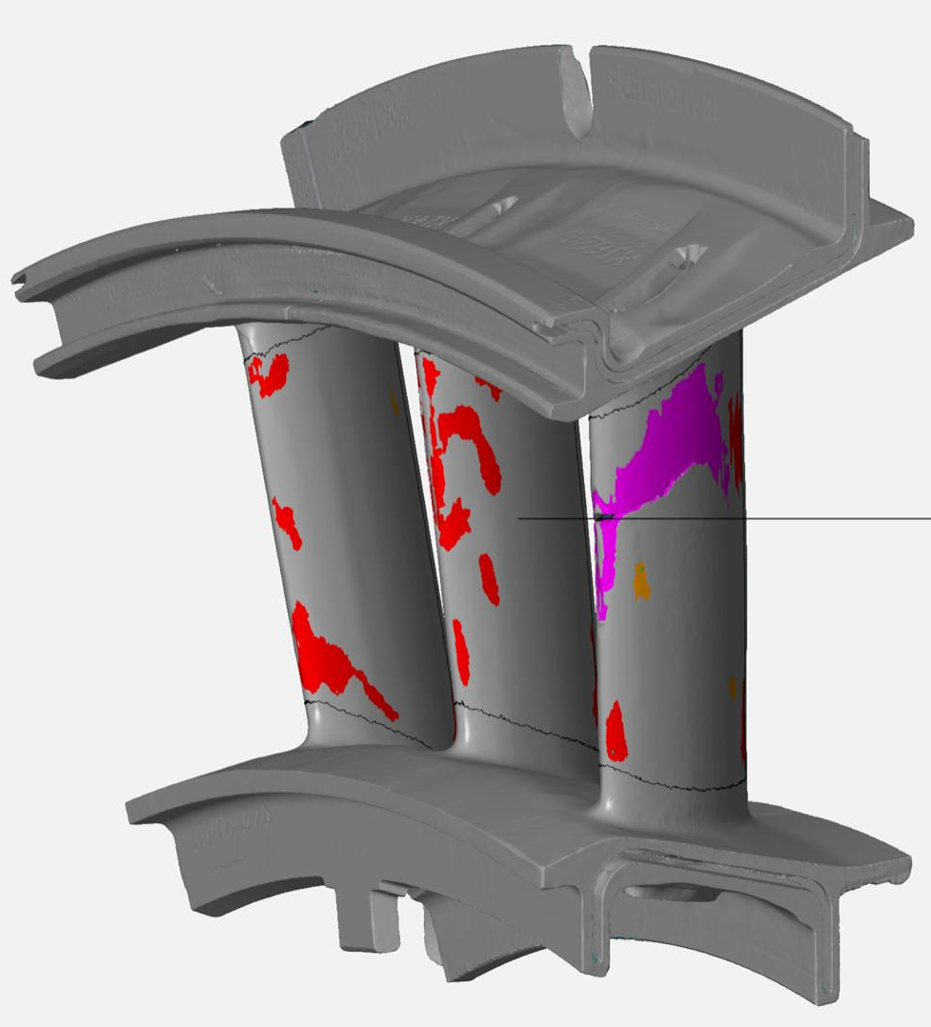
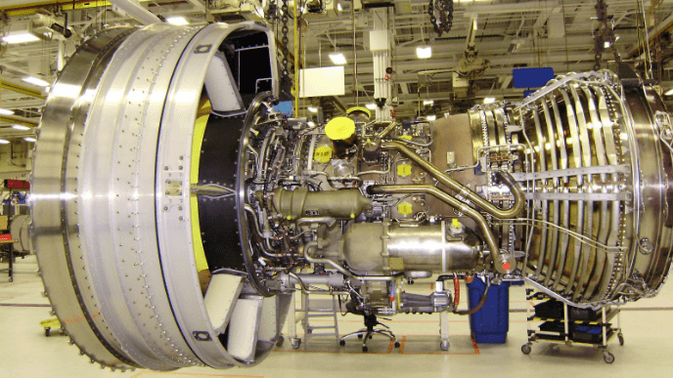
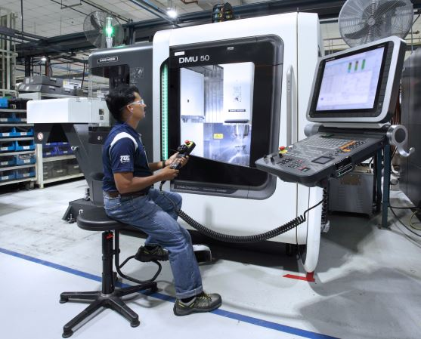
Digital Thread: From Data to Decisions
The Challenge: Disconnected Data
Our Solution: A Living Digital Model
The Value: Predictive Fleet Management
The history of a single engine part is scattered across silos:
• IMIS: Maintenance & Work Orders
• ESAS: Inspection & Defect Data
• CEMS: Flight & Operational Data
Answering critical questions takes weeks of manual data analysis.
We are building a Knowledge Graph that intelligently links these systems into a single, unified view.
We create a complete, queryable history for serialized parts.
This enables us to move from reactive to proactive decision-making, providing immediate answers to critical questions that:
INCREASE AIRCRAFT AVAILABILITY
Instantly see which parts have defects and where they are.
Predict which components will fail before they ground an aircraft.
REDUCE SUSTAINMENT COSTS
Pinpoint flight conditions that cause the most damage.
Optimize maintenance schedules and part life.
LOWER ENGINEERING RISK
Perform root cause analysis in minutes, not months.
Engine A
Inspection
Repair
Engine B
Install
Notes:
THE CHALLENGE . Right now, the history of a single, critical F119 engine part is fragmented across multiple systems. Its maintenance records are in IMIS, its inspection defects are in ESAS, and its operational history is in flight data logs. When we need to understand why a part failed, it takes weeks of manual effort to connect these dots."
OUR SOLUTION This project, the F119 Digital Thread, solves that problem. We are building a 'living digital model' by creating a Knowledge Graph that intelligently links these data sources. For the first time, we will have a complete, unified history for every single serialized part, no matter which engine it's been in.
THE VALUE "And this is the payoff. This model allows us to ask critical questions and get immediate, data-driven answers. We can increase aircraft availability by predicting which specific parts are at the highest risk of failure. We can reduce sustainment costs by identifying which flight conditions cause the most damage, allowing us to optimize operations. And we can lower engineering risk by performing root cause analysis in minutes instead of months.
Bottom Line Ultimately, this project transforms our scattered data into a true strategic asset—letting us make predictive decisions that will directly increase fleet readiness and drive down cost.

