Slide 1




Rapla
Resource-planner
In a world with…

Slide 2
Foody
The All-in-One Class-Board for everyone

Slide 3
What was the idea?
Provide all important university related information
Fast and easy access by both, students and professors
Easy login
Self organizing structures

Slide 4
That‘s not all
Build student relationships
Simplify and improve your days at DHBW

Slide 5
Foodies Inc.
Gino Messmer
Software Architect, Lead Integrator, Deployment Manager, Configuration Manager
Imke Schmidt
Implementer, Test Manager, Process Manager
Isabell Reitler
Implementer, Change Control Manager
Robin Matejka
System Analyst, Project Manager, Process Engineer, Change Control Manager

Slide 6


Frontend
Ionic
Angular
Easy Testing
Power of MVVM
Two-Way Data Binding
Less Writing
Cross-platform usage
Such as iOS, Android, Windows
Easy work with HTML, CSS and JS
Beautiful design and eye candy
Simplicity

Slide 7


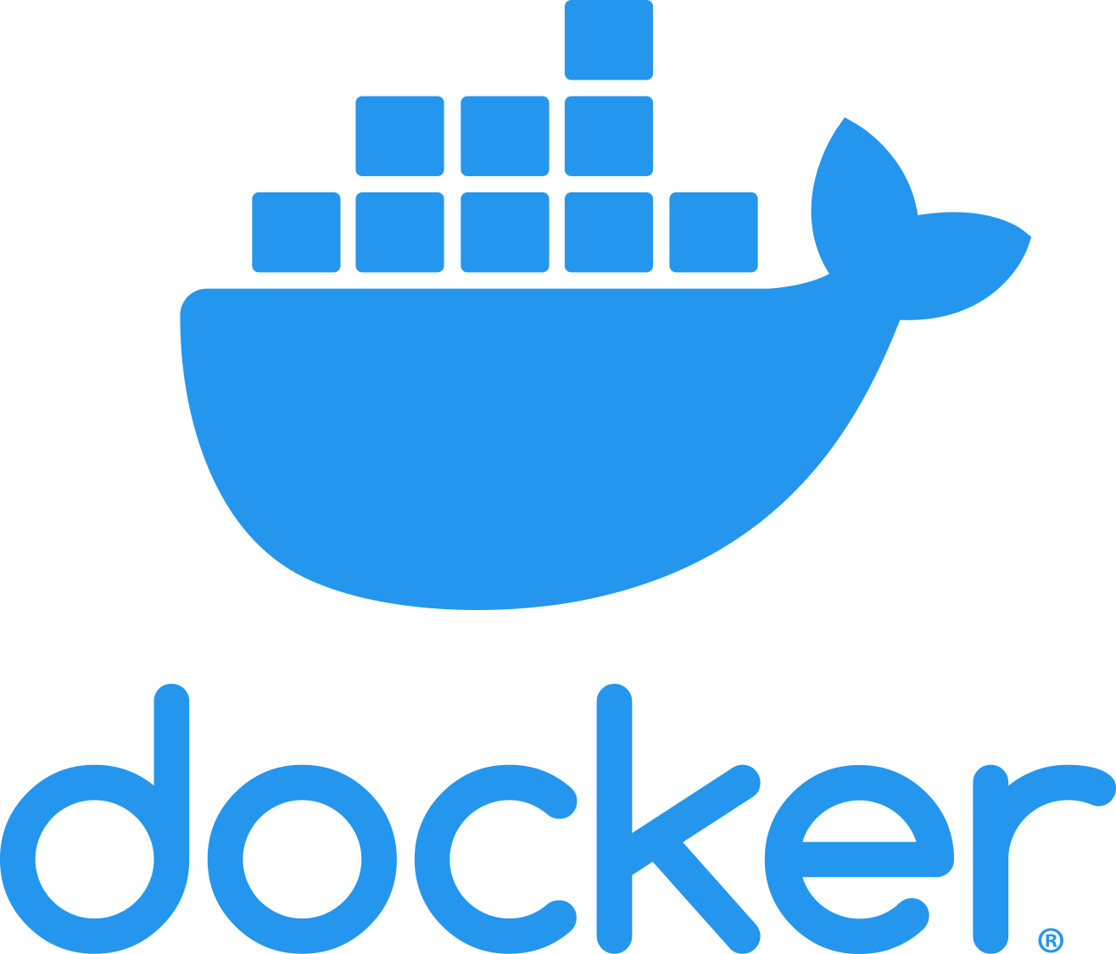
Backend
ASP.NET Core
Mongo DB
High Performance
Personal experience, great documentation
REST API
Swagger for documentation
Cross-Platform
C#
Makes it easy to use with repository pattern
Easy deployment
Integrates well in CI/CD pipeline
Docker

Slide 8
Microservices
Auth API
Canteen API
Timetable API
Train Schedule API

Slide 9
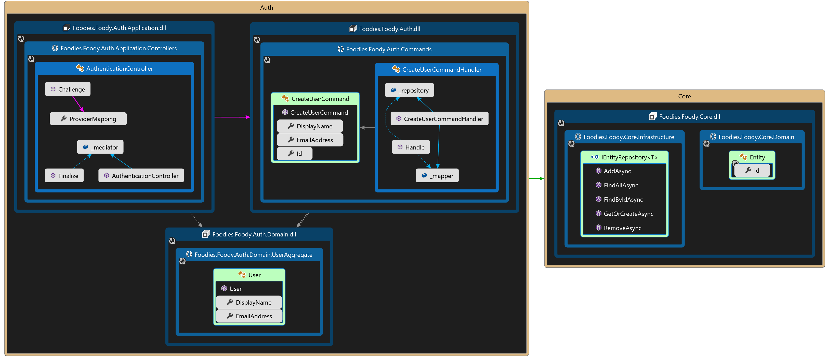
MVC Architecture

Slide 10
Quality
Accelerated by Test Driven Development for business logic
Contains unit and integration tests
Live Unit Testing in VS 2019: Runs tests during development
Part of CI pipeline

Slide 11
Our organization
Azure DevOps – for code and project management
Scrum
Transparent work and team orientation
High level of communication and support

Slide 12
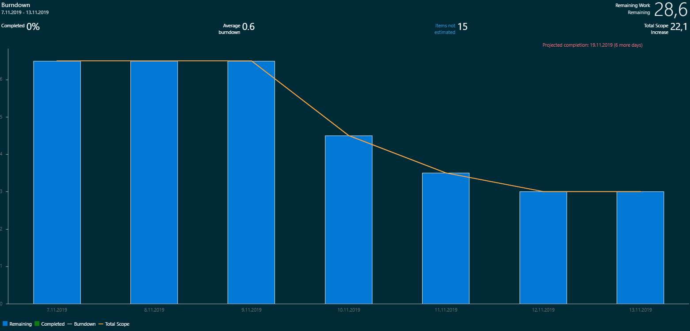
SCRUM

Slide 13
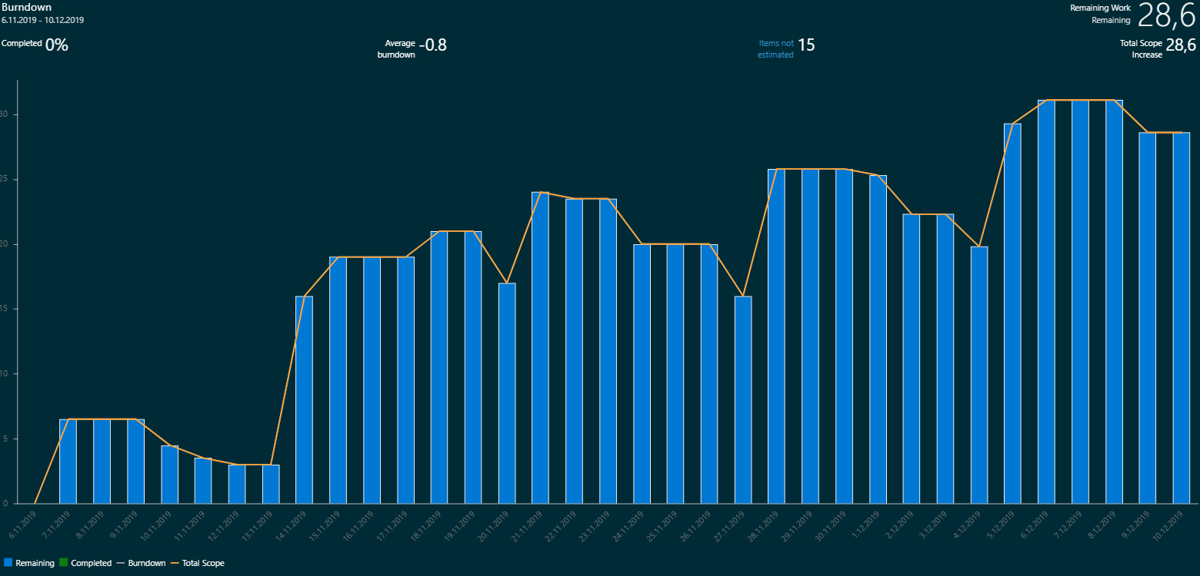
SCRUM

Slide 14


Our organization
Pull requests, Git repository, CI/CD, sprints, project management,… are realized by one single tool - Azure DevOps
Internal communication and parts of the documentation by Discord(-Webhooks)
Weekly sprints including reviews, plans and backlog analysis

Slide 15
A perfect plan(?)
Sprint review for further actions
Test the feature and code
Connect feature into actual build and infrastructure
Finalize programming and scoping
Achieve features by a 2-step strategy
Implementation
Prototyping
Imagine scope of the feature
Try out first usecases
Think of features and importance
Review it in sprint review

Slide 16
How to login?
New users can be invited via Mail
Login with Token delivered via Mail, no password necessary
Easy to handle, easy to provide for everyone, no further knowledge necessary

Slide 17
Features - information
Calendar fed with RaPla dates (iCal)
Meal Plans fed with openmensa.org dates
Deutsche Bahn schedules and connections
Important announcements by admins

Slide 18
Features - fun
Games for all users – Food-Forge™
Providing a virtual currency to play for
Use currency to unlock little rewards (like custom design, etc.)
Possibility to provide small games, apply your game now
Betting game for everyday bets with the currency
Chat to connect all students
No microtransactions (yet)!

