Slide 1
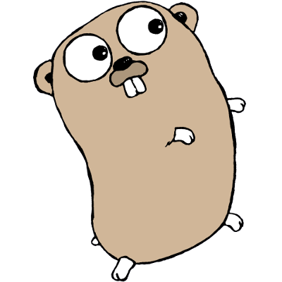
Look a Gopher!
todd
alan
neal
Foo
Foo
Foo
Foo

