Slide 1
Vince Velocci AIM 6943 April 30, 2015
Towards Numerical Simulations of Transcranial Magnetic Stimulation, and Fractional Order Differential Equations

Slide 2
Transcranial Magnetic Stimulation
A noninvasive procedure that utilizes pulsed magnetic fields to induce stimulating currents in brain tissue.
Used to treat neurological and psychiatric disorders, such as Parkinson’s and depression.
TMS is also used for research on various parts of the brain, such as the prefrontal cortex (judgment center, thought center, decision making, etc.)

Slide 3
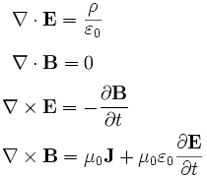
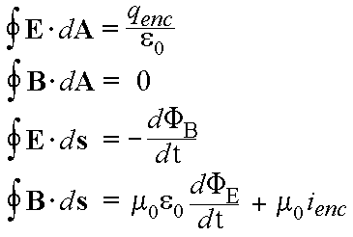
Maxwell’s Equations
TMS is a direct application of Maxwell’s Equations describing the force of electromagnetism
Rapidly changing magnetic field → induces strong electric field → currents in brain

Slide 4
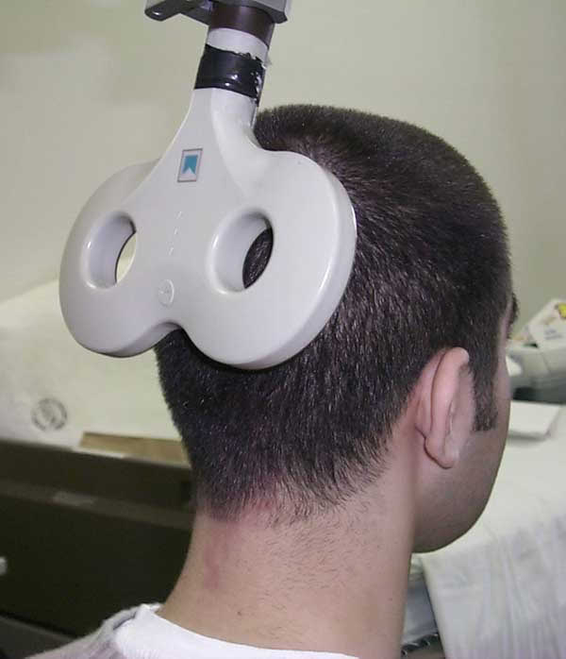
TMS

Slide 5
Problem: Simulate the currents and fields in the brain during TMS
Requires solving Maxwell’s Equations on the human brain (highly irregular 3D domain with varying permeability, permittivity, conductivity)
Must use the finite element method (FEM)
FEM: A numerical technique for solving PDEs with boundary conditions
Domain is subdivided/discretized into finite elements (eg. Tetrahedra in 3D)
Approximate the solution as a linear combination of suitable basis functions (eg. Piecewise linear)

Slide 6

Problem: Simulate the currents and fields in the brain during TMS
Original PDE is converted into an equivalent variational problem, VP
Approximate u by linear combination of finite number of basis functions: u_{h}=$\sum_{i}{c_{i}φ_{i}}$
Instead of solving VP on the (infinite D) space of continuous functions satisfying the BCs, we solve VP on the subspace spanned by $\left\{φ_{i}\right\}$
One may also obtain u_{h} by solving <R,ϕ_{j}>=0 $∀ j,$where R is the “residual”.

Slide 7
EIDORS
A MATLAB package that performs Electrical Impedance Tomography: infers conductivity/permittivity of a body from surface electrode measurements of voltage after applying alternating currents to body.
Contains PDE and linear solvers, and finite element code to discretize domains.
Would like to adapt EIDORS to the problem of simulating the fields and currents involved during Transcranial Magnetic Stimulation.
Involves obtaining high resolution MRI of the brain, converting images to FE meshes.
Software exists to do this, and to segment FE meshes into skin, skull, cerebrospinal fluid, gray and white matter.

Slide 8

EIDORS
A time harmonic electric field E and magnetic field H, with angular frequency ω, satisfies Maxwell’s Equations
$$∇ X E=jωμH$$
$$∇ X H=\left(σ−jωε\right)E$$
Small μ,ω → $∇ X E=$ 0 → E = $∇φ, φ is potential$
Maxwell’s Equations → $∇∙\left[\left(σ−jωε\right)∇φ\right]=0$ (1)
Known boundary data: $φ, n∙∇φ$
EIDORS takes this data, and solves for ε(x), σ(x) in (1) through an iterative process of solving the forward problem (using FEM) for ϕ, and using that to update ε, σ until numerical model matches the measured data to adequate precision.

Slide 9
SimNIBS Simulation of Non-Invasive Brain Stimulation
Uses MATLAB functions to calculate electric field induced by TMS via the finite element method
Generates tetrahedral volume meshes of the head from MR images
Uses FreeSurfer (open source, Linux) to analyze and visualize MR images; segments different tissue types from each other (each having different material properties) before model is converted to a FE mesh
Routine called mri2mesh then forms the tetrahedral head model for finite element calculations
One may also import meshes from SimNIBS into EIDORS using the EIDORS function gmsh_read_mesh

Slide 10
Modeling Using Fractional Order PDEs
Fractional order calculus can model certain viscoelastic behavior of materials
Such models have also been shown to adequately model dielectric behavior of materials and tissues
These incorporate a modified form of Maxwell’s Equations yielding a fractional order wave equation
I numerically solved examples of fractional order differential equations using MATLAB

Slide 11

Fractional Order Derivatives
n, positive integer: $f^{\left(n\right)}\left(t\right)=\lim_{h→0}{\frac{1}{h^{n}}}\sum_{r=0}^{n}{\left({n \atop r}\right){\left(−1\right)}^{r}f(t−rh)},$
$$where \left({n \atop r}\right)=\frac{n\left(n−1\right)…(n−r+1)}{r!}$$
For a continuous function with t ≥ a, we may define a fractional order (order α) derivative as
$$\lim_{\begin{aligned}h→0 \\ nh=t−a\end{aligned}}{h^{−α}}\sum_{j=0}^{n}{{\left(−1\right)}^{j}\left({α \atop j}\right)}f(t−jh)$$

Slide 12

Fractional Order Derivatives
We may approximate this as
_{a}$D_{t}^{α}$f(t) ≈ $\sum_{j=0}^{\left[\frac{t−a}{h}\right]}{{\left(−1\right)}^{j}\left({α \atop j}\right)}f(t−jh)$
Here, h is the time-step size, and the notation [A] denotes the largest integer not greater than A
We denote $w_{j}^{(α)}$=${(−1)}^{j}\left({α \atop j}\right)$ which obeys relationship
$w_{0}^{(α)}$= 1; $w_{k}^{(α)}$= $\left(1−\frac{α+1}{k}\right)w_{k−1}^{(α)}, k=1, 2, 3, …$

Slide 13

Fractional Order Derivatives
We may also define a fractional order derivative using the spectral decomposition of the matrix, A, representation of the FD approximation to $−\frac{d^{2}}{{dt}^{2}}$
Rows of A look like [0…0 -1 2 -1 0…0] (disregarding h⁻²)
A is SPD -> A can be diagonalized and can be written as
VΛV^{T}
Thus A^{α} = VΛ^{α}V^{T} and we may take any powers of the eigenvalues in Λ!

Slide 14
Fractional Order Derivatives
For fractional powers, A^{α} is a full matrix (α ≠ ½)
As α -> 1 the full matrix becomes tridiagonal

Slide 15
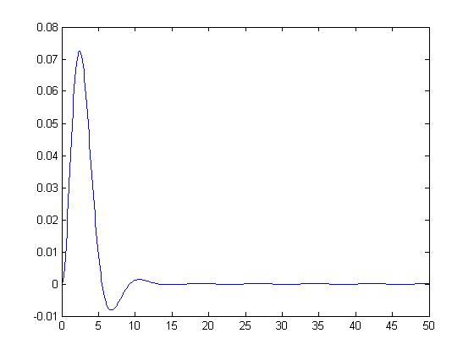
Fractional Order Derivatives
Numerically computed the solution to
₀D_{t}^{3/2}y(t) + y(t) = f(t), (t > 0), y(0) = y’(0) = 0
using four different choices for the “forcing function”, f(t).
Example: f(t) = t*exp(-t)

Slide 16
Fractional Order Derivatives
Numerically computed the solution to a fractional order wave-diffusion equation
₀D_{t}^{α}u(x,t) = u_{xx}(x,t) for 0 ≤ x ≤ 1, 0 ≤ t ≤ 10, u(x,0) = sin(πx)
for different values of the order of the time derivative, α.
Example: α = 3/2

