Slide 1
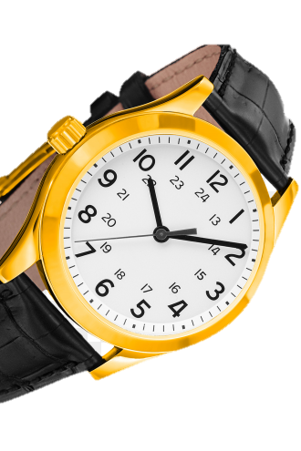

InLine Prod
Gabriele bottinelli & pietro belfanti

Slide 2
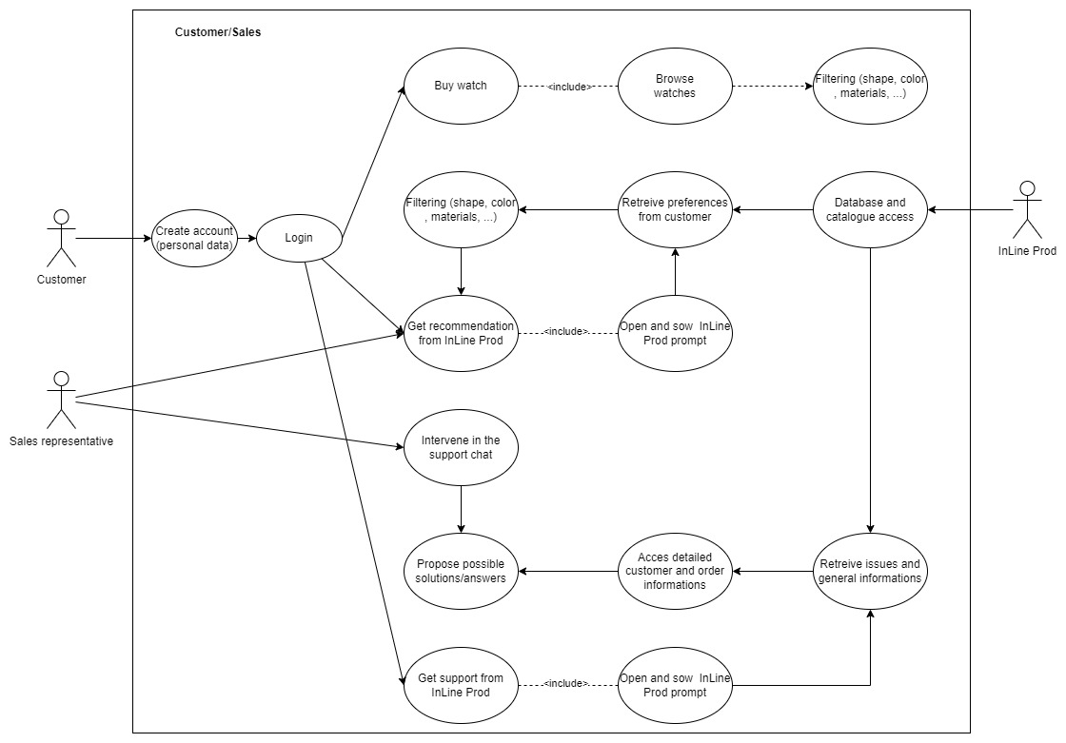
Use case 1: Customer and Sales
Notes:
Online customer:
own Filtering
InLine Prod (Filtering) suggestion
Propose solution

Slide 3
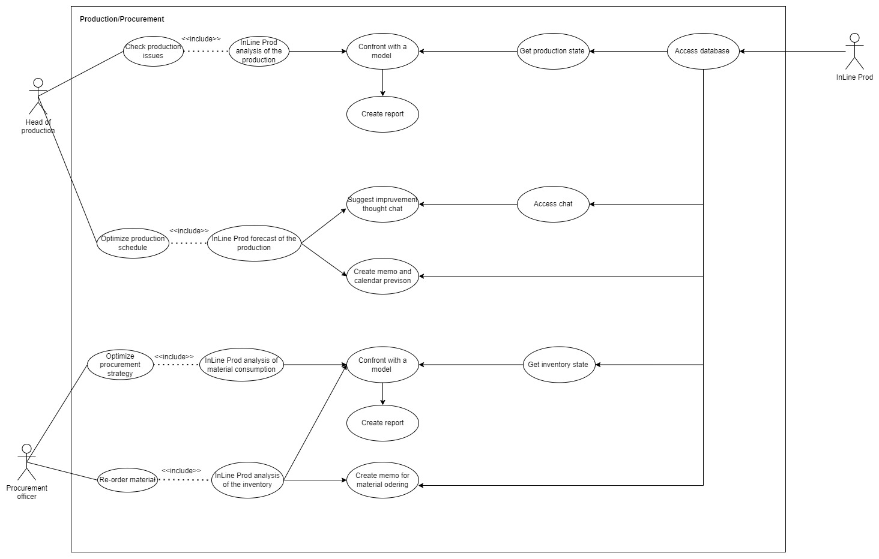
Use case 2: Production

Slide 4
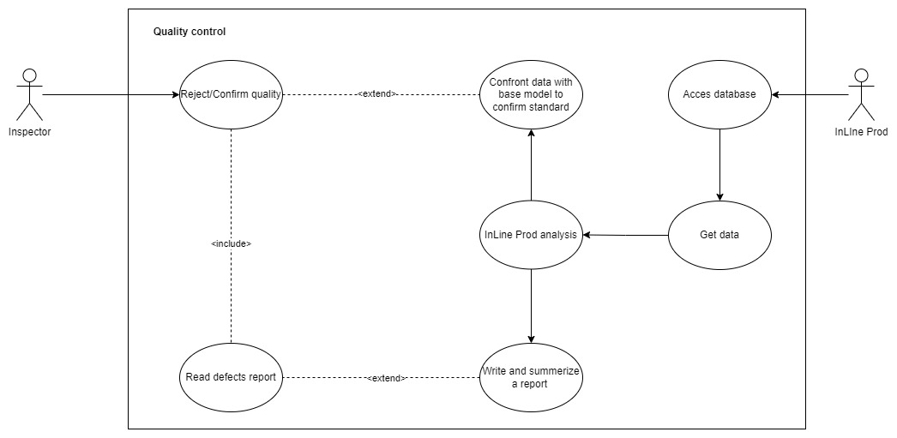
Use case 3: Quality control

Slide 5

Prompt example
Customer: Hello, I purchased a watch from your company, but it stopped working after a few days. Can you help me with the warranty process?
LLM: I'm here to guide you through the warranty process. Please provide me with the following details: the watch's serial number, the date of purchase and any relevant information from the purchase receipt. With this information, I'll be able to assist you further in initiating the warranty process for your watch.

Slide 6
IT Infrastructure
LLM Server
High-performance CPU
GPU for faster computation
Fast storage like SSD or NVMe
High-performance network in order to access external resources (like Llama index)
Substantial amount of RAM for handling data with efficiency
LLM framework, libraries, drivers, …
Document Database Server
Adequate CPU and RAM to manage and access the database efficiently
SSD for high-speed storage
DBMS for document storage and document retrieval
High-performance network to serve the documents to the LLM server

Slide 7
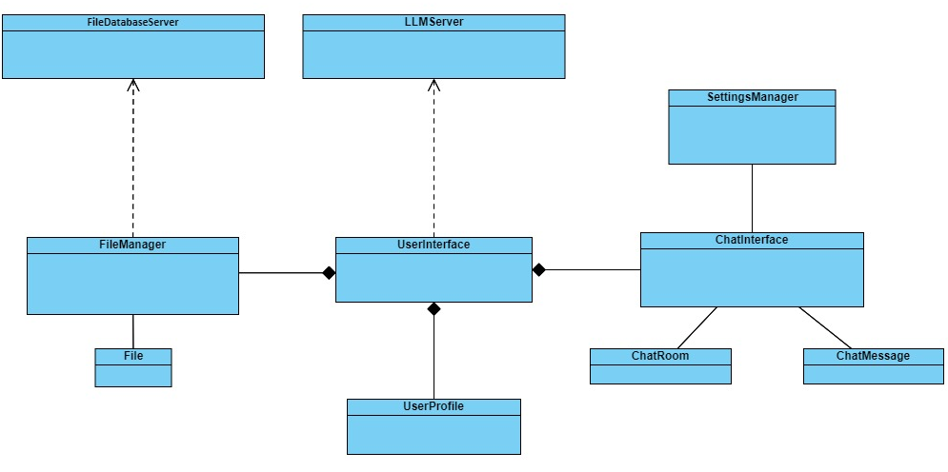
Class Diagram

