Slide 1
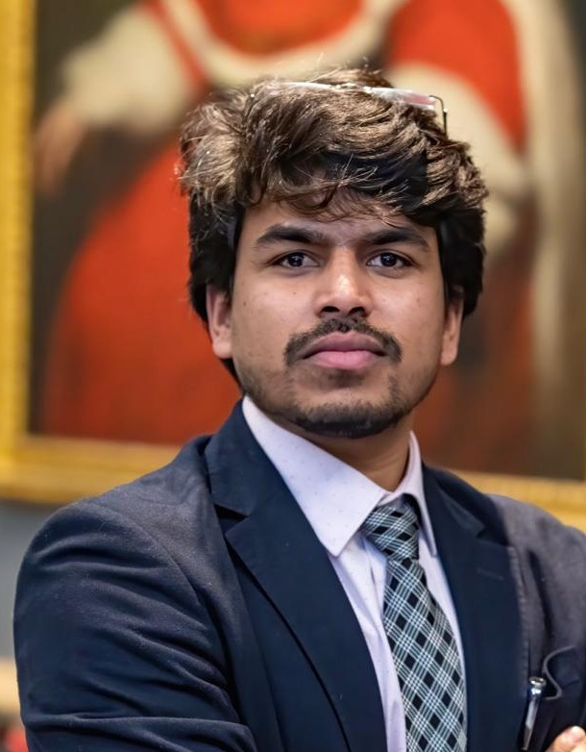
SUSHANT SINGH
ADVOCATE | LITIGATION & ARBITRATION COUNSEL
A DECADE OF LEGAL PRACTICE
Supreme Court of India • Delhi High Court • District Courts • Tribunals
Panel-A Counsel, UOI — Supreme Court
Senior Panel Counsel — CAT
Panel Counsel, MCD — Delhi HC
LL.M., SOAS, University of London
B.A. LL.B. (Hons.), NLU Delhi
01 PROFESSIONAL PROFILE
04 CORE PRACTICE AREAS
06 LITIGATION & ADVISORY
Litigation and arbitration counsel with a decade of practice before the Supreme Court of India, Delhi High Court, District Courts and specialised tribunals — across constitutional, civil, commercial, property, arbitration, land acquisition, infrastructure, education and service law matters. Combines courtroom advocacy with rigorous research, strategic case preparation and precise drafting.
Constitutional & Public Law
Writs, statutory challenges, public law remedies
Civil & Commercial Litigation
Suits, injunctions, recovery, contractual disputes
Civil suits, writ petitions, appeals, applications & legal opinions
Represents public authorities, statutory bodies & institutions
Contractual interpretation, enforcement & dispute strategy
Arbitral proceedings, written arguments & award-related work
Advisory: EPC agreements, MoUs, land acquisition compliance
Arbitration & Contract Disputes
A&C Act — Sections 9, 11 & 34 proceedings
Property & Real Estate
Landlord–tenant, possession, recovery, injunctions
02 PROFESSIONAL STANDING
Land Acquisition & Compensation
Acquisition disputes, reference proceedings
Infrastructure Disputes
Construction contracts, delay & escalation claims
Panel-A Counsel, Union of India, Supreme Court of India
Senior Panel Counsel, Union of India, Central Administrative Tribunal
Panel Counsel, Municipal Corporation of Delhi, Delhi High Court
Independent Counsel — Supreme Court of India & Delhi High Court
Regular practice: District Courts (Delhi-NCR), CAT, NGT, DRT, Arbitration Tribunals
07 REPRESENTATIVE ENGAGEMENTS
Education Law & Human Rights
Admissions, scholarships, access to education
Service & Administrative Law
Disciplinary, pension & retiral matters
MCD before Delhi High Court — writ & civil appellate matters
Union of India — Supreme Court & Central Admin. Tribunal
Land acquisition & enhanced compensation claims
Students & scholars — admissions, scholarships, access
Pro bono: property & land acquisition disputes
05 PROFESSIONAL EXPERIENCE
2017 — Present — Advocate & Independent Counsel
SC, Delhi HC, District Courts & Tribunals
03 ACADEMIC QUALIFICATIONS
Jul 2017 — Sep 2019 — Associate Lawyer
Chambers of Mr. Neeraj Dahiya, New Delhi
“
A litigation-first approach grounded in rigorous research, strong drafting and strategic advocacy — pursuing effective remedies with the highest professional standards.
— SUSHANT SINGH
LL.M., SOAS, University of London — Human Rights, Conflict and Justice
B.A. LL.B. (Hons.), National Law University Delhi

