Slide 1
Projet Informatique
2017
Steve Hostettler

Slide 2
Docker

Slide 3
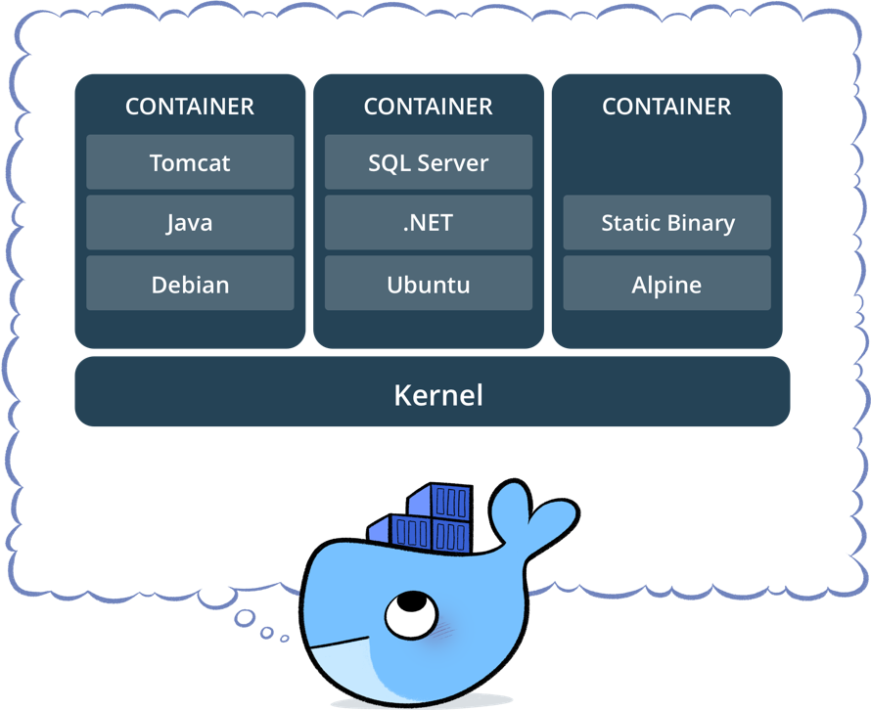
Package software into standardized units for development, shipment and deployment
Source : docker.io

Slide 4
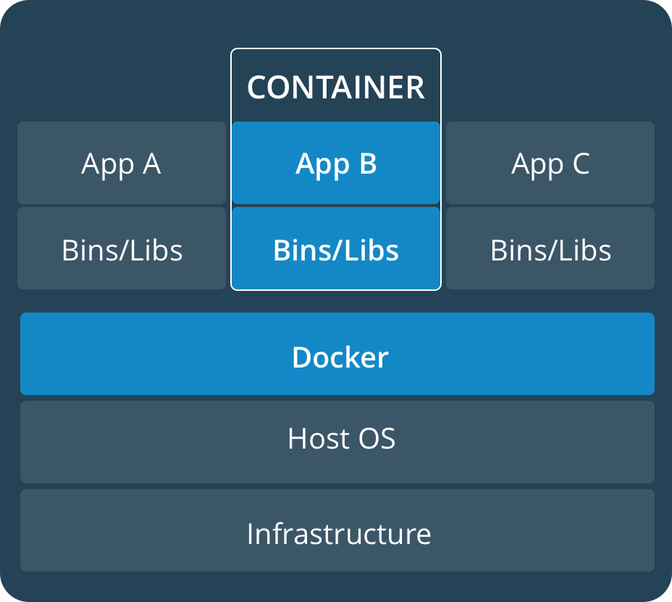
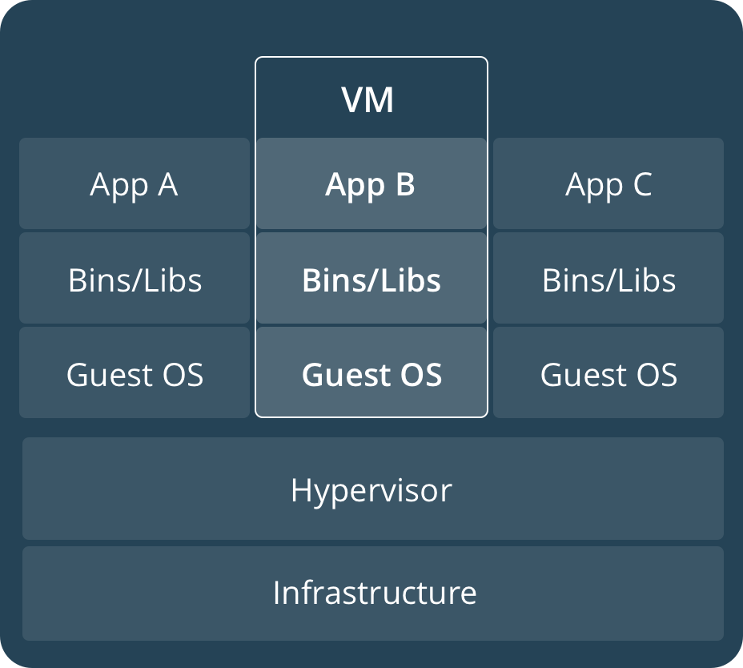
CONTAINERS
Containers are an abstraction at the app layer that packages code and dependencies together. Multiple containers can run on the same machine and share the OS kernel with other containers, each running as isolated processes in user space. Containers take up less space than VMs (container images are typically tens of MBs in size), and start almost instantly.
VIRTUAL MACHINES
Virtual machines (VMs) are an abstraction of physical hardware turning one server into many servers. The hypervisor allows multiple VMs to run on a single machine. Each VM includes a full copy of an operating system, one or more apps, necessary binaries and libraries - taking up tens of GBs. VMs can also be slow to boot.
Source : docker.io

Slide 5
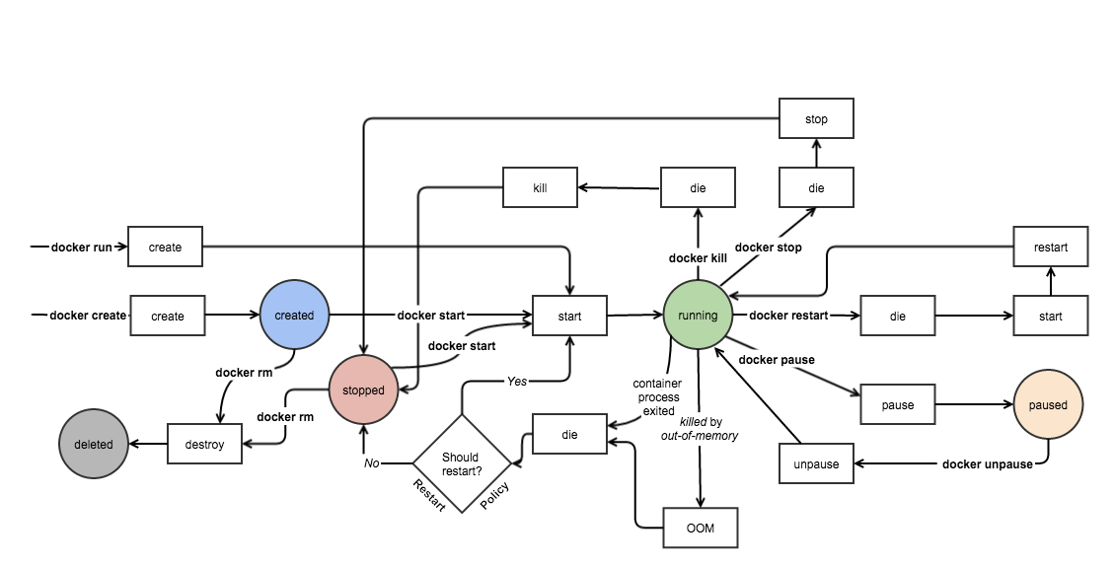
Image Source and Credits: http://docker-saigon.github.io/post/Docker-Internals/

Slide 6
Bibliographie
http://docker.io

