Slide 1
Projet Informatique
2018
Steve Hostettler

Slide 2
Unit Testing

Slide 3
A short reminder

Slide 4
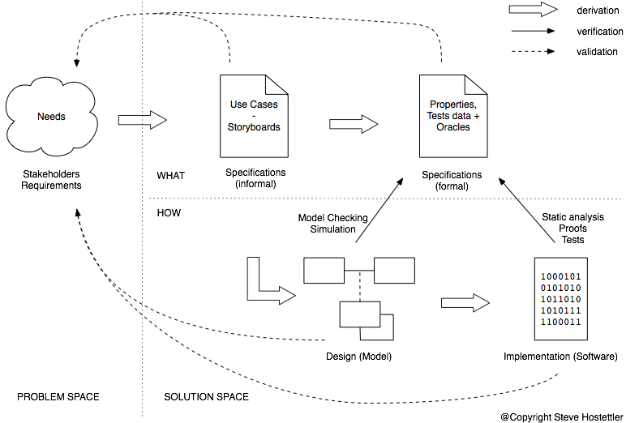
Validation & Verification

Slide 5
What do we chase?
human error:
misunderstanding
Mistake
manifestation of the mistake
(e.g. bad if statement)
Fault
The deviation from the expected behavior
Failure

Slide 6
The 10’000 feet view
User needs
derives from
Specification
setup, P
derives from
derives from
Test condition
Test case
Test condition
Test case
Test objective
Test case
verifies SUTsetup ⊦ P
Test case
SUTsetup ⊦ P

Slide 7
Anatomy of a test
SUTsetup
inputs +
initial state
SUT
outputs +
end state
Test setup
Oracle
Verification
OK/KO?
SUTsetup ⊦ P
consumes/produces
Information
Pass/Fail
Procedure
Oracle

Slide 8
Test Case
Setup/Configuration
Scenario/Exercice
SUT
Comparator
expected and obtained
Comparator
expected and obtained
Evaluator
is comparison ok
✔ / ✖
Verification / Oracle
Test Result
Test Case

Slide 9
Anatomy of a test
Setup
Component
Under
Test
Another
Component
Exercise
Verification
SUTsetup ⊦ P
SUT
Test result
Test setup and configuration (initial state, ...)
Invokation, returned values, exception
Oracle

Slide 10
Test Levels
Components Testing
Integration Testing
System Testing
Acceptance Testing

Slide 11
Component Testing
a.k.a. unit testing

Slide 12
Component Testing
a.k.a. Unit Testing, Module Testing
Test basis: Component requirements, detailled design, code
Test objects: Components (classes, package, programs, database scripts, ...)

Slide 13
Component Testing
In isolation
Uses mock, stubs, fakes
Tests functional and non-functional requirements
By programmers (low management overhead)

Slide 14
Test doubles
Helps to improve test isolation
Otherwise it would not be a component (unit) test
Many kind of doubles for many different usages

Slide 15
Test doubles
Setup
1) Creation and configuration
2) Installation in the CUT
Component
Under
Test
Another
Component
Exercise
3) Direct inputs
4) Indirect outputs
5) Indirect inputs
6) Direct outputs
Verification
SUTsetup ⊦ P
SUT
Test result
Test setup and configuration (initial state, ...)
Invokation, returned values, exception
Oracle

Slide 16
Example
package ch.demo.business.service;
public interface AnotherComponent {
Integer inc(Integer param);
}
package ch.demo.business.service;
public interface CUT {
public String doBusiness(String string, Integer delta);
}
package ch.demo.business.service;
public class CUTImpl implements CUT {
AnotherComponent component;
public CUTImpl(AnotherComponent c) {
this.component = c;
}
@Override
public String doBusiness(String param, Integer delta) {
return component.inc(Integer.valueOf(param)).toString();
}
}

Slide 17
Example
package ch.demo.business.service;
public class AnotherComponentImpl implements AnotherComponent {
public Integer inc(Integer param) {
if (param == null) {
throw new IllegalArgumentException("Param must be not null!");
} else if (param == Integer.MAX_INTEGER) {
throw new IllegalStateException("Incrementing MAX_INTEGER will result in overflow!");
} else {
return param + 1;
}
}
}
package ch.demo.business.service;
public class CUTTest {
public void testInc() {
Assert.assertEquals("inc(3) != 4", 4, new CUTImpl(new AnotherComponentImpl()).inc(“3”, 1));
}
}

Slide 18
Dummy objects
To satisfy compile time checks
For runtime executions
Parameter delta of the doBusiness can be set to null

Slide 19
Test doubles - Fake
Covers many cases and
has some logic
Setup
1) Creation and configuration
2) Installation in the CUT
Component
Under
Test
Another
Component
-
Fake
Exercise
3) Direct inputs
4) Indirect outputs
5) Indirect inputs
6) Direct outputs
Verification
SUTsetup ⊦ P
SUT
Test result
Assertions are
based on the
direct outputs
Test setup and configuration (initial state, ...)
Invokation, returned values, exception
Oracle

Slide 20
Example
package ch.demo.business.service;
public class AnotherComponentFake implements AnotherComponent {
public Integer inc(Integer param) {
return param + 1;
}
}
package ch.demo.business.service;
public class CUTTest {
public void testIncWhenAnotherComponentReturnsNull() {
CUT cut = new CUTImpl(new AnotherComponentFake());
Assert.assertEquals("inc(Integer.MIN_INTEGER) != Integer.MIN_INTEGER + 1", Integer.MIN_INTEGER + 1, cut.inc(Integer.MIN_INTEGER, 1));
Assert.assertEquals("inc(3) != 4", 4, cut.inc(3, 1));
Assert.assertEquals("inc(123) != 124", 124, cut.inc(123, 1));
}
}

Slide 21
Test doubles - Test Stub
Covers a limited
number of cases. Usually
borderline cases
Setup
1) Creation and configuration
2) Installation in the CUT
Component
Under
Test
Another
Component
-
Test Stub
Exercise
3) Direct inputs
4) Indirect outputs
5) Indirect inputs
6) Direct outputs
Verification
SUTsetup ⊦ P
SUT
Test result
Assertions are
based on the
direct outputs
Test setup and configuration (initial state, ...)
Invokation, returned values, exception
Oracle

Slide 22
Example
package ch.demo.business.service;
public class AnotherComponentStub implements AnotherComponent {
public Integer inc(Integer param) {
return null;
}
}
package ch.demo.business.service;
public class CUTTest {
public void testIncWhenAnotherComponentReturnsNull() {
Assert.assertEquals("inc(3) != 4", 4, new CUTImpl(new AnotherComponentStub()).inc(3, 1));
}
}

Slide 23
Test doubles - Mock
Assertions based
on the indirect outputs
the mock state
Setup
1) Creation and configuration
2) Installation in the CUT
Component
Under
Test
Another
Component
-
Mock
Exercise
3) Direct inputs
4) Indirect outputs
5) Indirect inputs
6) Direct outputs
Verification
SUTsetup ⊦ P
SUT
Test result
Assertions are
based on the
indirect inputs
Assertions are
based on the
direct outputs
Test setup and configuration (initial state, ...)
Invokation, returned values, exception

Slide 24
Example
package ch.demo.business.service;
public class CUTTest {
public void testIncWhenAnotherComponentReturnsNull() {
        AnotherComponent mock = mock(AnotherComponent.class);
when(mock.inc(Mockito.<Integer>anyObject())).thenReturn(null);
verify(mock, times(1)).inc(“3”, 1);
        Assert.assertEquals("inc(3) != 4", 4, new CUTImpl(mock).inc(3, 1));
}
}

Slide 25
Test doubles - Test spy
Records the indirect
outputs
Setup
1) Creation and configuration
2) Installation in the CUT
Component
Under
Test
Another
Component
-
Test Spy
Exercise
3) Direct inputs
4) Indirect outputs
5) Indirect inputs
6) Direct outputs
Verification
SUTsetup ⊦ P
SUT
Assertions on indirect inputs
Test result
Test setup and configuration (initial state, ...)
Invokation, returned values, exception
Oracle

