Slide 1
Technical presentation
Presenting the group workflow of Unitrade

Slide 2
Contents
Project management
Technical features
    Microservices and database architecture
    Project deployment

Slide 3
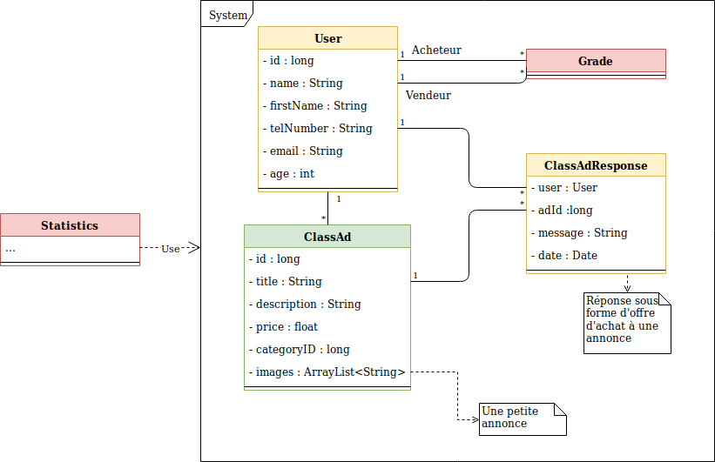
Our system

Slide 4
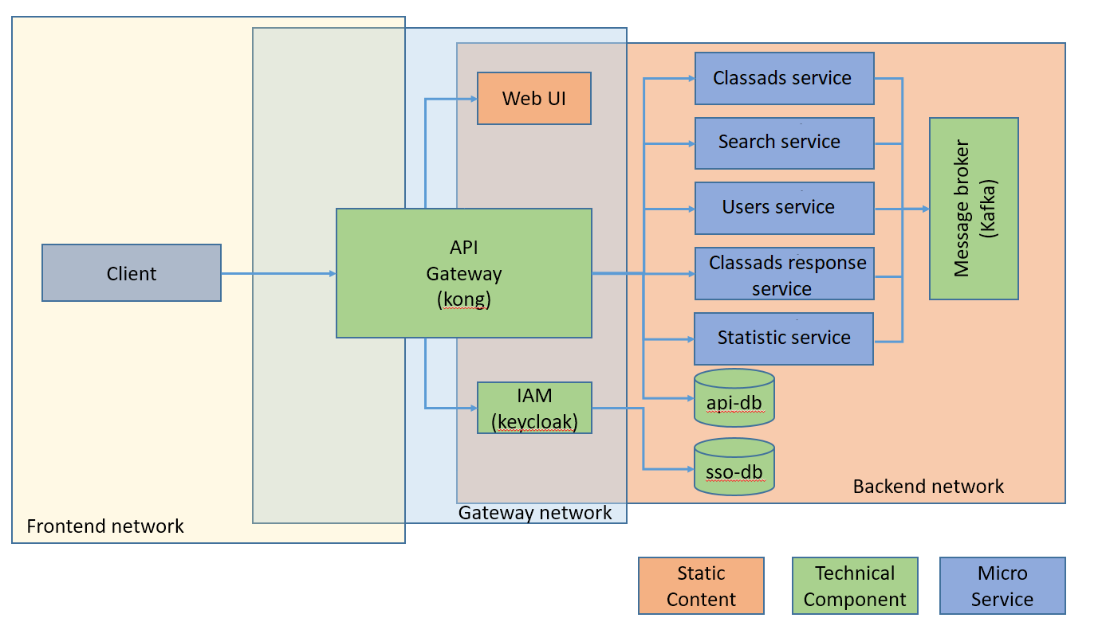
Microservices architecture
Source : Steve Hostettler, Microservice Architecture - Part 1

Slide 5
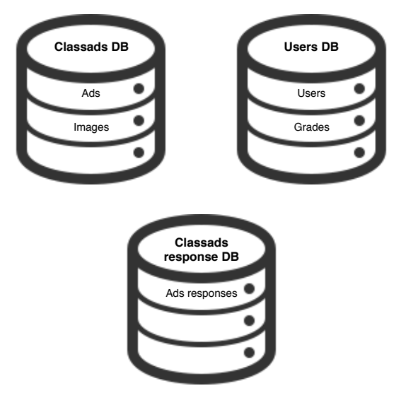
DataBase architecture

Slide 6
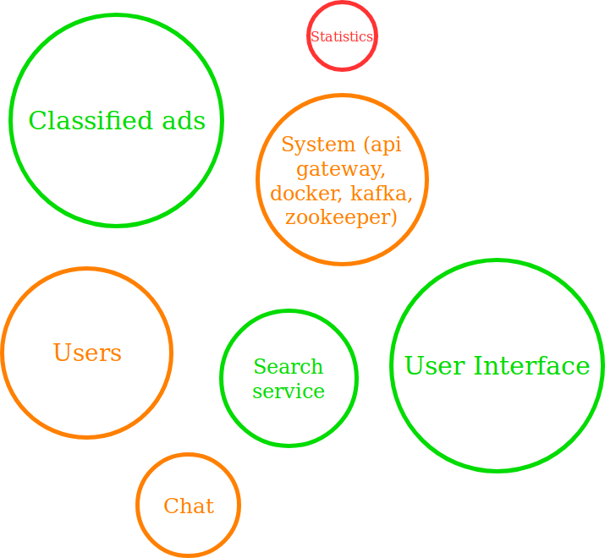
What have we done

Slide 7
Time invested
Last 8 weeks
Until June
42 hours/week
100 hours

Slide 8
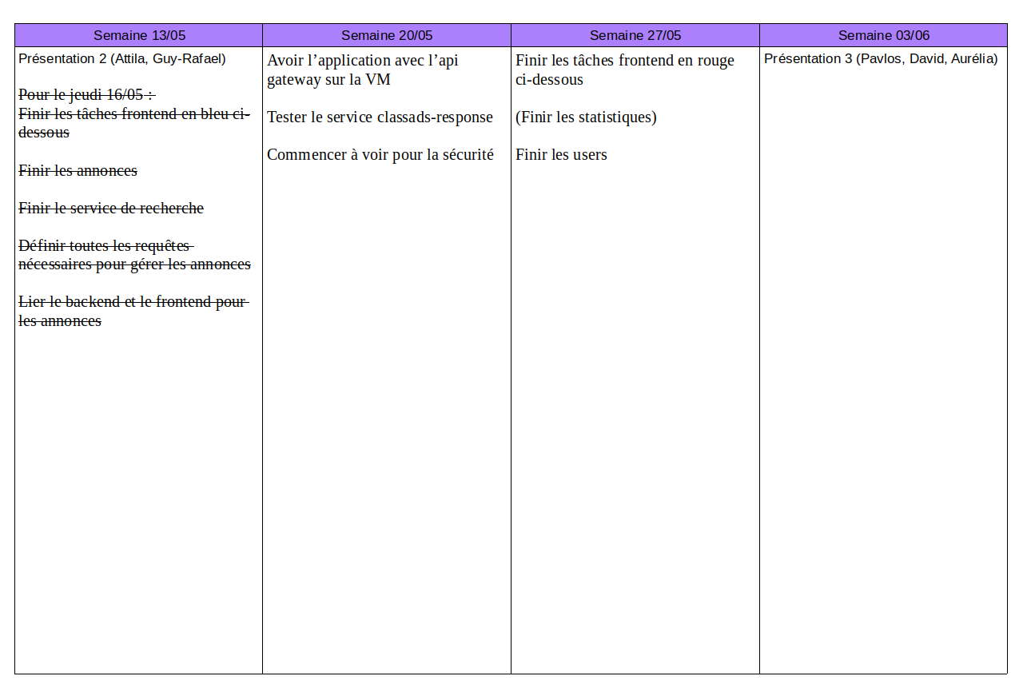
Planning

Slide 9




Technology
Data base:
Logging:
Tests:

Slide 10




Code hosting
Coding

Slide 11


TravisCI
Automatic
builds

Slide 12
Demonstrating the pages
Github
TravisCI
SonarCloud

Slide 13
Automatic Deployment
After building, a deployment phase begins on TravisCI
Travis is configured to ssh into the server and launch a deployment script

Slide 14


Automatic Deployment
Automatic
builds
Server

Slide 15
Demonstration

Slide 16
Thank you for your attention.

