Slide 1
Technical presentation
Presenting the group workflow of Unitrade

Slide 2
Contents
Project management
Technical features
    Microservices and database architecture
    Project deployment

Slide 3
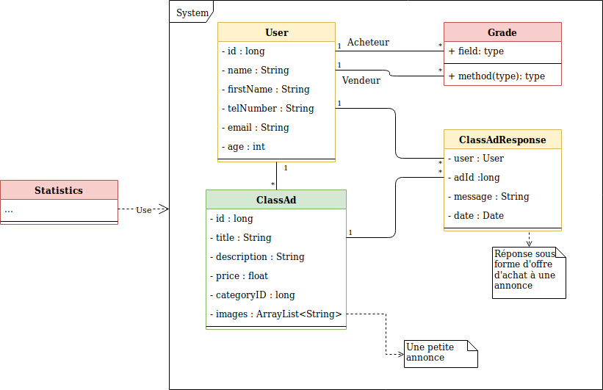
Our system

Slide 4
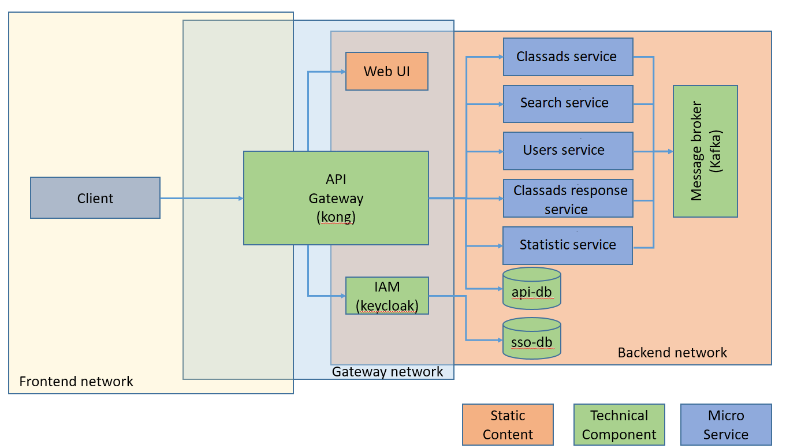
Microservices architecture
Source : Steve Hostettler, Microservice Architecture - Part 1

Slide 5
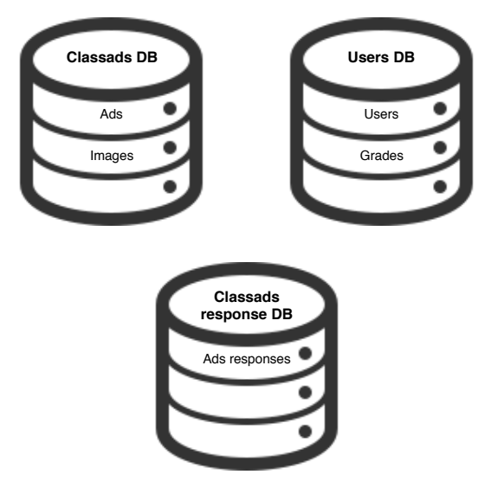
DataBase architecture

Slide 6
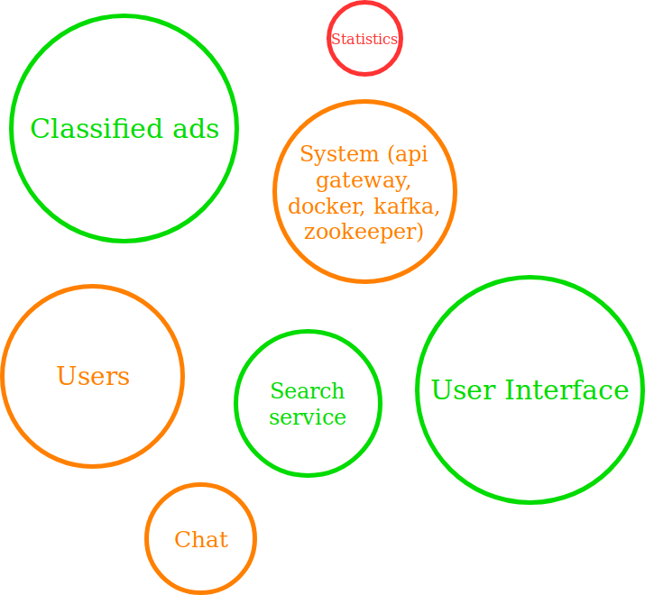
What have we done

Slide 7
Time invested
Last 8 weeks
Until June
42 hours/week
100 hours

Slide 8
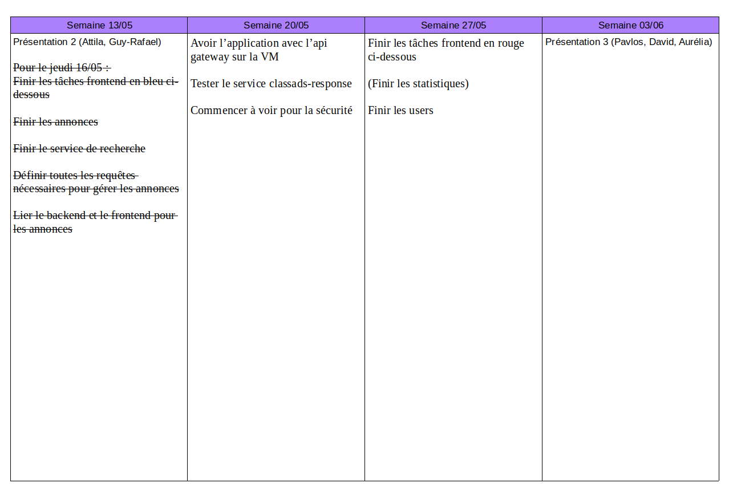
Planning

Slide 9




Technologie
Data base:
Logging:
Tests:

Slide 10




Deployement
Coding

Slide 11
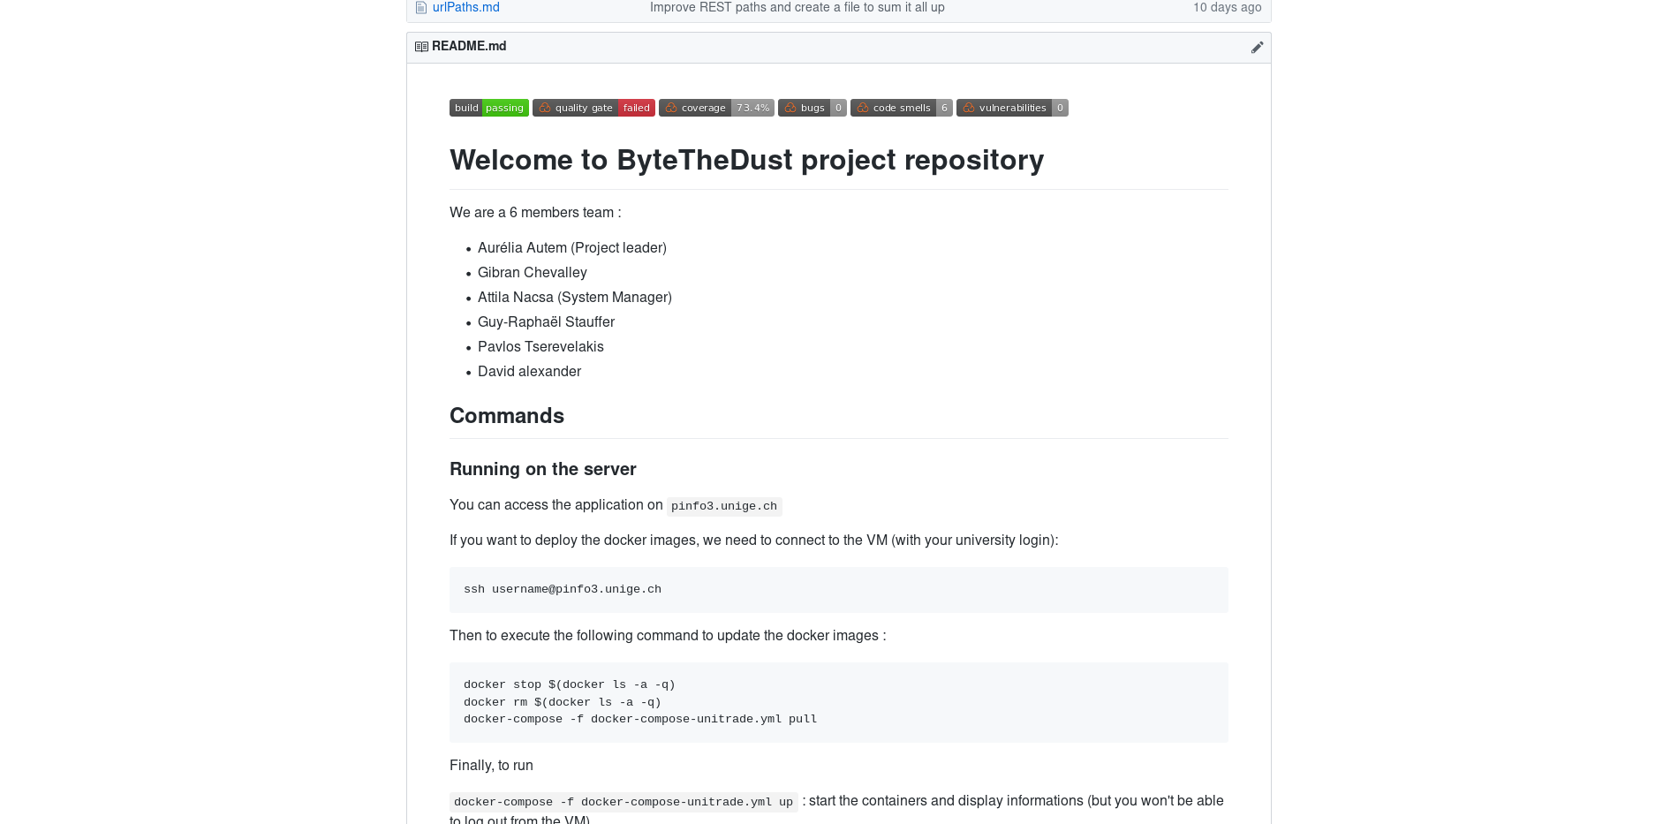
Github
Integration with services:
List of members:
Short documentation:

Slide 12
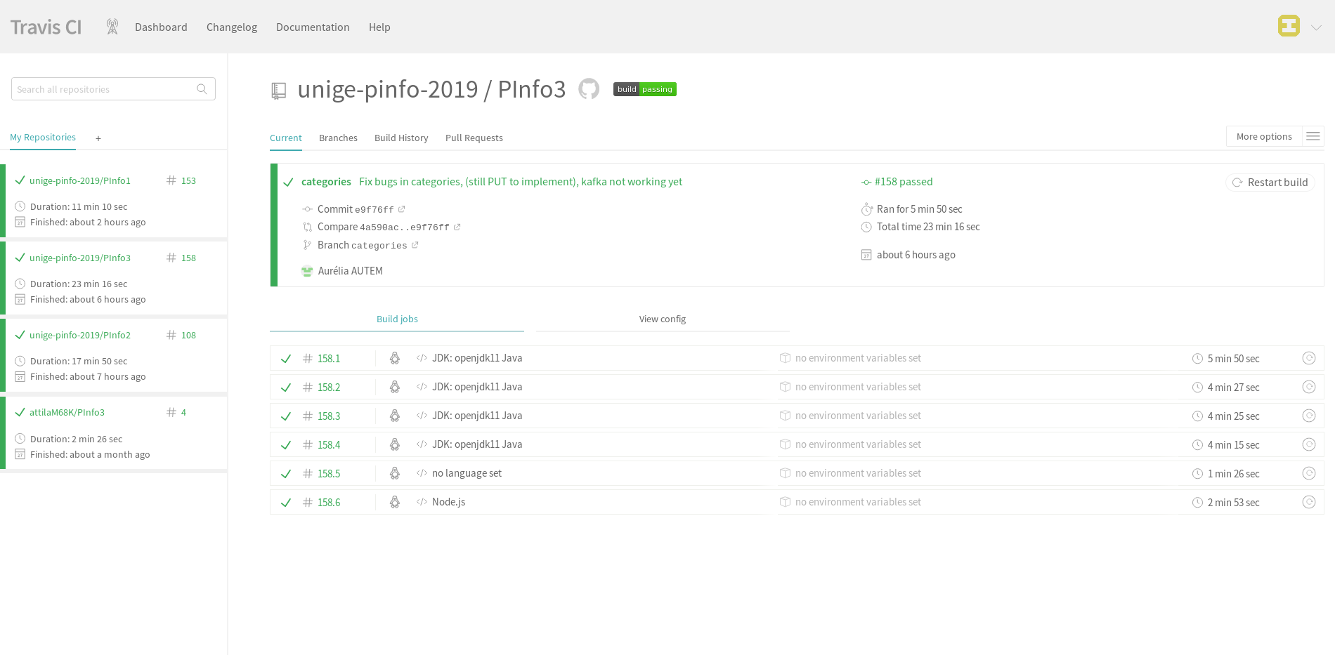
TravisCI
The main TravisCI page of the project showing a passing build

Slide 13
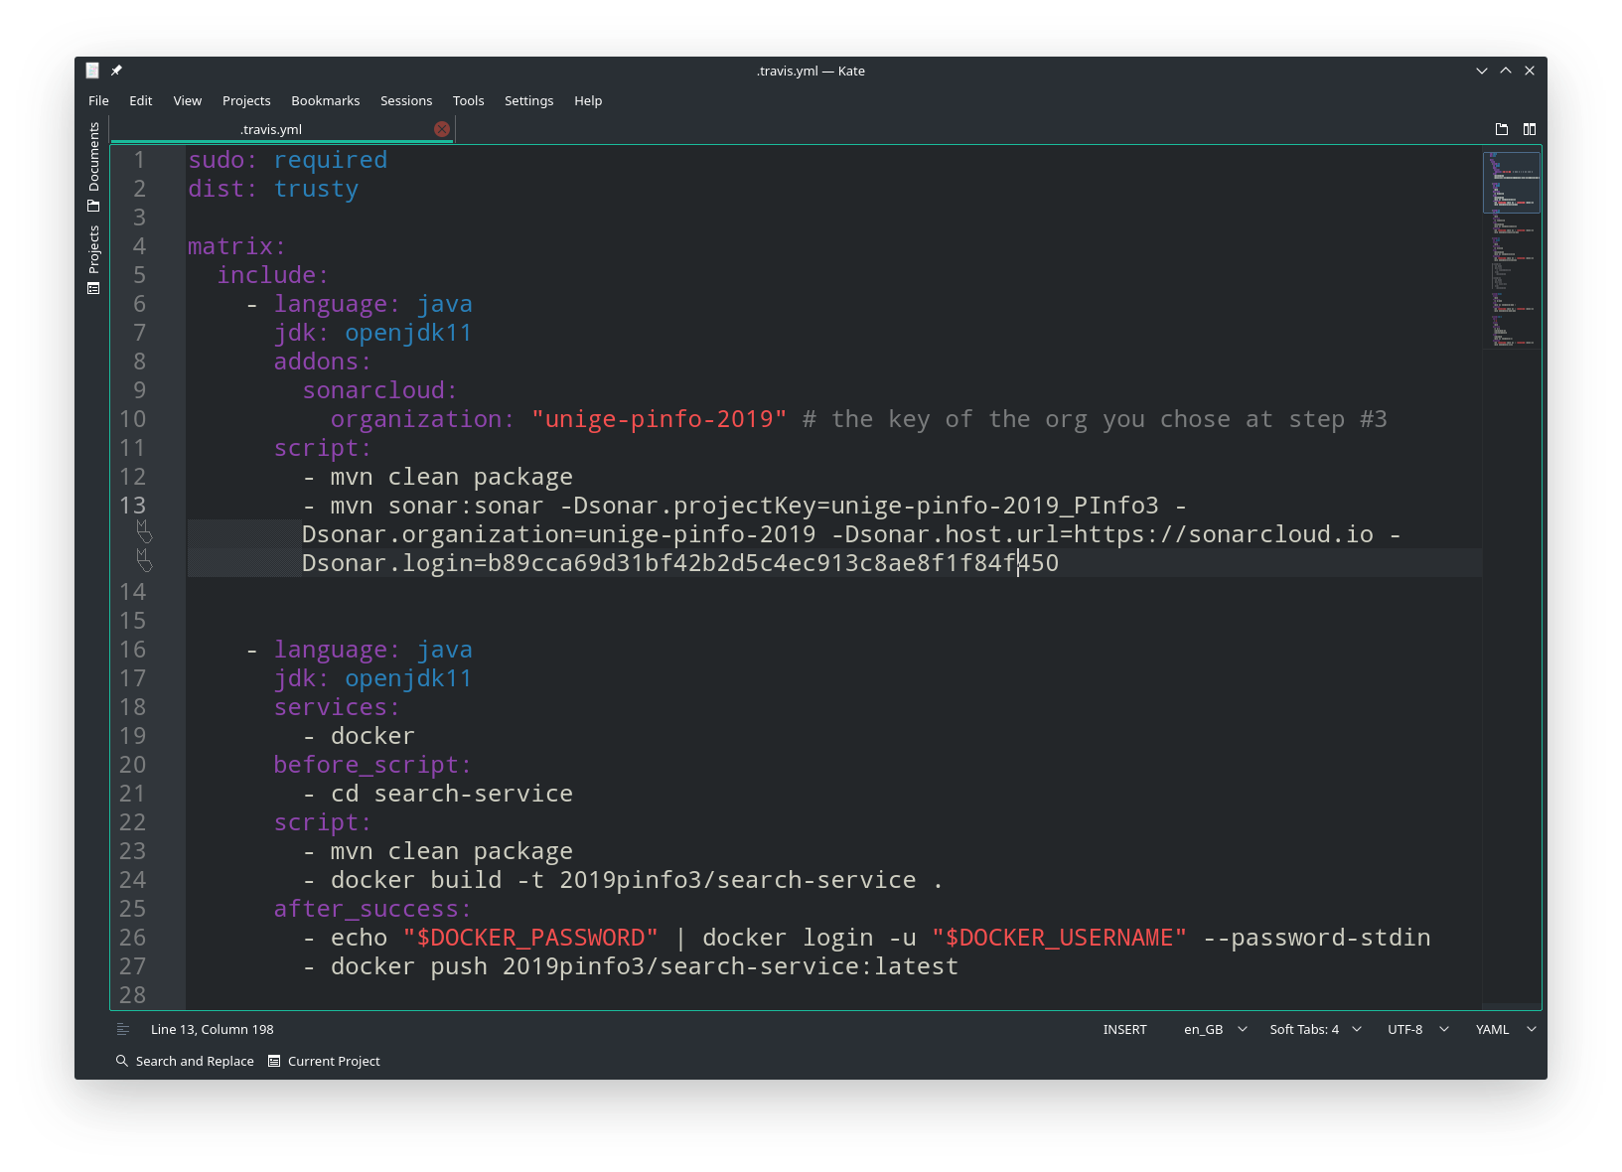
TravisCI - .travis.yml

Slide 14


Deployement (2)
Deployement
on the VM

Slide 15
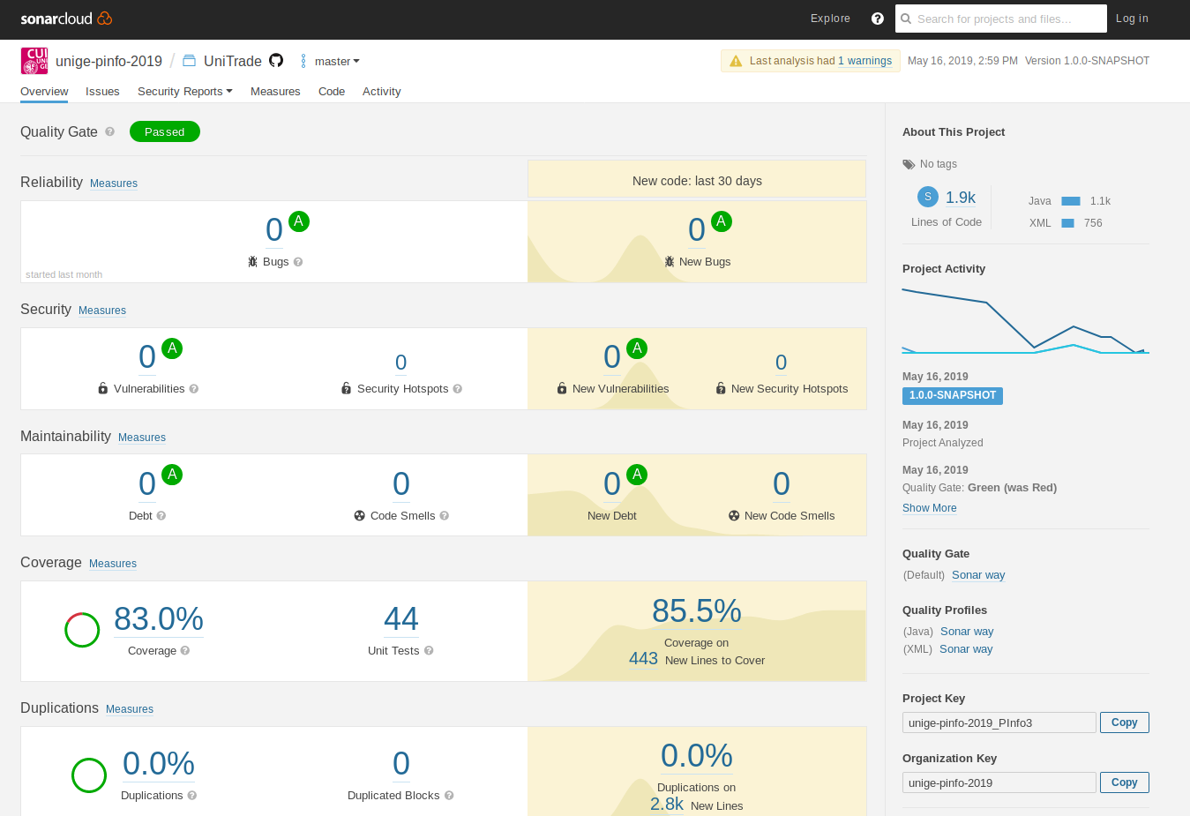
SonarCloud
SonarCloud main page

Slide 16
Automatic Deployment
Under work

Slide 17
Demonstration

Slide 18
Thank you for your attention.

