Slide 1
Technical presentation
Presenting the group workflow of Pinfo3

Slide 2

Github
The code is hosted on github
All experimental code go into separate branches from main
When the code is ready in a branch, it gets merged with the main branch
TravisCI (deployment) and Sonarcloud (code testing) are embeded into the Readme.md

Slide 3
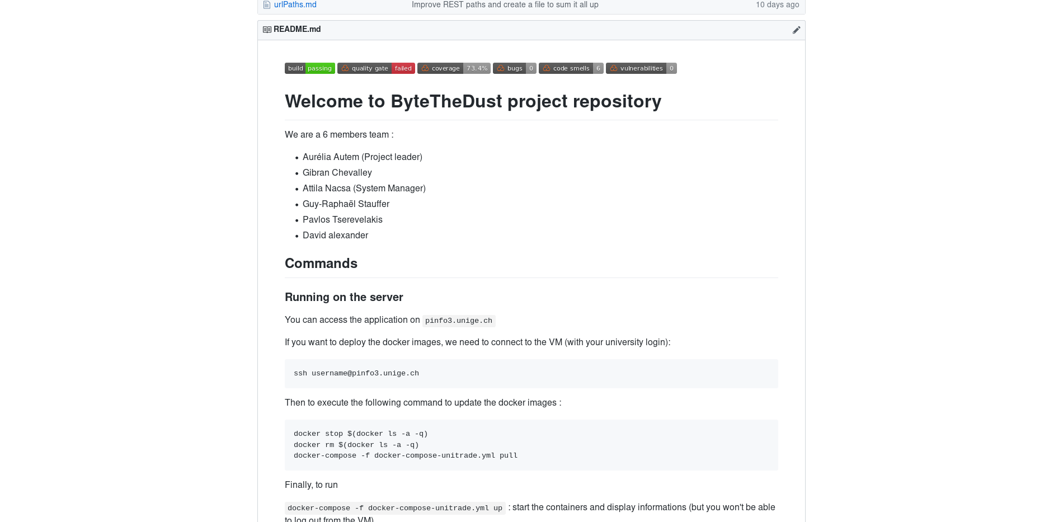
Github
Integration with the services:
List of members:
Short documentation:
The current frontpage

Slide 4
TravisCI
Used for compiling all parts of the project (microservices, frontend et.c)
Basic testing of code (whether it compiles or not)
Deployment to server is done through dockerhub:
- when the project successfully compiles, the generated images get pushed to dockerhub
The passing build is indicated on the github page, as previously mentioned

Slide 5
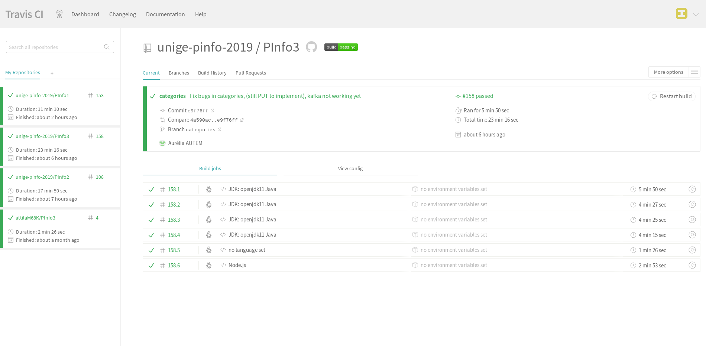
TravisCI
The main TravisCI page of the project showing a passing build

Slide 6
TravisCI – Automatic Deployment
Under work

