Slide 1

COUCHPOTATO

Slide 2
Talking points
Team Timeline - P Sprints - P Architecture - P (?) Technologies - F (?) API - overview Room service - T Recommendation service - C | Devops - config - F User-management Auth - N User-data - A Testing - A (?) Frontend - overview - N Product showcase - N (?)

Slide 3
1
THE TEAM

Slide 4

Petter
Faysal
Azeem
Christina
Antonin
Nicolas
Project Manager
Dev Ops
Backend
Backend
Backend / Frontend (lite)
Backend (lite) / Frontend

Slide 5
1I
TIMELINE

Slide 6
24 March
08 April
28 April - Delayed
13 May
18 May
11 June
S1
S2
S3
S4
S5
END
Deployment
Web UI redesign
Room service
Conception
Infrastructure
API design
Backend init.
API requests
K8s
Testing
Auth
Finalization
Project initial setup
Mock UI
Travis & Docker
Lots of debugging w/ Thorntail → takeaway: Don’t use deprecated stuff.
Mock API for UserManagement service
TMDB integration
Get movies by genre.
K8s initial setup
K8s & ingress working
Frontend routing
Room & recommendation services working
Sonarcloud setup, initial tests
Frontend final integration
OAuth2 proxy setup w/ auth0
auth0 mgmt. API replaces UserMgmt service.
More tests

Slide 7
I1I
SPRINTS

Slide 8
Sprint 1
Start: Wed 24.03
End: Wed 07.04
Way off on initial estimate (got < 30% of expected work done).
What we did well :
Conception of app
Setting up infrastructure, especially on the frontend.
A lot of effort spent on learning DevOps and setting up project.
Good effort spent in setting up MongoDB.
What we didn’t do too well:
With hindsight, members in idle roles could have spent time in a more proactive way, for example learning java-rest api for the backend in anticipation of next sprint.
Meetings not consistent enough
Scrum poker was very messy

Slide 9
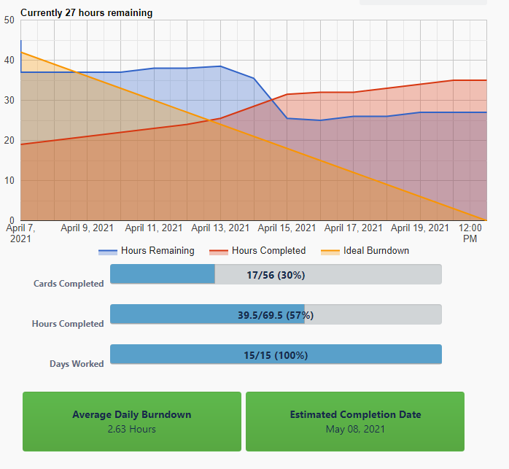
Sprint 2
Burndown
Start: Wed 07.04
End: Wed 28.04 (delayed 1 week)
Progress:
Switched from Mongo to Postgre
Backend running
Login page setup
Initial requests conceptualized for API, need to implement them
Set up Travis and docker for deployment
Problems:
Bottleneck: Frontend waiting on running backend
Took 2 weeks to solve backend problem.
was linked to versioning of old code w/ Thorntail & others

Slide 10
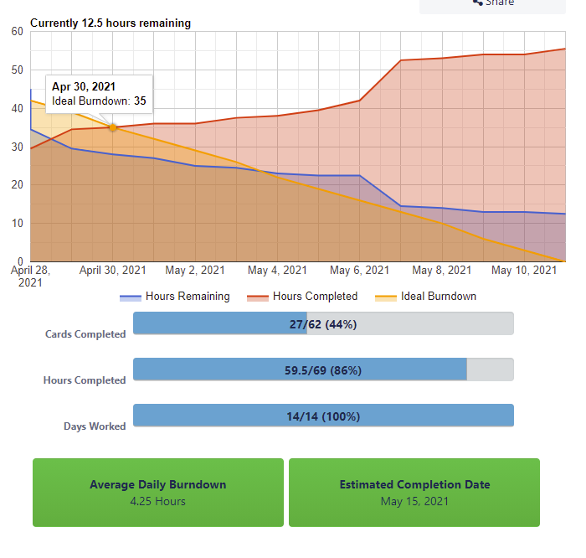
Sprint 3
Burndown
Start: Wed 28.04
End: Wed 12.05
2nd Checkpoint Friday 07.05
Progress:
API requests
Started integrating TMDB API
Get movie recommendations (front & back)
Started designing room
Initial setup of Kubernetes

Slide 11
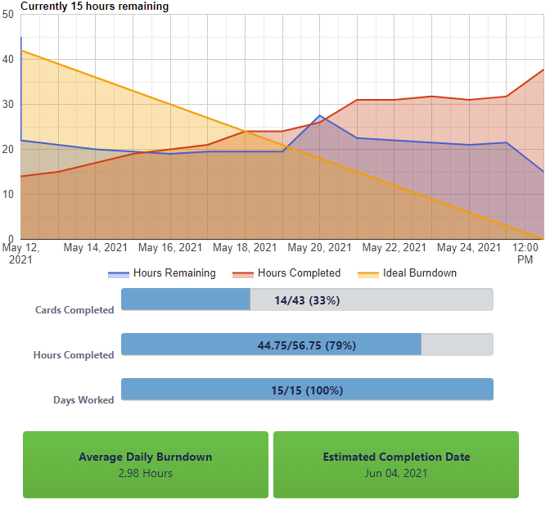
Sprint 4
Burndown
Start: Wed 13.05
End: Wed 27.05
Progress:
Got working recommendation service
Implemented Room service
Kubernetes setup and working
Ingress working
Had issues w/ metallb and others…
Web-ui redesigned
Frontend routing done

Slide 12
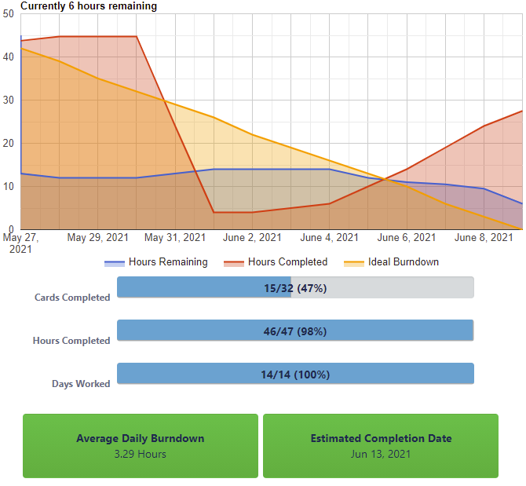
Sprint 5
-
Finalization
Burndown
Start: Wed 28.05
End: Fri.11.06
Progress:
Front & Back deployed
OAuth2-proxy integrated
auth0 user-management API setup
Web-UI revamped
SonarCloud & tests fixed
Main PR complete
Got initial SonarCloud report
API testing:
SonarCloud issues, required live testing
Hot fixes:
Additional tests
Serialization issue fixed

Slide 13
IV
ARCHITECTURE

Slide 14
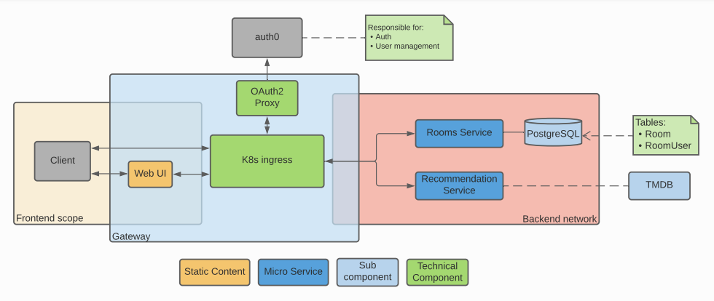

Slide 15
V
TECHNOLOGIES

Slide 16
Frontend
Backend
Npm 6.14
Angular 11
VS Code
SonarCloud/Qube
Open JDK 11
Maven 3.6.3
IntelliJ IDEA
PostgreSQL 10
SonarCloud/Qube
DevOps
Server
Travis CI
Microk8s
Helm 3
OAuth2
Ubuntu 20.04

Slide 17
VI
API - OVERVIEW

Slide 18
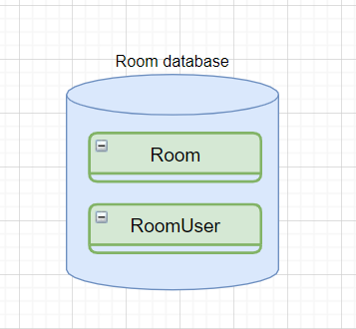
i. Room Service
2 tables
Manage rooms (CRUD)
Allow users to join, get movies, vote and get selected movie

Slide 19
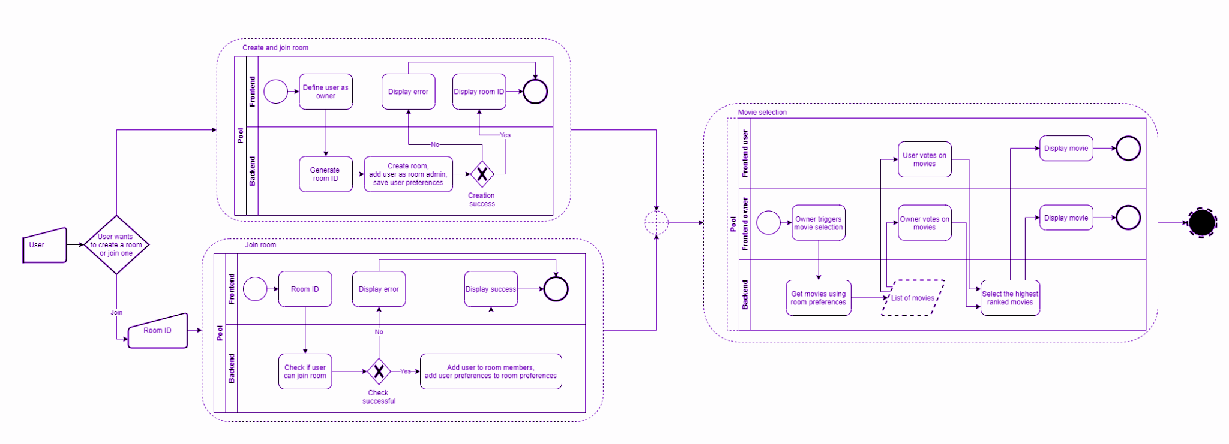
Main flow

Slide 20
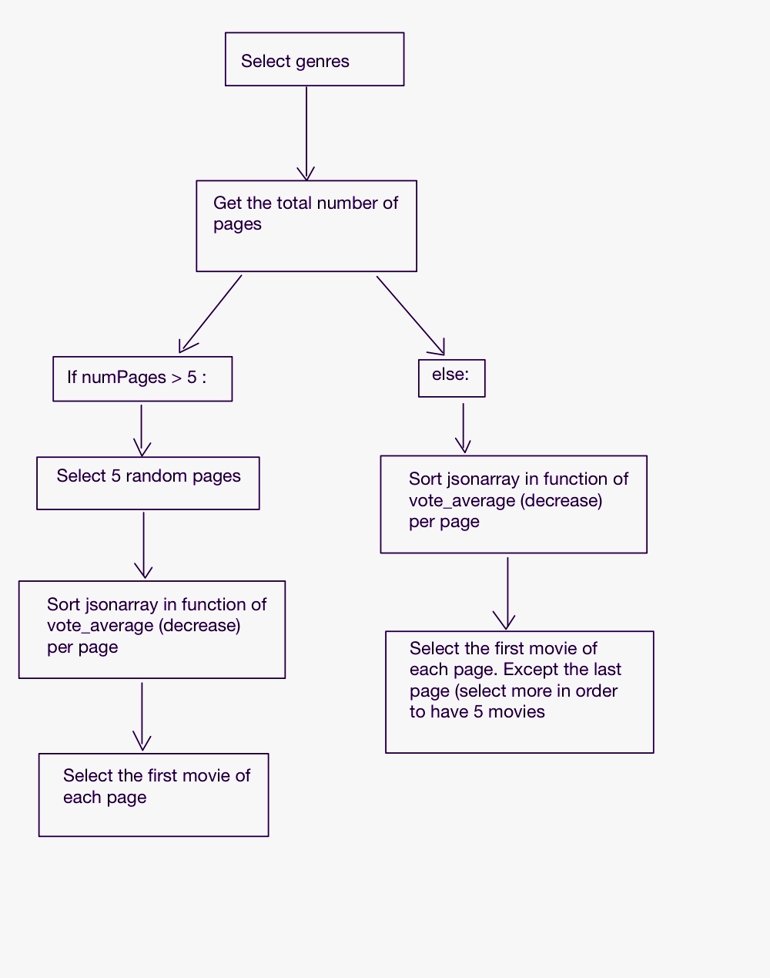
ii. Recommendation Service
TMBD API -> we want to select movies in function of genres and vote_average.
We want the selection of movies to be non-deterministic..

Slide 21
VII
DevOps CONFIG

Slide 22
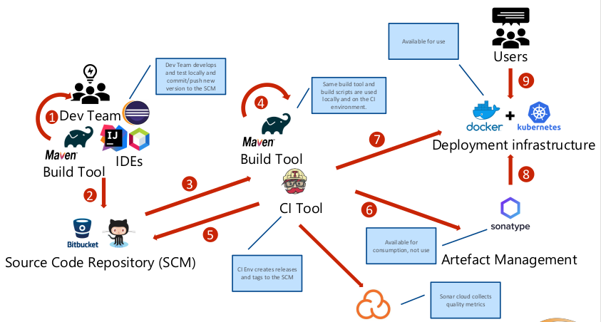
(Source: lecture)

Slide 23
VIII
USER-MANAGEMENT

Slide 24
Auth0
SERVICES
Auth0
User-Data
OAuth 2.0 - Authorization
Auth0 Management API usage
KISS - no need for 3rd microservice
RATE LIMITING

Slide 25
IX
TESTING

Slide 26
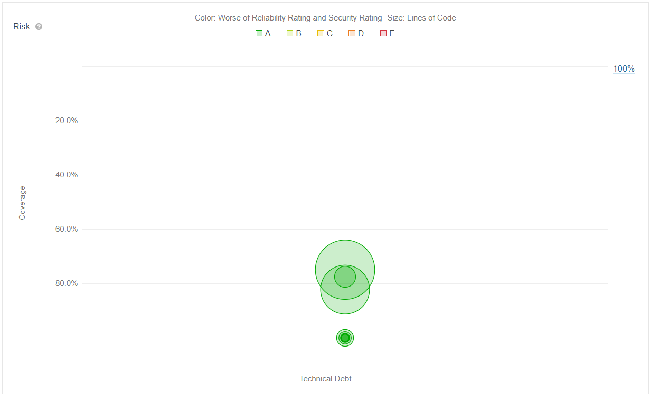
SonarCloud Analysis
Full coverage on API requests

Slide 27
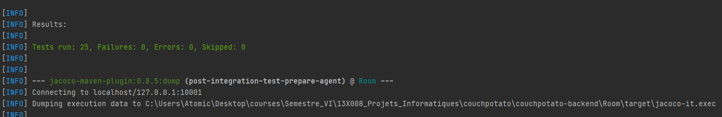
Unit Tests
Full coverage on API requests

Slide 28
X
FRONTEND - OVERVIEW

Slide 29
Visuals
Service-based approach
Absence of Testing
Ergonomic
Post-neon flair
Responsive
Auth0 Module
Authentication
API Gateway
Room Management
Service based approach means non-trivial injection approach necessary to test.

Slide 30
XI
PRODUCT SHOWCASE

Slide 31
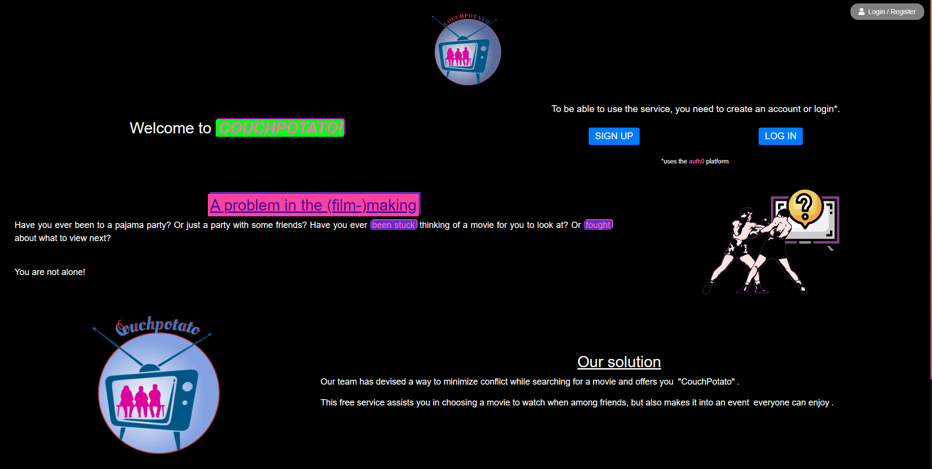
Access it on your desktop...
https://pinfo2.unige.ch/

Slide 32
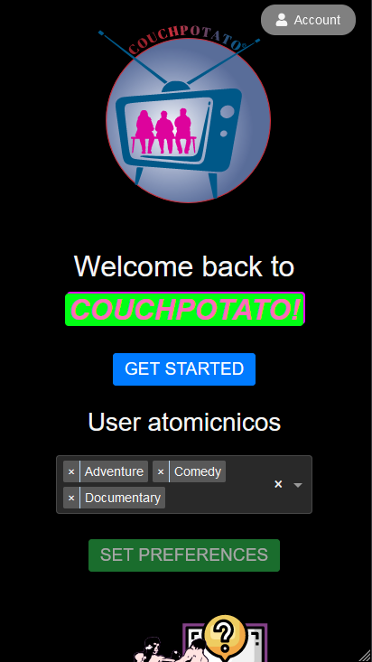
...or from your pocket!
https://pinfo2.unige.ch/

Slide 33
Questions?
More resources:
API Specification
Github
Process view
SonarCloud
THANKS!

Slide 34
CREDITS
Petter
Faysal
Nicolas
Antonin
Christina
Azeem
Assistants for the numerous questions answered
Professor for all the help and debugging at midnight

