Slide 1
Joomla-Content
Unioffices

Slide 2
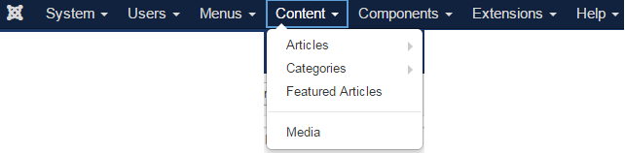
We will discuss the Content of Joomla in this slides.
Content has Articles, Categories, Featured Articles, Media.

Slide 3
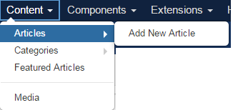
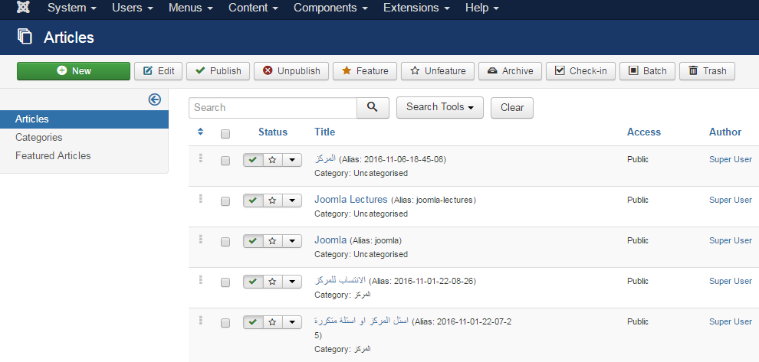
Article
In Article, you can create the standard pages that consist of images, text and hyperlinks.
Article has
Press on the Articles
Then a new window will appears for you

Slide 4
New: Create a new article.
Edit: Edit any specific article.
Publish: Publish the article to website.
Unpublish: Unpublish the article to website.
Featured: Selected article is featured. Multiple articles can also be featured.
Archive: It can change the status of the articles to published or unpublished by selecting archived in the select status filter.
Check In: Check-in the selected article. Multiple articles can be checked-in.
Trash: Delete the selected article permanently.
Batch: Selected articles are processed by batch.
Help: Help button is used to open the help screen.
Option: It opens the setting window where you can change the setting of the articles.

Slide 5
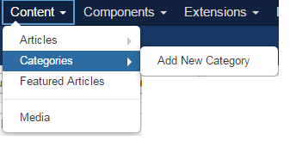
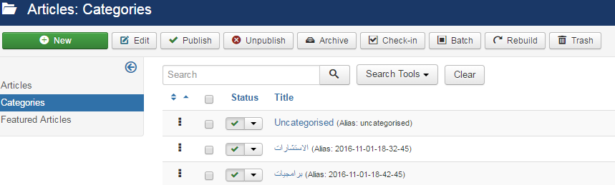
Categories
It manages to create categorize the articles which allows to group your content better. You can categories your Articles with a categories name for farther process.

Slide 6
New: It creates a new user.
Edit: It edits the selected user.
Activate: It activates multiple users.
Block: It blocks the selected user.
Unblock: It unblocks the selected users
Delete: It deletes the particular users.
Batch: Selected users are processed as a batch.
Help: Help button is used to open the help screen.
Option: It opens the setting window where you can change the setting of the articles.

Slide 7
References
https://www.tutorialspoint.com/joomla/joomla_tutorial.pdf

