Slide 1
Joomla -Menu
unioffices

Slide 2
Menu in Joomla
To make a menu you must have an article first, design your article then add it to the menu
First we will design and create a article
Second we will create a menu

Slide 3
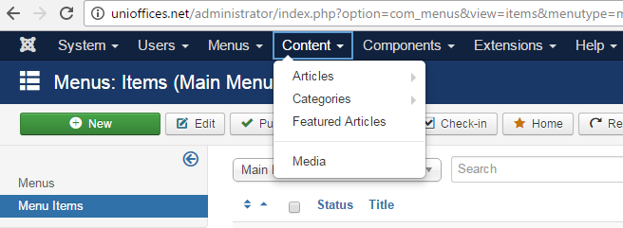
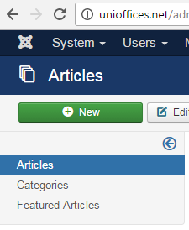
Write article about Joomla
To start an article at Joomla do the following
Go to Content->Articles
A list of action will appears ,
press the new bottom

Slide 4
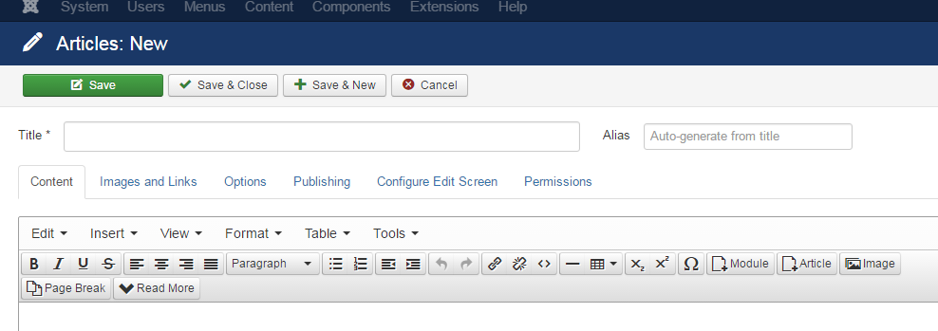
Write article about Joomla
Create an article about Joomla, write the name of the article, and design an article in the content.

Slide 5
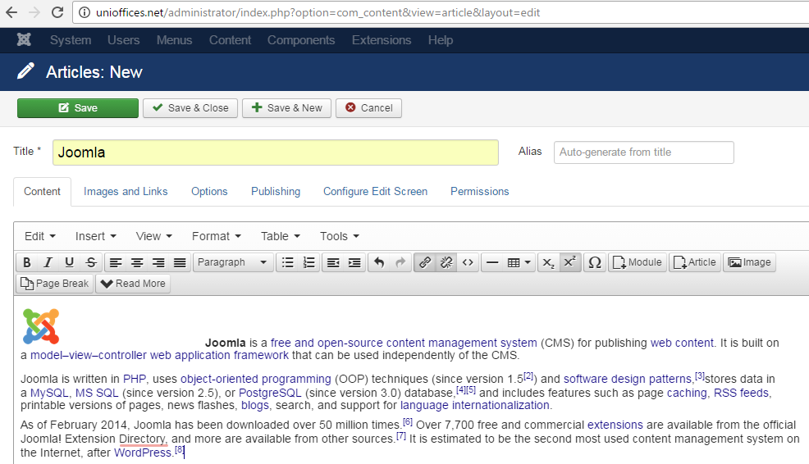
Write article about Joomla
After finishing your article save&close

Slide 6
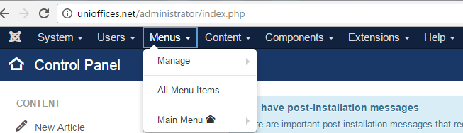
Create menu for Joomla
Open the account of your Joomla
Choose Main Menu if your templates has a menu.

Slide 7
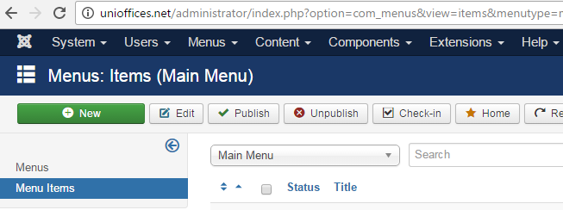
Create menu for Joomla
Add new item on your menu

Slide 8
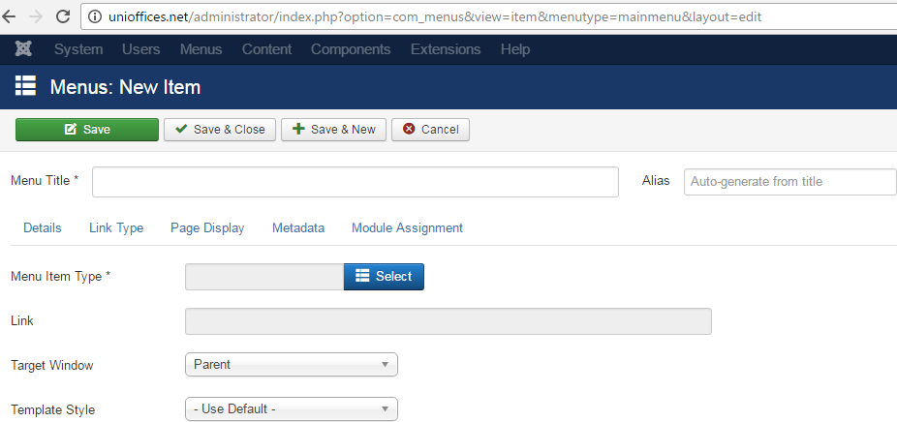
Create menu for Joomla
Insert your information
Write your item:Joomla
Select the type of the design, slide5
Choose your template name

Slide 9
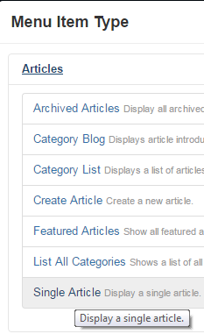
Create menu for Joomla
Select->Articles->Single Articles

Slide 10
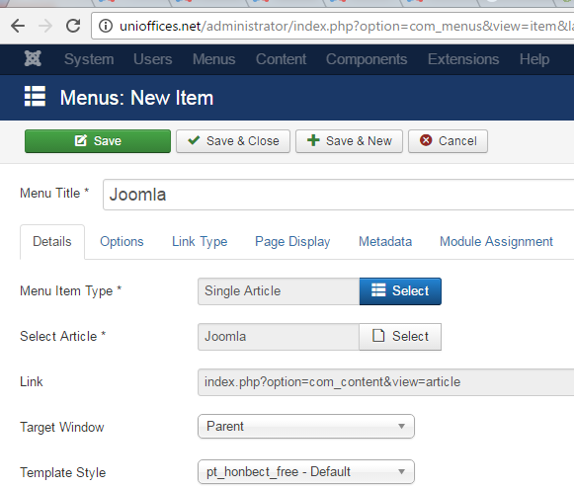
Create menu for Joomla
Select
article will
appears for
you

Slide 11
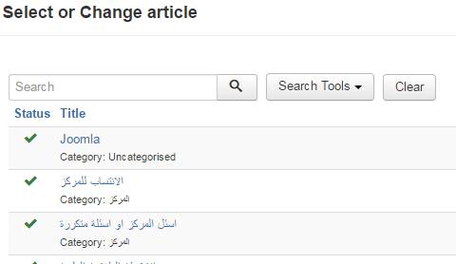
Create menu for Joomla
Select your article

Slide 12
Create menu for Joomla
Then you will finish , next save& close

Slide 13
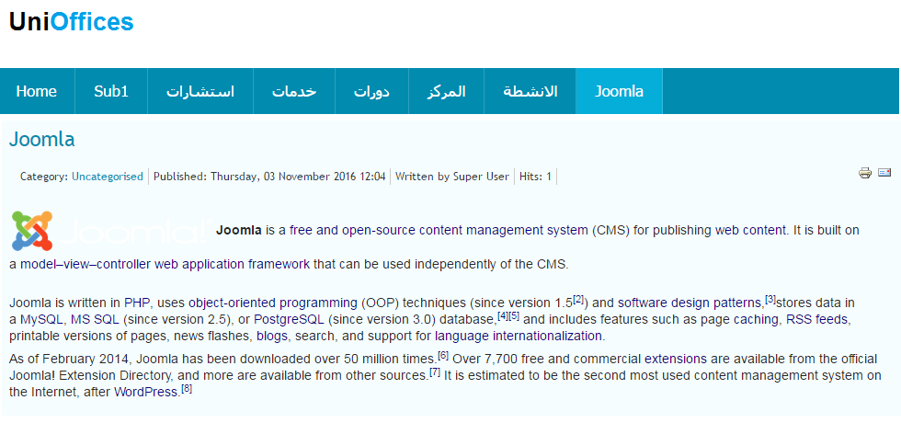
Final result
Joomla will appears on the menu bar, press it and your article of Joomla will appears at the web page.

Slide 14
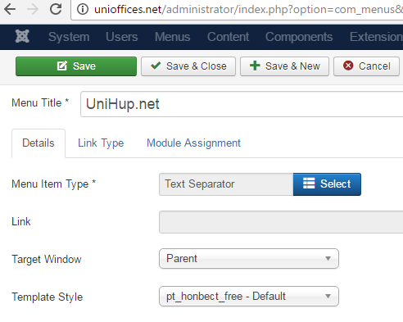
Item Type
Select the Menu Item Type.
Choose the system link.
Then Text separator.
Then Save & Close

Slide 15
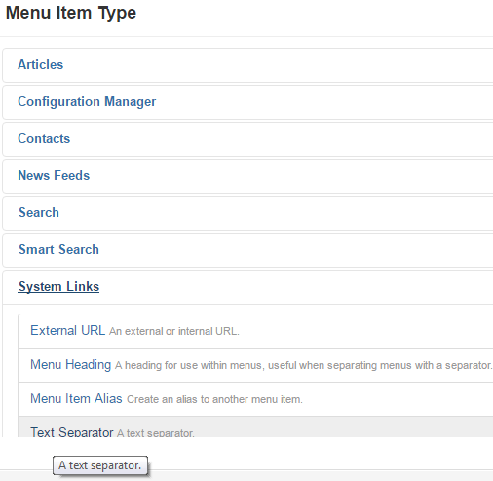
Drop list menu
You can have a drop list menu adding the type system links->text separator.

