Slide 1


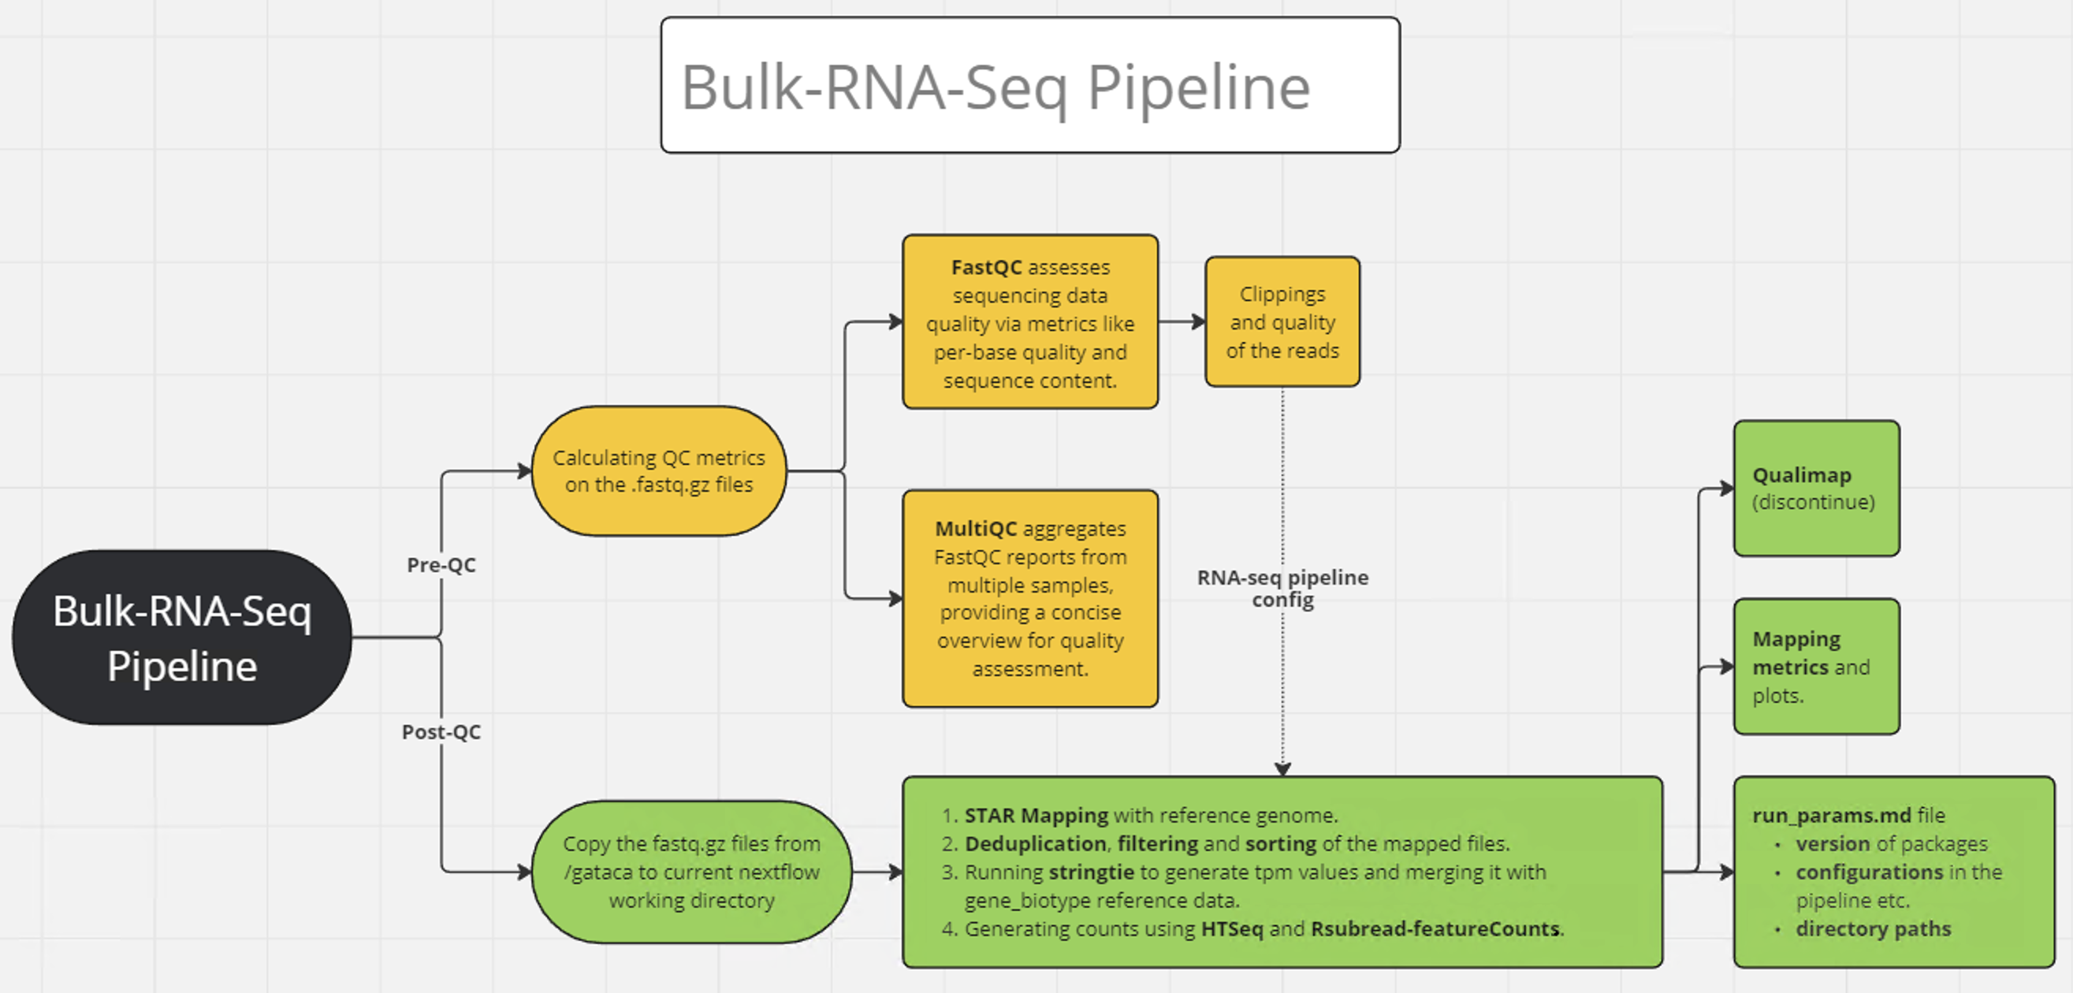
Automated Bulk-RNA-Sequencing Pipeline
using NextFlow and Docker…

Slide 2
Automated Bulk RNA-Seq Pipeline

Slide 3
About the pipeline…
Steps involved in the Bulk-RNA seq pipeline include: quality control, alignment, post-alignment processing, and counting.
The following packages are needed to run the pipeline: FastQC, MultiQC, STAR, Qualimap, Samtools, Bedtools, Sambamba, HTSeq, R, and Stringtie.
Using these packages, the pipeline is structured within a Nextflow script, generating outputs for mapping, filtering, and counting steps. These results can then be utilized to identify differentially expressed genes or processed through the TRAP/modified-TRAP pipeline.

Slide 4

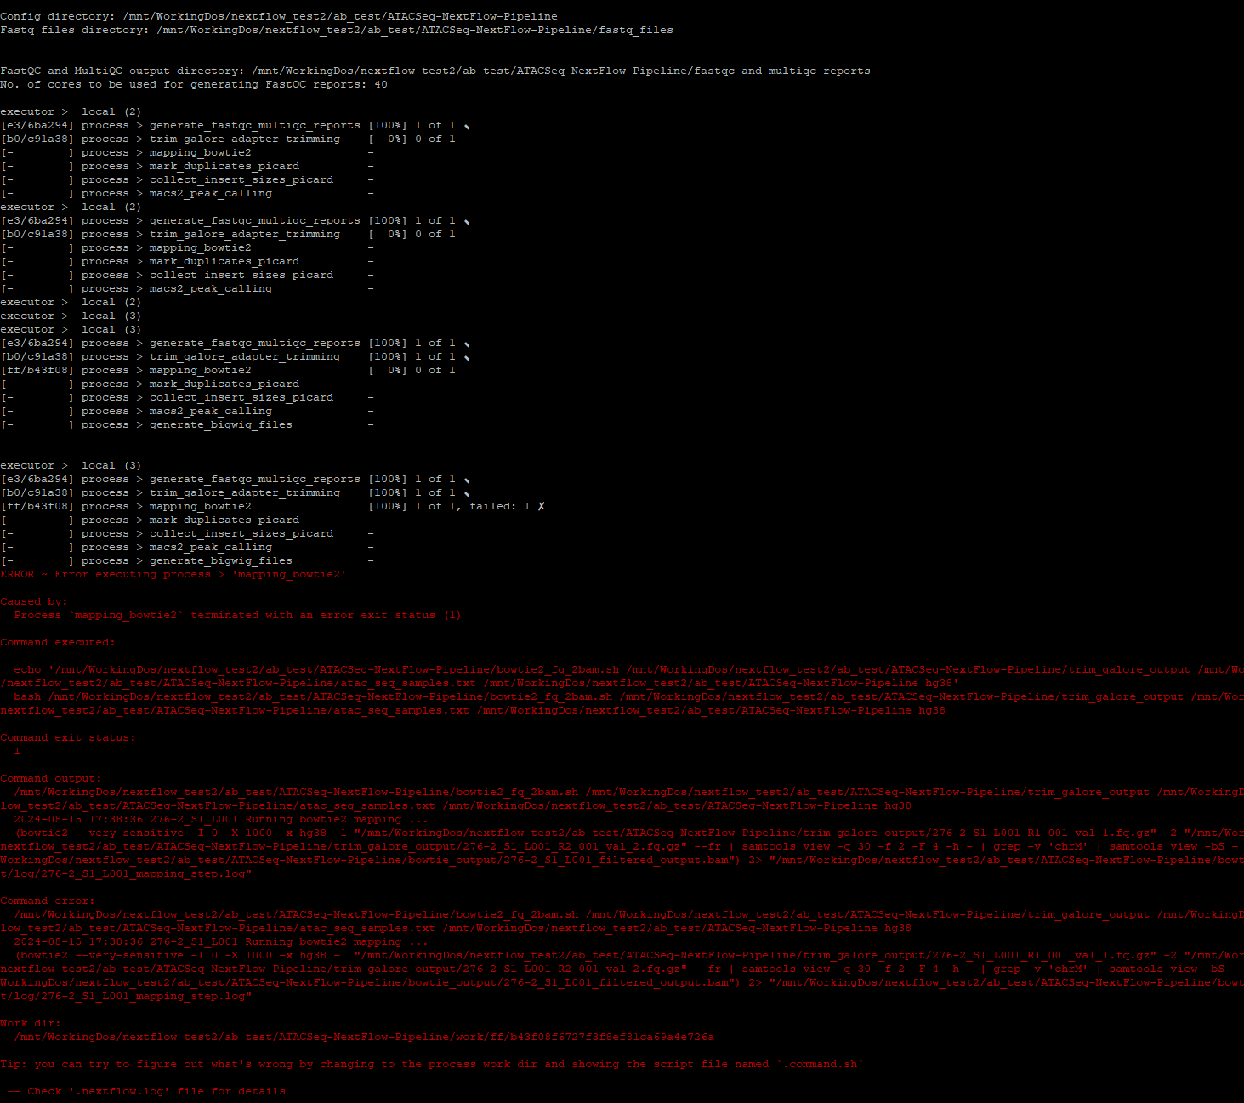
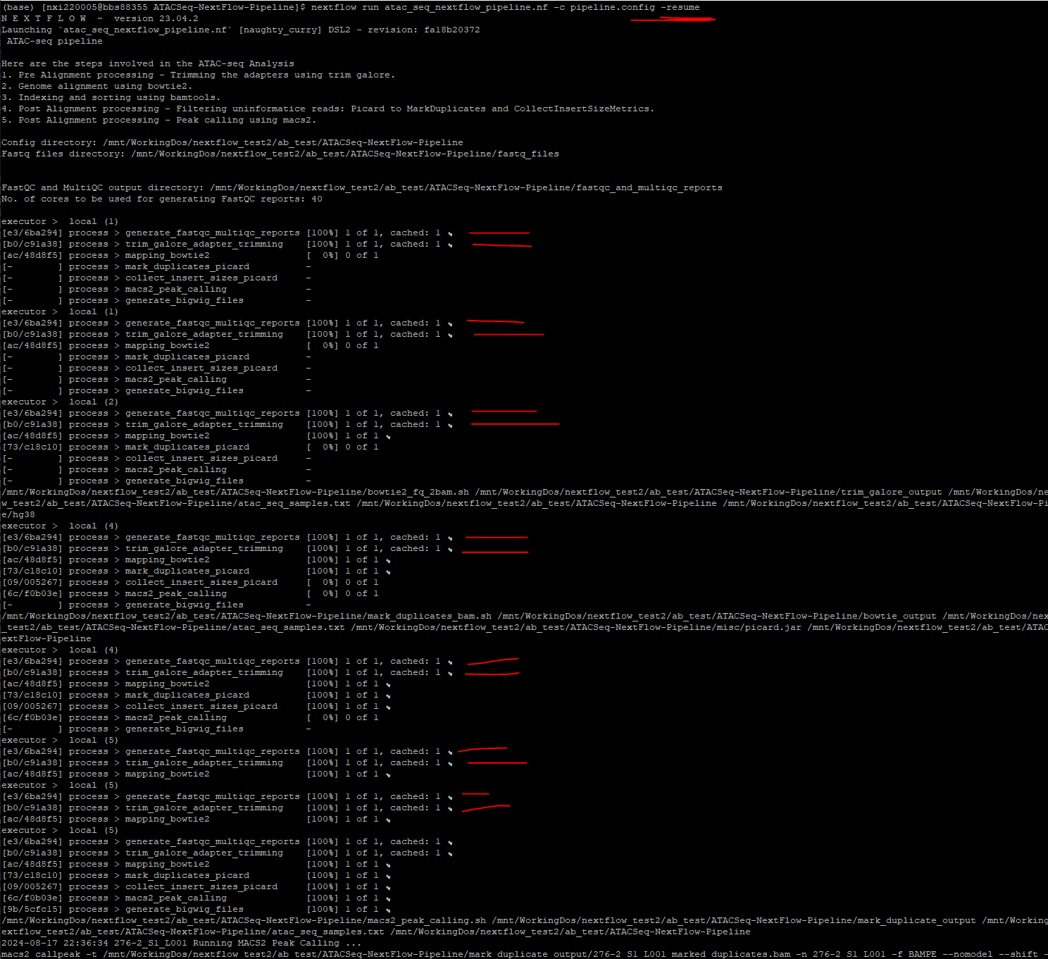
The Nextflow pipeline is comprehensive for error-handling, caching, dynamic parameter handling and packaging multiple resources.
Most importantly, Nextflow “-resume” caches each run and can resume from fail-points.

Slide 5
The Nextflow pipeline is comprehensive for error-handling, caching, dynamic parameter handling and packaging multiple resources.
Most importantly, Nextflow “-resume” caches each run and can resume from fail-points.

Slide 6
The Nextflow pipeline is comprehensive for error-handling, caching, dynamic parameter handling and packaging multiple resources.
Most importantly, Nextflow “-resume” caches each run and can resume from fail-points.

Slide 7

Docker is a platform that allows developers to automate the application deployment and management of applications within lightweight, portable containers.
Why use docker?
Containerization: Docker packages applications and their dependencies into containers, ensuring that they run consistently across different development environments.
Docker promotes portability, efficiency and isolation of environments.

Slide 8
Thank you!
Contributions, acknowledgments, or collaborations:
Dr. Tavares Ferreira, Diana
Dr. Mazhar, Khadijah

