Slide 1
Managing Your Research Data
Graduate School Training
23rd January 2013 (v.01)

Slide 2
Paul Stainthorp
Electronic Resources Librarian
http://staff.lincoln.ac.uk/pstainthorp
pstainthorp@lincoln.ac.uk
(01522) 88 6193
Orbital project: https://orbital.lincoln.ac.uk/
  “…develop, test and implement a state-
  of-the-art research data management infrastructure at the University of Lincoln, piloted with the School of Engineering”

Slide 3
What do we mean by research data?
“That which is collected, observed, or created in a digital form, for purposes of analysing to produce original research results.” (University of Edinburgh)
Irrespective of subject (i.e. not just the “hard sciences”)
Irrespective of collection method, form of research, or format:
  Textual, numerical, multimedia, structured (XML, databases), software code, proprietary software formats (University of So’ton)

Slide 4
Policies
Draft research data policy at the University of Lincoln: https://orbital.lincoln.ac.uk/rdm-policy
Research Councils UK “principles”: http://lncn.eu/bqz3
Research funders’ policies: http://lncn.eu/cz46
  Time limits on metadata (i.e. describing your data) and sharing / Open Access to your data
  Requirements to submit a data plan with your bid
  Long-term curation and storage (institutional)
Research data to be exempted from FoIA: http://lncn.eu/hi45

Slide 5
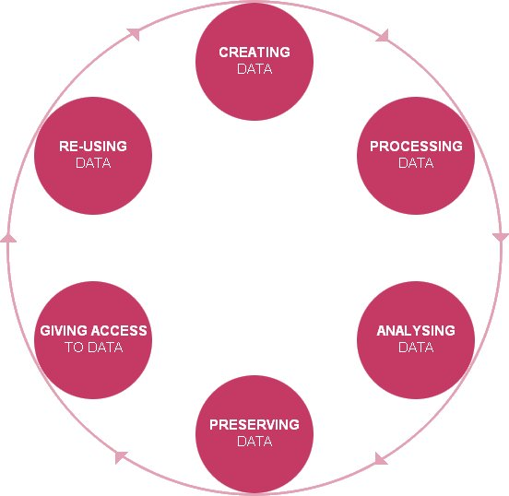

The research data lifecycle
Discovery
Planning
Creation
Storage
Reviewing
Description
Manipulation
Analysis
Sharing/publishing
Citation
Preservation
UK Data Archive © 2011 University of Essex

Slide 6
Data discovery tools
DataCite: http://datacite.org/
British Library: http://www.bl.uk/
Databib: http://databib.org/
Registry of Research Data Repositories: http://www.re3data.org/
UK Data Archive: http://data-archive.ac.uk/
Figshare: http://figshare.com/
Academic Subject Librarians: http://lncn.eu/gr27

Slide 7
Data Management Planning
DMP is required by all the major public research funders (possible exception of the EPSRC): http://lncn.eu/cz46
DMPOnline tool: http://lncn.eu/mryz
Data Asset Framework (DAF survey): http://lncn.eu/efj8

Slide 8
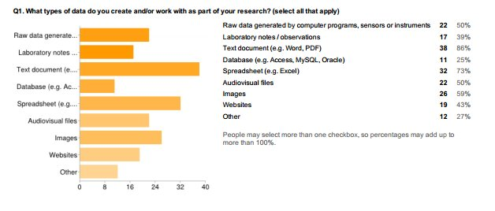
DAF survey 1
Source: Data Asset Framework survey, University of Lincoln, April 2012: http://lncn.eu/rs2

Slide 9
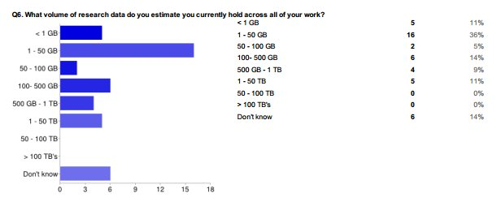
DAF survey 2
Source: Data Asset Framework survey, University of Lincoln, April 2012: http://lncn.eu/rs2

Slide 10
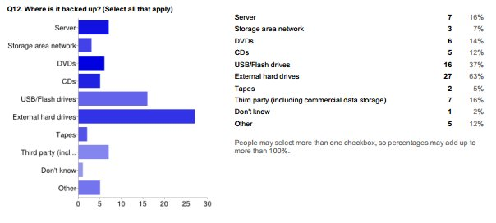
DAF survey 3
Source: Data Asset Framework survey, University of Lincoln, April 2012: http://lncn.eu/rs2

Slide 11
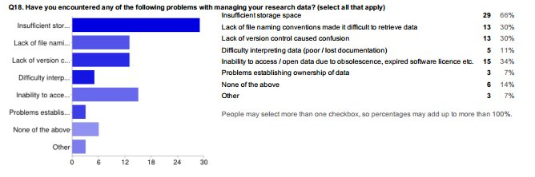
DAF survey 4
Source: Data Asset Framework survey, University of Lincoln, April 2012: http://lncn.eu/rs2

Slide 12
Practical tools for working with data
http://orbital.lincoln.ac.uk/researchtools
Collaborative, versioned document tools (Wikis, Git, Subversion, Google Docs, http://blogs.lincoln.ac.uk)
File storage and backup - H:\, I:\, Dropbox, Google Drive, external hard drives, USB sticks (danger!)
File management and naming conventions
  Good: experiment1_results_20130122_v001_raw.xls
  Not so good: results1newUSETHISONE.xls
What data should I keep? http://lncn.eu/aem5
CKAN: http://ckan.lincoln.ac.uk/
The Lincoln Repository: http://eprints.lincoln.ac.uk/

Slide 13
Data publishing and citation
Complex requirements of the major public research funders (covering publications, metadata about your data, and the data itself): http://lncn.eu/cz46
Benefits to sharing/publishing
  Supports research integrity and verification
  Discovery and collaboration, new uses
  Increased citations and evidence of impact
Data citation; identifiers: http://lncn.eu/ds37
CKAN / the Lincoln Repository

Slide 14
Where to go for help
Orbital project
  http://orbital.lincoln.ac.uk/contact
Library
  Finding data and publications, citation, preservation and curation of data
ICT Services
  File storage, backing up, software formats
Research Office
  IP, funding opportunities, bid writing, guidance
Graduate School
  Support with your degree, facilities

Slide 15
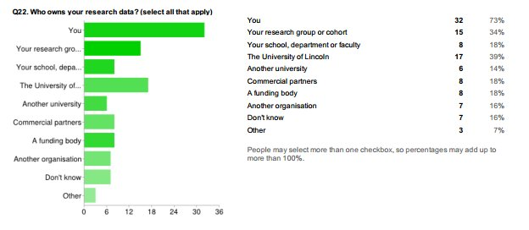
Final thought: who owns your research data?
Source: Data Asset Framework survey, University of Lincoln, April 2012: http://lncn.eu/rs2

