Slide 1


Python and MySQL
Dave Dalsveen

Slide 2
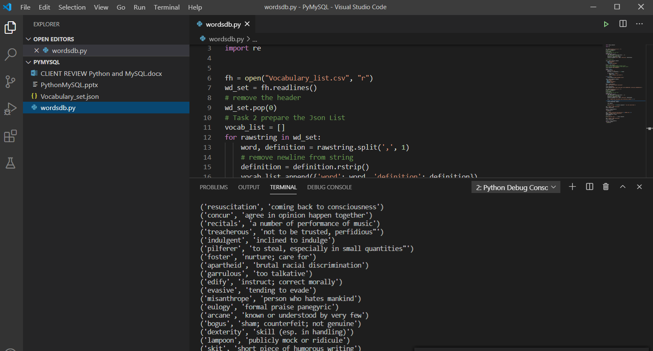
Visual Studio Code
The main Visual Studio Icons we are using are:
Explorer
Run->run without debugging
Code editor Window
Debugging Controls
Status Bar (run tests)

Slide 3
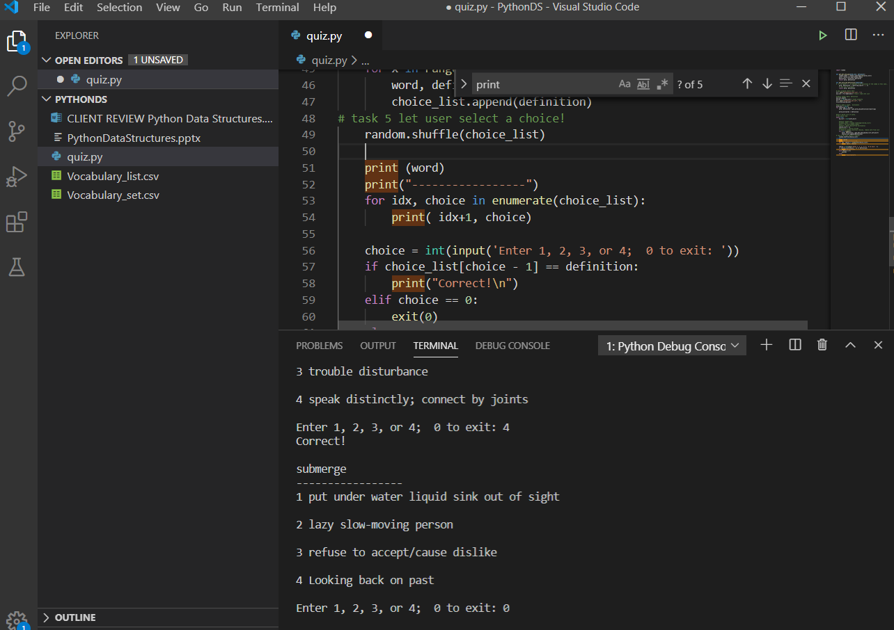
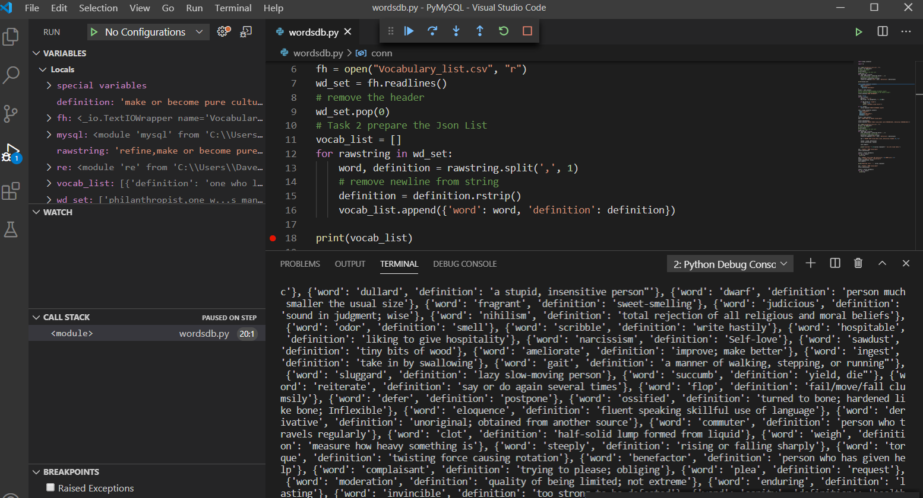
Task1: Prepare the File Data for MySQL
Read from a file into a list.
List is used eventually to insert into the Vocab Database Table.
Read data from comma separated file
Save it in the List as word, definition pairs: { 'cryptic', 'secret with a hidden meaning' }

Slide 4
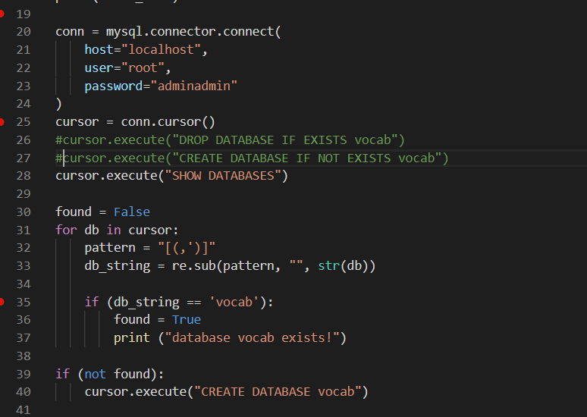
Task2: Create the MySQL Database
Create connection to MySQL
Name the database.
Check the database for existence.
If no database exists, create one.

Slide 5
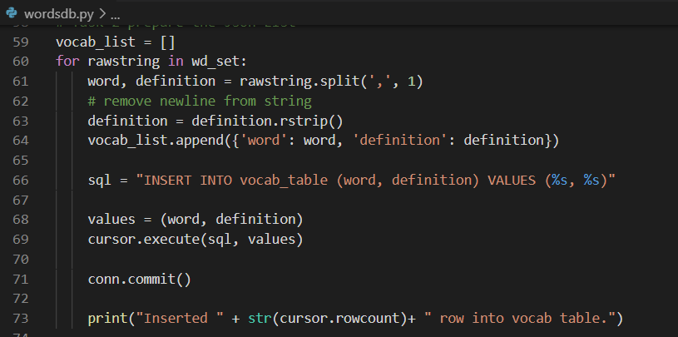
Task3: Populate the Database Table using Insert
CREATE the database table vocab_table.
Iterate through the file using previous code.
Use INSERT to insert word, definition pairs.
Commit the insert..
Check the rows affected.

Slide 6
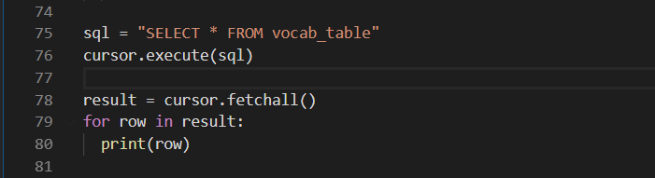
Task4: Query the Database Table using Select Statement
Use the SELECT to retrieve all rows from the vocab_table Table
Use the cursor object to execute the SELECT.
Process the result and print each row.
Use SELECT to retrieve a single entry from the voac_table Table.

Slide 7
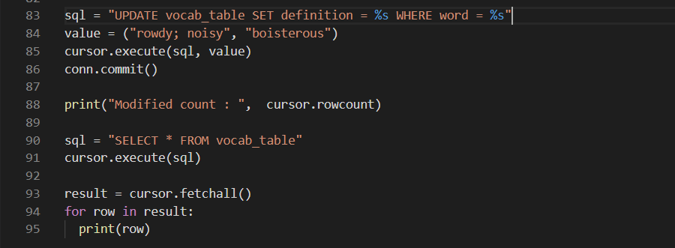
Task5: Update a Table Entry to Modify it.
Update a single document in the vocab_table.
Print the modified count.
Print the updated row.

