Slide 1








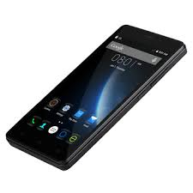
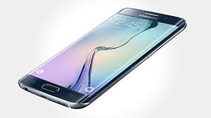



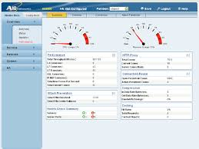
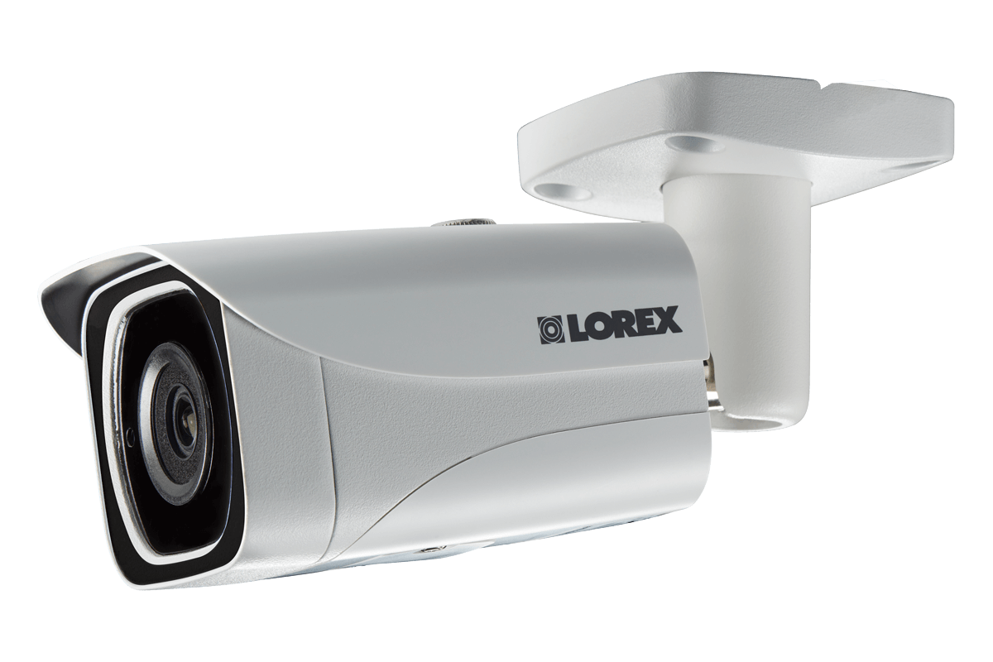


Amazon ReKognition
IOT Sensor
AWS IOT
Detects Object (e.g., Person) in Frames
IOT Sensor
Email
If HUMAN, compare with Collection of Persons of Interest
Sends SMS alert based on HUMAN Watch List
Amazon Kinesis Stream
SMS
Triggers Lambda Function to Capture Frame
Lambda Function
Frame Processor
Amazon SNS
Sample, Package and send Video
Frame to Amazon Kinesis
Stores Video Frame Image
Persists Image Metadata
View Video Frames (Images and Metadata)
Sends LIVE Video Stream
Amazon S3
Amazon Dynamo DB
Lambda Function
Frame Fetcher
Amazon API Gateway
Video Capture Client
Serverless – Real Time Video Frame Analysis and Alerting System
By Upender K. Nimbekar

Slide 2





Kinesis Consumer
Image-rekog-bucket
s3-image-getter
Kinesis Video Stream
Sends LIVE Video Stream
Kinesis Consumer
Kinesis Consumer
Kinesis Data Stream
MKV Single Frame
Triggers Lambda
To Capture Frame
Send Movie to Kinesis
Kinesis Producer
Frame-Processor
Amazon Image Rekognition
S3 Input Video File
S3 Video Frame Analysis and Alerting System
By Upender K. Nimbekar
Notes:
java -Dstream.name="my-mkv-stream" -Ds3.bucket="sage-media-bucket" -Ds3.key="demo/mkv/clusters.mkv" -jar jars/kinesisVideoProducer.jar

Slide 3
Producer:
java -Dstream.name="my-mkv-stream" -Ds3.bucket="sage-media-bucket" -Ds3.key="demo/mkv/clusters.mkv" -jar jars/kinesisVideoProducer.jar
Consumer:
java -Dstream.name="my-mkv-stream" -jar jars/kinesisVideoConsumerToS3Sender.jar

Slide 4
Alerting when a Person of Interest appears in a LIVE feed
A camera surveils a particular area, streaming video to a video capture client.
Video could streamed either locally or over the network to video capture client.
Video capture client samples video frames at a desired sampling rate, and sends them to AWS services, where they are analyzed and stored with meta-data.
If Amazon Rekognition detects a certain object—in this case, a human - in the analyzed video frames, detected HUMAN is compared with a collection of Persons of Interests (POI). If found, an AWS Lambda function sends an Amazon Simple Message Service (Amazon SMS) alert.
After you receive an SMS alert and / or Email, you will likely want to know what caused it. For that, the prototype displays sampled video frames with low latency in a web-based user interface.

Slide 5
Digital camera shoots video in MPEG format
If connected Locally, camera streams directly to Video Capture Client.
LAN connected Camera exposes a local URL (say http://192.68.0.23/video)
Video Capture Client, Ubutu Workstation in this case, connects to MPEG stream and receives .jpeg encoded frames.
Stream receiving Python script on client PC accepts two parameters: Livestream URL (none if local camera) and Sampling Rate. Default rate is 1 in 30 frames.
Sample a frame off of a live video stream

Slide 6
Video Capture Client samples and packages JPEG bytes into an Object
Adds attributes like time the frame was captured.
Serialized into Kinesis Stream.
AWS Kinesis makes it very easy to collect, process and analyze real-time streaming data. It is fully managed AWS service and can can scale unlimitedly.
Amazon Kinesis Stream
Package and send Video
Frame to Amazon Kinesis

Slide 7
Amazon Kinesis triggers Lambda fn. to fetch one or more video frames from the stream
Amazon Kinesis Stream
Trigger Lambda Function to Capture Frame
Lambda Function
Frame Processor

Slide 8
Image processor detects Object in Frame. It can detect Object, scene and faces, recognize celebrities etc.
Image Processor function is configured to detect ONLY HUMAN faces for this use case.
Confidence score ranges between 0 and 1.0. Could be adjusted.
Amazon ReKognition
Detects Object (e.g., Person) in Frames
Image Processor, Lambda Function
Stores Sampled Image
Stores Image URI and other Meta Data
Amazon S3
Amazon Dynamo DB

Slide 9
Detects any object on the watch list. For this use case ONLY HUMANS are considered.
Watch list – Configurable list of labels of interests, minimum threshold and Phone number of SMS recipient.
Alerts only when HUMAN is detected. Not for ANY object.
Iterates over all the label returned by Rekognition.
Email
If HUMAN, compare with Collection of Persons of Interest
Sends SMS alert based on HUMAN Watch List
SMS
Lambda Function
Frame Processor
Amazon SNS

Slide 10
Image Processor stores captured image into S3.
Persists metadata associated with the video frame in DynamoDB.
Enriched Frame – Stores metadata attributes which include:
Unique Frame ID
S3 bucket and key
Approximate Time the frame was stored.
Set of Labels and confidence level output by Amazon Rekognition.
Lambda Function
Frame Processor
Amazon S3
Amazon Dynamo DB

Slide 11
CREATE_COMPLETE AWS::CloudFormation::Stack video-analyzer-stack
CREATE_COMPLETE AWS::DynamoDB::Table EnrichedFrameTable
CREATE_COMPLETE AWS::Lambda::EventSourceMapping EventSourceMapping
CREATE_COMPLETE AWS::Lambda::Permission LambdaInvokePermissionGET
CREATE_COMPLETE AWS::Lambda::Permission LambdaInvokePermissionSTAR
CREATE_COMPLETE AWS::ApiGateway::UsagePlanKey DevUsagePlanKey
CREATE_COMPLETE AWS::ApiGateway::UsagePlan DevUsagePlan
CREATE_COMPLETE AWS::Lambda::Function ImageProcessorLambda
CREATE_COMPLETE AWS::ApiGateway::Stage DevStage
CREATE_COMPLETE AWS::ApiGateway::ApiKey VidAnalyzerApiKey
CREATE_COMPLETE AWS::Kinesis::Stream FrameStream
CREATE_COMPLETE AWS::ApiGateway::Deployment VidAnalyzerApiDeployment
CREATE_COMPLETE AWS::ApiGateway::Method EnrichedFrameResourceGET
CREATE_COMPLETE AWS::ApiGateway::Method EnrichedFrameResourceOPTIONS
CREATE_COMPLETE AWS::ApiGateway::Resource EnrichedFrameResource
CREATE_COMPLETE AWS::S3::Bucket FrameS3Bucket
CREATE_COMPLETE AWS::ApiGateway::RestApi VidAnalyzerRestApi
CREATE_COMPLETE AWS::Lambda::Function FrameFetcherLambda
CREATE_COMPLETE AWS::IAM::Role ImageProcessorLambdaExecutionRole
CREATE_COMPLETE AWS::IAM::Role FrameFetcherLambdaExecutionRole

Slide 12
UI to View the Incoming Video Frames and their metadata.
UI invokes Lambda fn. “Frame fetcher” periodically.
Frame Fetcher queries DynamoDB and returns the most recent list of enriched frame metadata
Frame Fetcher also generates short lived S3 presigned URL for every frame to include it in every response to Web UI.
Amazon API Gateway exposes Frame Fetcher Fn via a Restful API.
Lambda Function
Frame Fetcher
Amazon API Gateway

