Slide 1
RAMP Inundation sub project
Where are we up to?
Fundamental Components of the Model
The Tsunami Project
Future Plans
Data issues (Duncan)
Preliminary results (Duncan)

Slide 2
Developments since June 2003
Finite Volume Hydrodynamic model evolving
Name change from Storm Surge to Inundation
Pyvolution can accommodate 900,000+ elements
Smoothing capability
Wind fields
Tidal (or any ocean) boundary from file
Cartographic capabilities (UTM, lat-lon)
Polygons and tagged regions
Compiles and runs on ‘cyclone’

Slide 3
Demo

Slide 4
Future
Parallelisation (ANU)
Applications
  Tsunami(GA, ANU)
  Gippsland (GA, CSIRO)

Slide 5
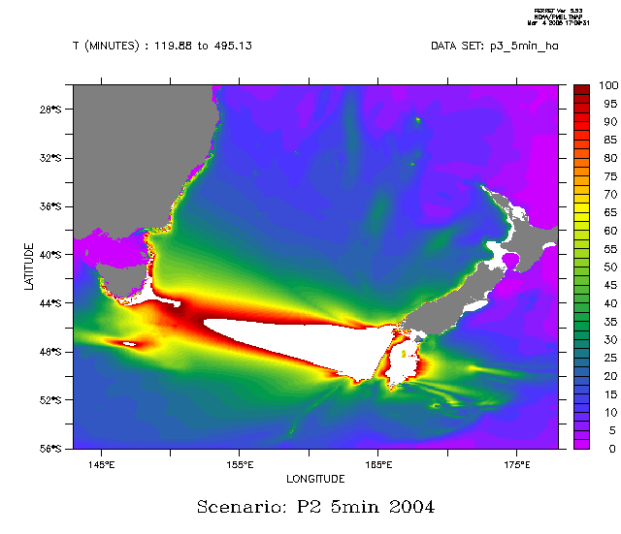

Slide 6
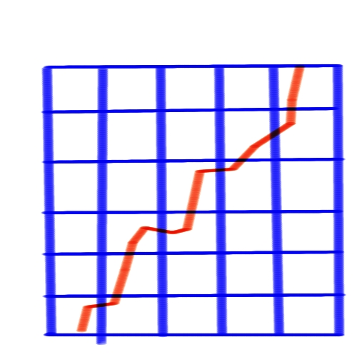
Interpolation in space and time

Slide 7
Data Flow Diagram
MOST
DEM
100m
10m
Mesh outline
MOST2boundary
least squares
pmesh
pyvolution
Inundation w.r.t. time and space

Slide 8
Domain information
36 km North, 28 km West.
Currently using 117,175 triangles
Three maximum triangle area resolutions –
  5,000 m² (70 m triangle sides)
  10,000 m²
  100,000 m²
One boundary condition

Slide 9
Testing
Unit tests avoids debugging large simulations
Diagnostics added
  Boundary max and min stage and momentum
    During initialisation
    While running
  Hard to ‘see’ 40 cm high tsunami

Slide 10
Results
Tsunami * 1000
Tsunami

