Slide 1

Origins of the
Linux
Operating System
Why?
What?
When?

Slide 2
The beginnings (UNIX)
1965 (Bell Labs): MULTICS (Multiplexed Information and Computing Service).
1969 (AT&T): Rewrite by Ken Thompson and Dennis Ritchie to run on smaller machines (PDP7, 4K RAM!). Named it UNICS as a joke.
1971 (11 March!): First version of UNIX released (incl commands used today).

Slide 3

Thompson and Ritchie

Slide 4
UNIX proliferation
1979: SCO founded as Unix porting and consulting company
1983: The GNU project announced by Richard Stallman: “GNU's Not Unix” - Unix was becoming proprietary software – Need for freedom to evolve.
IBM, SUN, SGI, AT&T, CRAY, HP, Fujitsu, ...

Slide 5
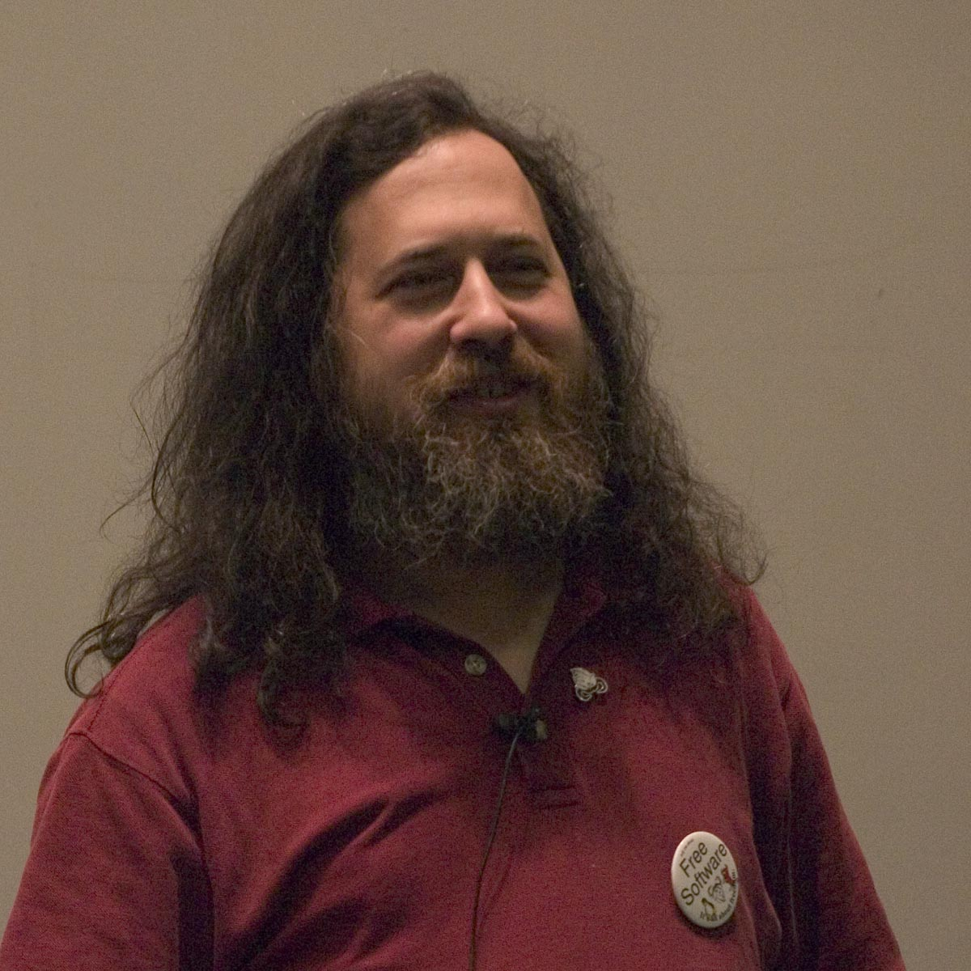
Richard Stallman

Slide 6
Linux
1991: First post by Linus Torvalds
From: torvalds@klaava.Helsinki.FI (Linus Benedict Torvalds)
Newsgroups: comp.os.minix
Subject: What would you like to see most in minix?
Summary: small poll for my new operating system
Date: 25 Aug 91 20:57:08 GMT
Organization: University of Helsinki
Hello everybody out there using minix -
I'm doing a (free) operating system (just a hobby, won't be big and
professional like gnu) for 386(486) AT clones. This has been brewing
since april, and is starting to get ready. I'd like any feedback on
things people like/dislike in minix, as my OS resembles it somewhat
(same physical layout of the file-system (due to practical reasons)
among other things).
I've currently ported bash(1.08) and gcc(1.40), and things seem to work.
This implies that I'll get something practical within a few months, and
I'd like to know what features most people would want. Any suggestions
are welcome, but I won't promise I'll implement them :-)
Linus (torvalds@kruuna.helsinki.fi)
PS. Yes - it's free of any minix code, and it has a multi-threaded fs.
It is NOT protable (uses 386 task switching etc), and it probably never
will support anything other than AT-harddisks, as that's all I have :-(.

Slide 7
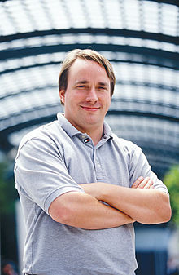
Linus Torvalds

Slide 8
Linux Proliferation
1992: Debian Linux and Slackware
1993: Over 100 developers work on Linux kernel
1994: Red Hat Linux
1995: Free BSD Unix
1998: IBM, Compaq, Oracle etc announce support for Linux
2004: Ubuntu Linux

Slide 9
SCO case
2003: SCO sues IBM for copyright infringement
2003: SCO starts selling Linux “licenses”
2004: Red Hat sues SCO, SCO sues Novell
2006: SCO's list of allegedly misused material are stricken by the magistrate judge in SCO v. IBM due to lack of specificity.
2007: Court rules that "Novell is the owner of the Unix and UnixWare copyrights."
2007: SCO stops trading and files for bankruptcy

Slide 10
Ubiquitous Linux
2009: Google Android based on Linux
2012: Android features merged back to Linux
2014: 93% of hiring managers plan to hire a Linux professional in the next six months
2015-: ”Linux is Everywhere. From Space Stations to Microwave Ovens, Linux powers everything.”: White House, US Navy, China 20,000 ICBC branches, Amazon, Wikipedia, Google, NASA, CERN, GA ;-)

Slide 11
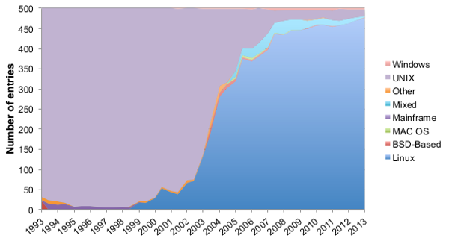
95.2% of top 500 (July '13)

