Slide 1
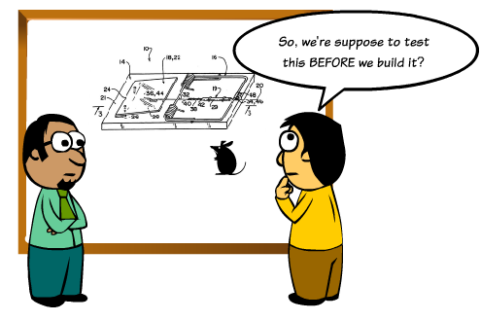
Experiences with Test Driven Development (TDD)
Ole Nielsen

Slide 2
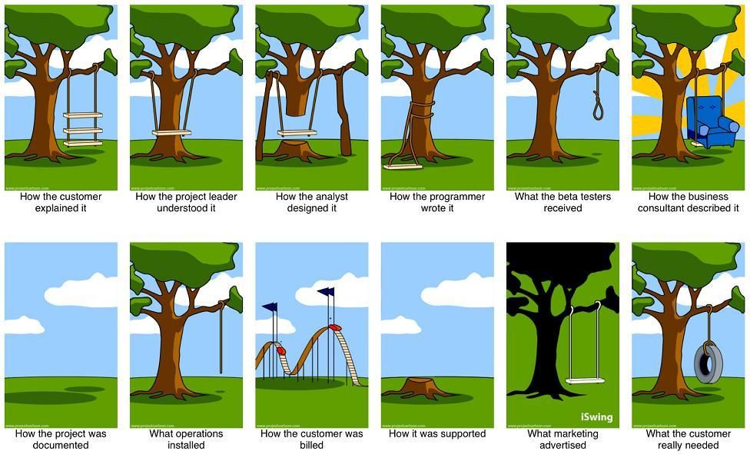

Slide 3



Slide 4
What is TDD
Why is it important
Examples
Reflections
Continuous Integration
Other important practices

Slide 5
What is Test Driven Development
Repetition of very short development cycle
Test first → minimal code → refactor → deploy
Maintaining a growing suite of tests
Large number of individual tests enforce requirements
Known as unit-, regression-, system- or integration-testing
Integral to Agile and Xtreme programming
  But universally applicable

Slide 6
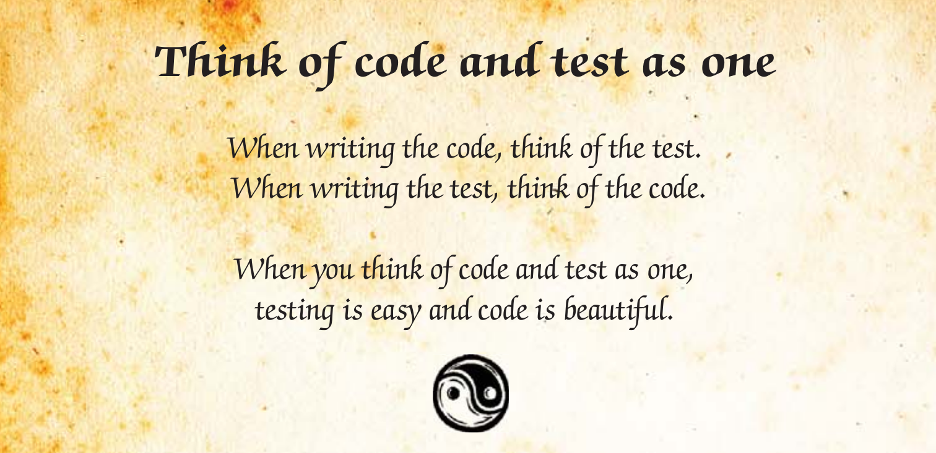

Slide 7
Why Test Driven Development?
Not possible to manually test all cases of a complex software project – must be automatic!
Protects against regression errors
Greatly assists in debugging
Empowers refactoring and optimisations
Codification of requirements!
Reduces fear (Kent Beck 2002)
Enables continuous integration and deployment

Slide 8
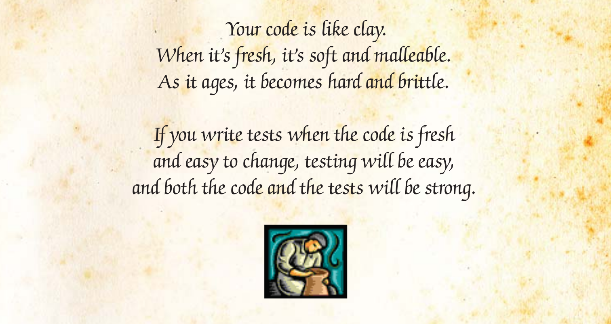

Slide 9
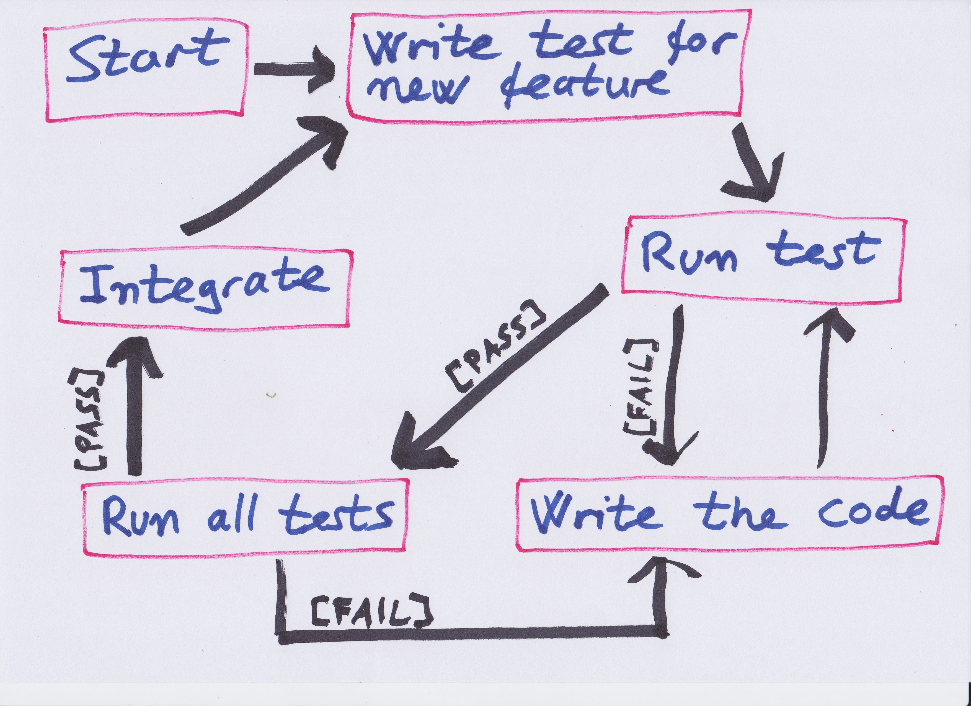

Slide 10
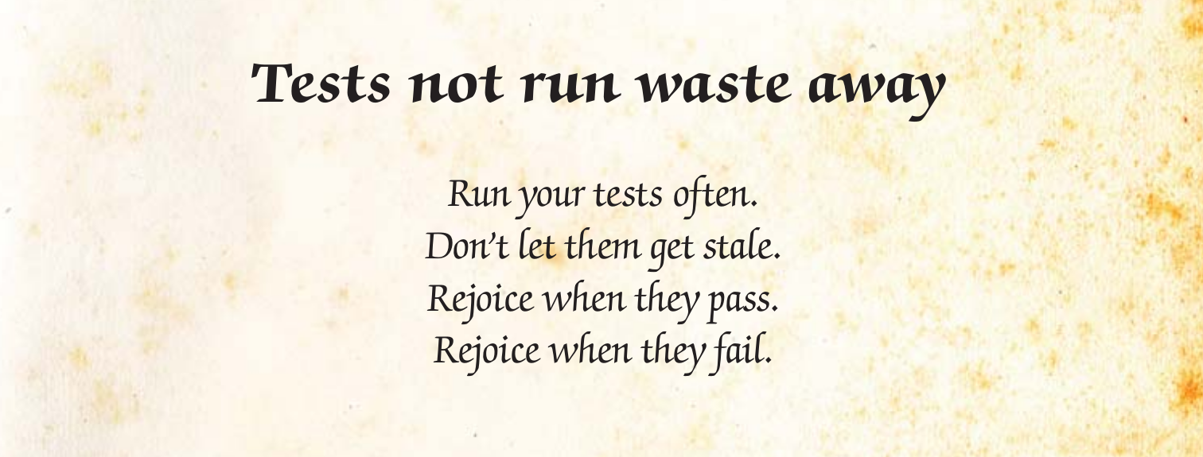

Slide 11
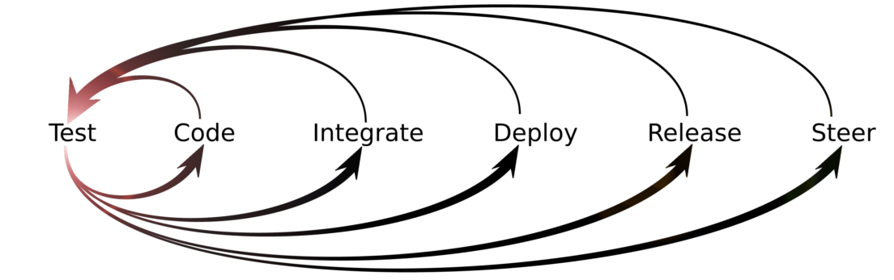

Slide 12
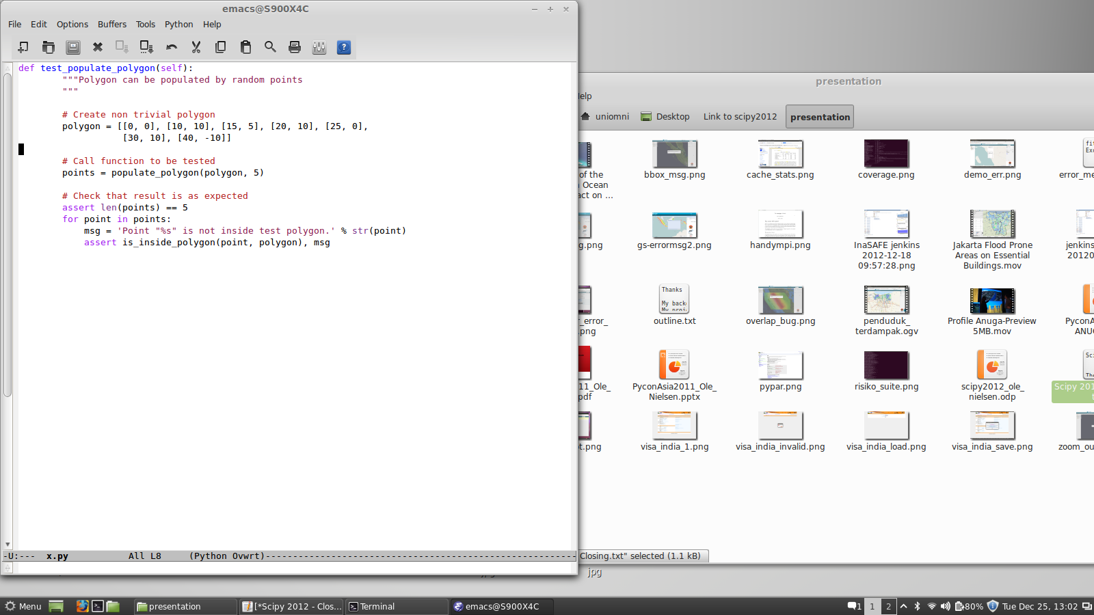
Simple but real test examples
pl

Slide 13
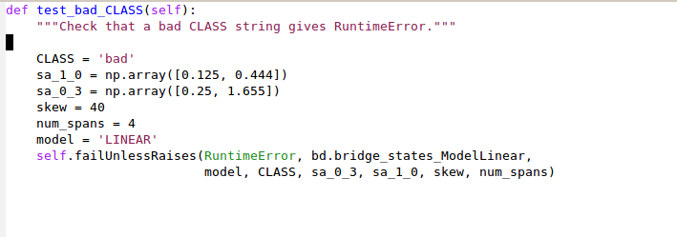

Slide 14
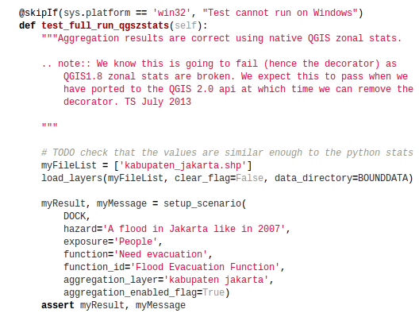

Slide 15
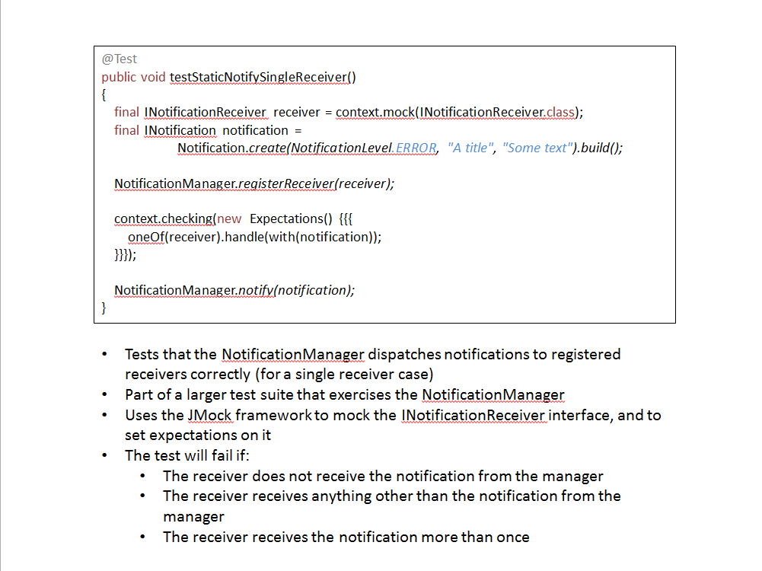

Slide 16
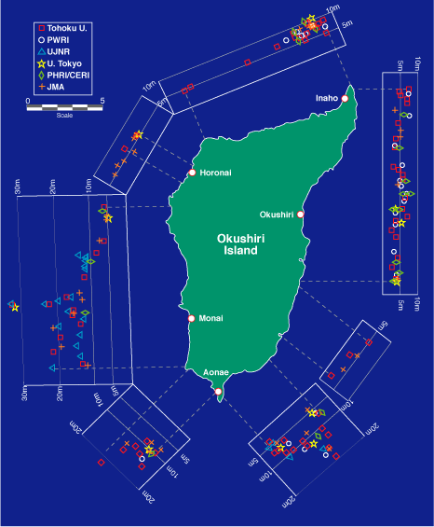

Okushiri Island 1993 Tsunami
Model validation as part of the test suite
Magnitude 7.8 earthquake
32 m run up height
Numerical Simulation of wave tank experiment shows why

Slide 17
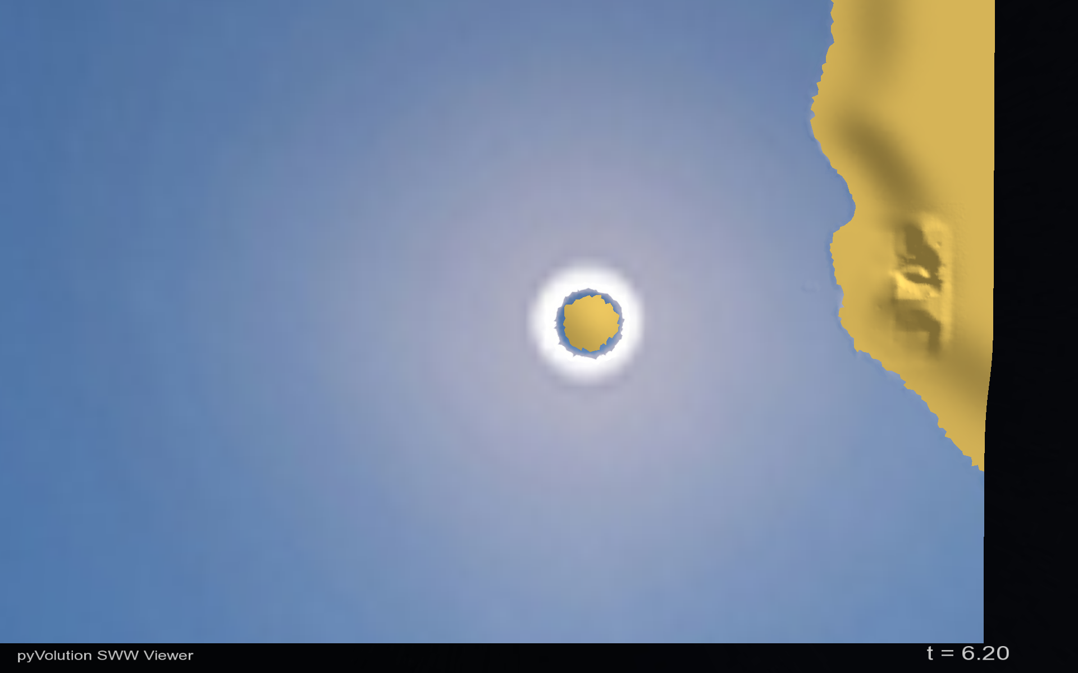
Okushiri Island
Sea of Japan
Monai Valley
Notes:
This is a computational model based on data from a Japanese wave tank experiment. It provides some insight into why Monai Valley received a disproportionate runup.

Slide 18
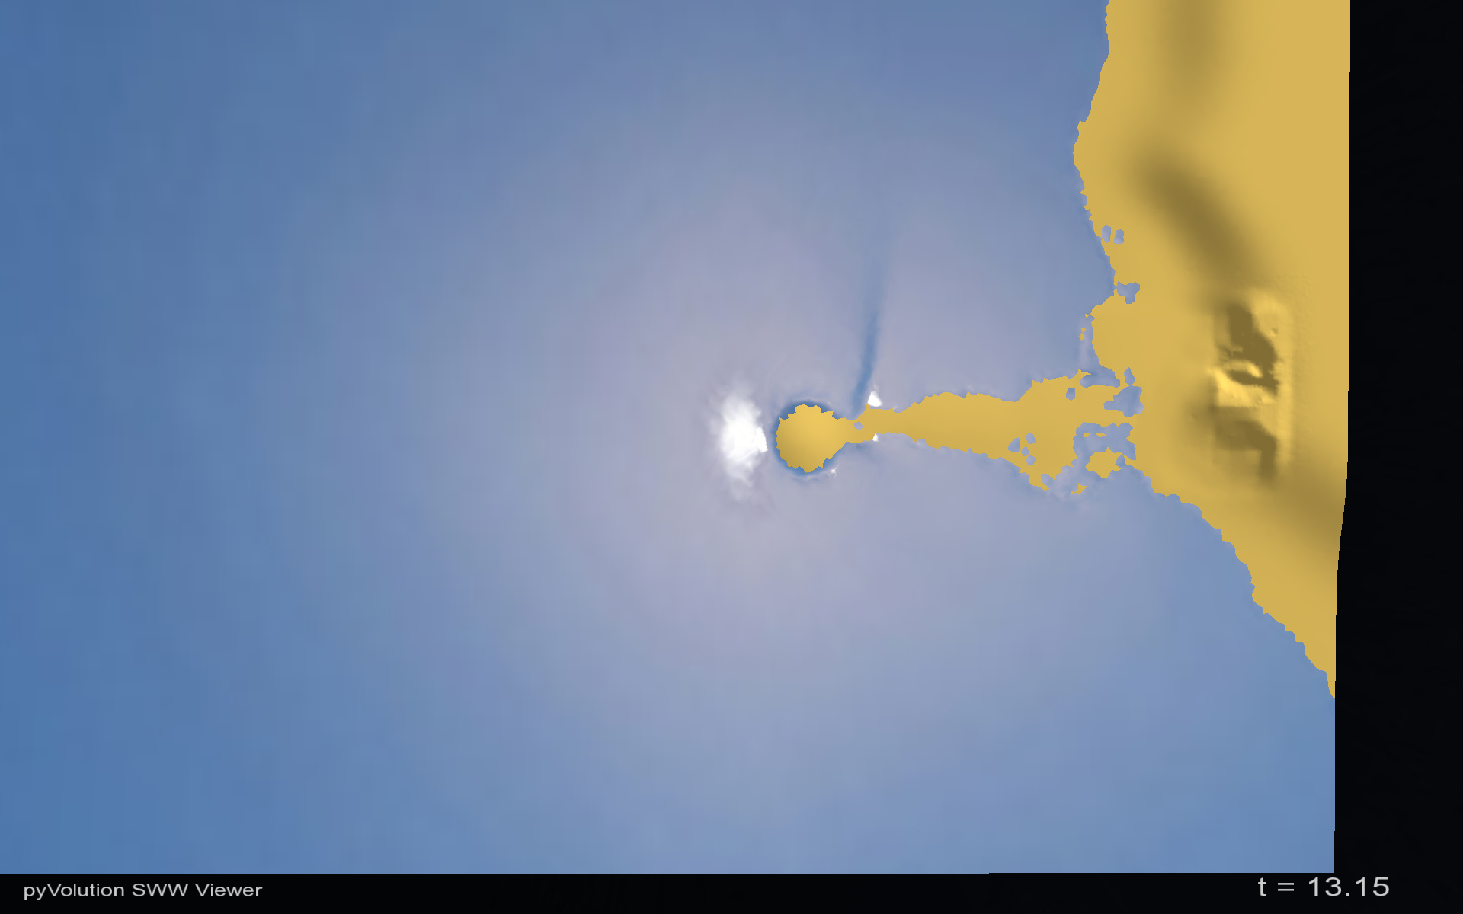
Okushiri Island
Sea of Japan
Drawdown
Monai Valley

Slide 19
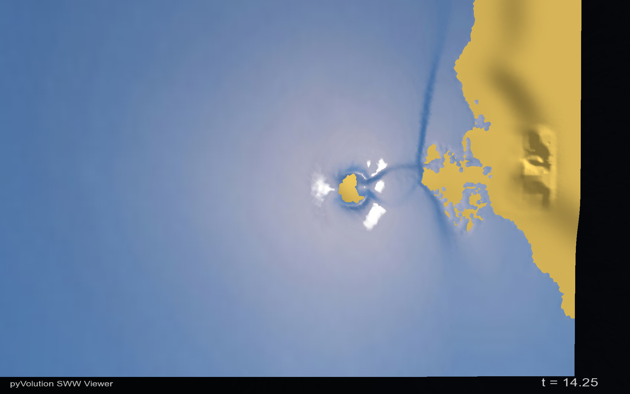
Okushiri Island
Sea of Japan
Monai Valley

Slide 20
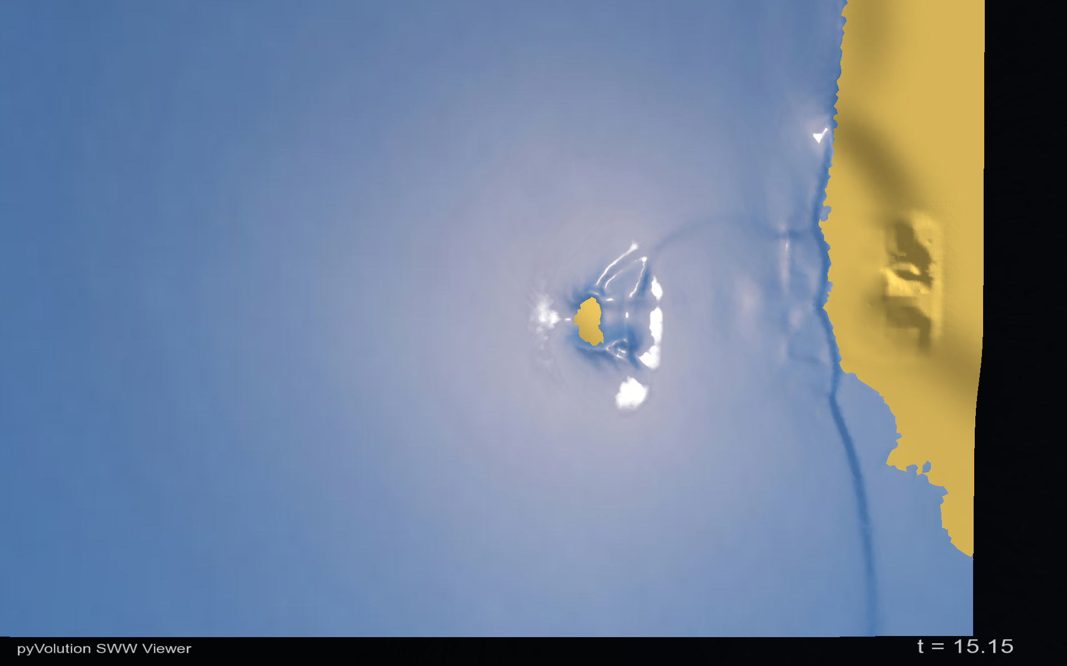
Okushiri Island
Sea of Japan
Monai Valley

Slide 21
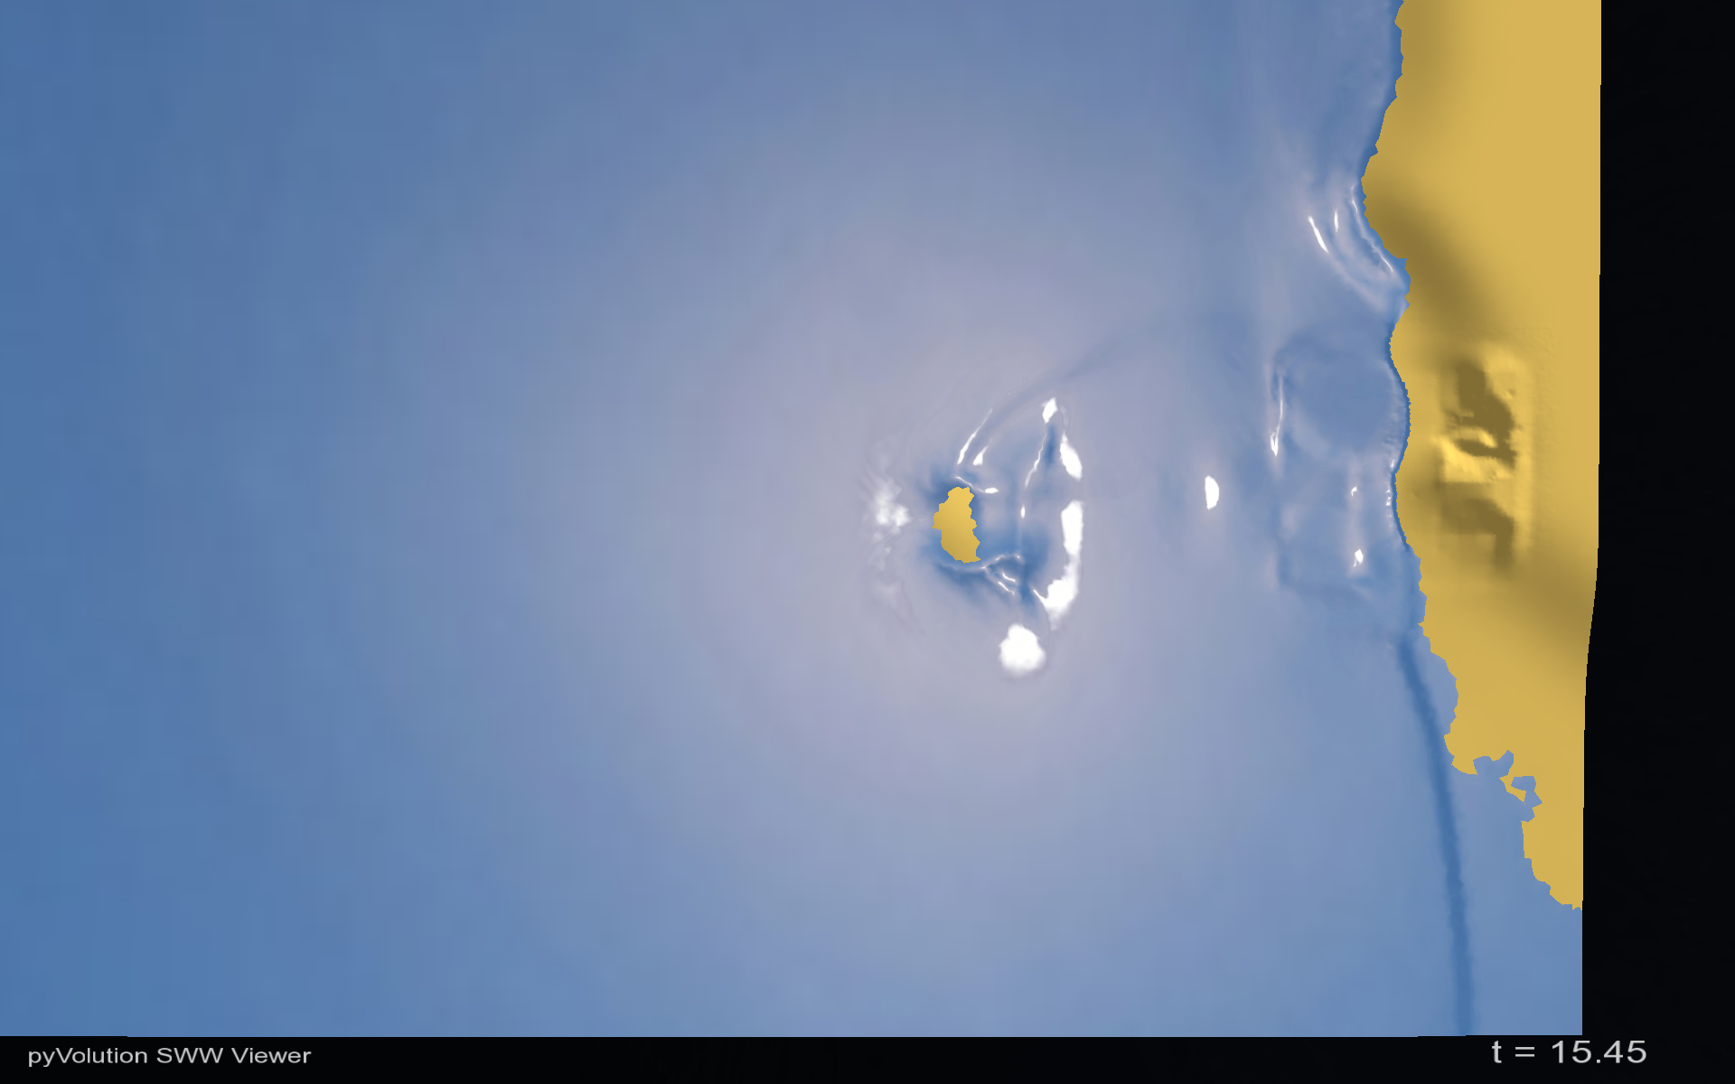
Reflection
Okushiri Island
Sea of Japan
Monai Valley

Slide 22
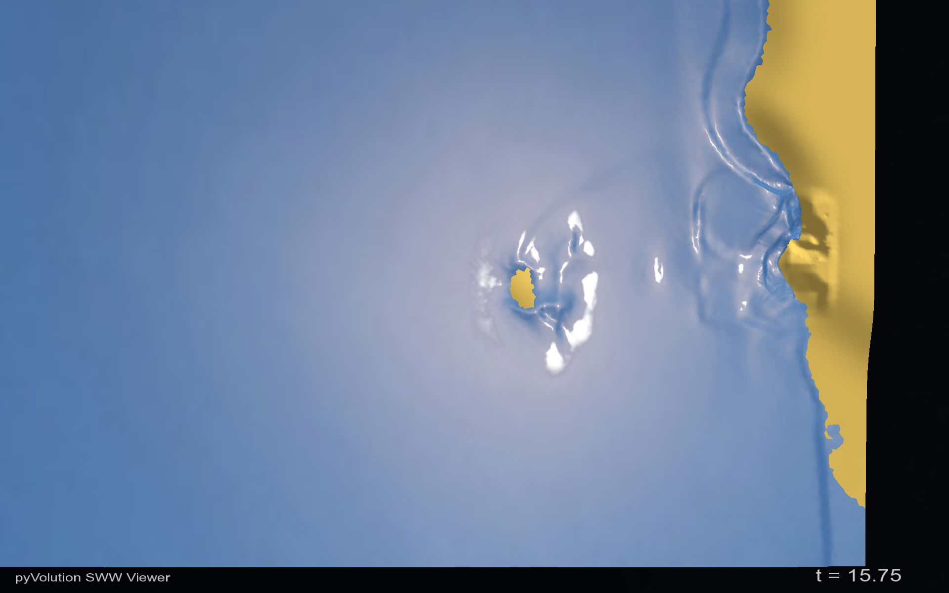
Reflection
Okushiri Island
Sea of Japan
Monai Valley

Slide 23
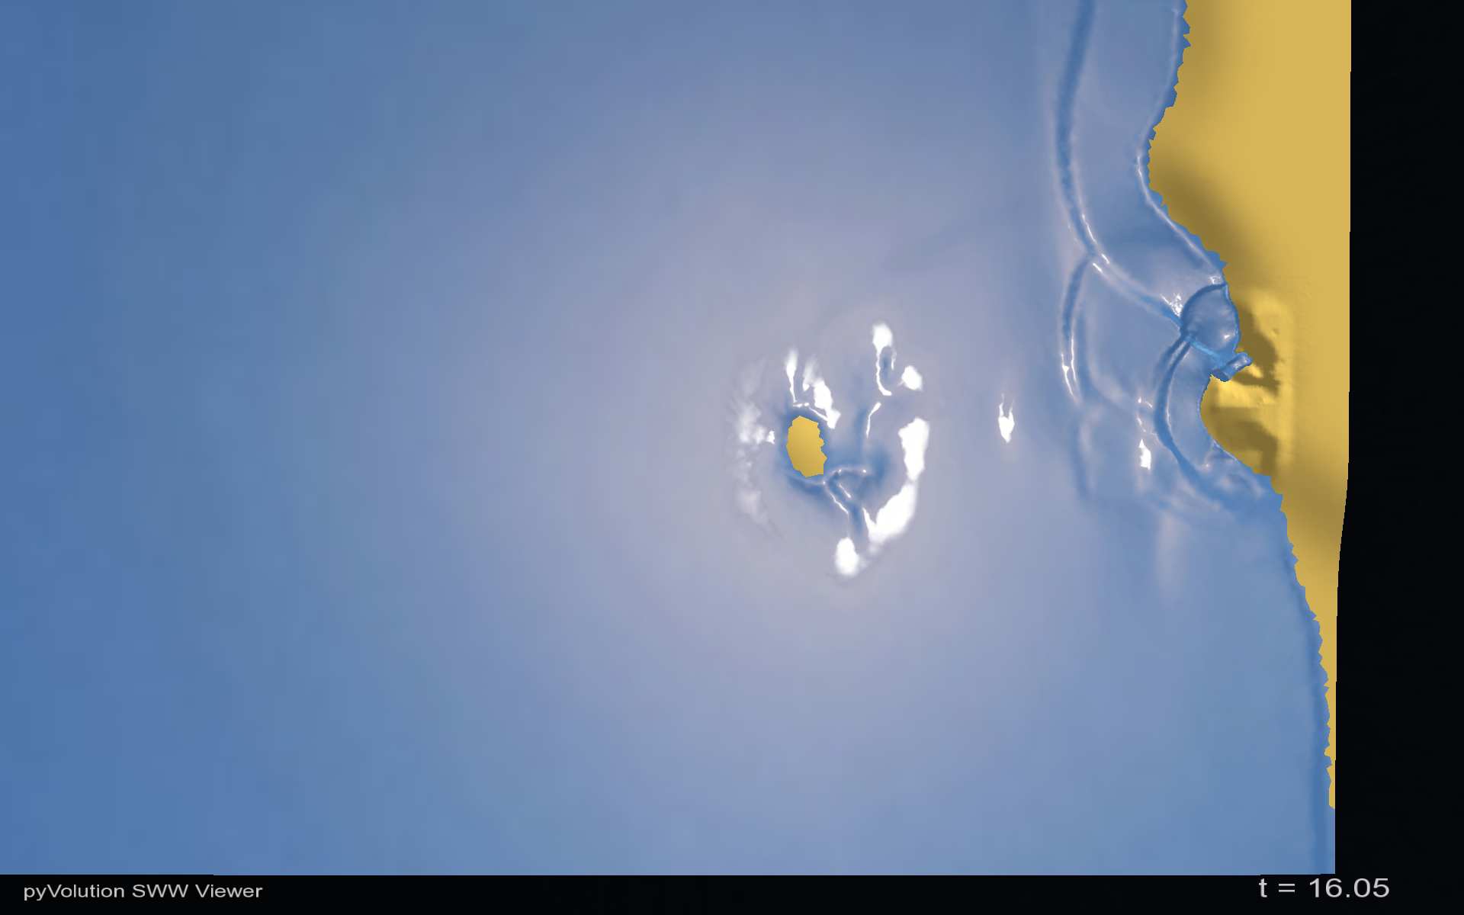
Okushiri Island
Sea of Japan
Shoaling
Monai Valley

Slide 24
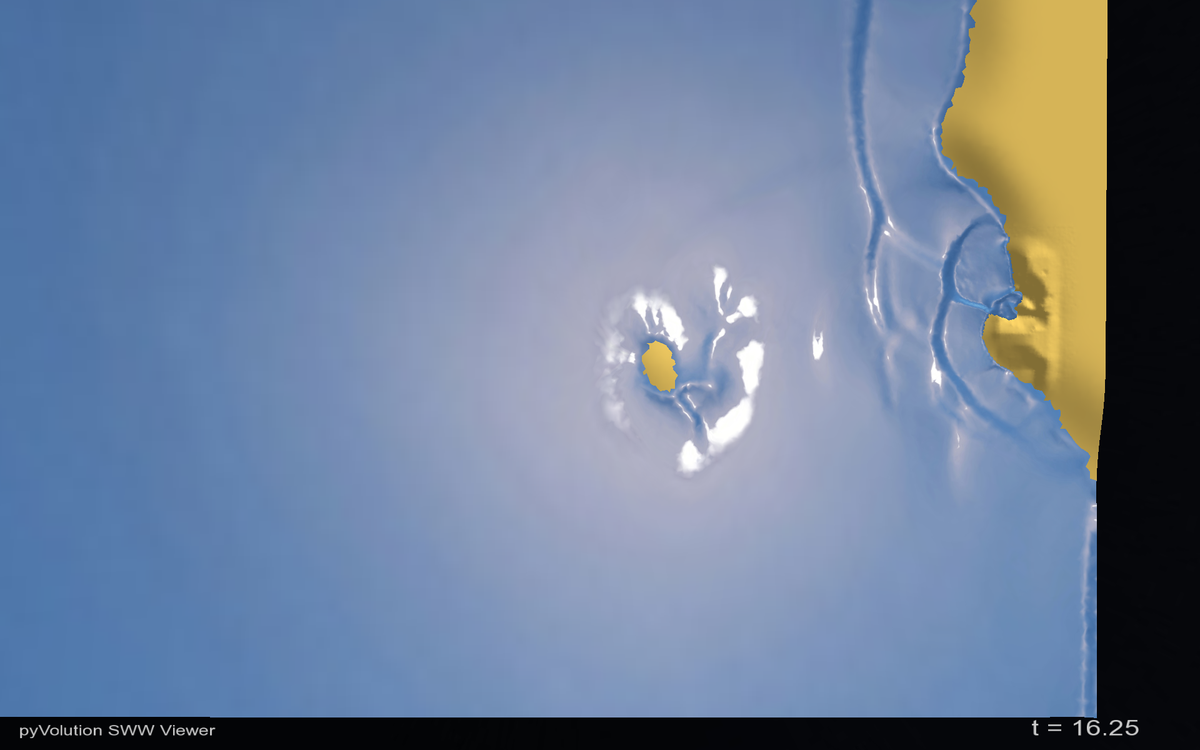
Okushiri Island
Sea of Japan
Monai Valley
Run up

Slide 25
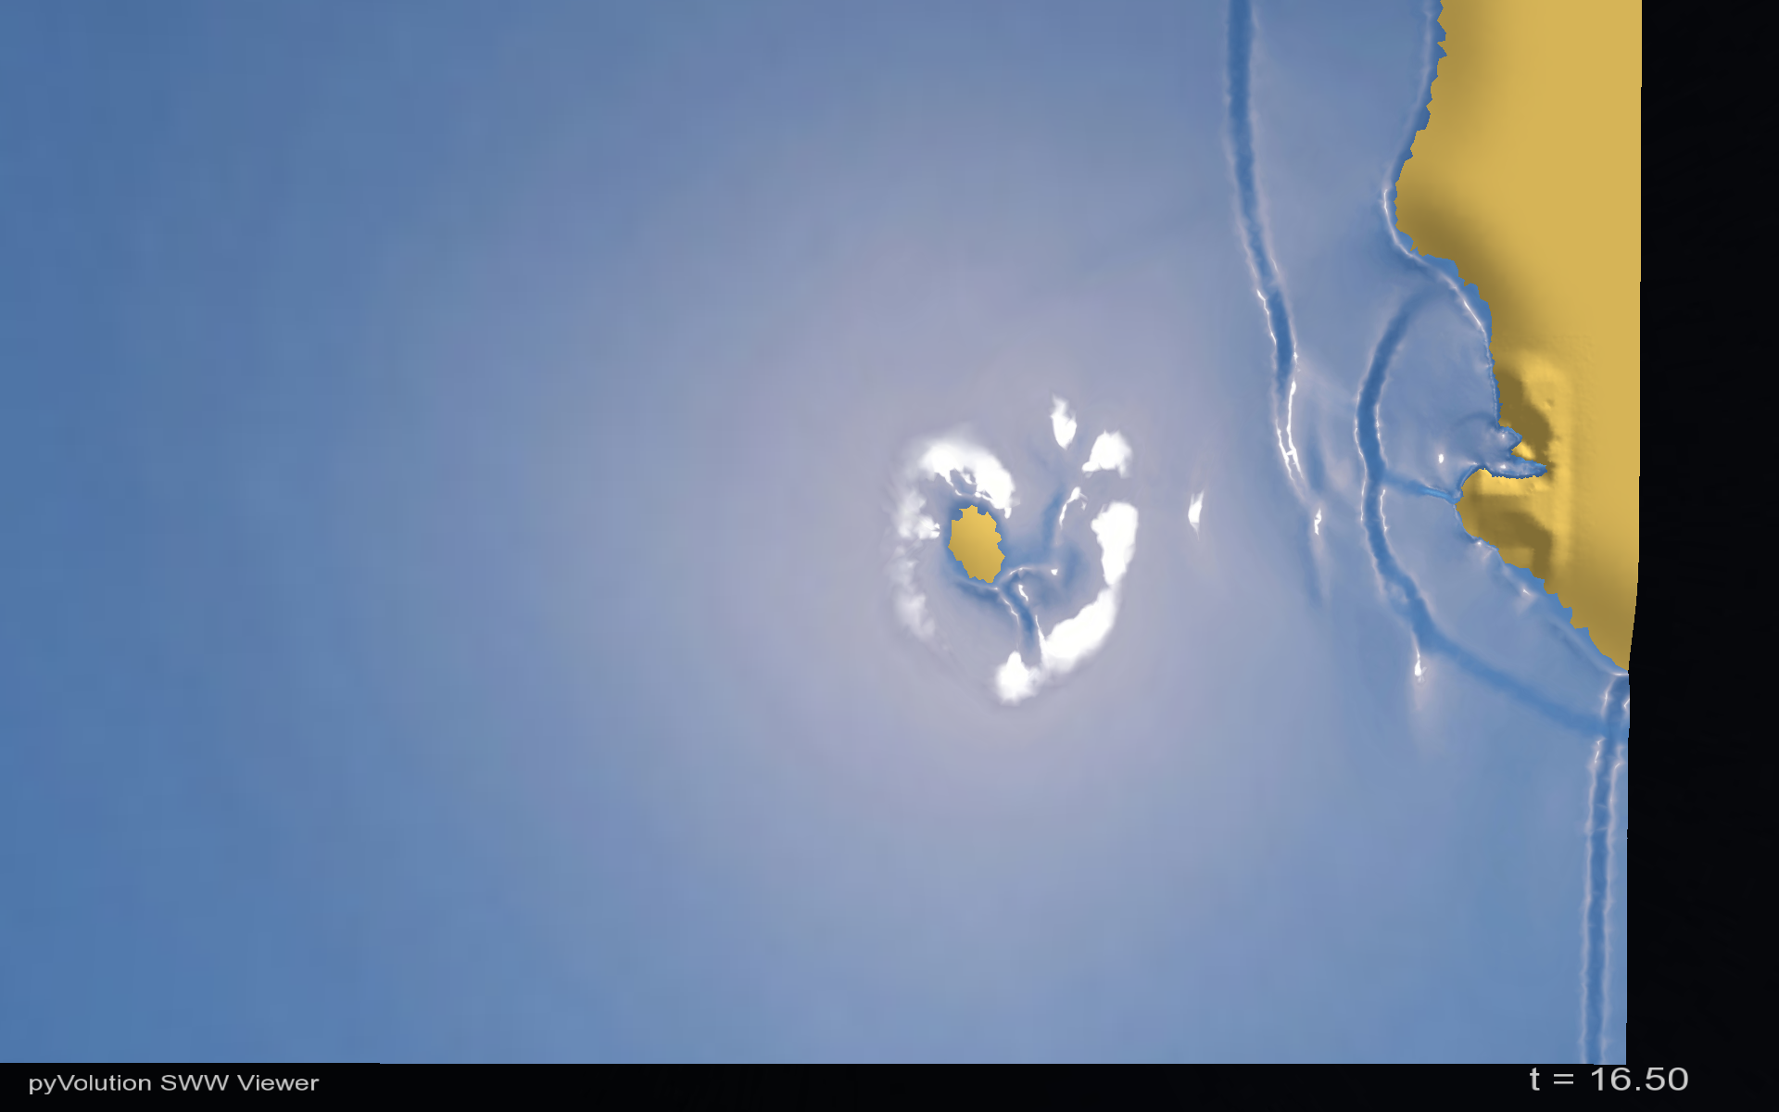
Okushiri Island
Sea of Japan
Monai Valley
Run up

Slide 26

Okushiri Island
Sea of Japan
Monai Valley
Run up

Slide 27
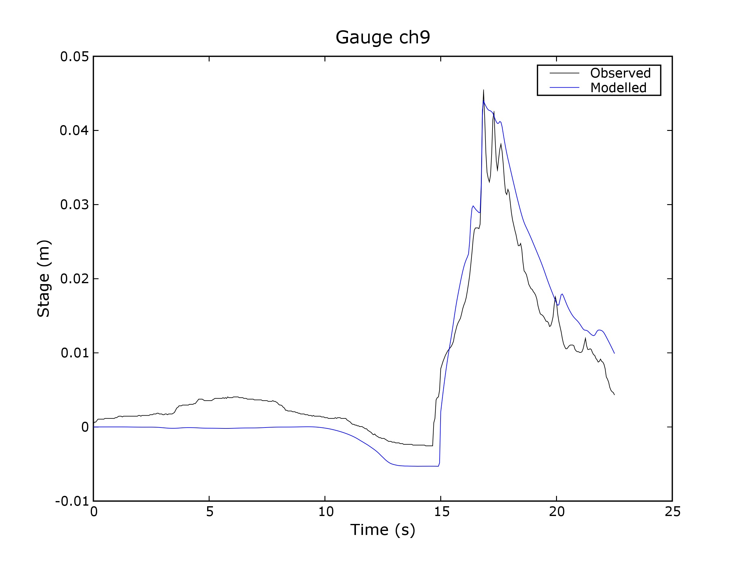
Model validation written as “unit” test

Slide 28
Reflections on testing
A development culture!
Have tests for the functionality you care about – future protection
The extra time invested comes back 100 fold when debugging, refactoring and moving to new platforms
Hard to start with existing project, so write half a dozen high level tests
Crucial when optimising (“Faster and faster – but wrong”!)
Crucial when refactoring (ripped out dependency in hours)
Also serves as trusted documentation of APIs
“I don't understand how people program without tests” (Duncan Gray)
The single most important practice – I'd rather keep my tests than the source code!
InaSAFE has over 300 tests - ANUGA almost 1000,

Slide 29
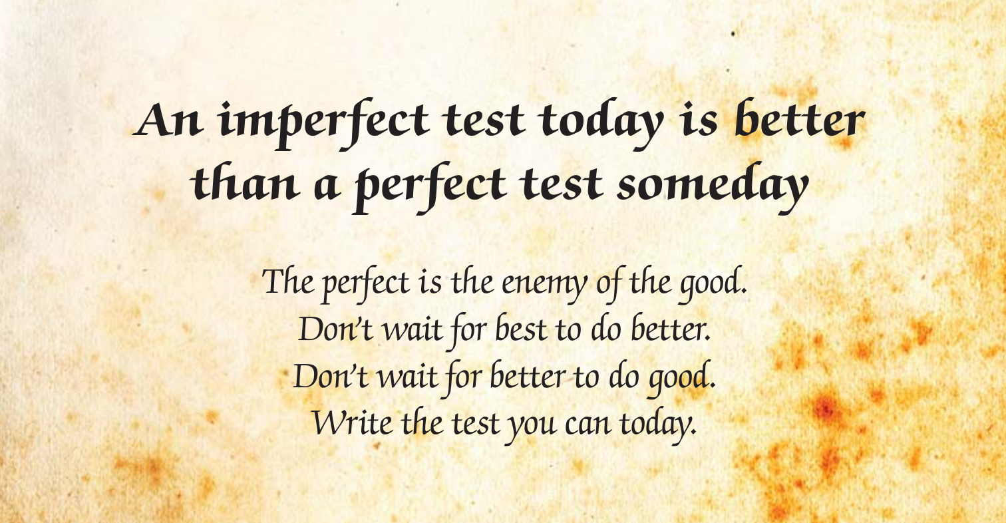

Slide 30
What makes good testing
Sets up all conditions, call the test, verify the result.
Verify result using known invariant conditions (e.g. conservation of mass, linearly interpolated points must lie within certain bounds, inverse transforms reproduce original inputs, read back what was written, retain double precision...)
Not only “happy path” but also corner cases (None, NaN, 0, max, min, %, &, $): E.g. intersection (Parallel lines, coinciding lines, intersecting at endpoints, ... )
Input that causes error conditions
If a new bug is found, write new test revealing it “It is a lot easier to debug a test than running the application” (Tim Sutton)
Independent of context, time and other tests
Named after what is being tested: (see next slide)
Good coverage (>80%) - but not 100%!
Programmers need GUTs
Google: Klaus P. Berg – Good Unit Tests

Slide 31
#148 Linear and quantile bins are correct ... ok
#149 Bounding boxes can be converted between list and string ... ok
#150 Intersections of bounding boxes work ... ok
#151 Bounding box can be buffered ... ok
#152 Centroid point data can be derived from polygon data ... ok
#153 Projections that are compatible but not identical are recognised ... ok
#154 Donut polygon can be read, interpreted and written correctly ... ok
#155 Empty keywords can be handled ... ok
#156 Bounding box can be extracted from geotransform ... ok
#157 Resolution can be extracted from geotransform ... ok
#158 Bounding box is correctly extracted from file. ... ok
#160 Vector and Raster objects can be instantiated with None ... ok
#161 Keywords can be written and read ... ok
#162 Keywords and values with colons raise error messages ... ok
#163 Vector and Raster instances have a similar API ... ok
#164 Points along line are computed correctly ... ok
#165 Bounding box minimal size can be controlled ... ok
#166 Multipart polygons are be converted to singlepart ... ok
#167 Raster layers with no projection causes Exception to be raised ... ok
#168 NODATA value is correctly handled for GDAL layers ... ok
#169 Ordering of polygon vertices is preserved when writing and reading ... ok
#170 Polygon areas are computed correctly ... ok
#171 Polygon centroids are computed correctly ... ok
#172 Polygons with inner rings can be written and read ... ok
#173 Projection information can be correctly compared ... ok
#174 Raster extrema (including NAN's) are correct. ... ok
#175 Raster layers can be converted to vector point layers ... ok

Slide 32
TDD Project examples in GA
Pypar (2002) – Python for parallel computing
ANUGA (2006) – Hydrodynamic modelling
EQRM (2007) – Earthquake risk modelling
PF3D (2010) – Volcanic ashload modelling
InaSAFE (2012) – Impact from natural disasters
HazIMP (2013) – Assess building vulnerability
EarthSci (2013) - Worldwind 4D visualisation

Slide 33
What doesn't easily lend itself to automated testing
Design
Performance
UI's
Error messages
Real time
Interdependent Systems (use Mock!)

Slide 34
Other types of testing
Style checking (e.g. PEP8 for Python)
Static code analysis (e.g. Pylint)
Customised checks:
  Scan for unwanted strings, e.g. assert, settrace, …
  IP status of bundled data (is it ok to publish?)
  Missing translations
  Passwords, connection strings, security issues
  - anything you care about, that can be automated

Slide 35
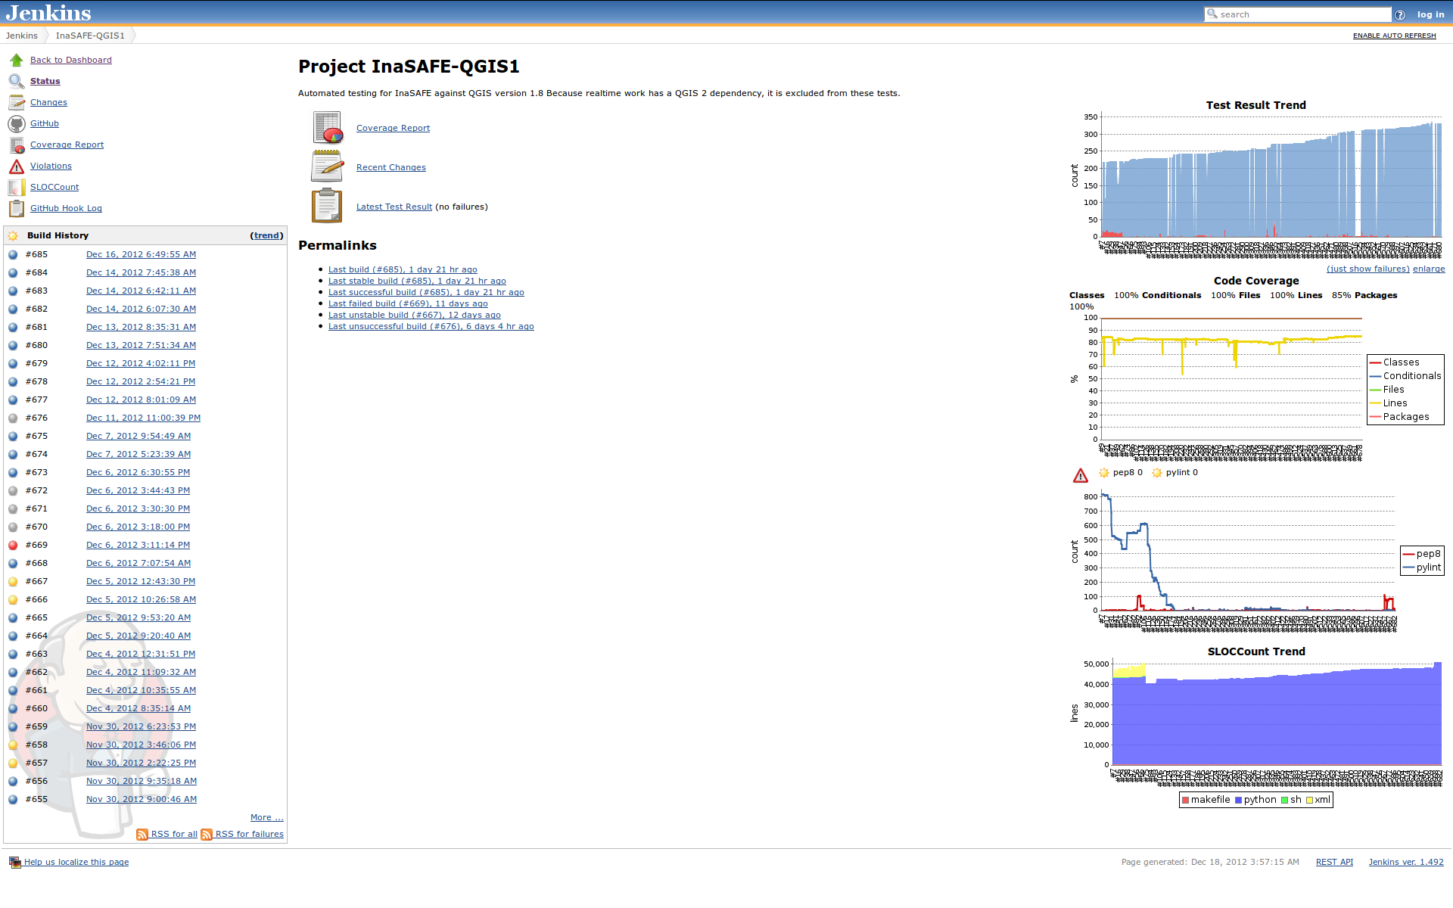
Continuous Integration Server

Slide 36
Live Jenkins server for InaSAFE release branch
http://jenkins.linfiniti.com/job/InaSAFE-Release-Branch-QGIS1/
Example of failing test and its resolution
http://jenkins.linfiniti.com/job/InaSAFE-QGIS1/754/
http://jenkins.linfiniti.com/job/InaSAFE-QGIS1/756/
Another set of fixes
http://jenkins.linfiniti.com/job/InaSAFE-Release-Branch-QGIS1/32/

Slide 37
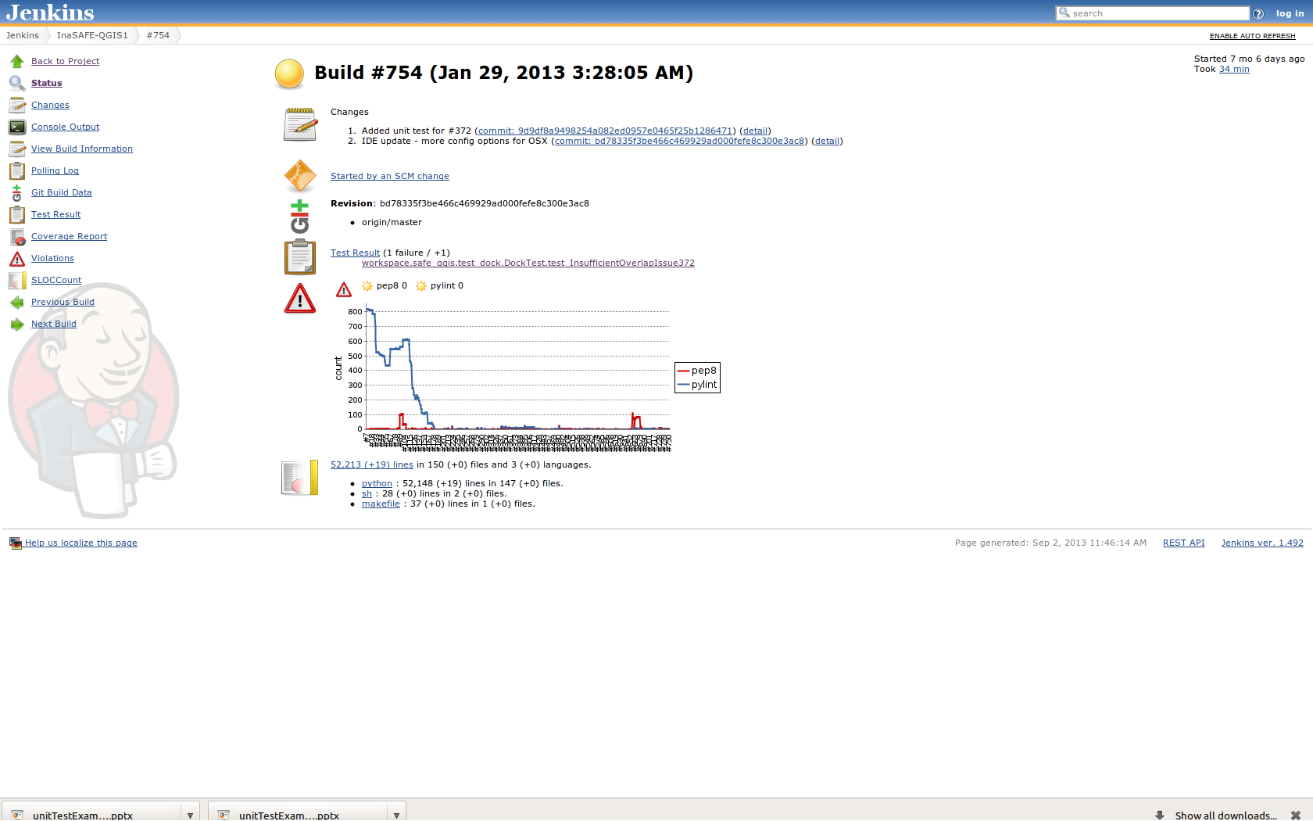

Slide 38
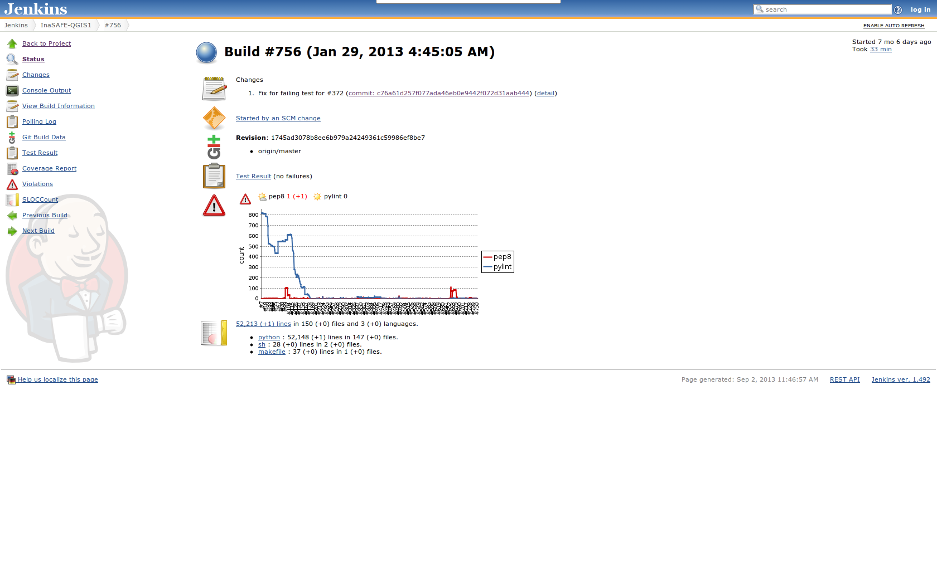

Slide 39
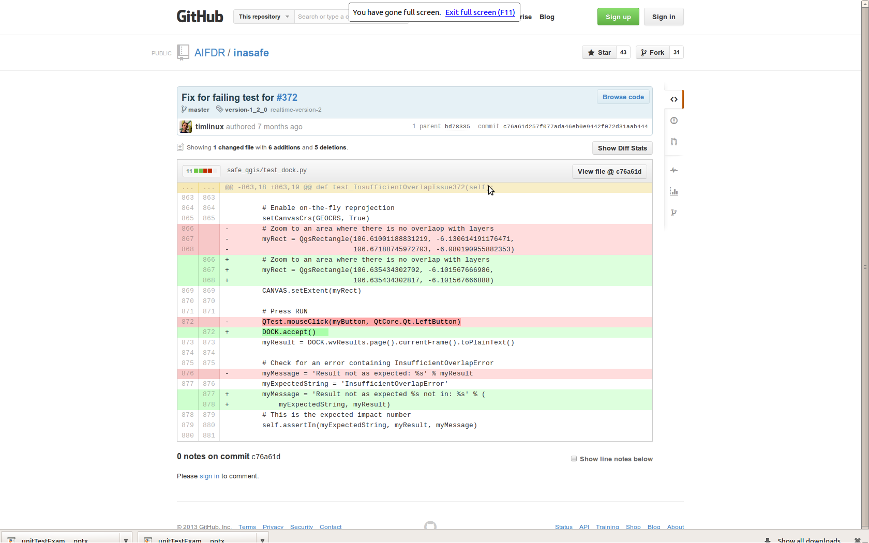

Slide 40
Dream?
One day all our software systems will
  Be under version control
  Have regression test suites
  Be managed by a continuous integration server
  Be Open Source
  Be easily deployed to dev, test, prod and elsewhere
  …. and more

Slide 41

7 noble steps to software that works
No news is good news
If it can't install – it doesn't exist
Without docs – it doesn't exist
Without testing – it doesn't exist
No future without a past
Sleep in the bed you make
Get it right – then fast

Slide 42

Thank You!
Links
http://www.agitar.com/downloads/TheWayOfTestivus.pdf
http://www.javaworld.com/javaworld/jw-03-2009/jw-03-good-unit-tests-1.html
http://www.javaworld.com/javaworld/jw-04-2009/jw-04-good-unit-tests-2.html

