Slide 1




Open Source – Of Course!
Lessons Learned from a more than a decade of Scientific Open Source development
Dr Ole Nielsen

Slide 2
Overview
My background
Current project in Jakarta
Previous projects
Lessons learned
Advice:
  Open Source Awareness
  The Importance of Software Quality
  Questions....

Slide 3
My Education
Math degree (model building): 1989
Computer science degree: 1993
Ph.D. Scientific Computing: 1998
  Wavelets
  Numerical Methods for Partial Differential Equations
  High Performance Computing
  Parallel Algorithms

Slide 4
My CV
Sound Engineer: 1982 - 1990
Consultant: 1998
Researcher, Australian National University: 1998 - 2003
Computational Scientist, Geoscience Australia: 2003 - 2010
Technical Specialist, AusAID: 2010 - 2013

Slide 5


Slide 6

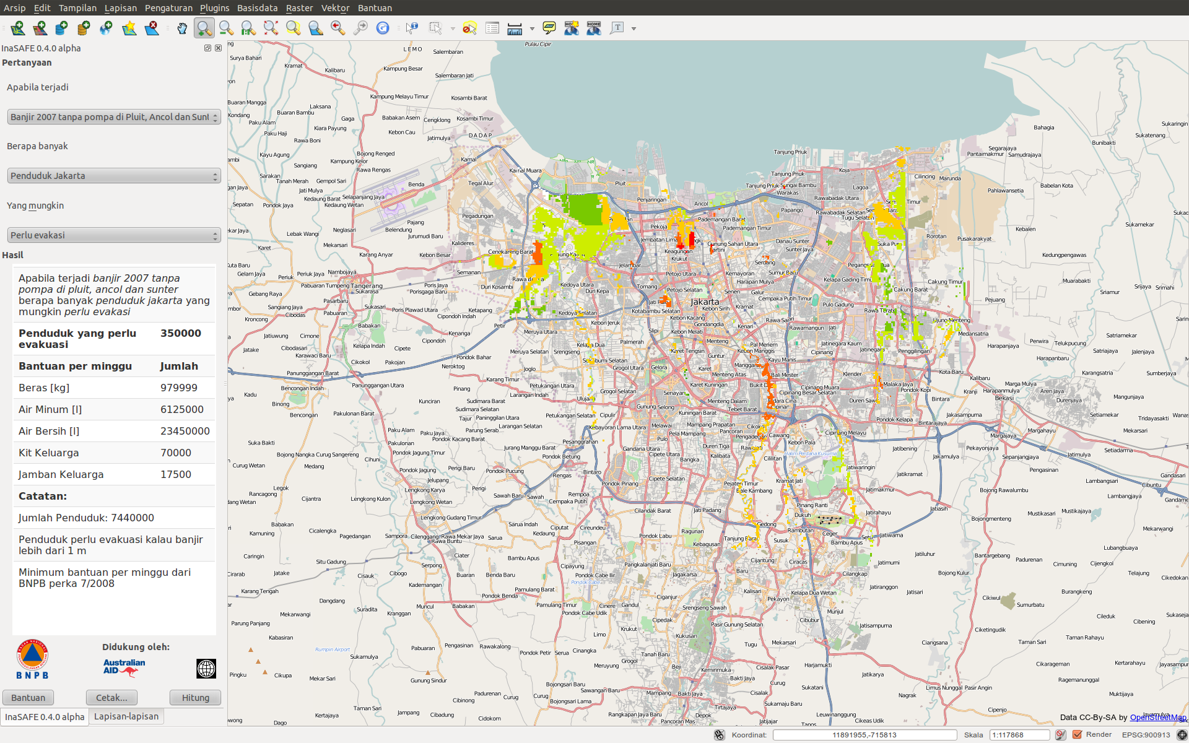
Indonesia Scenario Assessment for Emergencies
InaSAFE

Slide 7
Tujuan InaSAFE
Dapatkan informasi ilmu terbaik yang tersedia untuk menanggung pada keputusan manajemen bencana.
Memudahkan untuk menghasilkan skenario bencana yang realistis untuk digunakan dalam perencanaan kontingency.
Memberikan penilaian bukti dampak berbasis dan kuantitatif.

Slide 8

InaSAFE
Berdasarkan QGIS – kerangka kerja mapan
Menyediakan koleksi prosedur GIS untuk analisis dampak
Sistem kata kunci mengidentifikasi lapisan input dan secara otomatis memilih fungsi dampak
Mudah digunakan
Sistem bisa diperluas
“Free and Open Source”

Slide 9



Dikembangkan Dalam Kemitraan
BNPB
Bank Dunia
Australia Indonesia Fasilitas Pengurangan Bencana (AusAID)

Slide 10
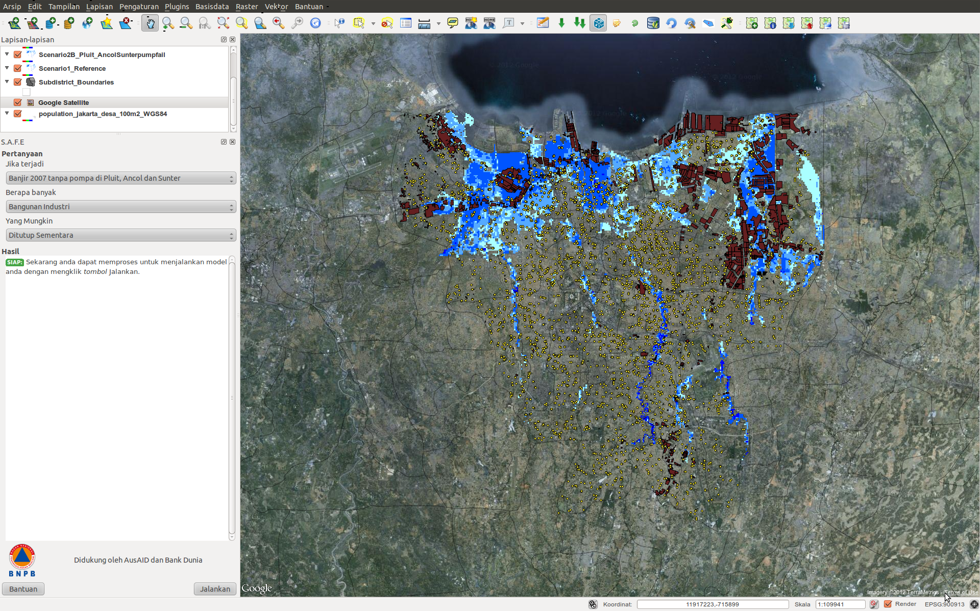
InaSAFE - Konsep
Apabila terjadi skenario ancaman berapa banyak terpapar yang mungkin terdampak?

Slide 11
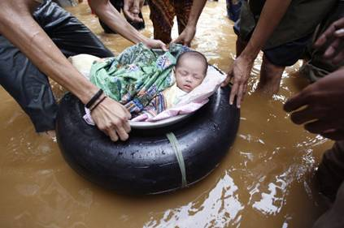
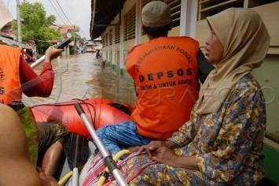
InaSAFE - Konsep
Apabila terjadi banjir di Jakarta seperti tahun 2007 berapa banyak penduduk yang mungkin dievakuasi?

Slide 12
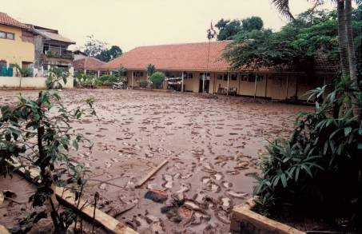
InaSAFE - Konsep
Apabila terjadi banjir di Jakarta dan pompa-pompa rusak, berapa banyak sekolah yang mungkin ditutup sementara?

Slide 13
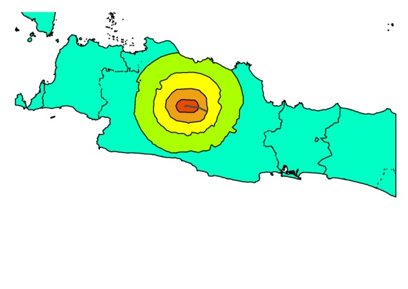
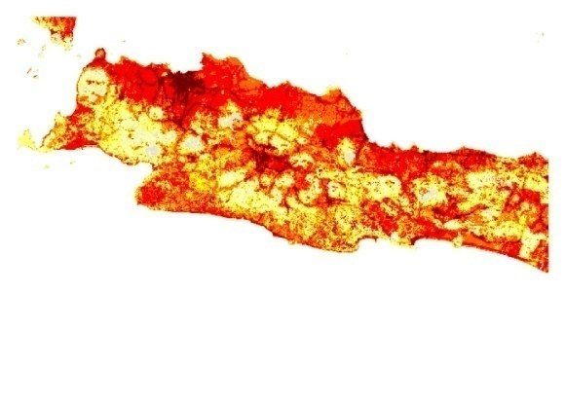
InaSAFE concept: Generic Framework for Impact Mapping
Hazard Footprint
Exposure
Impact Function
100%
Fatalities
0%
MMI

Slide 14
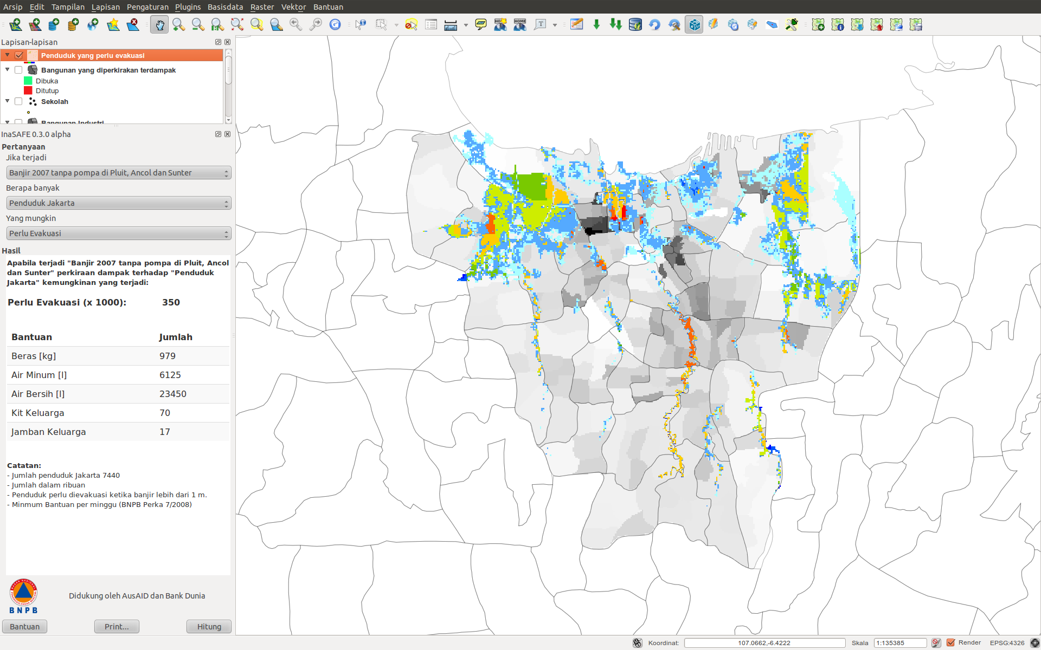
Example: Population impact from flood levels – evacuation and needs

Slide 15
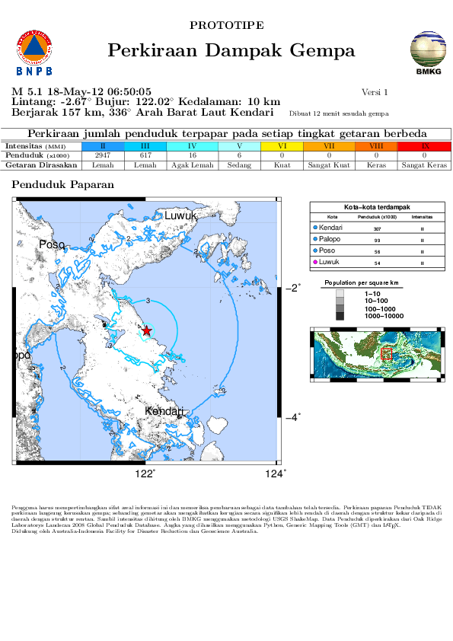

Slide 16
Tantangan
Data ancaman dan terpapar harus tersedia
Format, metadata and metode distribusi harus distandarisasi
Inisiatif seperti Open Street Map dapat membantu!

Slide 17
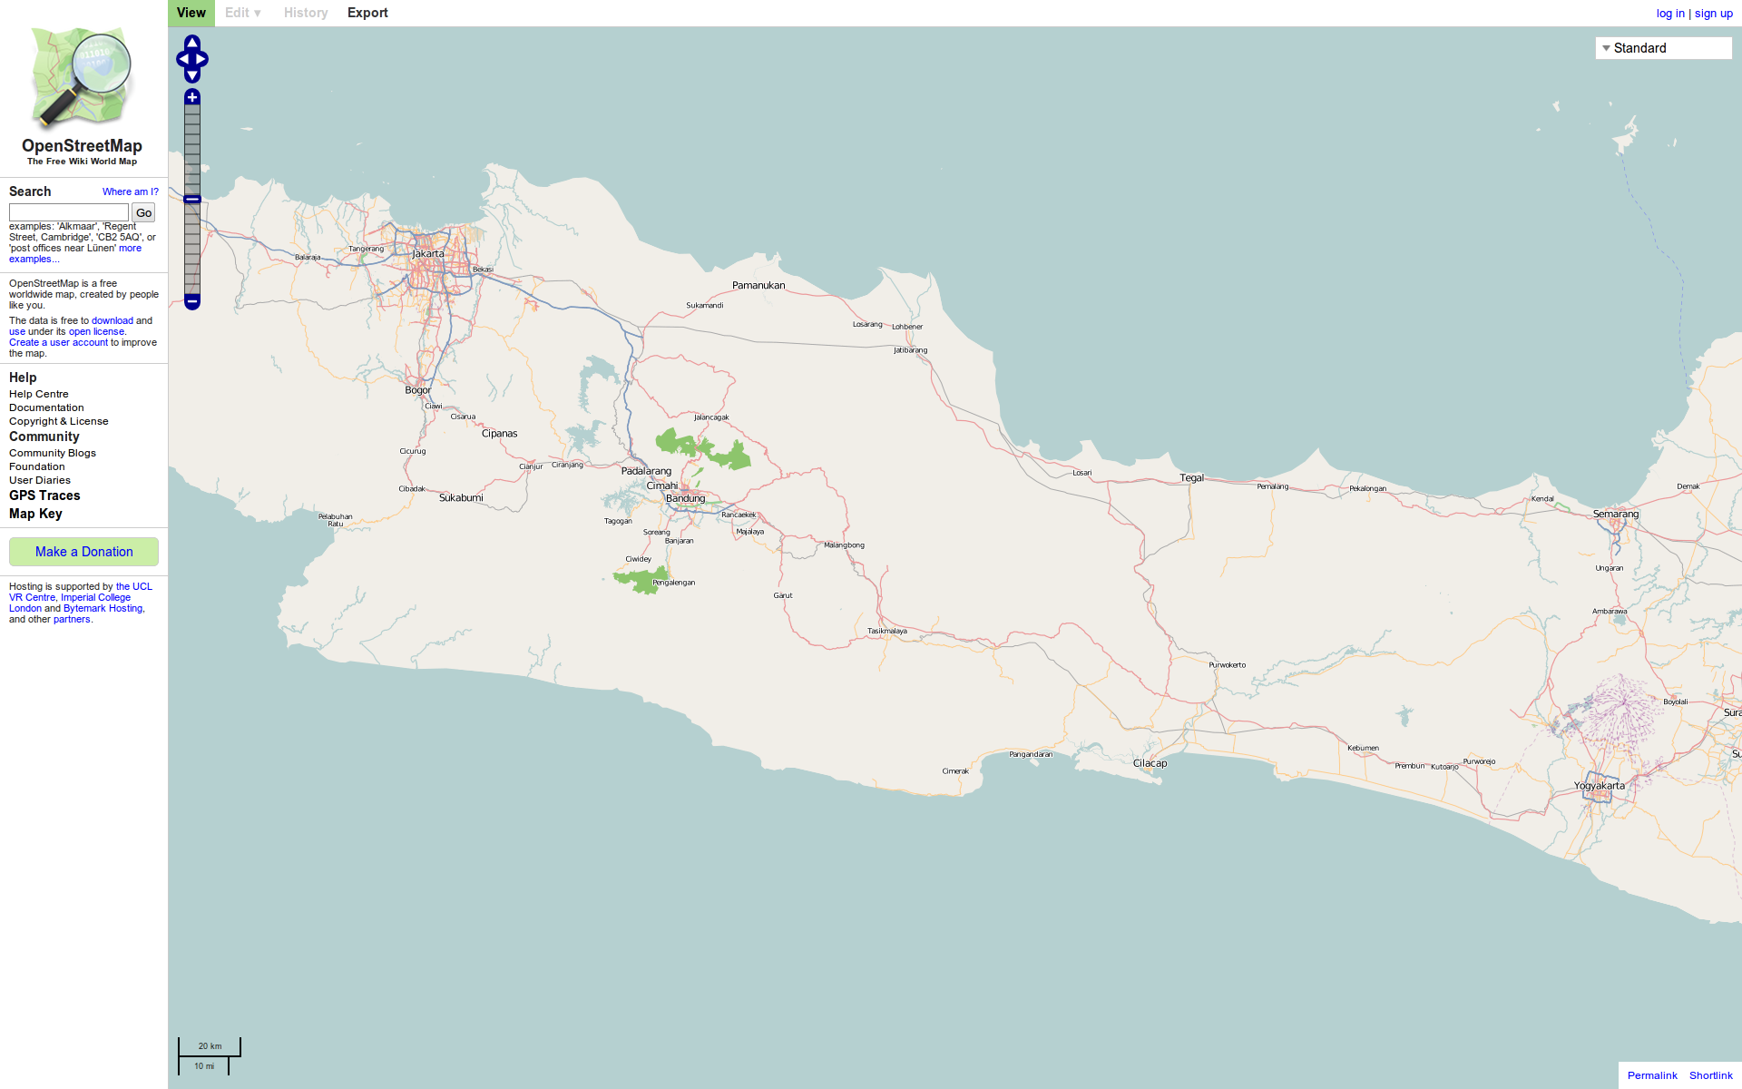
Open Street Map

Slide 18
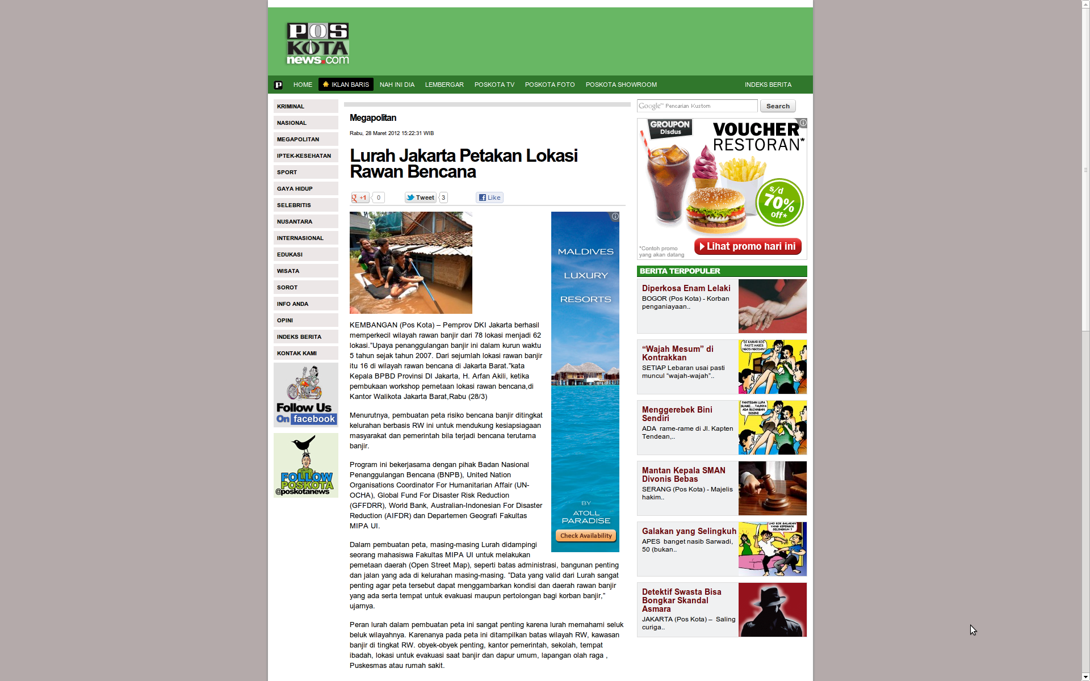
Memetakan Jakarta

Slide 19
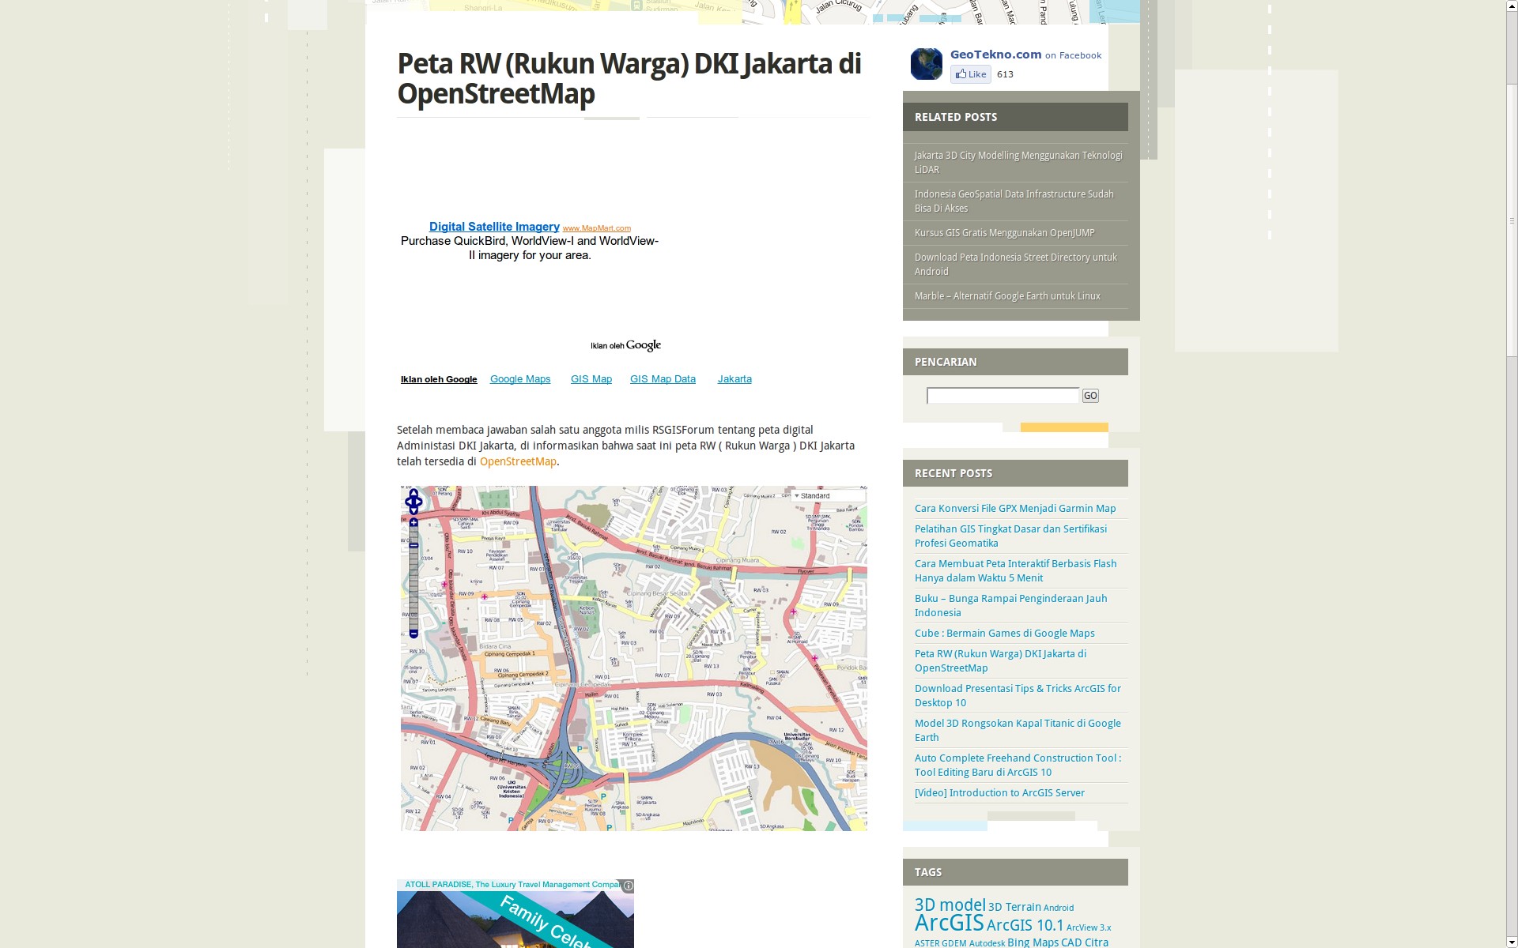
Rukun Warga mapped for the first time

Slide 20
Deep Breath!

Slide 21
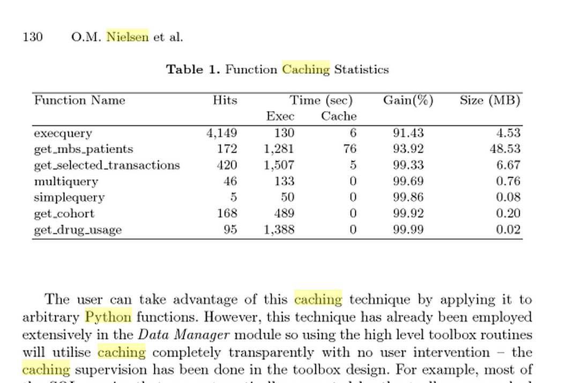
Early Days
Data Mining Tools (Australian National University)
Caching (persistent memoization - 2001)
result = func(arg1,...,argn)
result = cache(func, (arg1,...,argn), dependencies = <list of files>)

Slide 22
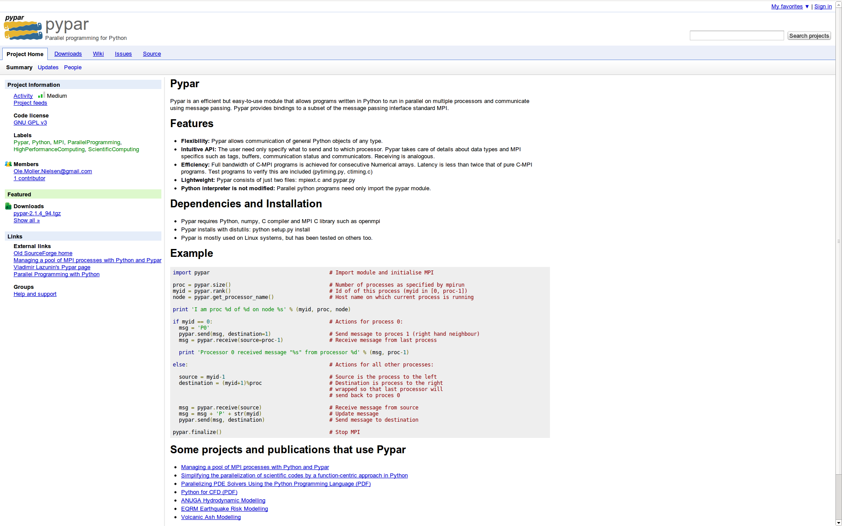
Pushing Python (pypar - 2002)

Slide 23
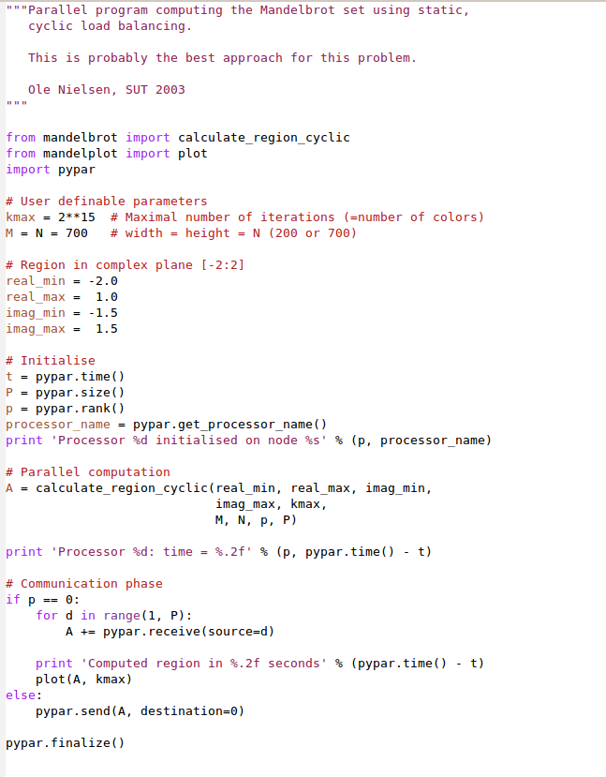
Standard MPI
int MPI_Send(
void *buf,
int count,
MPI_Datatype datatype,
int dest,
int tag,
MPI_Comm comm
);
Pypar
pypar.send(A, p)

Slide 24

Python in Government (2004-2009)
ANUGA
Open Source
Hydrodynamic Modelling
Ole Nielsen

Slide 25
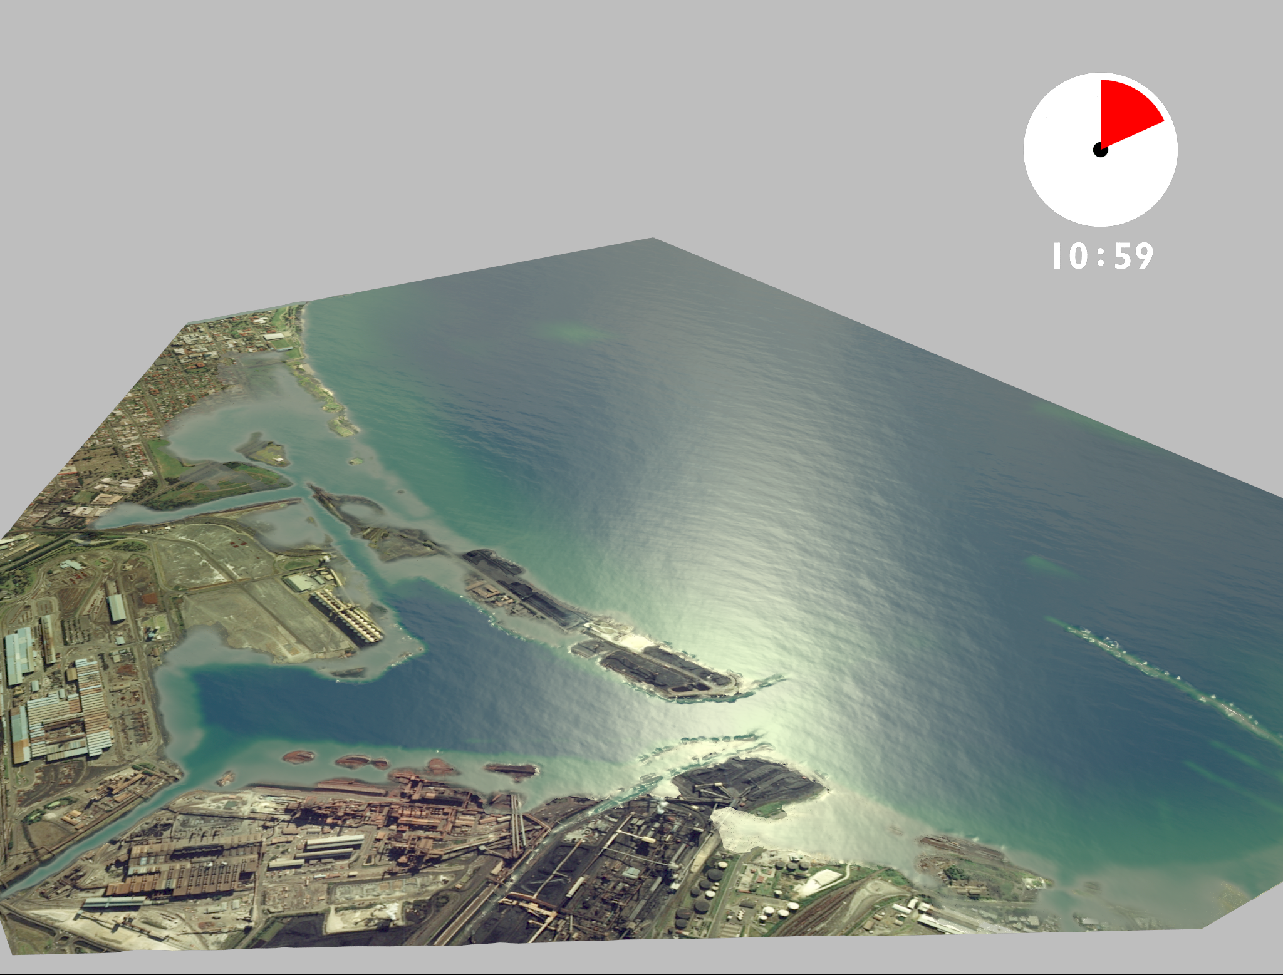
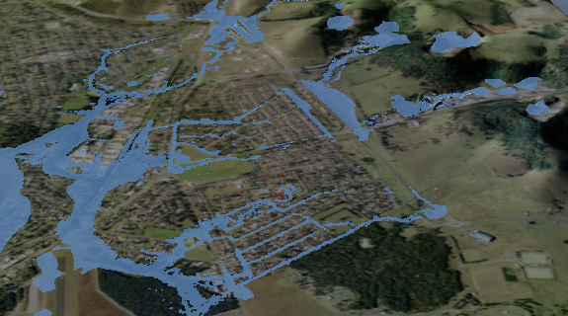
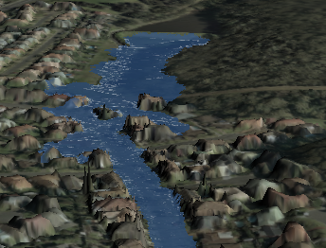
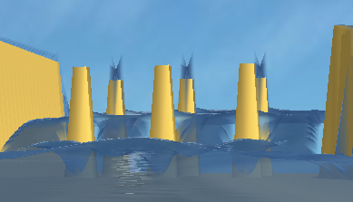
What is ANUGA
Tsunami Inundation
Riverine Flooding
Hydraulic Engineering
Dam Breaks

Slide 26
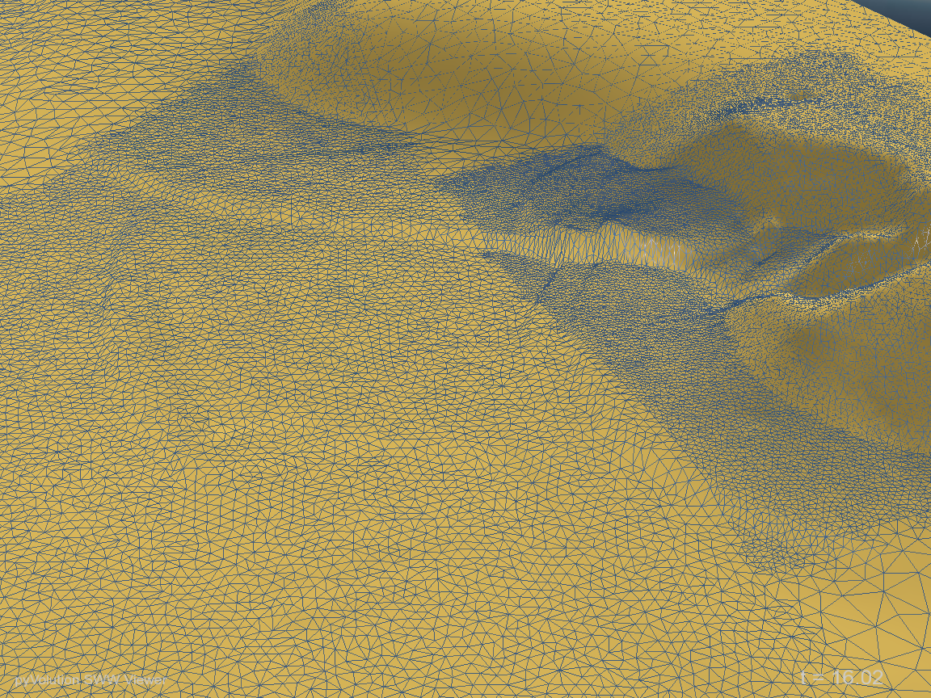
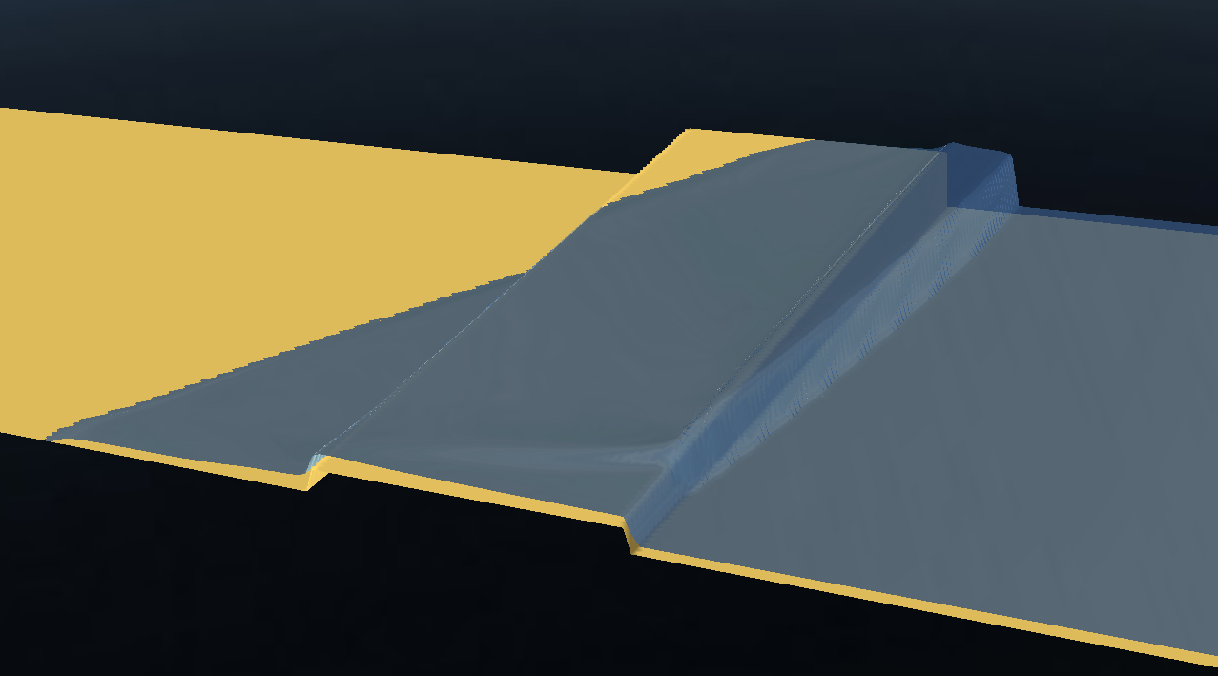
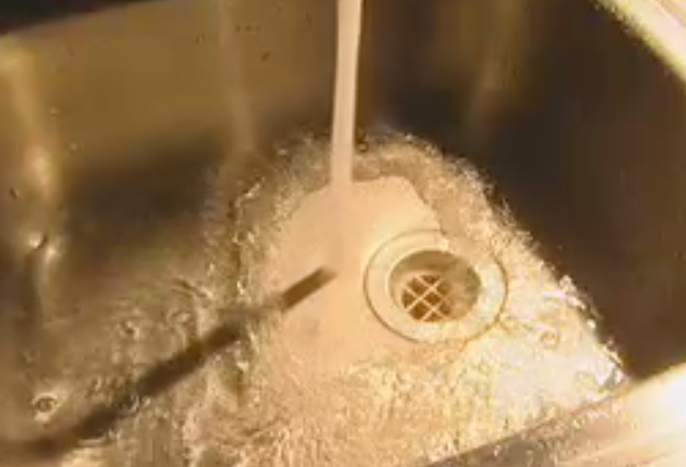
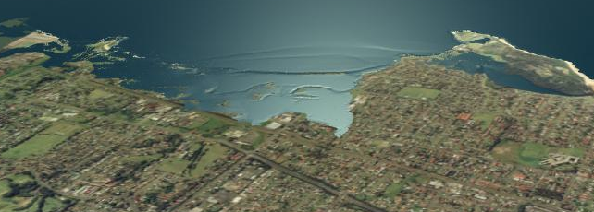
ANUGA Capabilities
Shallow Water Equations/Finite Volumes
Resolution of Hydraulic shocks
Transitions from sub- to super critical flows
Robust wetting/drying capability

Slide 27
Where is ANUGA used?
Underpins Australia’s Tsunami Modelling Program since 2005 (IWG10-D2-PM1-307-007)
Last-mile Evacuation study in West Sumatra by the Franzius Institute (SE58-D5-PM1-302-015)
Tsunami Hazards in New Zealand by GNS Science
Urban Flood Modelling Studies in Australia - Driven entirely by local councils
Research in Australia, New Zealand, Germany, India, Portugal, …

Slide 28
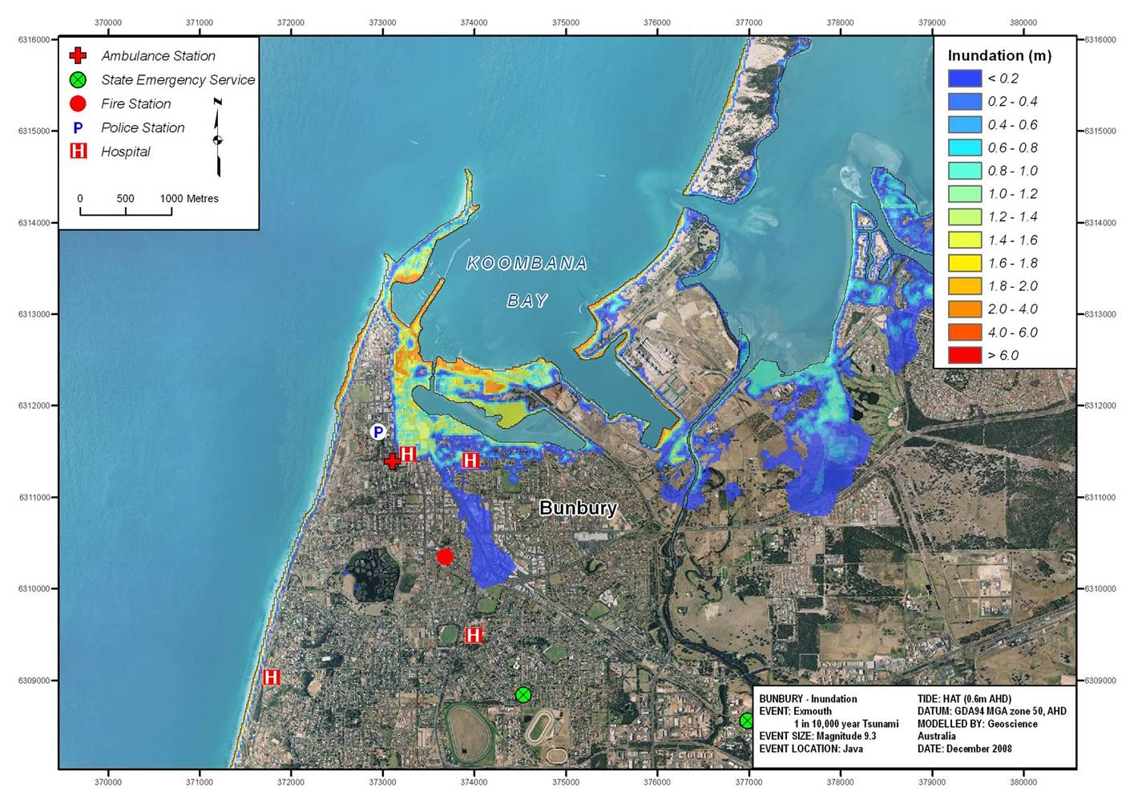
Tsunami Inundation Map Example
Notes:
Products for FESA
The animation is interesting and allows us to see what happens throughout the time the tsunami is impacting the community, but it doesn’t tell us anything about the depth or speed of the water, and is therefore not that useful to emergency managers. This series of inundation maps show how we typically deliver the tsunami impact modelling results to emergency managers.

Slide 29
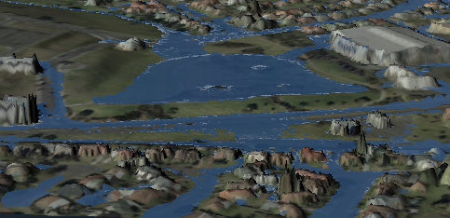
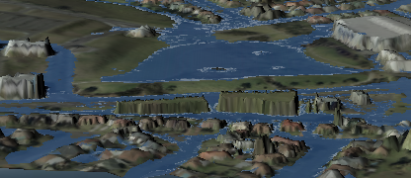
Flood Related Applications:
Assess the impact of new developments
Without proposed buildings
With proposed buildings

Slide 30
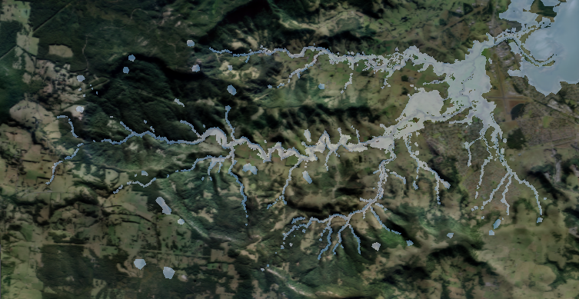
110km2 Full 2-D Model

Slide 31
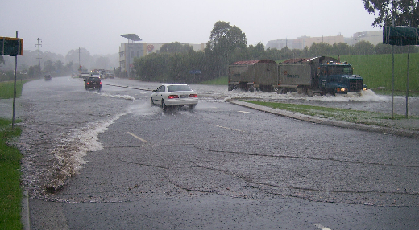
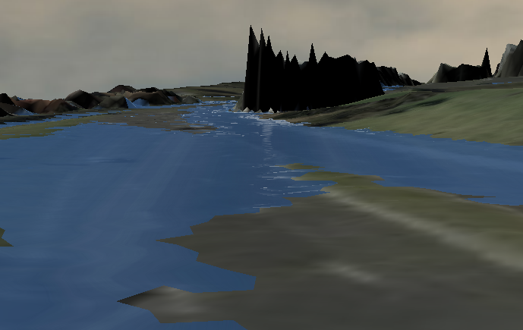
Investigating existing Flood problems…
Real World Flood…
ANUGA interpretation

Slide 32
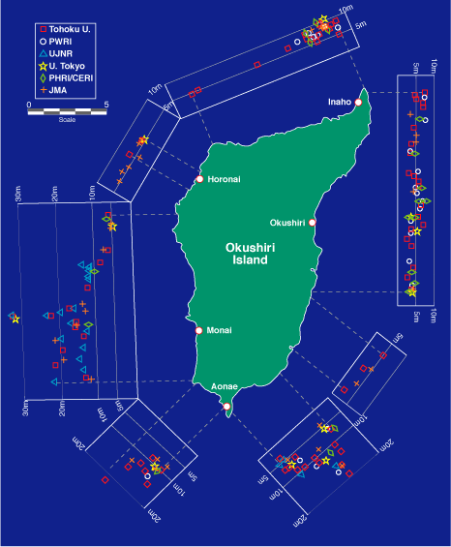
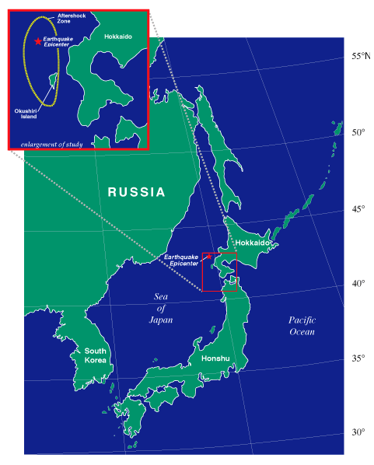

Okushiri Island 1993 Tsunami
Predicting Tsunami Run Up –
The Importance of Modelling
Magnitude 7.8 earthquake
32 m run up height
Numerical Simulation of wave tank experiment shows why

Slide 33
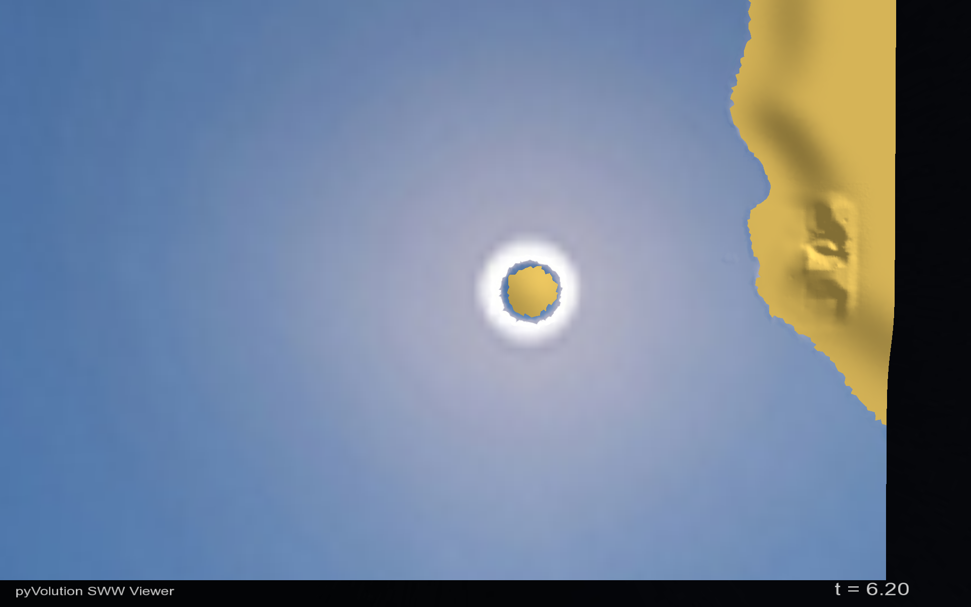
Okushiri Island
Sea of Japan
Monai Valley
Notes:
This is a computational model based on data from a Japanese wave tank experiment. It provides some insight into why Monai Valley received a disproportionate runup.

Slide 34
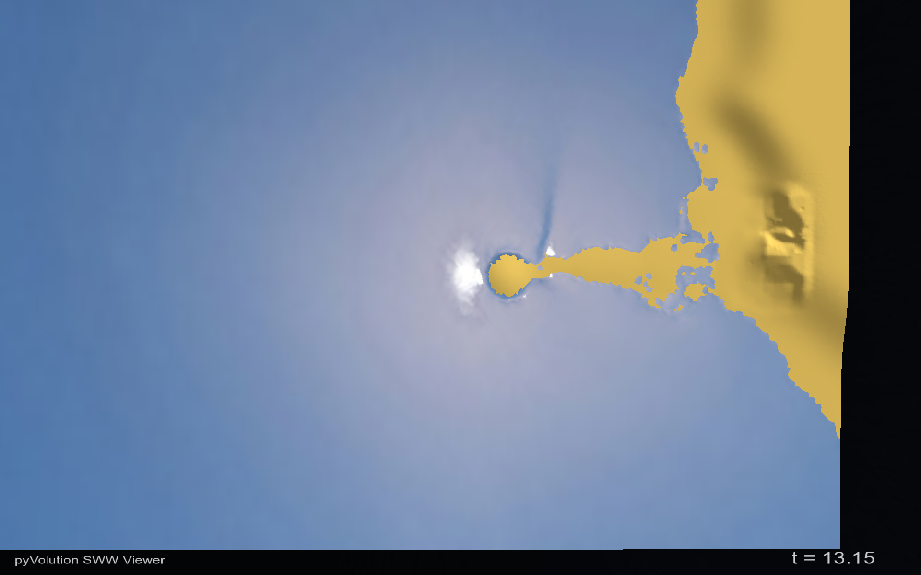
Okushiri Island
Sea of Japan
Drawdown
Monai Valley

Slide 35
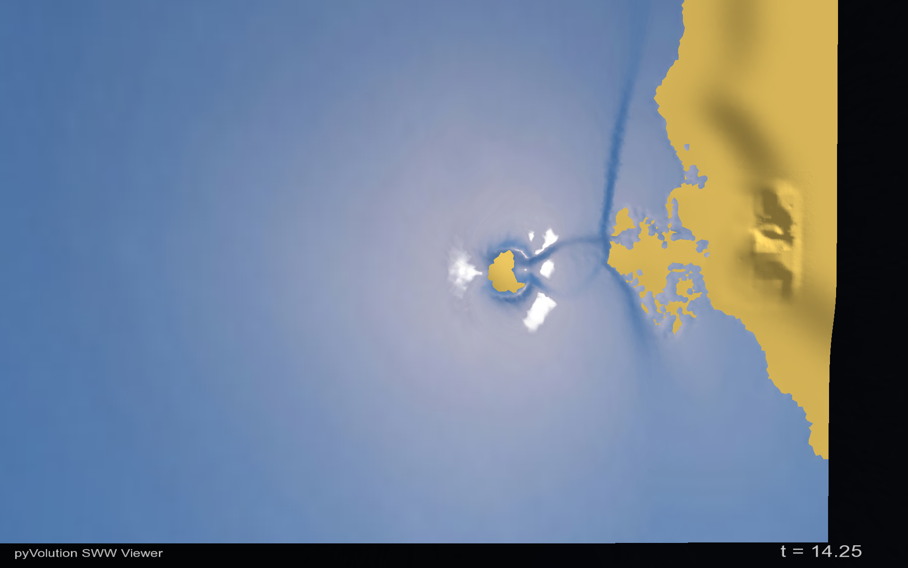
Okushiri Island
Sea of Japan
Monai Valley

Slide 36
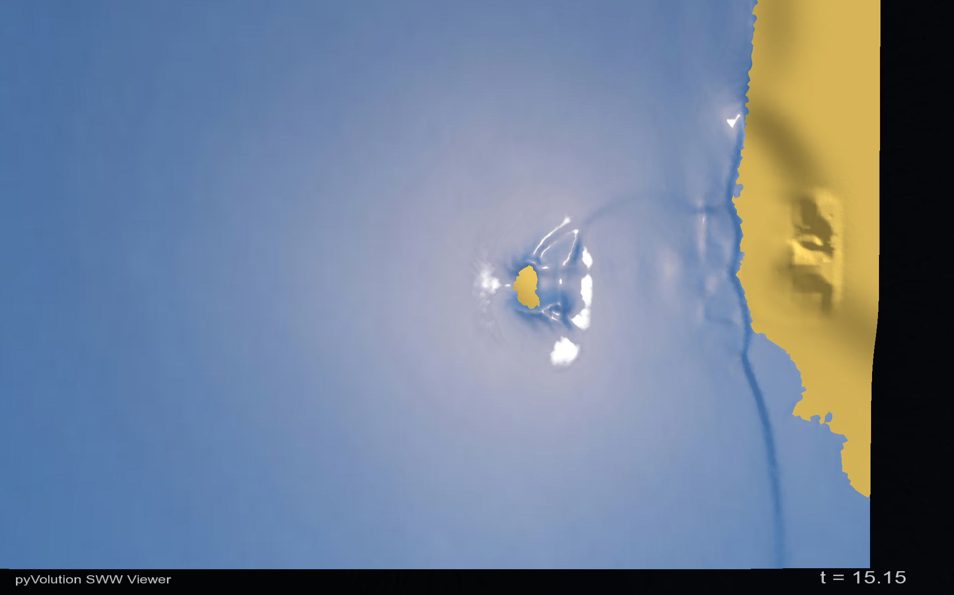
Okushiri Island
Sea of Japan
Monai Valley

Slide 37
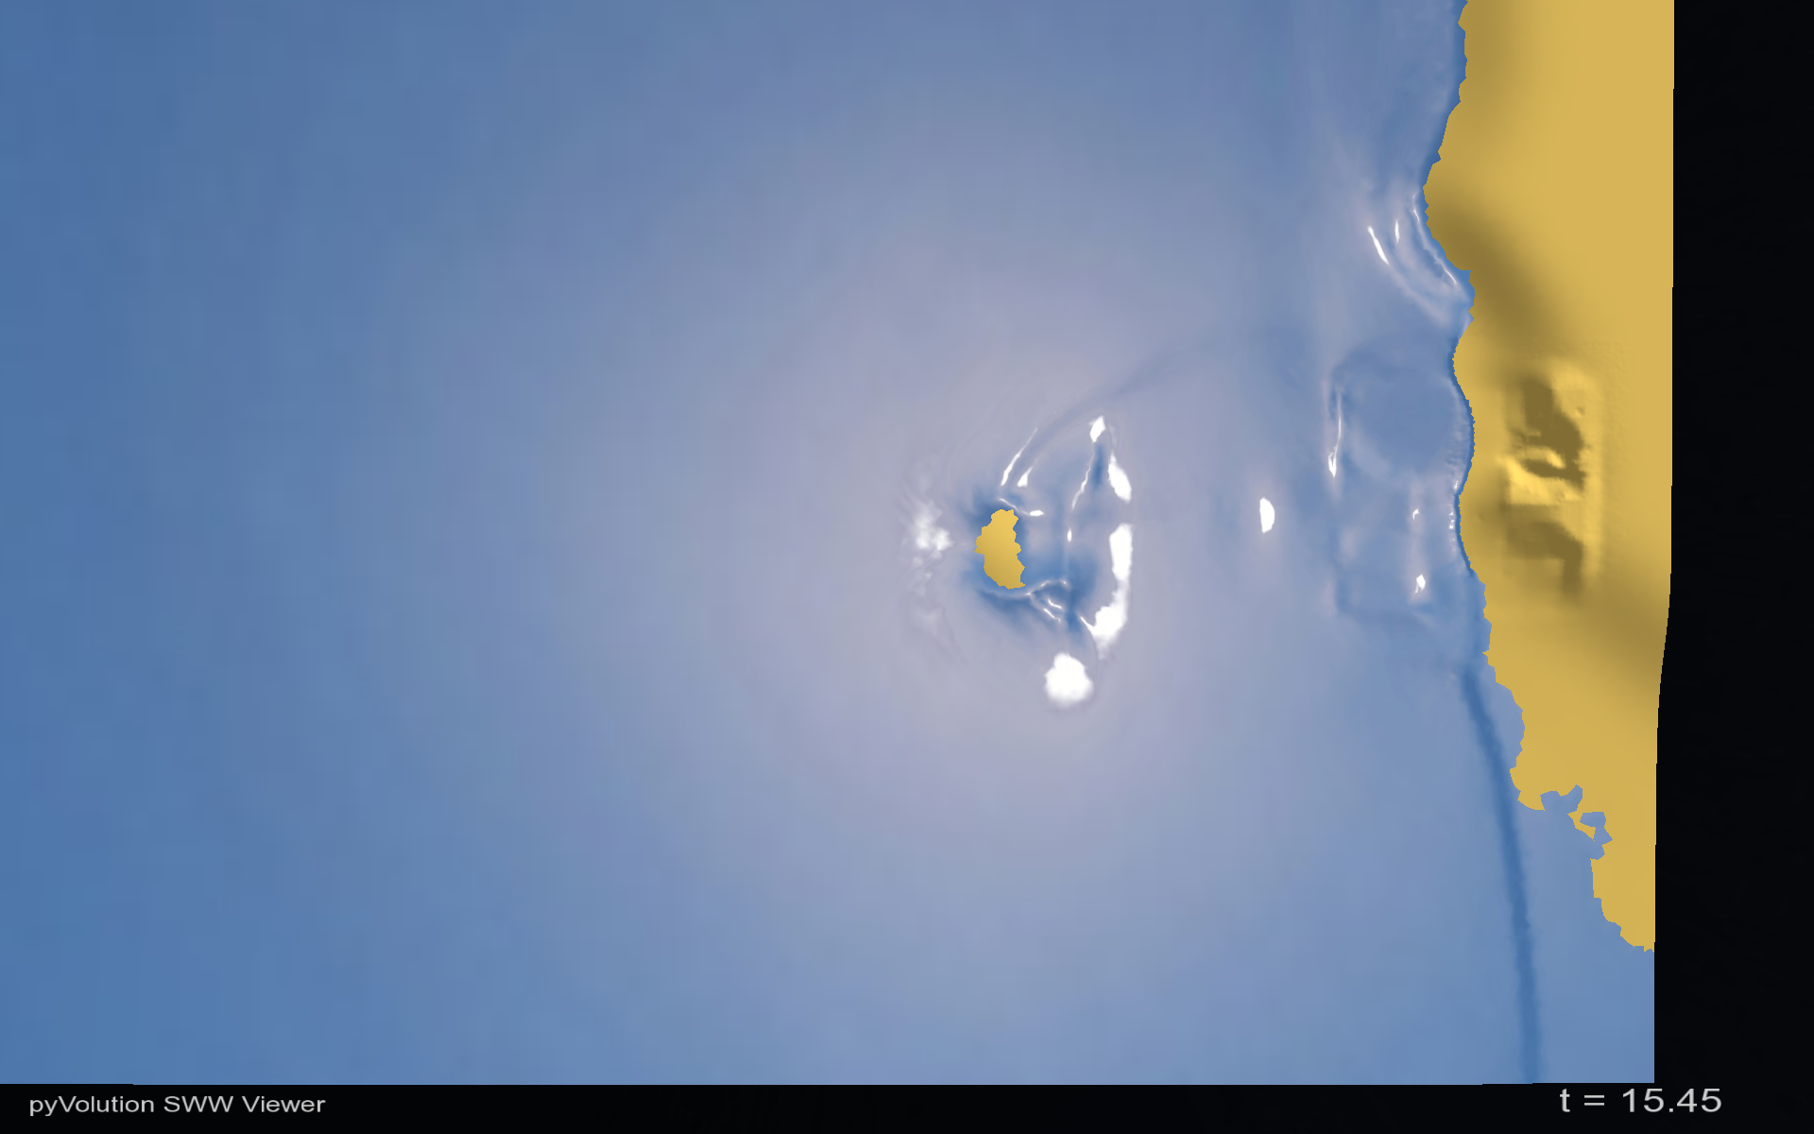
Reflection
Okushiri Island
Sea of Japan
Monai Valley

Slide 38
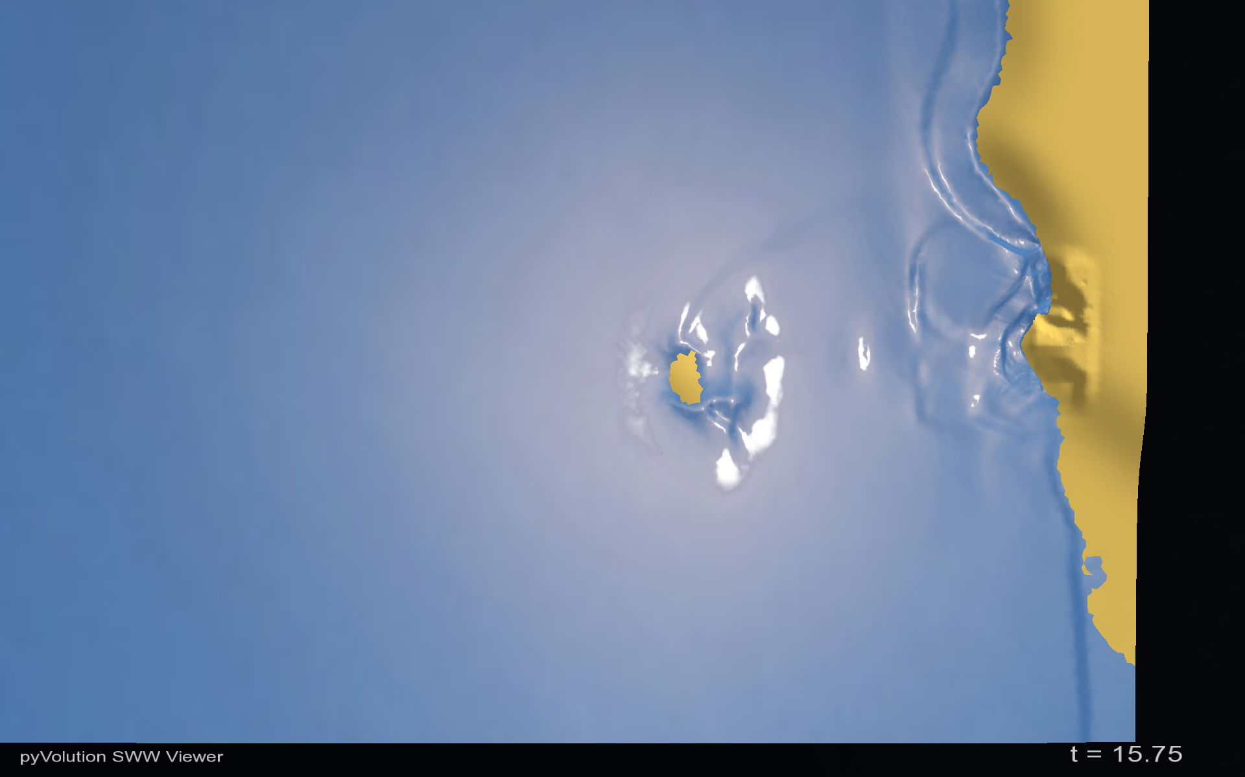
Reflection
Okushiri Island
Sea of Japan
Monai Valley

Slide 39
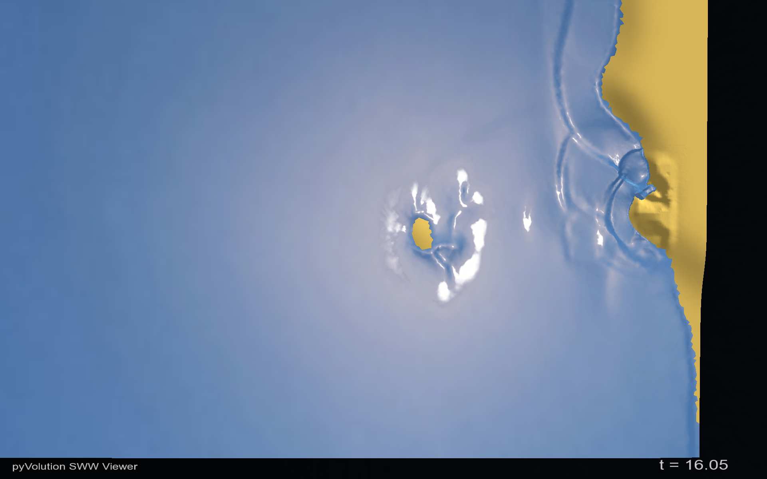
Okushiri Island
Sea of Japan
Shoaling
Monai Valley

Slide 40
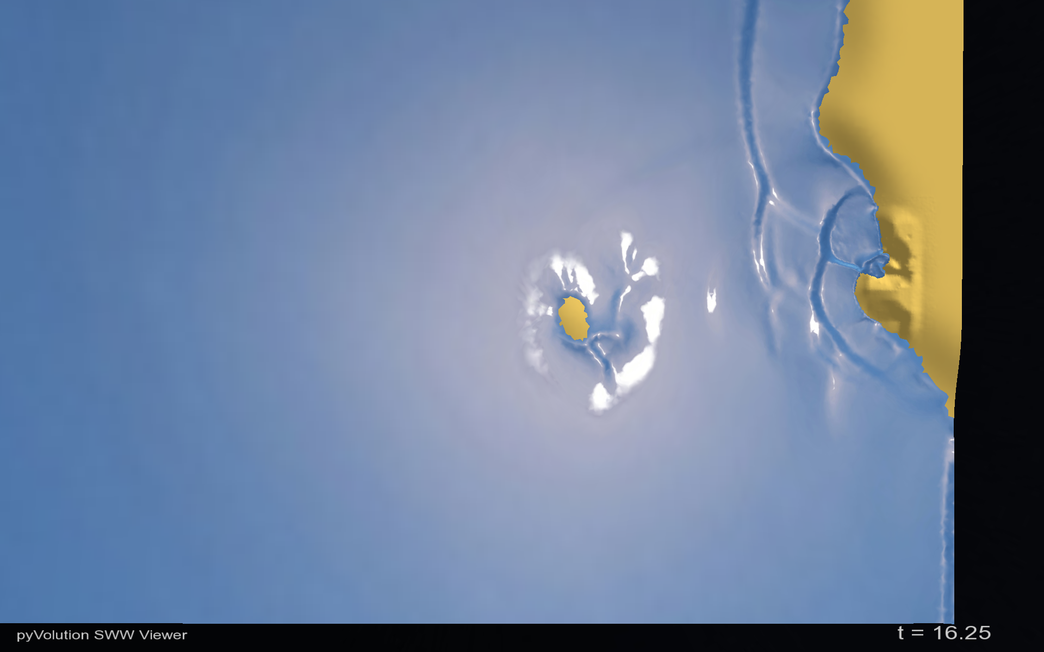
Okushiri Island
Sea of Japan
Monai Valley
Run up

Slide 41
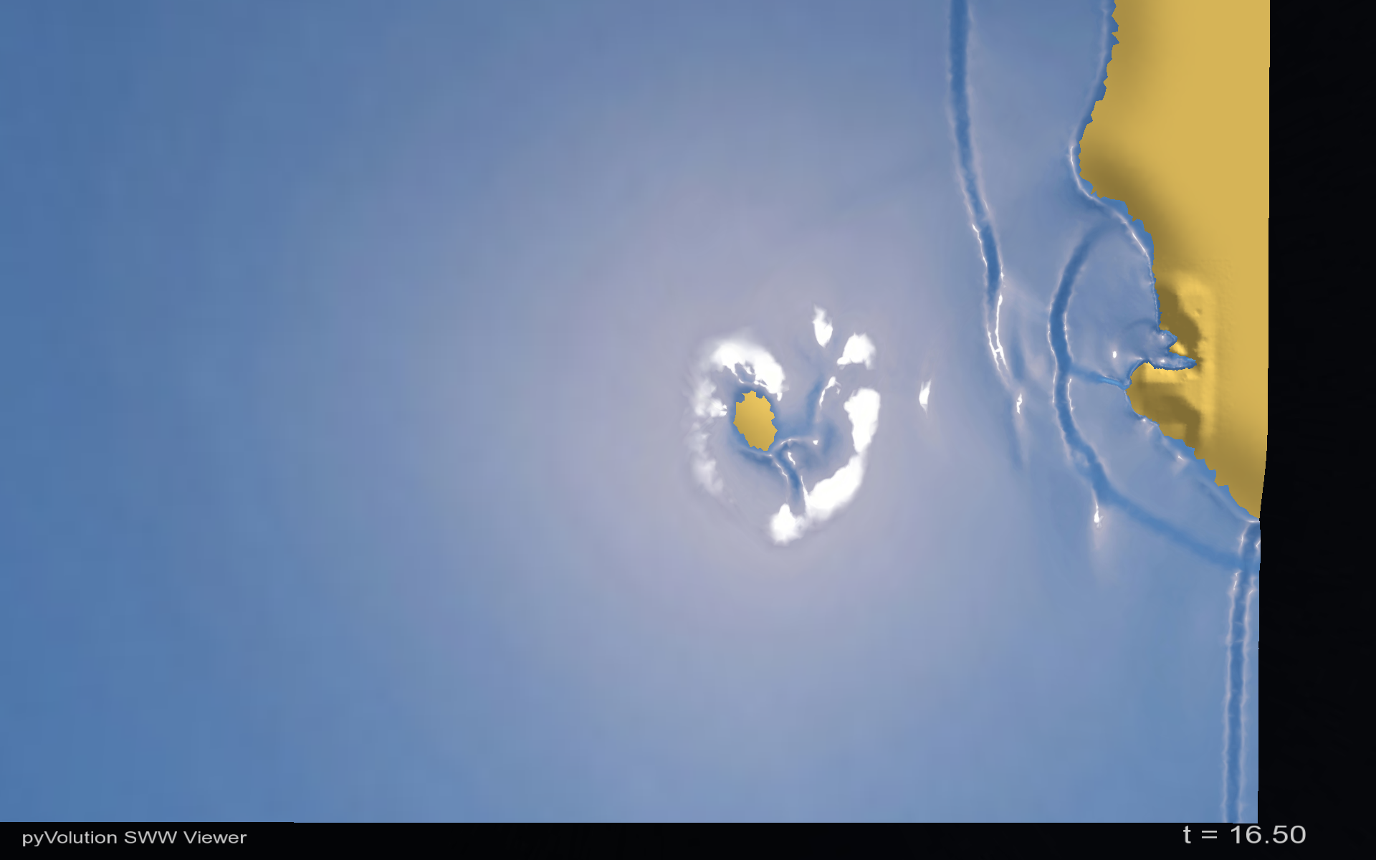
Okushiri Island
Sea of Japan
Monai Valley
Run up

Slide 42

Okushiri Island
Sea of Japan
Monai Valley
Run up

Slide 43
Testing and validation
890 individual unit tests
Numerous wave tank experiments
2004 Tsunami impact on Patong Beach

Slide 44
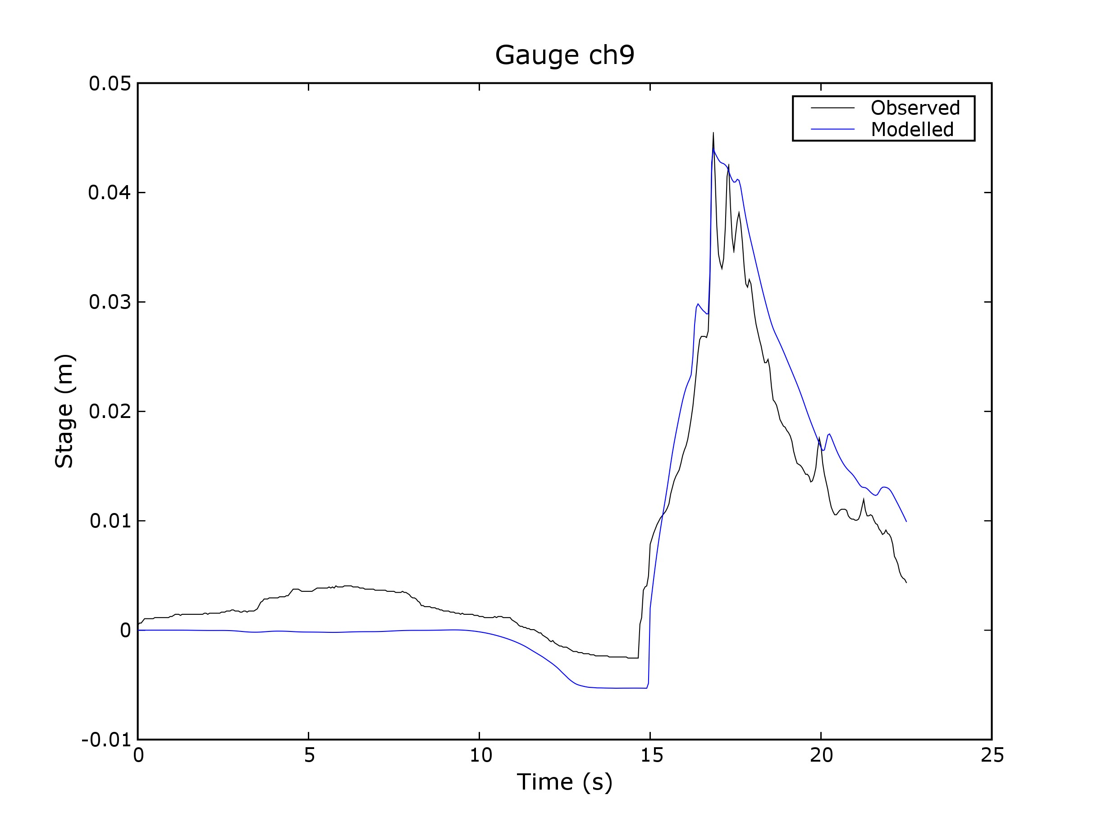

Slide 45
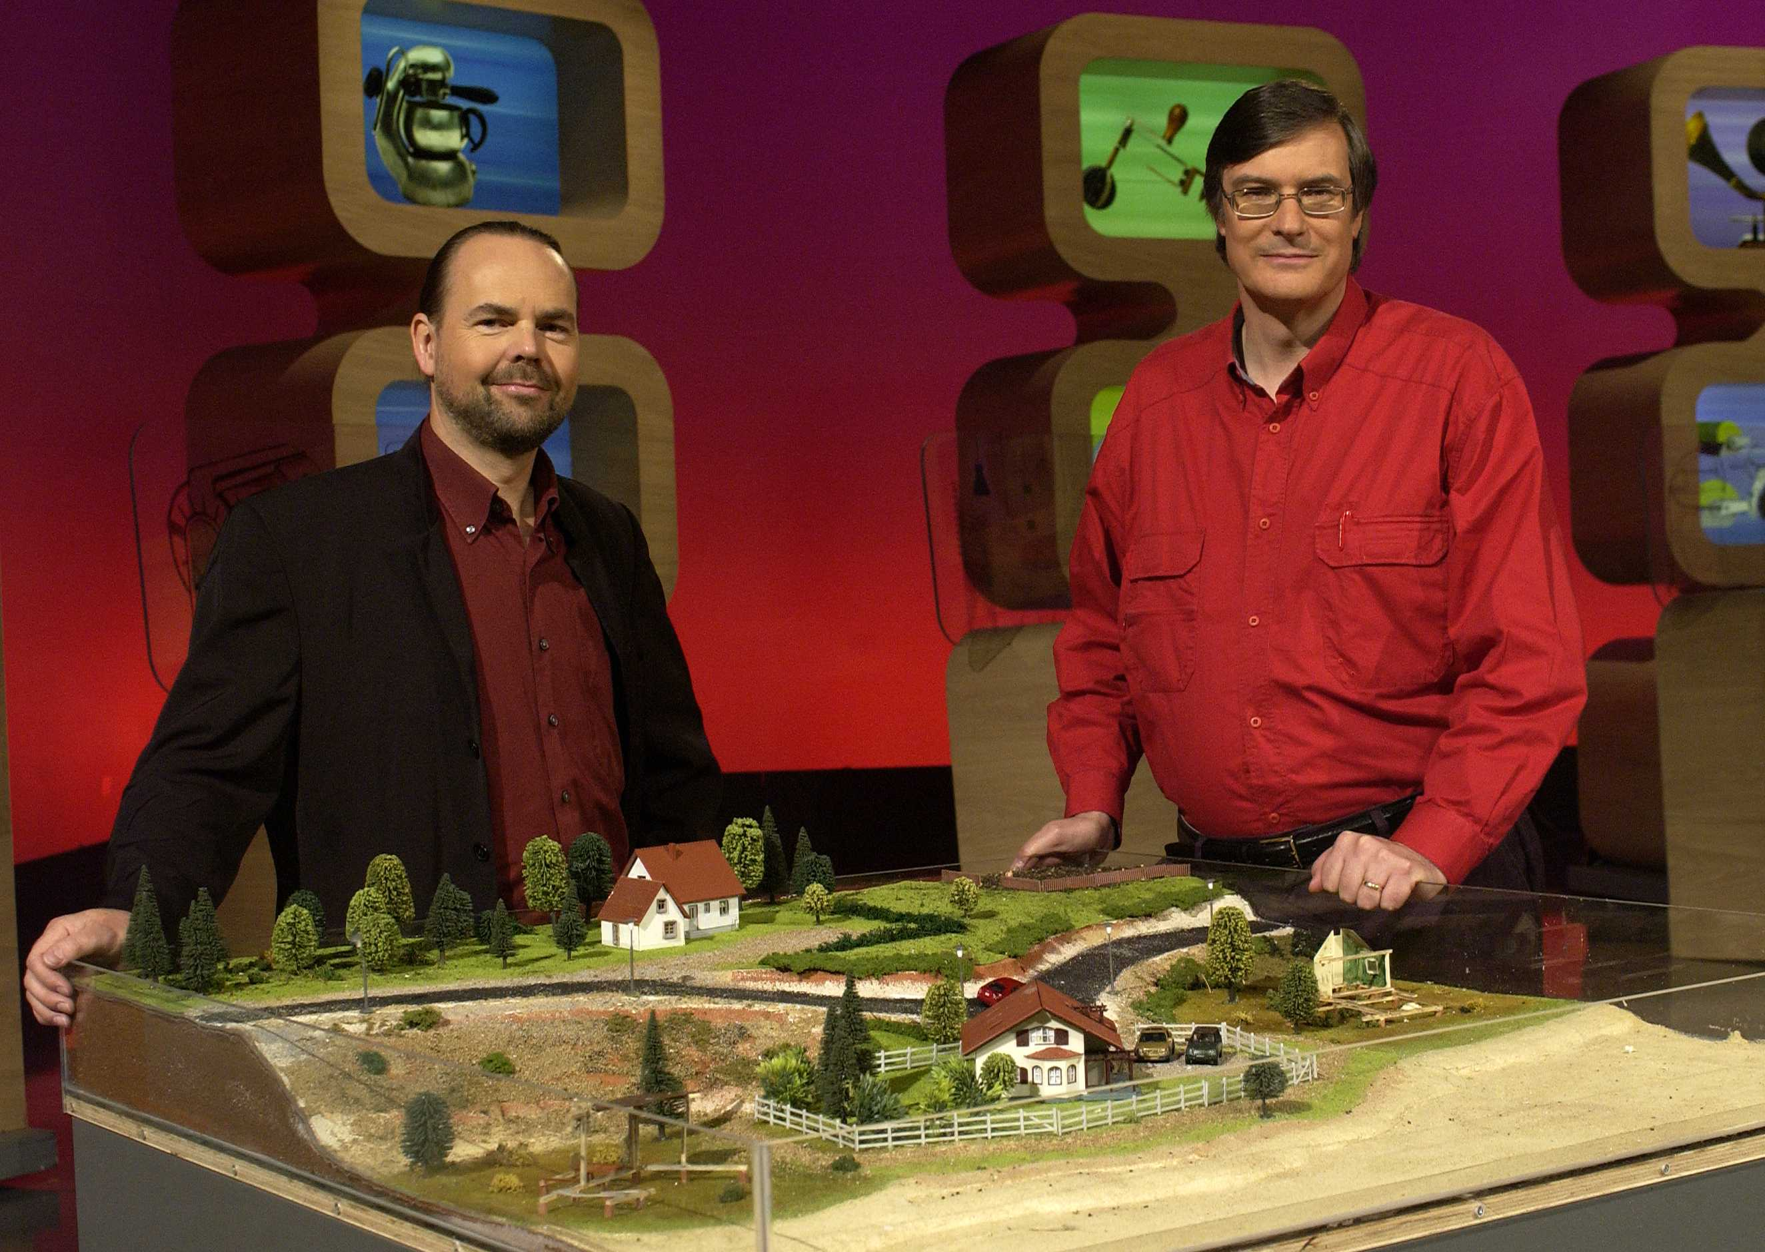
Featured on Australian TV
Further information:
Email: Ole.Nielsen@ga.gov.au
Stephen.Roberts@anu.edu.au
Google Search: ANUGA software
(ANUGA by itself will get German food fair)

Slide 46

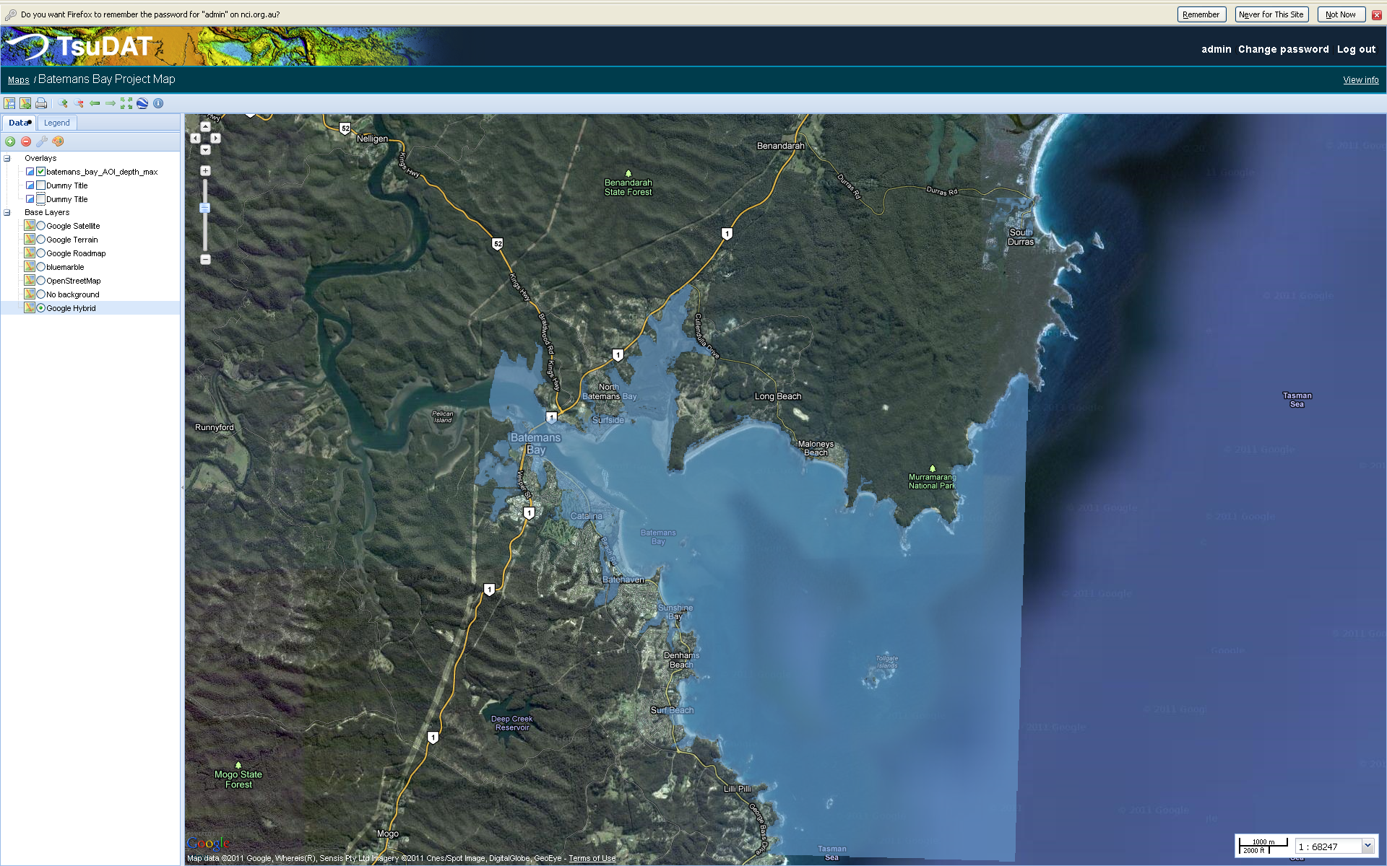
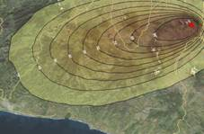


Python in International Development (2009 - )
And Python for everything else (e.g. building Beowulf........)
ANUGA: Hydrodynamic Hazards
EQRM: Probabilistic Earthquake Risk
TsuDAT: Tsunami Hazard
Python-FALL3D: Volcanic Ash
InaSAFE: Mapping Disaster Impact
Pypar: parallel computing

Slide 47

7 noble steps to software that works
No news is good news
If it can't install – it doesn't exist
Without docs – it doesn't exist
Without testing – it doesn't exist
There is no future without a past
Do it in style
Get it right – then fast

Slide 48
No news is good news
Either do as requested or raise an exception
Good error messages help everyone
Exception handling allow the error to treated at the appropriate level
  Index error at low level becomes a matter of selecting a viewport at a higher level
  XML parse error is typically not helpful at application level – it should explain why
  Conditions like file cannot open or division by zero can often be handled sensibly without raising errors.

Slide 49
Recent error messages I have seen
  (my>ky) failed for hidden my: regrid_smth:my=2
  syntax error: line 1, column 0
  write_dbs_grid: error in nf90_enddef

Slide 50
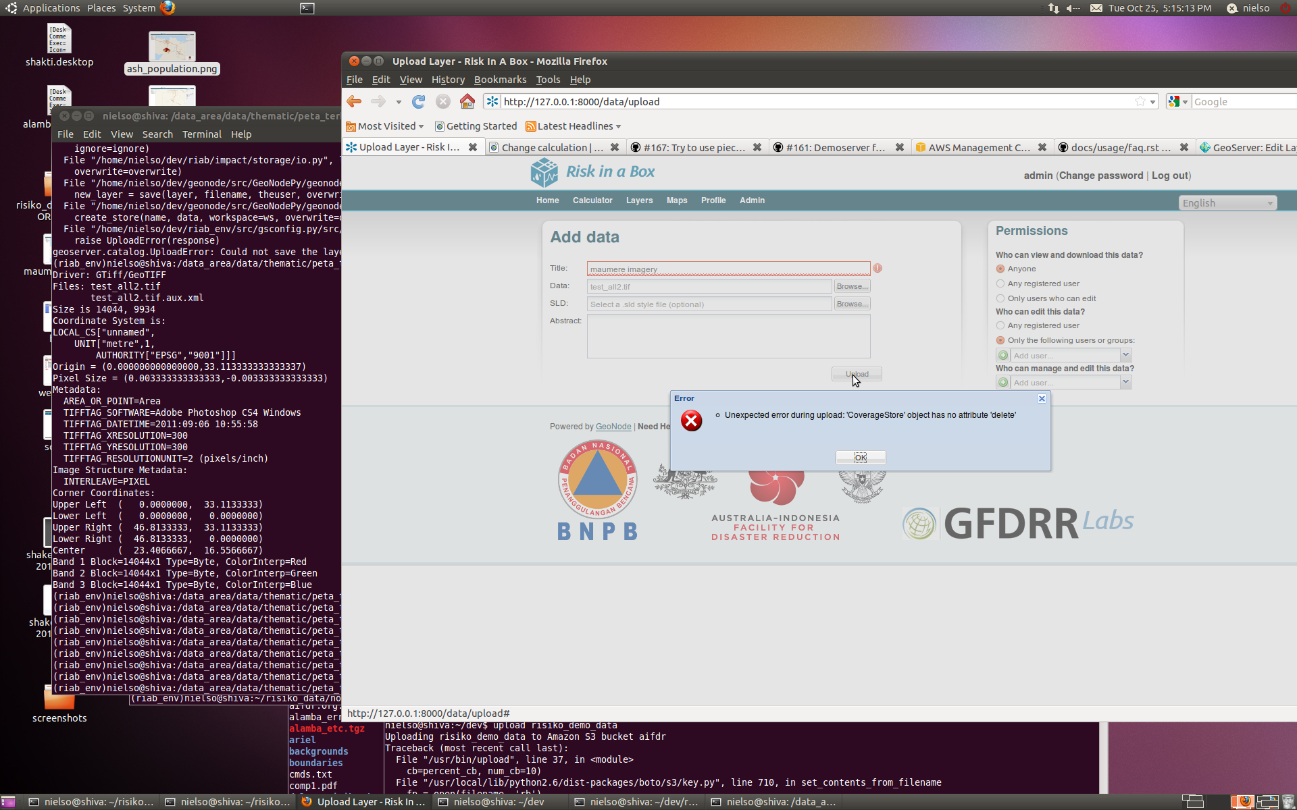

Slide 51
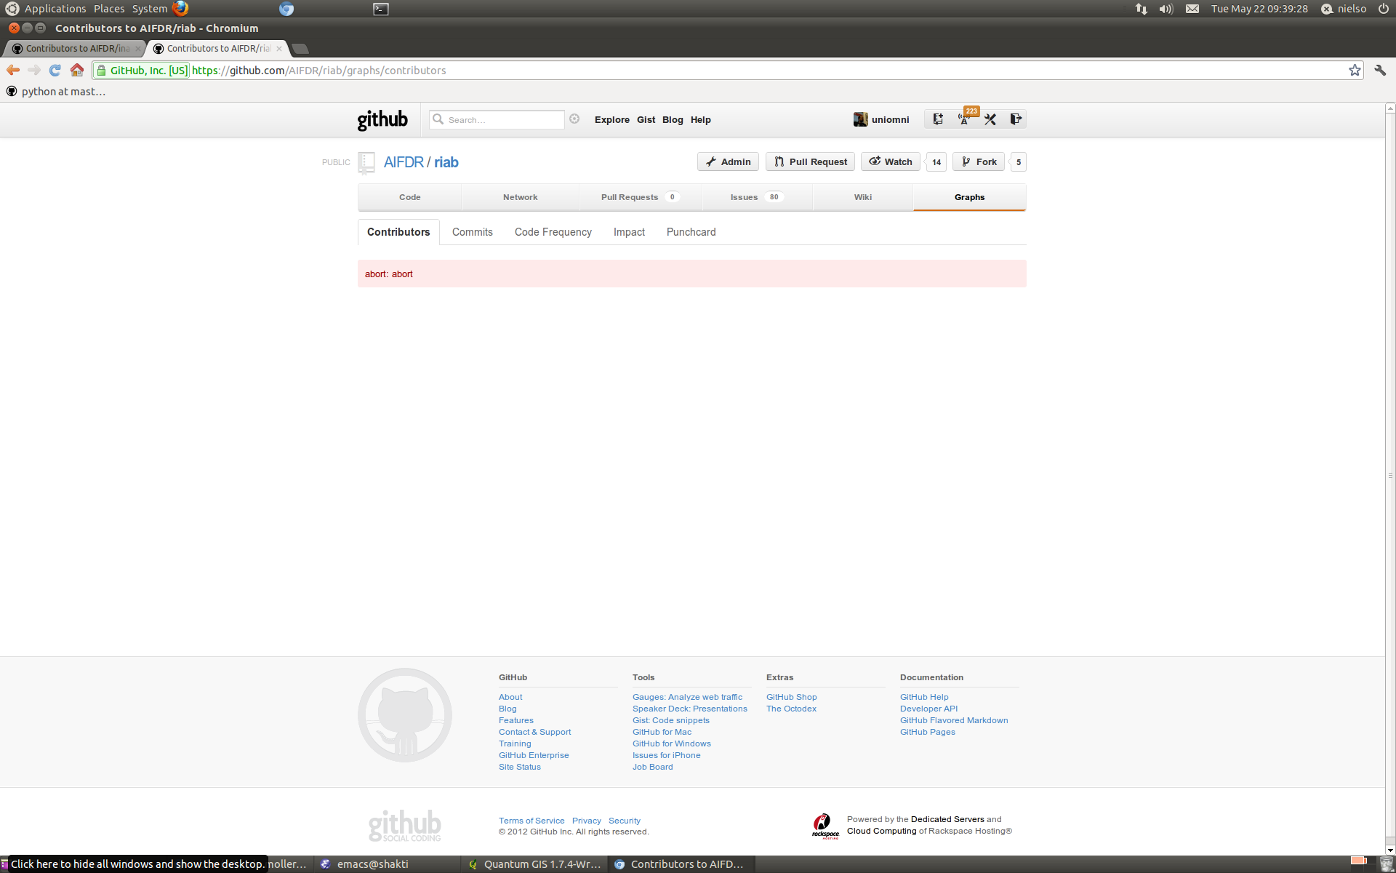

Slide 52
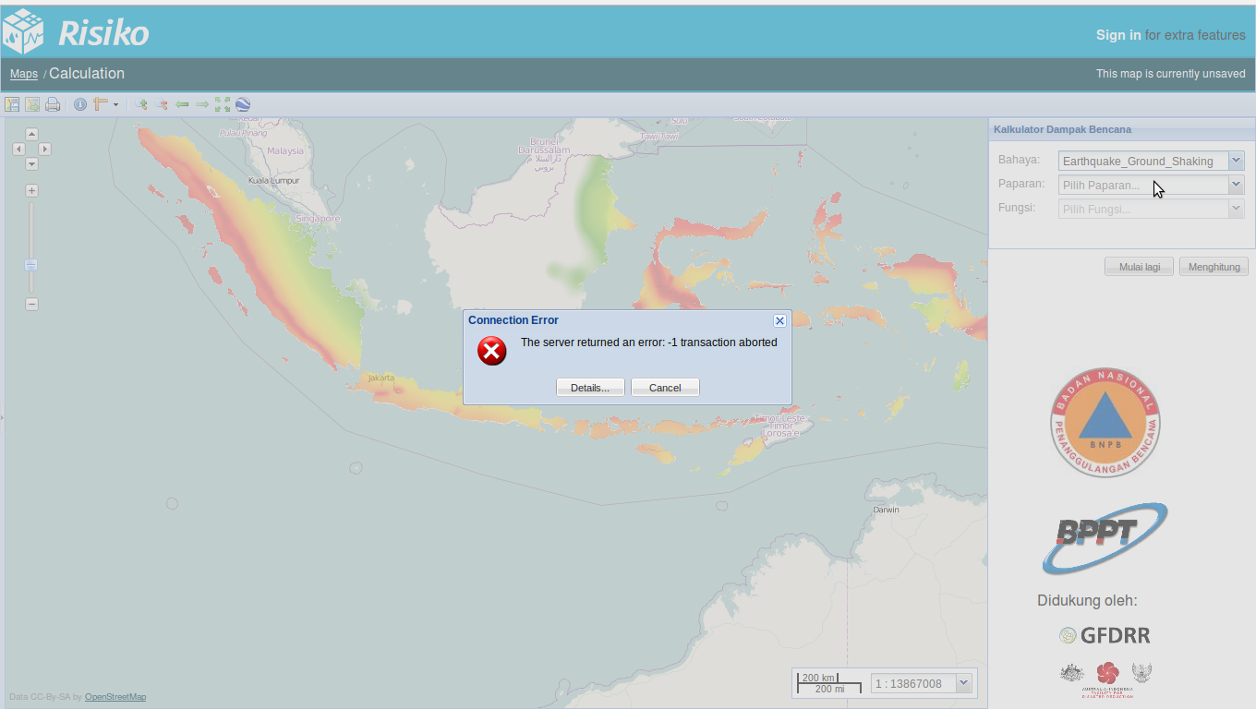

Slide 53
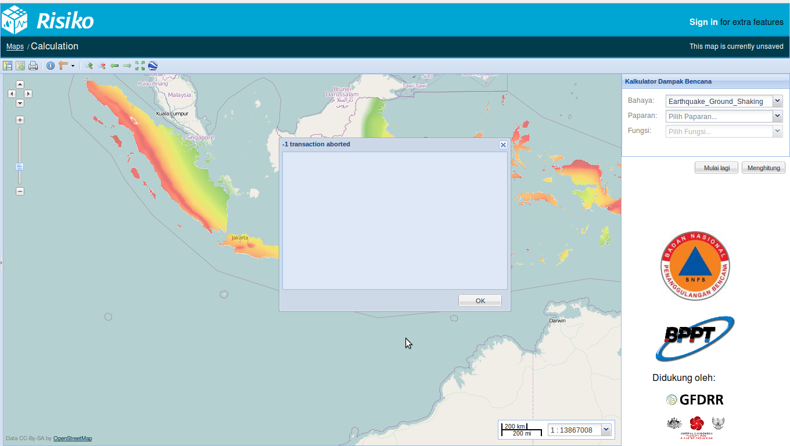

Slide 54
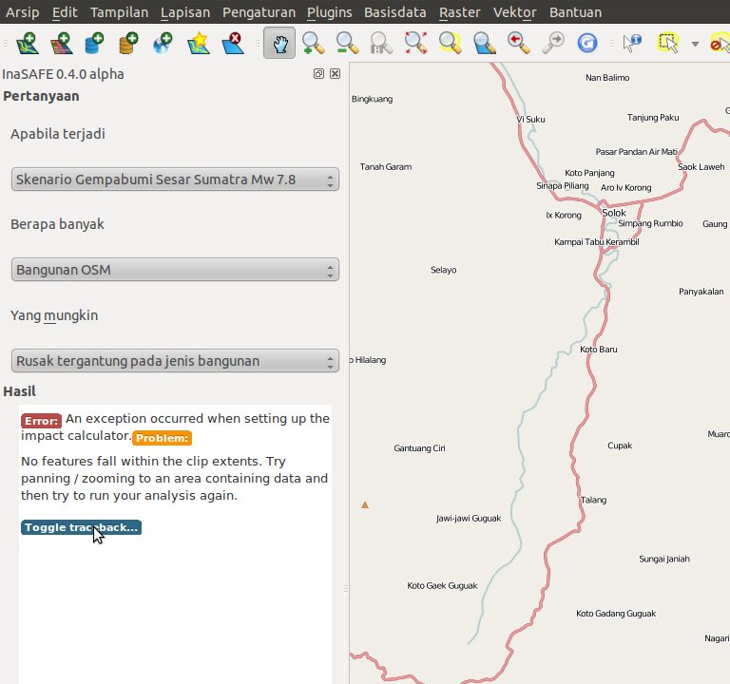
Good error message
if myCount < 1:
myMessage = tr('No features fall within the clip extents. '
'Try panning / zooming to an area containing data '
'and then try to run your analysis again.')
raise NoFeaturesInExtentException(myMessage)

Slide 55
try:
infile = open(self.projection_file)
except IOError:
msg = ('Projection file %s could not be opened. '
'The topography file must have a projection file with '
'extension .prj to georeference the model outputs '
'correctly. The projection file is assumed to follow '
'the ESRI WKT format ' % self.projection_file)
raise Exception(msg)
if intersection_bbox is None:
# Bounding boxes did not overlap
msg = ('Bounding boxes of hazard data [%s], exposure data [%s] '
'and viewport [%s] did not overlap, so no computation was '
'done. Please make sure you pan to where the data is and '
'that hazard and exposure data overlaps.'
% (bboxlist2string(haz_bbox, decimals=3),
bboxlist2string(exp_bbox, decimals=3),
bboxlist2string(vpt_bbox, decimals=3)))
logger.info(msg)
raise Exception(msg)

Slide 56
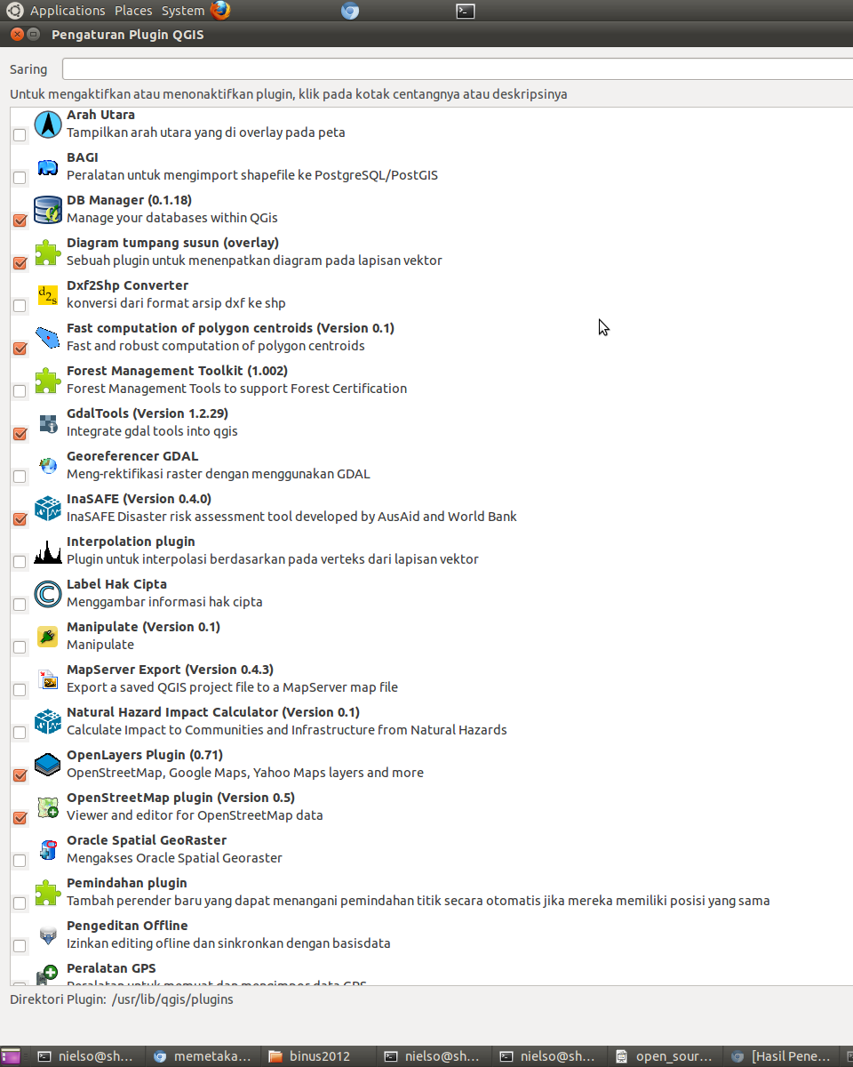

If it can't install – it doesn't exist
Should be simple – otherwise potential users/contributers will be wasting their time and loose interest. E.g. InaSAFE deployment is done from within QGIS

Slide 57
Without docs – it doesn't exist
Minimum is
  installation documentation
  how to run a few examples
  docstrings
Ideally – documentation driven
Critical if software is to take on its own life

Slide 58


Slide 59
Bad docstrings
def create_style(self, style_name):
def delete_style(self, style_name):
"""docstring for delete_style"""
def compatible_layers(func, layer_descriptors):
"""Fetches all the layers that match the plugin requirements.

Slide 60
Good docstrings
def osm2padang(E):
"""Map OSM attributes to Padang vulnerability classes
This maps attributes collected in the OpenStreetMap exposure data
(data.kompetisiosm.org) to 9 vulnerability classes identified by
Geoscience Australia and ITB in the post 2009 Padang earthquake
survey (http://trove.nla.gov.au/work/38470066).
The mapping was developed by Abigail Baca, GFDRR.
Input
E: Vector object representing the OSM data
Output:
Vector object like E, but with one new attribute ('VCLASS')
representing the vulnerability class used in the Padang dataset
Algorithm
…
...

Slide 61
def interpolate2d(x, y, Z, points, mode='linear', bounds_error=False):
"""Fundamental 2D interpolation routine
Input
x: 1D array of x-coordinates of the mesh on which to interpolate
y: 1D array of y-coordinates of the mesh on which to interpolate
Z: 2D array of values for each x, y pair
points: Nx2 array of coordinates where interpolated values are sought
mode: Determines the interpolation order. Options are
'constant' - piecewise constant nearest neighbour interpolation
'linear' - bilinear interpolation using the four
nearest neighbours (default)
bounds_error: Boolean flag. If True (default) an exception will
be raised when interpolated values are requested
outside the domain of the input data. If False, nan
is returned for those values
Output
1D array with same length as points with interpolated values
Notes
Input coordinates x and y are assumed to be monotonically increasing,
but need not be equidistantly spaced.
Z is assumed to have dimension M x N, where M = len(x) and N = len(y).
In other words it is assumed that the x values follow the first
(vertical) axis downwards and y values the second (horizontal) axis
from left to right.

Slide 62
Without testing – it doesn't exist
Not possible to manually test all aspects and case of a complex software project – must be automatic!
Known as unit-, regression-, system-, integration- or stress-testing
Have tests for the functionality you care about
The extra time invested comes back 100 fold when debugging, refactoring and moving to new platforms
Also serves as trusted documentation
The single most important practice – I'd rather keep my tests than the source code
InaSAFE has over 200 tests - ANUGA almost 1000,

Slide 63


Centroid formula

Slide 64


Slide 65

Hower not good for smaller scales

Slide 66
Solution is Normalisation
# Normalise to ensure numerical accurracy.
# This requirement in backed by tests in test_io.py and without it
# centroids at building footprint level may get shifted outside the
# polygon!
P_origin = numpy.amin(P, axis=0)
P = P - P_origin
# Calculate centroids as usual
# Translate back to real location
C = numpy.array([Cx, Cy]) + P_origin
return C

Slide 67

After Normalisation

Slide 68
Hower not good for smaller scales

Slide 69

InaSAFE test suite

Slide 70

InaSAFE test coverage

Slide 71

No future without a past
Revision Control (svn, cvs, git, …..)
Tracking (main thing is linking commits to issues)

Slide 72
Do it in style
delta_x = bbox[2 ] -bbox[ 0 ]
deltA_y =bbox[3] - bbox[1]
if delta_x<min_res:
dx = ( min_res - delta_x )/2+eps
bbox[ 0 ] -= dx; bbox[2] += dx
if deltA_y < min_res:
dy=(min_res - deltA_y) / 2 + eps
bbox[1] -= dy
bbox[3] += dy
return bbox
delta_x = bbox[2] - bbox[0]
delta_y = bbox[3] - bbox[1]
if delta_x < min_res:
dx = (min_res - delta_x) / 2 + eps
bbox[0] -= dx
bbox[2] += dx
if delta_y < min_res:
dy = (min_res - delta_y) / 2 + eps
bbox[1] -= dy
bbox[3] += dy
Return bbox
PEP8 style guide for Python

Slide 73
7. Get it right – then fast
Recipe refined during development of ANUGA
Write one or two tests
Implement brute force simple algorithm
Implement smarter algorithm and more tests
After profiling, write bottlenecks in C using test suite to maintain correctness
Don't optimise without profiling and testing

Slide 74
Why Open Source
Security
Quality
Customisability
Freedom
Flexibility
Interoperability
Auditability
Cost
Try before you buy
http://www.pcworld.com/businesscenter/article/209891/10_reasons_open_source_is_good_for_business.html

Slide 75
Why we use and make Open Source
Open Source makes software better
  Generates interest and attracts feedback
  Facilitates re-use
  Helps in capacity building
  Critical to scientific reproducibility
Open Source principles underpin the
Australian-Indonesian Facility for Disaster Reduction

Slide 76
Thank You!
Questions?

