Slide 1
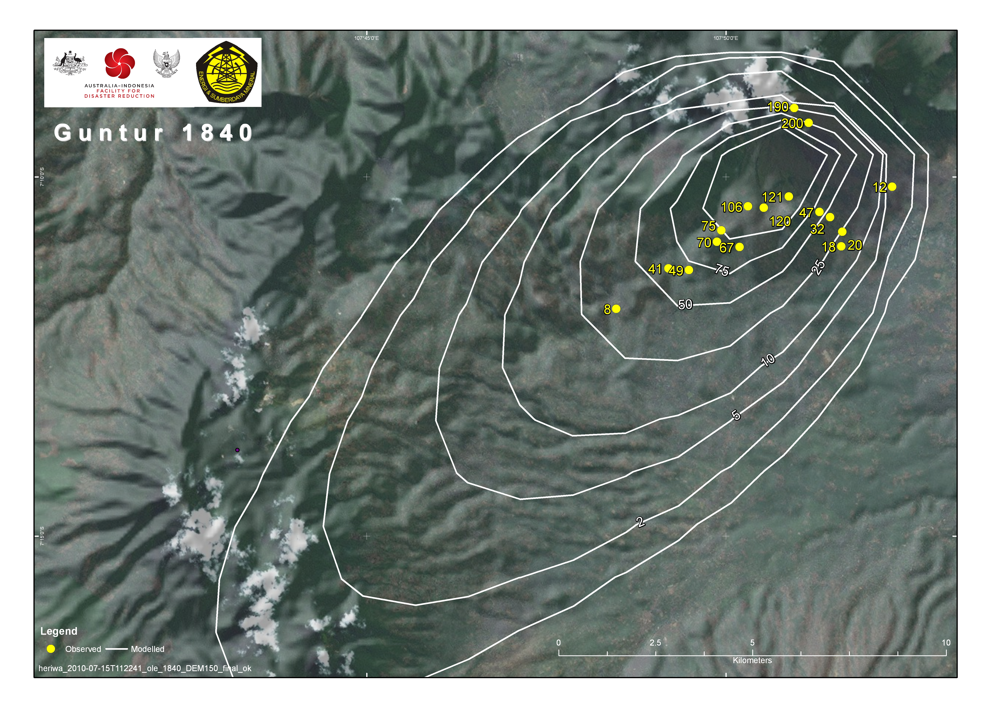
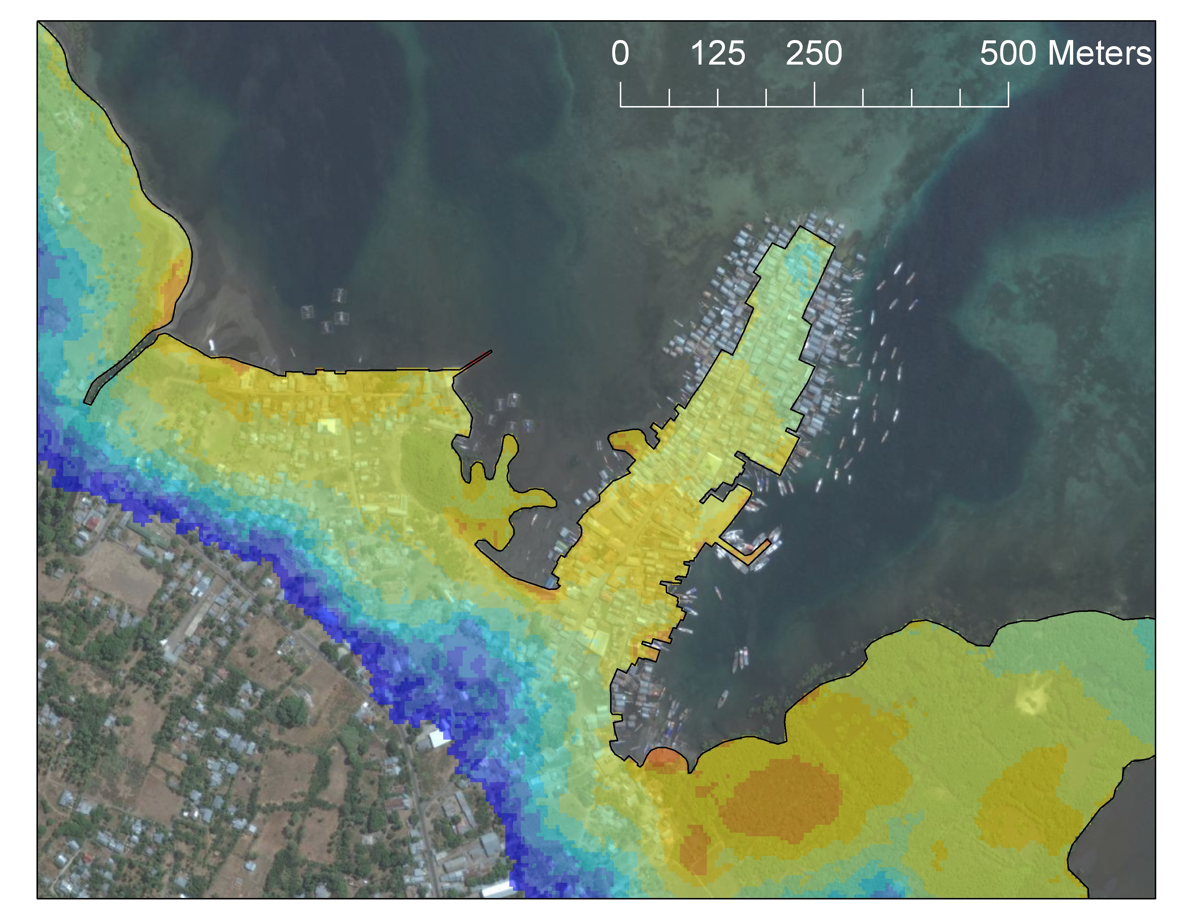
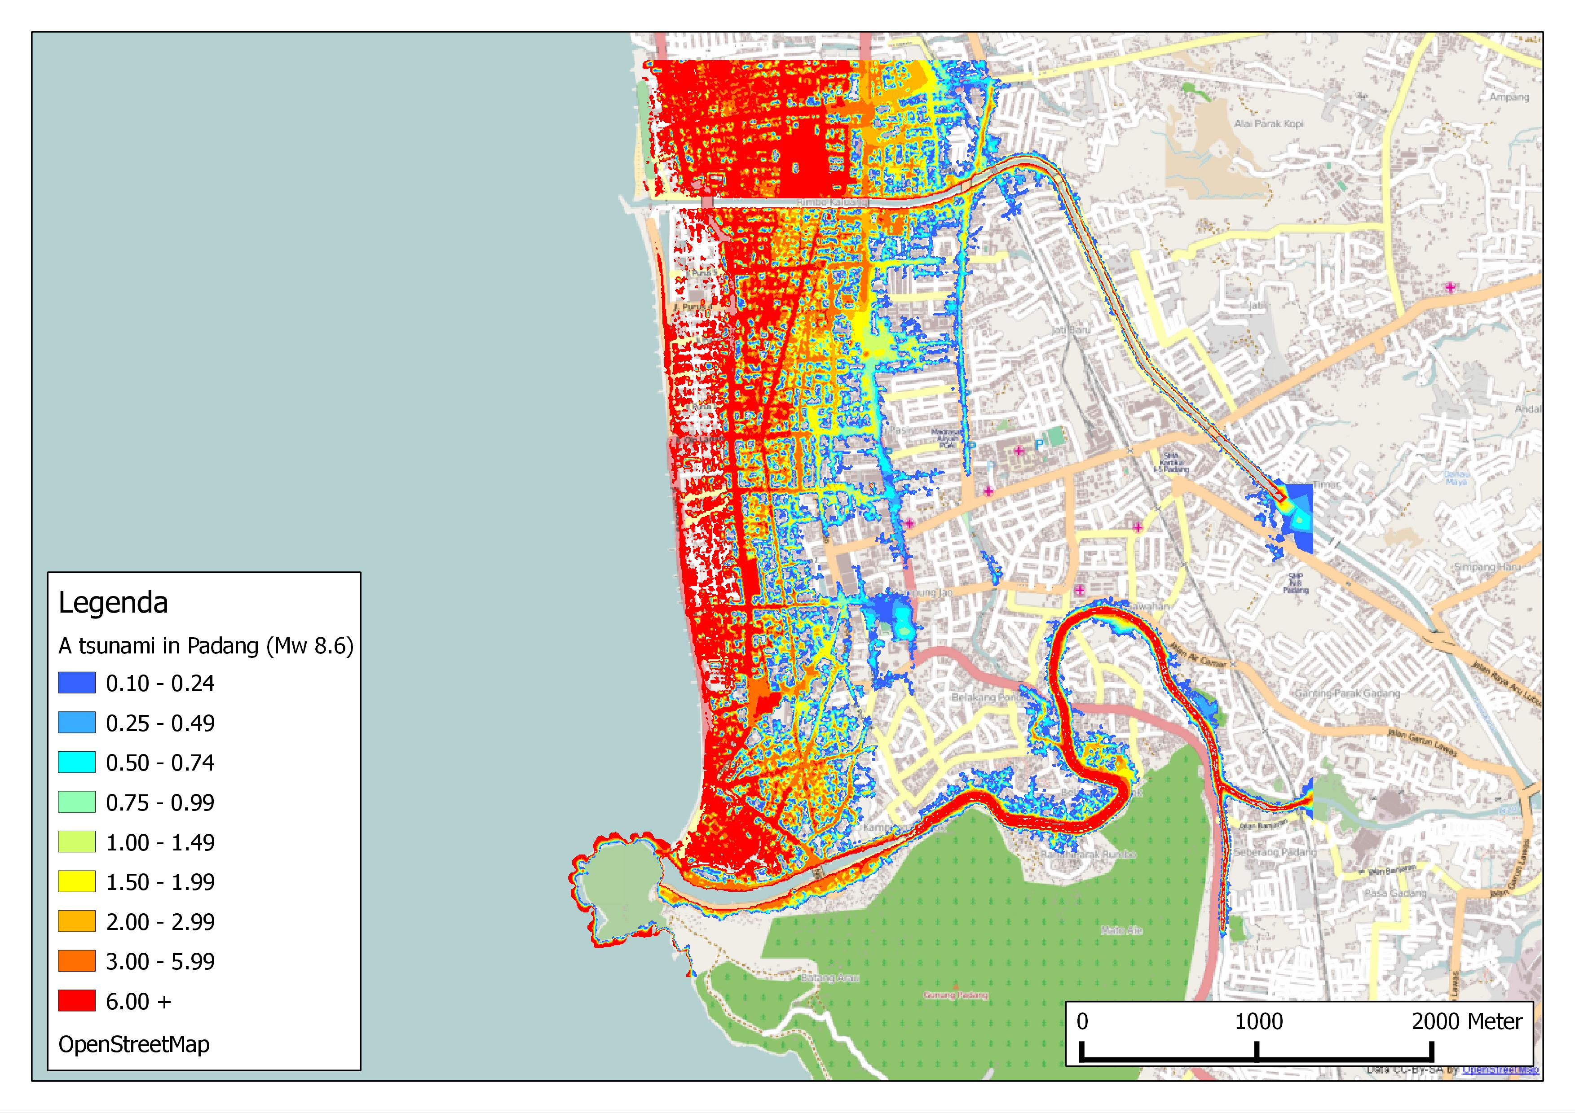
Putting stuff on maps 101

Slide 2



Math vs Maps
Spatial Capabilities
Numerical Algorithms
http://www.qgis.org

Slide 3
Prerequisites
Familiarity with Python and Numpy
Familiarity with Linux
Code is platform independent, but tutorial designed for a Debian/Ubuntu/Mint system.
Dependencies are: python, python-numpy, python-gdal and qgis

Slide 4
Outline
Learn to Read and Write (spatial data)
View and overlay spatial data
Geoprocessing exercises
Note for this tutorial:
All coordinates in geographic coordinates in datum WGS84.
Tools will work with any spatial reference.

Slide 5
Spatial Information Formats
Raster Data (Grids)
  Ascii format
  GeoTiff
Vector Data (Points, Lines, Polygons)
  Shape format
  KML (Google Earth)

Slide 6
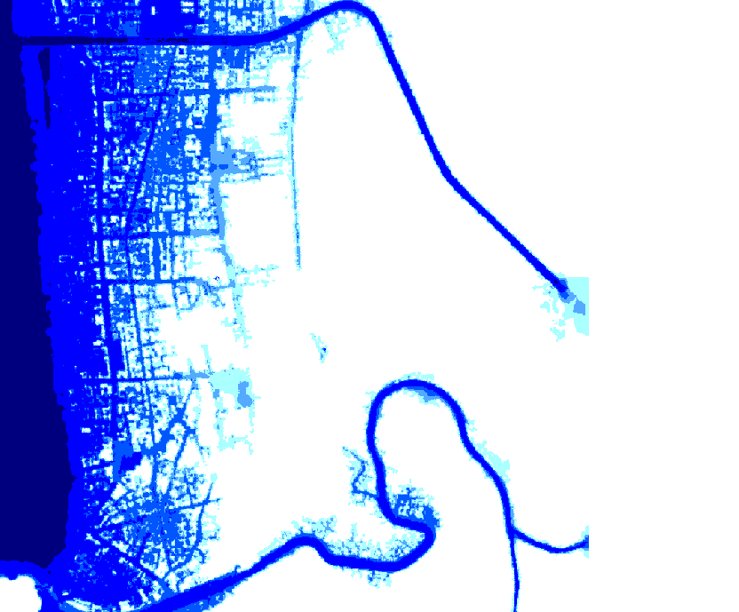
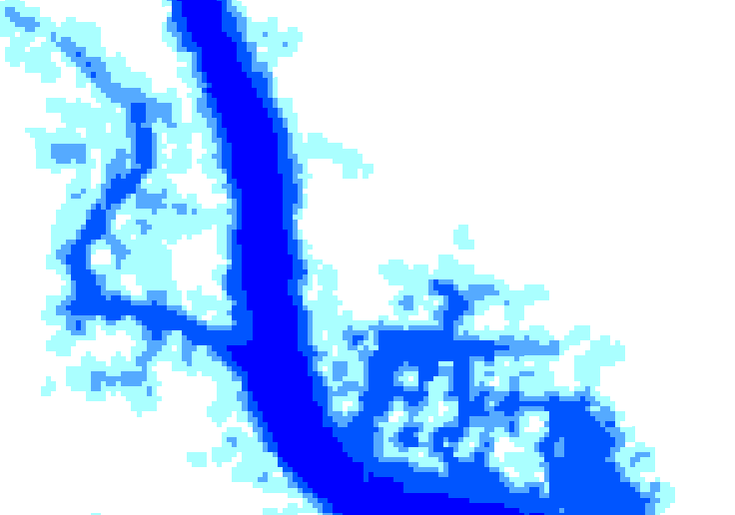
Raster Example

Slide 7
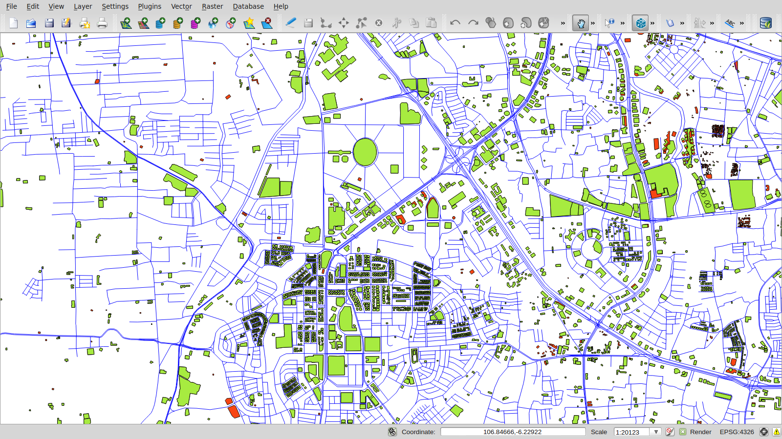
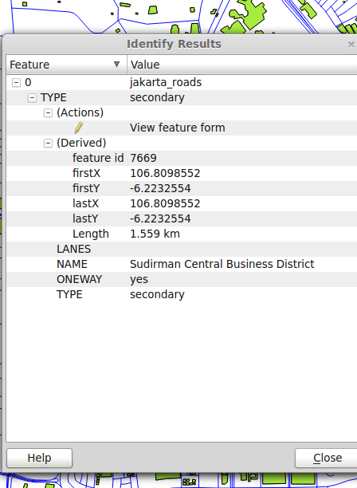
Vector Example

Slide 8
Some GIS tools
Quantum GIS: Analysis and Visualisation
GDAL (& Python Bindings): Geographic Data Abstraction Library (Frank Warmerdam)
GDAL doesn't really provide data in a Python/numpy friendly for, so we wrote wrappers around GDAL*:
https://github.com/AIFDR/inasafe/tree/master/safe/storage
* Also included in the tutorial material.

Slide 9
Writing spatial raster data
R = Raster(data=A, geotransform=G)
R.write_to_file(<filename>.tif) # or .asc
where
A: 2D numpy array
G: GDAL geotransform (see next slide) defining
where on earth the grid will be situated.

Slide 10
GDAL Geotransform
The affine geotransform consists of six coefficients which map grid cells into georeferenced space:
Top left x coordinate
W-E pixel resolution,
Rotation (always 0 if north is up)
Top left y coordinate
Rotation (always 0 if north is up)
N-S pixel resolution
Example (in geographic coordinates) with upper left corner at the IIT and a pixel resolution of 0.008333, 0.008333 (approx 1km x 1km):
[72.91645, 0.008333, 0, 19.12543, 0, -0.008333]

Slide 11
Reading spatial raster data
R = read_layer(<filename>.asc) (or .tif)
A = R.get_data() # Numpy array
G = R.get_geotransform() # GDAL ref
Wrapper can also do
R.get_geometry(): The grid axes - latitudes and longitudes
R.get_resolution()
R.get_bounding_box()
R.get_nodata_value() # Often -9999
R.get_extrema() # Ignoring NODATA value

Slide 12
Writing spatial vector data
V = Vector(geometry, attributes)
V.write_to_file(<filename>.shp) # or .kml
Geometry: List of points, lines or polygons
Attributes: List of dictionaries of attribute names and values
Exercise 1 will play with this

Slide 13
Reading spatial vector data
V = read_layer(<filename>.asc) (or .tif)
A = V.get_data() # Attributes
G = V.get_geometry() # Point, line or polygon

Slide 14
Install dependencies
For Debian/Ubuntu/Mint etc:
sudo apt-get install qgis python-numpy python-gdal
For Windows and Mac it works too, but I don't know the installation commands

Slide 15
Get The Source
Open a terminal
Download tarball from scipy website and unpack
Test the installation
cd source
python test_installation.py
To run exercises (from tutorial root):
export PYTHONPATH=. (Linux)
Set PYTHONPATH=. (Windows)
python exercises/exercise1a.py

Slide 16
Exercise 1 (a,b,c)
Read and write spatial data.
Raster data represented as numpy 2d array
Vector data represented as
  List of attributes (on dictionary per feature)
  List of geometries (point, lines or polygons)

Slide 17
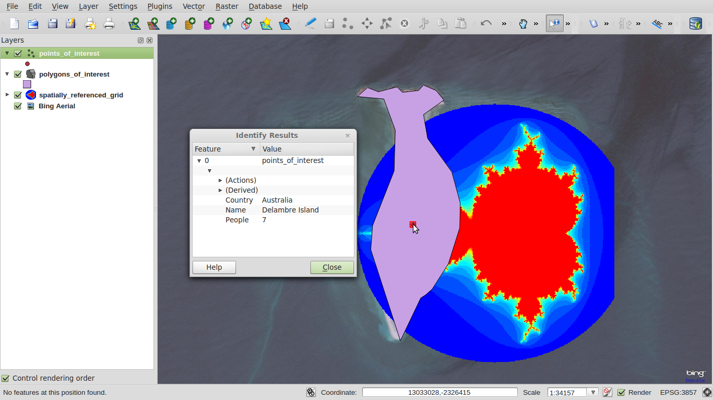
QGIS Screenshot of exercise 1 Data

Slide 18
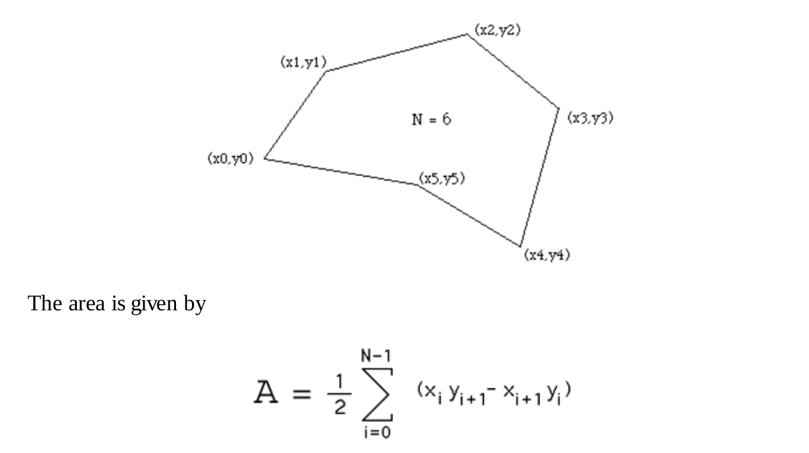
Exercise 2 – polygon area
Paul Bourke, 1988

Slide 19
Exercise 3 – use numpy
If the loop is written in Python it'll be slow.
Using numpy vector operations can speed things up several orders of magnitude.

Slide 20

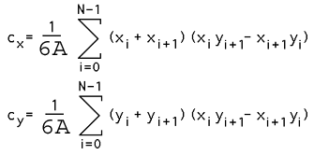
Exercise 4 & 5 – Polygon Centroids

Slide 21
Exercise 5 result
Calculated centroids stored, please review with qgis:
qgis ../spatial_test_data/kecamatan_geo.shp calculated_centroids_kecamatan_geo.shp ../spatial_test_data/kecamatan_geo_centroids.shp
Test 1 passed
Calculated centroids stored, please review with qgis:
qgis ../spatial_test_data/OSM_subset.shp calculated_centroids_OSM_subset.shp ../spatial_test_data/OSM_subset_centroids.shp
Traceback (most recent call last):
File "exercises/exercise5.py", line 179, in <module>
assert numpy.allclose(c_geometry, r_geometry, rtol=1.0e-9), msg
AssertionError: Centroids of OSM_subset.shp were not correct

Slide 22
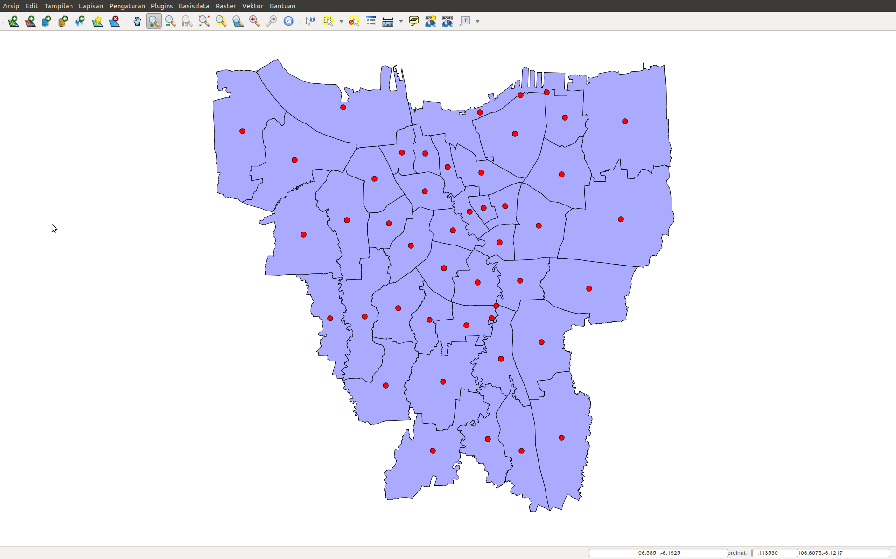

Slide 23
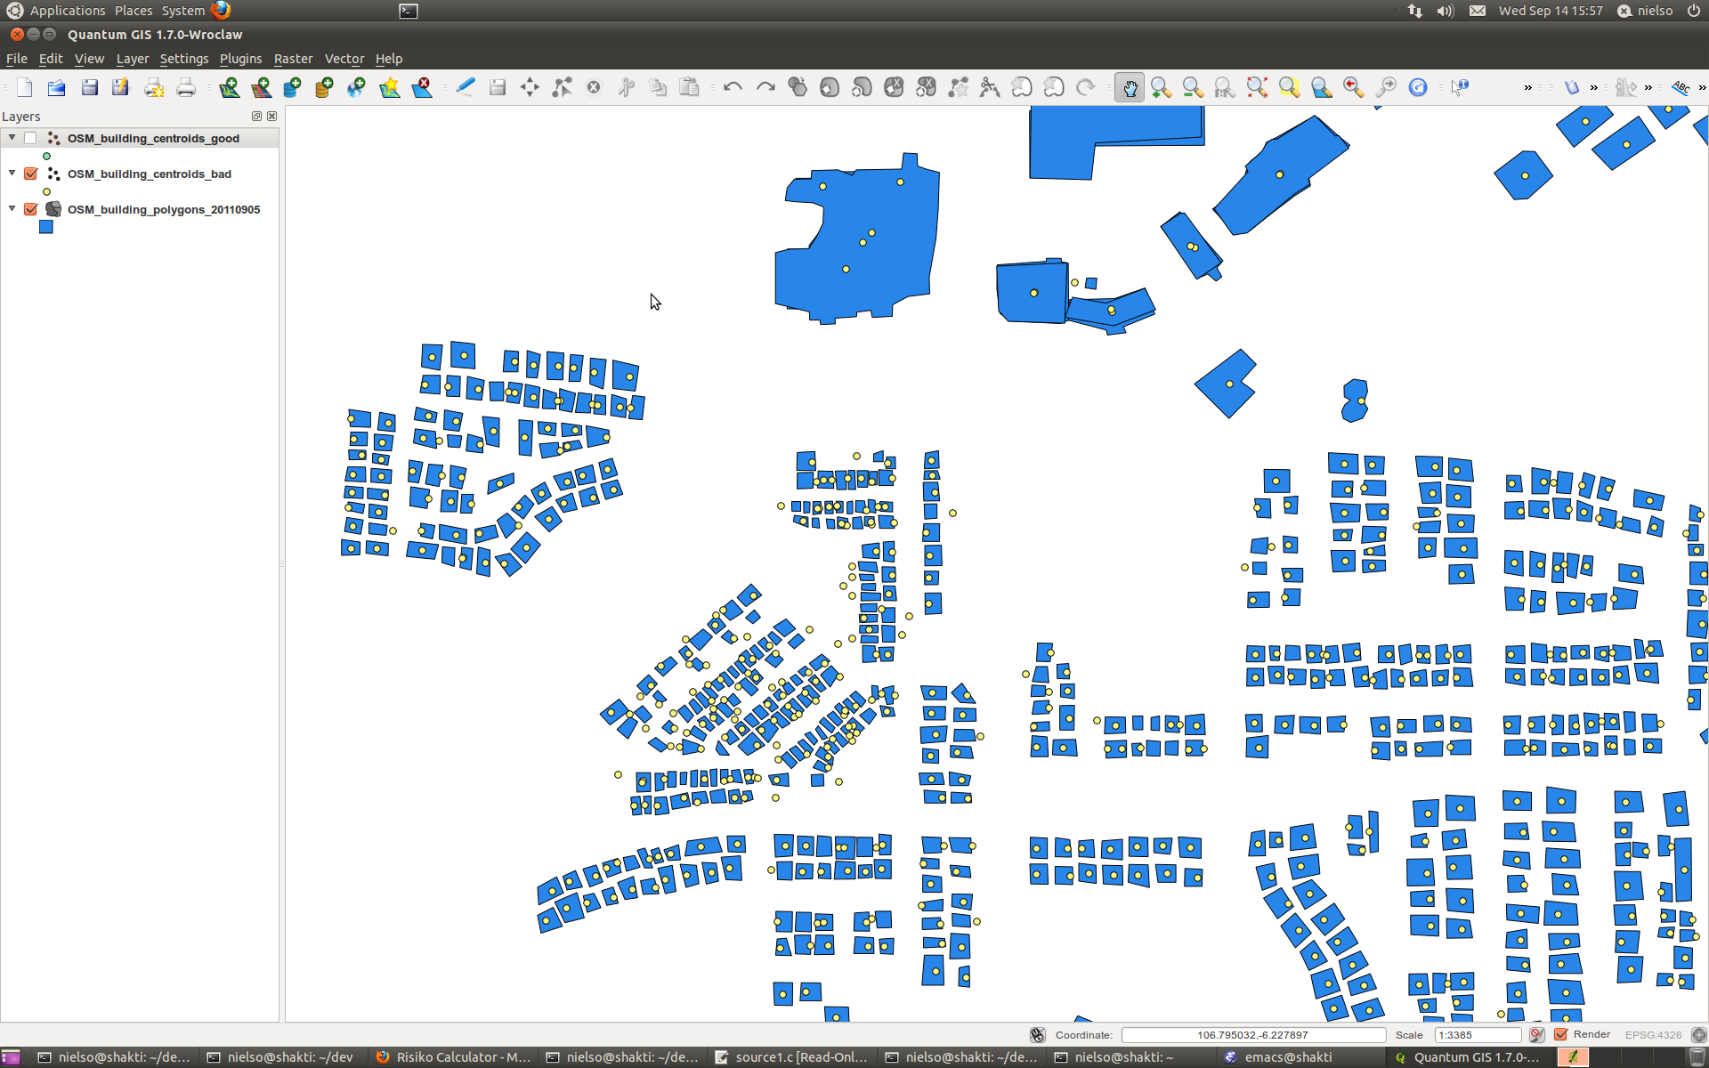
Hower not good for smaller scales

Slide 24
Solution is Normalisation
# Normalise to ensure numerical accurracy.
# This requirement in backed by tests in test_io.py and without it
# centroids at building footprint level may get shifted outside the
# polygon!
P_origin = numpy.amin(P, axis=0)
P = P - P_origin
# Calculate centroids as usual
# Translate back to real location
C = numpy.array([Cx, Cy]) + P_origin
return C

Slide 25
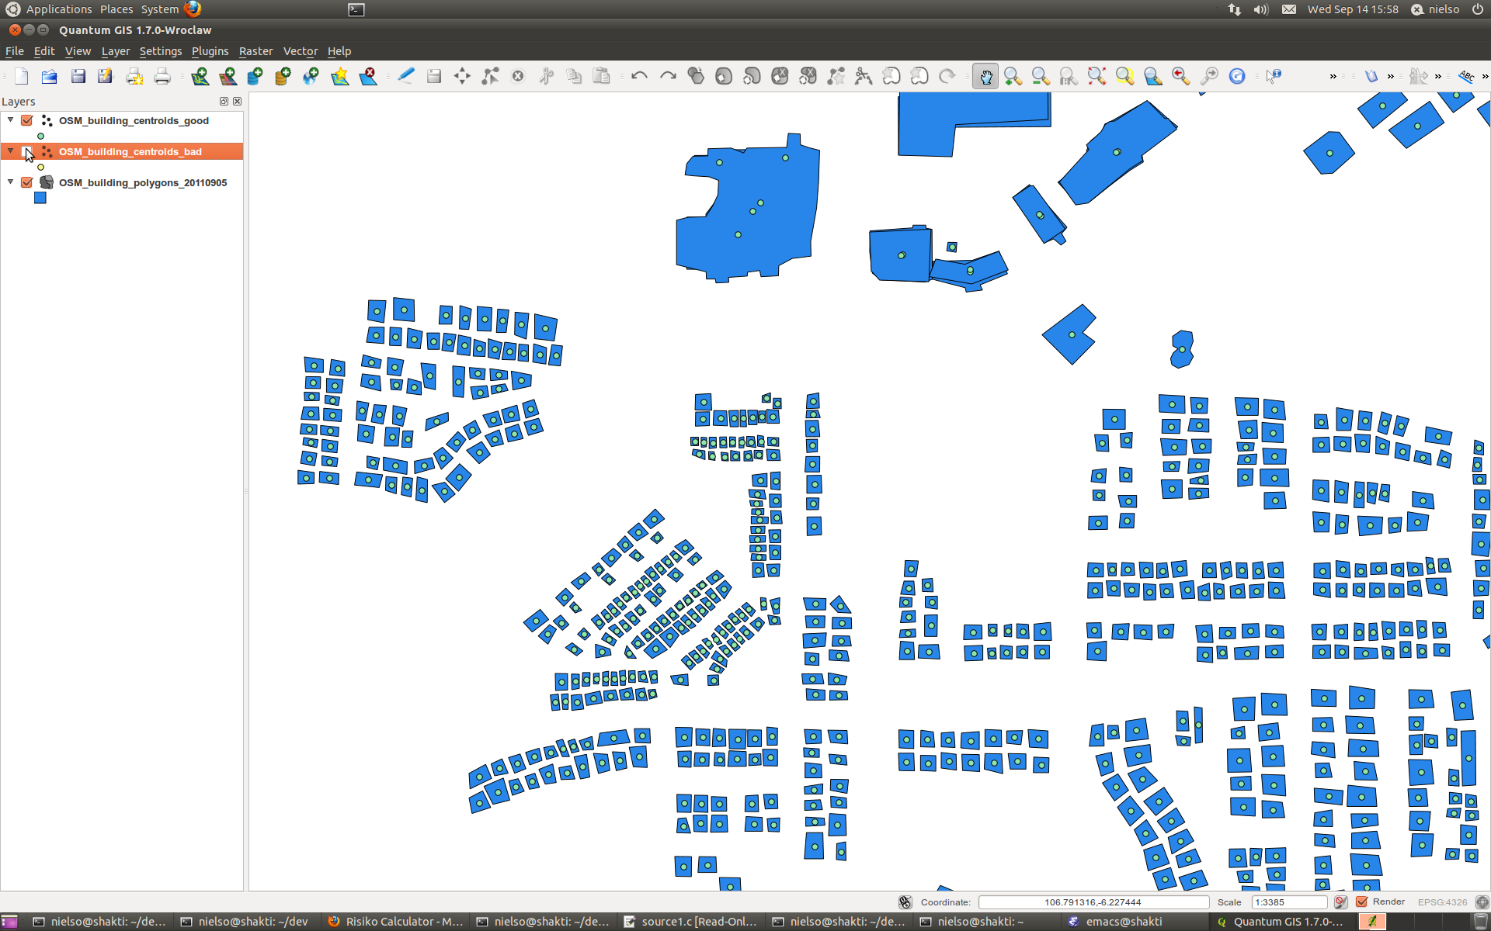
After Normalisation

Slide 26
Exercise 6 – just taking a look
Numpy implementation of bi-linear interpolation
Taking NaN into account

Slide 27
Thank you very much!
The code you have seen was built for the InaSAFE project: www.inasafe.org
Please have a look at all of it at:
https://github.com/AIFDR/inasafe

