Slide 1

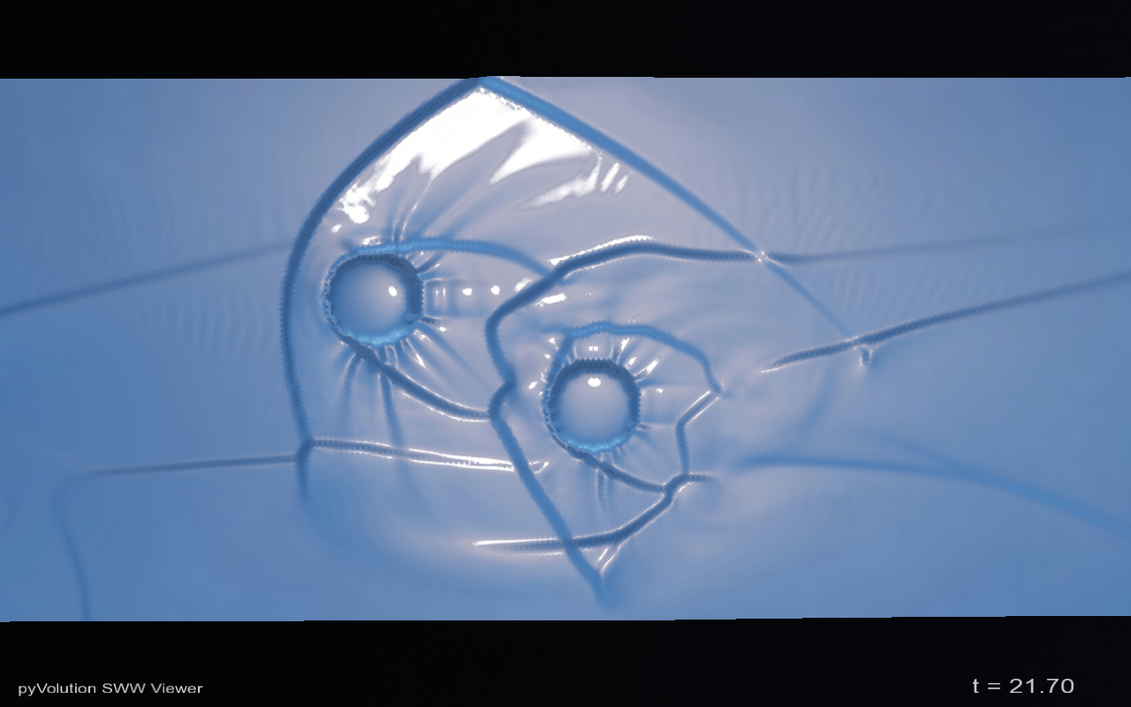
Australian Government
Geoscience Australia
ANUGA
Open Source
Hydrodynamic Modelling
Ole Nielsen

Slide 2
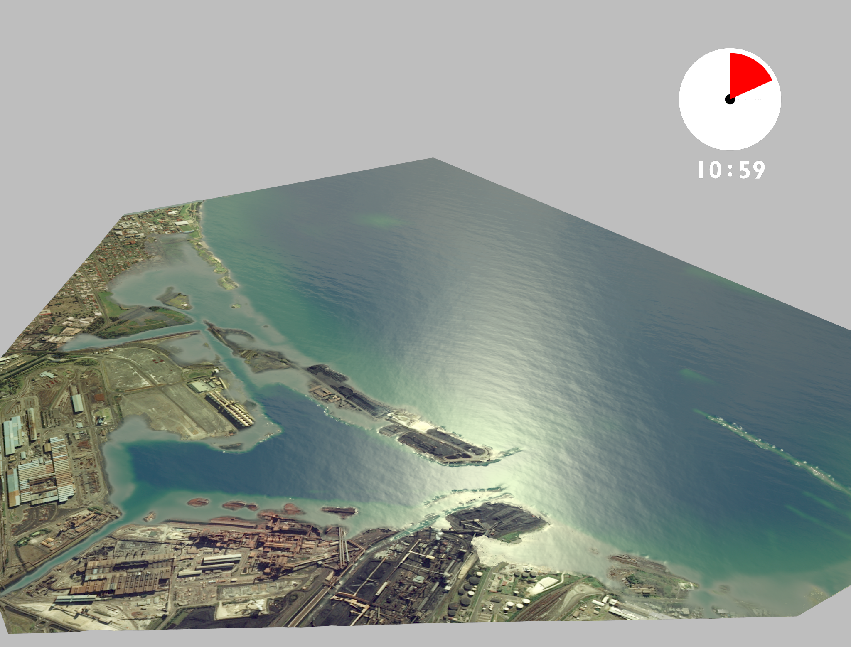
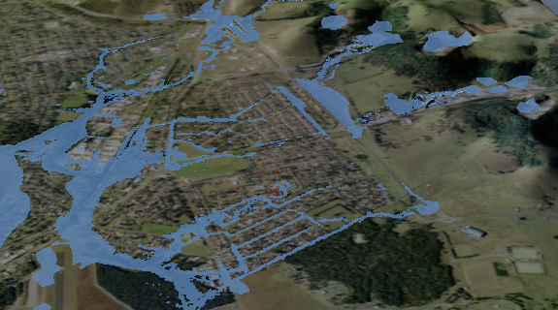
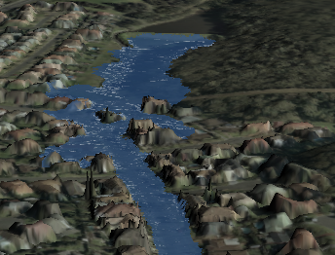
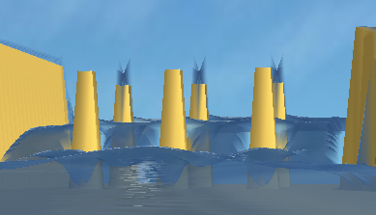
What is ANUGA
Tsunami Inundation
Riverine Flooding
Hydraulic Engineering
Dam Breaks

Slide 3
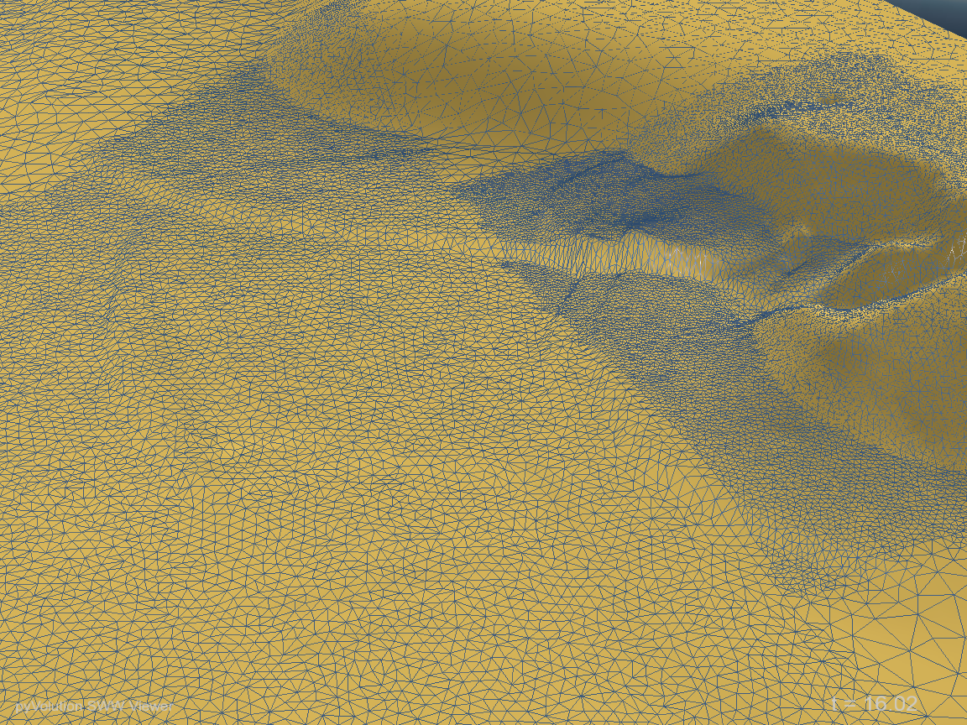
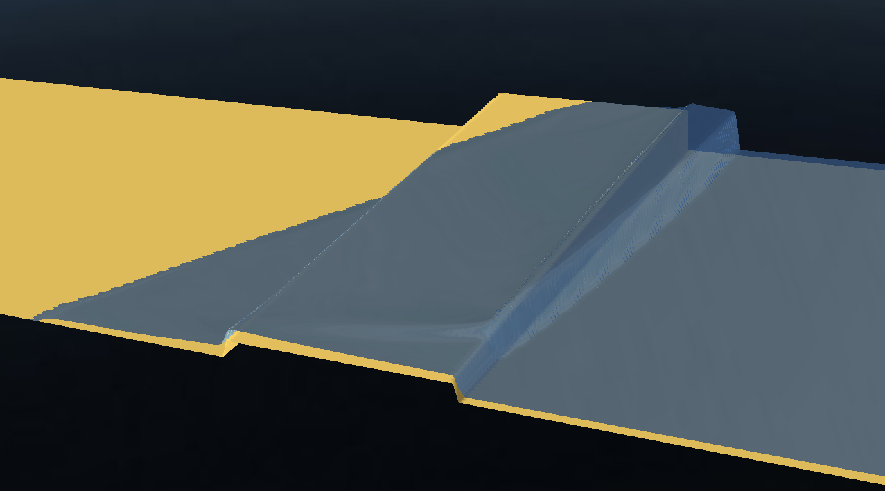
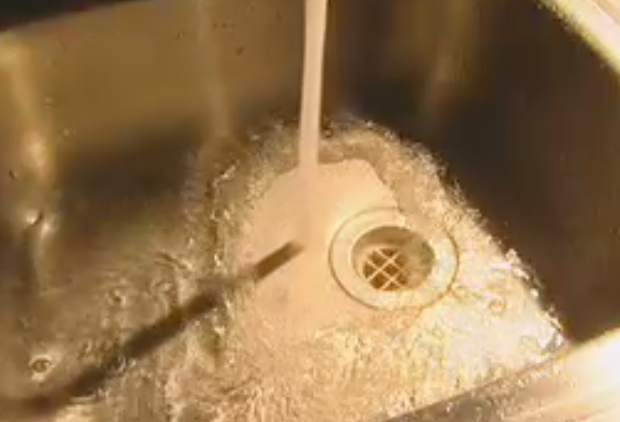
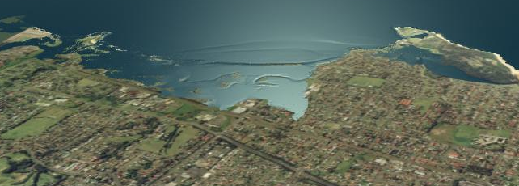
ANUGA Capabilities
Shallow Water Equations/Finite Volumes
Resolution of Hydraulic shocks
Transitions from sub- to super critical flows
Robust wetting/drying capability

Slide 4
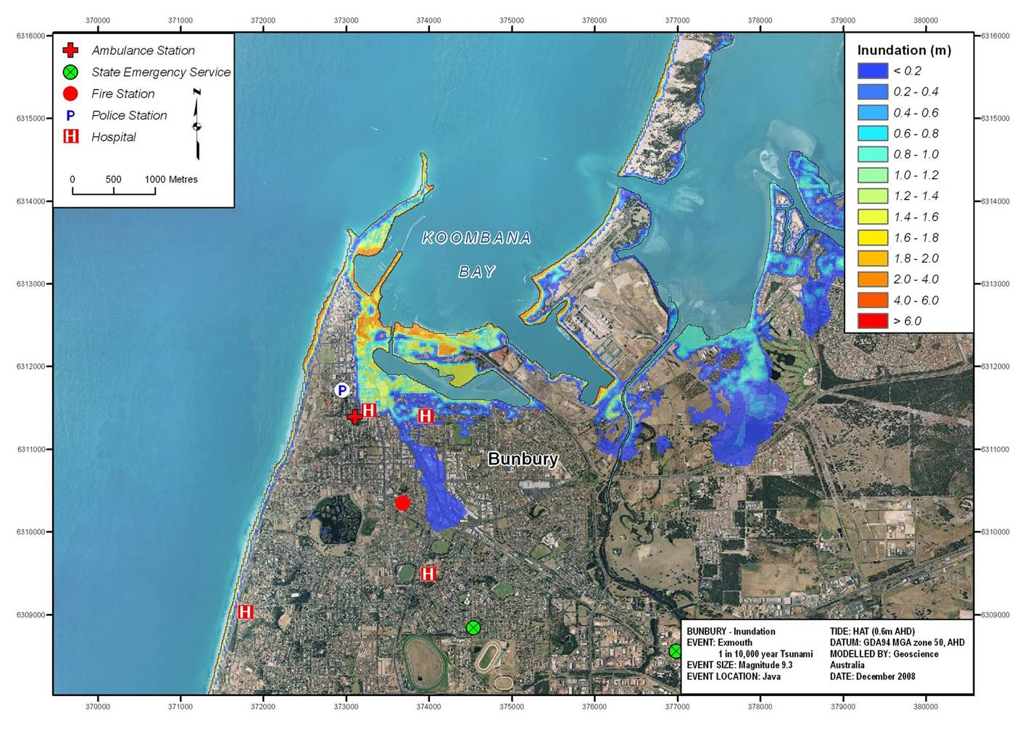
Tsunami Inundation Map Examples
Notes:
Products for FESA
The animation is interesting and allows us to see what happens throughout the time the tsunami is impacting the community, but it doesn’t tell us anything about the depth or speed of the water, and is therefore not that useful to emergency managers. This series of inundation maps show how we typically deliver the tsunami impact modelling results to emergency managers.

Slide 5
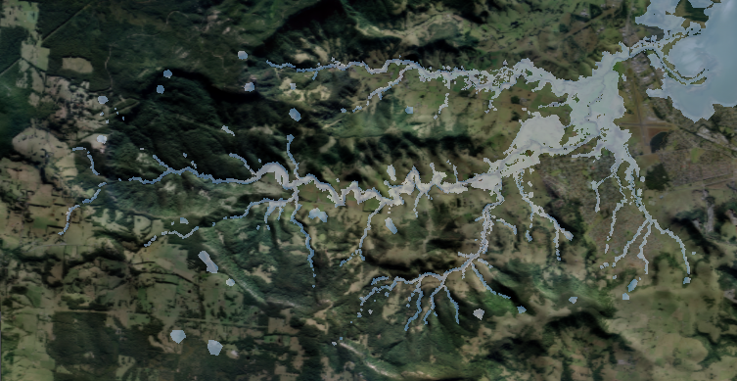
110km2 Full 2-D Model

Slide 6
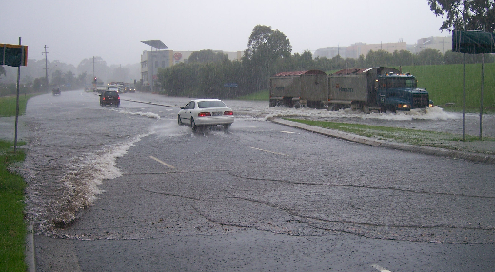
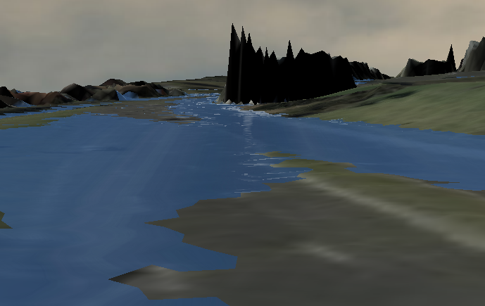
Investigating existing Flood problems…
Real World Flood…
ANUGA interpretation

Slide 7
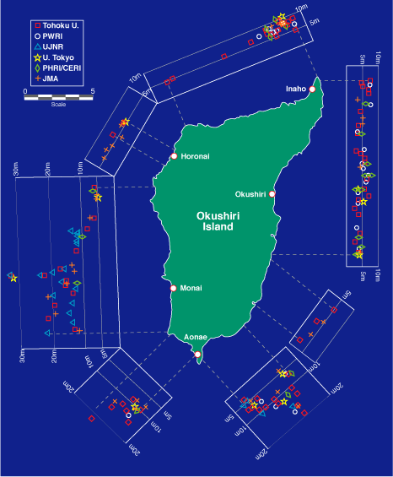
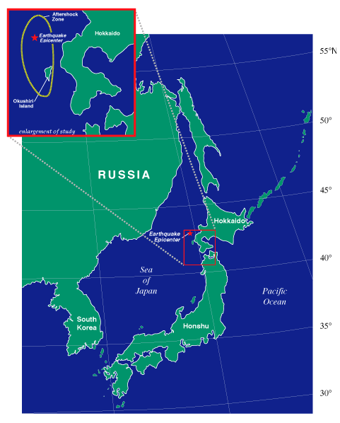

Okushiri Island 1993 Tsunami
Predicting Tsunami Run Up –
The Importance of Modelling
Magnitude 7.8 earthquake
32 m run up height
Numerical Simulation of wave tank experiment shows why
Animation
Stills

Slide 8
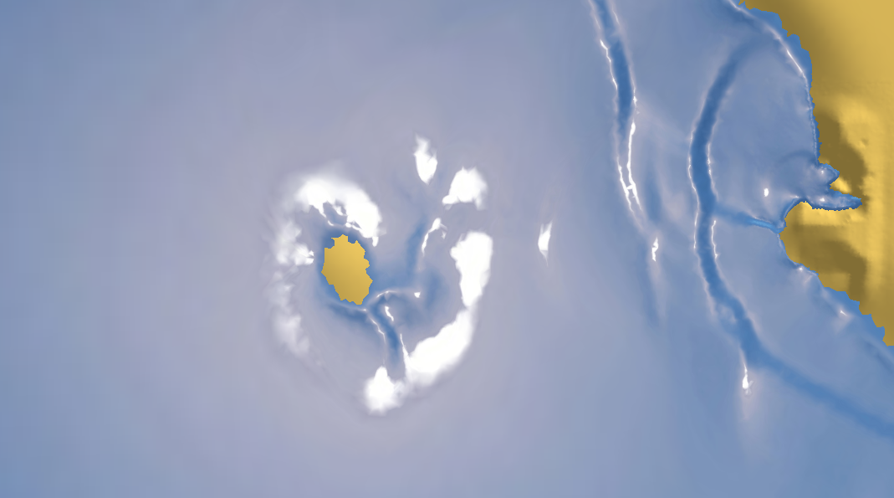
Testing and validation
890 individual unit tests
Numerous wave tank experiments
2004 Tsunami impact on Patong Beach

Slide 9
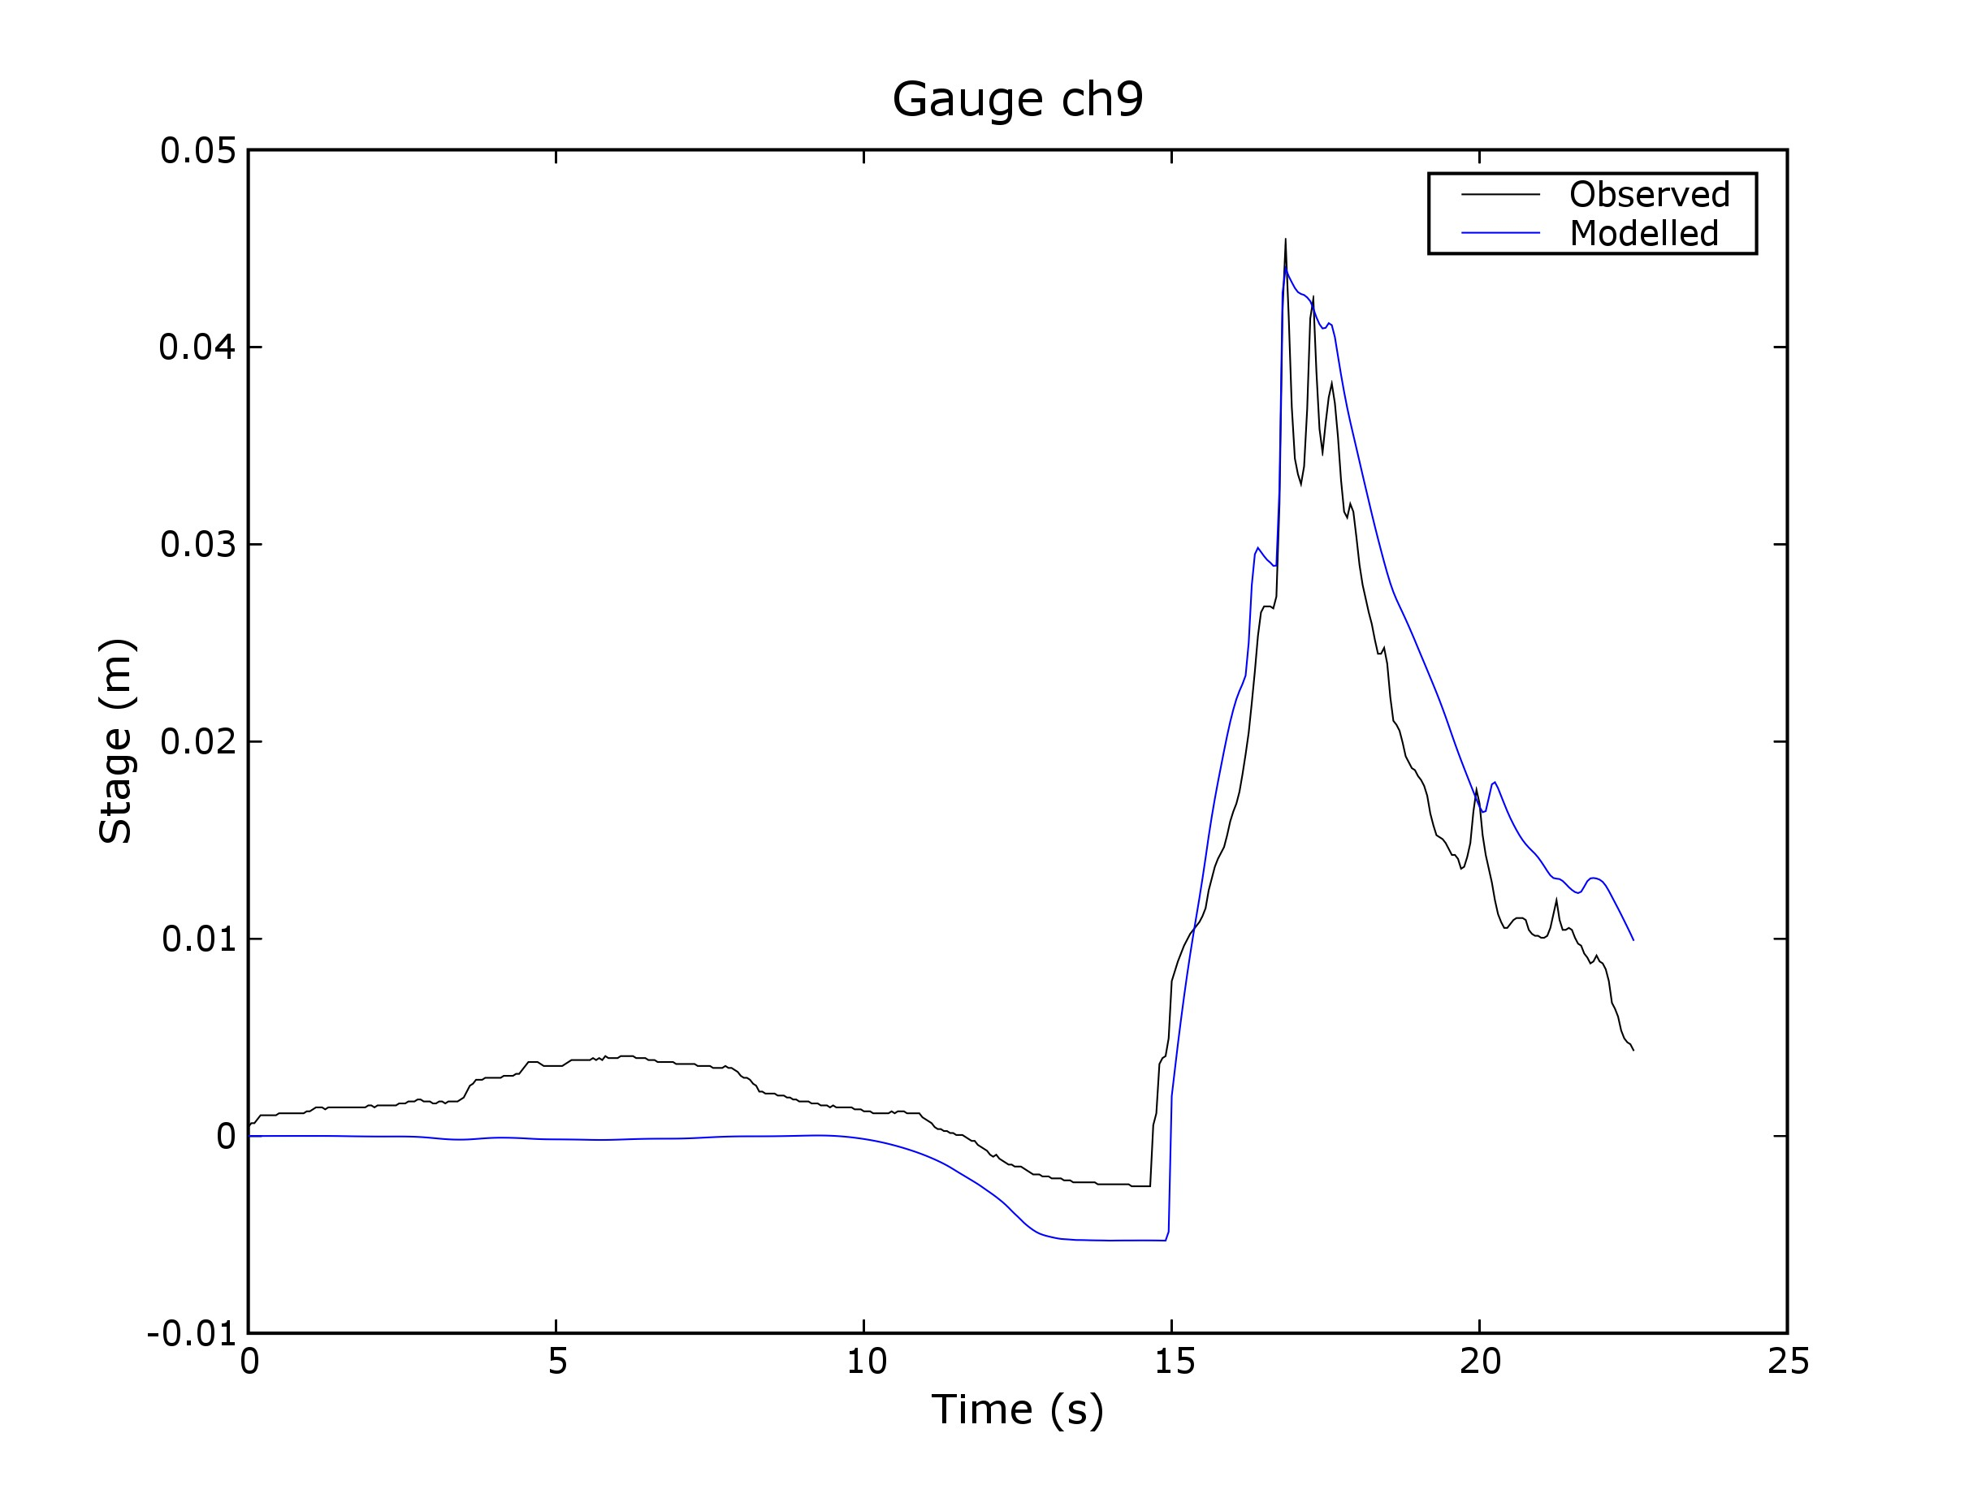

Slide 10
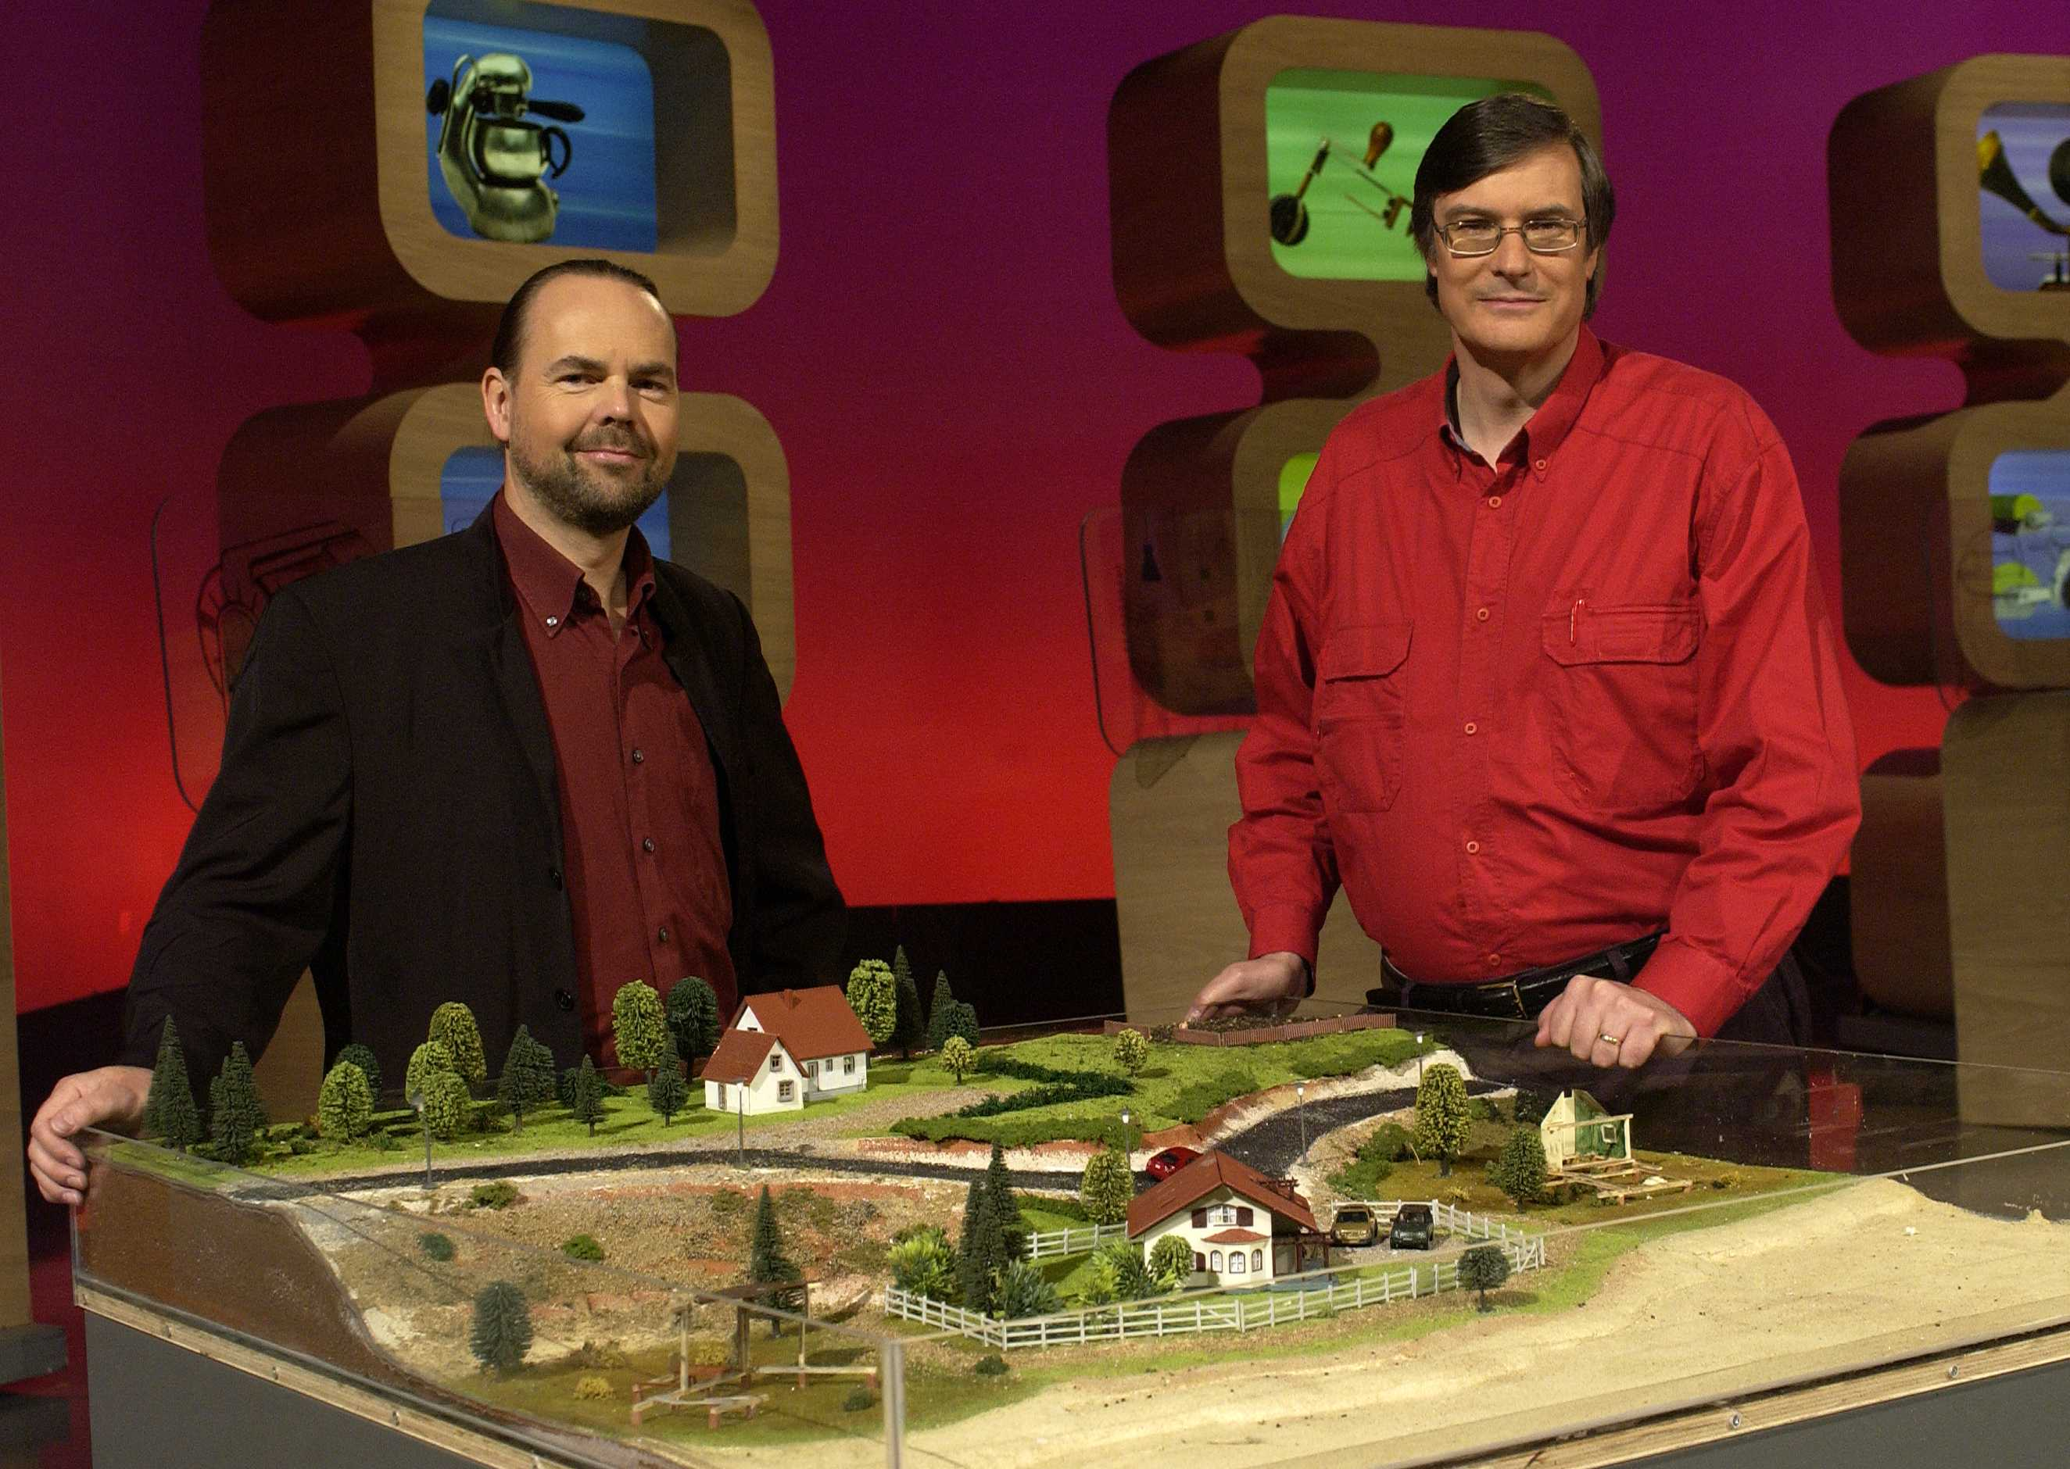
Thank You!
Further information:
Email: Ole.Nielsen@ga.gov.au
Stephen.Roberts@anu.edu.au
Google Search: ANUGA software
(ANUGA by itself will get German food fair)

