Slide 1


Open Source – Of Course!
Lessons Learned from two decades of
Scientific Open Source Software development
Dr Ole Nielsen

Slide 2
Last Century
Became aware of Linux, GNU emacs and Netlib (1994): Disks mailed to Bulgaria!
Published Matlab, C and F90 toolboxes for wavelet transforms (1997): A procrastinating PhD student.
Discovered Python (1999): Boss didn't want to pay for Matlab

Slide 3
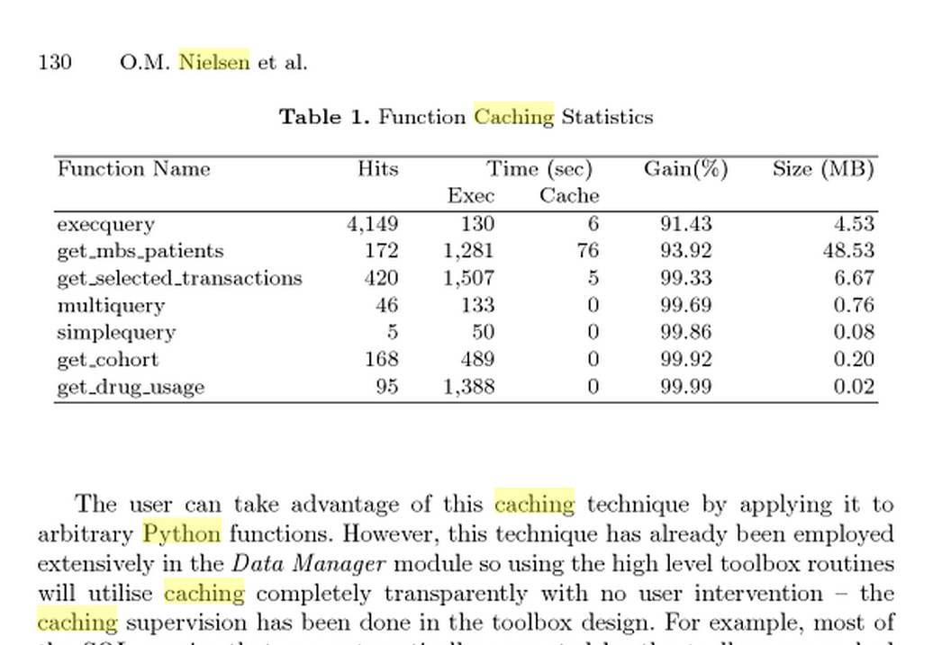
Early Days
Datamining Web Tools (Australian National University 2001)
Required caching module (persistent memoization)
result = func(args, kwargs)
result = cache(func, args, kwargs, dependencies = <files>)

Slide 4
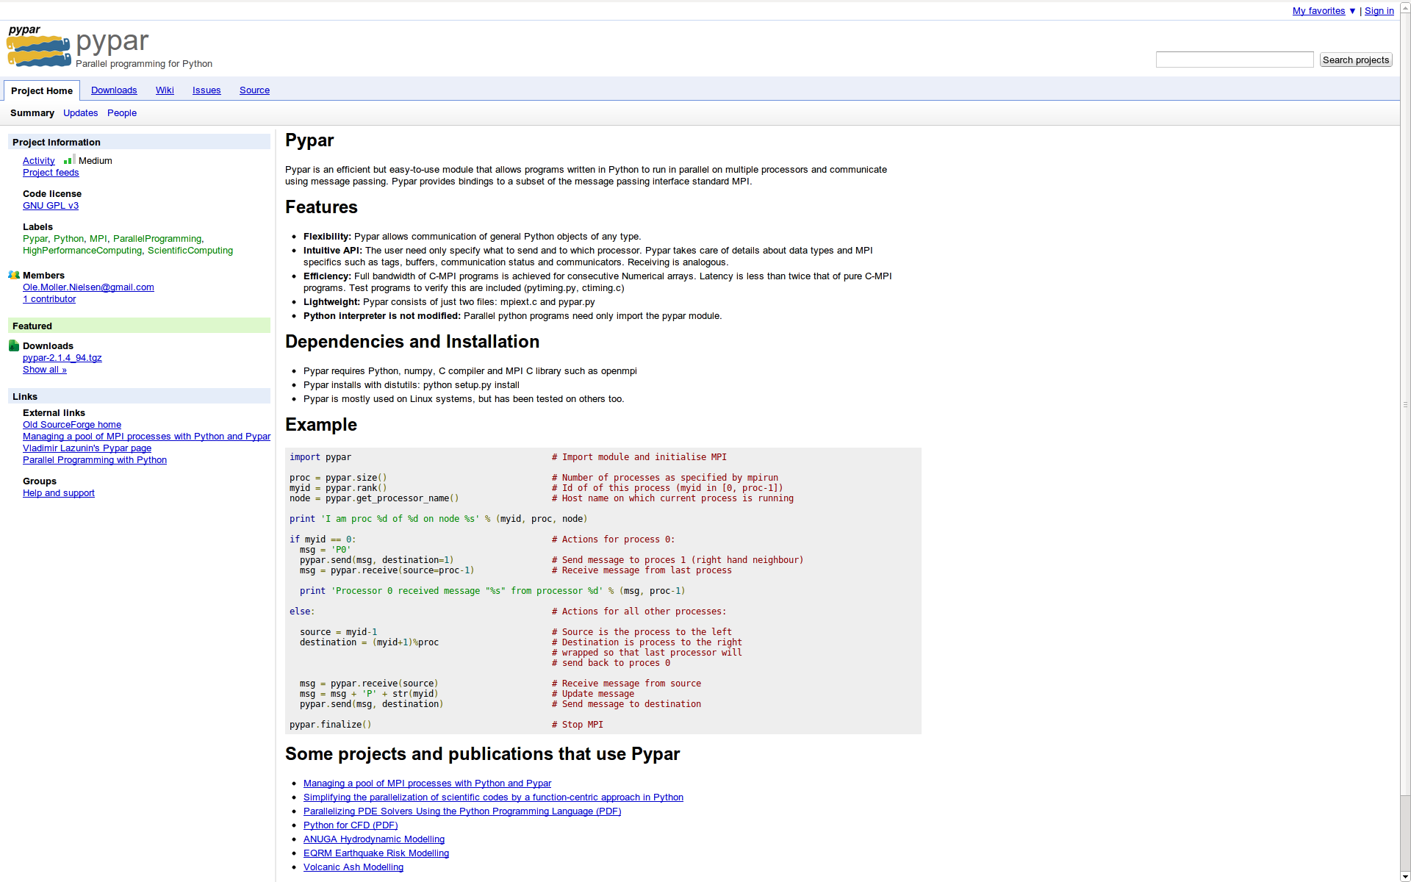
Pushing Python (pypar - 2002)

Slide 5
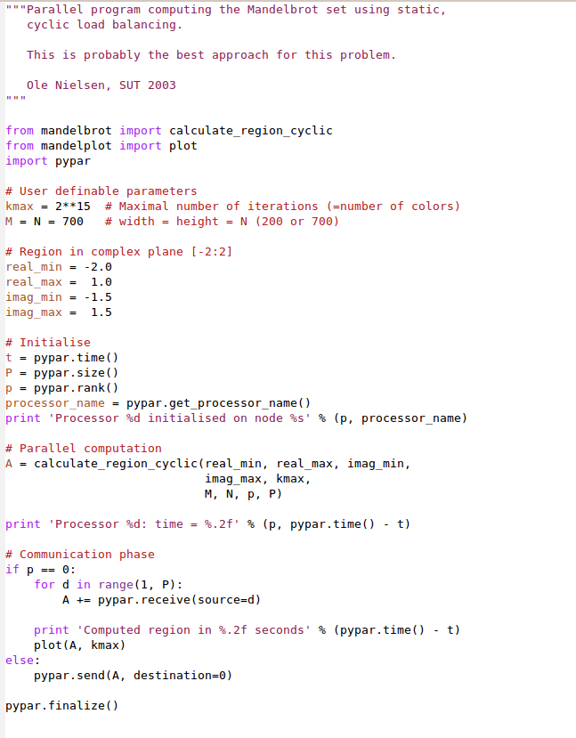
Standard MPI
int MPI_Send(
void *buf,
int count,
MPI_Datatype datatype,
int dest,
int tag,
MPI_Comm comm
);
Pypar
pypar.send(A, p)

Slide 6
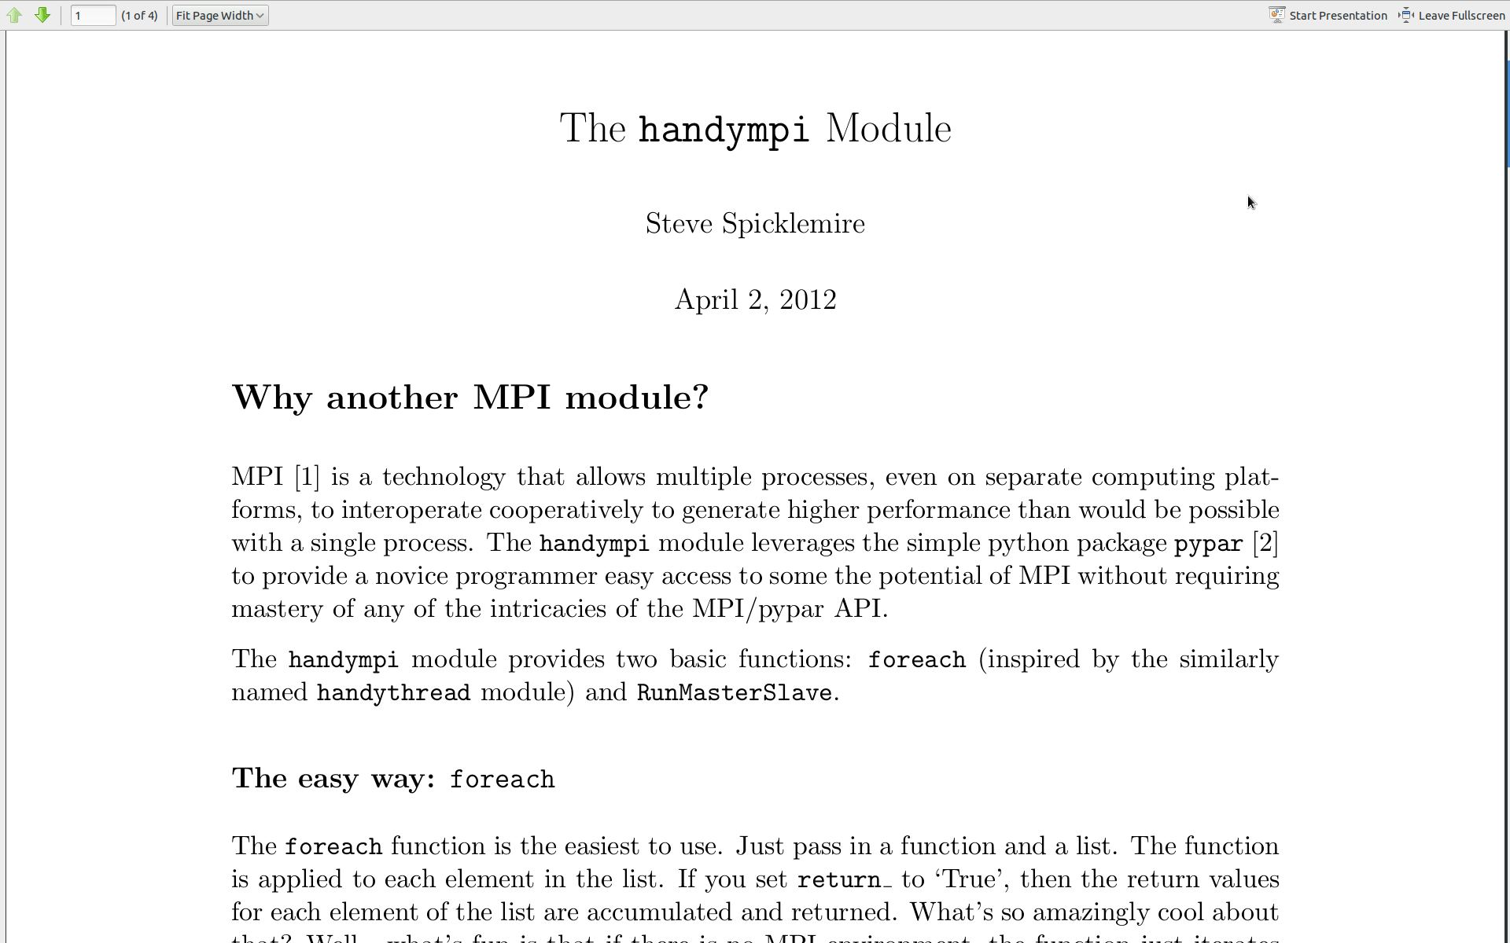
10 years on Pypar is still used

Slide 7
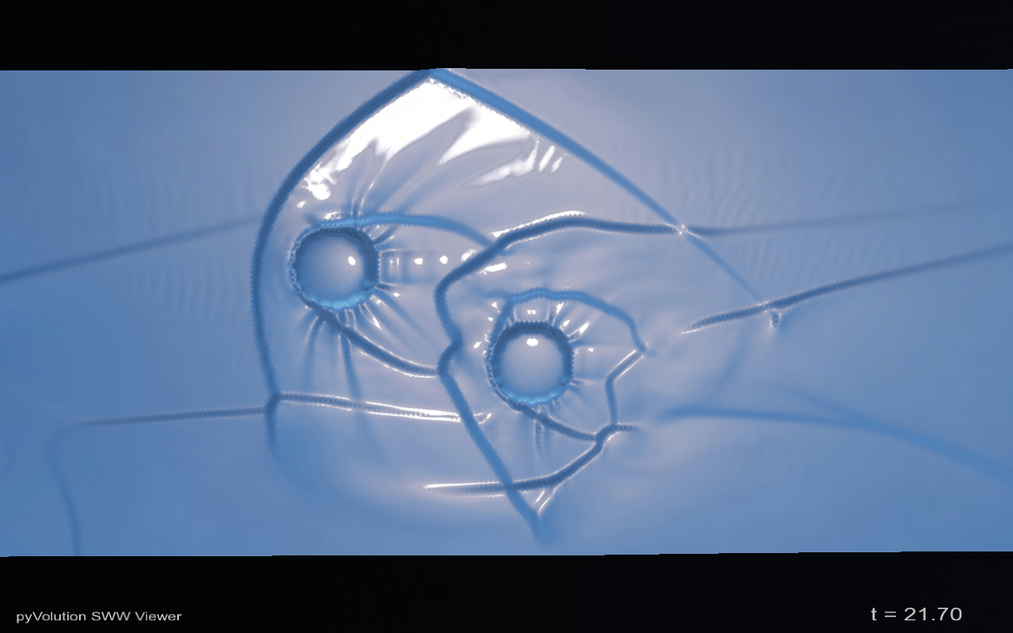
Python in Government (2004-2009)
ANUGA
Open Source
Hydrodynamic Modelling
Ole Nielsen

Slide 8
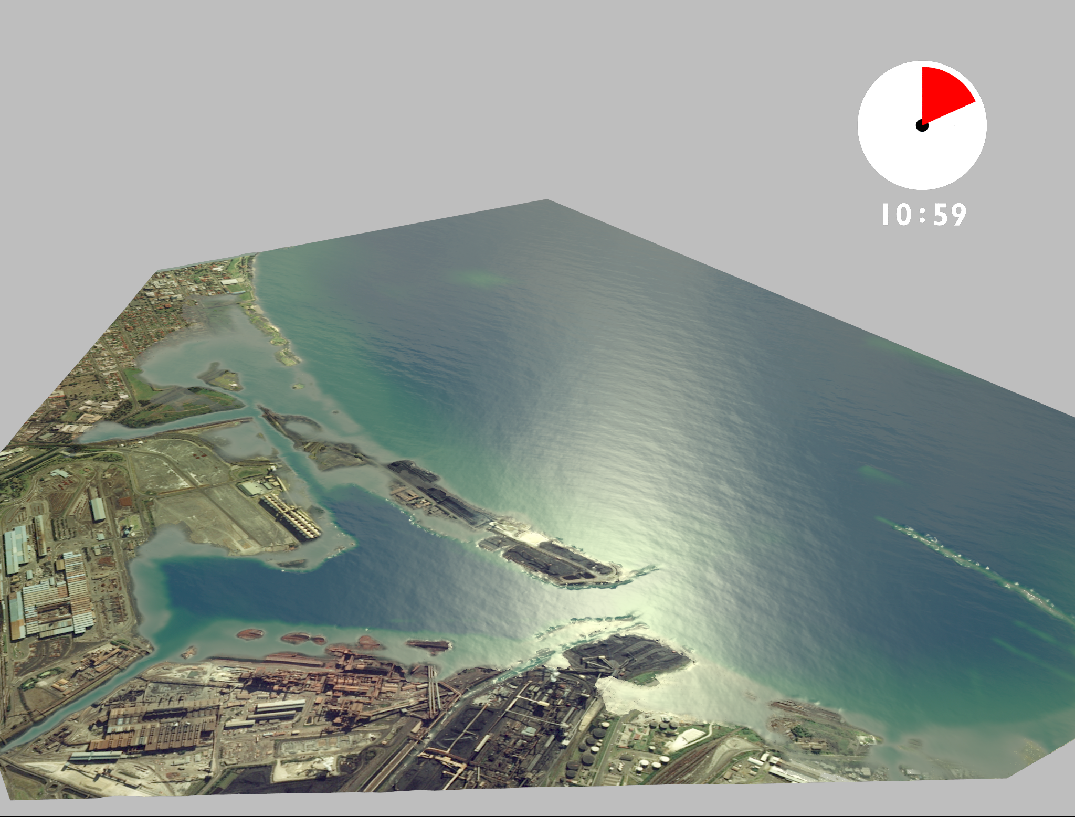
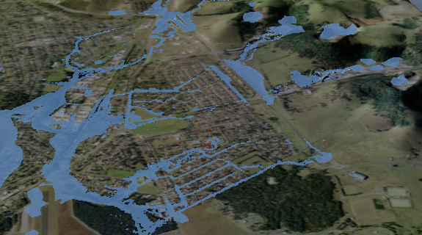
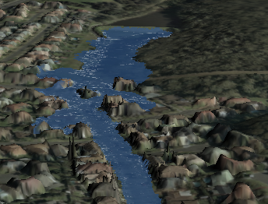
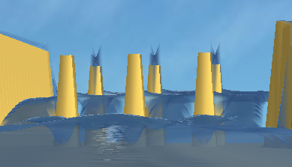
What is ANUGA
Tsunami Inundation
Riverine Flooding
Hydraulic Engineering
Dam Breaks

Slide 9
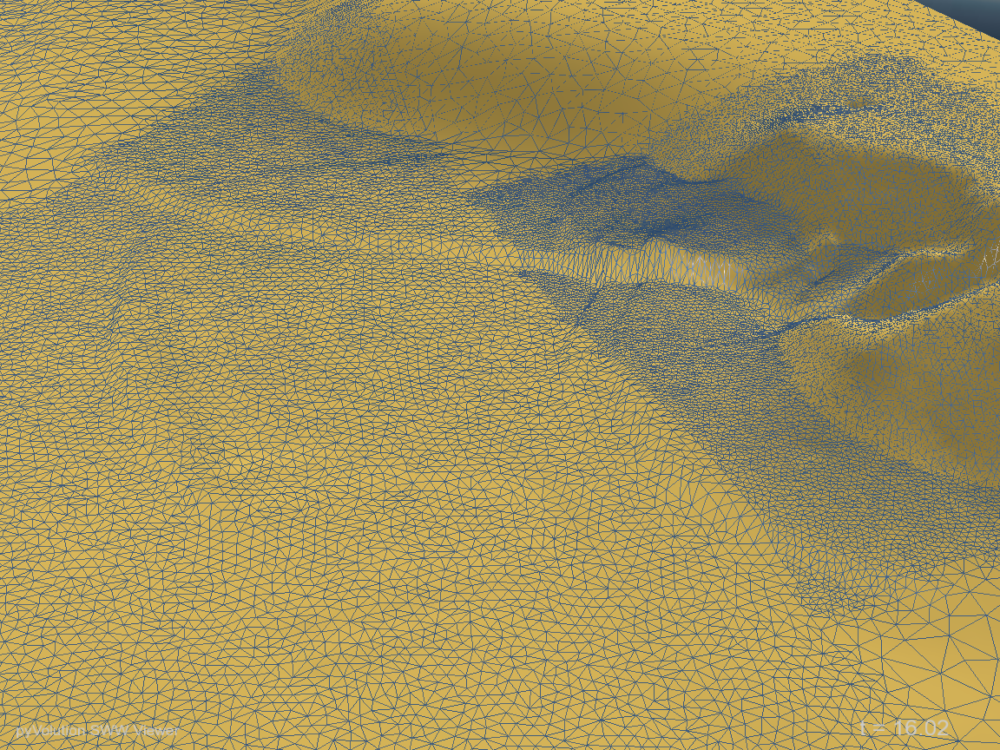
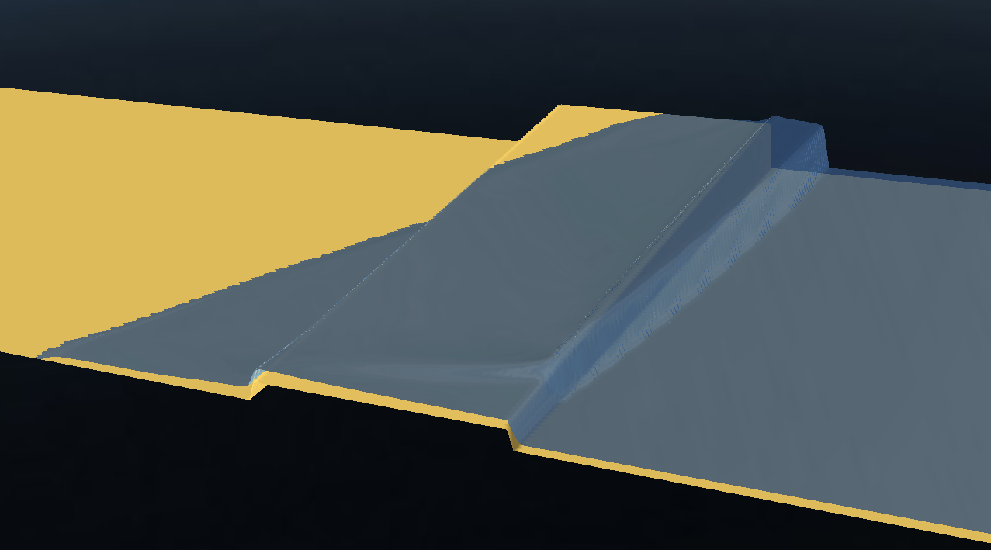
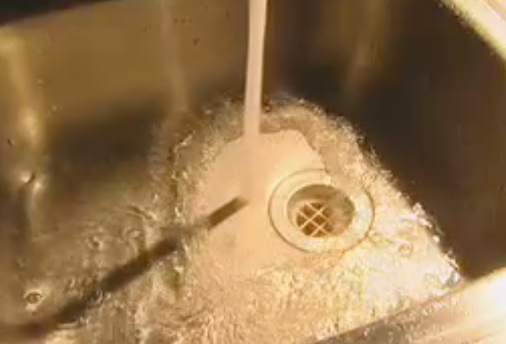
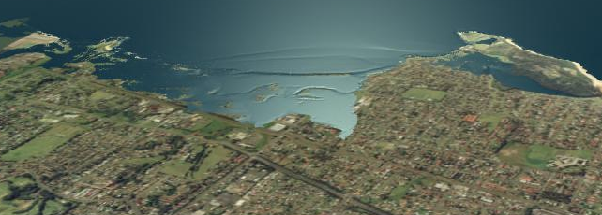
ANUGA Capabilities
Resolution of Hydraulic shocks
Transitions from sub- to super critical flows
Robust wetting/drying capability
Flexible API (e.g. dynamic typing)

Slide 10
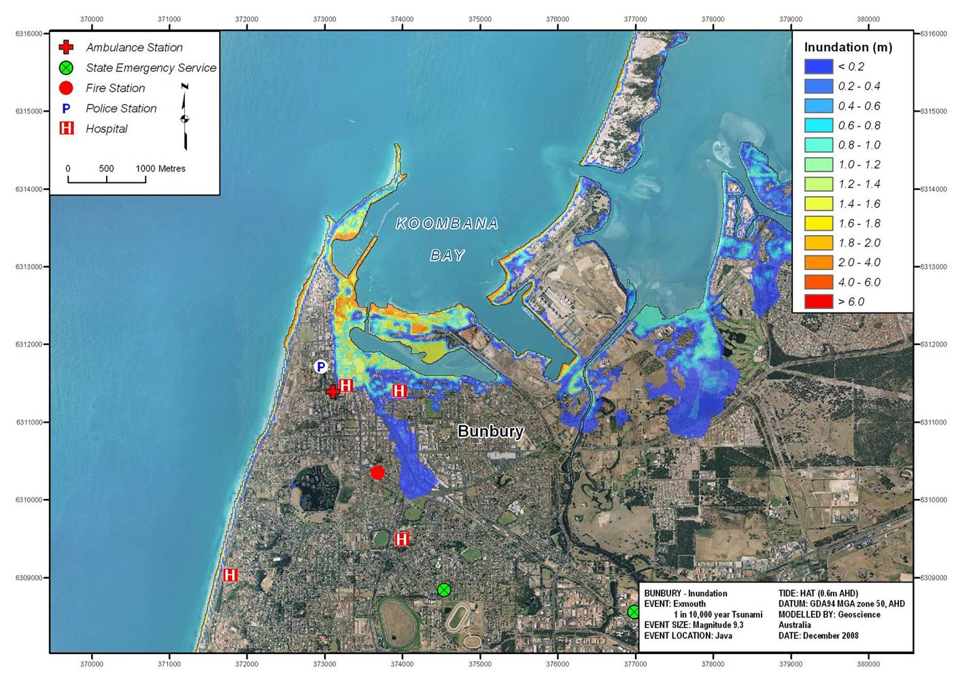
Australian Tsunami Inundation
Notes:
Products for FESA
The animation is interesting and allows us to see what happens throughout the time the tsunami is impacting the community, but it doesn’t tell us anything about the depth or speed of the water, and is therefore not that useful to emergency managers. This series of inundation maps show how we typically deliver the tsunami impact modelling results to emergency managers.

Slide 11
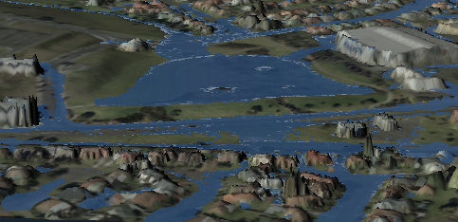
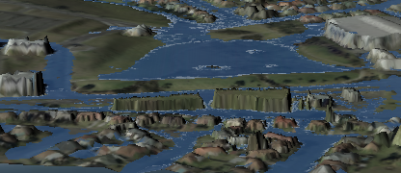
Flood Related Applications:
Assess the impact of new developments
Without proposed buildings
With proposed buildings

Slide 12
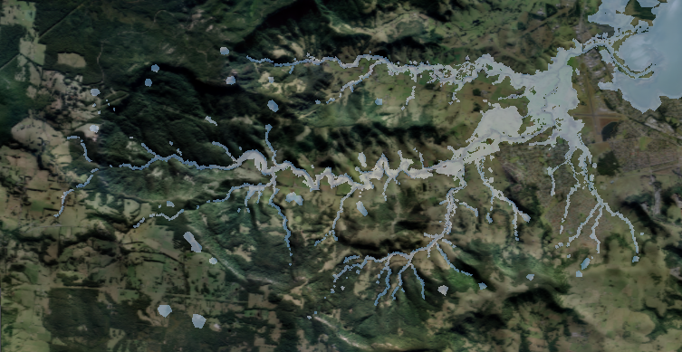
110km2 Full 2-D Model

Slide 13
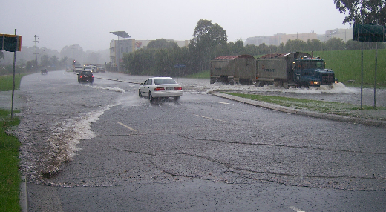
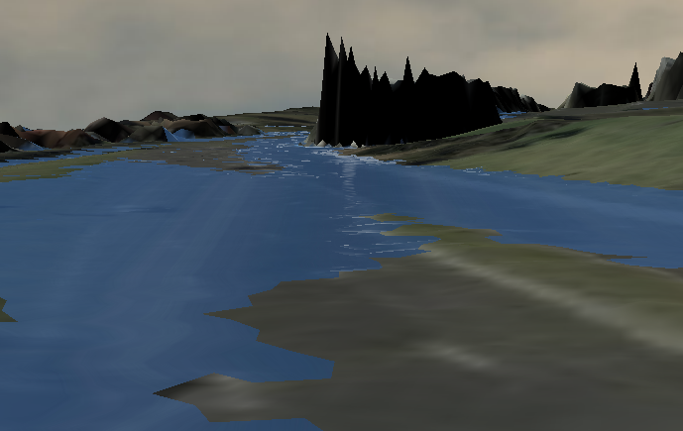
Investigating existing Flood problems…
Real World Flood…
ANUGA interpretation

Slide 14
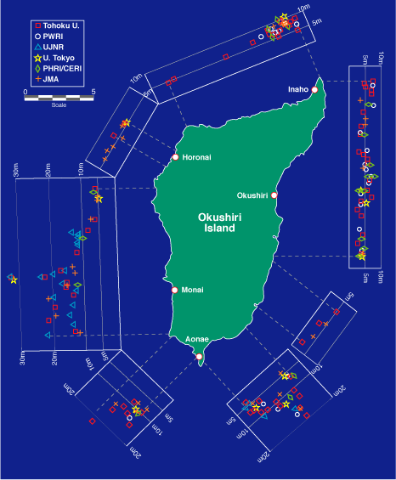

Okushiri Island 1993 Tsunami
Predicting Tsunami Run Up –
The Importance of Modelling
Magnitude 7.8 earthquake
32 m run up height
Numerical Simulation of wave tank experiment shows why

Slide 15
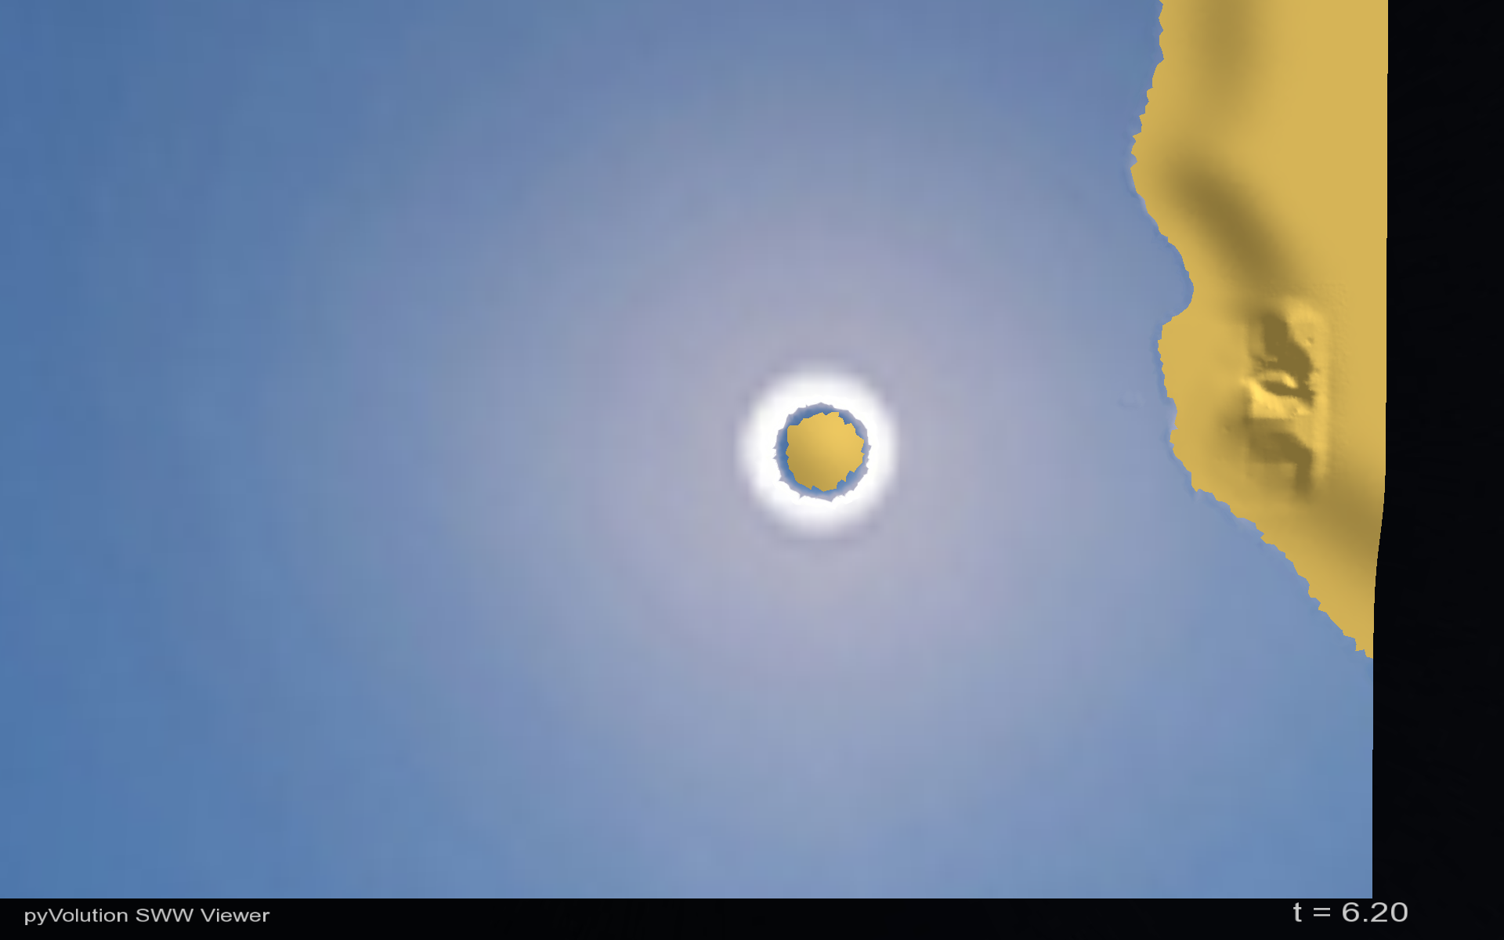
Okushiri Island
Sea of Japan
Monai Valley
Notes:
This is a computational model based on data from a Japanese wave tank experiment. It provides some insight into why Monai Valley received a disproportionate runup.

Slide 16
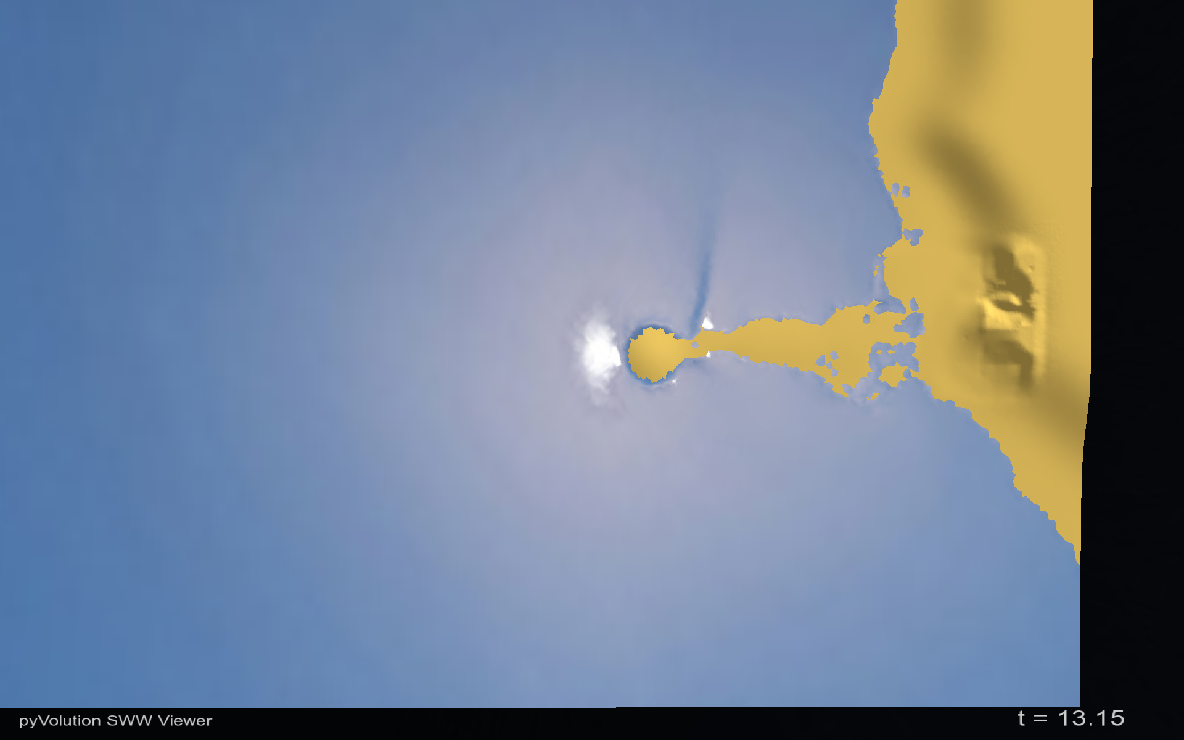
Okushiri Island
Sea of Japan
Drawdown
Monai Valley

Slide 17
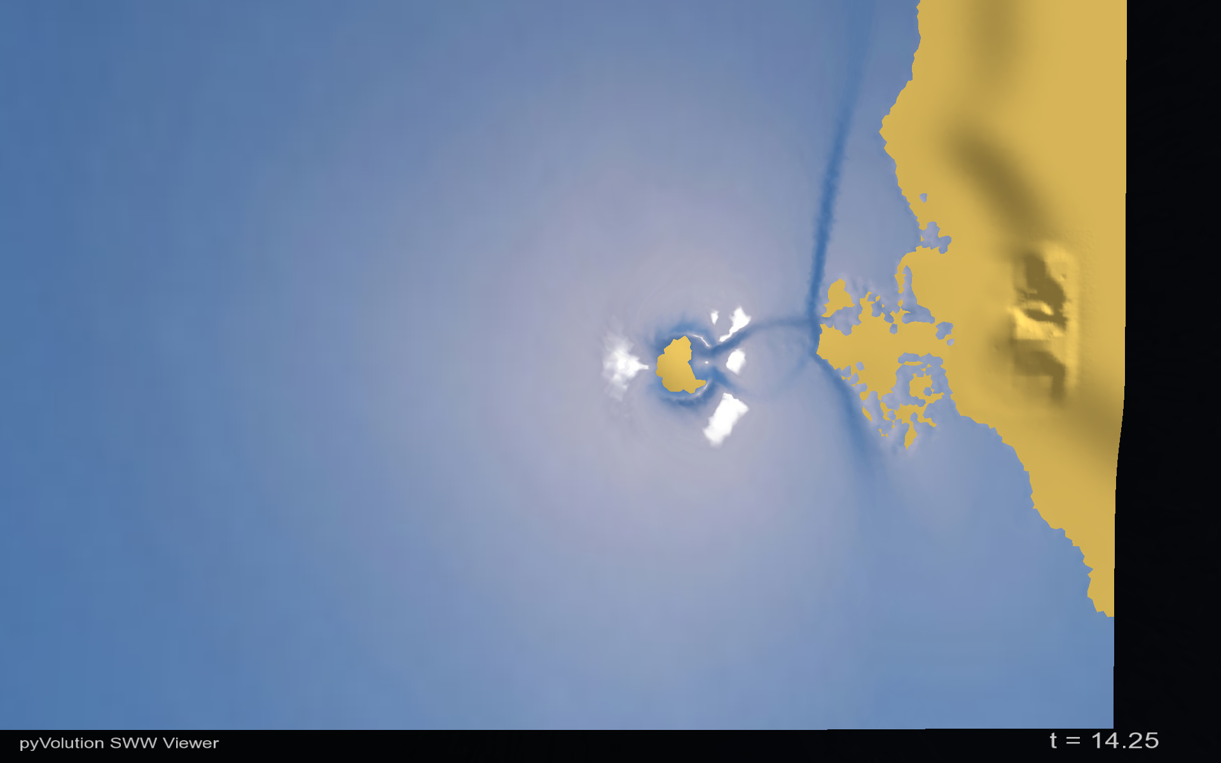
Okushiri Island
Sea of Japan
Monai Valley

Slide 18
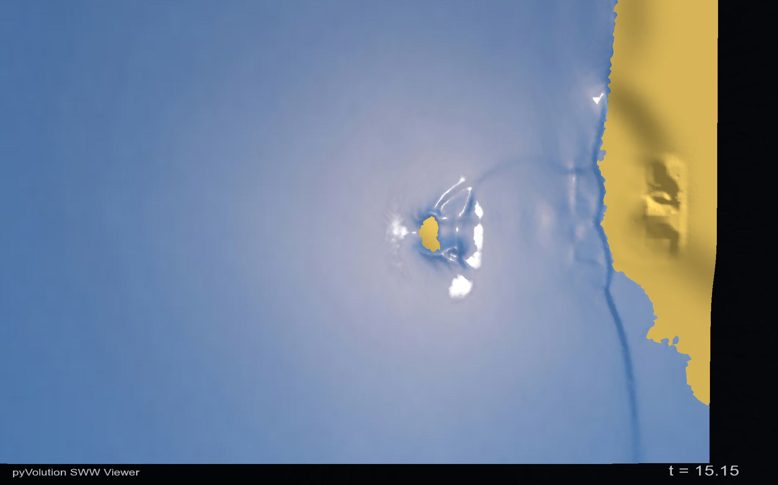
Okushiri Island
Sea of Japan
Monai Valley

Slide 19
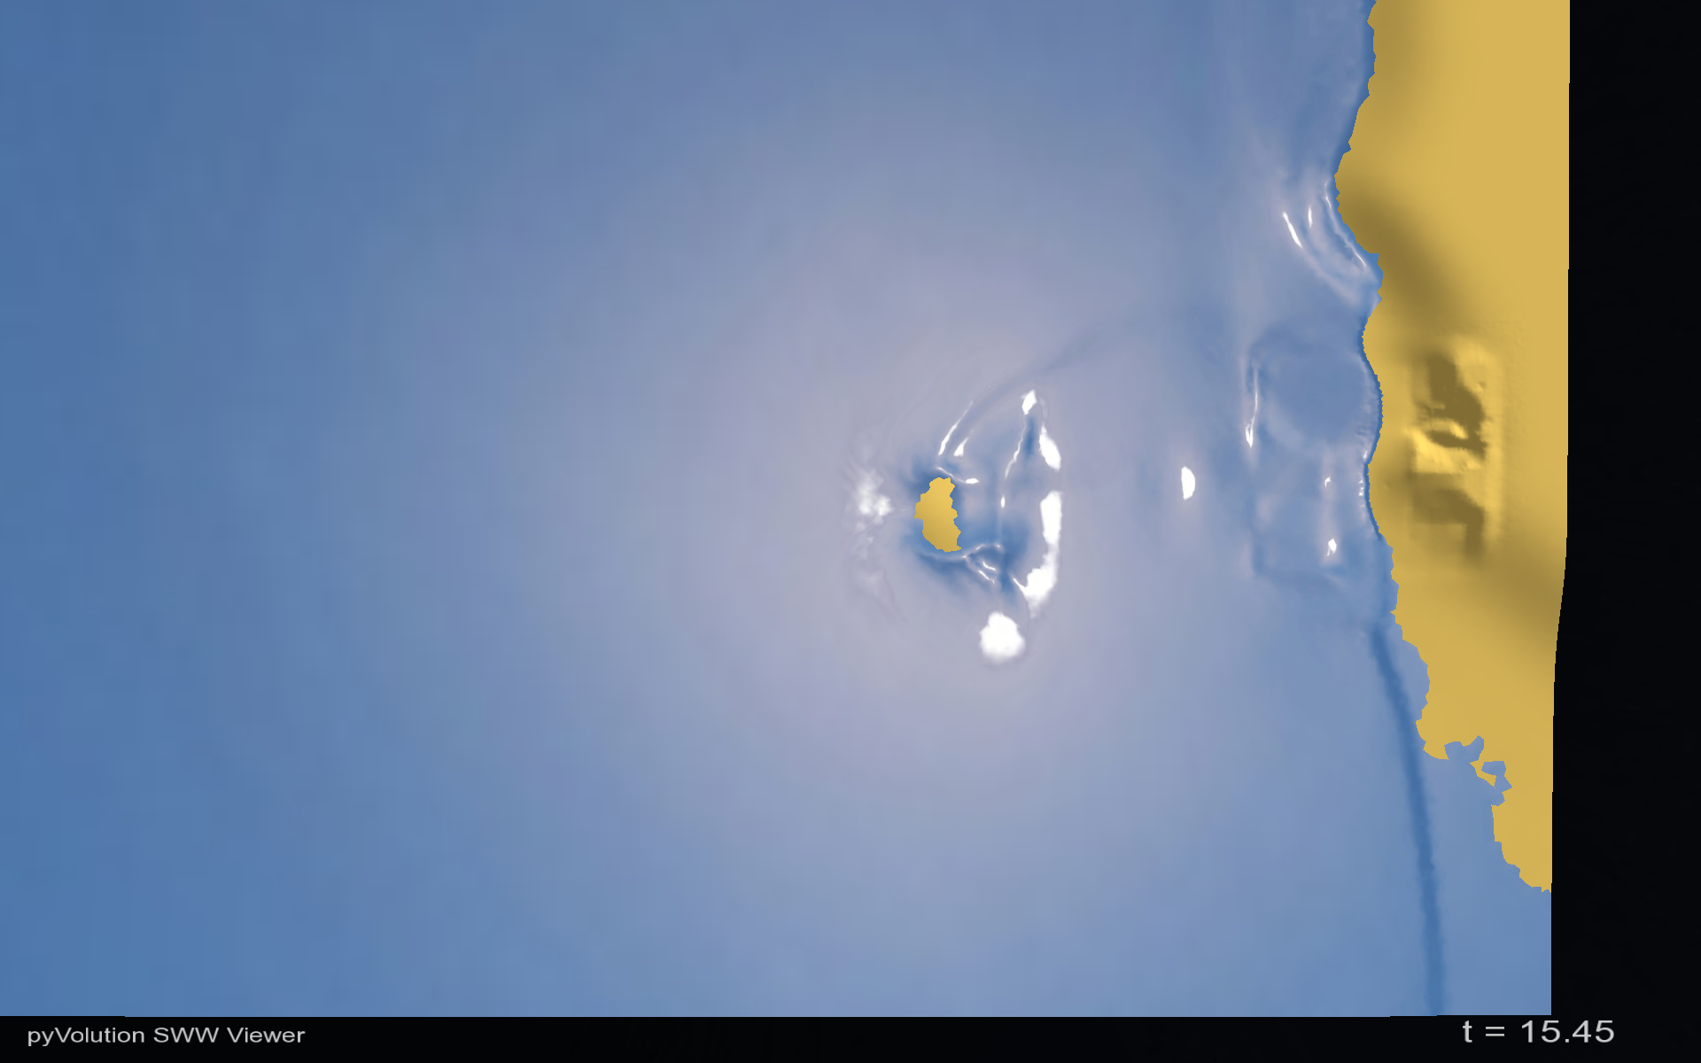
Reflection
Okushiri Island
Sea of Japan
Monai Valley

Slide 20
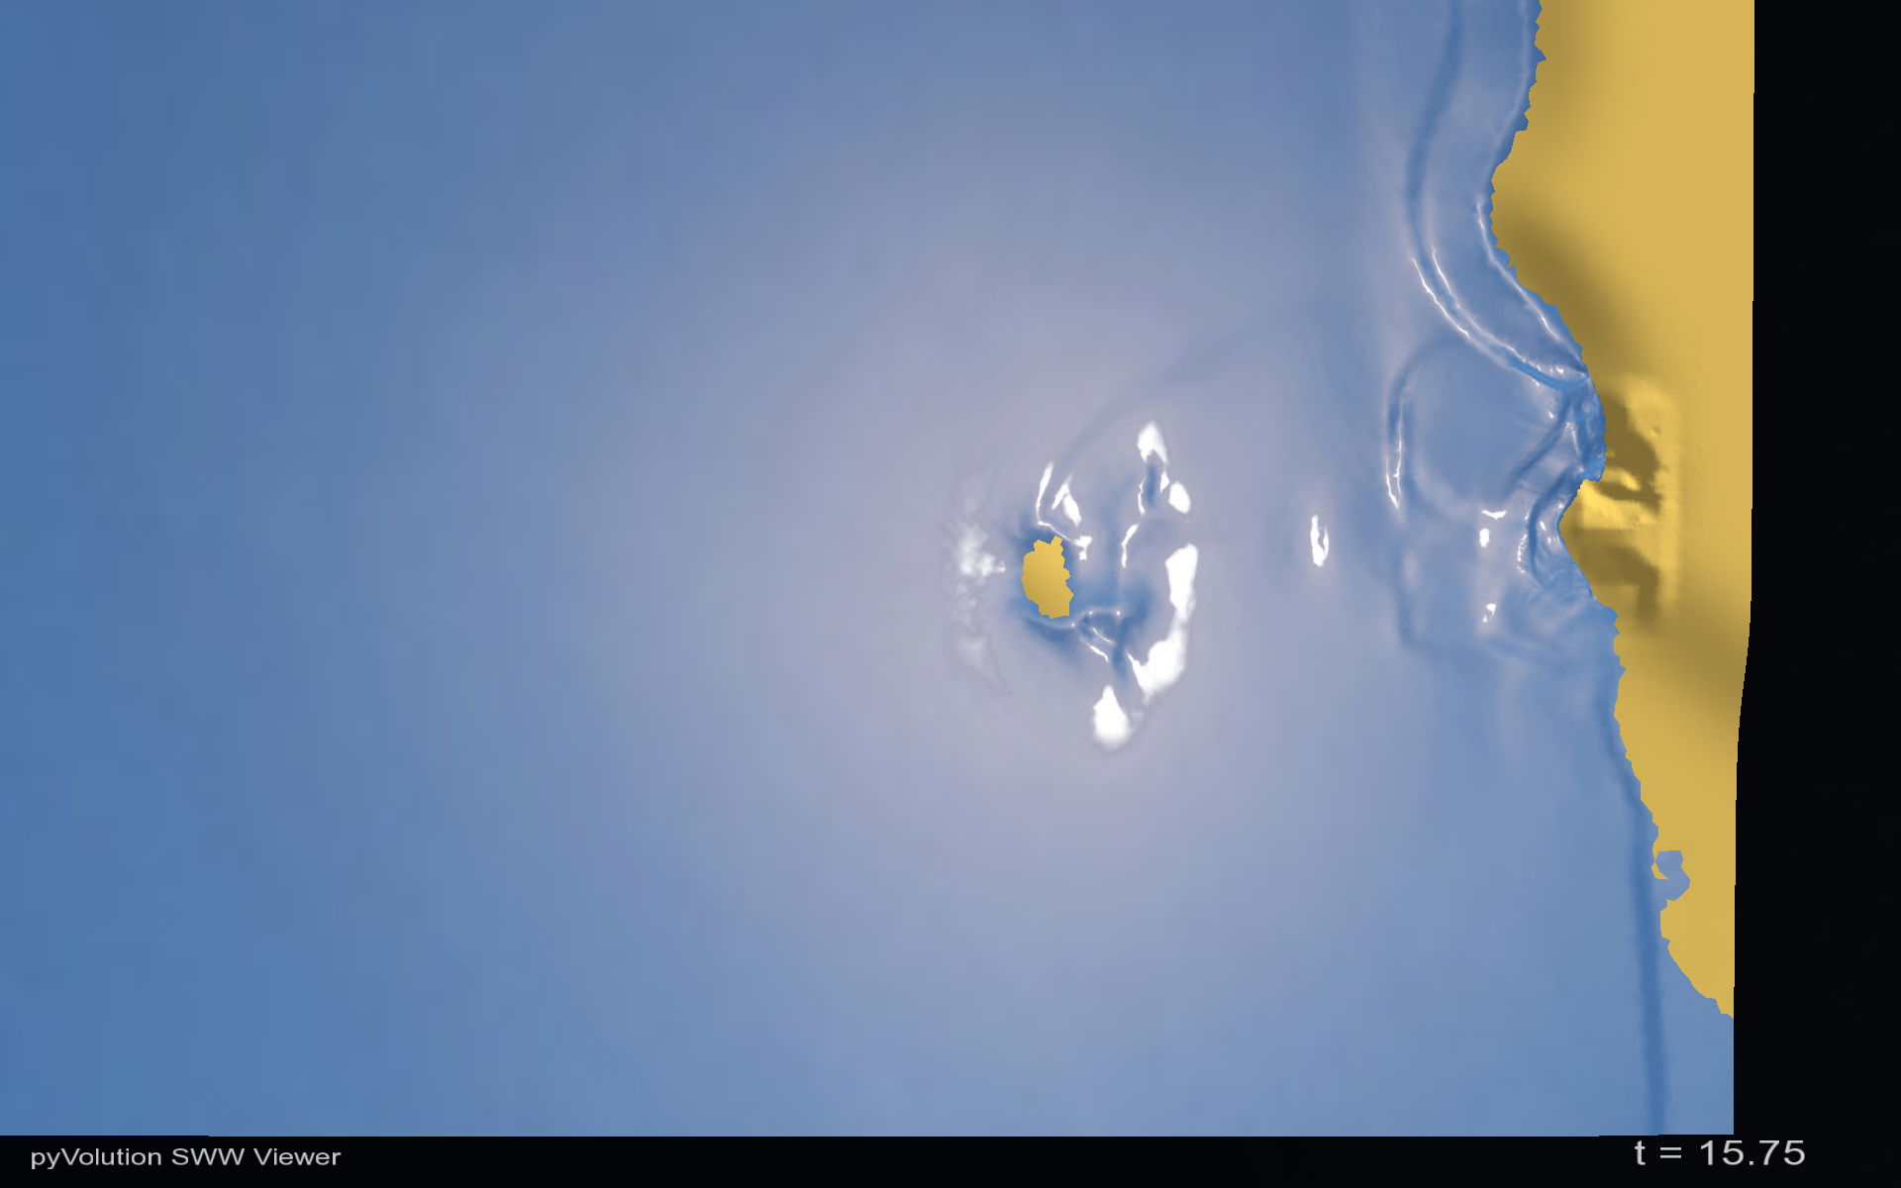
Reflection
Okushiri Island
Sea of Japan
Monai Valley

Slide 21
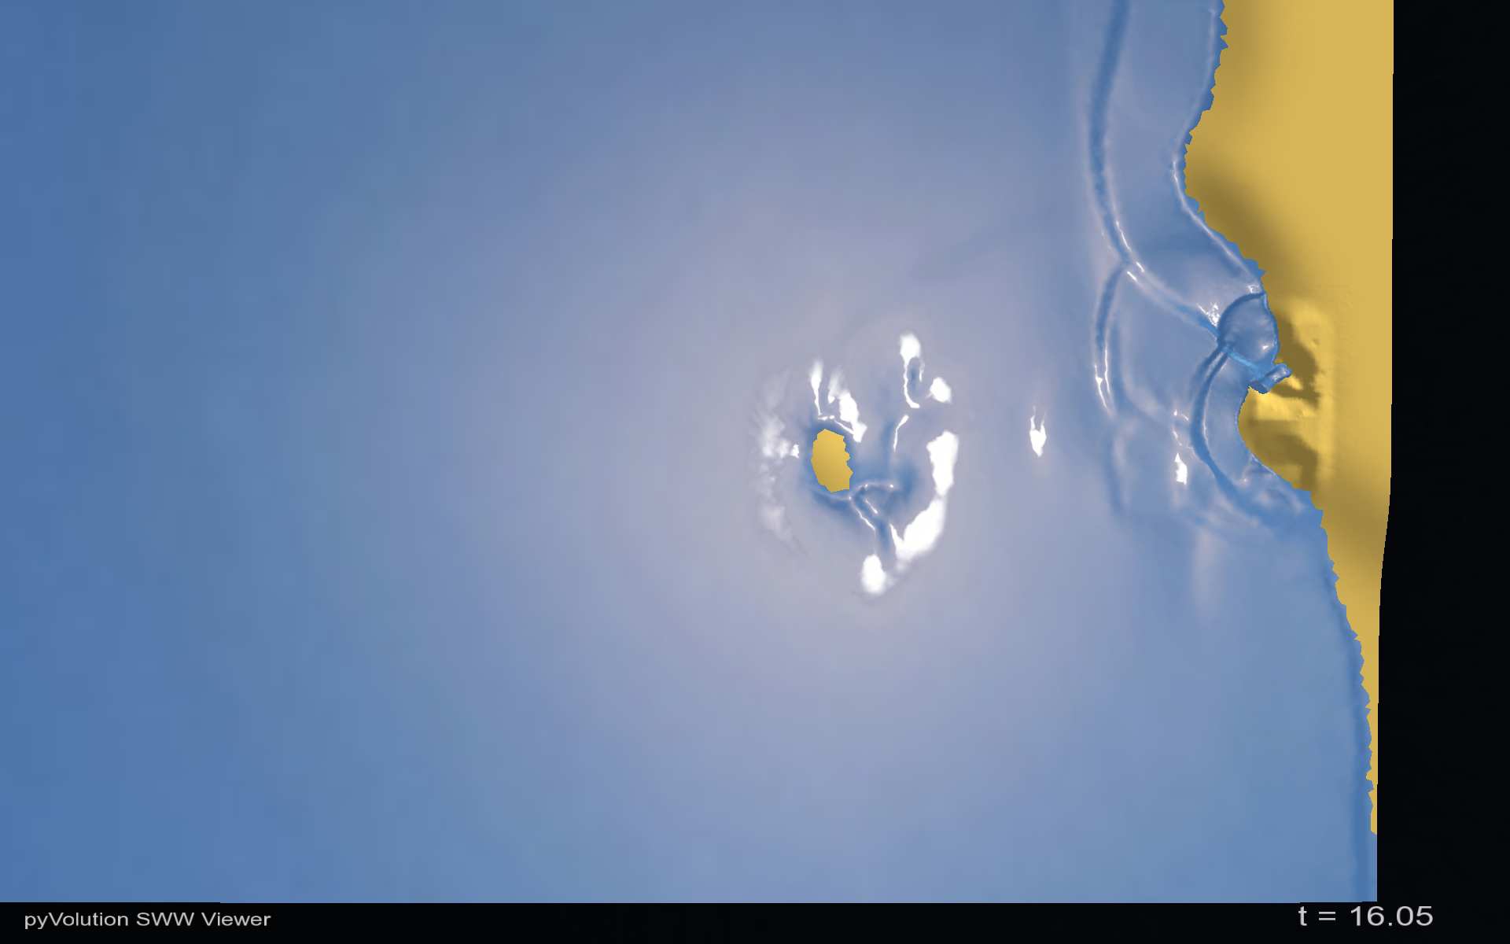
Okushiri Island
Sea of Japan
Shoaling
Monai Valley

Slide 22
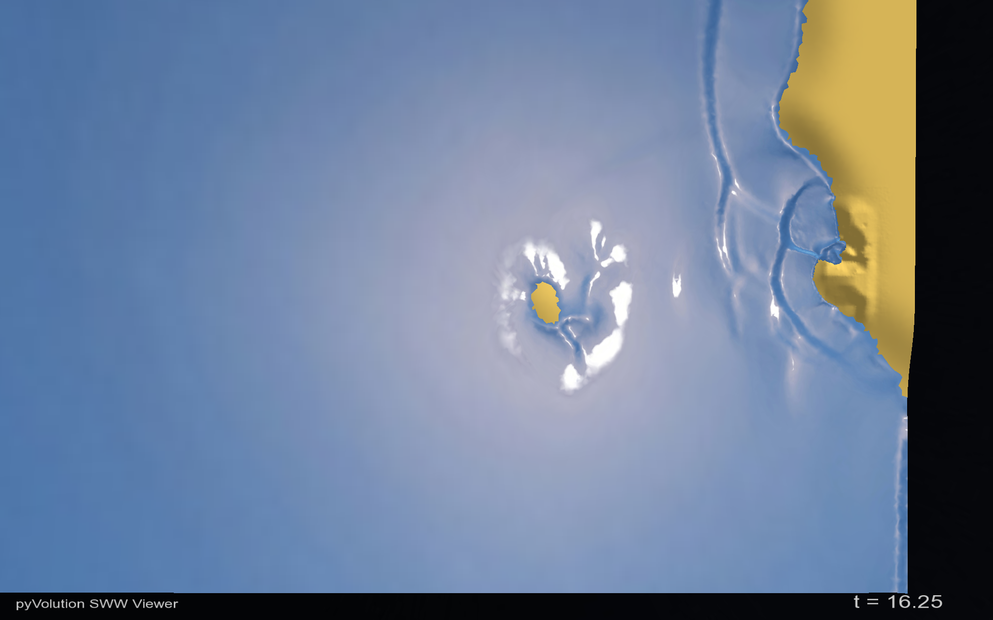
Okushiri Island
Sea of Japan
Monai Valley
Run up

Slide 23
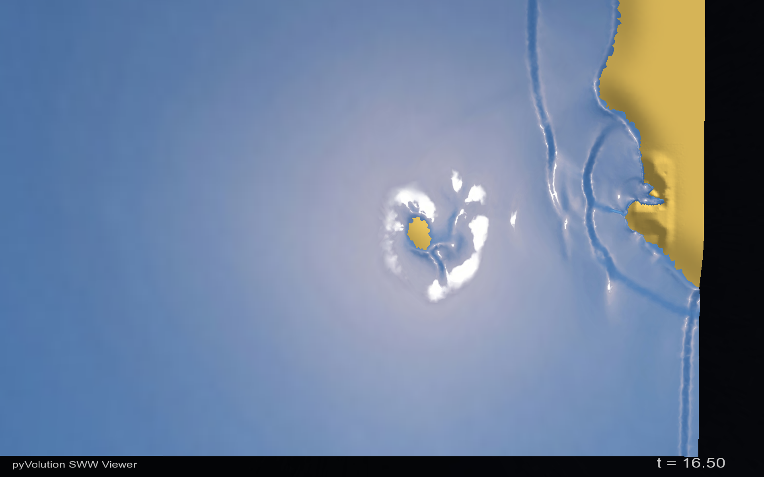
Okushiri Island
Sea of Japan
Monai Valley
Run up

Slide 24

Okushiri Island
Sea of Japan
Monai Valley
Run up

Slide 25
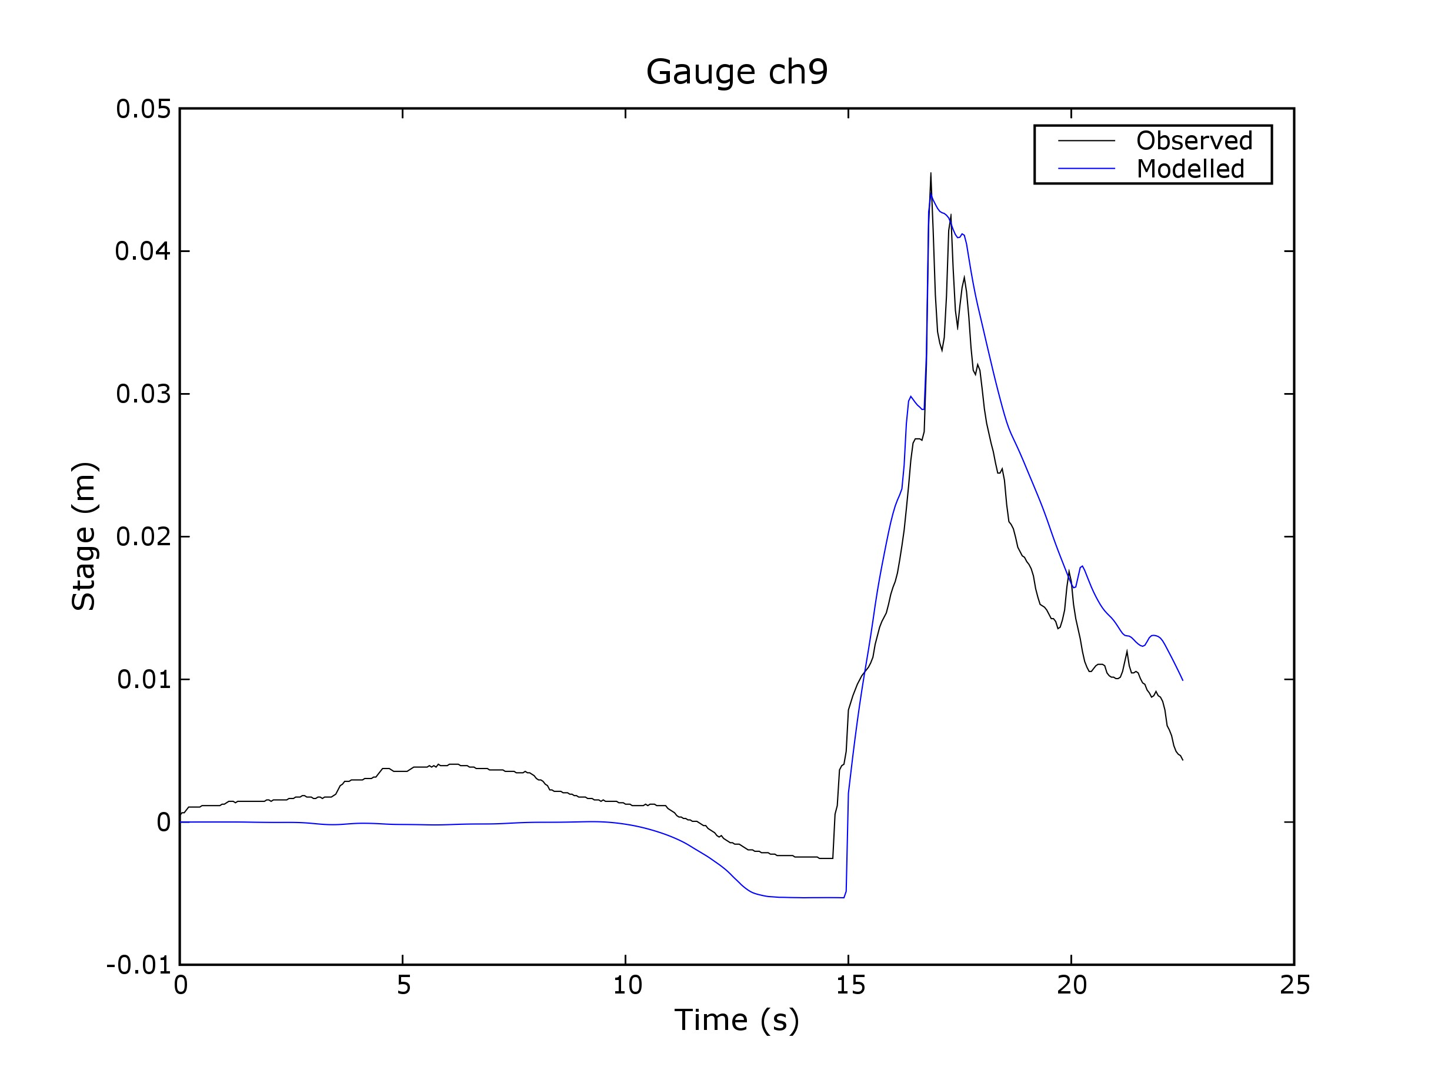

Slide 26
Testing and validation
890 individual unit tests
Numerous wave tank experiments
2004 Tsunami impact on Patong Beach

Slide 27
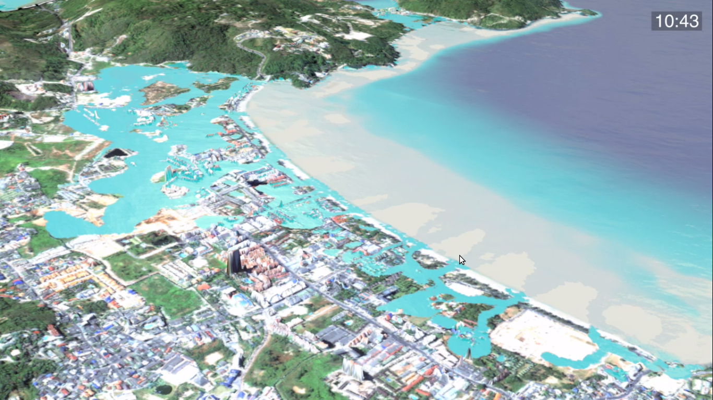
Validation 2004 Tsunami
Took 2 years to get elevation, source and survey data.
Validation run and comparison is part of the ANUGA test suite (although it takes forever to run :-).

Slide 28
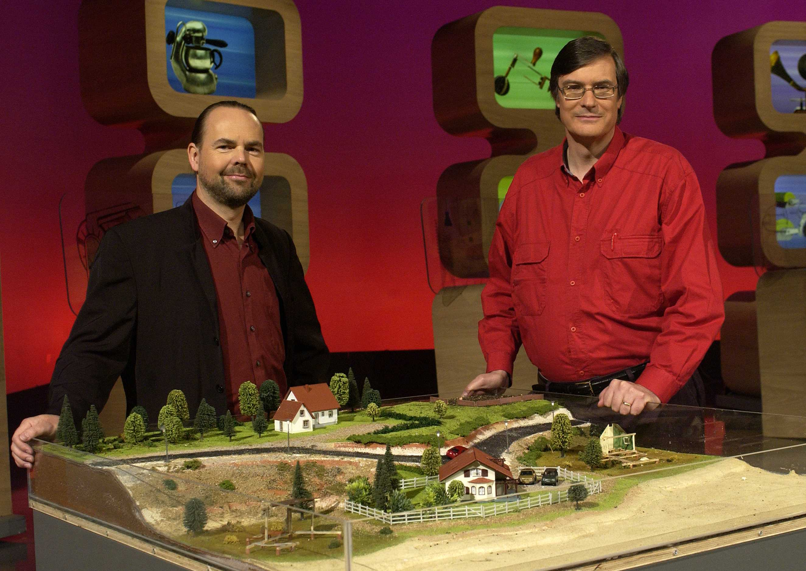
Featured on Australian TV
Further information:
Email: Ole.Nielsen@ga.gov.au
Stephen.Roberts@anu.edu.au
Google Search: ANUGA software
(ANUGA by itself will get German food fair)

Slide 29

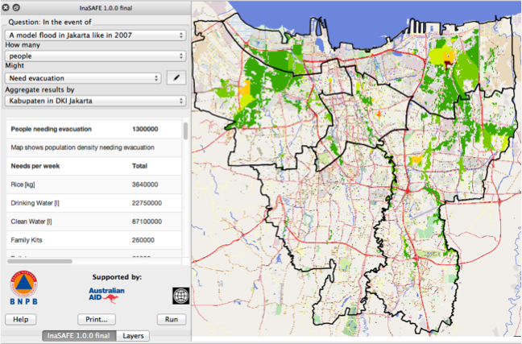
Python in International AID: 2010 - 2012
InaSAFE
Indonesia Scenario Assessment For Emergencies
Notes:
THIS SECTION IS FOR MATT TO PROVIDE INTRODUCTION

Slide 30
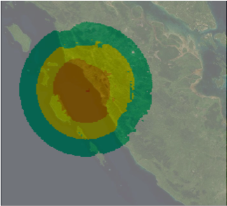

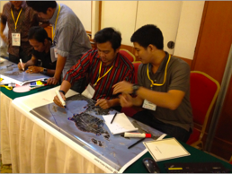
InaSAFE
Hazard Maps
(Ground shaking,Inundation, etc)
Science Agencies
Population and Buildings
Mapping and statistical agencies
Also Communities
Decision Making
  Hazard
  Exposure

Slide 31
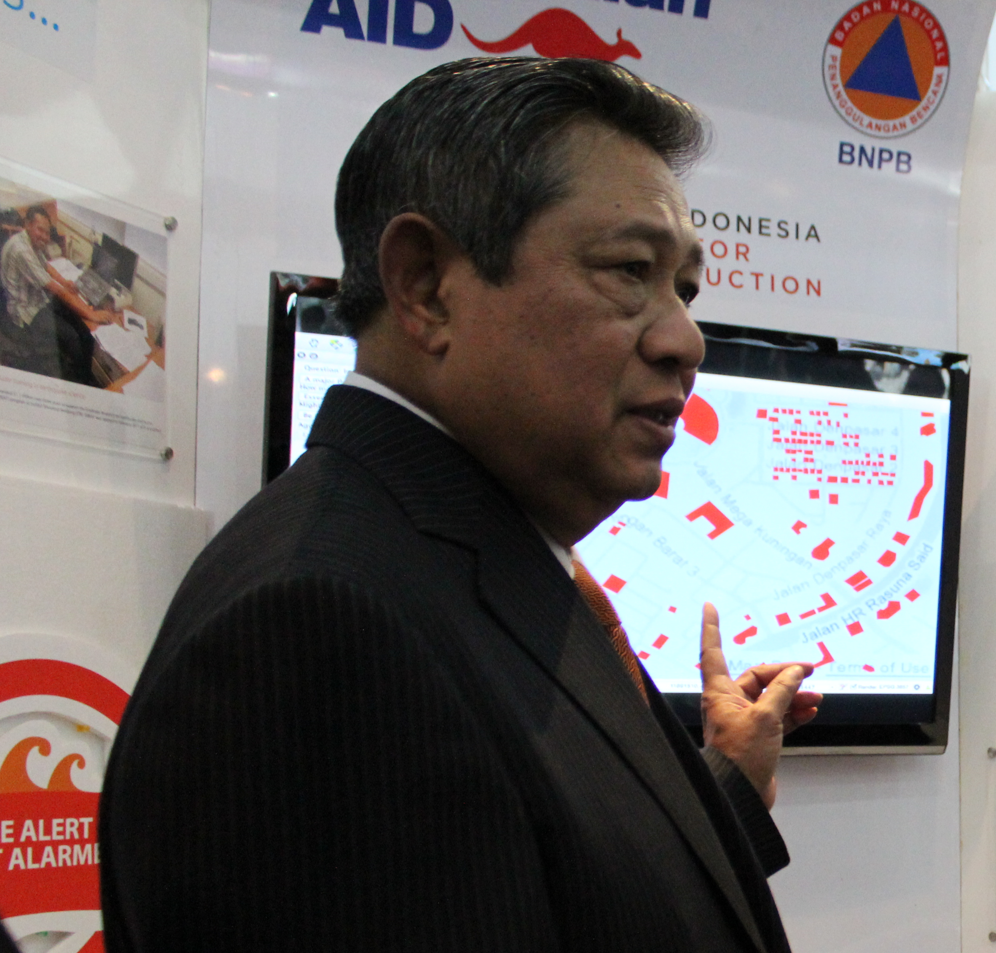
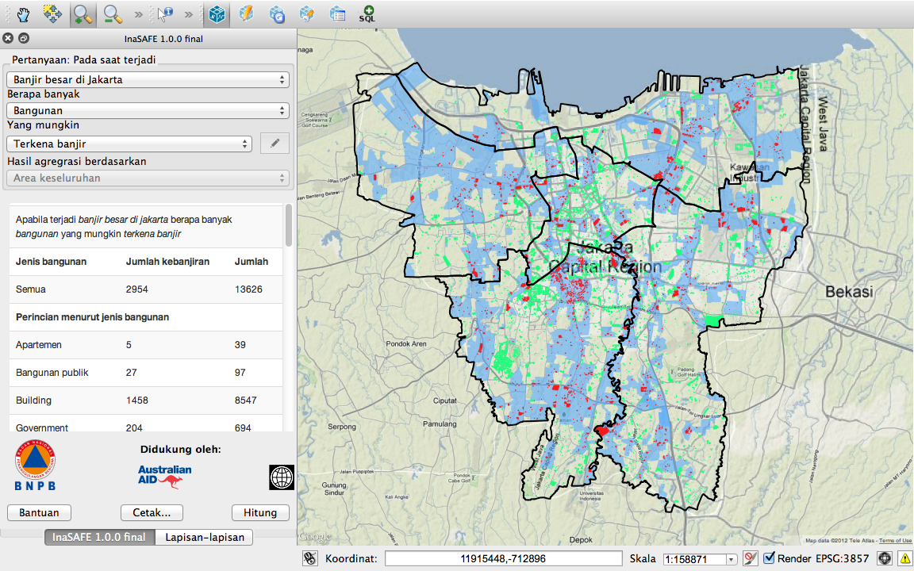

Slide 32
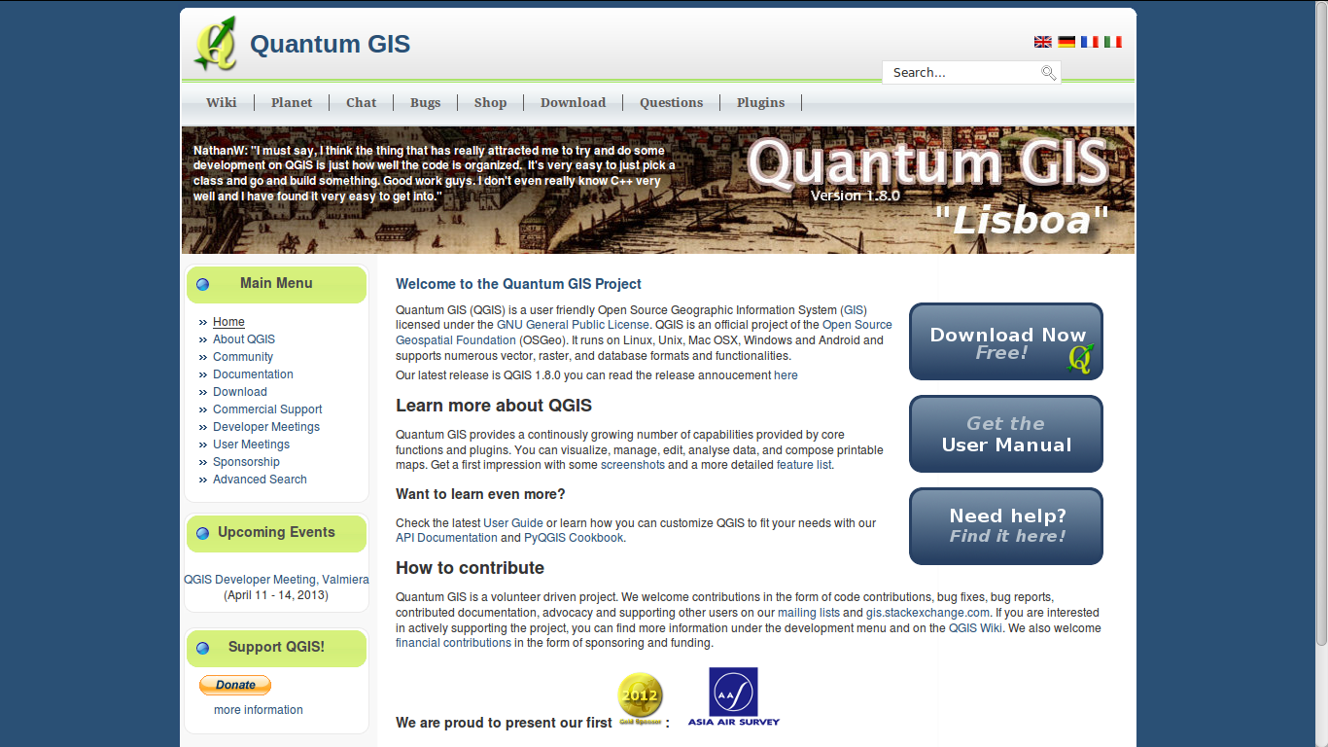

Slide 33
Who has used OpenStreetMap?
OSM is a community driven, community owned version of Google Maps
  Free (download the data and do anything with it)
  Open (anyone can create new tools on top of it)
  Editable (you can map what is important to you)

Slide 34
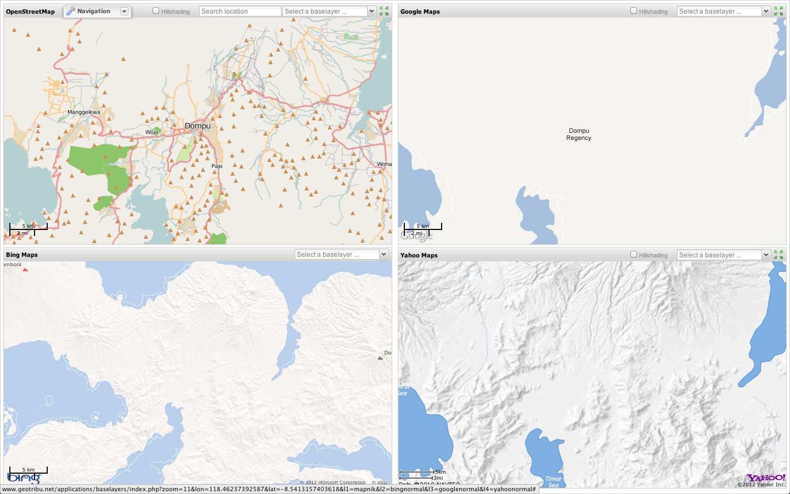
Spatial Data is often not available.
Open Street Map allows communities to self map

Slide 35
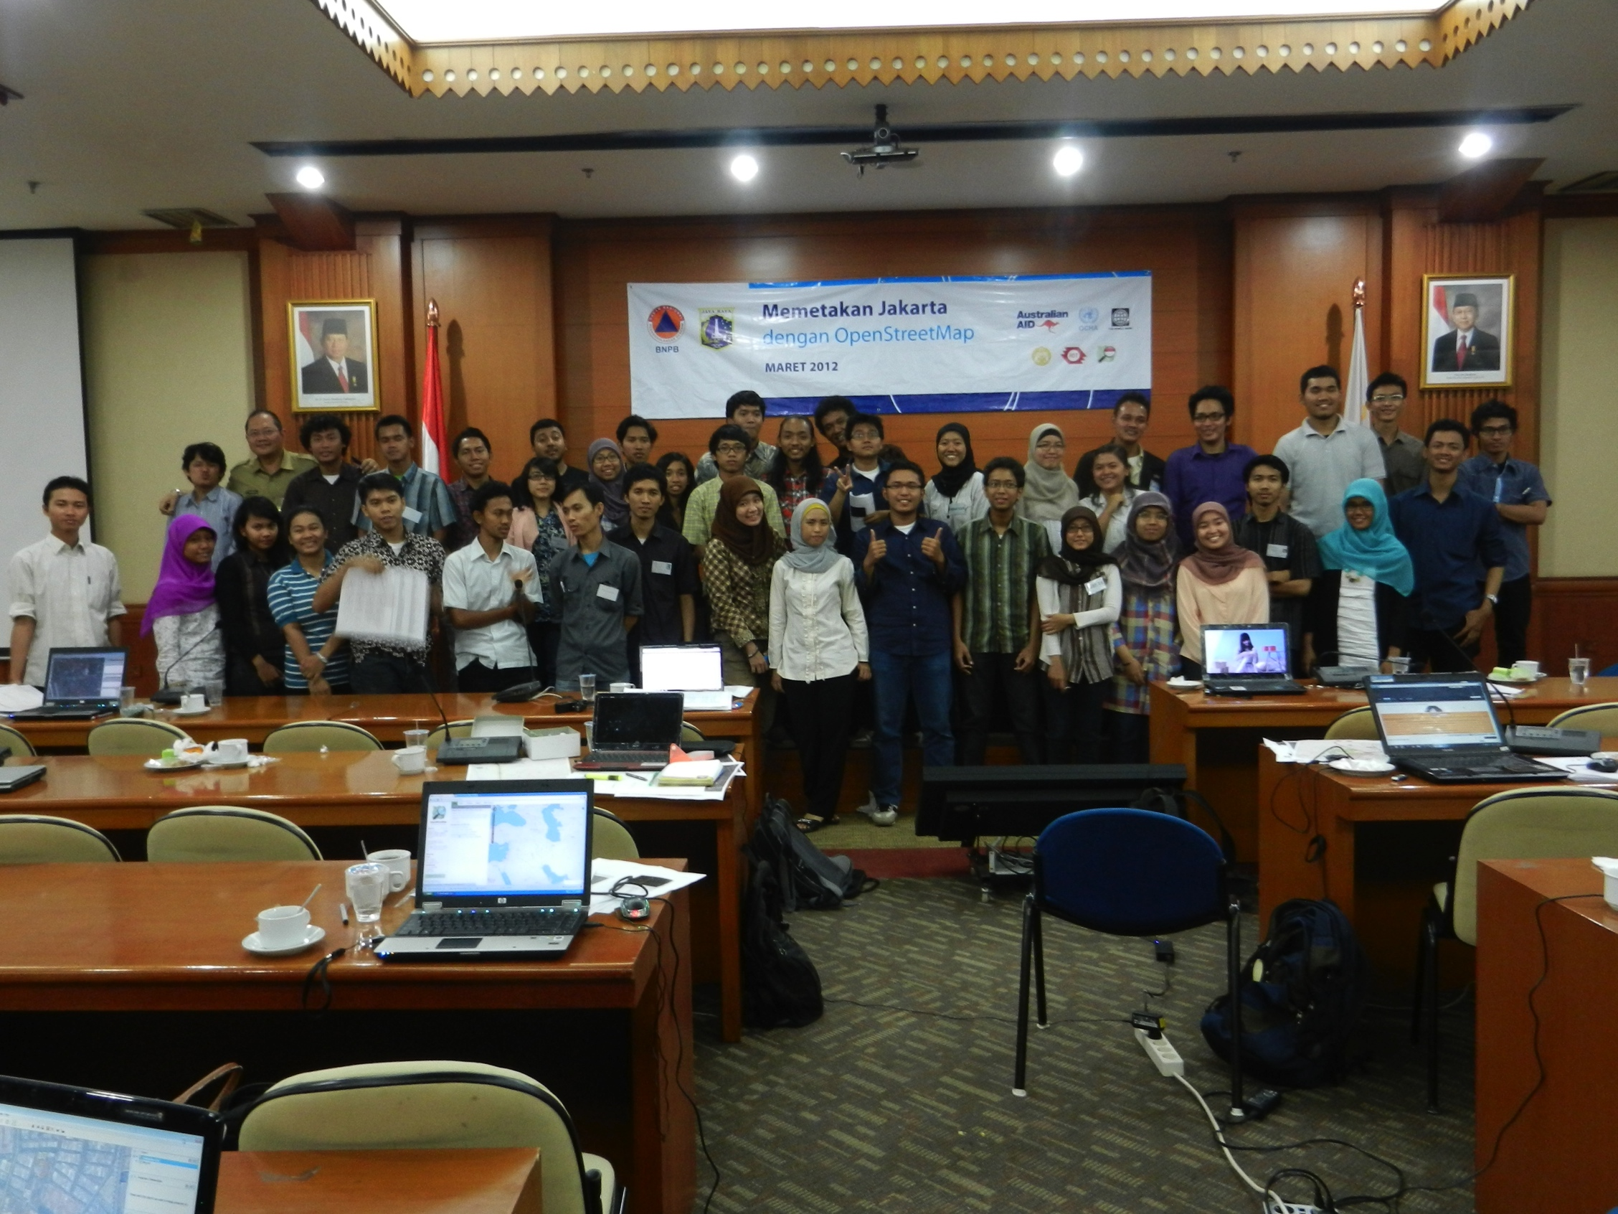
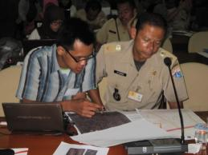
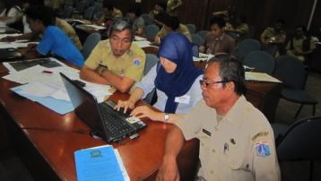
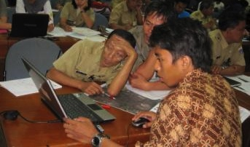
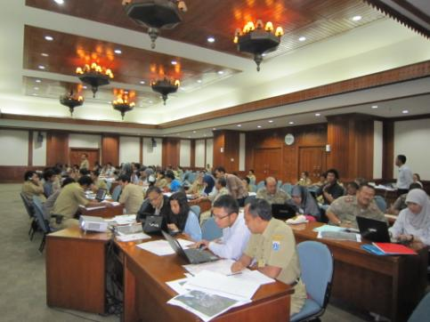
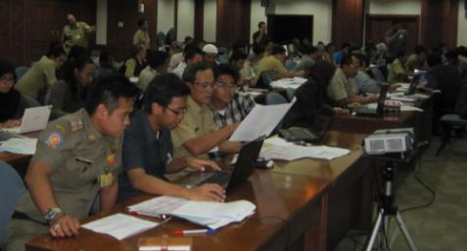

Slide 37
So what have I learned (if anything)?

Slide 38

7 noble steps to software that works
No news is good news
If it can't install – it doesn't exist
Without docs – it doesn't exist
Without testing – it doesn't exist
No future without a past
Sleep in the bed you make
Get it right – then fast

Slide 39
No news is good news
Either do as requested or raise an exception
Good error messages help everyone
Exception handling allows the error to be treated at the appropriate level
  Index error at low level becomes a matter of selecting a viewport at a higher level
  XML parse error is typically not helpful at application level – it should explain why
  Conditions like “file cannot open” or “division by zero” can often be handled sensibly without raising errors.

Slide 40

My online visa application
Ø

Slide 41
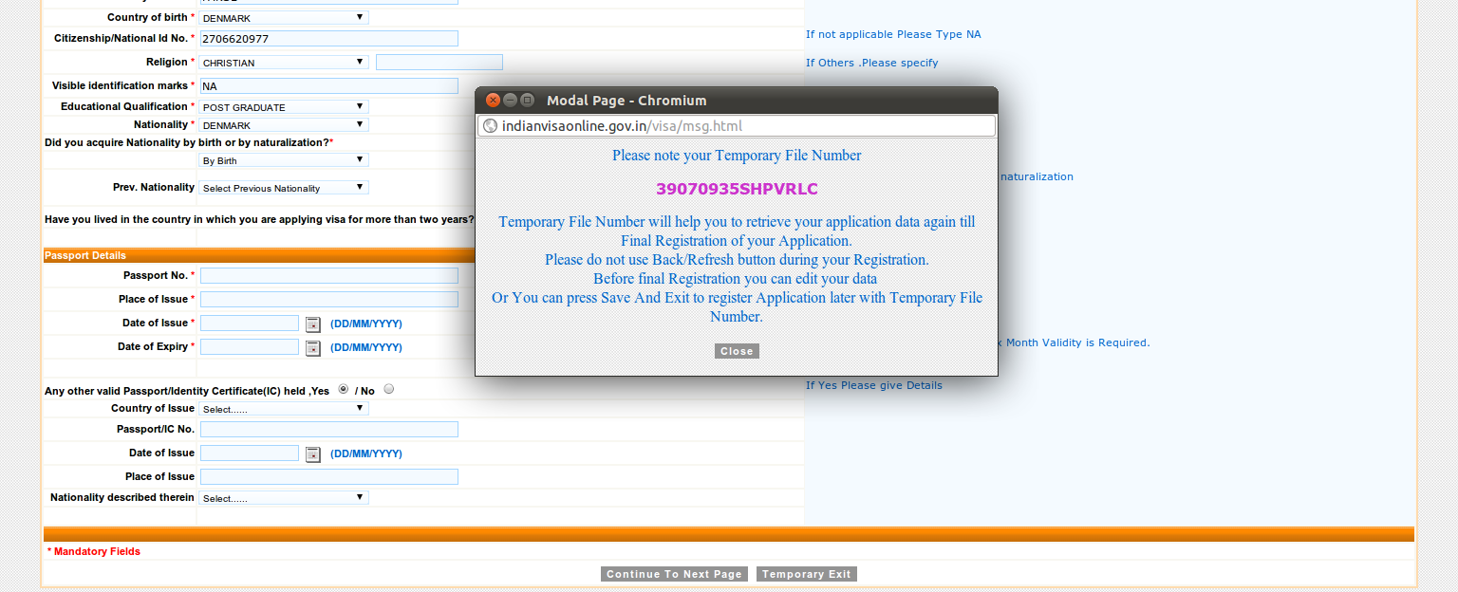
Saving the application

Slide 42

Loading it again

Slide 43

What?

Slide 44
The Story of Ø

Slide 45
Other error messages I have seen
  (my>ky) failed for hidden my: regrid_smth:my=2
  syntax error: line 1, column 0
  write_dbs_grid: error in nf90_enddef

Slide 46
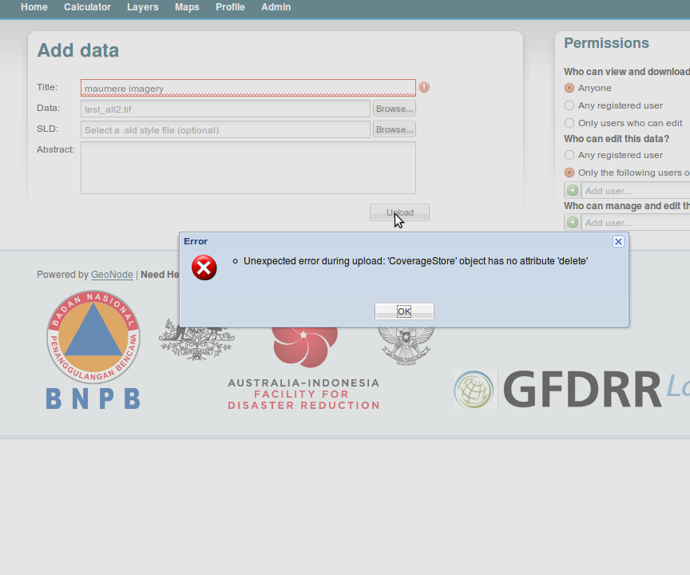

Slide 47
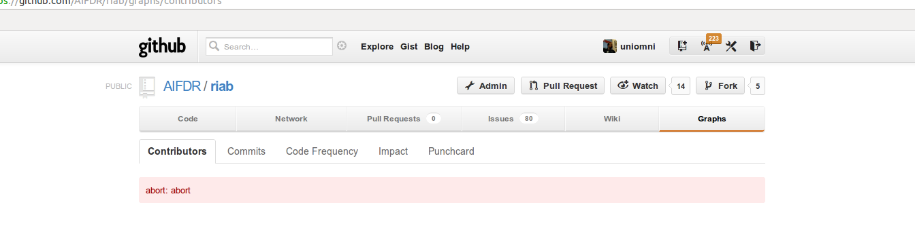
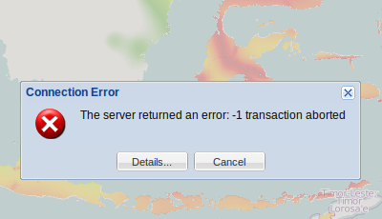

Slide 48
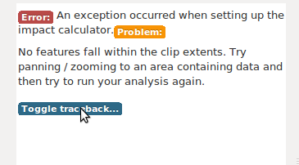
Good error message

Slide 49
Example of error messaging
try:
infile = open(self.projection_file)
except IOError:
msg = ('Projection file %s could not be opened. '
'The topography file must have a projection file with '
'extension .prj to georeference the model outputs '
'correctly. The projection file is assumed to follow '
'the ESRI WKT format ' % self.projection_file)
raise Exception(msg)

Slide 50
Without docs – it doesn't exist
Minimum
  installation documentation
  how to run a few examples
  docstrings
Ideally – documentation driven
Critical if software is to take on its own life

Slide 51


Slide 52
Bad docstrings
def delete_style(self, style_name):
"""docstring for delete_style"""
def compatible_layers(func, layer_descriptors):
"""Fetches all the layers that match the plugin requirements.
“””

Slide 53
Good docstrings
def osm2padang(E):
"""Map OSM attributes to Padang vulnerability classes
This maps attributes collected in the OpenStreetMap exposure data
(data.kompetisiosm.org) to 9 vulnerability classes identified by
Geoscience Australia and ITB in the post 2009 Padang earthquake
survey (http://trove.nla.gov.au/work/38470066).
The mapping was developed by Abigail Baca, GFDRR.
Input
E: Vector object representing the OSM data
Output:
Vector object like E, but with one new attribute ('VCLASS')
representing the vulnerability class used in the Padang dataset
Algorithm
…
...

Slide 54
def interpolate2d(x, y, Z, points, mode='linear', bounds_error=False):
"""Fundamental 2D interpolation routine
Input
x: 1D array of x-coordinates of the mesh on which to interpolate
y: 1D array of y-coordinates of the mesh on which to interpolate
Z: 2D array of values for each x, y pair
points: Nx2 array of coordinates where interpolated values are sought
mode: Determines the interpolation order. Options are
'constant' - piecewise constant nearest neighbour interpolation
'linear' - bilinear interpolation using the four
nearest neighbours (default)
bounds_error: Boolean flag. If True (default) an exception will
be raised when interpolated values are requested
outside the domain of the input data. If False, nan
is returned for those values
Output
1D array with same length as points with interpolated values
Notes
Input coordinates x and y are assumed to be monotonically increasing,
but need not be equidistantly spaced.
Z is assumed to have dimension M x N, where M = len(x) and N = len(y).
In other words it is assumed that the x values follow the first
(vertical) axis downwards and y values the second (horizontal) axis
from left to right.

Slide 55
Without testing – it doesn't exist
Not possible to manually test all cases of a complex software project – must be automatic!
Known as unit-, regression-, system- or integration-testing
Have tests for the functionality you care about
The extra time invested comes back 100 fold when debugging, refactoring and moving to new platforms
Crucial when optimising (“Faster and faster – but wrong”!)
Also serves as trusted documentation
The single most important practice – I'd rather keep my tests than the source code!
InaSAFE has over 300 tests - ANUGA almost 1000,

Slide 56
What makes good testing
Sets up all conditions, call the test, verify the result.
Verify result using known invariant conditions (e.g. conservation of mass, linearly interpolated points must lie within certain bounds, inverse transforms reproduce original inputs, ...)
Not only “happy path” but also corner cases (None, NaN, 0, max, min, %, &, $): E.g. intersection (Parallel lines, coinciding lines, intersecting at endpoints, ... )
Input that causes error conditions
If a new bug is found, write new test revealing it “It is a lot easier to debug a test than running the application” (Tim Sutton)
Independent of context, time and other tests
Named after what is being tested: (see next slides)
Good coverage (>80%) - but not 100%!
Programmers need GUTs
Google: Klaus P. Berg – Good Unit Tests

Slide 57

Simple but real test example
pl

Slide 58
#148 Linear and quantile bins are correct ... ok
#149 Bounding boxes can be converted between list and string ... ok
#150 Intersections of bounding boxes work ... ok
#151 Bounding box can be buffered ... ok
#152 Centroid point data can be derived from polygon data ... ok
#153 Projections that are compatible but not identical are recognised ... ok
#154 Donut polygon can be read, interpreted and written correctly ... ok
#155 Empty keywords can be handled ... ok
#156 Bounding box can be extracted from geotransform ... ok
#157 Resolution can be extracted from geotransform ... ok
#158 Bounding box is correctly extracted from file. ... ok
#160 Vector and Raster objects can be instantiated with None ... ok
#161 Keywords can be written and read ... ok
#162 Keywords and values with colons raise error messages ... ok
#163 Vector and Raster instances have a similar API ... ok
#164 Points along line are computed correctly ... ok
#165 Bounding box minimal size can be controlled ... ok
#166 Multipart polygons are be converted to singlepart ... ok
#167 Raster layers with no projection causes Exception to be raised ... ok
#168 NODATA value is correctly handled for GDAL layers ... ok
#169 Ordering of polygon vertices is preserved when writing and reading ... ok
#170 Polygon areas are computed correctly ... ok
#171 Polygon centroids are computed correctly ... ok
#172 Polygons with inner rings can be written and read ... ok
#173 Projection information can be correctly compared ... ok
#174 Raster extrema (including NAN's) are correct. ... ok
#175 Raster layers can be converted to vector point layers ... ok

Slide 59
Other types of testing
PEP8: Style checking
Pylint: Static code analysis
Customised checks:
  Scan for unwanted strings, e.g. assert, settrace, …
  IP status of bundled data (is it ok to publish?)
  Missing translations
  - anything you care about, that can be automated

Slide 60


Slide 61
Get it right – Then fast
Recipe refined during development of ANUGA
Write one or two tests
Implement brute force simple algorithm
Implement smarter algorithm and more tests
After profiling, write bottlenecks in C using test suite to maintain correctness
Never optimise without profiling and testing!

Slide 62
Why use and make Open Source
Open Source makes software better
  Generates interest and attracts feedback
  Facilitates re-use
  Allows large teams to collaborate
  Critical to scientific reproducibility
  (please include the source code in papers!)

Slide 63



Appeal: Get involved in QGIS!
Spatial Capabilities
Numerical Algorithms
http://www.qgis.org
Notes:
Use Quantum GIS – it is a great piece of Open Source software for spatial visualisation and analysis
Contribute to Quantum GIS – the project needs quality mathematics and scientific algorithms (e.g. polygon simplification)

Slide 64
Thank You So Much!
Questions?

