Slide 1




Open Source – Of Course!
Lessons Learned from two decades of
Scientific Open Source Software development
Dr Ole Nielsen

Slide 2
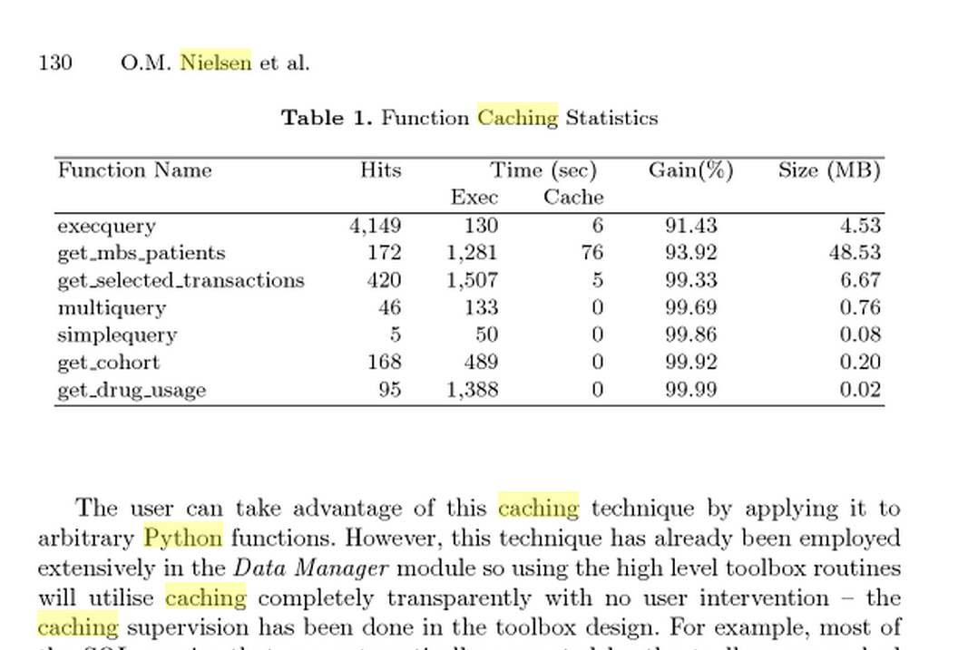
Early Days
Data Mining Tools (Australian National University)
Caching (persistent memoization - 2001)
result = func(arg1,...,argn)
result = cache(func, (arg1,...,argn), dependencies = <list of files>)

Slide 3
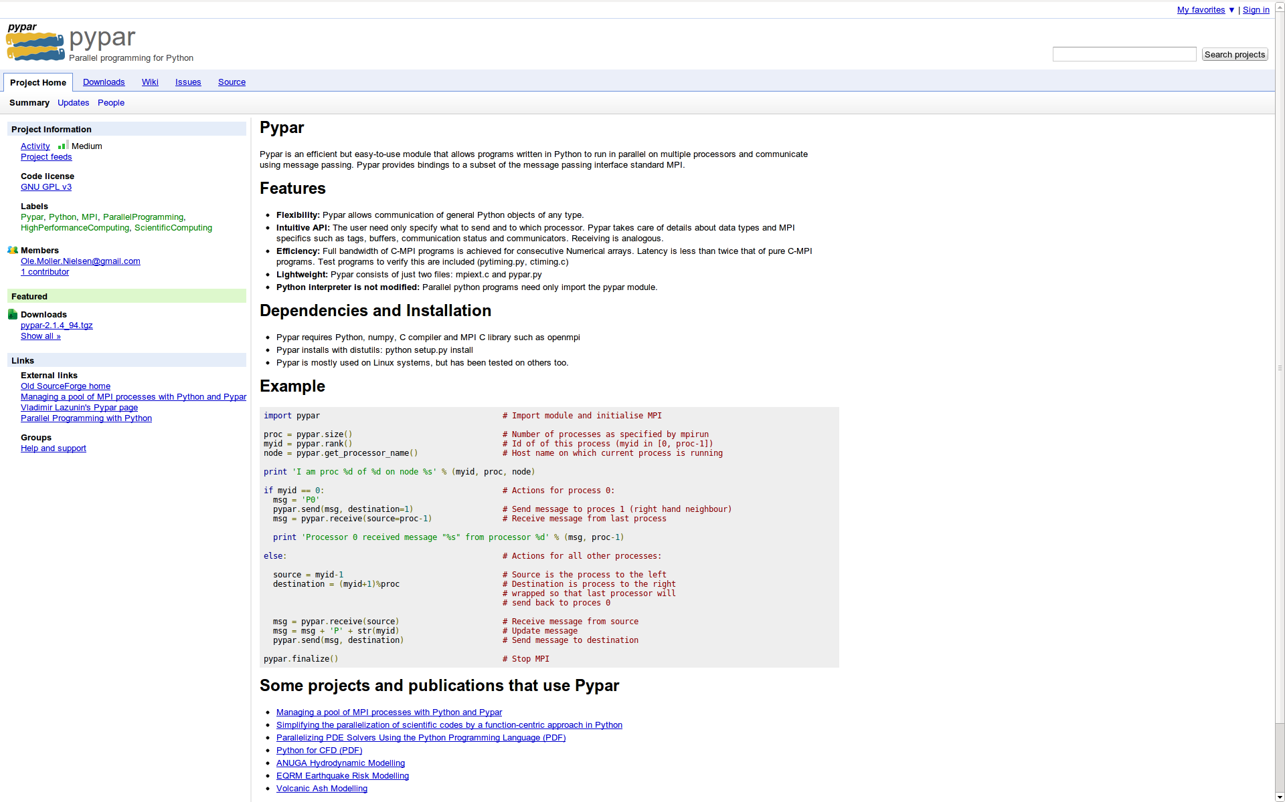
Pushing Python (pypar - 2002)

Slide 4
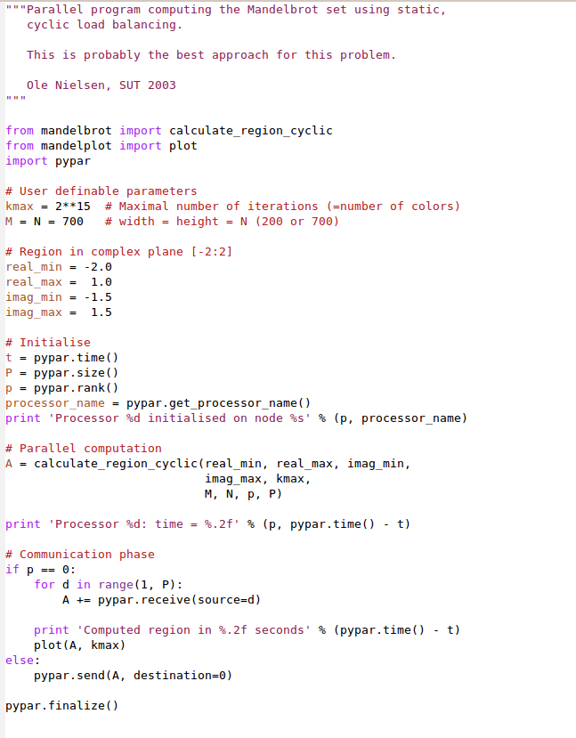
Standard MPI
int MPI_Send(
void *buf,
int count,
MPI_Datatype datatype,
int dest,
int tag,
MPI_Comm comm
);
Pypar
pypar.send(A, p)

Slide 5
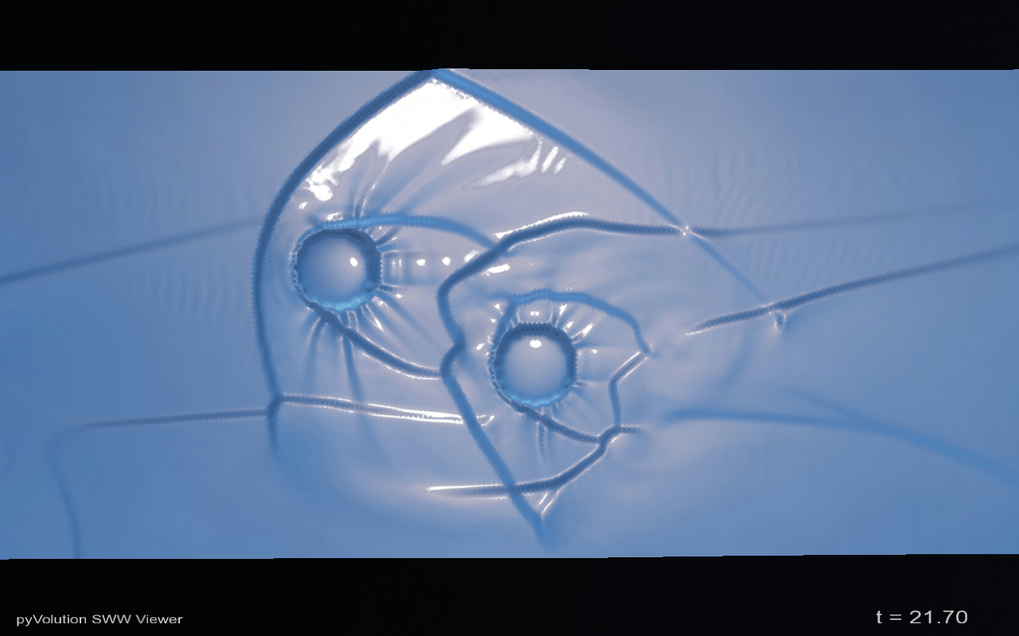
Python in Government (2004-2009)
ANUGA
Open Source
Hydrodynamic Modelling
Ole Nielsen

Slide 6
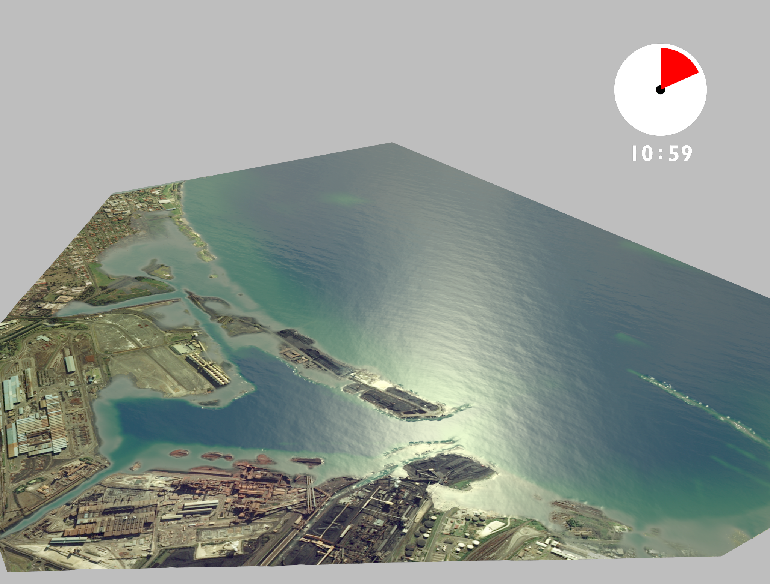
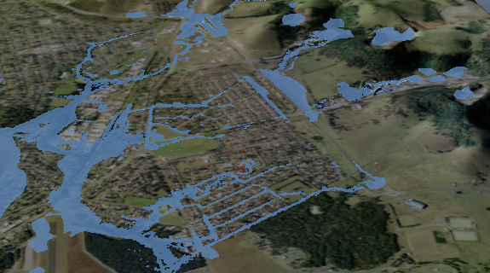
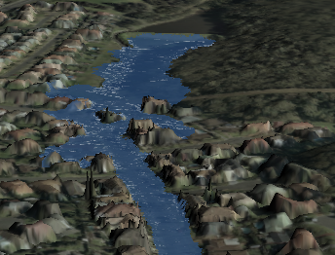
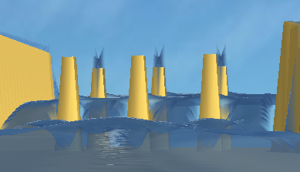
What is ANUGA
Tsunami Inundation
Riverine Flooding
Hydraulic Engineering
Dam Breaks

Slide 7
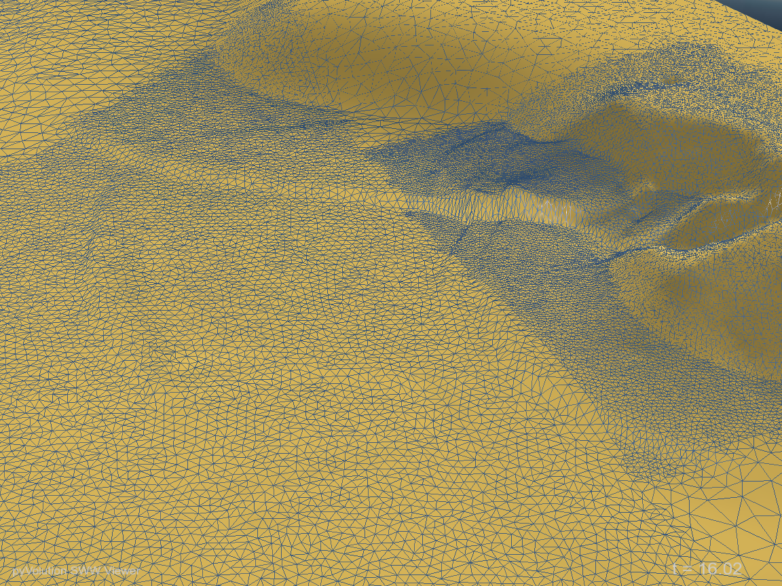
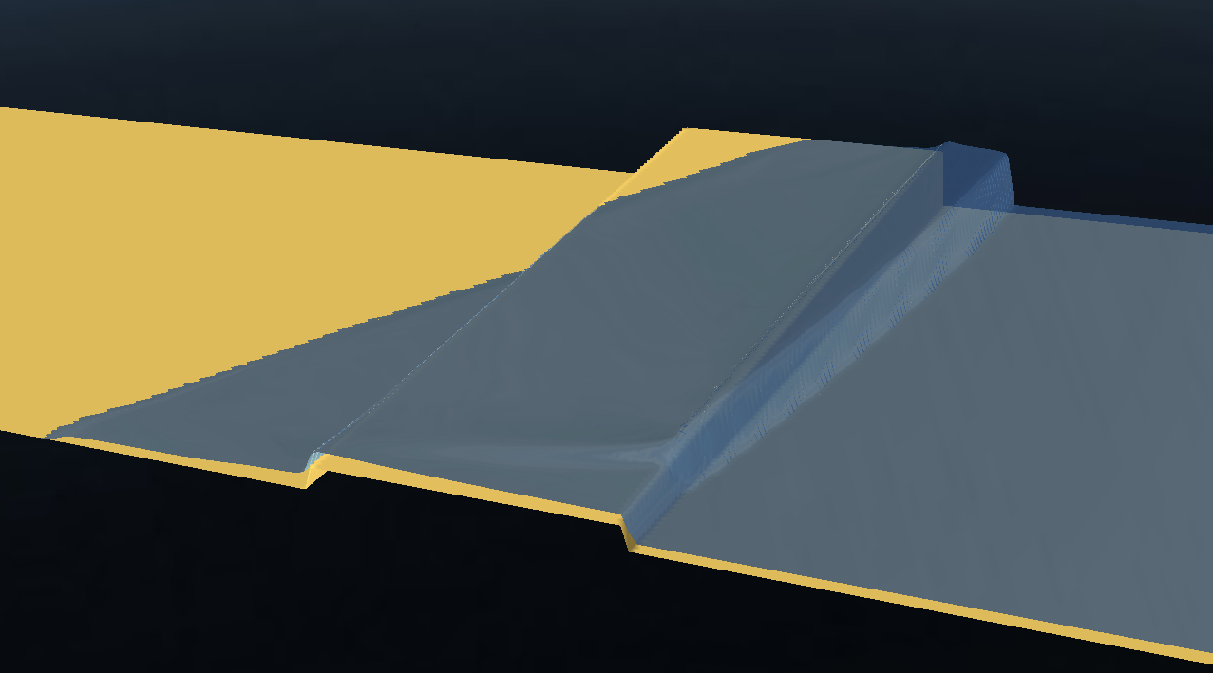
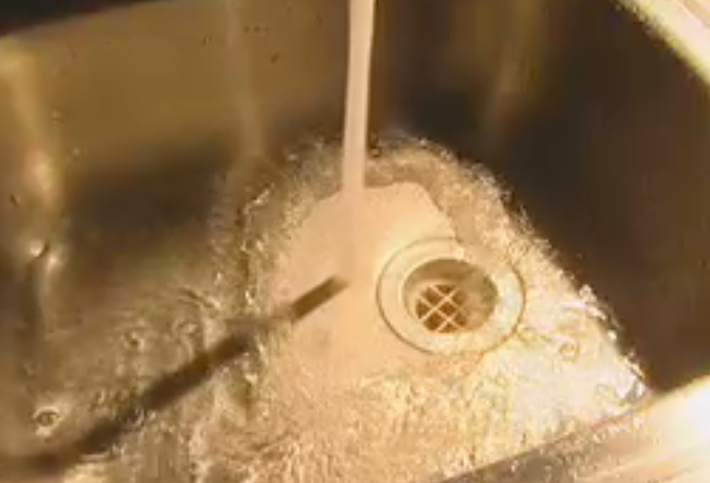
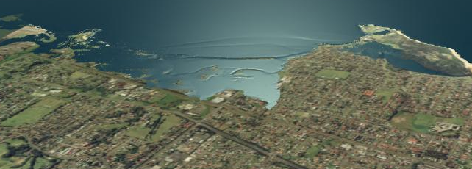
ANUGA Capabilities
Shallow Water Equations/Finite Volumes
Resolution of Hydraulic shocks
Transitions from sub- to super critical flows
Robust wetting/drying capability

Slide 8
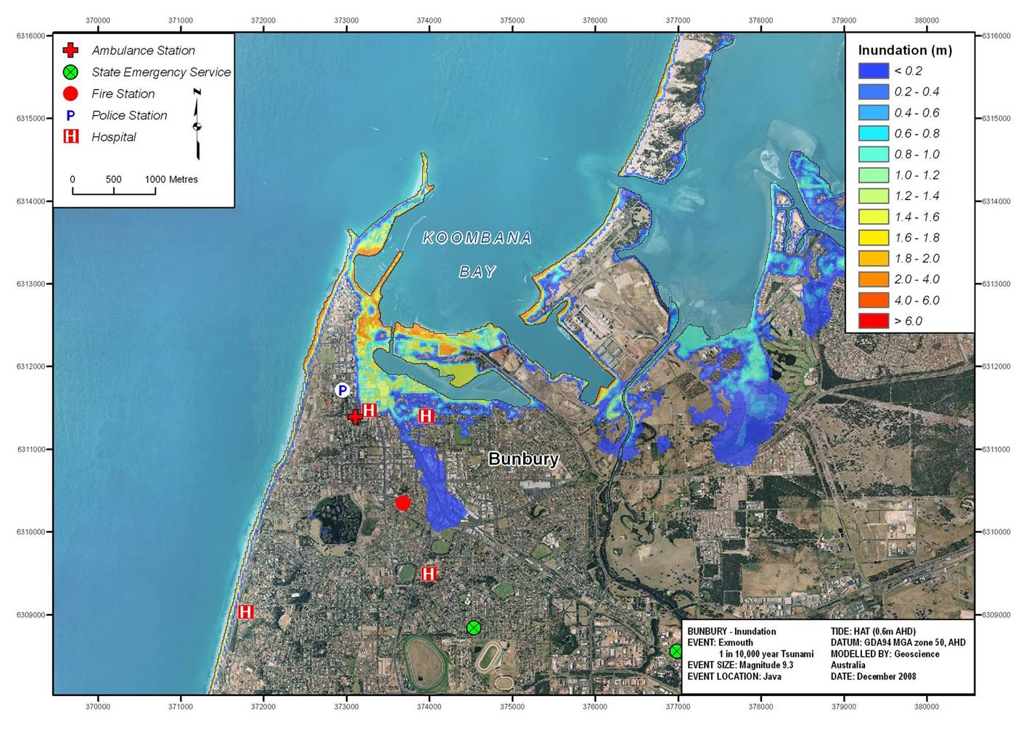
Tsunami Inundation Map Examples
Notes:
Products for FESA
The animation is interesting and allows us to see what happens throughout the time the tsunami is impacting the community, but it doesn’t tell us anything about the depth or speed of the water, and is therefore not that useful to emergency managers. This series of inundation maps show how we typically deliver the tsunami impact modelling results to emergency managers.

Slide 9
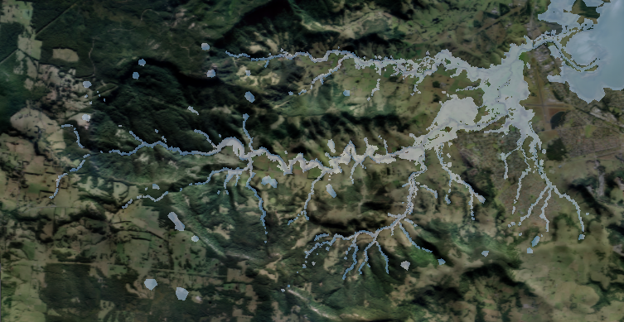
110km2 Full 2-D Model

Slide 10
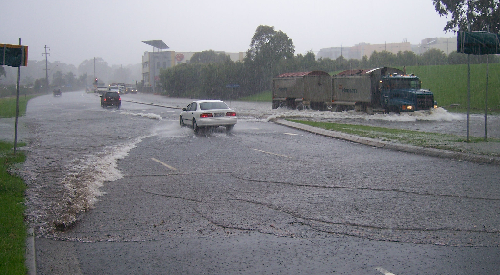
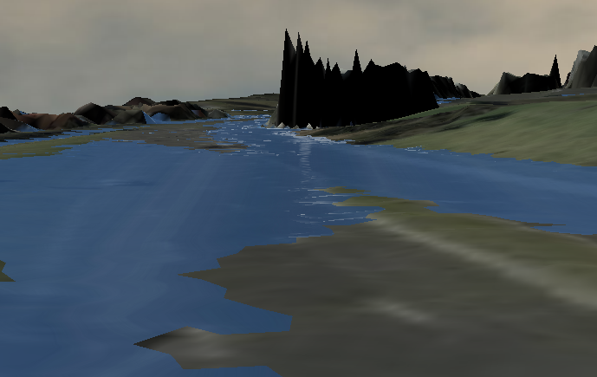
Investigating existing Flood problems…
Real World Flood…
ANUGA interpretation

Slide 11
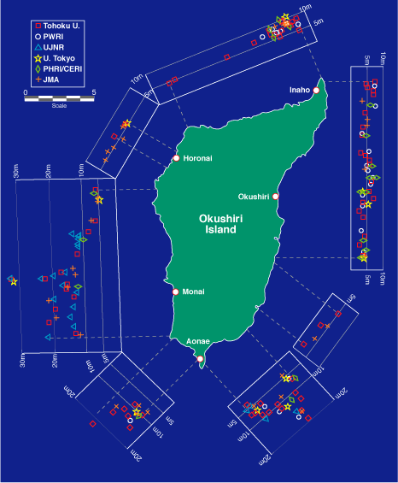
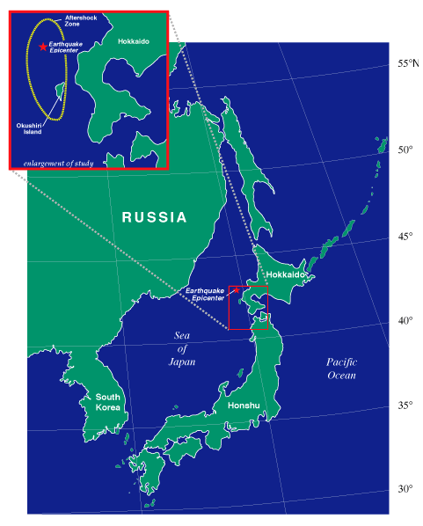

Okushiri Island 1993 Tsunami
Predicting Tsunami Run Up –
The Importance of Modelling
Magnitude 7.8 earthquake
32 m run up height
Numerical Simulation of wave tank experiment shows why
Animation
Stills

Slide 12
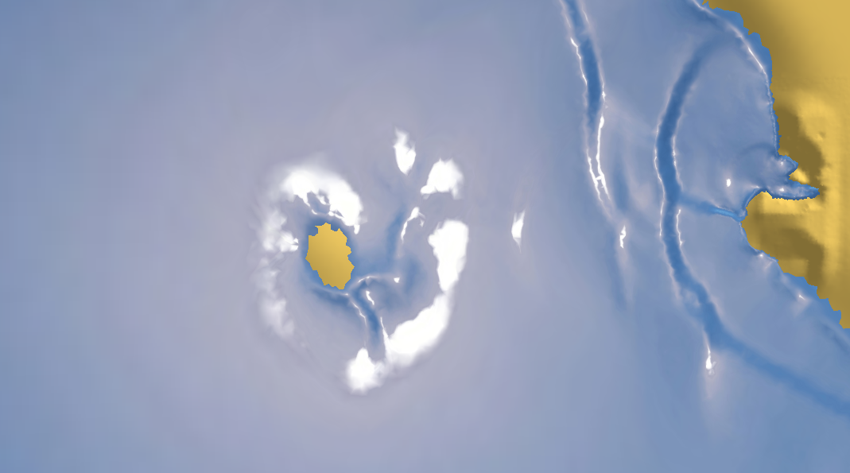
Testing and validation
890 individual unit tests
Numerous wave tank experiments
2004 Tsunami impact on Patong Beach

Slide 13
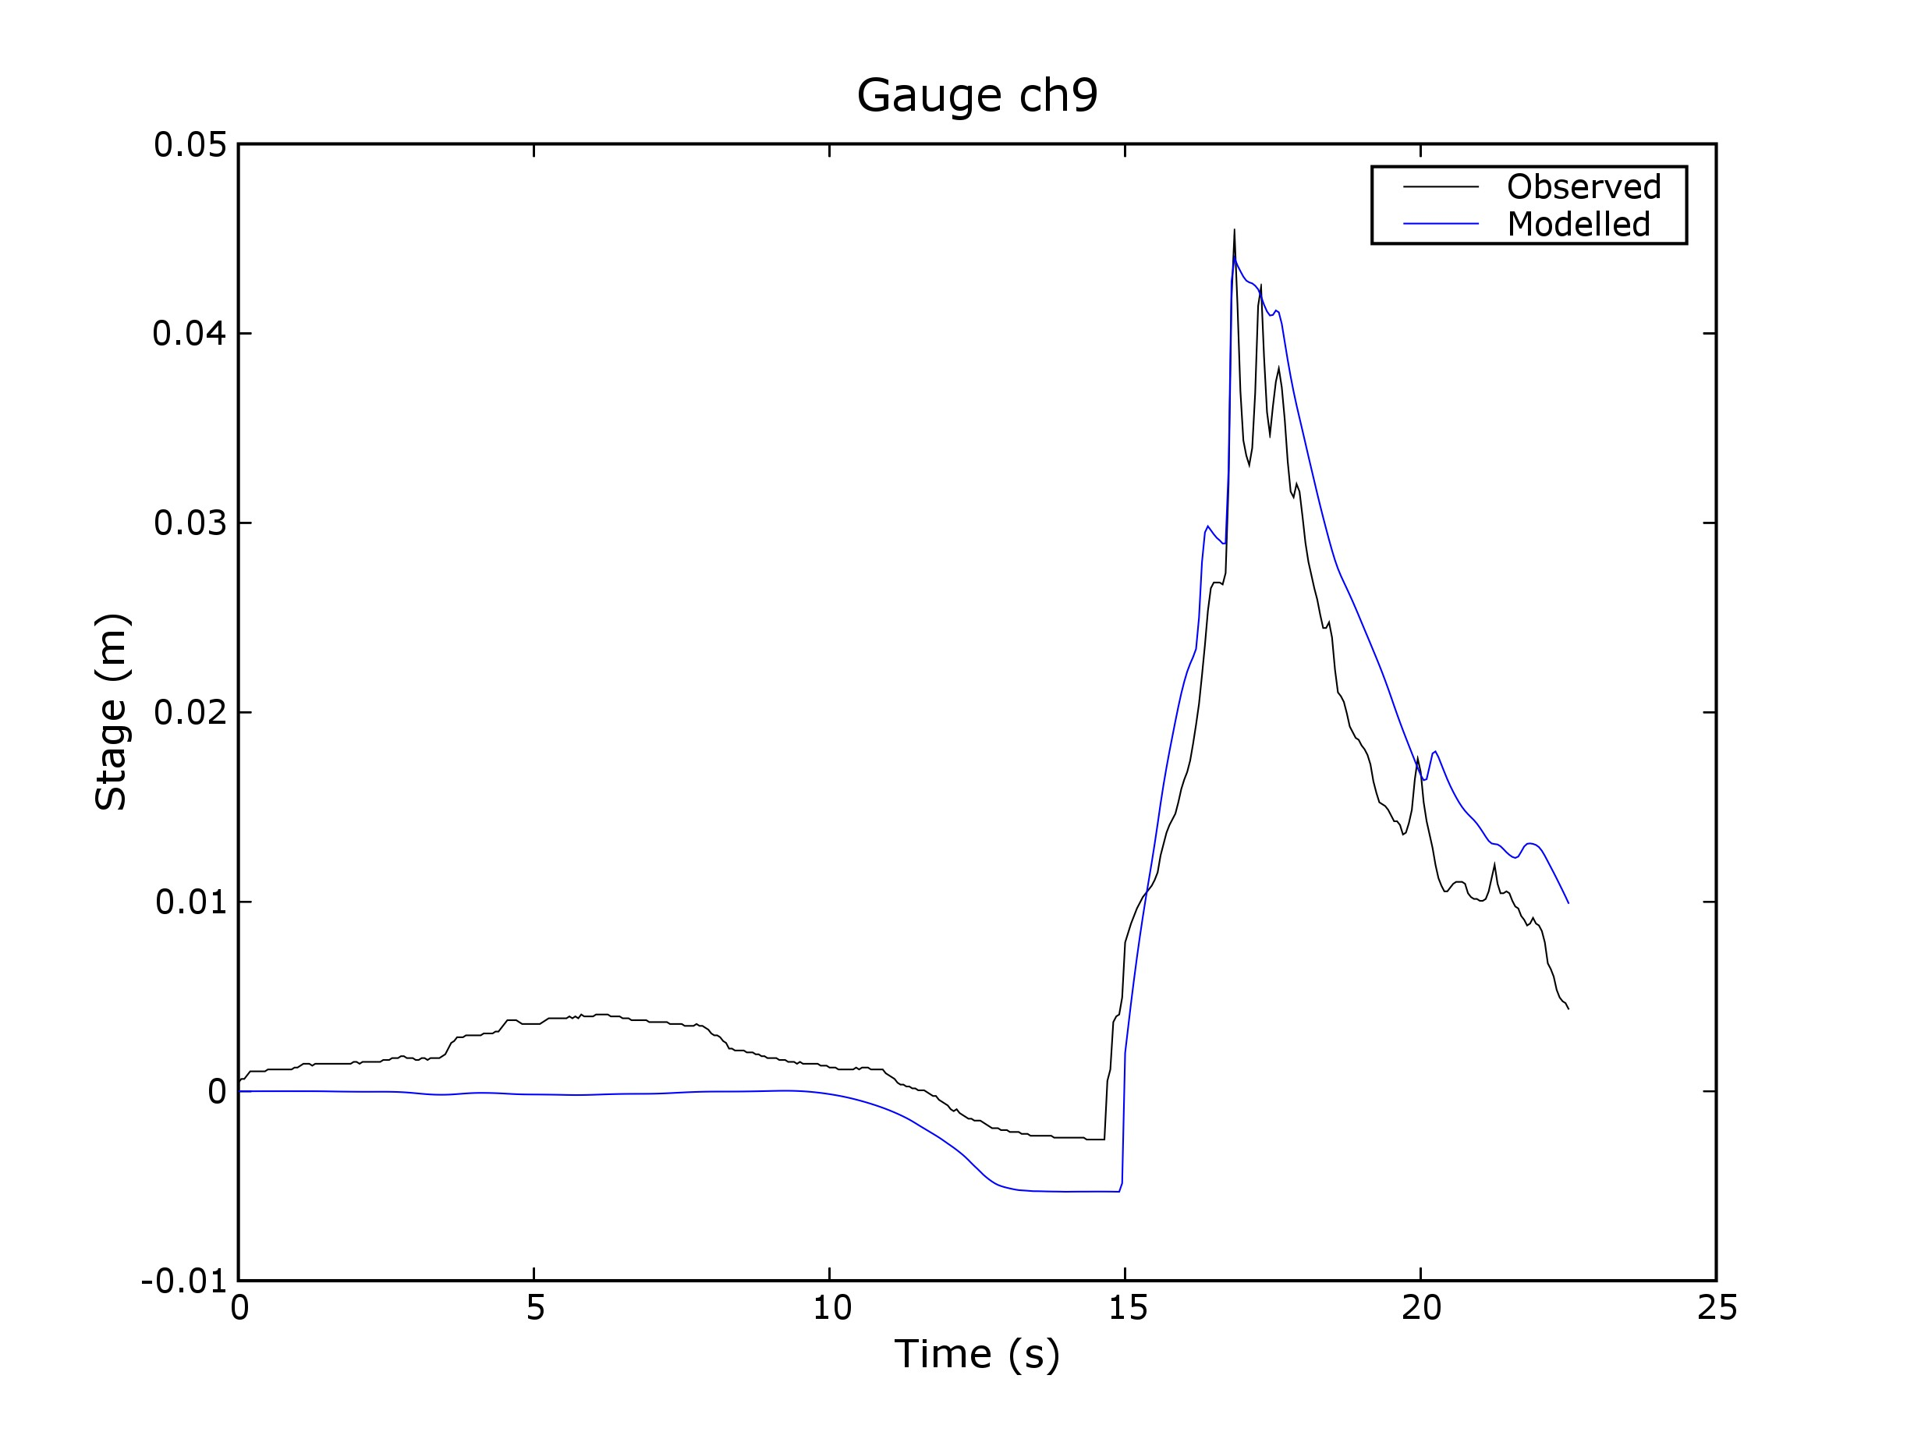

Slide 14
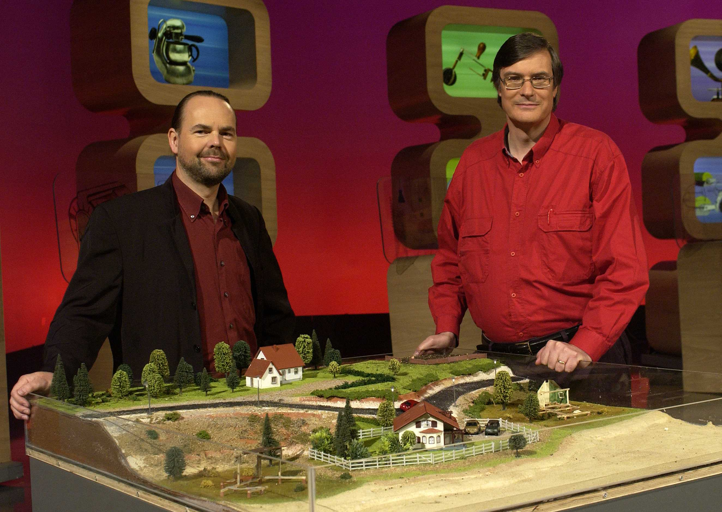
Featured on Australian TV
Further information:
Email: Ole.Nielsen@ga.gov.au
Stephen.Roberts@anu.edu.au
Google Search: ANUGA software
(ANUGA by itself will get German food fair)

Slide 15

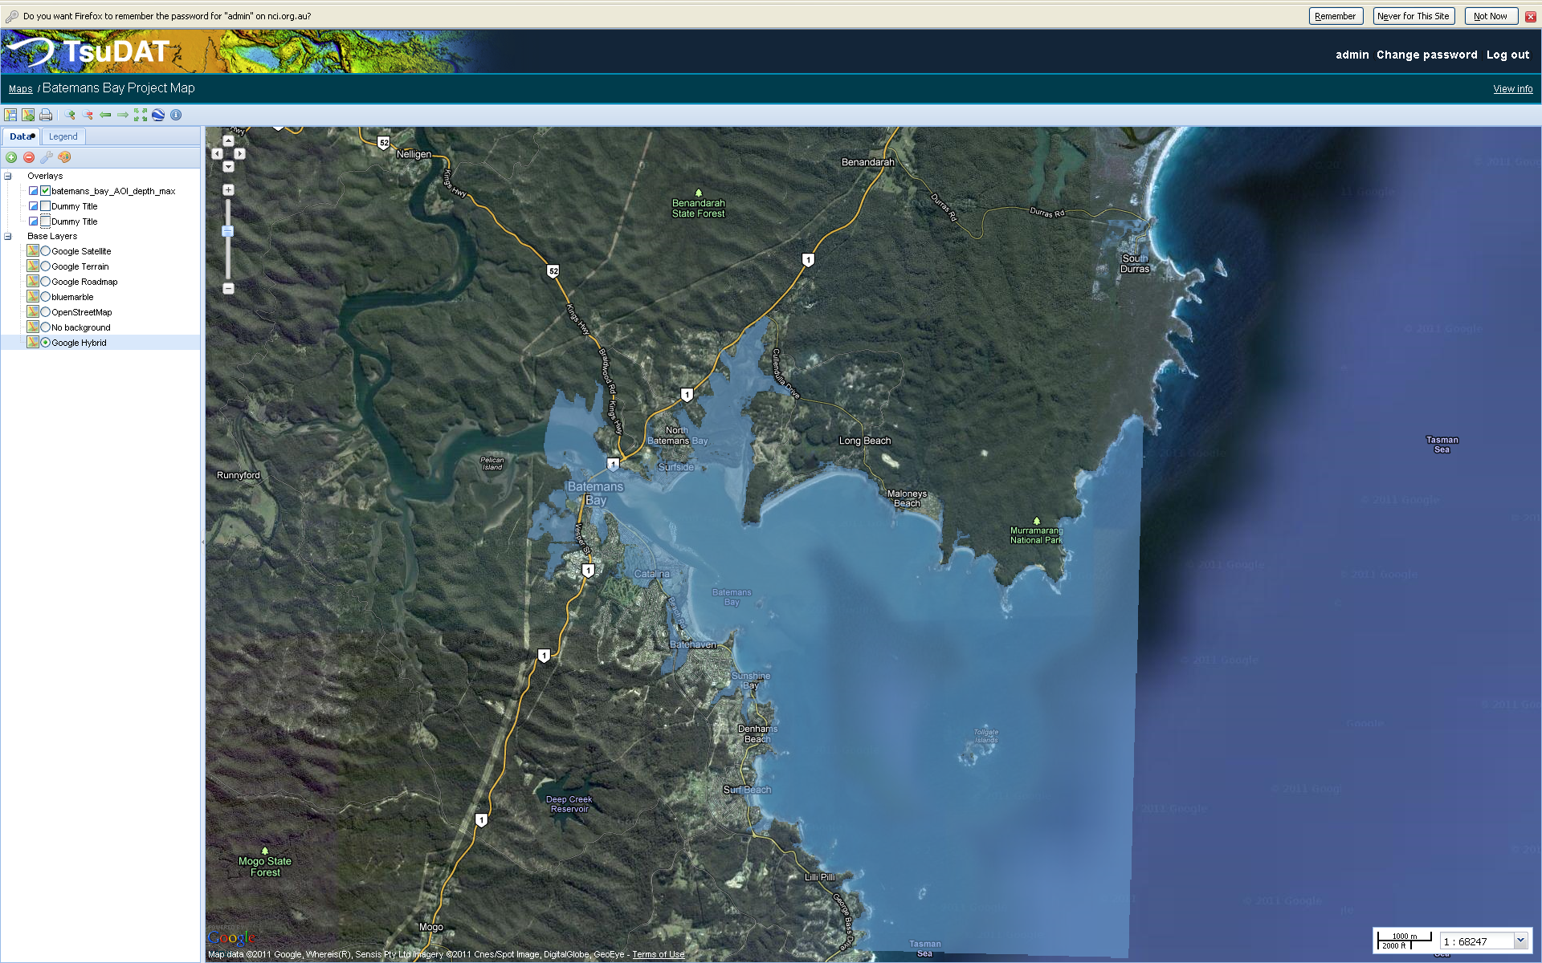
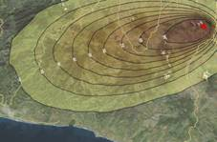


Python in International Development (2009 - )
And Python for everything else (e.g. building Beowulf........)
ANUGA: Hydrodynamic Hazards
EQRM: Probabilistic Earthquake Risk
TsuDAT: Tsunami Hazard
Python-FALL3D: Volcanic Ash
Risiko: Risk Mapping
Pypar: parallel computing

Slide 16
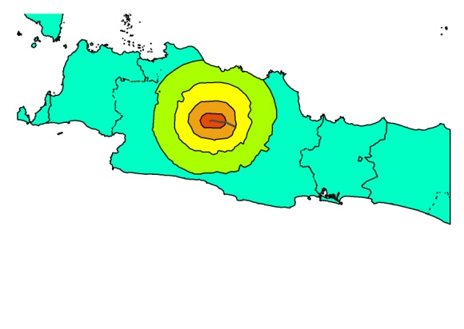
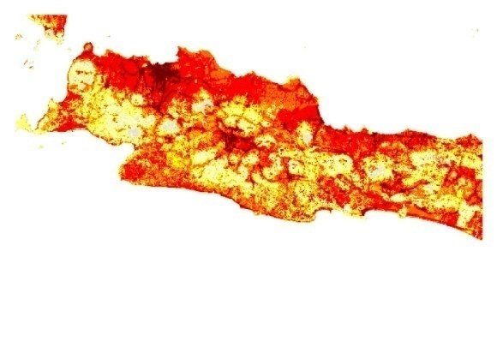
Generic Framework for Risk Mapping
Hazard Footprint
Exposure
Impact Function
100%
Fatalities
0%
MMI

Slide 17
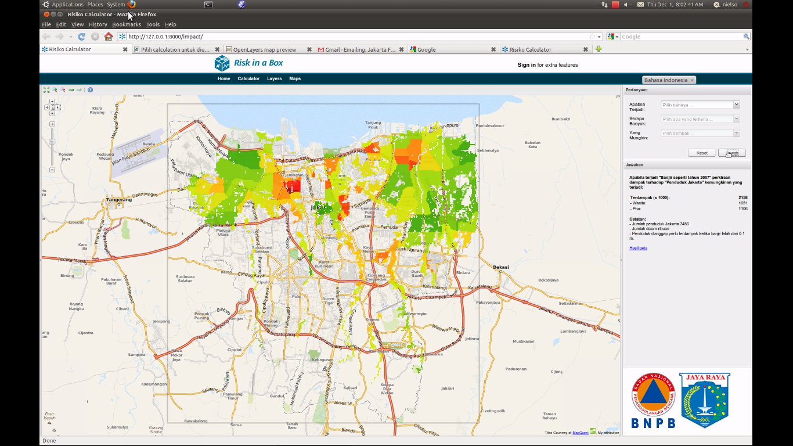

Slide 18

7 steps to software that works

Slide 19
Why?
No news is good news
If it can't install – it doesn't exist
Without docs – it doesn't exist
Without testing – it doesn't exist
There is no future without a past
Do it in style
Get it right – then fast

Slide 20
No news is good news
Either do as requested or raise an exception
Good error messages help everyone
Exception handling allow the error to treated at the appropriate level
  Index error at low level becomes a matter of selecting a viewport at a higher level
  XML parse error is typically not helpful at application level – it should explain why
  Conditions like file cannot open or division by zero can often be handled sensibly without raising errors.

Slide 21
Recent error messages I have seen
  (my>ky) failed for hidden my: regrid_smth:my=2
  syntax error: line 1, column 0
  write_dbs_grid: error in nf90_enddef

Slide 22
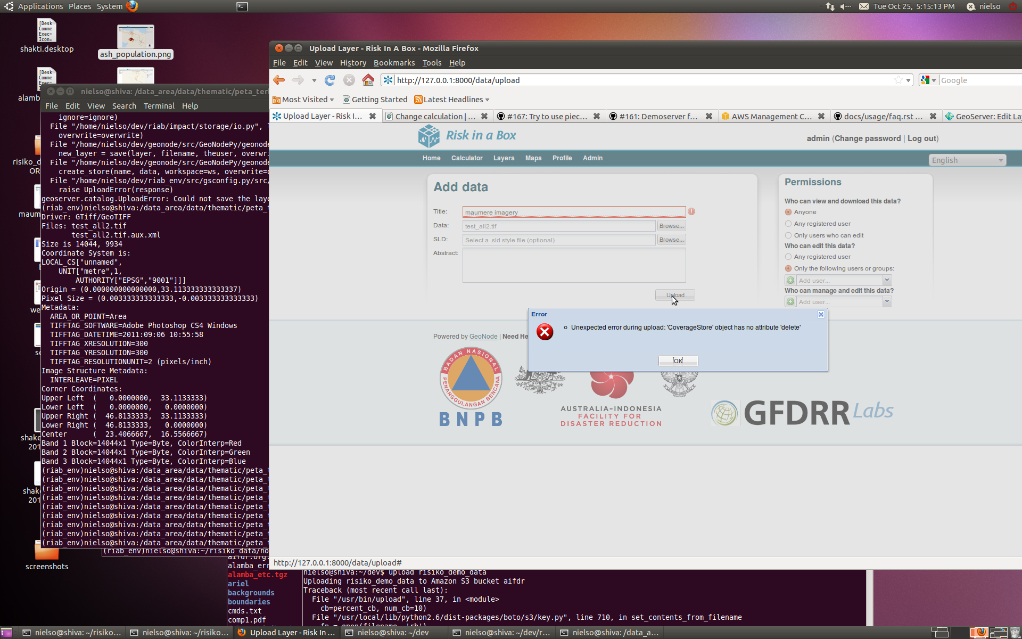

Slide 23
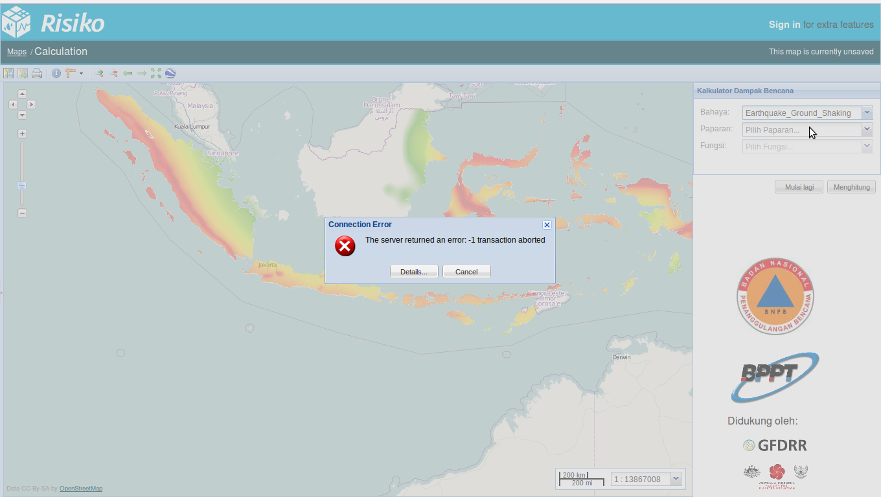

Slide 24
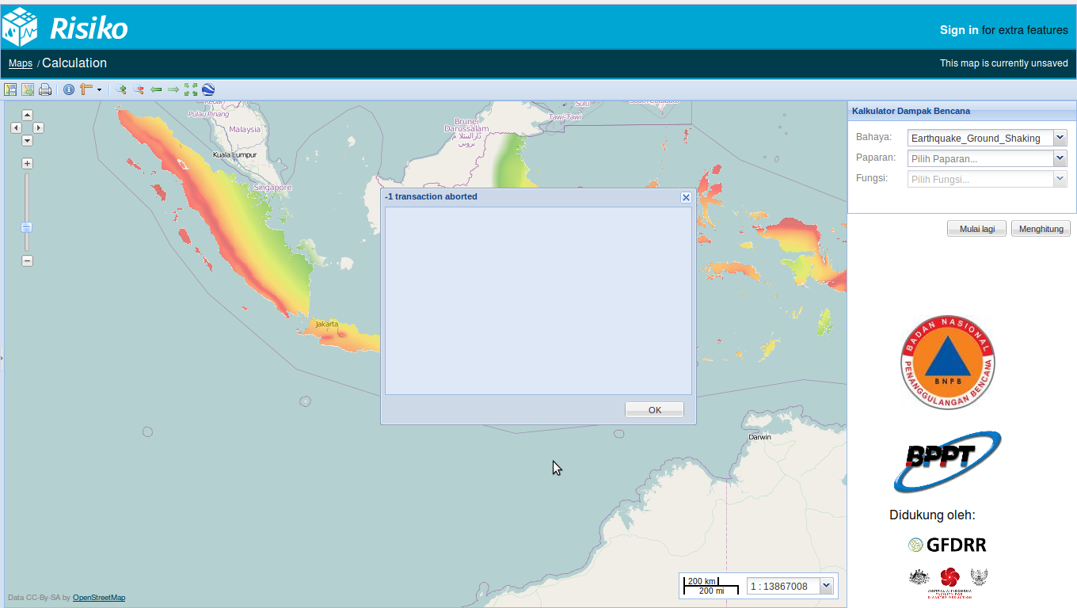

Slide 25
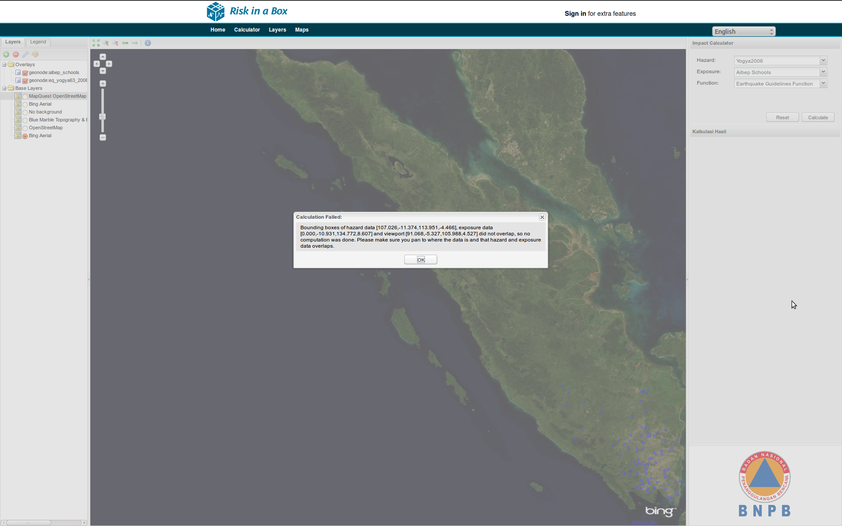

Slide 26
try:
infile = open(self.projection_file)
except IOError:
msg = ('Projection file %s could not be opened. '
'The topography file must have a projection file with '
'extension .prj to georeference the model outputs '
'correctly. The projection file is assumed to follow '
'the ESRI WKT format ' % self.projection_file)
raise Exception(msg)
if intersection_bbox is None:
# Bounding boxes did not overlap
msg = ('Bounding boxes of hazard data [%s], exposure data [%s] '
'and viewport [%s] did not overlap, so no computation was '
'done. Please make sure you pan to where the data is and '
'that hazard and exposure data overlaps.'
% (bboxlist2string(haz_bbox, decimals=3),
bboxlist2string(exp_bbox, decimals=3),
bboxlist2string(vpt_bbox, decimals=3)))
logger.info(msg)
raise Exception(msg)

Slide 27
If it can't install – it doesn't exist
Should be simple – otherwise potential users/contributers will be wasting their time and loose interest. E.g. risk-in-a-box deployment is two commands
wget http://bit.ly/risiko-install
bash risiko-install

Slide 28
Without docs – it doesn't exist
Minimum is
  installation documentation
  how to run a few examples
  docstrings
Ideally – documentation driven
Critical if software is to take on its own life

Slide 29
Bad docstrings
def create_style(self, style_name):
def delete_style(self, style_name):
"""docstring for delete_style"""
def compatible_layers(func, layer_descriptors):
"""Fetches all the layers that match the plugin requirements.

Slide 30
Good docstring
def osm2padang(E):
"""Map OSM attributes to Padang vulnerability classes
This maps attributes collected in the OpenStreetMap exposure data
(data.kompetisiosm.org) to 9 vulnerability classes identified by
Geoscience Australia and ITB in the post 2009 Padang earthquake
survey (http://trove.nla.gov.au/work/38470066).
The mapping was developed by Abigail Baca, GFDRR.
Input
E: Vector object representing the OSM data
Output:
Vector object like E, but with one new attribute ('VCLASS')
representing the vulnerability class used in the Padang dataset
Algorithm
…
...

Slide 31
def interpolate2d(x, y, Z, points, mode='linear', bounds_error=False):
"""Fundamental 2D interpolation routine
Input
x: 1D array of x-coordinates of the mesh on which to interpolate
y: 1D array of y-coordinates of the mesh on which to interpolate
Z: 2D array of values for each x, y pair
points: Nx2 array of coordinates where interpolated values are sought
mode: Determines the interpolation order. Options are
'constant' - piecewise constant nearest neighbour interpolation
'linear' - bilinear interpolation using the four
nearest neighbours (default)
bounds_error: Boolean flag. If True (default) an exception will
be raised when interpolated values are requested
outside the domain of the input data. If False, nan
is returned for those values
Output
1D array with same length as points with interpolated values
Notes
Input coordinates x and y are assumed to be monotonically increasing,
but need not be equidistantly spaced.
Z is assumed to have dimension M x N, where M = len(x) and N = len(y).
In other words it is assumed that the x values follow the first
(vertical) axis downwards and y values the second (horizontal) axis
from left to right.

Slide 32
Without testing – it doesn't exist
I don't care if it is called unit-, regression-, system-, integration- or stress-testing
Have tests for the functionality you care about
The extra time invested comes back 100 fold when debugging, refactoring and moving to new platforms
Also serves as trusted documentation
The single most important practice – I'd rather keep my tests than the source code
Risiko has 100 tests - ANUGA almost 1000,

Slide 33
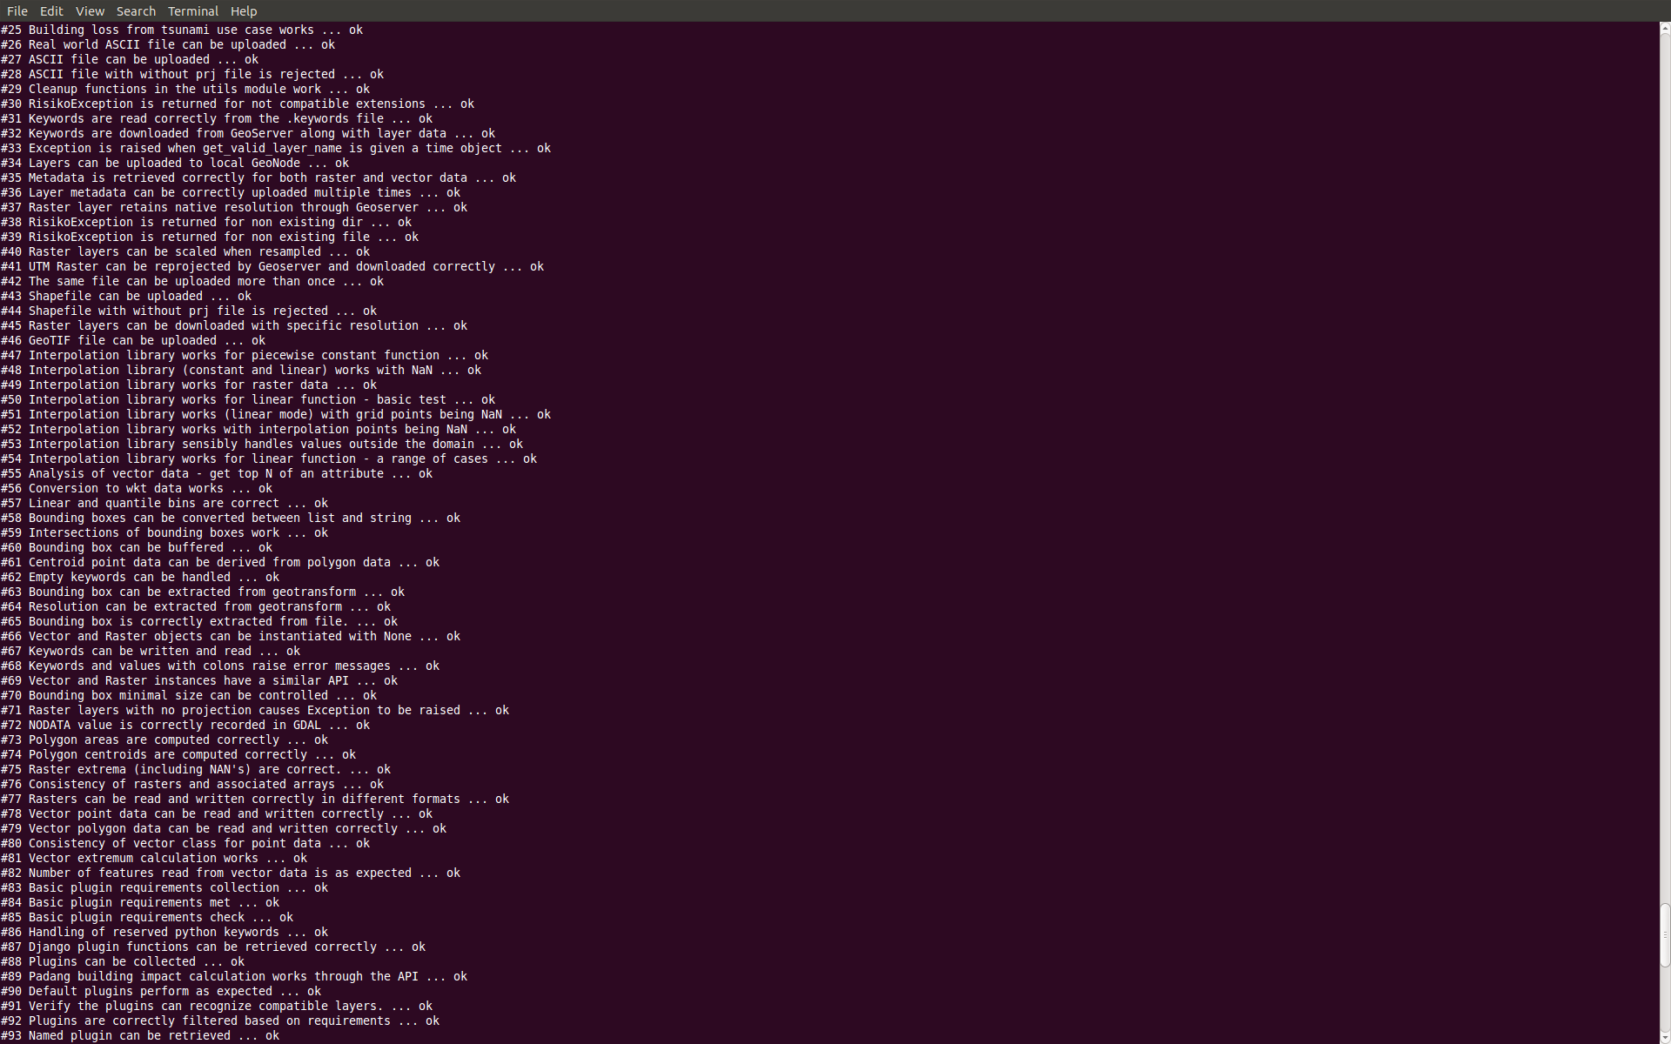

Slide 34
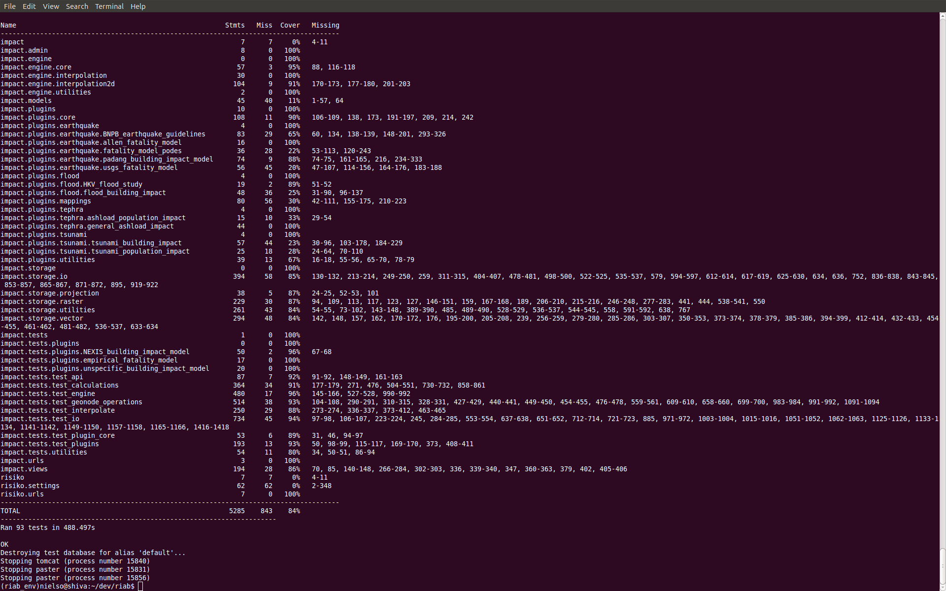

Slide 35
No future without a past
Revision Control (svn, cvs, git, …..)
Tracking (main thing is linking commits to issues)

Slide 36
Do it in style
PEP8 style guide for Python

Slide 37
7. Get it right – then fast
Recipe refined during development of ANUGA
Write one or two tests
Implement brute force simple algorithm
Implement smarter algorithm and more tests
After profiling, write bottlenecks in C using test suite to maintain correctness
Don't optimise without profiling and testing

Slide 38
I Wish I was in Mumbai!
Thank You!

