Slide 1
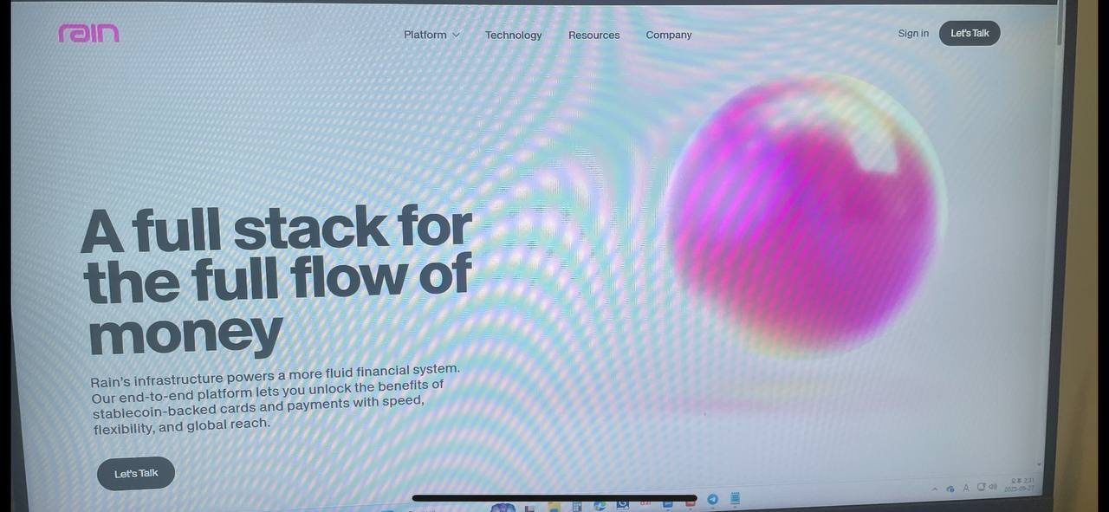
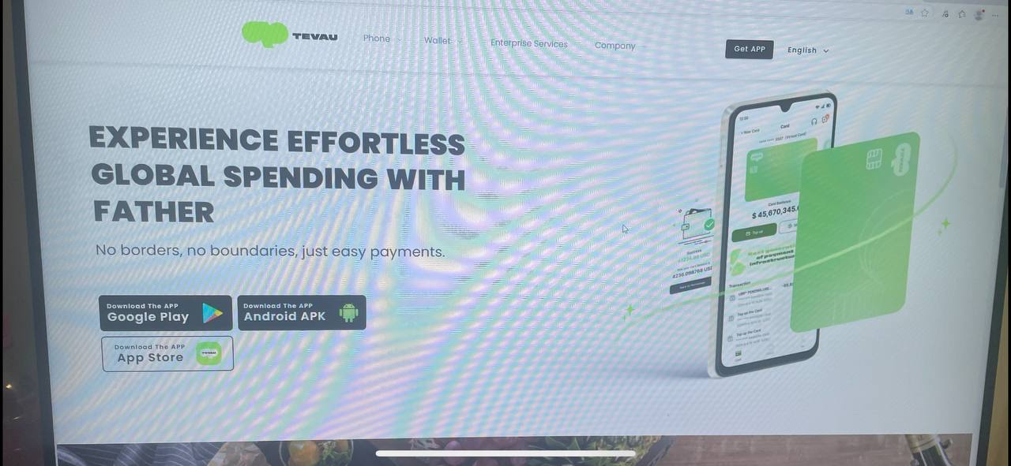
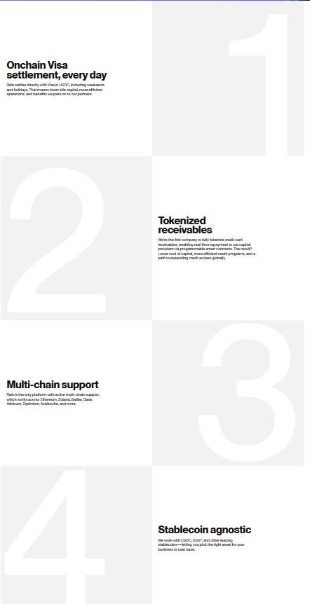
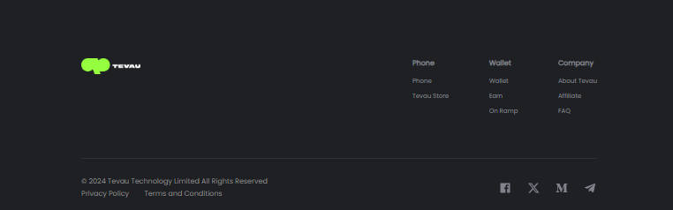
Home 화면 : 전체적으로 화면 구성을 만들어보았습니다.
UNIONE Card Platform▽ Company
1. 메인화면 문구 : A new Web3 payment paradigm in one Unione platform.
Unione is the bridge between your crypto and the real world powered by a USDT card that works globally. (이미지처럼 앱 설치 버튼도 생성하면 될듯합니다)
이미지 느낌처럼 적용을 하고 플랫폼 서비스 내용이 들어가면 될듯합니다. 1. Card -Turn your crypto into real-world spending power. Instantly use your assets anywhere Visa is accepted — online, offline, or at ATMs. 2. Earn - Make your assets work for you. Choose flexible or fixed plans, earn in real time, and enjoy full on-chain transparency. 3. Reward - Grow together with your network. Invite friends, boost your mining speed, and unlock greater rewards through a community-driven model. 4. Wallet - Safely store, send, and receive crypto in one secure place. Manage assets, top up your card, stake, and shop — all from your wallet.
Footer는 아래와 같은 형식으로 해주시면 될듯하구요. 트위터와 텔레그램, 인스타그램의 링크를 드릴테니 로고도 함께 부탁드립니다. 메뉴의 내용이 들어가면 될듯합니다.

Slide 2
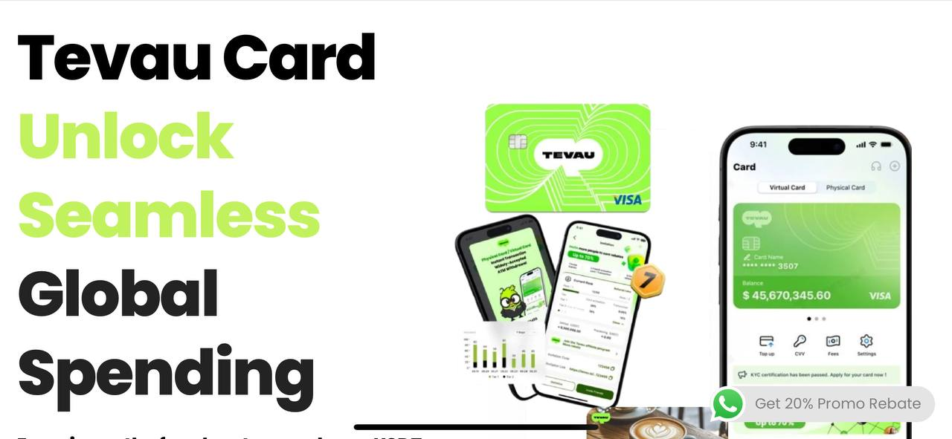

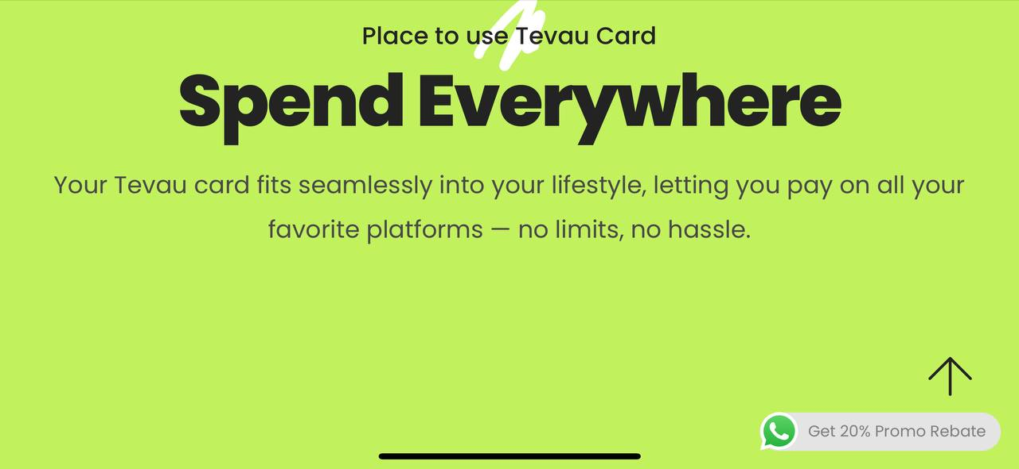
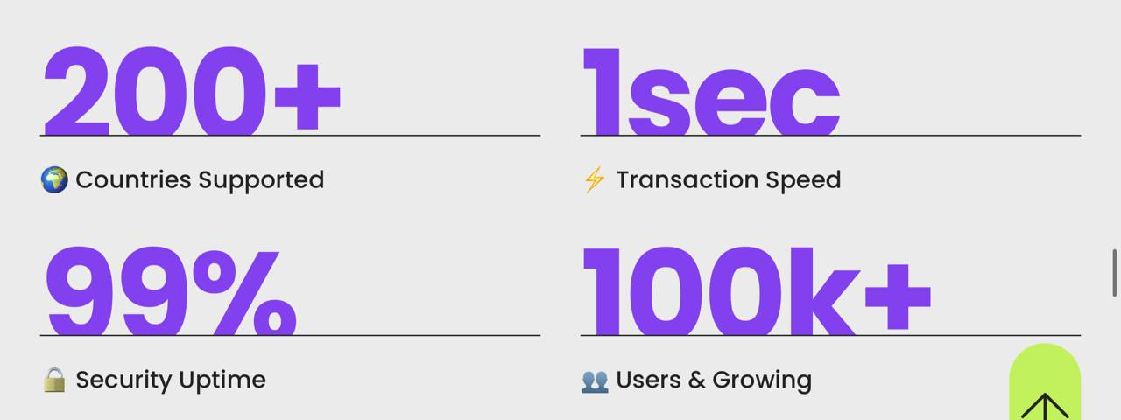
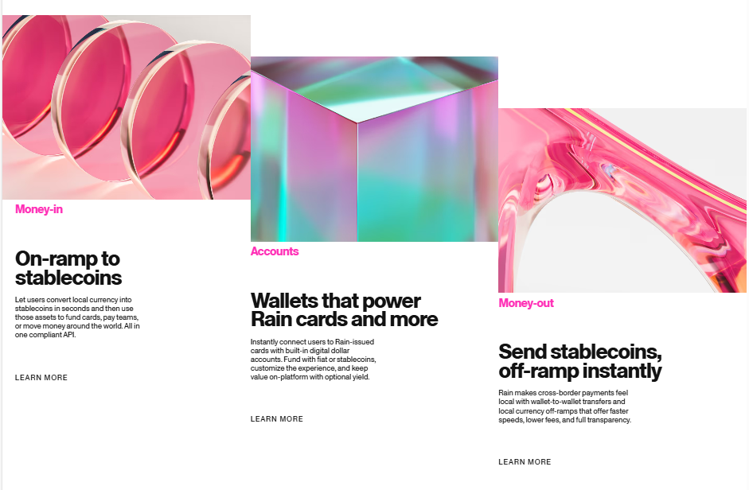
Card 화면
UNIONE Card Platform▽ Company
큰 문구 : Unione Card opens the door to borderless payments 아래 문구 : Enjoy the convenience of using your USDT digital assets instantly, wherever and whenever around the world. (Get your Card 설치 버튼 추가)
Unione Card is designed for your everyday life — simple, limitless, and effortless. Spend your assets wherever you go, anytime you need. 아래 4가지 부분은 다른 이미지로 똑같이 표현하도록 하겠습니다.
Real-Time Conversion, Low Fees, Global usage, Easy-to-Use App (사진에서는 3가지의 서비스 내용이지만 저희는 4가지의 특징을 표현하려 합니다)
여기부터 위의 특징 각각의 설명입니다.
1. Real-Time Conversion
Seamlessly convert your crypto into fiat at the moment of purchase. No need for manual exchanges transactions are instant, automatic, and come without conversion fees, can spend with confidence anytime, anywhere.
2. Low Fees
Enjoy peace of mind with a transparent fee structure. No hidden markups, no surprise charges — just fair and predictable costs every time use your card, whether at home or abroad.
Global Usage Use your Unione card seamlessly across the globe. From online shopping to in-store purchases and ATM withdrawals, it works anywhere Visa is accepted, turning your crypto into true borderless money.
Easy-to-Use App Control your entire financial experience from one intuitive app. Easily top up, monitor spending, manage your card, and explore features all from a clean dashboard available on both iOS and Android.

Slide 3
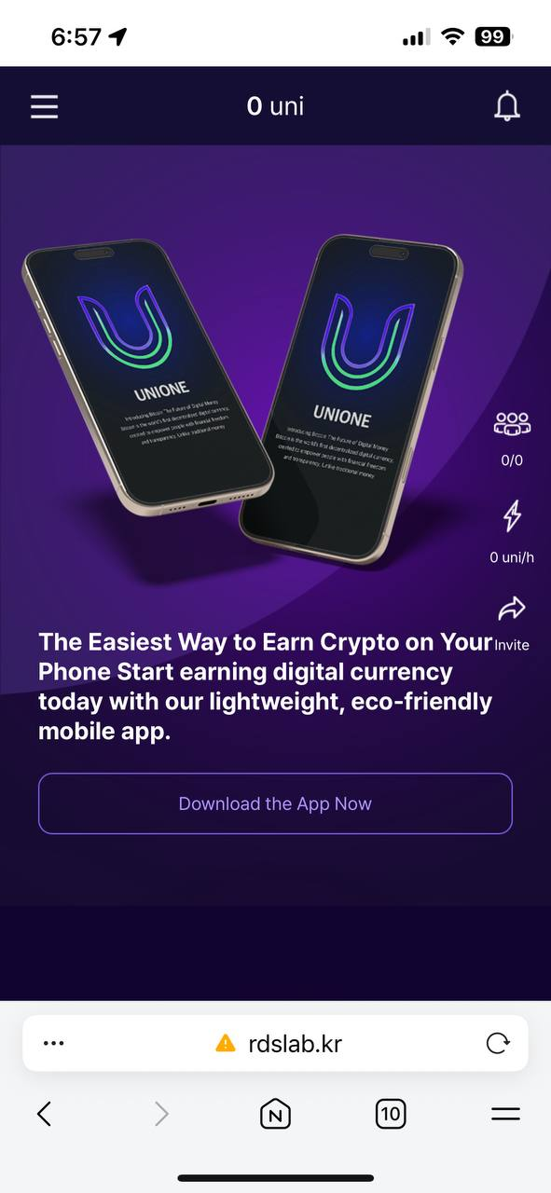
Reward 화면
UNIONE Card Platform▽ Company
Boost your mining speed with UNIONE network, and maximize your earnings by unlocking tiered rewards through friend invitations.

Slide 4
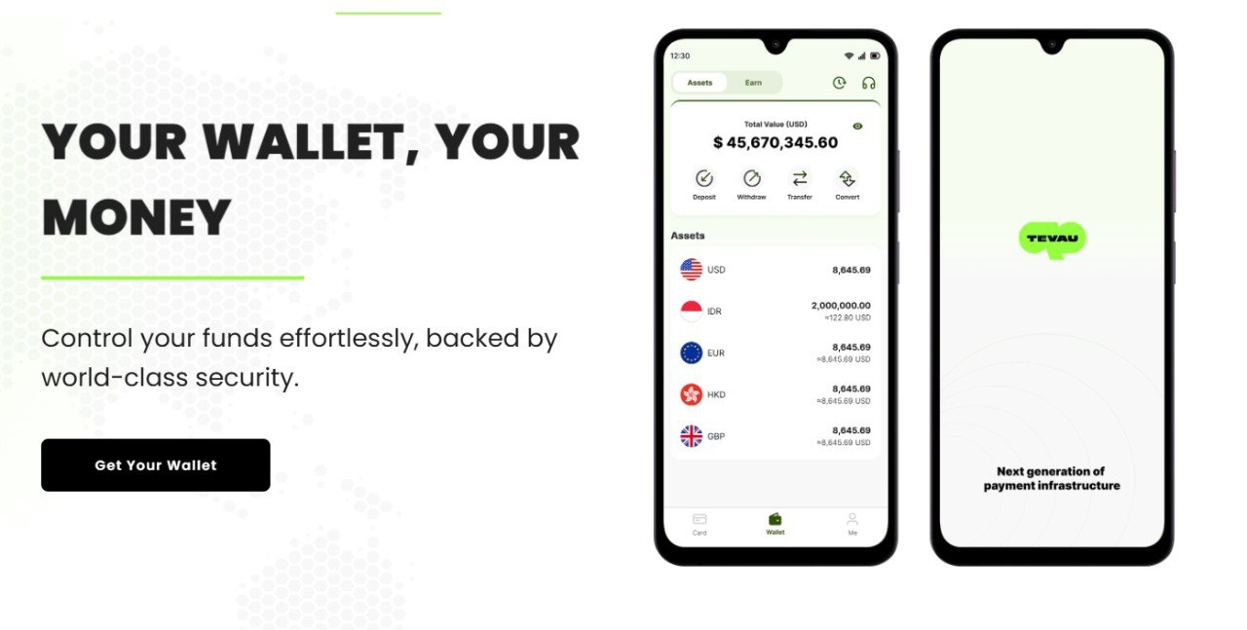
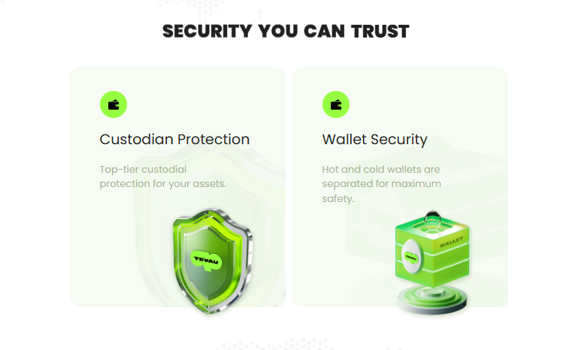
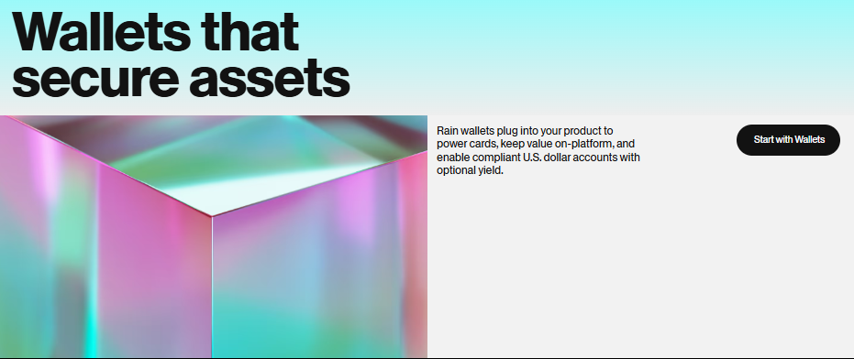
Wallet 화면
UNIONE Card Platform▽ Company
Wallet 메뉴
상단 내용 : All Your Digital Assets, Your Smart Wallet
아래 내용 : Manage your assets with ease, protected by industry-leading security.
위의 내용처럼 App 설치버튼 (우측의 이미지는 두번째 Tevau를 제외하고 올려주시면 될 듯 합니다)
1.Custodian Protection
-Your assets, secured with trusted custodial solutions.
2.Wallet Security
-Enhanced safety with separate hot and cold wallets. 이미지에 Tevau사 로고가 있는데 보라색으로 회사 로고와 사명으로 변경을 했으면 합니다.
위 문구 : Protect your value with next-gen wallets 아래 : Unione wallets integrate seamlessly with your platform, enabling card functionality, holding balances within the ecosystem, and offering compliant U.S. dollar accounts with optional earning potential.

Slide 5
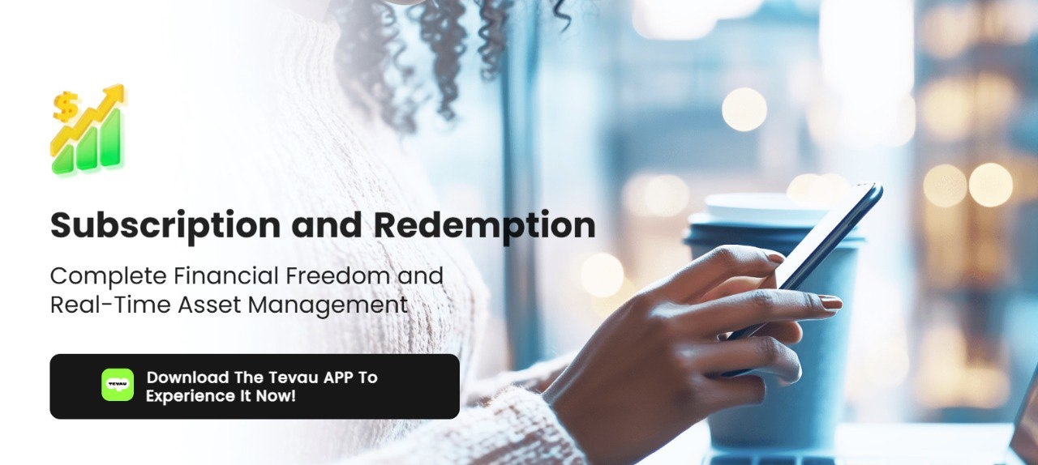
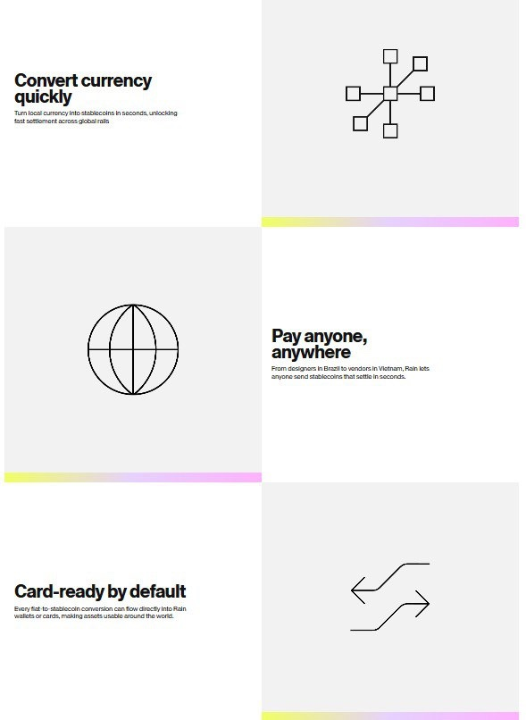
Earn 화면
UNIONE Card Platform▽ Company
User-friendly staking service backed by institutional security, delivering real-time yields.
위와 같이 앱 설치 버튼이 들어가며 뒤의 이미지는 다른 걸로 부탁드리겠습니다.
1. Flexible Entry and Exit Anytime
-Total control of your wealth with instant access and management
2. Make your idle money work for you
-Begin your journey with only $1 Unlock unlimited growth
3. Rewards paid out every hour
-Calculated accurately, down to the very minute
위의 3가지 내용을 이런 이미지 느낌으로 표현하려고 합니다.

