Slide 1

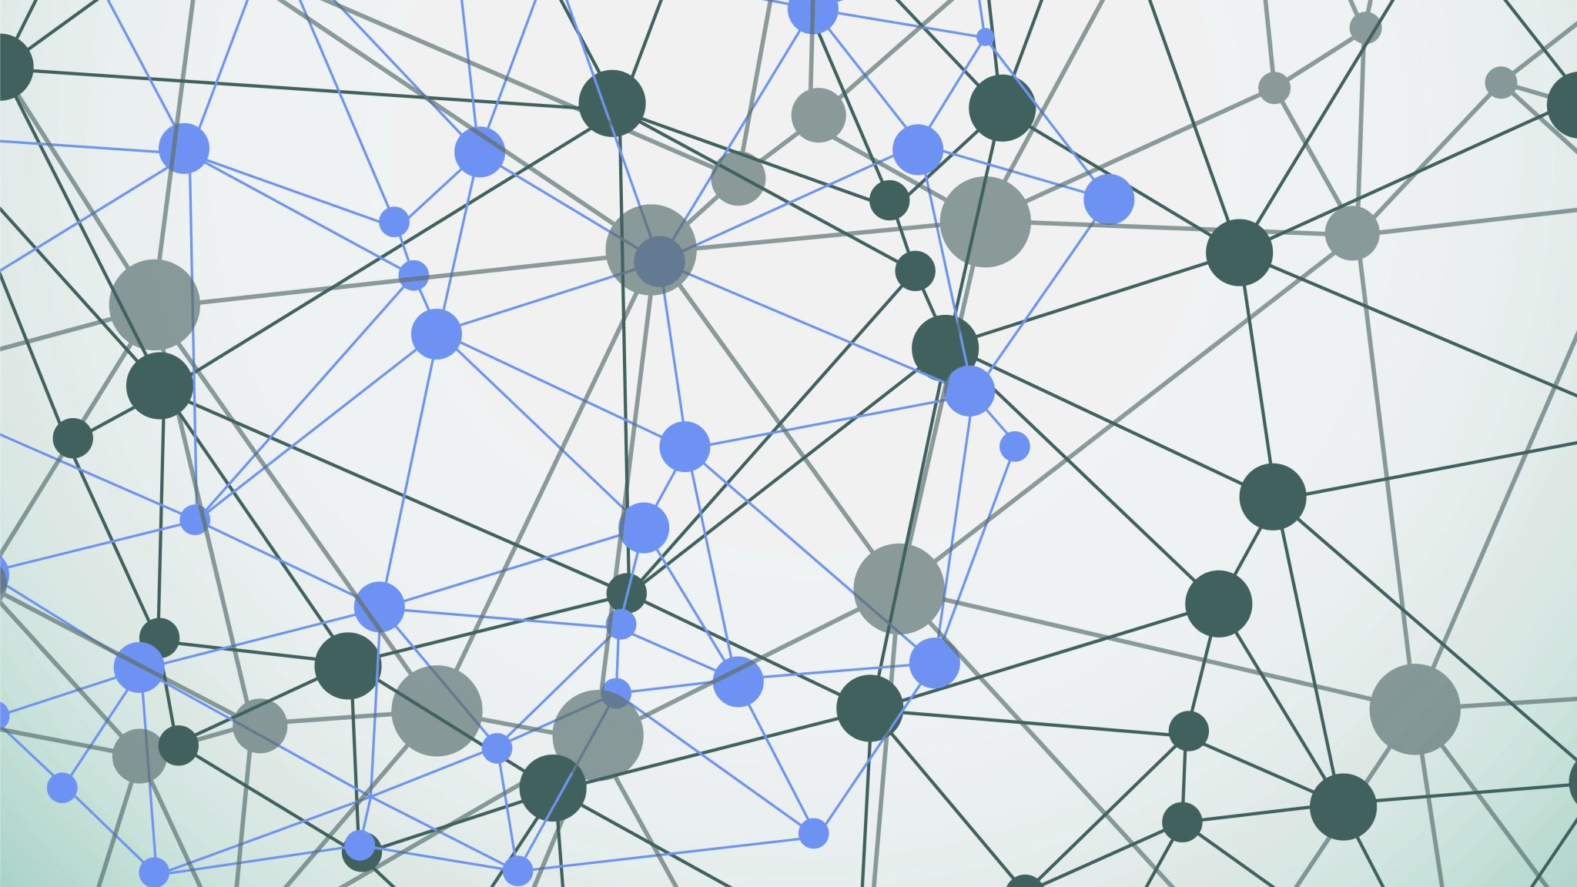
Distributed Systems and Middleware Technologies PisaEat
Alessandro Madonna, Andrea Tubak, Francesco Ronchieri

Slide 2
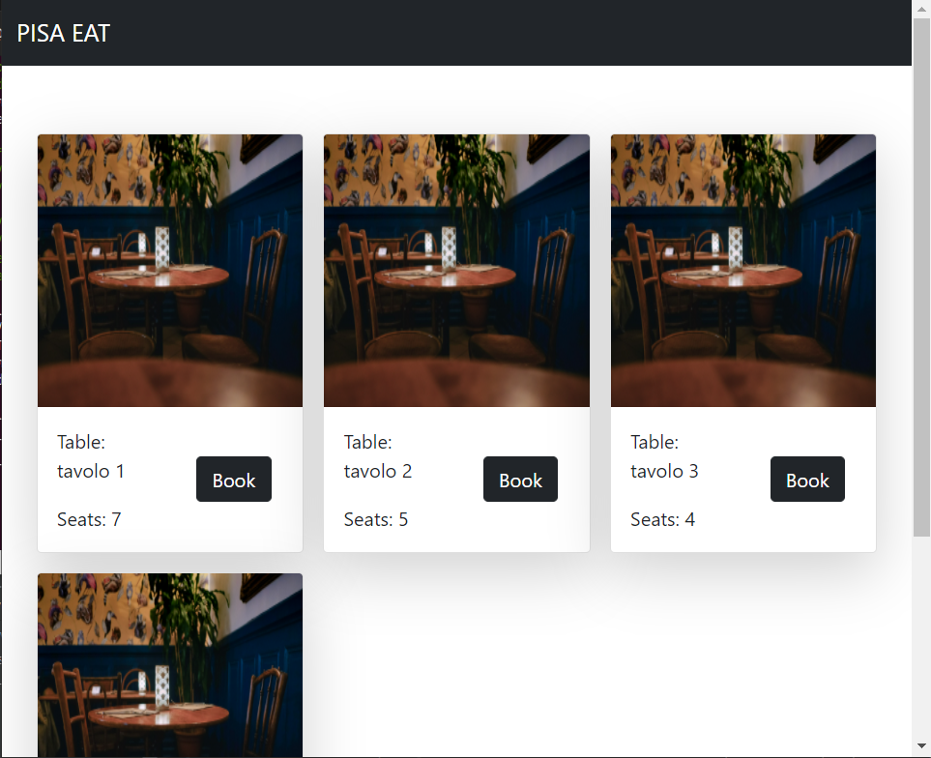
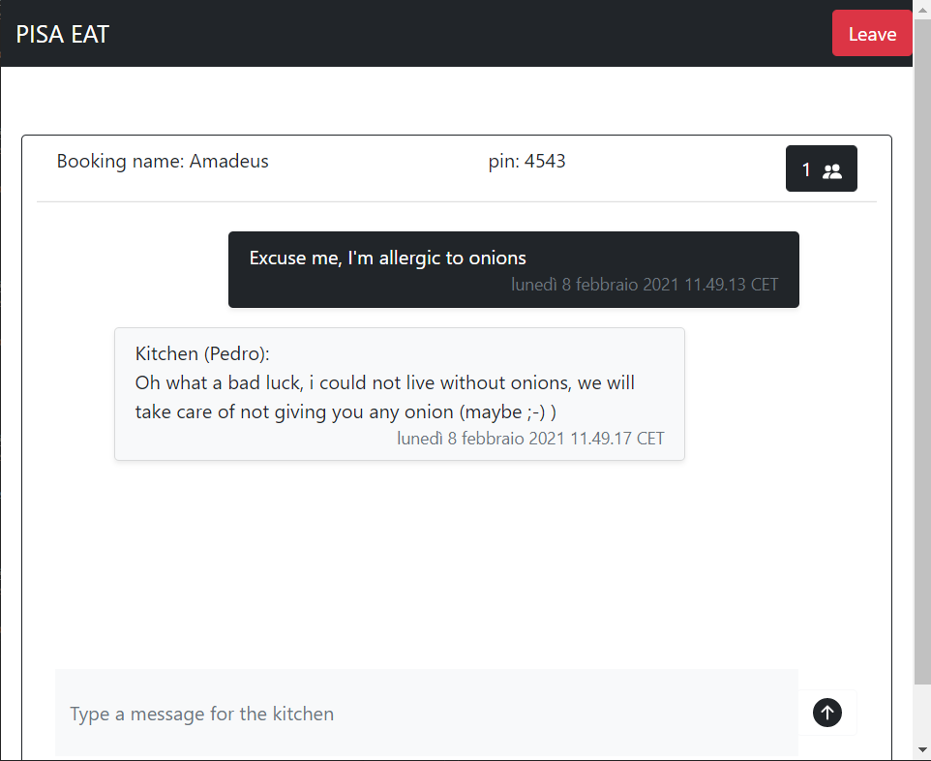
Introduction
PisaEat is a web platform where users can book a table on their favorite restaurant.
Once a table is booked, other users can join in (provided they know the right pin code) and exchange messages with the kitchen in order to communicate any kind of information (es. allergies or intolerances)

Slide 3
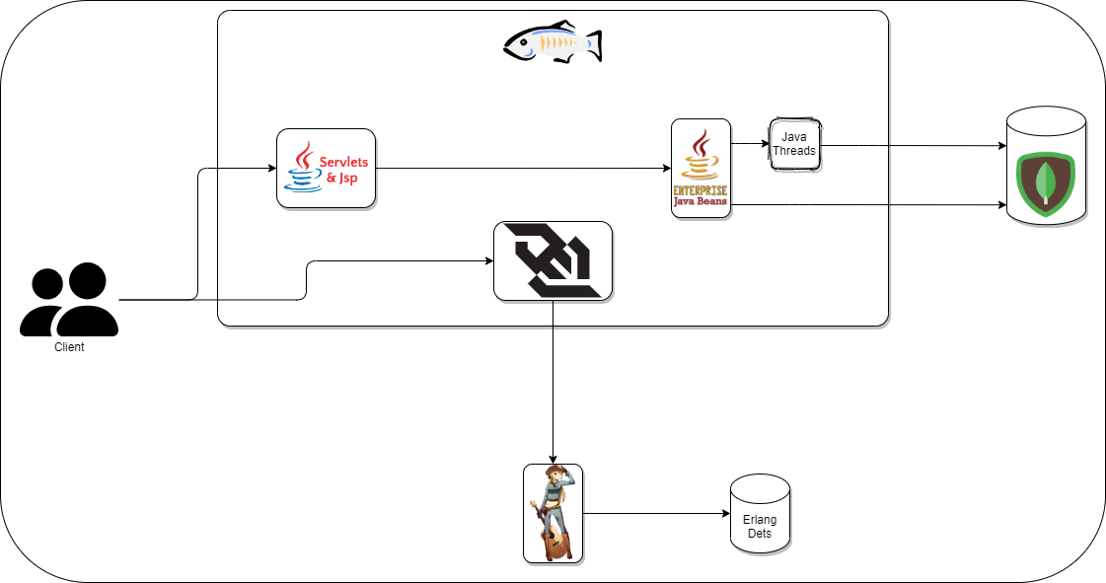
General Schema
Glassfish (port 8080):
Servlet: http://<host>:8080/PisaEat/
WebSocket: ws://<host>:8080/chat-WebSocket/chat/
Cowboy: http://<erl-host>:8081/api/
MongoDB: http://<mongo-host>:27017

Slide 4

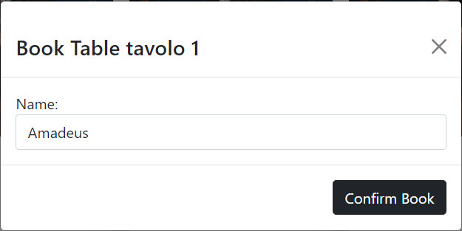
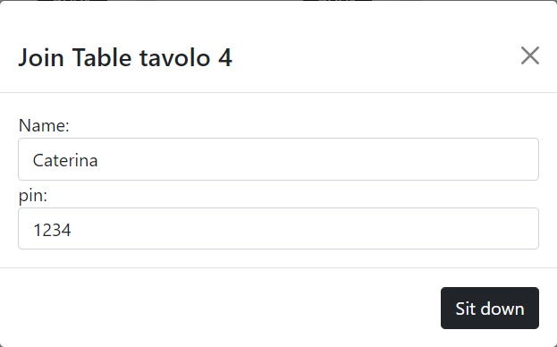
Synchronization Problems
Two or more people can try to book the same table, at the same time. So, a race begins.
The seats of a table are limited, if there’s only one seat left, a race can begin.

Slide 5
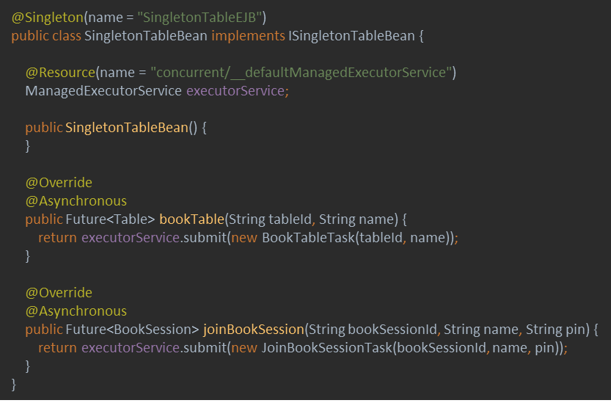
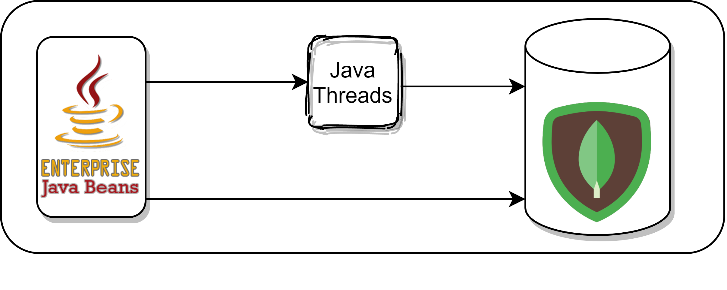
Solution to Syncronization Problems
the critical sections will be managed through a Singleton EJB which will have the task of:
1) take charge of the requests
2) create an ad-hoc task to manage the request (containing code for mutual exclusion)
3) let Glassfish default ManagedExecutorService execute the task by returning a Future <> of the return type to the caller

Slide 6
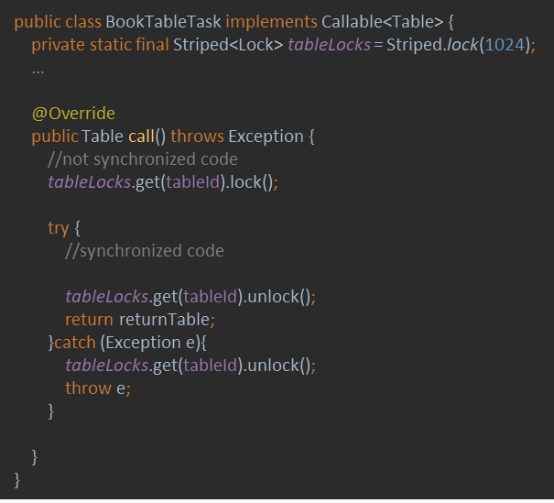
Thread Syncronization
As said before, the synchronization among threads is handled by tasks submitted to GlassFish Executor Service.
To obtain a performance compromise, accesses in mutual exclusion are provided based on a hashing function applied to the identifier of the resource that we want to modify

Slide 7
Comunication Problem
After booking a table, there is a chat with the kitchen in order to communicate any kind of information (es. allergies or intolerances)

Slide 8
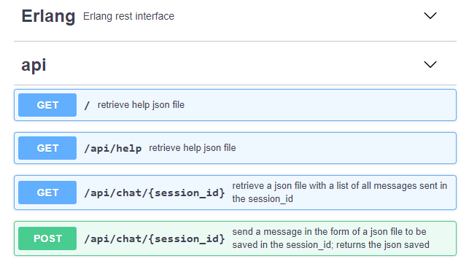
Communication Solutions
In order to implements the chat we made use of 2 components:
An Erlang Rest Web Service (ERWS) with some base operations for reading and saving messages in a dedicated dets table
A WebSocket: it was necessary in order to coordinate the messages sent by other users of the same table:
Storing incoming messages using the ERWS
Forwarding the messages to all other clients currently in the session

Slide 9

End

