Slide 1

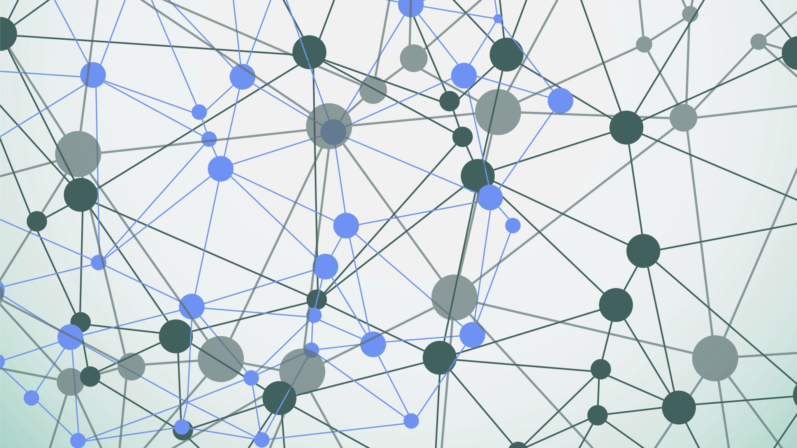
PisaEat Distributed Systems and Middleware Technologies project
Alessandro Madonna, Andrea Tubak, Francesco Ronchieri

Slide 2
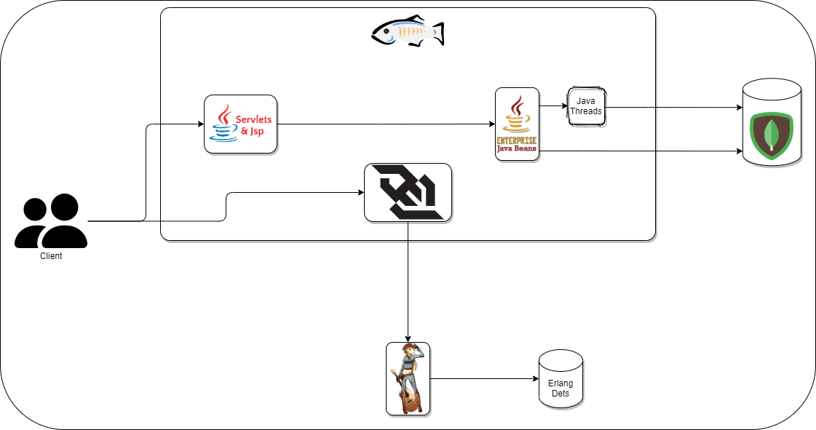
General Schema
Glassfish (port 8080):
Servlet: http://<Deploy address of glassfish>/PisaEat/
WebSocket: ws://<Deploy address of glassfish>//chat-WebSocket-1.0-SNAPSHOT/chat/
Cowboy: http://<Deploy address of cowboy>:8081/
MongoDB: http://<Deploy address of mongoDB>:27017

Slide 3

Synchronization Problems
Two or more people can try to book the same table, at the same time. So, a race begins.
The seat of a table is limited. So, if only one seats is left, a race can begin.

Slide 4
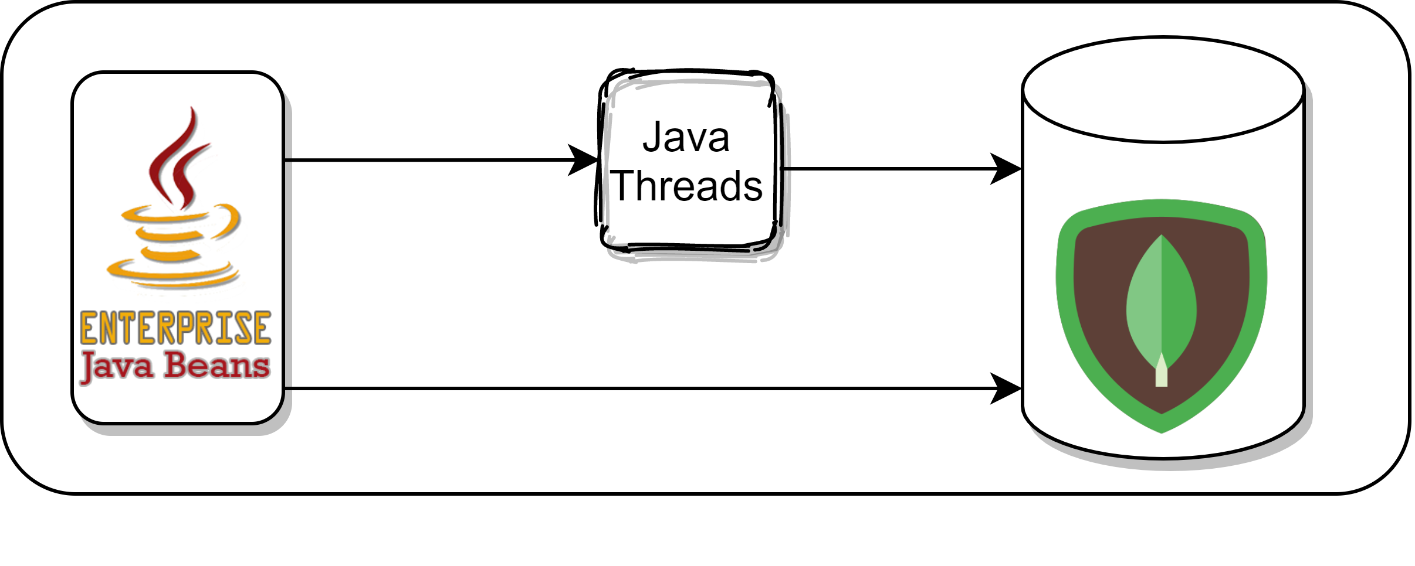
Solution To Synchronization Problems
A singleton ejb for operations that must be thread-safe, that spawn threads using the executors service of glassfish. The thread will be synchronized.

Slide 5
Communication Problems & Solutions
Problem: After booking a table, there is a chat with the kitchen, for some special communication, like possible intolerances.
Adopted Solution: An erlang Rest Service (Cowboy) and a webSocket are used to realize this chat. With the web socket, a client can receive events from the server.

Slide 6
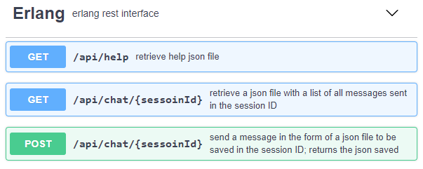
Cowboy Rest Erlang Service
The Rest service, implement these calls.

Slide 7
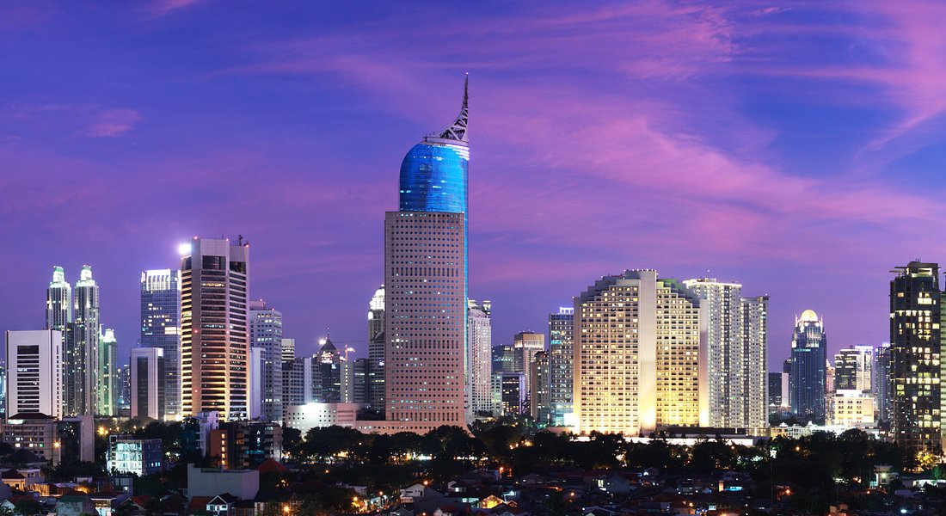
End

