Slide 1
Lending club case study
Ravi Khandelwal
Hari Satuluri
​

Slide 2
AGENDA
Problem Statement
Driving variables
Univariate Analysis
Bivariate Analysis
Multivariate Analysis
Recommendations

Slide 3
Problem Statement
Analysis required to take a decision for loan application received by lending club.
The analysis should help making decision which would avoid both financial loss to investor and business loss to lending club and investor.

Slide 4
Driving Variables

Slide 5
Driving Variables
Driver variables which would help to analyze if the customer can be a defaulter
loan_amnt/funded_amnt/funded_amnt_inv :
If the customer is requesting a higher loan amount we need to understand his purpose and other things as higher the loan amount the risk would be higher to be a defaulter
term :
Term period customer trying to repay the loan could be driving factor, if customer taking huge loan and trying to close it in short term that could be a defaulter, need analysis in that variable
grade :
We can derive some data as which graded customers are being highly defaulters, grades are given for a reason right.
home_ownership :
The place customer stays could lead him as defaulter, like if the customer is not having own house tracking them for repayment could be difficult, so they could become defaulter.
annual_inc :
customer with less income and high loans could become a defaulter.

Slide 6
Driving Variables
verification_status :
This is something same reason as home ownership, if the customer is not verified that would be difficult to track for repayments and could become a defaulter.
purpose :
Purpose of the loan could give us information as if the customer is trying to manage his expenses or spending for luxury, with that we could analyze the behaviour of defaulter
zip_code/addr_state :
with these we could analyze the behaviour based on living region
dti :
Debt to Income Ratio is another highly informative parameter, which would tell us customers current financial status and the behaviour to be a defaulter.
pub_rec :
This would give us the general behaviour of the customer if the customer is having any derogatory issues in public
pub_rec_bankruptcies :
This variable helps us to analyze the behaviour of the defaulter as he might be having banckrupticies before

Slide 7
Univariate Analysis

Slide 8
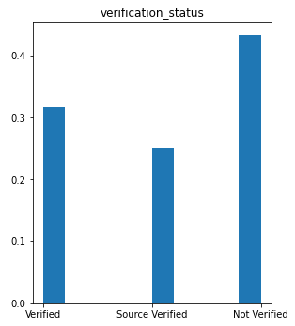
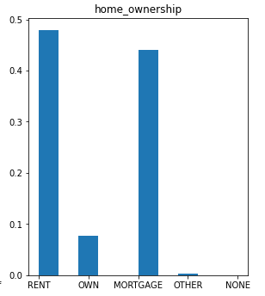
Univariate Analysis - home_ownership & verification status
Most loan applications are from the people staying in rented house followed by mortgage properties.
Less than 10% people who have own house applied for loan.
By looking histogram of verification status, most people lies in 'not verified' status.
Suggested to follow strict verification process, as not verified could lead to defaulter

Slide 9
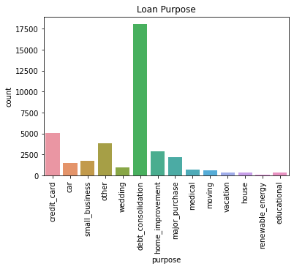
Univariate Analysis – loan purpose
By looking at this graph we can say most of the loan applications to lending club are for debt consolidation.
When the customer is looking for debt consolidation, we might need to analyze how much income he gets and his DTI

Slide 10
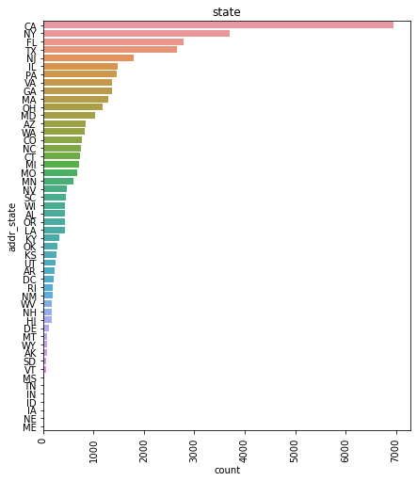
Univariate Analysis – state
By this histogram we see that most of the loan applications are from CA state.
We found out that 50% loan application belong to top 6 state out of 50 states.
Six state - CA,NY,FL,TX,NJ,IL

Slide 11
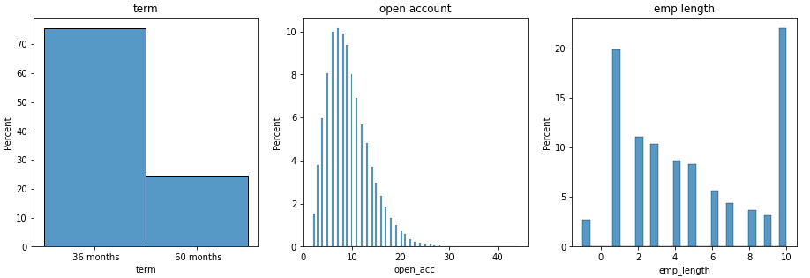
Univariate Analysis – term, open_account, emp_length
With emp_length hist, we obeserve as employement term increases, they are less likeyly to apply loan application.
As we can view on Open Account Histogram, Initially people open account increases, loan application increase, But after reaching at maximum point around 9,frquency of loan applications start decreases on higher size.

Slide 12
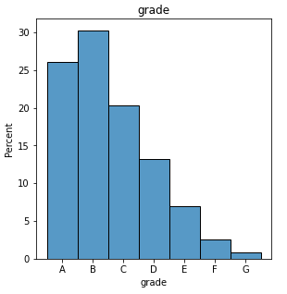
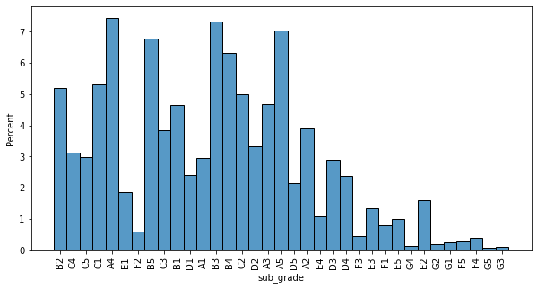
Univariate Analysis – grade & sub_grade
From Grade categorical histogram, loan applications follow negatives trends as grade increase from A to G.
May be loan disbursement for lower grades is at lower scale when compared to higher grades.
Analysis should be done while approving loan to lower grades.

Slide 13
BiVariate Analysis

Slide 14
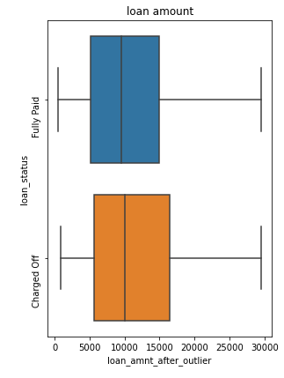
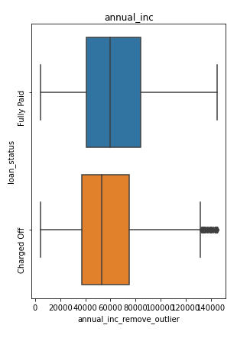
Bivariate Analysis – loan_amount, annual_inc
It is visible from loan amount box plot, iqr is bigger for charged off loans, which means higher the loan amount risk is higher for being defaulter
From Box plot of annual income, Q3 value of charged off loan is lower than fully paid loan. It means good income persons are more likely to close loan as fully paid.

Slide 15
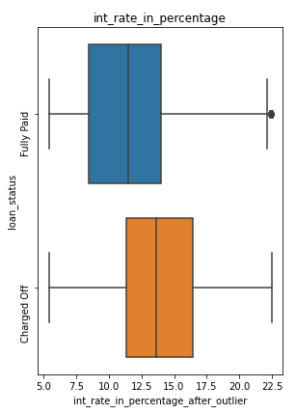
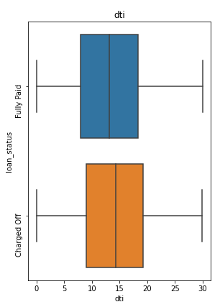
Bivariate Analysis – int_rate, dti
From int_rate graph it’s clear information that higher intrest rate loan is more likely to end up with charged off.
From Box plot of Debt-to-income ratio, q1, median, and q3 having larger value in charged off loan. higher debt to income ratio is not good.

Slide 16
MULTIVariate Analysis

Slide 17
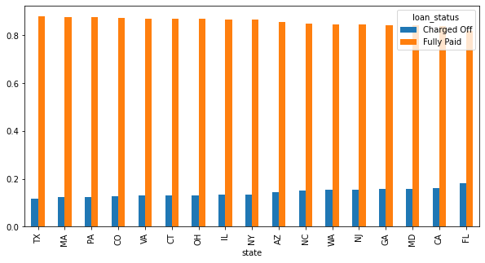
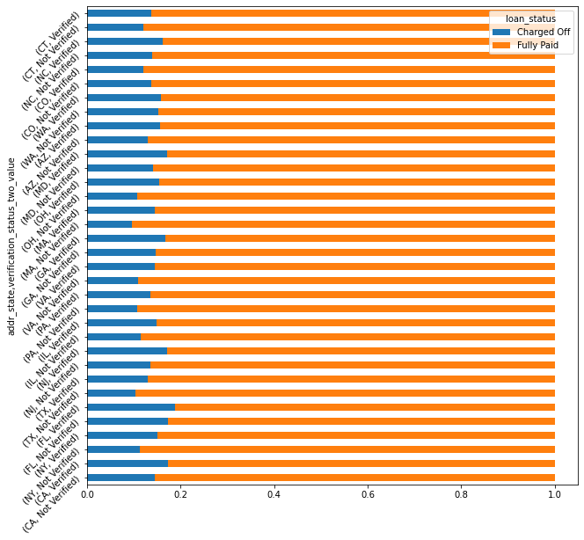
Multivariate Analysis – addr_state vs varification status with loan_status
State FL is having most defaulter loans.
State TX is having most fully paid loans.
Verification process is not good because blue line (charged off) for verification status are bigger than not verified.

Slide 18
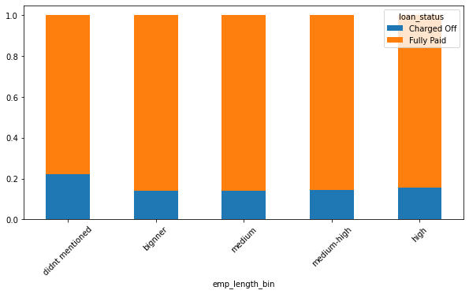
Multivariate Analysis – emp length vs loan_status
Applicants who doesn’t mention Employee length are having high defaulters compared with others

Slide 19
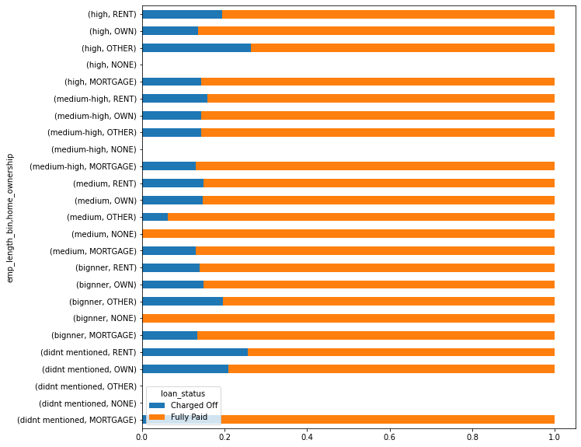
Multivariate Analysis – employee length,home_ownership vs loan_status
loan applications of people who did not mentioned employee length with home ownership rent are more risky application. (as visible at blue bar of didn't mentioned vs rent)
Beginner employee length with other home ownership and high employment length with other are with more risk.

Slide 20
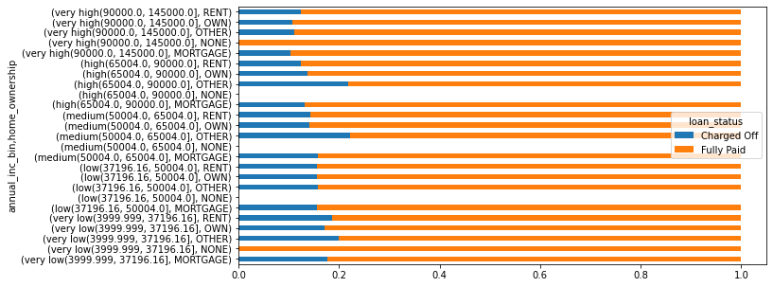
Multivariate Analysis – employee income,home_ownership vs loan_status
It is evident that People with 'other' Home ownership are more risky no matter what they belong to any income category.
High chance of loan application from very low income going to be a defaulter.
People with mortgage home ownership are likely to complete loan succesfully.

Slide 21
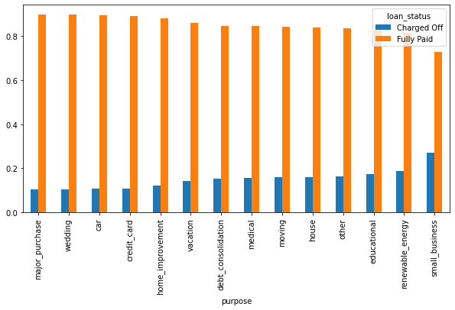
Multivariate Analysis – Purpose vs loan status
Loan application with small_business purpose are high on charged off side, it’s clear that business can be successful or might become loss.
Thorough analysis of business is also very much required for those kind of loans.

Slide 22
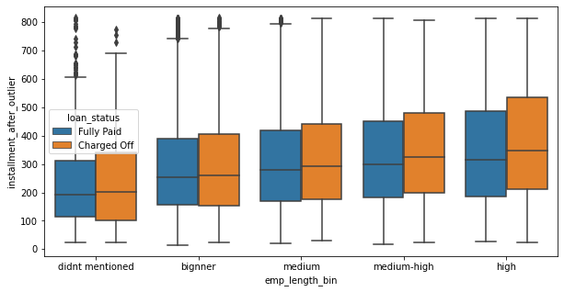
Multivariate Analysis – Installment vs home_ownership against loan_status
Median of installment of each category of not paying people is higher than paid off people, Same happening with third quartile. Which means people of any category with lower installments are fully payable customers
But after looking at Q1 of each category, there are some who are also not able to make pay lower emi as well.

Slide 23
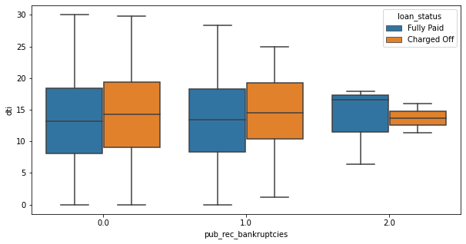
Multivariate Analysis – dti vs pub_rec_bankruptcies variable against loan_status
Bigger debt to income ratio and higher number of public bankrupt means more chance to become loan defaulter.
But little deviation toward total 2 bankrupts. It may be because number of loan given to such people is very few.

Slide 24
Recommendations

Slide 25
Recommendations
Applicants with High DTI and low income or high bankruptcies in past or requesting high loan amount with higher EMI or lower tenure could be a defaulter
When consolidated applications as per states, customers from FL are more likely to be defaulters and on positive note customers from TX state are more likely to close their loans.
Customers who has own houses or mortgage homes are more likely to finish their loans on time, but to be vigilant on company financials customers who specify home ownership as other are most likely to charge off their loans no matter of their employment length or annual income.
Applications which haven’t specified their employment experience are more riskier as most of those applications are charged off.
When it comes with verification of applications in lending club, seems that verification process is not so perfect, because we could see most of the charged off loans verification is completed successfully.

Slide 26
THANK YOU
Ravi Khandelwal
Hari Satuluri

