Slide 1
INF-461-GROUP B
MBAME MBAME MARTIN JAMES
M1/SIGL

Slide 2
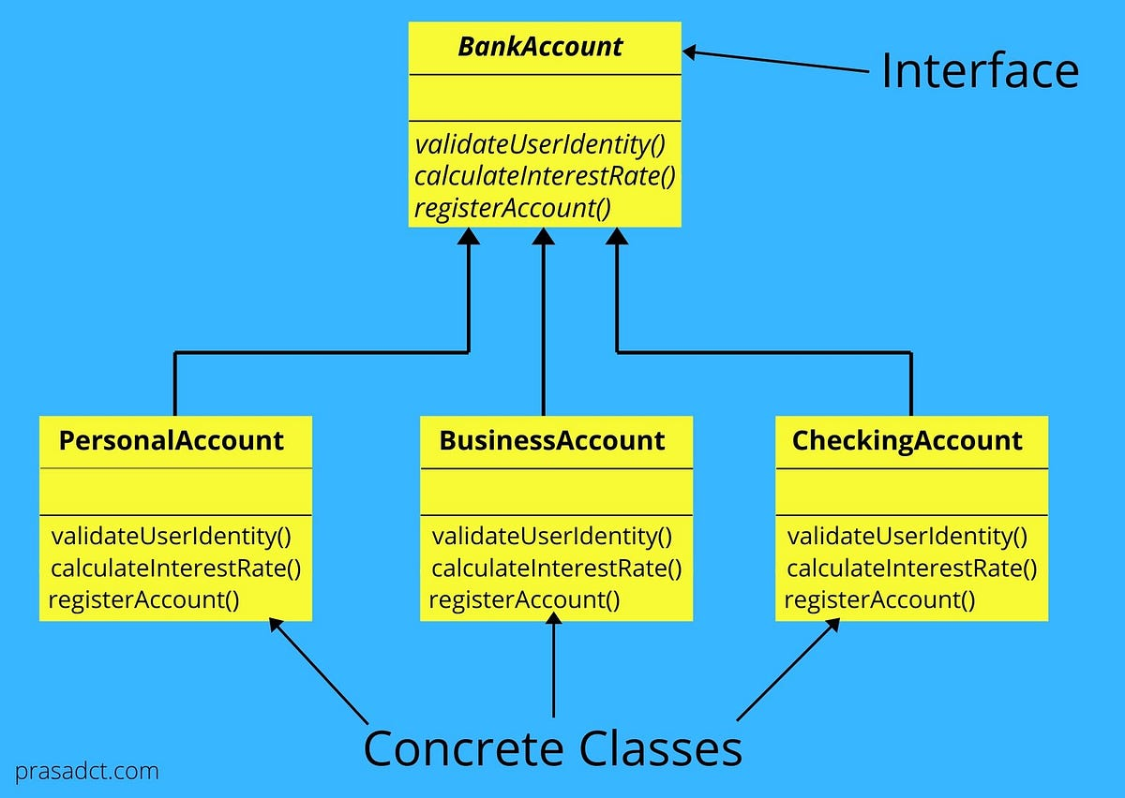
Brief explanation of factory method in creation pattern
The Factory Method is a design pattern from the "Creational Patterns" family in object-oriented programming. It provides a way to delegate the instantiation of objects to subclasses, promoting loose coupling and enhancing code flexibility and reuse.

Slide 3
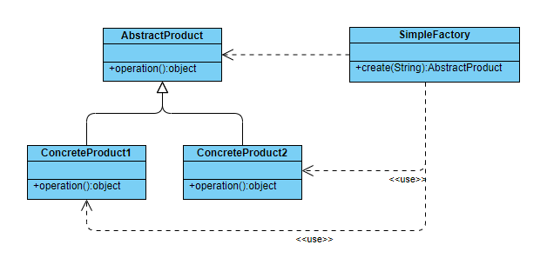
Simple Factory
Description: Not an actual design pattern but a simple implementation that encapsulates the object creation process. It provides a static method to create objects without exposing the instantiation logic to the client.
Use Case: When you have a single place to centralize the creation logic of similar objects.

Slide 4
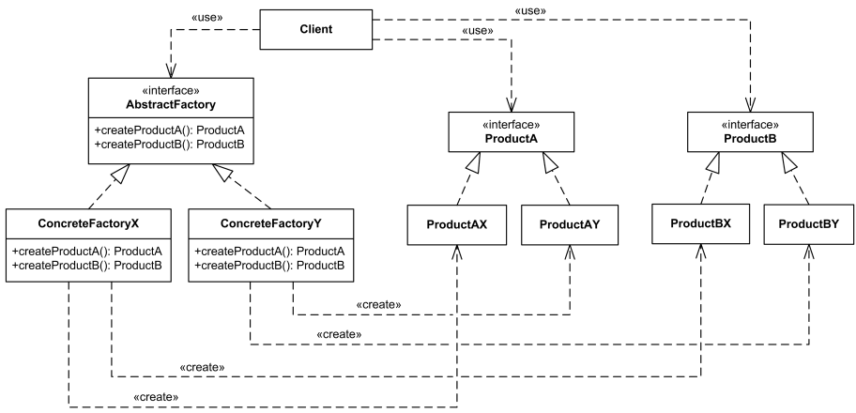
Abstract Factory
Description: Provides an interface for creating families of related or dependent objects without specifying their concrete classes. It often involves multiple factory methods to create various related objects.
Use Case: When you need to create a suite of products (like GUI elements: buttons, checkboxes, etc.) that belong together and vary across families (e.g., different operating systems).

Slide 5
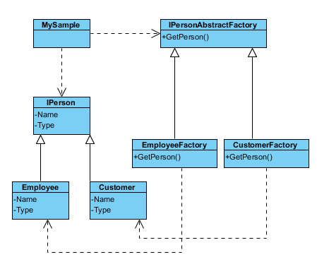
FACTORY KIT
Description: A more advanced type of factory pattern where the creation logic is encapsulated in a factory object that can be configured at runtime, often using a registry or map of creation functions.
Use Case: When the creation logic needs to be dynamically adaptable based on runtime conditions or configurations.

