Slide 1
Online job portal management
Using Hibernate

Slide 2
Team members
SOURADIP MUKHERJEE – AF0346142
DOLON MANDAL – AF0350532

Slide 3
Problem Statement:
The aim of this project is to develop an online job portal management system that serves as a platform for both job seekers and employers to interact and fulfill their respective needs efficiently. The system should provide a user-friendly interface for job seekers to search and apply for suitable job opportunities and for employers to post job listings and manage applications.
Constraints:
The system should be scalable to handle a large number of users, job listings, and applications.
Security measures should be implemented to protect user data and prevent unauthorized access.

Slide 4
Technologies Stack
Programming Languages: Java
Frameworks/Libraries: Hibernate (for ORM)
Other Tools: Git (for version control), Maven (for dependency management)

Slide 5
Plan
Design
Generate the skeleton as per class design provided
TDD approach
Identify test cases for each module
Write Failing Test cases
Convert the Test Cases in GREEN
Implement the case study in incremental manner

Slide 6
Modules
Job Search Module
User Management Module
Job Listing Module
Category Management Module
Application Manager Module

Slide 7
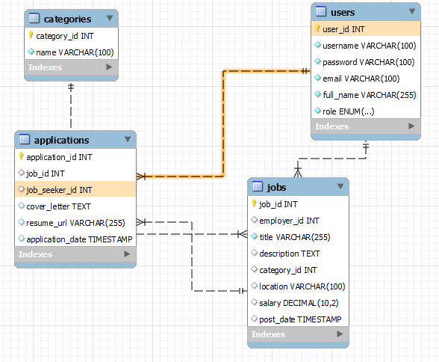
Class Design [Schema Diagram]

Slide 8
Class Design [Interface]
UserDao
void addUser(User user); User getUserById(int userId); User getUserByUsername(String username); void updateUser(User user); void deleteUser(int userId); List<User> getAllUsers();
CatagoryDao
void addCategory(Category category); Category getCategoryById(int categoryId); List<Category> getAllCategories(); void updateCategory(Category category); void deleteCategory(int categoryId);
JobDao
void addJob(Job job); Job getJobById(int jobId); List<Job> getAllJobs(); List<Job> getJobsByEmployer(int employerId); void updateJob(Job job); void deleteJob(int jobId);
ApplicationDao
void applyForJob(Application application); List<Application> getApplicationsByJob(int jobId); List<Application> getApplicationsByJobSeeker(int jobSeekerId); void updateApplicationStatus(int applicationId, ApplicationStatus status);

