Slide 1


Slide 2
Agenda
JMX Overview
JMX Details
Example
Q & A

Slide 3
Chapter 1 : JMX Overview
What’s JMX
Benefit from JMX
JMX Architecture

Slide 4
What’s JMX
What’s JMX
 Java Management Extensions
 Resource management
 Cross platform
 All java application can use it.

Slide 5
Benefit from JMX
Benefit from JMX
The JMX technology enables Java developers to encapsulate resources as Java objects and expose them as management resources in a distributed environment. The JMX specification lists the following benefits to using it to build a management infrastructure:
Manages Java applications and services without heavy investment: JMX architecture relies on a core managed object server that acts as a management agent and can run on most Java-enabled devices. Java applications can be managed with little impact on their design.
Provides a scalable management architecture: A JMX agent service is independent and can be plugged into the management agent. The component-based approach enables JMX solutions to scale from small footprint devices to large telecommunications switches.
Can leverage future management concepts: It can implement flexible and dynamic management solutions. It can leverage emerging technologies; for example JMX solutions can use lookup and discovery services such as Jini network technology, UPnP, and Service Location Protocol (SLP).
Focuses on management: While JMX technology provides a number of services designed to fit into a distributed environment, its APIs are focused on providing functionality for managing networks, systems, applications, and services.

Slide 6
JMX Architecture
JMX Architecture
- Instrumentation Level
- Agent Level
- Distributed Service Level

Slide 7
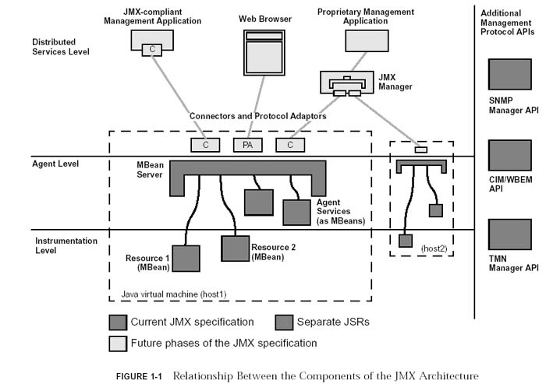

Slide 8
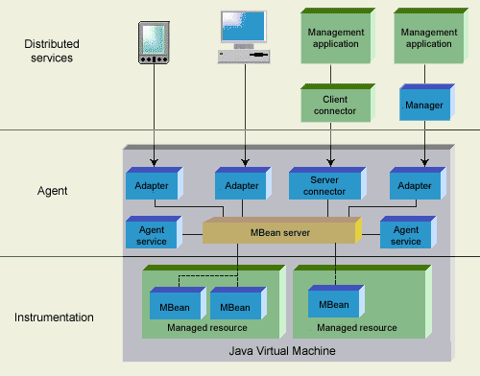

Slide 9
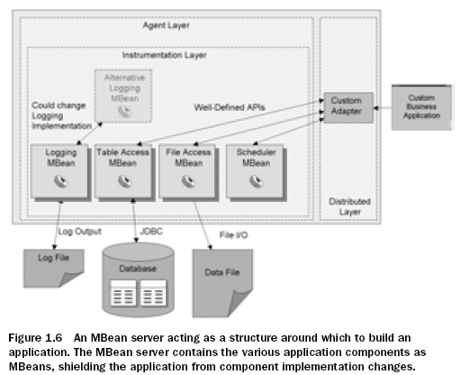
Using JMX as an application arch

Slide 10
Chapter 2 : JMX Layers
Instrumentation Level
Agent Level
Distributed Service Level

Slide 11
Instrumentation Level
Instrumentation Level
- MBean
- Notification Model
- MBean Metadata

Slide 12
Example for an MBean
Mbean Example
public interface HelloMBean {
public String getName();
public void setName(String name);
public void print();
}

Slide 13
Example for an MBean
Mbean Example
public class Hello implements HelloMBean {
private String name = "";
public String getName() {
return name;
}
public void setName(String name) {
this.name = name;
}
public void print() {
System.out.println("Hello, " + name + "!!" );
}
}

Slide 14
MBean Types
Mbean
- Standard MBeans
- Dynamic MBeans
- Model MBeans
- Open MBeans
- MXBean

Slide 15
Standard MBean
Standard MBeans
--Introspection mechanism
--Is composed of 4 items:
- public construction
- attributes
- operations
- notifications
Notes:
Standard MBeans rely on a set of naming rules, called design patterns,
The process of inspecting the MBean interface and applying these design patterns is
called introspection.

Slide 16
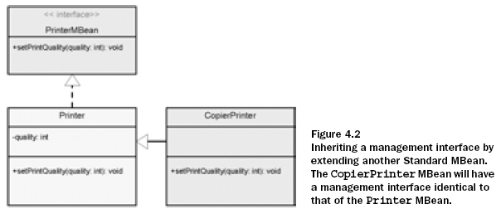
Inheritance patterns

Slide 17
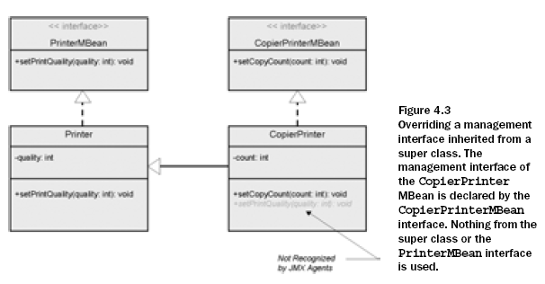
Inheritance patterns

Slide 18
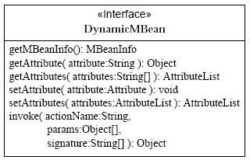
Dynamic MBeans
Dynamic MBeans
Notes:
Expose interface:
Standard Mbean: Mbean interface
Dynamic Mbean: getMBeanInfo()
最大的特点是可以在运行期暴露自己的管理接口,并且运行期间也可以改变接口

Slide 19
Dynamic MBeans
Dynamic MBean example
Notes:
Expose interface:
Standard Mbean: Mbean interface
Dynamic Mbean: getMBeanInfo()

Slide 20
Model MBeans
Model MBeans
- Provides management template.
- Agent must implements RequiredModelMBean
- Implements
DynamicMBean
PersistentMBean
ModelMBeanNotificationBroadcaster
- Mbean Server is a factory for Model MBean.
- Discriminated by ModelMBeanInfoSupport
Notes:
提供了一个改进的抽象层，并扩展了 Dynamic MBean 模型以进一步减少对给定实现的依赖性。这对于可能使用多个版本的 JVM 或者需要用松散耦合管理第三方类的情况会有帮助。Dynamic MBean 与 Model MBean 之间的主要区别是，在 Model MBean 中有额外的元数据
1)持久性
定义了持久机制，可以利用Java的序列化或JDBC来存储模型MBean的状态。
2)通知和日志功能
能记录每一个发出的通知，并能自动发出属性变化通知。
3)属性值缓存
具有缓存属性值的能力。
Apache, commons-modeler

Slide 21
Open MBeans
Open MBeans
- A type of Dynamic Mbean
- Only predefine data type
- No recompilation, dynamic link.
- No special interface to implement
- Discriminated by getMBeanInfo(), it returns OpenMBeanInfo which is sub class of MBeanInfo.
Notes:
Open MBeans are dynamic MBeans, with specific constraints on their data types, that allow management applications and their human administrators to understand and use new managed objects as they are discovered at runtime. Open MBeans provide a flexible means of instrumenting resources which need to be open to a wide range of applications compliant with the Java Management Extensions (JMX) specification.
To provide its own description to management applications, an open MBean must be a dynamic MBean, with the same behavior and functionality as a dynamic MBean. Thus it implements the DynamicMBean interface and no corresponding open MBean interface is required. The open functionality of open MBeans is obtained by providing descriptively rich metadata and by using exclusively certain predefined data types in the management interface.
受限的 Model MBean，它限制类型为固定的一组类型，以得到最大的可移植性。通过限制数据类型，可以使用更多的适配器，并且像 SMTP 这样的技术可以更容易适应 Java 应用程序的管理

Slide 22
MXBeans
An MXBean is a type of MBean that references only a predefined set of data types. In this way, you can be sure that your MBean will be usable by any client, including remote clients, without any requirement that the client have access to model-specific classes representing the types of your MBeans. MXBeans provide a convenient way to bundle related values together, without requiring clients to be specially configured to handle the bundles.

Slide 23
MetaData class
MetaData class
MBeanInfo - lists the attributes, operations, constructors and notifications
MBeanFeatureInfo - superclass for the following classes
MBeanAttributeInfo - describes an attribute
MBeanConstructorInfo - describes the signature of a constructor
MBeanOperationInfo - describes the signature of an operation
MBeanParameterInfo - describes a parameter of an operation or constructor
MBeanNotificationInfo - describes a notification

Slide 24
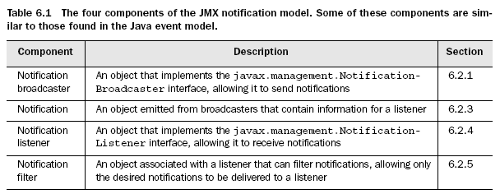
Notifications
Notifications
Notes:
you come to work one day and the application has
crashed. The MBean should have been able to inform you that the application
had gone into an error state and needed help.

Slide 25
Notifications Demo
Notifications Demo

Slide 26
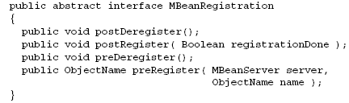
MBean use another MBean
Two ways
- Construct the Mbean with Mbean server parameter.
- Implements MBeanRegistration interface.

Slide 27
Chapter 3 : Agent
Agent Level
- MBean Server
- Service
+ Time service
+ Monitoring
+ Dynamic loading
+ Relation service
- Adaptor or Connector

Slide 28
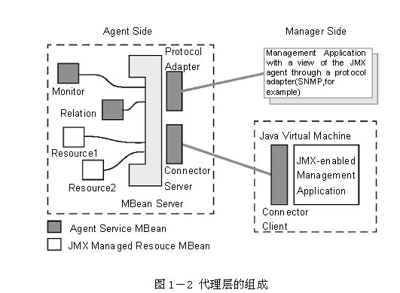
Agent components

Slide 29
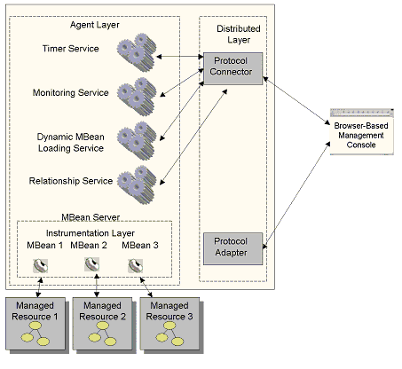
Agent components

Slide 30
MBean server
Mbean Server interface
- Registration methods
- Creation methods
- Notification methods
- Querying for MBeans.
Notes:
Mbean服务器为代理层的核心，设备层的所有管理构件都在其注册，管理者只用通过它才能访问管理构件。
管理构件可以通过以下三种方法实例化和注册：
1)通过另一个管理构件
2)管理代理本身
3)远程应用程序
注册一个管理构件时，必须提供一个唯一的对象名。管理应用程序用这个对象名进行标识管理构件并对其操作。这些操作包括：
1)发现管理构件的管理接口
2)读写属性值
3)执行管理构件中定义的操作
4)获得管理构件发出的通告
5)基于对象名和属性值来查询管理构件

Slide 31
Agent services
Time service
Notes:
时间服务可以在制定的时间和日期发出通告，也可以定期的周期性的发出通告，依赖于管理应用程序的配置。时间服务也是一个管理构件，它能帮助管理应用程序建立一个可配置的备忘录，从而实现智能管理服务。

Slide 32
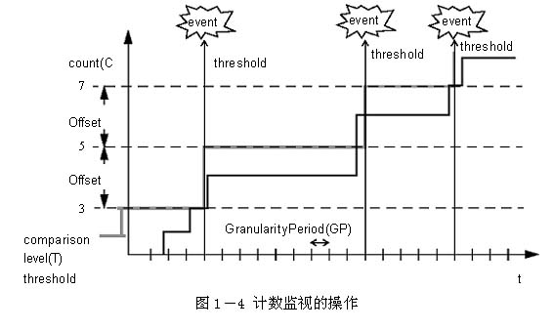
Agent services
Monitoring
Notes:
通过使用监视服务，管理构件的属性值就会被定期监视，从而保证始终处于一个特定的范围。当监视的属性值的变化超出了预期定义的范围，一个特定的通告就会发出。JMX规范当前规定了三种监视器：
1)计数器监视器，监视计数器类型的属性值，通常为整型，且只能按一定规律递增。
2)度量监视器，监视度量类型的属性值，通常为实数，值能增能减。
3)字符串监视器，监视字符串类型的属性值。
每一个监视器都是作为一个标准管理构件存在的，需要提供服务时，可以由相应的管理构件或远程管理应用程序动态创建并配置注册使用。

Slide 33
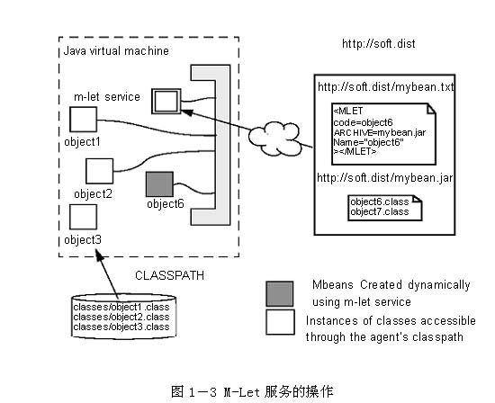
Agent services
Dynamic Class Loading
Notes:
动态类装载是通过m-let（management applet）服务来实现的，它可以从网络上的任何URL处下载并实例化管理构件，然后向MBean服务器注册。在一个M-let服务过程中，首先是下载一个m-let文本文件，该文件是XML格式的文件，文件的内容标识了管理构件的所有信息，比如构件名称、在MBean服务器中唯一标识该构件的对象名等。然后根据这个文件的内容，m-let服务完成剩余的任务。

Slide 34
Agent services
Relation Service
Notes:
JMX规范定义了管理构件之间的关系模型。一个关系是用户定义的管理构件之间的N维联系。
关系模型定义如下一些术语：
1)角色：就是是一个关系中的一类成员身份，它含有一个角色值。
2)角色信息：描述一个关系中的一个角色。
3)关系类型：由角色信息组成，作为创建和维持关系的模板。
4)关系：管理构件之间的当前联系，且必须满足一个关系类型的要求。
5)角色值：在一个关系中当前能满足给定角色的管理构件的列表。
6)关系服务：是一个管理构件，能接触和维持所有关系类型和关系实例之间的一致性。
JMX关系模型只能保证所有的管理构件满足它的设计角色，也就是说，不允许一个管理构件同时出现在许多关系中。

Slide 35
Adaptors and Connectors
Adaptors and Connectors

Slide 36
Agent Code feel
What it looks like ?
Demo code

Slide 37
Distributed Service Level
Distributed Service Level
- Provides the interfaces for implementing JMX
managers.
- no details in JMX specification.

Slide 38
Others
JMX security
Weblogic JMX service
MX4J
http://docs.oracle.com/javase/6/docs/technotes/guides/jmx/examples.html

Slide 39
Q & A

Slide 40

THANKS

