Slide 1
JMX Introduction
DSP Team, Zhou Feng

Slide 2
JMX Overview

Slide 3
Why Management & Monitoring?
Infrastructure Software is Getting More Complicated
Administration
Configuration
Monitoring
Enterprise Business Application Characteristics:
Distributed
Complex
Mission Critical
High-Volume
Dynamic

Slide 4
JMX Benefits
Low Cost
Scalable Management Architecture – Modularization of agent services
Easy Integration – JMX smart agents manageable through various protocols
Dynamic Management
Integrates Existing Management Solutions
Leverages Existing Standard Java Technologies
Applicable to a Wide Range of Applications
Possible Automatic Instrumentation

Slide 5
Typical JMX Usage
Reading and Changing Application Configurations
Infrastructure and Business Level Operational Statistics
Availability
Early Detection of Capacity Problems
Application Performance, Business Process Productivity
Resources usage
Problems
Signaling events
Faults
State changes
Improving Services via Proactive Alerting

Slide 6
Management Before JMX
Firewall
Primary Servers
Web Server
Application
Server
Database
Failover
Hardware
Web Server
Management
Console
App Server
Management
Console
Database
Management
Console
Failover
Management
Console
Web Server
Management
Console
App Server
Management
Console
Database
Management
Console
Firewall
Management
Console
Secondary Servers
Web Server
Application
Server
Database

Slide 7
Management With JMX
Firewall
Primary Servers
Web Server
Application
Server
Database
Failover
Hardware
MBean Server
Management
Application
Console
Connector/
Adaptor
Instrumentation Layer
Secondary Servers
Web Server
Application
Server
Database

Slide 8
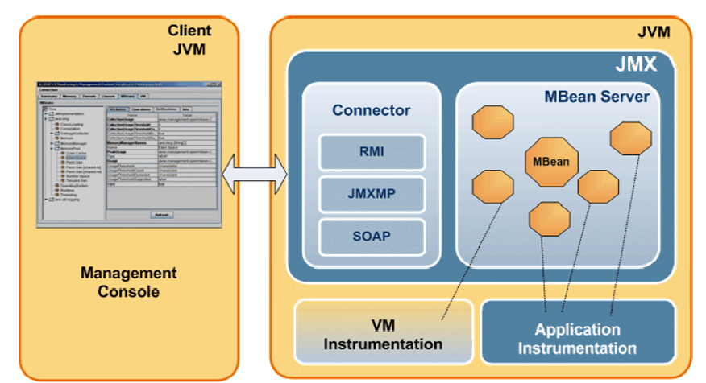
JMX Management

Slide 9
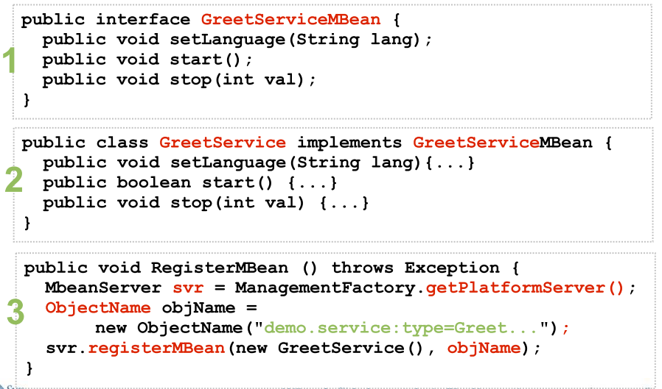
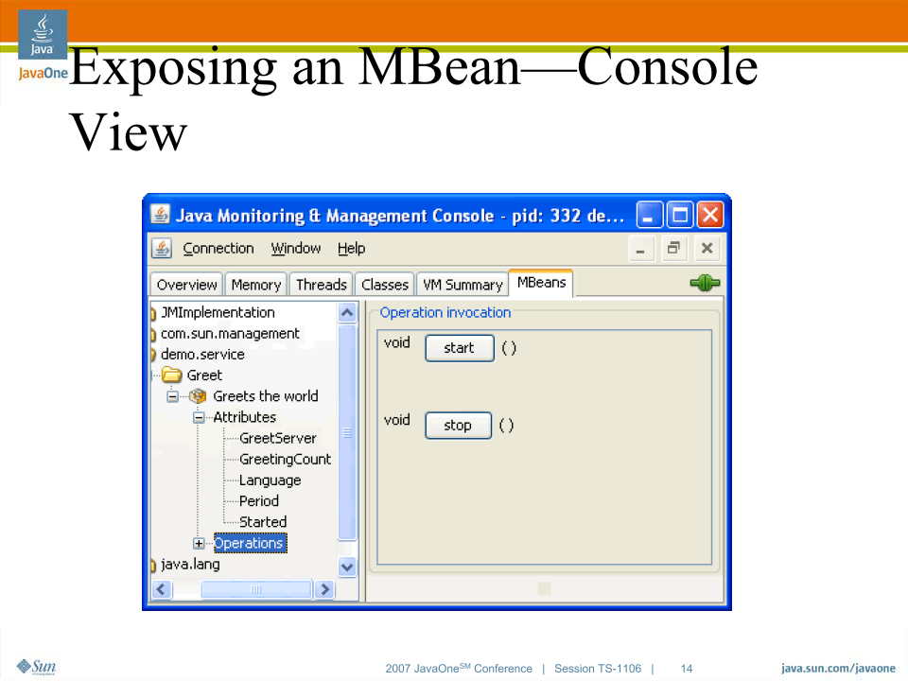
Exposing an MBean Code & Console View

Slide 10
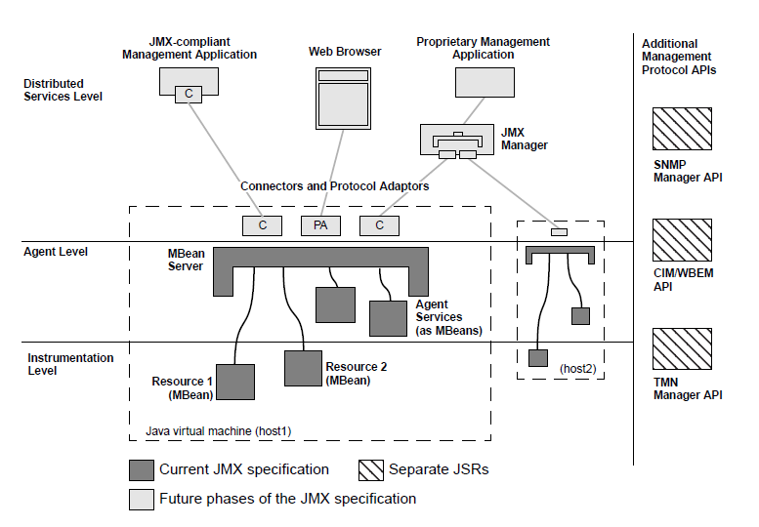
JMX Architecture

Slide 11
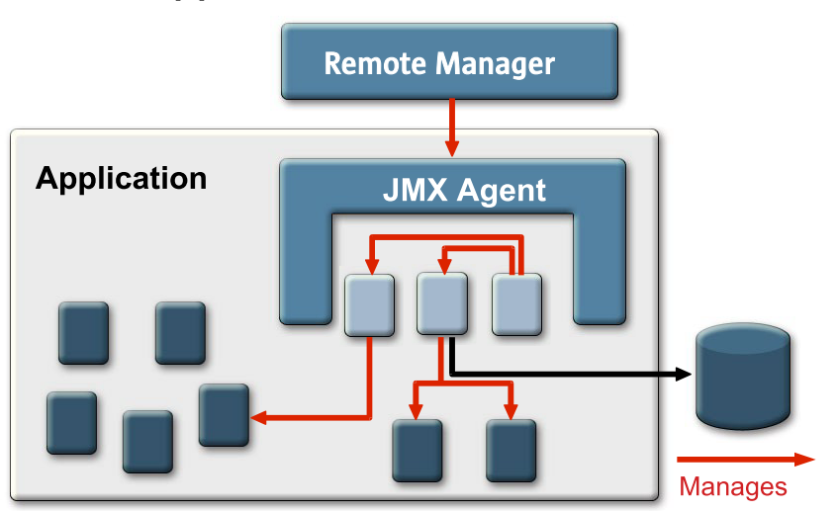
Adding JMX Instrumentation to Your Application

Slide 12
MBeans
An MBean is a named managed object representing a resource
Application configuration setting
Program module
Device
Collection of statistics
etc.
An MBean can have:
Attributes that can be read and/or written
Operations that can be invoked
Notifications that the MBean can send

Slide 13
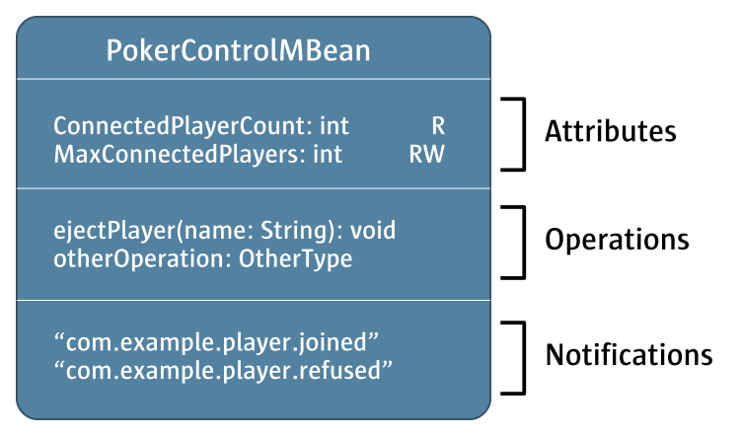
MBean Example

Slide 14
Standard MBeans
There are several kinds of MBeans
Standard, MXBean, Dynamic, Model, Open
The simplest are Standard MBeans and their cousins, MXBeans
Provides a static representation of a manageable resource.
Implements a management interface of attributes and methods that a device or application exposes for management.
To make a Standard MBean:
Write a bean interface called SomethingMBean
Implement it in a class called Something
Then an instance of Something is a Standard MBean
public interface PokerControlMBean {
// a read-write attribute called
// MaxConnectedPlayers of type int
public int getMaxConnectedPlayers();
public void setMaxConnectedPlayers(int n);
// a read-only attribute called
// ConnectedPlayerCountCode of type int
public int getConnectedPlayerCount();
// an operation called ejectPlayer
// with a String parameter
public void ejectPlayer(String name);
}
public class PokerControl implements PokerControlMBean {
public int getMaxConnectedPlayers() {
...logic to determine MaxConnectedPlayers...

Slide 15
Dynamic MBeans
Useful if the management interface is not stable.
The management interface is defined at runtime.
Developer is responsible for checking the validity of the invocations.
<<Interface>>
DynamicMBean
getAttribute(String attribute)
setAttribute(Attribute attribute)
getAttributes (String[] attributes)
setAttributes(AttibuteList attributes)
getMBeanInfo()
invoke(String actionName, Object[] params, String[] signatures)
Notes:
With standard mbeans the agent discovers the management interface through introspection
With dynamic Mbeans the developer is responsible for providing this metadata
Allows the interface to be developed via an XML file.

Slide 16
Model MBeans
Most flexible and thus most complicated MBeans
Extension of the dynamic MBean
Developers do not write an MBean class
The agent must supply the RequiredModelMBean and the Management Interface is defined outside of the Bean via setter methods.
Features include persistence, logging, and attribute caching.

Slide 17
Notifications
Can be used to inform registered listeners with important events or state changes.
Similar to the java event model
Register once to all types of notifications
Can supply a filter to say which notifications it is interested in.

Slide 18
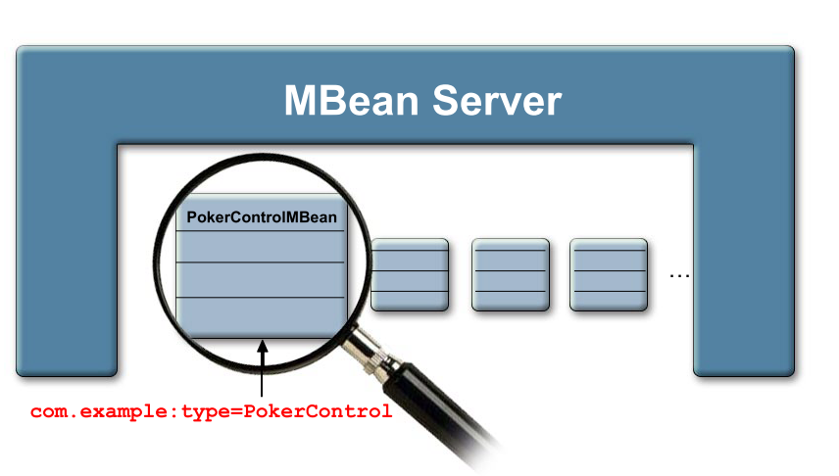
MBeanServer
The core of the agent. It provides a registry for MBeans.
Allows clients to discover and execute operations exposed by the MBeans
Makes available various services to facilitate management (I.e. monitoring, scheduling, etc)
Use “ObjectName” class to register objects with the MBeanServer
Notes:
Object Name 2 parts Domain Name
Key=value property list to uniquely identify mbeans and

Slide 19

Naming MBeans
Every MBean has a name
A name is an instance of the ObjectName class (javax.management.ObjectName)
Uniquely identifies MBean
A name has a domain and one or more key properties
Spaces are significant everywhere (Don’t put a space after a comma!)
Key properties are unordered
Format: [domainName]:key=value[,key=value]*
com.example:type=CacheControl
com.example:type=CacheControl,name=whatsitCache
java.lang:type=MemoryPool,name=PS Perm Gen

Slide 20
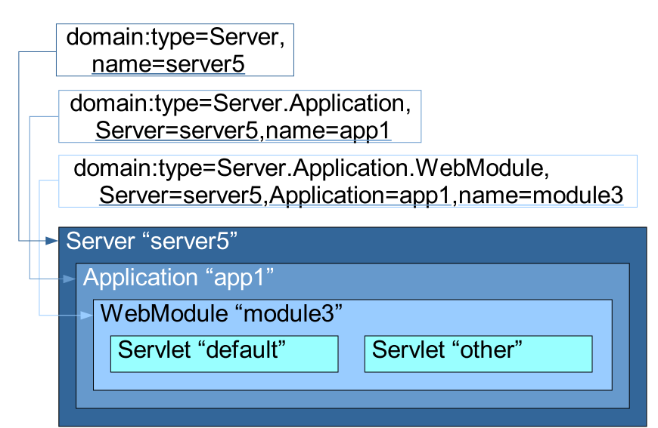
ObjectName Conventions
Domain is (or starts with) a Java package
Domain character “/” reserved for structuring domains
Key properties include type=something
ObjectName pattern *:type=MemoryPool,* means all MemoryPool Mbeans
Likewise java.lang:type=MemoryPool,*
If there can be more than one instance, use name=something to differentiate
Sometimes appropriate to have other keys too

Slide 21
Agent Services
Mlet: (Management Applet) Dynamically adds class files to the server either locally or from a remote location.
Relation Service: Allows the definition of relationships between MBeans
Monitors: Observe MBean attributes and emit notifications when values change.
Timers: Emits user defined notifications at specific times.

Slide 22
JMX Remote
Connectors/Adapters
A connector makes a Java Management Extensions (JMX) API MBean server accessible to remote Java technology-based clients.
Adapters are similar to connectors except they provide protocol translations (I.e. SNMP, HTML, etc.)
JMX Remote API
Adds remote capability to the JMX spec
Makes the JMX agent accessible from outside the JVM.
Developed through the JCP JSR 160
Standard support via RMI
Optional support via TCP Sockets (JMXMP)
API is as close as possible to the API defined by the JMX API.
Also support discovery/lookup services and defines security between the client and server.
As with RMI code must handle communication exceptions

Slide 23
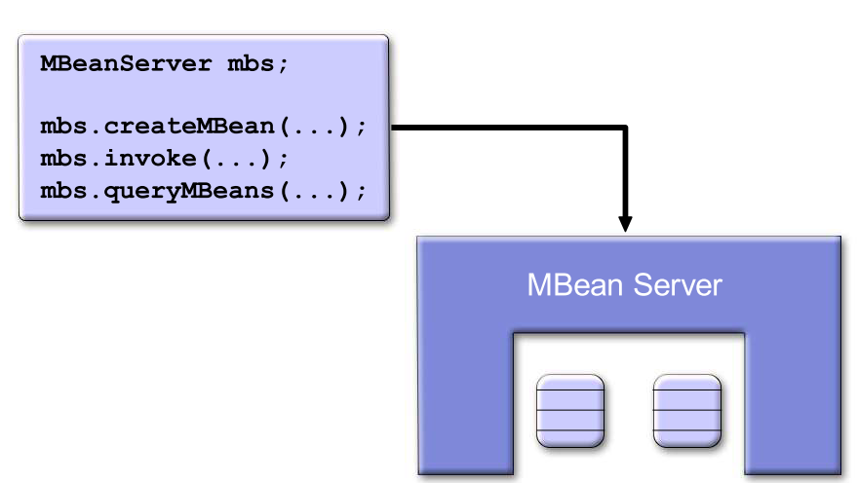
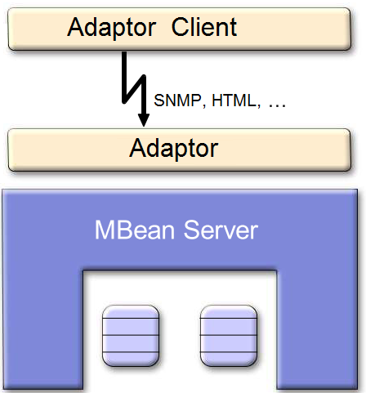
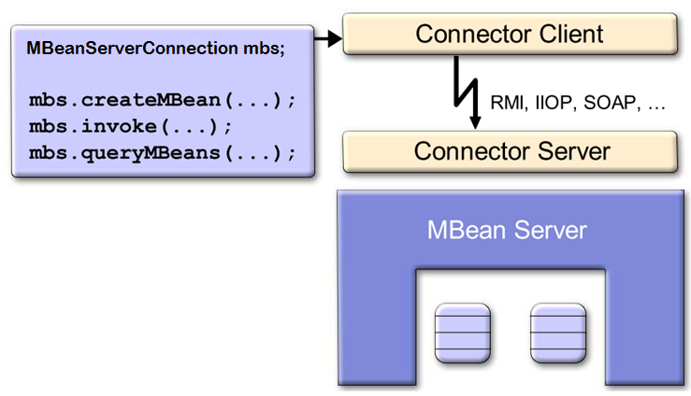
JMX API for Clients
JMX API for Local Clients
Adaptor Clients
JMX API for Remote Clients

Slide 24
Available JMX Implementations
Sun JDK1.5
JBOSS JBOSS-MX
MX4J
XMOJO
Commercial implementations available;
Weblogic
Adventnet
XtreamJ
WebSphere Tivioli

Slide 25
Examples
MX4J - Dynamic MBean Example (CacheMBean)
MC4J Console
XMOJO - Model MBean Example (ServerInfo)
XMOJO Web based console
JBoss – “XMBean” Example (CacheMBean)
JBoss Web based console & MC4J Console
JDK1.5 Standard MBeans and JConsole

Slide 26
References
Sun JMX Page: http://java.sun.com/products/JavaManagement
JBOSS MX: http://www.jboss.org/developers/projects/jboss/jbossmx.jsp
MX4J Page: http://mx4j.sourceforge.org
MC4J Page: http://mc4j.sourceforge.org
XMOJO Page: http://www.xmojo.org
Jconsole page: http://java.sun.com/j2se/1.5.0/docs/tooldocs/share/jconsole.html
Tutorial Page: http://www.admc.com/blaine/howtos/jmx/jmx.html
Article on JMX: http://www.onjava.com/pub/a/onjava/2004/09/29/tigerjmx.html

Slide 27
JMX API

Slide 28
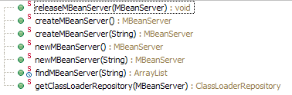
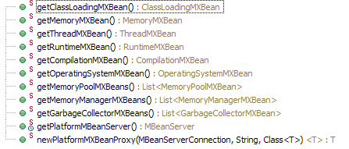
MBean Server MBeanServerFactory
javax.management.MBeanServerFactory
Create MBeanServer
Find MBeanServer
Close MBeanServer
java.lang.management.ManagementFactory
Locate Platform MBeanServer
Locate Standard Platform MBeans

Slide 29
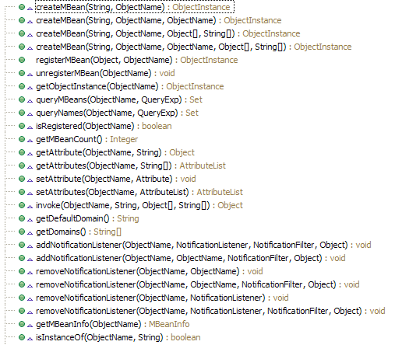
MBean Server MBeanServer
javax.management.MBeanServer
Retrieve a specific MBean by its object name.
Query a collection of Mbeans
By means of pattern matching on their names,
Optionally by means of a filter applied to their attribute values
Get one or several attribute value(s) of an MBean.
Invoke an operation on an MBean
Introspection of the MBean
Register interest in the notifications emitted by an MBean

Slide 30

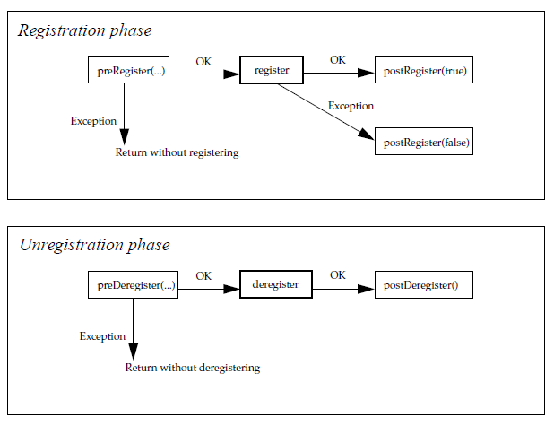
MBean Server MBeanRegistration
javax.management.MBeanRegistration
Registration
ObjectName
MBeanServer
Unregistration

Slide 31
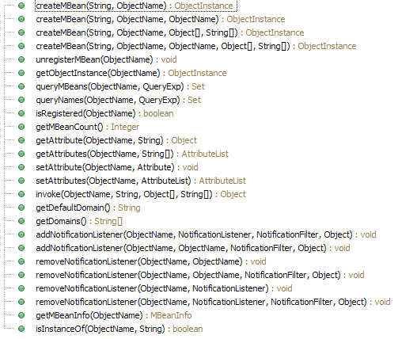


MBeanServer MBeanServerConnection
javax.management.MBeanServerConnection
Super Interface of MBeanServer
No registerMBean
No IOException

Slide 32
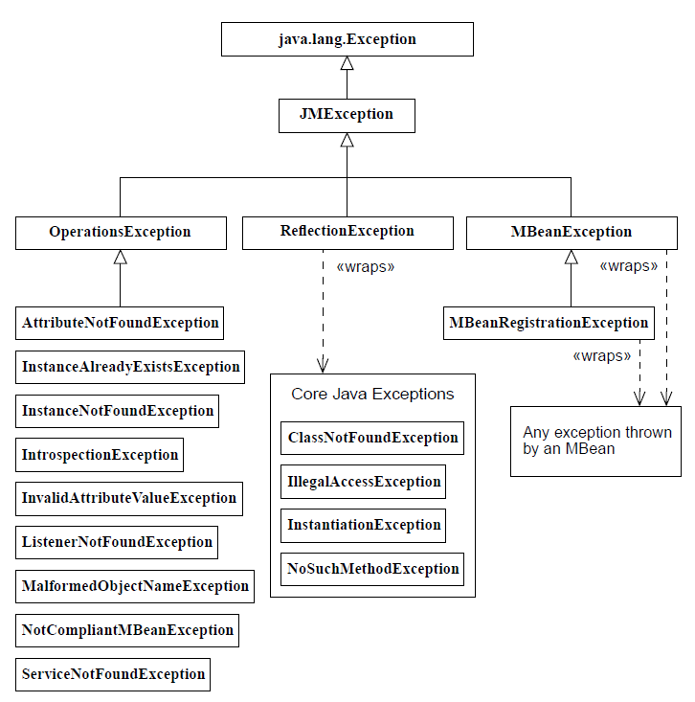
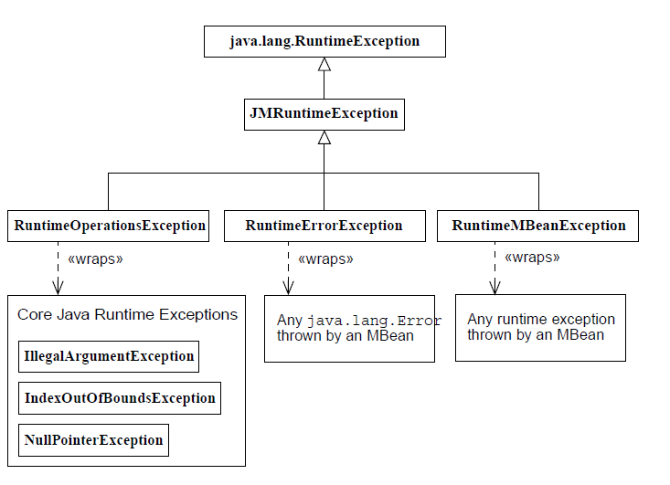
MBeanServer JMX Exception

Slide 33
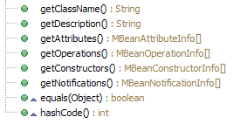
MBean MBeanInfo
javax.management.MBeanInfo
javax.management.MBeanAttributeInfo
Type
Name
Readable/Writeable
javax.management.MBeanOperationInfo
Name
Return Type
Impact (Action, Info, Action & Info, Other)
Signature
javax.management.MBeanConstructorInfo
Name
Signature

Slide 34

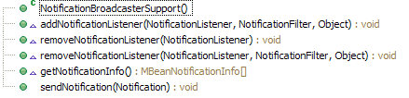
MBean Notification
javax.management.NotificationBroadcaster
javax.management.NotificationEmitter
Extends Notification Broadcaster
javax.management.NotificationListener
javax.management.NotificationFilter
javax.management.NotificationBroadcasterSupport
Default Listener Support
Implements Listener

Slide 35
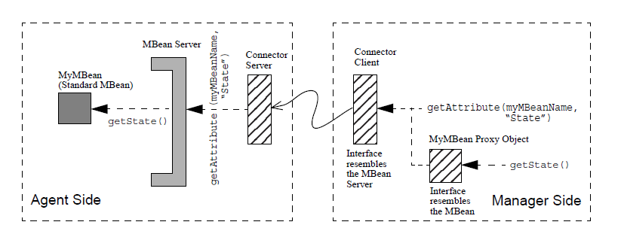
JMX Remote

Slide 36
JMX Remote Sample Code
Start JMX Connector Server
Start JMX Connector
LocateRegistry.createRegistry(1099);
Map<String, Object> env = new HashMap<String, Object>();
env.put(Context.INITIAL_CONTEXT_FACTORY,
"com.sun.jndi.rmi.registry.RegistryContextFactory");
env.put(RMIConnectorServer.JNDI_REBIND_ATTRIBUTE, "true");
JMXServiceURL url = new JMXServiceURL("service:jmx:rmi:///jndi/rmi://127.0.0.1:1099/server");
JMXConnectorServer server = JMXConnectorServerFactory
.newJMXConnectorServer(url, env, mbeanServer);
try {
server.start();
} catch (IOException e) {
e.printStackTrace();
}
Map<String, Object> env = new HashMap<String, Object>();
env.put(Context.INITIAL_CONTEXT_FACTORY,
"com.sun.jndi.rmi.registry.RegistryContextFactory");
env.put(RMIConnectorServer.JNDI_REBIND_ATTRIBUTE, "true");
JMXServiceURL url = new JMXServiceURL("service:jmx:rmi:///jndi/rmi://127.0.0.1:1099/server");
JMXConnector connector = JMXConnectorFactory.newJMXConnector(url, env);
MBeanServerConnection mbsc = connector.getMBeanServerConnection();
String result = (String) mbsc.invoke(new ObjectName("Test:name=Sample"), "hello", new Object[0], new String[0]);

