Slide 1
Shell Scripts Introduction
Dongdong Wang

Slide 2
Topics
Introduction to Shell Scripts
Special Variables
Flow Control
Debug

Slide 3
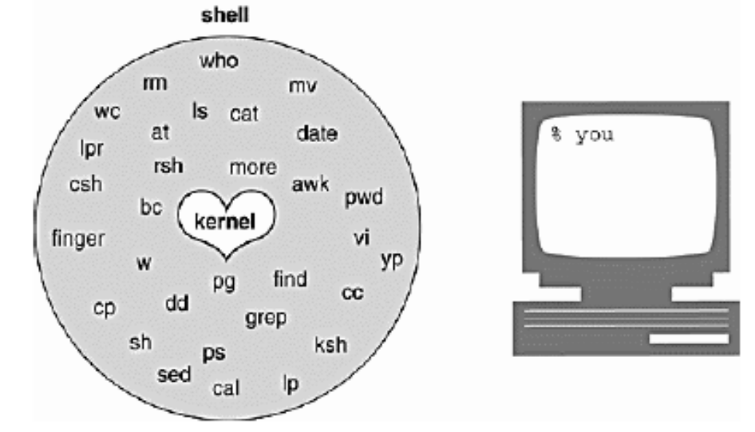
What Is Unix Shell
  The shell is a utility program that starts up when you log on. It allows users to interact with the kernel by interpreting commands that are typed either at the command line or in a script file.

Slide 4
Typical Shells in Unix/Linux
Bourne Shell Compatible
  Bourne shell (sh) -- Written by Steve Bourne, while at Bell Labs. First distributed with Version 7 Unix, circa 1978, and enhanced over the years.
  Bourne-Again shell (bash) -- Written as part of the GNU project to provide a superset of Bourne Shell functionality.
  Korn shell (ksh) -- Written by David Korn, while at Bell Labs.
  Z shell (zsh) -- considered as the most complete shell: it is the closest thing that exists to a superset of sh, ash, bash, csh, ksh, and tcsh.
C Shell Compatible
  C shell (csh) -- Written by Bill Joy, while at the University of California, Berkeley. First distributed with BSD, circa 1979.
  TENEX C shell (tcsh)

Slide 5
What is ‘#!/bin/sh’ for?
  The Sha-bang refers to the characters #! (Sharp Bang) in an interpreter directive as the first line of a text file. System tries to execute that script using the interpreter specified by the rest of the first line in the file.
    Examples:
    #!/bin/sh
    #!/bin/bash
    #!/usr/bin/perl
    #!/bin/sed -f
    #!/usr/awk -f
  #! can be omitted if the script consists only of a set of generic system commands, it will be interpreted by the current shell .

Slide 6
Special Variables
$# - The number of parameters being passed
$0 - The shell script being called from
$1-$9 - The Nth parameter being passed
$* - The entire list of arguments, treated as a single word (starting at $1).
$@ - The entire list of arguments, treated as a series of words.
$$ - The process number of this shell
$? – The return code of last executed command
IFS - Internal Field Seperator

Slide 7
Working Directory vs. Script Directory
  Working directory: where you run the script.
  Script directory: where the script is.
  Example:
  dw00460@tpslnx4d: /home/dw00460
  $ shell/hello.sh
  $0=shell/hello.sh
  working dir=/home/dw00460
  script dir=/home/dw00460/shell

Slide 8
TEST
-d file The specified file exists and is a directory.
-e file The specified file exists.
-r file The specified file exists and is readable.
-s file The specified file exists and has non-zero size.
-w file The specified file exists and is writable.
-x file The specified file exists and is executable.
-L file The specified file exists and is a symbolic link.
f1 -nt f2 File f1 is newer than file f2.
f1 -ot f2 File f1 is older than file f2.
-n s1 String s1 has nonzero length.
-z s1 String s1 has zero length.
s1 = s2 String s1 is the same as string s2.
s1 != s2 String s1 is not the same as string s2.
Notes:
http://www.ibm.com/developerworks/cn/linux/l-tip-prompt/tip01/index.html

Slide 9
TEST
n1 -eq n2 Integer n1 is equal to integer n2.
n1 -ge n2 Integer n1 is greater than or equal to integer n2.
n1 -gt n2 Integer n1 is greater than integer n2.
n1 -le n2 Integer n1 is less than integer n2.
n1 -lt n2 Integer n1 is less than or equal to integer n2.
n1 -ne n2 Integer n1 is not equal to integer n2.
! The not operator, which reverses the value of the following condition.
-a The and operator, which joins two conditions. Both conditions must be true for the overall result to be true.
-o The or operator, which joins two conditions. If either condition is true, the overall result is true.
Notes:
http://www.ibm.com/developerworks/cn/linux/l-tip-prompt/tip01/index.html

Slide 10
IF
if COMMAND
then
…
fi
if [ "$VAR" = “TRUE” ] ; then
…
else
…
fi
Notes:
http://www.ibm.com/developerworks/cn/linux/l-tip-prompt/tip01/index.html

Slide 11
CASE
case value in
pattern1) commands;;
pattern2) commands ;;
...
esac
case $1 in
-r) echo Force deletion without confirmation ;;
-i) echo Confirm before deleting ;;
*) echo Unknown argument ;;
esac

Slide 12
WHILE
while command
do
commands
done
COUNT=0
while [ $COUNT -lt 10 ]; do
echo $COUNT
COUNT=`expr $COUNT + 1`
done
Notes:
http://www.ibm.com/developerworks/cn/linux/l-tip-prompt/tip01/index.html

Slide 13
FOR
for variable in list
do
commands
done
#IFS=“ ”
fruitlist="Apple Pear Tomato Peach Grape”
for fruit in $fruitlist; do
if [ "$fruit" = "Tomato" ] || [ "$fruit" = "Peach" ]; then
echo "I like ${fruit}es”
else
echo "I like ${fruit}s”
fi
done
Notes:
http://www.ibm.com/developerworks/cn/linux/l-tip-prompt/tip01/index.html

Slide 14
FUNCTION
sh_function_name() {
commands
…
}
function bash_function_name {
echo $1
…
}
function_name
Notes:
http://www.ibm.com/developerworks/cn/linux/l-tip-prompt/tip01/index.html

Slide 15
Debug
  -v : prints shell input lines as they are read.
  -x : traces of each command plus its arguments are printed after the commands have been expanded but before they are executed.
  Example:
  dw00460@tpslnx1d: /home/dw00460/shell
  $ bash -x debug.sh
  + a='x y'
  + '[' x y = 'x y' ']'
  debug.sh: line 5: [: too many arguments
  + echo No
  No

Slide 16
HOMEWORK
  Search specified keywords in the directory.
  Usage: search [OPTION] [KEYWORD] [FILES]
  -r do recursively search
  Example:
  search -r Method dir/*.java
  Output:
  dir/path1/JavaObject1.java line 5 public void Method1() {
  dir/path2/JavaObject2.java line 3 public void Method2() {

Slide 17
THE END
  QUESTIONS?

