Slide 1
JVM GC Tools

Slide 2
Command
jps
jstat
jmap

Slide 3
jstat
1、jstat –gcutil [pid] [intervel] [count]
Notes:
public class PSGCDirectOldDemo {
// -Xms20m -Xmx20m -Xmn10m -XX:SurvivorRatio=8 -XX:+UseParallelGC
// S0=1 S1=1 E=8 O=10
// S0 S1 E O P YGC YGCT FGC FGCT GCT
// 0.00 0.00 6.20 0.00 18.82 0 0.000 0 0.000 0.000
// 0.00 0.00 31.20 0.00 18.82 0 0.000 0 0.000 0.000
// 0.00 0.00 56.20 0.00 18.82 0 0.000 0 0.000 0.000
// 0.00 0.00 81.20 0.00 18.82 0 0.000 0 0.000 0.000
// 0.00 0.00 81.20 40.00 18.82 0 0.000 0 0.000 0.000
// 0.00 0.00 83.20 40.00 18.87 0 0.000 0 0.000 0.000
// -Xms40m -Xmx40m -Xmn20m -XX:SurvivorRatio=2 -XX:+UseParallelGC
// S0=5 S1=5 E=10 O=20
// S0 S1 E O P YGC YGCT FGC FGCT GCT
// 0.00 0.00 6.01 0.00 18.82 0 0.000 0 0.000 0.000
// 0.00 0.00 26.01 0.00 18.82 0 0.000 0 0.000 0.000
// 0.00 0.00 46.01 0.00 18.82 0 0.000 0 0.000 0.000
// 0.00 0.00 66.01 0.00 18.82 0 0.000 0 0.000 0.000
// 0.00 83.60 40.00 10.00 18.87 1 0.015 0 0.000 0.015
// Ready to direct allocate to old!
// Heap
// PSYoungGen total 15360K, used 10036K [0x07dd0000, 0x091d0000, 0x091d0000)
// eden space 10240K, 98% used [0x07dd0000,0x0879d058,0x087d0000)
// from space 5120K, 0% used [0x08cd0000,0x08cd0000,0x091d0000)
// to space 5120K, 0% used [0x087d0000,0x087d0000,0x08cd0000)
// PSOldGen total 20480K, used 0K [0x069d0000, 0x07dd0000, 0x07dd0000)
// object space 20480K, 0% used [0x069d0000,0x069d0000,0x07dd0000)
// PSPermGen total 12288K, used 2318K [0x029d0000, 0x035d0000, 0x069d0000)
// object space 12288K, 18% used [0x029d0000,0x02c13a10,0x035d0000)
// public static void main(String[] args) throws Exception {
// byte[] byte1 = new byte[1024 * 1024 * 2];
// byte[] byte2 = new byte[1024 * 1024 * 2];
// byte[] byte3 = new byte[1024 * 1024 * 2];
// //System.out.println("Ready to direct allocate to old!");
// Thread.sleep(3000);
// byte[] byte4 = new byte[1024 * 1024 * 5];
// Thread.sleep(3000);
// }
// -Xms28m -Xmx28m -Xmn18m -XX:SurvivorRatio=1 -XX:+UseParallelGC
// S0 S1 E O P YGC YGCT FGC FGCT GCT
// S0=6 S1=6 E=6 O=10
// 0.00 0.00 6.26 0.00 18.82 0 0.000 0 0.000 0.000
// 0.00 0.00 39.60 0.00 18.82 0 0.000 0 0.000 0.000
// 0.00 0.00 72.93 0.00 18.82 0 0.000 0 0.000 0.000
// 0.00 0.00 89.60 0.00 18.82 0 0.000 0 0.000 0.000
// 0.00 0.00 89.60 50.00 18.82 0 0.000 0 0.000 0.000
// -Xms28m -Xmx28m -Xmn18m -XX:SurvivorRatio=1 -XX:+UseParNewGC
// S0 S1 E O P YGC YGCT FGC FGCT GCT
// S0=6 S1=6 E=6 O=10
// 0.00 0.00 6.26 0.00 18.82 0 0.000 0 0.000 0.000
// 0.00 0.00 39.60 0.00 18.82 0 0.000 0 0.000 0.000
// 0.00 0.00 72.93 0.00 18.82 0 0.000 0 0.000 0.000
// 0.00 0.00 89.60 0.00 18.82 0 0.000 0 0.000 0.000
// 0.00 85.82 83.33 0.00 18.87 1 0.034 0 0.000 0.034
// 5.14m 5m
public static void main(String[] args) throws Exception {
byte[] byte1 = new byte[1024 * 1024 * 2];
byte[] byte2 = new byte[1024 * 1024 * 2];
byte[] byte3 = new byte[1024 * 1024 * 1];
//System.out.println("Ready to direct allocate to old!");
Thread.sleep(3000);
byte[] byte4 = new byte[1024 * 1024 * 5];
Thread.sleep(3000);
}
public static byte[] allocation(int m) {
byte[] byte1 = new byte[1024 * 1024 * m];
return byte1;
}
}

Slide 4
jmap
jmap -dump:[live,]format=b,file=<filename> pid
jmap -heap pid(Don’t use with CMS)
jmap -histo pid
Notes:
jmap -dump:[live,]format=b,file=<filename> pid
Eclipse MAT是SAP公司贡献的一个工具， 用它打开*.hprof文件.
http://www.eclipse.org/mat/about/screenshots.php
jmap -heap pid(与CMS 有冲突)
Attaching to process ID 2060, please wait... Warning: the type "const char*" (declared in the remote VM in VMStructs::localHotSpotVMTypes) had its size declared as 4 twice. Continuing. Warning: the type "const size_t" (declared in the remote VM in VMStructs::localHotSpotVMTypes) had its size declared as 4 twice. Continuing. Warning: the type "const int" (declared in the remote VM in VMStructs::localHotSpotVMTypes) had its size declared as 4 twice. Continuing. Warning: the type "const MemRegion" (declared in the remote VM in VMStructs::localHotSpotVMTypes) had its size declared as 8 twice. Continuing. Debugger attached successfully. Client compiler detected. JVM version is 21.0-b05 using thread-local object allocation. Mark Sweep Compact GC Heap Configuration: MinHeapFreeRatio = 40 MaxHeapFreeRatio = 70 MaxHeapSize = 402653184 (384.0MB) NewSize = 1048576 (1.0MB) MaxNewSize = 4294901760 (4095.9375MB) OldSize = 4194304 (4.0MB) NewRatio = 2 SurvivorRatio = 8 PermSize = 12582912 (12.0MB) MaxPermSize = 134217728 (128.0MB) Heap Usage: New Generation (Eden + 1 Survivor Space): capacity = 46596096 (44.4375MB) used = 457800 (0.43659210205078125MB) free = 46138296 (44.00090789794922MB) 0.9824857430116034% used Eden Space: capacity = 41418752 (39.5MB) used = 457800 (0.43659210205078125MB) free = 40960952 (39.06340789794922MB) 1.1052964608880538% used From Space: capacity = 5177344 (4.9375MB) used = 0 (0.0MB) free = 5177344 (4.9375MB) 0.0% used To Space: capacity = 5177344 (4.9375MB) used = 0 (0.0MB) free = 5177344 (4.9375MB) 0.0% used tenured generation: capacity = 103399424 (98.609375MB) used = 62037328 (59.16340637207031MB) free = 41362096 (39.44596862792969MB) 59.99775008417842% used Perm Generation: capacity = 34603008 (33.0MB) used = 34430344 (32.83533477783203MB) free = 172664 (0.16466522216796875MB) 99.50101447827888% used
jmap -histo pid
num #instances #bytes class name ---------------------------------------------- 1: 103126 38723408 [B 2: 74925 11593384 <constMethodKlass> 3: 106124 8206592 [C 4: 74925 6006624 <methodKlass> 5: 6944 4741688 <constantPoolKlass> 6: 6944 3260216 <instanceKlassKlass> 7: 21764 3017480 [I 8: 5872 2773872 <constantPoolCacheKlass> 9: 103201 2476824 java.lang.String 10: 62669 1504056 java.util.HashMap$Entry

Slide 5
GUI Tools
JConcole
JVisualVM
MAT
Notes:
JConsole > JDK5
JVisualVM > JDK6 update7

Slide 6
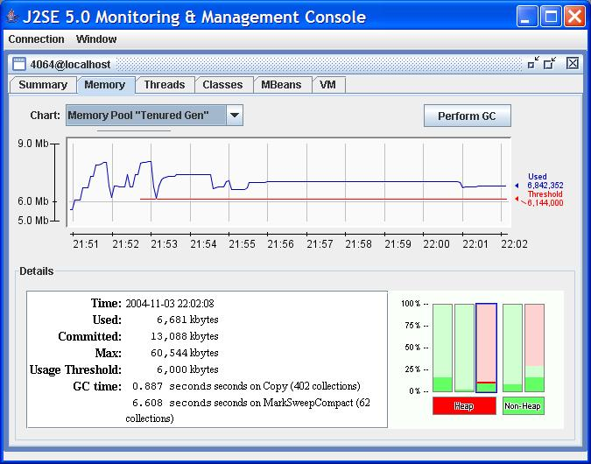
Jconsole

Slide 7
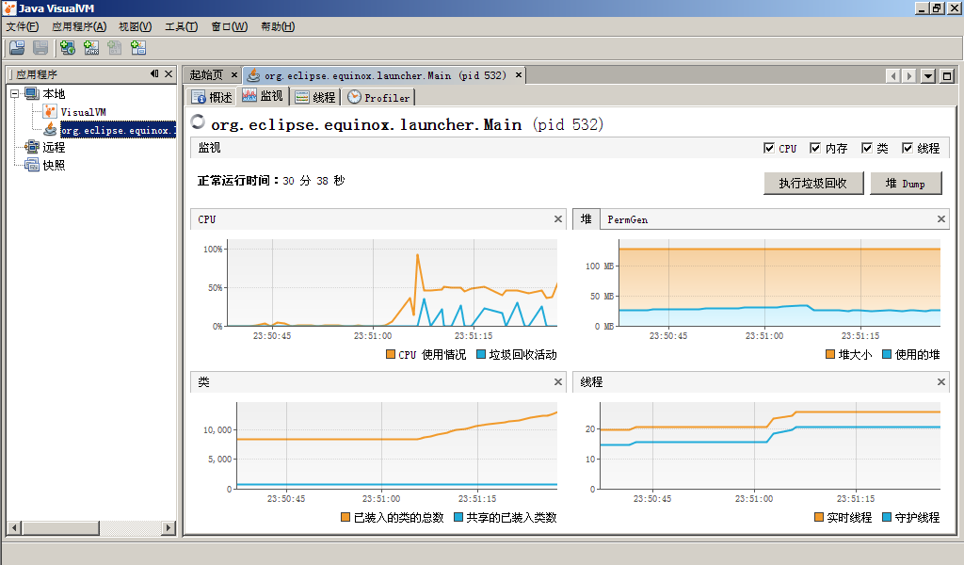
JVisualVM

Slide 8
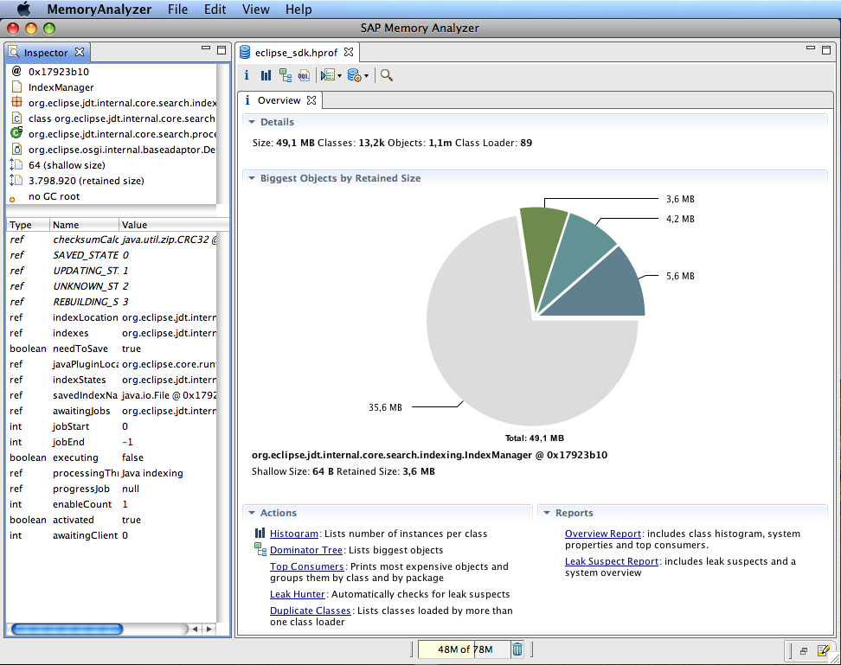
MAT
Notes:
MAT

Slide 9
