Slide 1
Java VM
Runtime Execution
Share Session
Leo Luo 2011-10

Slide 2
Runtime Data Area
Runtime Data Area
  PC (Program Counter) Register
  Stacks
  Heap
  Method Area (Code; text segment)
  Runtime Constant Pool
Frame
  Local Variables
  Operand Stack
  Byte Code
  Class File
  Line Number Table
  Local Variable Table

Slide 3
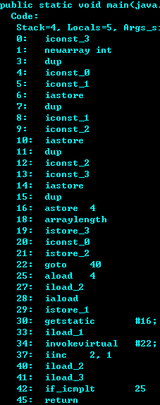


Stacks
Thread Data Area
Code(Method Data)
PC
Stack
Heap
Frame
Object
Operand Stack
Local Variables
Object
Frame
Object
Operand Stack
Object
Local Variables
Frame
Object
Operand Stack
Object
Local Variables

Slide 4
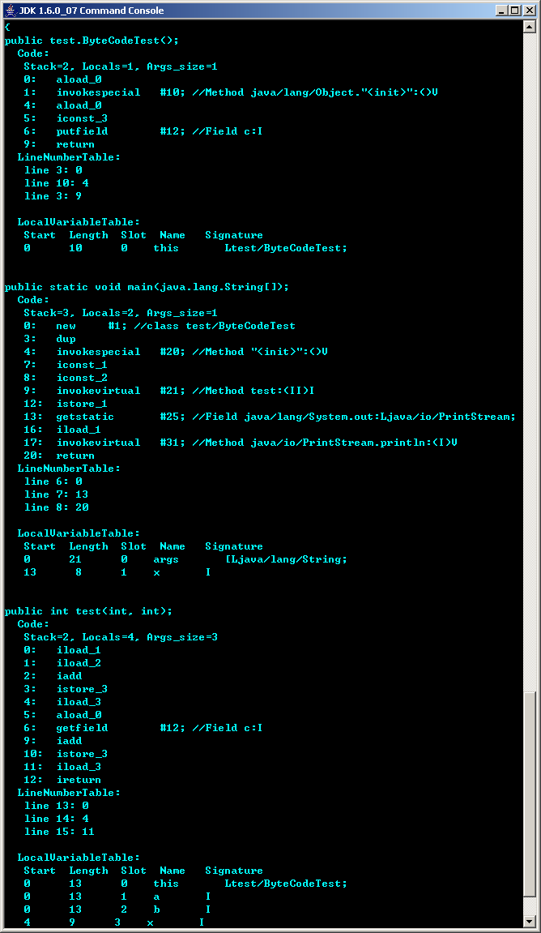
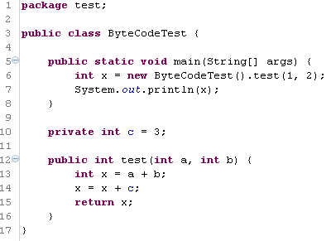
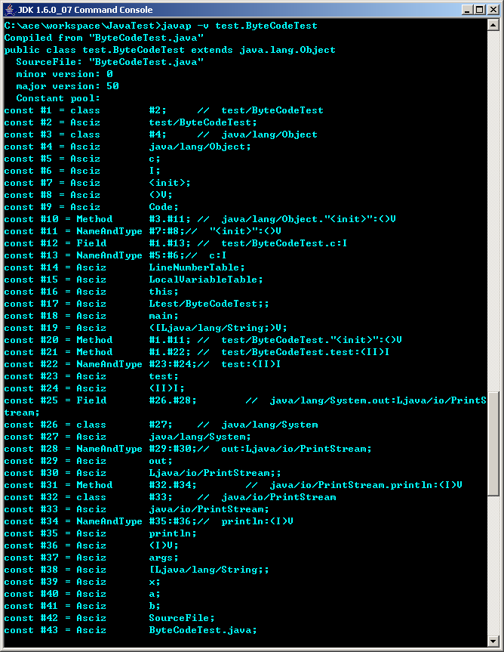
Byte Code Execution

Slide 5
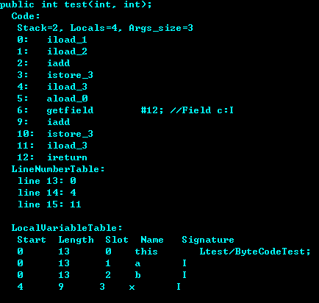
Example
PC
0 | this
1 | 100
2 | 200
3

Slide 6
Example
100
PC
0 | this
1 | 100
2 | 200
3

Slide 7
Example
100
200
PC
0 | this
1 | 100
2 | 200
3

Slide 8
Example
300
PC
0 | this
1 | 100
2 | 200
3

Slide 9
Example
PC
0 | this
1 | 100
2 | 200
3 | 300

Slide 10
Example
300
PC
0 | this
1 | 100
2 | 200
3 | 300

Slide 11
Example
300
this
PC
0 | this
1 | 100
2 | 200
3 | 300

Slide 12
Example
300
3
PC
0 | this
1 | 100
2 | 200
3 | 300

Slide 13
Example
303
PC
0 | this
1 | 100
2 | 200
3 | 300

Slide 14
Example
PC
0 | this
1 | 100
2 | 200
3 | 303

Slide 15
Example
303
PC
0 | this
1 | 100
2 | 200
3 | 303

Slide 16
References
http://java.sun.com/docs/books/jvms/second_edition/html/VMSpecTOC.doc.html

