Slide 1
Web Services in Weblogic
Luo Xian-Qiang
Muni Syndicate, DBD CIB III
Leo.Luo@citigroup.com
Notes:
Copyright 2006 Citicorp Software & Technology Service (Shanghai) Ltd.
Hello, everyone! I am very glad to share my experience of Web Services in Weblogic.

Slide 2
What is Web Services
A Web service is a software system designed to support interoperable machine-to-machine interaction over a network.
It has an interface described in a machine-processable format (specifically WSDL).
Other systems interact with the Web service in a manner prescribed by its description using SOAP messages, typically conveyed using HTTP with an XML serialization in conjunction with other Web-related standards.
Notes:
Web Service is from 2000
Many related technology and standard, and still in improving…
It is powerful and important… Because it is base on XML?

Slide 3
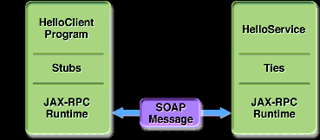
WS Communication
Communication Between a JAX-WS Web Service and a Client
Notes:
Remote Call, like IIOP, RMI, …
Difference is Web Services use XML. More important , it use standard format ☺
There are so many related standard and concepts, JAX-RPC, SOAP, JAXB, XML, XSL, Schema, DTD, JAXP, SAX, DOM, …

Slide 4
Java Standards for Web Services
SAAJ (JSR 67)
JAX-WS 2.0 (JSR 224)
JAX-RPC 1.1 (JSR 101)
JAXB 2.0 (JSR 222)
Implementing Enterprise Web Services (JSR109)
Streaming API for XML (JSR 173)
Web Service Metadata for the Java Platform (JSR181)

Slide 5
Weblogic8.1 Implemented
Soap 1.1/1.2 and SAAJ 1.1
WSDL 1.1
JAX-RPC 1.0
WS-Security from OASYS Standard 1.0
UDDI 2.0
Basic Profile Version 1.0 (WS-I)
Other Java or XML related

Slide 6
Implementing Web Services
Java Servlet Endpoint
EJB endpoints
Notes:
Two approach to implement Web Services in J2EE

Slide 7
Programming JSE Endpoint
POJO
Optional Interfaces:
javax.servlet.SingleThreadModel
java.xml.rpc.server.ServiceLifeCycle

Slide 8
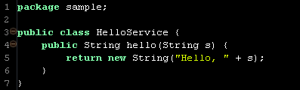
JSE Endpoint Example

Slide 9
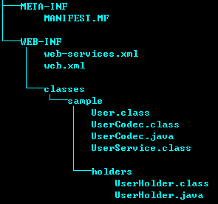
JSE Package Structure

Slide 10
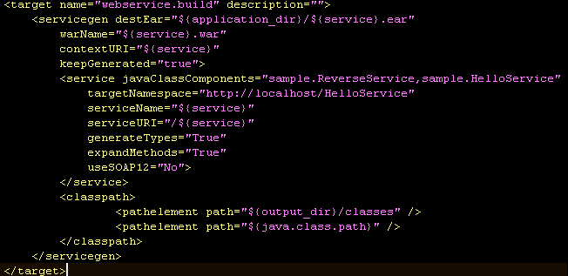
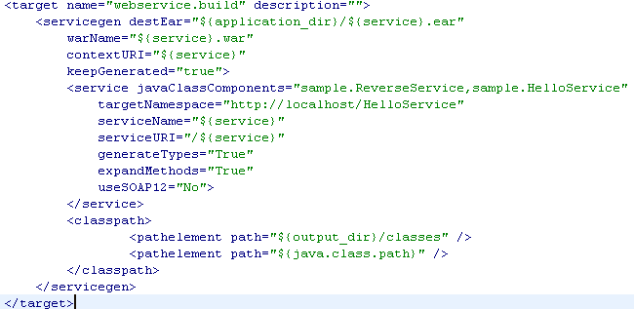
Build JSE package

Slide 11
Programming EJB Endpoint
Normal Stateless Session Bean

Slide 12
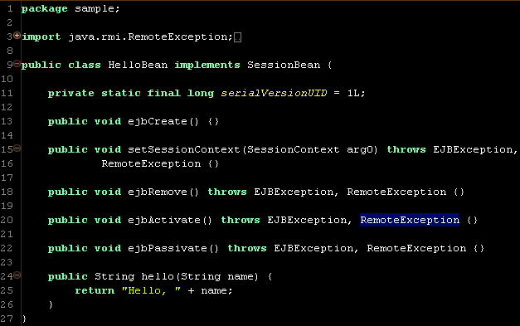
EJB Endpoint Example

Slide 13
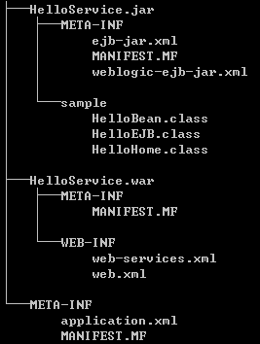
EJB Endpoint Package Structure

Slide 14
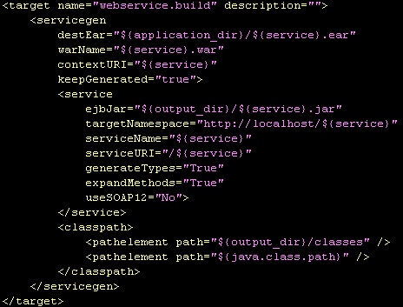
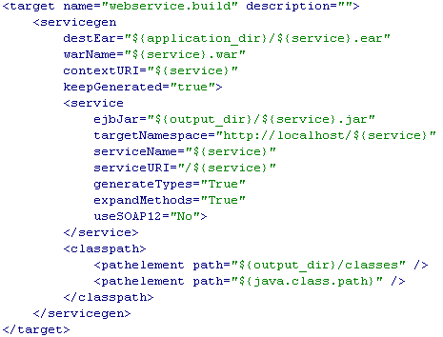
Package EJB Endpoint
Notes:
Two more files than the normal package…

Slide 15
Test from Weblogic Console
http://localhost:7001/console
http://localhost:7001/HelloService/HelloService
Notes:
The Weblogic Console is only for Test. We should only use the standard way to access the Services

Slide 16
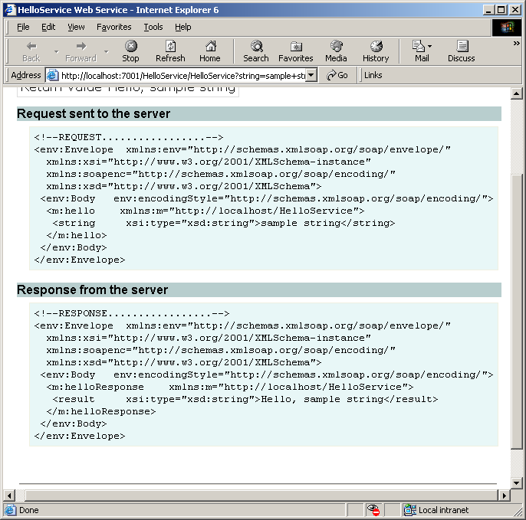
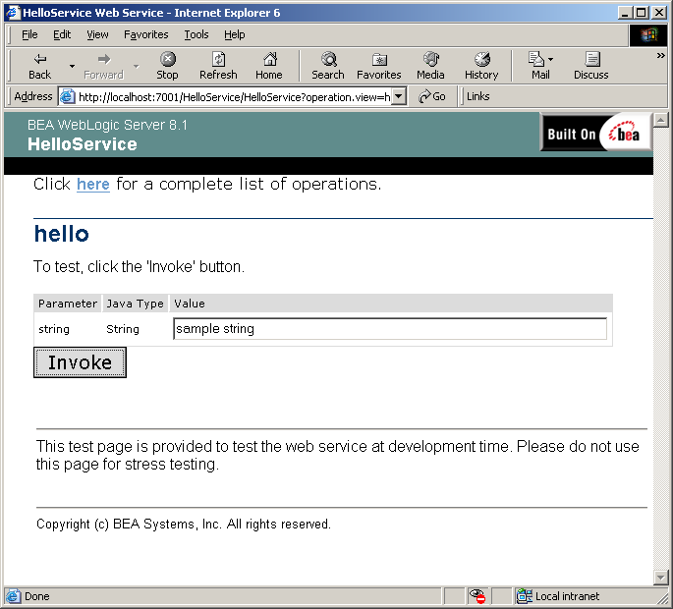
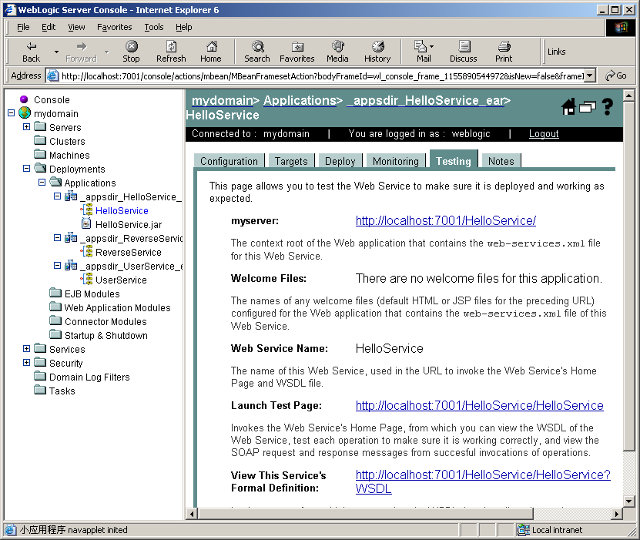
Test from Console

Slide 17
Invoke from A client
Static Client:
Invoke with generated client jar
Advanced Web Services Client
Programming JAX-RPC
Notes:
It’s easy to invoke if you have a generated lib. All communications is transparent to programmer.

Slide 18

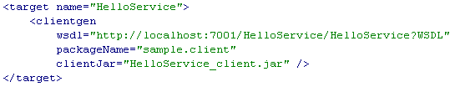
Generated Client jar
Notes:
A little hard?
There is a harder way, you programming Socket and xml parse … ;-)

Slide 19
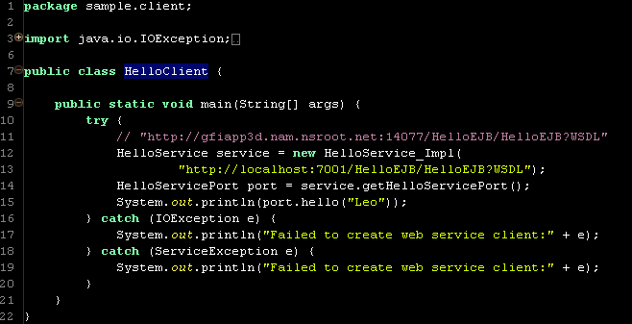
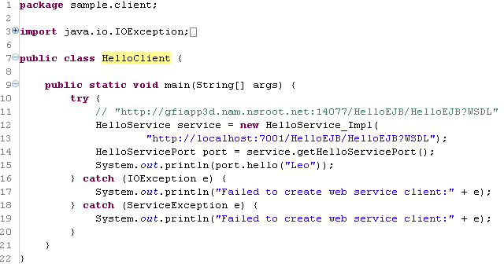
Static Client Sample

Slide 20
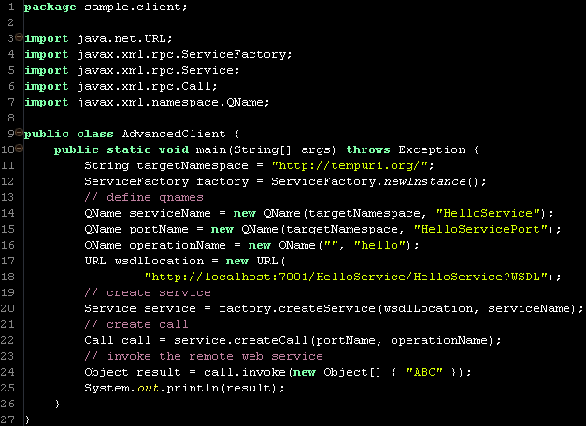
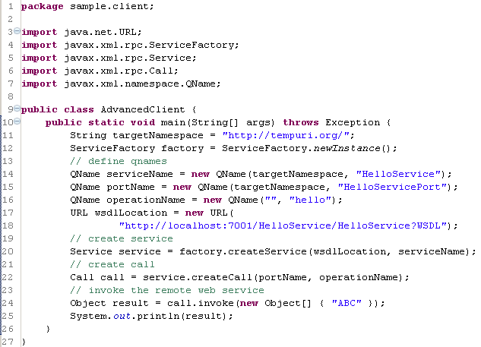
Advanced Client Sample

Slide 21
Links
BEA Product Documentation
http://e-docs.bea.com/
Web Service Ant Tasks and Command-Line Utilities
http://e-docs.bea.com/wls/docs81/webserv/1080062
Java Web Services API Specification
http://java.sun.com/webservices/reference/api/index.html
JSR109 Implementing Enterprise Web Services
http://jcp.org/en/jsr/detail?id=109

Slide 22
Q&A
?

