Slide 1
A Beginner’s Guide To Asynchronous JavaScript
Using Memes

Slide 2
What is Async?
Lets imagine you are ordering a Pizza from somewhere
Step 1: You order the pizza.
Step 2: You complete other tasks.
Step 3: The Pizza arrives.
Step 4: You eat it.

Slide 3

A Bit About Me – Before I started JavaScript

Slide 4


After I started JavaScript

Slide 5
What I Do
Software Engineer At Turbolab Technologies
Have Worked In JS Both Frontend, Mobile and Backend for past 4 years
Frameworks I am working now – Electron and Vue.js

Slide 6

Why Async

Slide 7

You Dont Need To Add Complex Multithreading If You Add Async

Slide 8
Advantages Of Async
Simpler Code than Multithreading
Easier To Debug
Easier To Scale

Slide 9
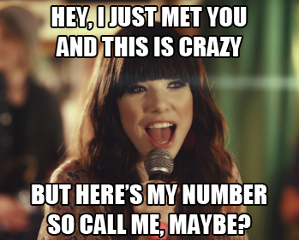
Async In Old Days - Callbacks

Slide 10
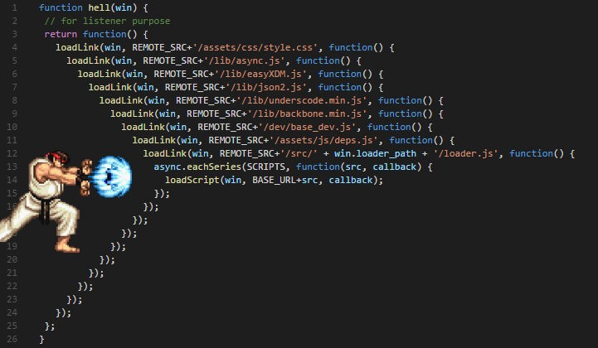
Callback Hell

Slide 11

She: I bet he is thinking about other women
He: How to use variable from 5th callback in 3rd

Slide 12

Enter Promises

Slide 13
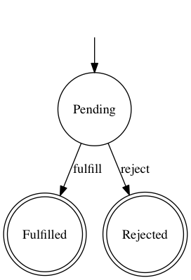
States Of A Promise

Slide 14
Advantages Of Promises Over Callbacks
Cleaner code
Easier to maintain
Better error handling
Can be chained

Slide 15
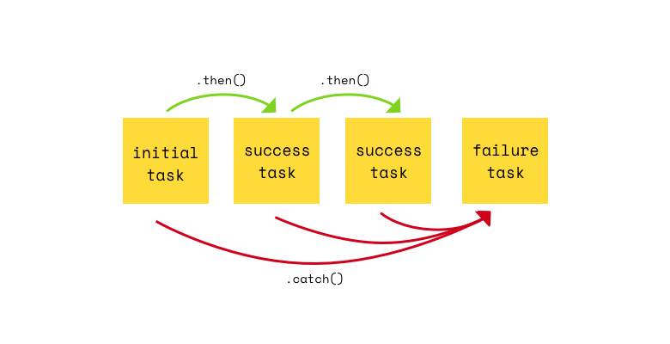
Priomise Chaining

Slide 16
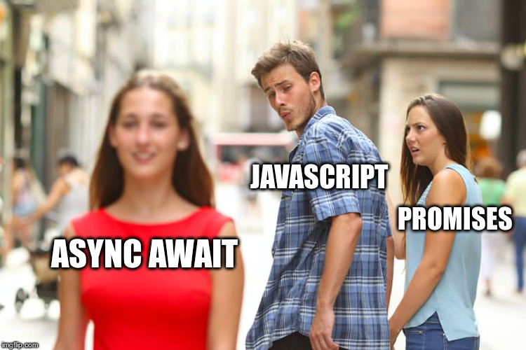
So What Is Async Await

Slide 17

The Final Solution To JS Async

Slide 18
Advantages Of Async Await
Linear code which is easier to understand
Easier to throw and catch errors
Easier to debug
Creates more maintainable code

Slide 19
Questions
https://t.me/sauravmodak
fb.com/sauravmodak

