Slide 1
Chapter 1 Introduction to Networking
Dr. Cemal Gemci
cgemci@baskent.edu.tr

Slide 2
Chapter 1: Introduction
Our goal:
get “feel” and terminology
more depth, detail later in course
approach:
use Internet as example
Overview:
what’s the Internet?
what’s a protocol?
network edge; hosts, access net, physical media
network core: packet/circuit switching, Internet structure
performance: loss, delay, throughput
security
protocol layers, service models
history

Slide 3
Chapter 1: roadmap
1.1 What is the Internet?
1.2 Network edge
end systems, access networks, links
1.3 Network core
circuit switching, packet switching, network structure
1.4 Delay, loss and throughput in packet-switched networks
1.5 Protocol layers, service models
1.6 Networks under attack: security
1.7 History

Slide 4

What’s the Internet: “nuts and bolts” view
PC
millions of connected computing devices: hosts = end systems
running network apps
Mobile network
server
Global ISP
wireless
laptop
cellular
handheld
Home network
communication links
fiber, copper, radio, satellite
transmission rate = bandwidth
Regional ISP
access
points
Institutional network
wired
links
routers: forward packets (chunks of data)
router

Slide 5


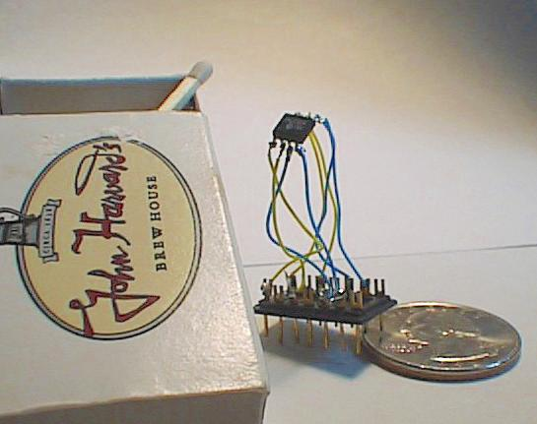

“Cool” internet appliances
Web-enabled toaster +
weather forecaster
IP picture frame
http://www.ceiva.com/
World’s smallest web server
http://www-ccs.cs.umass.edu/~shri/iPic.html
Internet phones

Slide 6
What’s the Internet: “nuts and bolts” view
protocols control sending, receiving of msgs
e.g., TCP, IP, HTTP, Skype, Ethernet
Internet: “network of networks”
loosely hierarchical
public Internet versus private intranet
Internet standards
RFC: Request for comments
IETF: Internet Engineering Task Force
Mobile network
Global ISP
Home network
Regional ISP
Institutional network
Notes:
Somunlar ve civatalar

Slide 7
What’s the Internet: a service view
communication infrastructure enables distributed applications:
Web, VoIP, email, games, e-commerce, file sharing
communication services provided to apps:
reliable data delivery from source to destination
“best effort” (unreliable) data delivery

Slide 8
What’s a protocol?
human protocols:
“what’s the time?”
“I have a question”
introductions
… specific msgs sent
… specific actions taken when msgs received, or other events
network protocols:
machines rather than humans
all communication activity in Internet governed by protocols
protocols define format, order of msgs sent and received among network entities, and actions taken on msg transmission, receipt

Slide 9


What’s a protocol?
a human protocol and a computer network protocol:
Hi
TCP connection
request
Hi
TCP connection
response
Got the
time?
Get http://www.awl.com/kurose-ross
2:00
<file>
time
Q: Other human protocols?

Slide 10
Chapter 1: roadmap
1.1 What is the Internet?
1.2 Network edge
end systems, access networks, links
1.3 Network core
circuit switching, packet switching, network structure
1.4 Delay, loss and throughput in packet-switched networks
1.5 Protocol layers, service models
1.6 Networks under attack: security
1.7 History

Slide 11
A closer look at network structure:
network edge: applications and hosts
access networks, physical media: wired, wireless communication links
network core:
interconnected routers
network of networks

Slide 12
The network edge:
end systems (hosts):
run application programs
e.g. Web, email
at “edge of network”
peer-peer
client/server model
client host requests, receives service from always-on server
e.g. Web browser/server; email client/server
client/server
peer-peer model:
minimal (or no) use of dedicated servers
e.g. Skype, BitTorrent

Slide 13
Access networks and physical media
Q: How to connect end systems to edge router?
residential access nets
institutional access networks (school, company)
mobile access networks
Keep in mind:
bandwidth (bits per second) of access network?
shared or dedicated?

Slide 14
Residential access: point to point access
Dialup via modem
up to 56Kbps direct access to router (often less)
Can’t surf and phone at same time: can’t be “always on”
DSL: digital subscriber line
deployment: telephone company (typically)
up to 1 Mbps upstream (today typically < 256 kbps)
up to 8 Mbps downstream (today typically < 1 Mbps)
dedicated physical line to telephone central office

Slide 16
Residential access: cable modems
HFC: hybrid fiber coax
asymmetric: up to 30Mbps downstream, 2 Mbps upstream
network of cable and fiber attaches homes to ISP router
homes share access to router
deployment: available via cable TV companies

Slide 18
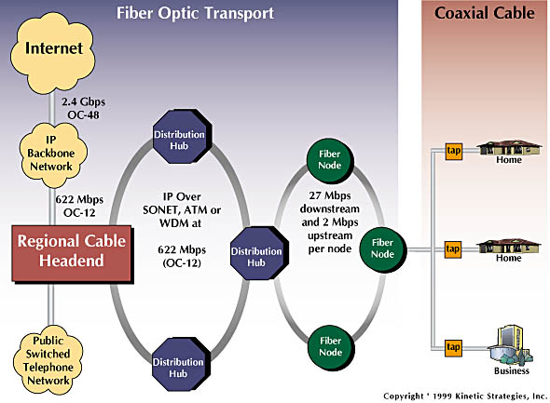
Residential access: cable modems
Diagram: http://www.cabledatacomnews.com/cmic/diagram.html

Slide 19

Cable Network Architecture: Overview
Typically 500 to 5,000 homes
cable headend
cable distribution
network (simplified)
home

Slide 20
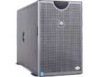
Cable Network Architecture: Overview
server(s)
cable headend
cable distribution
network
home

Slide 21
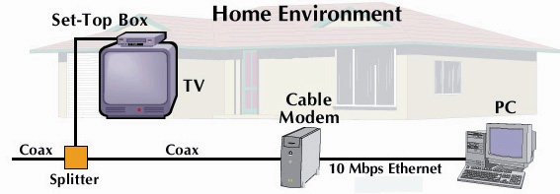
Cable Network Architecture: Overview
cable headend
cable distribution
network (simplified)
home

Slide 22
Cable Network Architecture: Overview
FDM (more shortly):
C
O
N
T
R
O
L
V
I
D
E
O
V
I
D
E
O
V
I
D
E
O
V
I
D
E
O
V
I
D
E
O
V
I
D
E
O
D
A
T
A
D
A
T
A
1
2
3
4
5
6
7
8
9
Channels
cable headend
cable distribution
network
home

Slide 23
Company access: local area networks
company/univ local area network (LAN) connects end system to edge router
Ethernet:
10 Mbs, 100Mbps, 1Gbps, 10Gbps Ethernet
modern configuration: end systems connect into Ethernet switch
LANs: chapter 5

Slide 24
Wireless access networks
shared wireless access network connects end system to router
via base station aka “access point”
wireless LANs:
802.11b/g (WiFi): 11 or 54 Mbps
wider-area wireless access
provided by telco operator
~1Mbps over cellular system (EVDO, HSDPA)
next up (?): WiMAX (10’s Mbps) over wide area
router
base
station
mobile
hosts

Slide 25
Home networks
Typical home network components:
DSL or cable modem
router/firewall/NAT
Ethernet
wireless access
point
wireless
laptops
to/from
cable
headend
cable
modem
router/
firewall
wireless
access
point
Ethernet

Slide 26
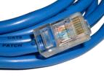
Physical Media
Twisted Pair (TP)
two insulated copper wires
Category 3: traditional phone wires, 10 Mbps Ethernet
Category 5: 100Mbps Ethernet
Bit: propagates between transmitter/rcvr pairs
physical link: what lies between transmitter & receiver
guided media:
signals propagate in solid media: copper, fiber, coax
unguided media:
signals propagate freely, e.g., radio

Slide 27


Physical Media: coax, fiber
Fiber optic cable:
glass fiber carrying light pulses, each pulse a bit
high-speed operation:
high-speed point-to-point transmission (e.g., 10’s-100’s Gps)
low error rate: repeaters spaced far apart ; immune to electromagnetic noise
Coaxial cable:
two concentric copper conductors
bidirectional
baseband:
single channel on cable
legacy Ethernet
broadband:
multiple channels on cable
HFC

Slide 28
Physical media: radio
signal carried in electromagnetic spectrum
no physical “wire”
bidirectional
propagation environment effects:
reflection
obstruction by objects
interference
Radio link types:
terrestrial microwave
e.g. up to 45 Mbps channels
LAN (e.g., Wifi)
11Mbps, 54 Mbps
wide-area (e.g., cellular)
3G cellular: ~ 1 Mbps
satellite
Kbps to 45Mbps channel (or multiple smaller channels)
270 msec end-end delay
geosynchronous versus low altitude

Slide 29
Chapter 1: roadmap
1.1 What is the Internet?
1.2 Network edge
end systems, access networks, links
1.3 Network core
circuit switching, packet switching, network structure
1.4 Delay, loss and throughput in packet-switched networks
1.5 Protocol layers, service models
1.6 Networks under attack: security
1.7 History

Slide 30
The Network Core
mesh of interconnected routers
the fundamental question: how is data transferred through net?
circuit switching: dedicated circuit per call: telephone net
packet-switching: data sent thru net in discrete “chunks”

Slide 31
Network Core: Circuit Switching
End-end resources reserved for “call”
link bandwidth, switch capacity
dedicated resources: no sharing
circuit-like (guaranteed) performance
call setup required

Slide 32
Network Core: Circuit Switching
network resources (e.g., bandwidth) divided into “pieces”
pieces allocated to calls
resource piece idle if not used by owning call (no sharing)
dividing link bandwidth into “pieces”
frequency division
time division

Slide 33
Circuit Switching: FDM and TDM
Example:
FDM
4 users
frequency
time
TDM
frequency
time
Notes:
Two simple multiple access control techniques.
Each mobile’s share of the bandwidth is divided into portions for the uplink and the downlink. Also, possibly, out of band signaling.
As we will see, used in AMPS, GSM, IS-54/136

Slide 34
Numerical example
How long does it take to send a file of 640,000 bits from host A to host B over a circuit-switched network?
All links are 1.536 Mbps
Each link uses TDM with 24 slots/sec
500 msec to establish end-to-end circuit
Let’s work it out!

Slide 35
Network Core: Packet Switching
each end-end data stream divided into packets
user A, B packets share network resources
each packet uses full link bandwidth
resources used as needed
resource contention:
aggregate resource demand can exceed amount available
congestion: packets queue, wait for link use
store and forward: packets move one hop at a time
Node receives complete packet before forwarding
Bandwidth division into “pieces”
Dedicated allocation
Resource reservation

Slide 36
Packet Switching: Statistical Multiplexing
100 Mb/s
Ethernet
A
C
statistical multiplexing
1.5 Mb/s
B
queue of packets
waiting for output
link
D
E
Sequence of A & B packets does not have fixed pattern, bandwidth shared on demand ➔ statistical multiplexing.
TDM: each host gets same slot in revolving TDM frame.

Slide 37
Packet-switching: store-and-forward
L
R
R
R
takes L/R seconds to transmit (push out) packet of L bits on to link at R bps
store and forward: entire packet must arrive at router before it can be transmitted on next link
delay = 3L/R (assuming zero propagation delay)
Example:
L = 7.5 Mbits
R = 1.5 Mbps
transmission delay = 15 sec
more on delay shortly …

Slide 38
Packet switching versus circuit switching
Packet switching allows more users to use network!
1 Mb/s link
each user:
100 kb/s when “active”
active 10% of time
circuit-switching:
10 users
packet switching:
with 35 users, probability > 10 active at same time is less than .0004
N users
1 Mbps link
Q: how did we get value 0.0004?

Slide 39
Packet switching versus circuit switching
Is packet switching a “slam dunk winner?”
great for bursty data
resource sharing
simpler, no call setup
excessive congestion: packet delay and loss
protocols needed for reliable data transfer, congestion control
Q: How to provide circuit-like behavior?
bandwidth guarantees needed for audio/video apps
still an unsolved problem (chapter 7)
Q: human analogies of reserved resources (circuit switching) versus on-demand allocation (packet-switching)?

Slide 40
Internet structure: network of networks
roughly hierarchical
at center: “tier-1” ISPs (e.g., Verizon, Sprint, AT&T, Cable and Wireless), national/international coverage
treat each other as equals
Tier-1 providers interconnect (peer) privately
Tier 1 ISP
Tier 1 ISP
Tier 1 ISP

Slide 41
Tier-1 ISP: e.g., Sprint
POP: point-of-presence
to/from backbone
…
peering
….
…
…
…
to/from customers

Slide 42
Internet structure: network of networks
“Tier-2” ISPs: smaller (often regional) ISPs
Connect to one or more tier-1 ISPs, possibly other tier-2 ISPs
Tier-2 ISPs also peer privately with each other.
Tier-2 ISP pays tier-1 ISP for connectivity to rest of Internet
tier-2 ISP is customer of
tier-1 provider
Tier-2 ISP
Tier-2 ISP
Tier 1 ISP
Tier 1 ISP
Tier 1 ISP
Tier-2 ISP
Tier-2 ISP
Tier-2 ISP

Slide 43
Internet structure: network of networks
“Tier-3” ISPs and local ISPs
last hop (“access”) network (closest to end systems)
local
ISP
Tier 3
ISP
local
ISP
local
ISP
local
ISP
Local and tier- 3 ISPs are customers of
higher tier ISPs
connecting them to rest of Internet
Tier-2 ISP
Tier-2 ISP
Tier 1 ISP
Tier 1 ISP
Tier 1 ISP
Tier-2 ISP
Tier-2 ISP
Tier-2 ISP
local
ISP
local
ISP
local
ISP
local
ISP

Slide 44
Internet structure: network of networks
a packet passes through many networks!
local
ISP
Tier 3
ISP
local
ISP
local
ISP
local
ISP
Tier-2 ISP
Tier-2 ISP
Tier 1 ISP
Tier 1 ISP
Tier 1 ISP
Tier-2 ISP
Tier-2 ISP
Tier-2 ISP
local
ISP
local
ISP
local
ISP
local
ISP

Slide 45
Chapter 1: roadmap
1.1 What is the Internet?
1.2 Network edge
end systems, access networks, links
1.3 Network core
circuit switching, packet switching, network structure
1.4 Delay, loss and throughput in packet-switched networks
1.5 Protocol layers, service models
1.6 Networks under attack: security
1.7 History

Slide 46
How do loss and delay occur?
packets queue in router buffers
packet arrival rate to link exceeds output link capacity
packets queue, wait for turn
packet being transmitted (delay)
A
B
packets queueing (delay)
free (available) buffers: arriving packets
dropped (loss) if no free buffers

Slide 47
Four sources of packet delay
1. nodal processing:
check bit errors
determine output link
2. queueing
time waiting at output link for transmission
depends on congestion level of router
transmission
A
propagation
B
nodal
processing
queueing

Slide 48
Delay in packet-switched networks
3. Transmission delay:
R=link bandwidth (bps)
L=packet length (bits)
time to send bits into link = L/R
4. Propagation delay:
d = length of physical link
s = propagation speed in medium (~2x10⁸ m/sec)
propagation delay = d/s
Note: s and R are very different quantities!
transmission
A
propagation
B
nodal
processing
queueing

Slide 49
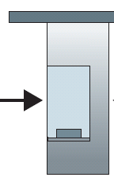
Caravan analogy
100 km
100 km
ten-car
caravan
toll
booth
toll
booth
cars “propagate” at 100 km/hr
toll booth takes 12 sec to service car (transmission time)
car~bit; caravan ~ packet
Q: How long until caravan is lined up before 2nd toll booth?
Time to “push” entire caravan through toll booth onto highway = 12*10 = 120 sec
Time for last car to propagate from 1st to 2nd toll both: 100km/(100km/hr)= 1 hr
A: 62 minutes

Slide 50
Caravan analogy (more)
100 km
100 km
ten-car
caravan
toll
booth
toll
booth
Yes! After 7 min, 1st car at 2nd booth and 3 cars still at 1st booth.
1st bit of packet can arrive at 2nd router before packet is fully transmitted at 1st router!
See Ethernet applet at AWL Web site
Cars now “propagate” at 1000 km/hr
Toll booth now takes 1 min to service a car
Q: Will cars arrive to 2nd booth before all cars serviced at 1st booth?

Slide 51
Nodal delay
d_{proc} = processing delay
typically a few microsecs or less
d_{queue} = queuing delay
depends on congestion
d_{trans} = transmission delay
= L/R, significant for low-speed links
d_{prop} = propagation delay
a few microsecs to hundreds of msecs

Slide 52
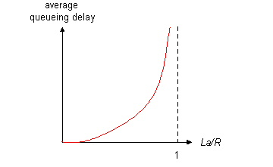
Queueing delay (revisited)
R=link bandwidth (bps)
L=packet length (bits)
a=average packet arrival rate
traffic intensity = La/R
La/R ~ 0: average queueing delay small
La/R -> 1: delays become large
La/R > 1: more “work” arriving than can be serviced, average delay infinite!

Slide 53
“Real” Internet delays and routes
What do “real” Internet delay & loss look like?
Traceroute program: provides delay measurement from source to router along end-end Internet path towards destination. For all i:
sends three packets that will reach router i on path towards destination
router i will return packets to sender
sender times interval between transmission and reply.
3 probes
3 probes
3 probes

Slide 54
“Real” Internet delays and routes
traceroute: gaia.cs.umass.edu to www.eurecom.fr
Three delay measurements from
gaia.cs.umass.edu to cs-gw.cs.umass.edu
1 cs-gw (128.119.240.254) 1 ms 1 ms 2 ms
2 border1-rt-fa5-1-0.gw.umass.edu (128.119.3.145) 1 ms 1 ms 2 ms
3 cht-vbns.gw.umass.edu (128.119.3.130) 6 ms 5 ms 5 ms
4 jn1-at1-0-0-19.wor.vbns.net (204.147.132.129) 16 ms 11 ms 13 ms
5 jn1-so7-0-0-0.wae.vbns.net (204.147.136.136) 21 ms 18 ms 18 ms
6 abilene-vbns.abilene.ucaid.edu (198.32.11.9) 22 ms 18 ms 22 ms
7 nycm-wash.abilene.ucaid.edu (198.32.8.46) 22 ms 22 ms 22 ms
8 62.40.103.253 (62.40.103.253) 104 ms 109 ms 106 ms
9 de2-1.de1.de.geant.net (62.40.96.129) 109 ms 102 ms 104 ms
10 de.fr1.fr.geant.net (62.40.96.50) 113 ms 121 ms 114 ms
11 renater-gw.fr1.fr.geant.net (62.40.103.54) 112 ms 114 ms 112 ms
12 nio-n2.cssi.renater.fr (193.51.206.13) 111 ms 114 ms 116 ms
13 nice.cssi.renater.fr (195.220.98.102) 123 ms 125 ms 124 ms
14 r3t2-nice.cssi.renater.fr (195.220.98.110) 126 ms 126 ms 124 ms
15 eurecom-valbonne.r3t2.ft.net (193.48.50.54) 135 ms 128 ms 133 ms
16 194.214.211.25 (194.214.211.25) 126 ms 128 ms 126 ms
17 * * *
18 * * *
19 fantasia.eurecom.fr (193.55.113.142) 132 ms 128 ms 136 ms
trans-oceanic
link
* means no response (probe lost, router not replying)

Slide 55
Packet loss
queue (aka buffer) preceding link in buffer has finite capacity
packet arriving to full queue dropped (aka lost)
lost packet may be retransmitted by previous node, by source end system, or not at all
buffer
(waiting area)
packet being transmitted
A
B
packet arriving to
full buffer is lost

Slide 56
Throughput
throughput: rate (bits/time unit) at which bits transferred between sender/receiver
instantaneous: rate at given point in time
average: rate over longer period of time
link capacity
R_{s} bits/sec
link capacity
R_{c} bits/sec
server, with
file of F bits
to send to client
pipe that can carry
fluid at rate
R_{s} bits/sec)
pipe that can carry
fluid at rate
R_{c} bits/sec)
server sends bits
(fluid) into pipe

Slide 57
Throughput (more)
R_{s} < R_{c} What is average end-end throughput?
R_{s} bits/sec
R_{c} bits/sec
R_{s} > R_{c} What is average end-end throughput?
R_{s} bits/sec
R_{c} bits/sec
bottleneck link
link on end-end path that constrains end-end throughput

Slide 58
Throughput: Internet scenario
R_{s}
per-connection end-end throughput: min(R_{c},R_{s},R/10)
in practice: R_{c} or R_{s} is often bottleneck
R_{s}
R_{s}
R
R_{c}
R_{c}
R_{c}
10 connections (fairly) share backbone bottleneck link R bits/sec

Slide 59
Chapter 1: roadmap
1.1 What is the Internet?
1.2 Network edge
end systems, access networks, links
1.3 Network core
circuit switching, packet switching, network structure
1.4 Delay, loss and throughput in packet-switched networks
1.5 Protocol layers, service models
1.6 Networks under attack: security
1.7 History

Slide 60
Protocol “Layers”
Networks are complex!
many “pieces”:
hosts
routers
links of various media
applications
protocols
hardware, software
Question:
Is there any hope of organizing structure of network?
Or at least our discussion of networks?

Slide 61
Organization of air travel
ticket (purchase)
baggage (check)
gates (load)
runway takeoff
airplane routing
ticket (complain)
baggage (claim)
gates (unload)
runway landing
airplane routing
airplane routing
a series of steps

Slide 62
Layering of airline functionality
ticket (purchase)
baggage (check)
gates (load)
runway (takeoff)
airplane routing
ticket (complain)
baggage (claim
gates (unload)
runway (land)
airplane routing
ticket
baggage
gate
takeoff/landing
airplane routing
airplane routing
airplane routing
departure
airport
intermediate air-traffic
control centers
arrival
airport
Layers: each layer implements a service
via its own internal-layer actions
relying on services provided by layer below

Slide 63
Why layering?
Dealing with complex systems:
explicit structure allows identification, relationship of complex system’s pieces
layered reference model for discussion
modularization eases maintenance, updating of system
change of implementation of layer’s service transparent to rest of system
e.g., change in gate procedure doesn’t affect rest of system
layering considered harmful?

Slide 64
Internet protocol stack
application: supporting network applications
FTP, SMTP, HTTP
transport: process-process data transfer
TCP, UDP
network: routing of datagrams from source to destination
IP, routing protocols
link: data transfer between neighboring network elements
PPP, Ethernet
physical: bits “on the wire”
application
transport
network
link
physical

Slide 65
ISO/OSI reference model
presentation: allow applications to interpret meaning of data, e.g., encryption, compression, machine-specific conventions
session: synchronization, checkpointing, recovery of data exchange
Internet stack “missing” these layers!
these services, if needed, must be implemented in application
needed?
application
presentation
session
transport
network
link
physical

Slide 66
Encapsulation
source
message
M
application
transport
network
link
physical
segment
H_{t}
M
H_{t}
datagram
H_{n}
H_{n}
H_{t}
M
frame
H_{l}
H_{n}
H_{t}
M
link
physical
switch
destination
H_{n}
H_{t}
M
network
link
physical
M
application
transport
network
link
physical
H_{l}
H_{n}
H_{t}
M
H_{n}
H_{t}
M
H_{t}
M
H_{n}
H_{t}
M
H_{l}
H_{n}
H_{t}
M
router

Slide 67
Chapter 1: roadmap
1.1 What is the Internet?
1.2 Network edge
end systems, access networks, links
1.3 Network core
circuit switching, packet switching, network structure
1.4 Delay, loss and throughput in packet-switched networks
1.5 Protocol layers, service models
1.6 Networks under attack: security
1.7 History

Slide 68
Network Security
The field of network security is about:
how bad guys can attack computer networks
how we can defend networks against attacks
how to design architectures that are immune to attacks
Internet not originally designed with (much) security in mind
original vision: “a group of mutually trusting users attached to a transparent network” ☺
Internet protocol designers playing “catch-up”
Security considerations in all layers!

Slide 69
Bad guys can put malware into hosts via Internet
Malware can get in host from a virus, worm, or trojan horse.
Spyware malware can record keystrokes, web sites visited, upload info to collection site.
Infected host can be enrolled in a botnet, used for spam and DDoS attacks.
Malware is often self-replicating: from an infected host, seeks entry into other hosts

Slide 70
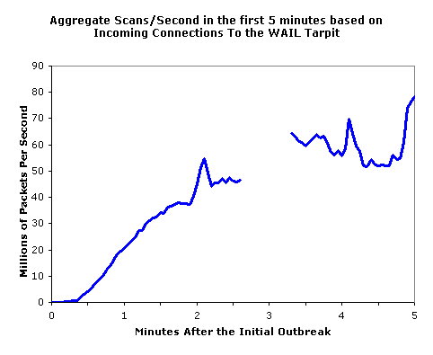
Bad guys can put malware into hosts via Internet
Trojan horse
Hidden part of some otherwise useful software
Today often on a Web page (Active-X, plugin)
Virus
infection by receiving object (e.g., e-mail attachment), actively executing
self-replicating: propagate itself to other hosts, users
Worm:
infection by passively receiving object that gets itself executed
self- replicating: propagates to other hosts, users
Sapphire Worm: aggregate scans/sec
in first 5 minutes of outbreak (CAIDA, UWisc data)

Slide 71
Bad guys can attack servers and network infrastructure
Denial of service (DoS): attackers make resources (server, bandwidth) unavailable to legitimate traffic by overwhelming resource with bogus traffic
select target
break into hosts around the network (see botnet)
send packets toward target from compromised hosts
target

Slide 72
The bad guys can sniff packets
Packet sniffing:
broadcast media (shared Ethernet, wireless)
promiscuous network interface reads/records all packets (e.g., including passwords!) passing by
A
C
src:B dest:A payload
B
Wireshark software used for end-of-chapter labs is a (free) packet-sniffer

Slide 73
The bad guys can use false source addresses
IP spoofing: send packet with false source address
A
C
src:B dest:A payload
B

Slide 74
The bad guys can record and playback
record-and-playback: sniff sensitive info (e.g., password), and use later
password holder is that user from system point of view
C
A
src:B dest:A user: B; password: foo
B

Slide 75
Network Security
more throughout this course
chapter 8: focus on security
crypographic techniques: obvious uses and not so obvious uses

Slide 76
Chapter 1: roadmap
1.1 What is the Internet?
1.2 Network edge
end systems, access networks, links
1.3 Network core
circuit switching, packet switching, network structure
1.4 Delay, loss and throughput in packet-switched networks
1.5 Protocol layers, service models
1.6 Networks under attack: security
1.7 History

Slide 77
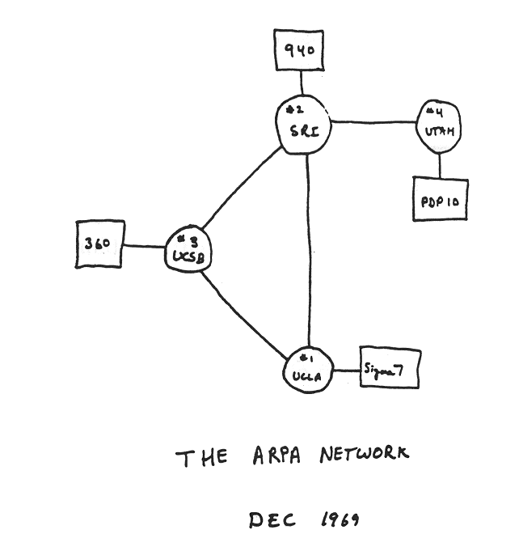
Internet History
1961-1972: Early packet-switching principles
1961: Kleinrock - queueing theory shows effectiveness of packet-switching
1964: Baran - packet-switching in military nets
1967: ARPAnet conceived by Advanced Research Projects Agency
1969: first ARPAnet node operational
1972:
ARPAnet public demonstration
NCP (Network Control Protocol) first host-host protocol
first e-mail program
ARPAnet has 15 nodes

Slide 78
Internet History
1972-1980: Internetworking, new and proprietary nets
1970: ALOHAnet satellite network in Hawaii
1974: Cerf and Kahn - architecture for interconnecting networks
1976: Ethernet at Xerox PARC
ate70’s: proprietary architectures: DECnet, SNA, XNA
late 70’s: switching fixed length packets (ATM precursor)
1979: ARPAnet has 200 nodes
Cerf and Kahn’s internetworking principles:
minimalism, autonomy - no internal changes required to interconnect networks
best effort service model
stateless routers
decentralized control
define today’s Internet architecture

Slide 79
Internet History
1980-1990: new protocols, a proliferation of networks
1983: deployment of TCP/IP
1982: smtp e-mail protocol defined
1983: DNS defined for name-to-IP-address translation
1985: ftp protocol defined
1988: TCP congestion control
new national networks: Csnet, BITnet, NSFnet, Minitel
100,000 hosts connected to confederation of networks

Slide 80
Internet History
1990, 2000’s: commercialization, the Web, new apps
Early 1990’s: ARPAnet decommissioned
1991: NSF lifts restrictions on commercial use of NSFnet (decommissioned, 1995)
early 1990s: Web
hypertext [Bush 1945, Nelson 1960’s]
HTML, HTTP: Berners-Lee
1994: Mosaic, later Netscape
late 1990’s: commercialization of the Web
Late 1990’s – 2000’s:
more killer apps: instant messaging, P2P file sharing
network security to forefront
est. 50 million host, 100 million+ users
backbone links running at Gbps

Slide 81
Internet History
2007:
~500 million hosts
Voice, Video over IP
P2P applications: BitTorrent (file sharing) Skype (VoIP), PPLive (video)
more applications: YouTube, gaming
wireless, mobility

Slide 82
Introduction: Summary
Covered a “ton” of material!
Internet overview
what’s a protocol?
network edge, core, access network
packet-switching versus circuit-switching
Internet structure
performance: loss, delay, throughput
layering, service models
security
history
You now have:
context, overview, “feel” of networking
more depth, detail to follow!

